Slide 1
Laplace Transforms of Discontinuous Forcing Functions
MAT 275

Slide 2
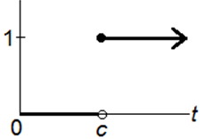
We need a better way to describe functions with discontinuities. We use the Heaviside Function, which is
$$u_{c}\left(t\right)=\left\{\begin{matrix}0, & t<c \\ 1, & t≥c\end{matrix}\right.$$
The graph looks like this:
It’s “off” (= 0) when $t<c$, then is “on” (= 1) when $t≥c$.

Slide 3
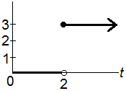
Using coefficients, we can control the size of the “jumps”. For example, $y=3u_{2}(t)$ is equivalent to
$$y=\left\{\begin{matrix}0, & t<2 \\ 3, & t≥2\end{matrix}\right.$$
The jump discontinuity occurs at $t$ = 2, and has a vertical change of 3 units:
Note how much cleaner $3u_{2}(t)$ is in expressing the piecewise model.

Slide 4
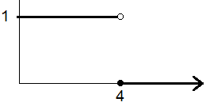
Example: Sketch $y=1−u_{4}(t)$.
Solution:
When $0≤t<4$, then $u_{4}\left(t\right)=0$, and $y=1−0=1$.
When $t≥4$, then $u_{4}\left(t\right)=1$, and $y=1−1=0$.
The graph looks like this:

Slide 5
Example: Sketch $y=2−3u_{1}\left(t\right)+5u_{3}\left(t\right)−u_{5}(t)$.
Solution: There are three jumps, at $t=1, 3$ and 5.
For $0≤t<1$, all three of the $u$ terms are 0. Thus, $y=2−3\left(0\right)+5\left(0\right)−\left(0\right)=2$.
For $1≤t<3$, we have $u_{1}\left(t\right)=1$ but the other $u$ terms are 0.
Thus, $y=2−3\left(1\right)+5\left(0\right)−\left(0\right)=−1.$
For $3≤t<5$, we have $u_{3}\left(t\right)=1$. Note that $u_{1}\left(t\right)=1$ (it stays “on”) but that $u_{5}\left(t\right)=0$. Thus, $y=2−3\left(1\right)+5\left(1\right)−\left(0\right)=2−3+5=4$.
For $t≥5$, we have $u_{5}\left(t\right)=1$. Note that $u_{1}\left(t\right)=1$ and that $u_{3}\left(t\right)=1$. All of the $u$ terms are now “on”. Thus, $y=2−3\left(1\right)+5\left(1\right)−\left(1\right)=2−3+5−1=3$.
The graph is on the next slide.

Slide 6
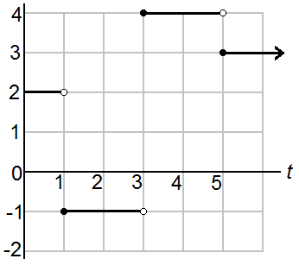
Sketch $y=2−3u_{1}\left(t\right)+5u_{3}\left(t\right)−u_{5}(t)$.
When $3≤t<5$, then $y=4$. Note a “jump” of 5 units from –1 to 4.
When $0≤t<1$, then $y=2$.
When $t≥5$, then $y=3$. Note a “jump” of –1 units from 4 to 3.
When $1≤t<3$, then $y=−1$. Note a “jump” of –3 units from 2 to –1.
The closed point always occurs at the left endpoint of the interval!

Slide 7
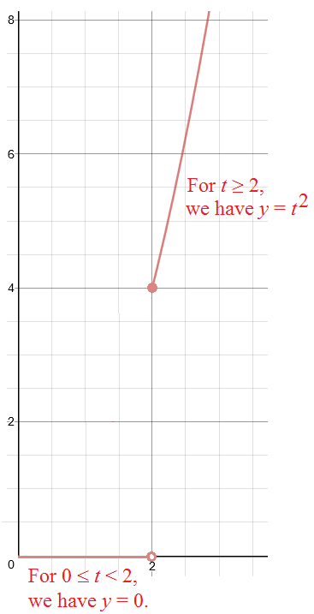
Combining $u_{c}(t)$ notation with non-constant functions.
Example: Sketch $y=u_{2}\left(t\right)t^{2}$.
Solution: When $0≤t<2$, we have $u_{2}\left(t\right)=0$, so that $y=0t^{2}=0$.
When $t≥2$, we have $u_{2}\left(t\right)=1$, so that $y=1t^{2}=t^{2}$.
This is equivalent to the piecewise notation $y=\left\{\begin{matrix}0, & t<2 \\ t^{2}, & t≥2\end{matrix}\right.$ .
The graph is 0 when $0≤t<2$, and then at $t=2$,
the parabola $t^{2}$ “starts” here and continues upward.

Slide 8
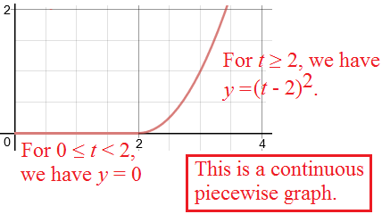
The $u_{c}(t)$ notation is useful for combining two or more function types into a single function, where continuity is desired.
Example: Sketch $y=u_{2}\left(t\right){\left(t−2\right)}^{2}$.
Solution. When $0≤t<2$, we have $u_{2}\left(t\right)=0$, so that $y=0{(t−2)}^{2}=0$.
When $t≥2$, we have $u_{2}\left(t\right)=1$, so that $y=1{(t−2)}^{2}={(t−2)}^{2}$.
Here, the graph ${\left(t−2\right)}^{2}$ is a shift of $t^{2}$ two units to the right. It “starts” at (2,0). Note that is it continuous with the portion y = 0, where $0≤t<2$.
When taking the Laplace Transform of these types of functions, we need to “build in” the shift first!

Slide 9
Laplace Transform of $y=u_{c}\left(t\right)f(t−c)$
Start with: $L\left\{u_{c}\left(t\right)f(t−c)\right\}=\int_{0}^{∞}{u_{c}\left(t\right){f(t−c)e}^{−st} dt}.$
Since $u_{c}\left(t\right)=0$ when $0≤t<c$, and $u_{c}\left(t\right)=1$ when $t≥c$, we have
$$L\left\{u_{c}\left(t\right)f(t−c)\right\}=\int_{c}^{∞}{f(t−c)e^{−st} dt}.$$
Now, let $w=t−c$, so that $t=w+c$. This is essentially a shift of c units to the left. Furthermore, $dw=d\left(t−c\right)=dt−dc=dt$, since $dc=0$. We now have
$$\int_{c}^{∞}{f(t−c)e^{−st} dt}=\int_{0}^{∞}{f\left(w\right)e^{−s\left(w+c\right)}dw}.$$
Note that $e^{−s\left(w+c\right)}=e^{−sw−sc}=e^{−sw}e^{−sc}$, and that $e^{−sc}$ is constant (it has no $w$).

Slide 10
Thus, we have
$$\int_{0}^{∞}{f\left(w\right)e^{−s\left(w+c\right)}dw}=e^{−sc}\int_{0}^{∞}{f\left(w\right)e^{−sw}dw}.$$
The integral on the right is just the Laplace Transform of $f(w)$:
$$L\left\{f\left(w\right)\right\}=\int_{0}^{∞}{f\left(w\right)e^{−sw}dw}.$$
Here, $w$ is just a dummy variable. It can be replaced with $t$. Thus, we have
$$L\left\{u_{c}\left(t\right)f\left(t−c\right)\right\}=e^{−sc}L\left\{f\left(t\right)\right\}.$$
For this to work, you must shift the function $f$ by $c$ units first, then evaluate the Laplace Transform as though the $c$ was not present.

Slide 11
Example: Find $L\left\{u_{3}\left(t\right)\right\}$.
Solution: We can treat $u_{3}(t)$ as $u_{3}\left(t\right)=u_{3}\left(t\right)⋅1$. Shifting y = 1 left or right makes no difference, so we can proceed:
$$L\left\{u_{3}\left(t\right)\right\}=e^{−3s}L\left\{1\right\}=e^{−3s}\left(\frac{1}{s}\right)=\frac{e^{−3s}}{s} .$$
Example: Find $L\left\{u_{5}\left(t\right){\left(t−5\right)}^{3}\right\}$.
Solution: Here, $c=5$, so the function $t^{3}$ must be shifted 5 units to the right, and we see that ${\left(t−5\right)}^{3}$ already has the shift “built in”. Thus, we have
$$L\left\{u_{5}\left(t\right){\left(t−5\right)}^{3}\right\}=e^{−5s}L\left\{t^{3}\right\}=e^{−5s}\left(\frac{3!}{s^{3+1}}\right)=\frac{6e^{−5s}}{s^{4}} .$$

Slide 12
Example: Find $L\left\{u_{3}\left(t\right)t^{2}\right\}$.
Solution: Here, we have $c=3$, so we need to rewrite $t^{2}$ so that is has a shift of 3 units to the right. We do this by writing $t^{2}={\left(t−3+3\right)}^{2}$.
Now, multiply (FOIL) by grouping $t−3$ and 3 separately:
$$t^{2}={\left(t−3+3\right)}^{2}={\left(t−3\right)}^{2}+2\left(t−3\right)\left(3\right)+3^{2}$$
Therefore, with a shift of 3 units to the right built in, $t^{2}={\left(t−3\right)}^{2}+6\left(t−3\right)+9$.
Thus,
$$L\left\{u_{3}\left(t\right)t^{2}\right\}=e^{−3s}L\left\{t^{2}+6t+9\right\}=e^{−3s}\left(\frac{2}{s^{3}}+\frac{6}{s^{2}}+\frac{9}{s}\right).$$
Remember, once you build in the shift, take the Laplace Transform of each term as though the shift was not there.

Slide 13
Example: Find $L\left\{u_{π/4}\left(t\right)\sin\left(t\right)\right\}$.
Solution: Since $c=\frac{π}{4}$, we build in the shift by writing $\sin{(t)}$ as $\sin\left(t−\frac{π}{4}+\frac{π}{4}\right)$.
Now, we use the identity $\sin\left(a+b\right)=\sin{a}\cos{b}+\cos{a}\sin{b}$, where $a=t−\frac{π}{4}$ and $b=\frac{π}{4}$:
$$\sin\left(t−\frac{π}{4}+\frac{π}{4}\right)=\sin\left(t−\frac{π}{4}\right)\cos\left(\frac{π}{4}\right)+\cos\left(t−\frac{π}{4}\right)\sin\left(\frac{π}{4}\right).$$
Recall that $\cos\left(\frac{π}{4}\right)=\frac{\sqrt{2}}{2}$ and that $\sin\left(\frac{π}{4}\right)=\frac{\sqrt{2}}{2}$. So now we have
$$\sin\left(t−\frac{π}{4}+\frac{π}{4}\right)=\frac{\sqrt{2}}{2}\sin\left(t−\frac{π}{4}\right)+\frac{\sqrt{2}}{2}\cos\left(t−\frac{π}{4}\right).$$
Now the shifts are built in. We can now find the Transform (next slide).

Slide 14
Solution, continued.
$$L\left\{u_{π/4}\left(t\right)\sin\left(t\right)\right\}=e^{−\left(π/4\right)s}L\left\{\frac{\sqrt{2}}{2}\sin\left(t−\frac{π}{4}\right)+\frac{\sqrt{2}}{2}\cos\left(t−\frac{π}{4}\right)\right\}$$
$$=\frac{\sqrt{2}}{2}e^{−\left(π/4\right)s}L\left\{\sin\left(t\right)+\cos\left(t\right)\right\}$$
$$=\frac{\sqrt{2}}{2}e^{−\left(π/4\right)s}\left[\left(\frac{1}{s^{2}+1}\right)+\left(\frac{s}{s^{2}+1}\right)\right]$$
$$=\frac{\sqrt{2}}{2}e^{−\left(π/4\right)s}\left(\frac{s+1}{s^{2}+1}\right).$$

Slide 15
Inverting Laplace Transforms with $u_{c}(t)$ notation.
Hint: When you see $e^{−cs}$ in the Laplace Transform, this means there is a $u_{c}(t)$ in the resulting inversion (function).
Example: Find $L^{−1}\left\{\frac{{5e}^{−6s}}{s^{2}}\right\}$.
Solution: The 5 can be moved out front: $L^{−1}\left\{\frac{{5e}^{−6s}}{s^{2}}\right\}=5L^{−1}\left\{\frac{e^{−6s}}{s^{2}}\right\}.$
The $e^{−6s}$ suggests that there is a $u_{6}(t)$ in the resulting function.
Thus, we need to invert $\frac{1}{s^{2}}$. Note that $L\left\{t\right\}=\frac{1}{s^{2}}$, so that $L^{−1}\left\{\frac{1}{s^{2}}\right\}=t$.
The shift needs to be put back in. Thus, we have $L^{−1}\left\{\frac{{5e}^{−6s}}{s^{2}}\right\}=5u_{6}(t)(t−6)$.

Slide 16
Example: Find $L^{−1}\left\{\frac{e^{−2s}}{s^{4}}\right\}$.
Solution: The $e^{−2s}$ suggests that $u_{2}(t)$ is in the function. The shift is c = 2 units.
Ignore the e factor for the moment, we find $L^{−1}\left\{\frac{1}{s^{4}}\right\}$. Recall the general formula $L\left\{t^{n}\right\}=\frac{n!}{s^{n+1}}$ .
This suggests that n = 3. so we need 3! = 6 in the numerator and its reciprocal outside:
$$L^{−1}\left\{\frac{1}{s^{4}}\right\}=\frac{1}{6}L^{−1}\left\{\frac{6}{s^{4}}\right\}=\frac{1}{6}t^{3}.$$
To perform the inversion, we need the shift of 2 units in with the variable $t$. Thus,
$$L^{−1}\left\{\frac{e^{−2s}}{s^{4}}\right\}=\frac{1}{6}u_{2}\left(t\right){\left(t−2\right)}^{3}.$$

Slide 17
Example: Find $L^{−1}\left\{\frac{e^{−s}}{s^{2}+9}\right\}$.
Solution: The $e^{−s}$ suggests that $u_{1}(t)$ is in the result and that c = 1 is the shift.
Recall that $L\left\{\sin\left(3t\right)\right\}=\frac{3}{s^{2}+9}$. Thus, $L^{−1}\left\{\frac{1}{s^{2}+9}\right\}=\frac{1}{3}L^{−1}\left\{\frac{3}{s^{2}+9}\right\}=\frac{1}{3}sin⁡(3t)$.
Note that we multiplied by a 3 on the “inside” and a 1/3 on the “outside” so that the inversion could be performed.
The shift c = 1 is then accounted for in the sine function. Thus,
$$L^{−1}\left\{\frac{e^{−s}}{s^{2}+9}\right\}=\frac{1}{3}u_{1}\left(t\right)\sin\left(3\left(t−1\right)\right).$$

