Slide 1
Method of Undetermined Coefficients
MAT 275

Slide 2
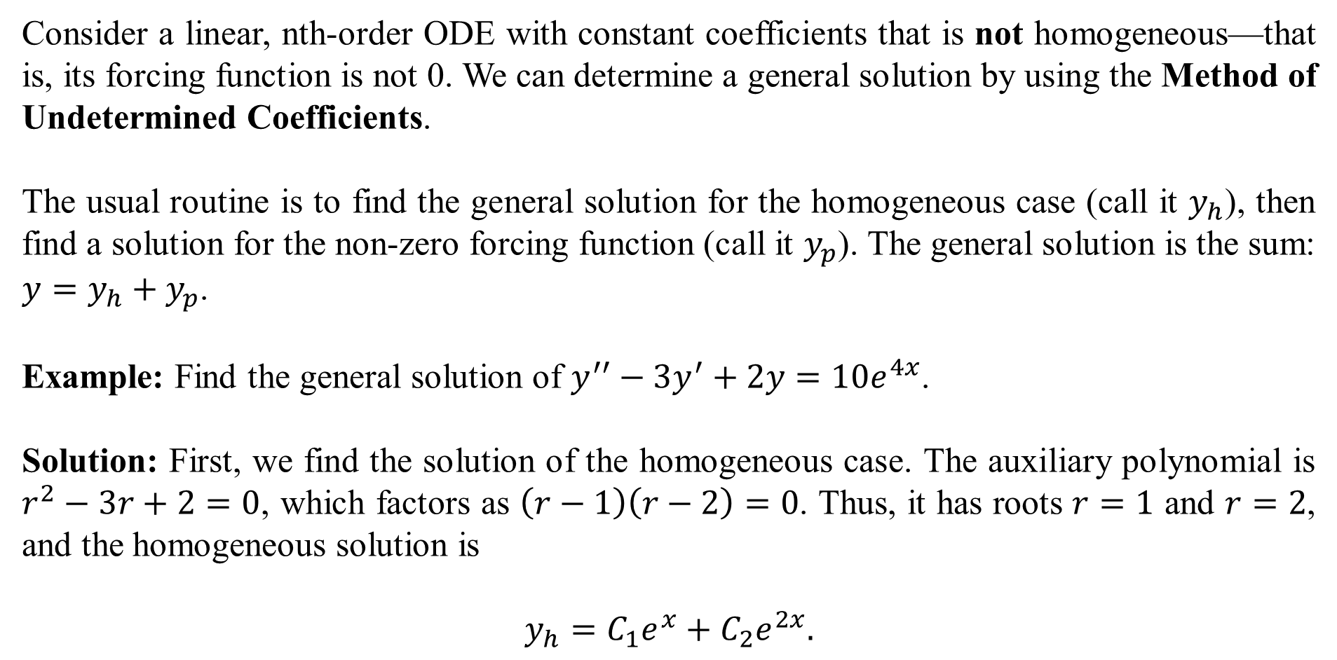
Consider a linear, nth-order ODE with constant coefficients that is not homogeneous—that is, its forcing function is not 0. We can determine a general solution by using the Method of Undetermined Coefficients.
The usual routine is to find the general solution for the homogeneous case (call it $y_{h}$), then find a solution for the non-zero forcing function (call it $y_{p}$). The general solution is the sum: $y=y_{h}+y_{p}$.
Example: Find the general solution of $y^{′′}−3y^{′}+2y=10e^{4x}$.
Solution: First, we find the solution of the homogeneous case. The auxiliary polynomial is $r^{2}−3r+2=0$, which factors as $\left(r−1\right)\left(r−2\right)=0$. Thus, it has roots $r=1$ and $r=2$, and the homogeneous solution is
$$y_{h}=C_{1}e^{x}+C_{2}e^{2x}.$$

Slide 3
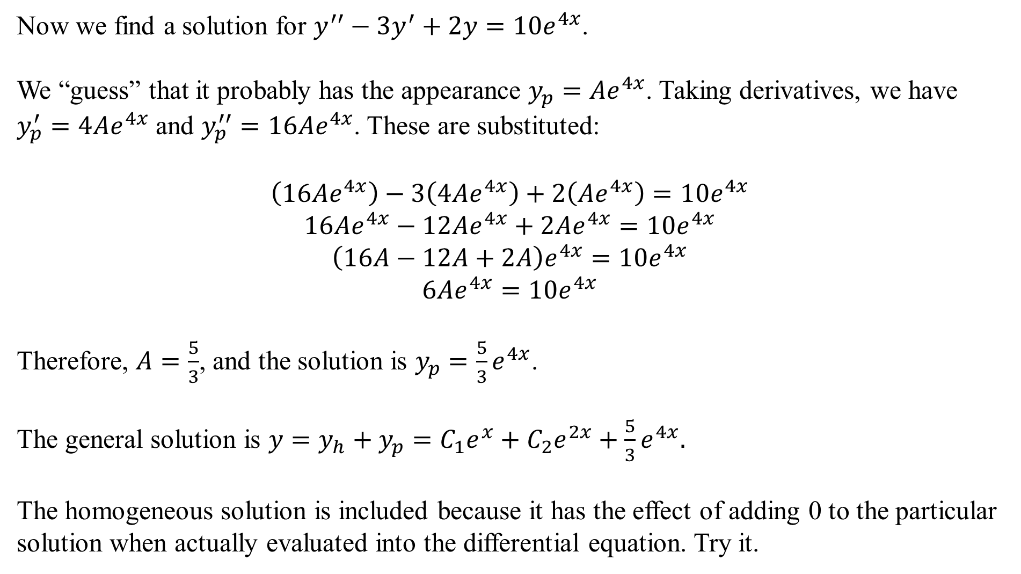
Now we find a solution for $y^{′′}−3y^{′}+2y=10e^{4x}$.
We “guess” that it probably has the appearance $y_{p}=Ae^{4x}$. Taking derivatives, we have $y_{p}^{′}=4Ae^{4x}$ and $y_{p}^{′′}=16Ae^{4x}$. These are substituted:
$$\left(16Ae^{4x}\right)−3\left(4Ae^{4x}\right)+2\left(Ae^{4x}\right)=10e^{4x}$$
$$16Ae^{4x}−12Ae^{4x}+2Ae^{4x}=10e^{4x}$$
$$\left(16A−12A+2A\right)e^{4x}=10e^{4x}$$
$$6Ae^{4x}=10e^{4x}$$
Therefore, $A=\frac{5}{3}$, and the solution is $y_{p}=\frac{5}{3}e^{4x}$.
The general solution is $y=y_{h}+y_{p}=C_{1}e^{x}+C_{2}e^{2x}+\frac{5}{3}e^{4x}.$
The homogeneous solution is included because it has the effect of adding 0 to the particular solution when actually evaluated into the differential equation. Try it.

Slide 4
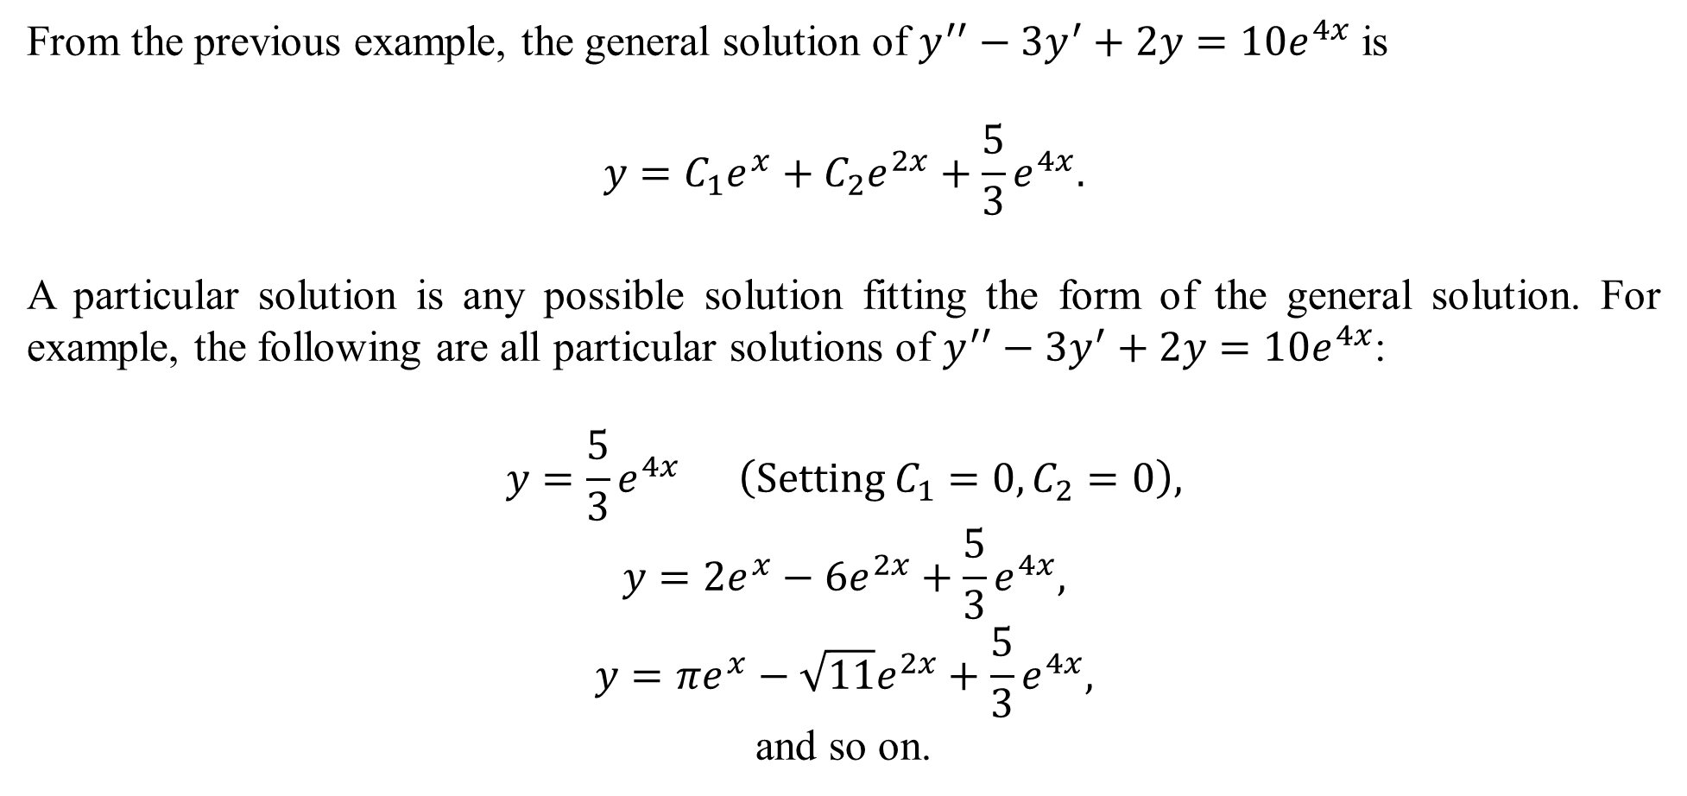
From the previous example, the general solution of $y^{′′}−3y^{′}+2y=10e^{4x}$ is
$$y=C_{1}e^{x}+C_{2}e^{2x}+\frac{5}{3}e^{4x}.$$
A particular solution is any possible solution fitting the form of the general solution. For example, the following are all particular solutions of $y^{′′}−3y^{′}+2y=10e^{4x}$:
$$y=\frac{5}{3}e^{4x} \left(Setting C_{1}=0, C_{2}=0\right),$$
$$y=2e^{x}−6e^{2x}+\frac{5}{3}e^{4x},$$
$$y=πe^{x}−\sqrt{11}e^{2x}+\frac{5}{3}e^{4x},$$
and so on.

Slide 5
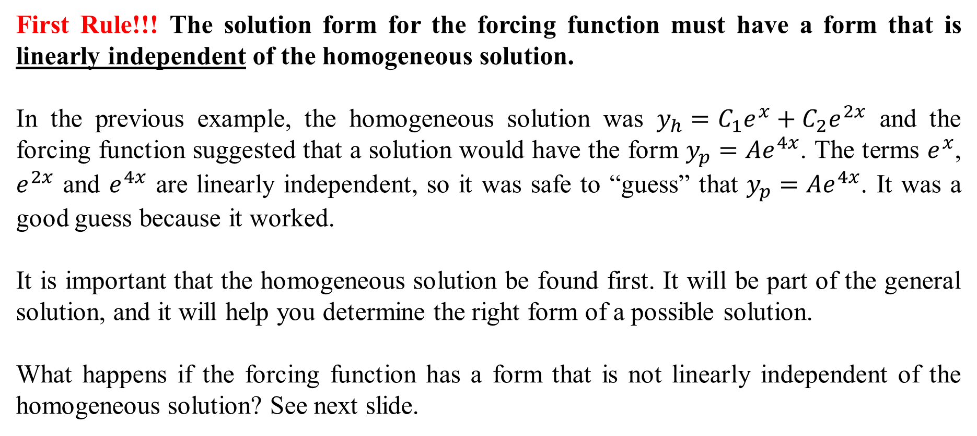
First Rule!!! The solution form for the forcing function must have a form that is linearly independent of the homogeneous solution.
In the previous example, the homogeneous solution was $y_{h}=C_{1}e^{x}+C_{2}e^{2x}$ and the forcing function suggested that a solution would have the form $y_{p}=Ae^{4x}$. The terms $e^{x}$, $e^{2x}$ and $e^{4x}$ are linearly independent, so it was safe to “guess” that $y_{p}=Ae^{4x}$. It was a good guess because it worked.
It is important that the homogeneous solution be found first. It will be part of the general solution, and it will help you determine the right form of a possible solution.
What happens if the forcing function has a form that is not linearly independent of the homogeneous solution? See next slide.

Slide 6
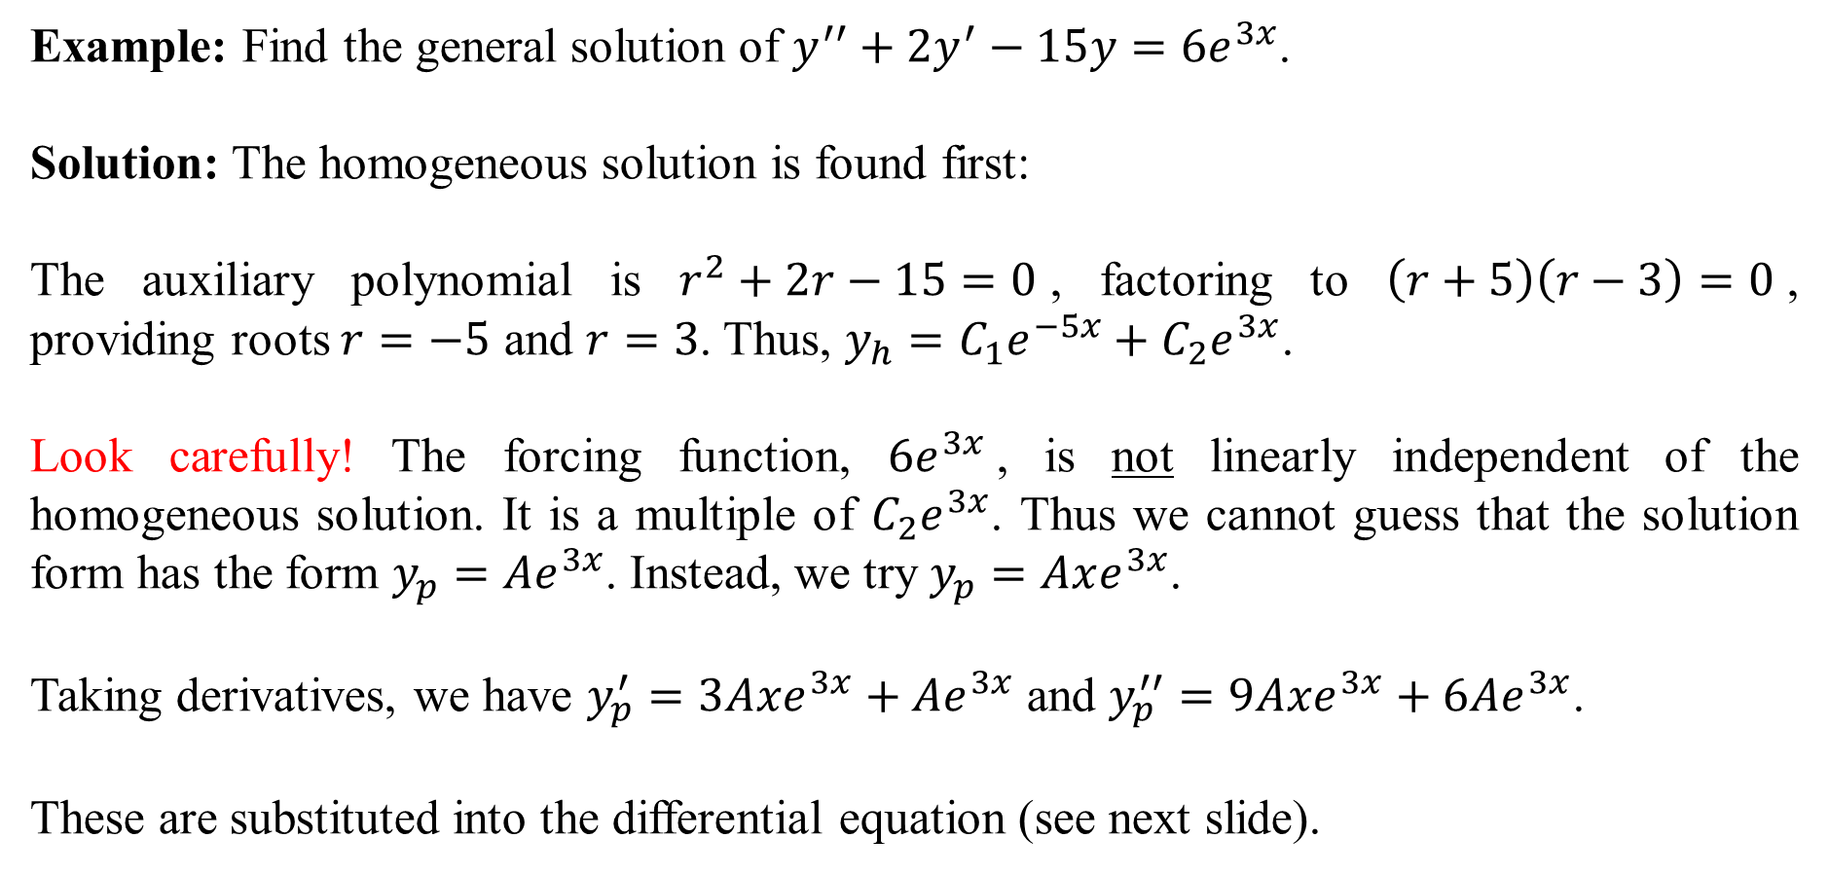
Example: Find the general solution of $y^{′′}+2y^{′}−15y=6e^{3x}$.
Solution: The homogeneous solution is found first:
The auxiliary polynomial is $r^{2}+2r−15=0$, factoring to $\left(r+5\right)\left(r−3\right)=0$, providing roots $r=−5$ and $r=3$. Thus, $y_{h}=C_{1}e^{−5x}+C_{2}e^{3x}$.
Look carefully! The forcing function, $6e^{3x}$, is not linearly independent of the homogeneous solution. It is a multiple of $C_{2}e^{3x}$. Thus we cannot guess that the solution form has the form $y_{p}=Ae^{3x}$. Instead, we try $y_{p}=Axe^{3x}$.
Taking derivatives, we have $y_{p}^{′}=3Axe^{3x}+Ae^{3x}$ and $y_{p}^{′′}=9Axe^{3x}+6Ae^{3x}$.
These are substituted into the differential equation (see next slide).

Slide 7
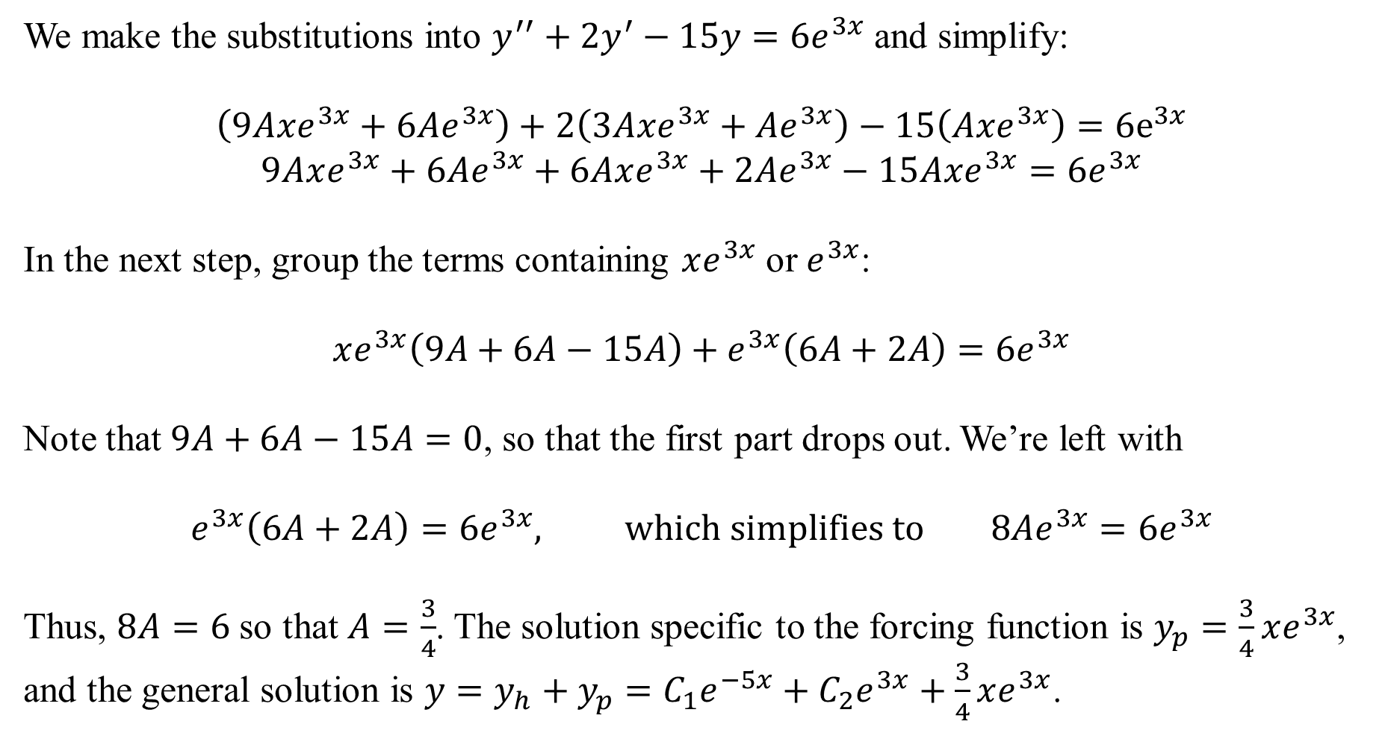
We make the substitutions into $y^{′′}+2y^{′}−15y=6e^{3x}$ and simplify:
$$\left(9Axe^{3x}+6Ae^{3x}\right)+2\left(3Axe^{3x}+Ae^{3x}\right)−15\left(Axe^{3x}\right)=6e^{3x}$$
$$9Axe^{3x}+6Ae^{3x}+6Axe^{3x}+2Ae^{3x}−15Axe^{3x}=6e^{3x}$$
In the next step, group the terms containing $xe^{3x}$ or $e^{3x}$:
$$xe^{3x}\left(9A+6A−15A\right)+e^{3x}\left(6A+2A\right)=6e^{3x}$$
Note that $9A+6A−15A=0$, so that the first part drops out. We’re left with
$$e^{3x}\left(6A+2A\right)=6e^{3x}, which simplifies to 8Ae^{3x}=6e^{3x}$$
Thus, $8A=6$ so that $A=\frac{3}{4}$. The solution specific to the forcing function is $y_{p}=\frac{3}{4}xe^{3x}$, and the general solution is $y=y_{h}+y_{p}=C_{1}e^{−5x}+C_{2}e^{3x}+\frac{3}{4}xe^{3x}$.

Slide 8
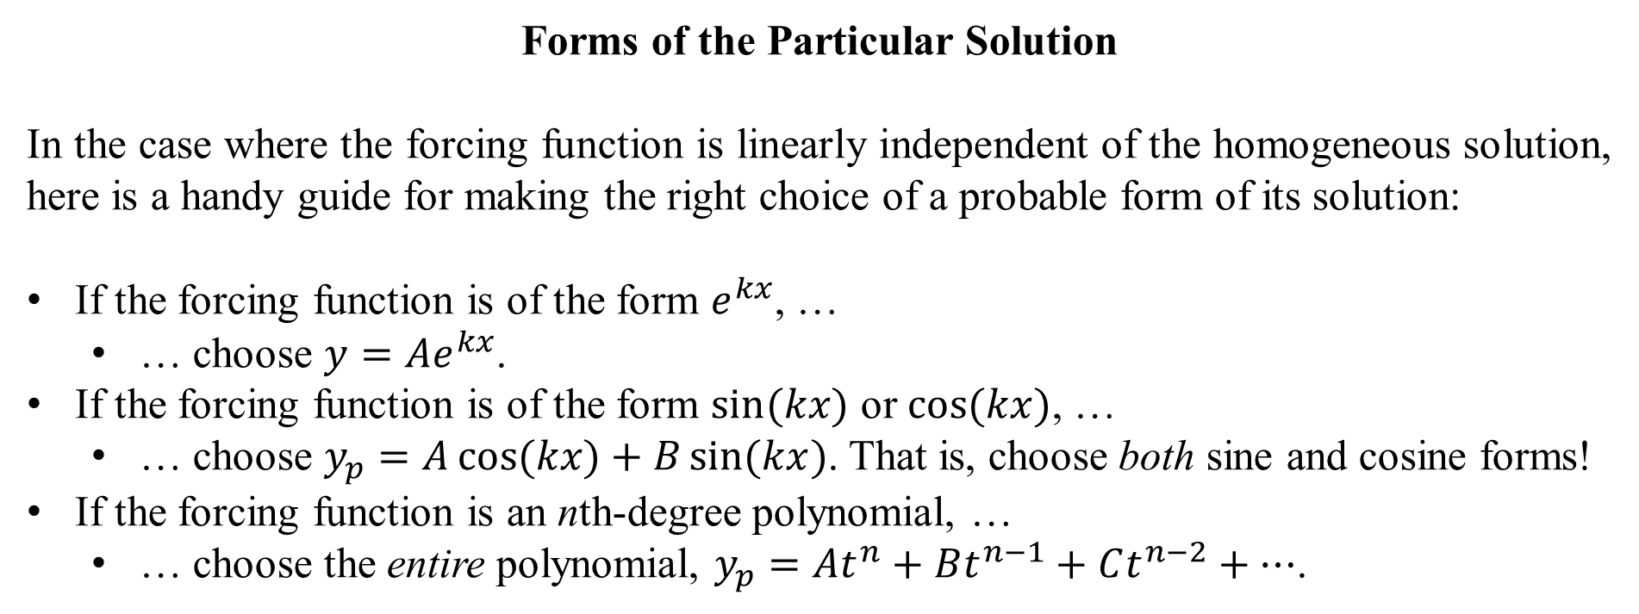
Forms of the Particular Solution
In the case where the forcing function is linearly independent of the homogeneous solution, here is a handy guide for making the right choice of a probable form of its solution:
If the forcing function is of the form $e^{kx}$, …
  … choose $y=Ae^{kx}$.
If the forcing function is of the form $\sin{(kx)}$ or $\cos{(kx})$, …
  … choose $y_{p}=A\cos{(kx)}+B\sin{(kx})$. That is, choose both sine and cosine forms!
If the forcing function is an nth-degree polynomial, …
  … choose the entire polynomial, $y_{p}=At^{n}+Bt^{n−1}+Ct^{n−2}+…$.

Slide 9
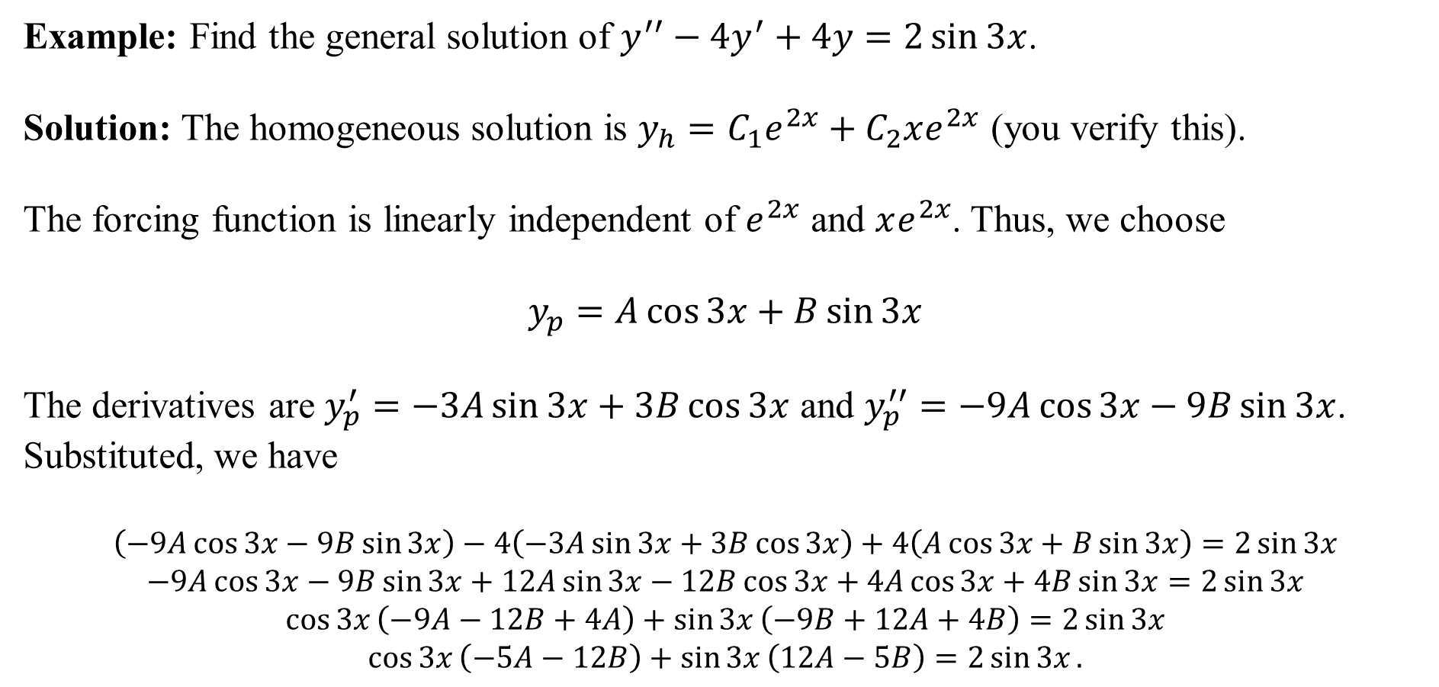
Example: Find the general solution of $y^{′′}−4y^{′}+4y=2\sin{3x}$.
Solution: The homogeneous solution is $y_{h}=C_{1}e^{2x}+C_{2}xe^{2x}$ (you verify this).
The forcing function is linearly independent of $e^{2x}$ and $xe^{2x}$. Thus, we choose
$$y_{p}=A\cos{3x}+B\sin{3x}$$
The derivatives are $y_{p}^{′}=−3A\sin{3x}+3B\cos{3x}$ and $y_{p}^{′′}=−9A\cos{3x}−9B\sin{3x}$. Substituted, we have
$$\left(−9A\cos{3x}−9B\sin{3x}\right)−4\left(−3A\sin{3x}+3B\cos{3x}\right)+4\left(A\cos{3x}+B\sin{3x}\right)=2\sin{3x}$$
$$−9A\cos{3x}−9B\sin{3x}+12A\sin{3x}−12B\cos{3x}+4A\cos{3x}+4B\sin{3x}=2\sin{3x}$$
$$\cos{3x}\left(−9A−12B+4A\right)+\sin{3x}\left(−9B+12A+4B\right)=2\sin{3x}$$
$$\cos{3x}\left(−5A−12B\right)+\sin{3x}\left(12A−5B\right)=2\sin{3x}.$$

Slide 10


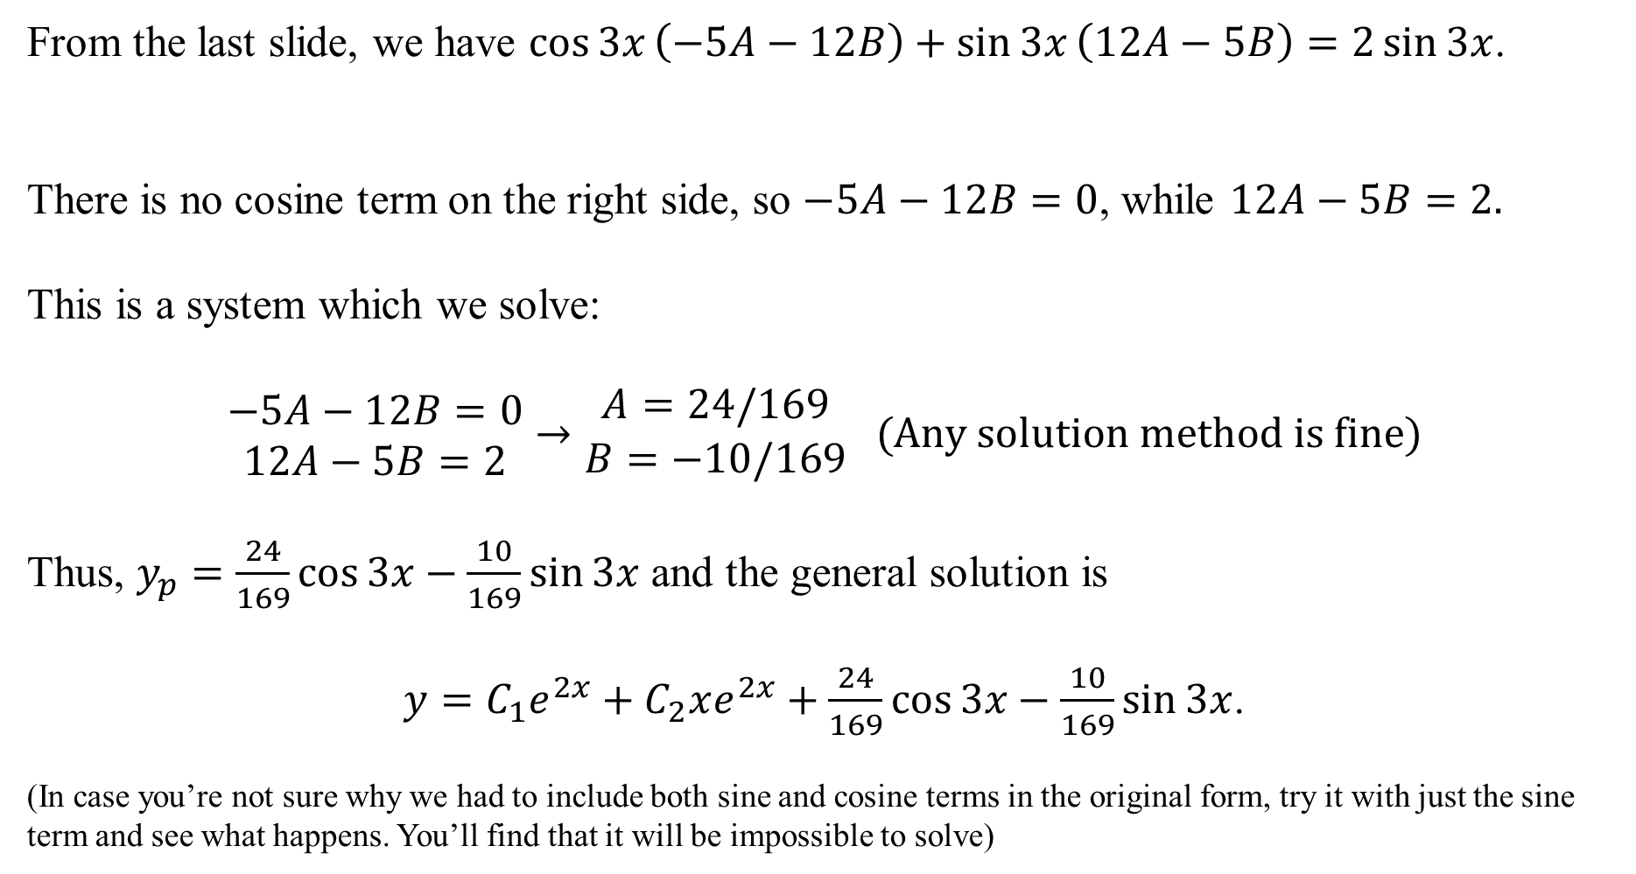
From the last slide, we have $\cos{3x}\left(−5A−12B\right)+\sin{3x}\left(12A−5B\right)=2\sin{3x}$.
There is no cosine term on the right side, so $−5A−12B=0$, while $12A−5B=2.$
This is a system which we solve:
$$\begin{matrix}−5A−12B=0 \\ 12A−5B=2\end{matrix}→\begin{matrix}A=24/169 \\ B=−10/169\end{matrix} (Any solution method is fine)$$
Thus, $y_{p}=\frac{24}{169}\cos{3x}−\frac{10}{169}\sin{3x}$ and the general solution is
$y=C_{1}e^{2x}+C_{2}xe^{2x}+\frac{24}{169}\cos{3x}−\frac{10}{169}\sin{3x}$.
(In case you’re not sure why we had to include both sine and cosine terms in the original form, try it with just the sine term and see what happens. You’ll find that it will be impossible to solve)

Slide 11
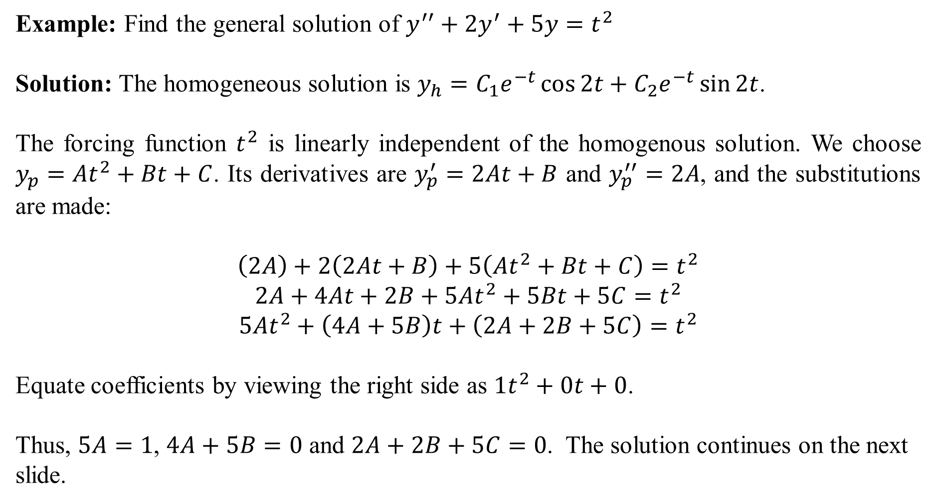
Example: Find the general solution of $y^{′′}+2y^{′}+5y=t^{2}$
Solution: The homogeneous solution is $y_{h}=C_{1}e^{−t}\cos{2t}+C_{2}e^{−t}\sin{2t}$.
The forcing function $t^{2}$ is linearly independent of the homogenous solution. We choose $y_{p}=At^{2}+Bt+C$. Its derivatives are $y_{p}^{′}=2At+B$ and $y_{p}^{′′}=2A$, and the substitutions are made:
$$\left(2A\right)+2\left(2At+B\right)+5\left(At^{2}+Bt+C\right)=t^{2}$$
$$2A+4At+2B+5At^{2}+5Bt+5C=t^{2}$$
$$5At^{2}+\left(4A+5B\right)t+\left(2A+2B+5C\right)=t^{2}$$
Equate coefficients by viewing the right side as $1t^{2}+0t+0$.
Thus, $5A=1$, $4A+5B=0$ and $2A+2B+5C=0$. The solution continues on the next slide.

Slide 12
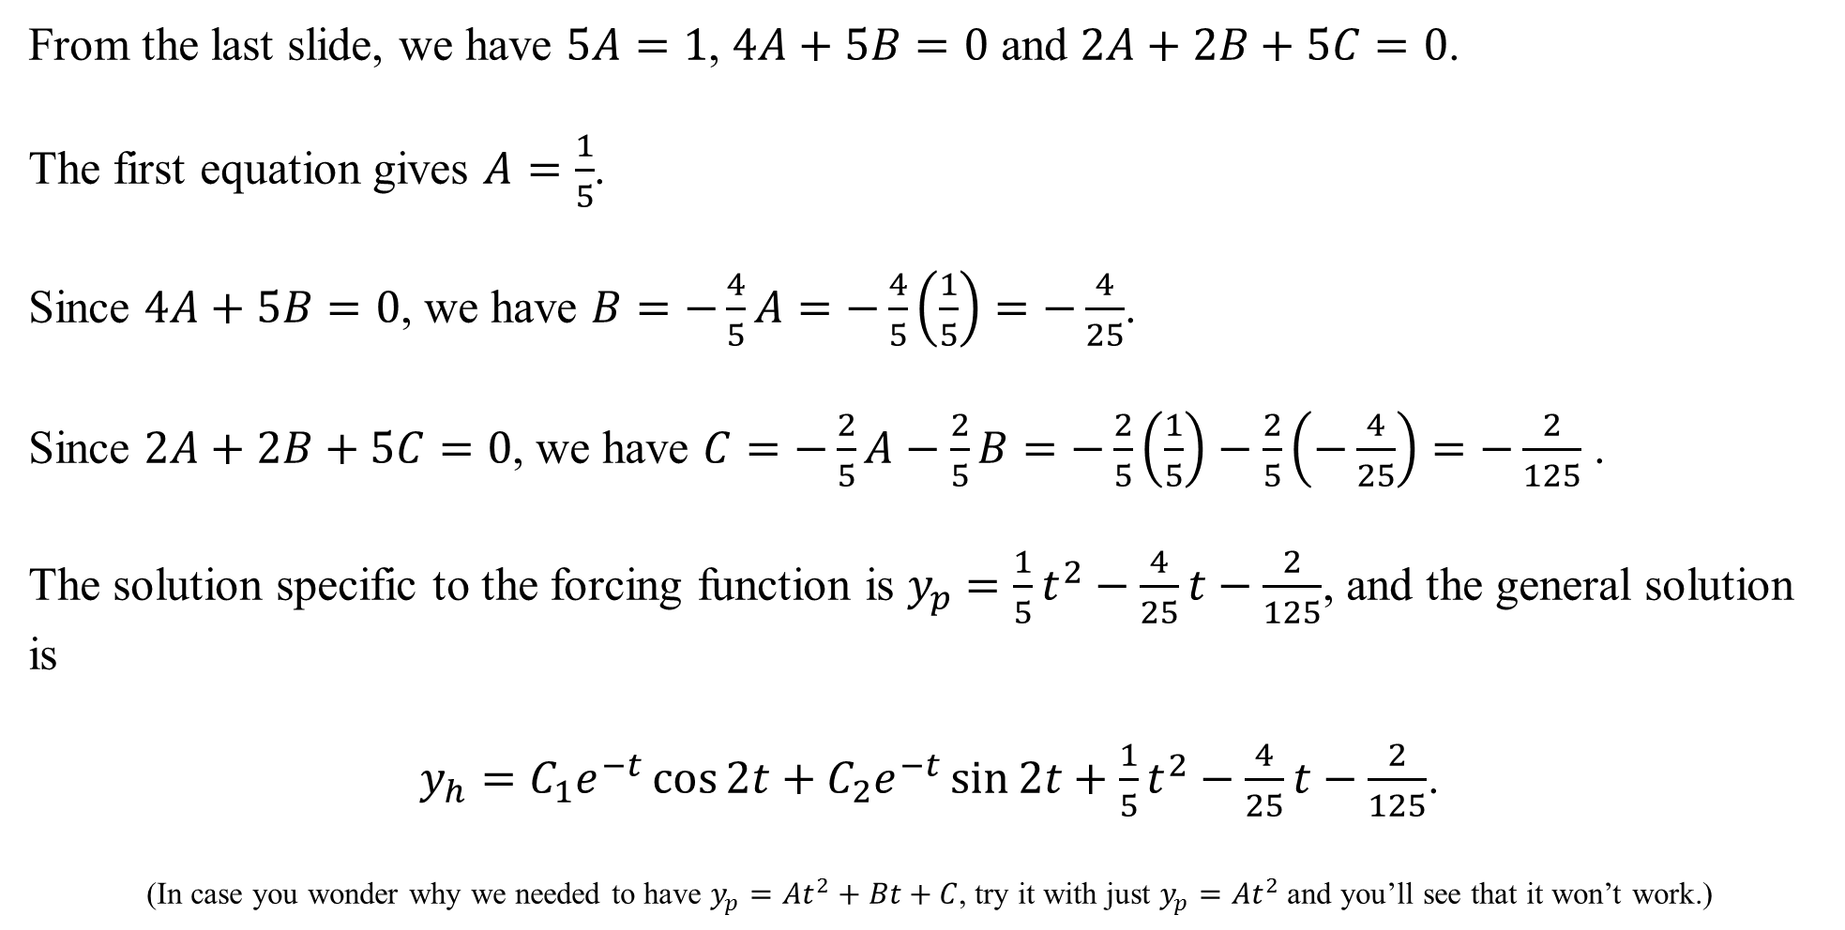
From the last slide, we have $5A=1$, $4A+5B=0$ and $2A+2B+5C=0$.
The first equation gives $A=\frac{1}{5}$.
Since $4A+5B=0$, we have $B=−\frac{4}{5}A=−\frac{4}{5}\left(\frac{1}{5}\right)=−\frac{4}{25}$.
Since $2A+2B+5C=0$, we have $C=−\frac{2}{5}A−\frac{2}{5}B=−\frac{2}{5}\left(\frac{1}{5}\right)−\frac{2}{5}\left(−\frac{4}{25}\right)=−\frac{2}{125}$ .
The solution specific to the forcing function is $y_{p}=\frac{1}{5}t^{2}−\frac{4}{25}t−\frac{2}{125}$, and the general solution is
$y_{h}=C_{1}e^{−t}\cos{2t}+C_{2}e^{−t}\sin{2t}+\frac{1}{5}t^{2}−\frac{4}{25}t−\frac{2}{125}$.
(In case you wonder why we needed to have $y_{p}=At^{2}+Bt+C$, try it with just $y_{p}=At^{2}$ and you’ll see that it won’t work.)

Slide 13
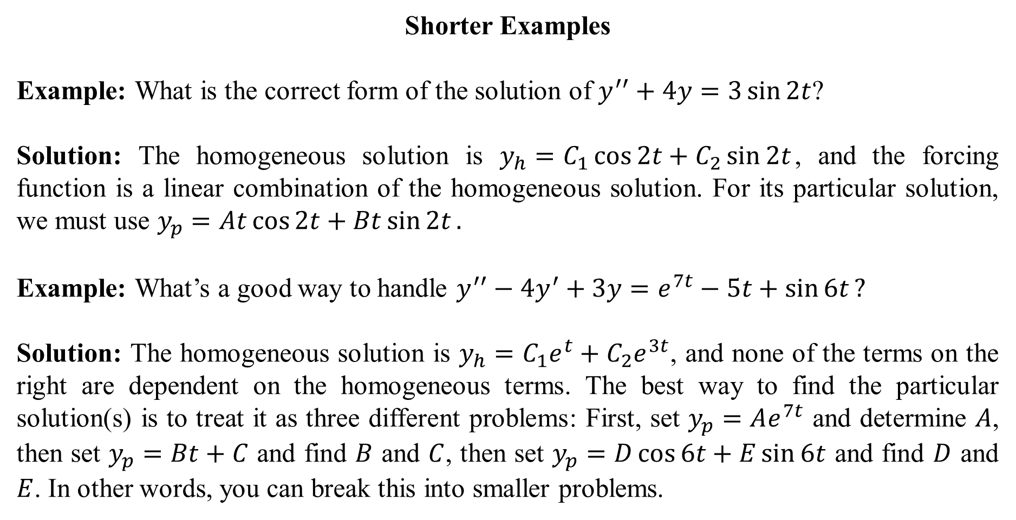
Shorter Examples
Example: What is the correct form of the solution of $y^{′′}+4y=3\sin{2t}$?
Solution: The homogeneous solution is $y_{h}=C_{1}\cos{2t}+C_{2}\sin{2t}$, and the forcing function is a linear combination of the homogeneous solution. For its particular solution, we must use $y_{p}=At\cos{2t}+Bt\sin{2t}.$
Example: What’s a good way to handle $y^{′′}−4y^{′}+3y=e^{7t}−5t+\sin{6t}?$
Solution: The homogeneous solution is $y_{h}=C_{1}e^{t}+C_{2}e^{3t}$, and none of the terms on the right are dependent on the homogeneous terms. The best way to find the particular solution(s) is to treat it as three different problems: First, set $y_{p}=Ae^{7t}$ and determine $A$, then set $y_{p}=Bt+C$ and find $B$ and $C$, then set $y_{p}=D\cos{6t}+E\sin{6t}$ and find $D$ and $E$. In other words, you can break this into smaller problems.

