Slide 1
Systems of Ordinary Differential Equations Case II: Complex Eigenvalues
MAT 275

Slide 2
Recall that $e^{ait}=\cos{at}+i\sin{at}$. We will use this identity when solving systems of differential equations with constant coefficients in which the eigenvalues are complex.
Example: Solve $x^{′}=\left[\begin{matrix}3 & −2 \\ 4 & −1\end{matrix}\right]x$.
Solution: Find the eigenvalues first. Starting with $\det\left[\begin{matrix}3−λ & −2 \\ 4 & −1−λ\end{matrix}\right]=0$, we get
$λ^{2}−2λ+5=0$, which has roots $λ=\frac{−\left(−2\right)±\sqrt{{\left(−2\right)}^{2}−4(1)(5)}}{2(1)}=1±2i$.
We’ll get the eigenvectors next.

Slide 3
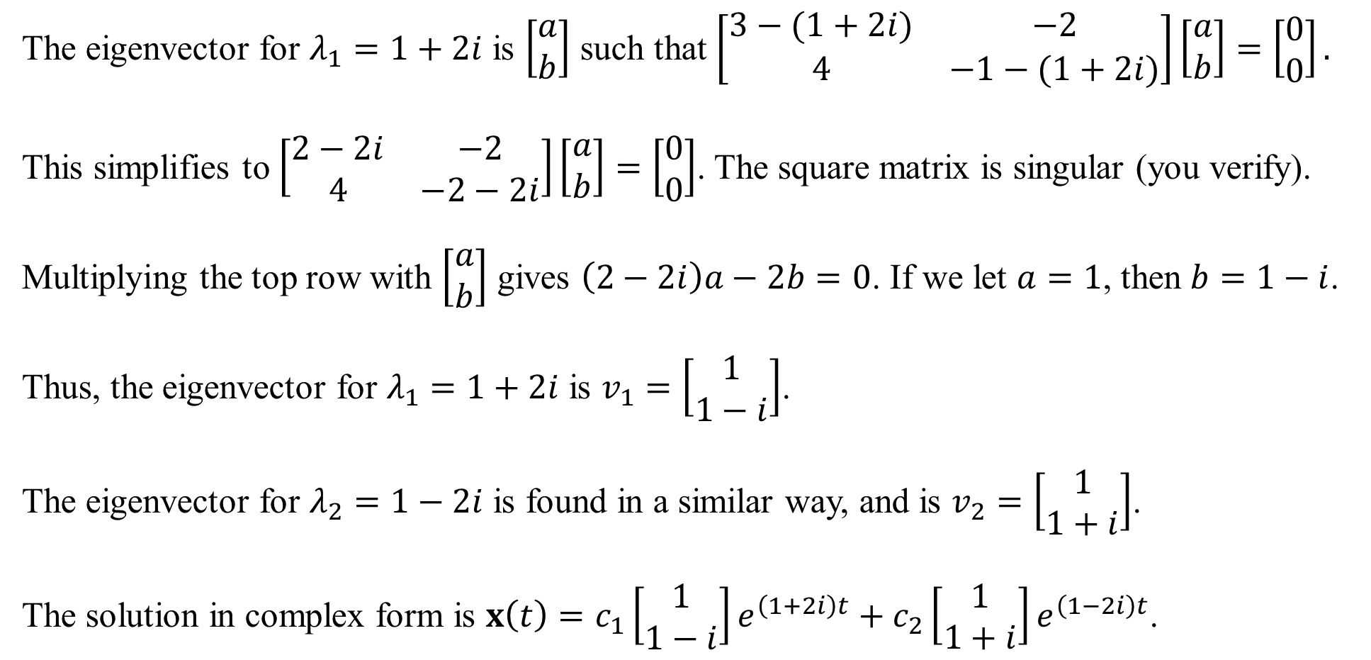
The eigenvector for $λ_{1}=1+2i$ is $\left[\begin{matrix}a \\ b\end{matrix}\right]$ such that $\left[\begin{matrix}3−(1+2i) & −2 \\ 4 & −1−(1+2i)\end{matrix}\right]\left[\begin{matrix}a \\ b\end{matrix}\right]=\left[\begin{matrix}0 \\ 0\end{matrix}\right].$
This simplifies to $\left[\begin{matrix}2−2i & −2 \\ 4 & −2−2i\end{matrix}\right]\left[\begin{matrix}a \\ b\end{matrix}\right]=\left[\begin{matrix}0 \\ 0\end{matrix}\right]$. The square matrix is singular (you verify).
Multiplying the top row with $\left[\begin{matrix}a \\ b\end{matrix}\right]$ gives $\left(2−2i\right)a−2b=0$. If we let $a=1$, then $b=1−i$.
Thus, the eigenvector for $λ_{1}=1+2i$ is $v_{1}=\left[\begin{matrix}1 \\ 1−i\end{matrix}\right]$.
The eigenvector for $λ_{2}=1−2i$ is found in a similar way, and is $v_{2}=\left[\begin{matrix}1 \\ 1+i\end{matrix}\right]$.
The solution in complex form is $x\left(t\right)=c_{1}\left[\begin{matrix}1 \\ 1−i\end{matrix}\right]e^{\left(1+2i\right)t}+c_{2}\left[\begin{matrix}1 \\ 1+i\end{matrix}\right]e^{\left(1−2i\right)t}$.

Slide 4
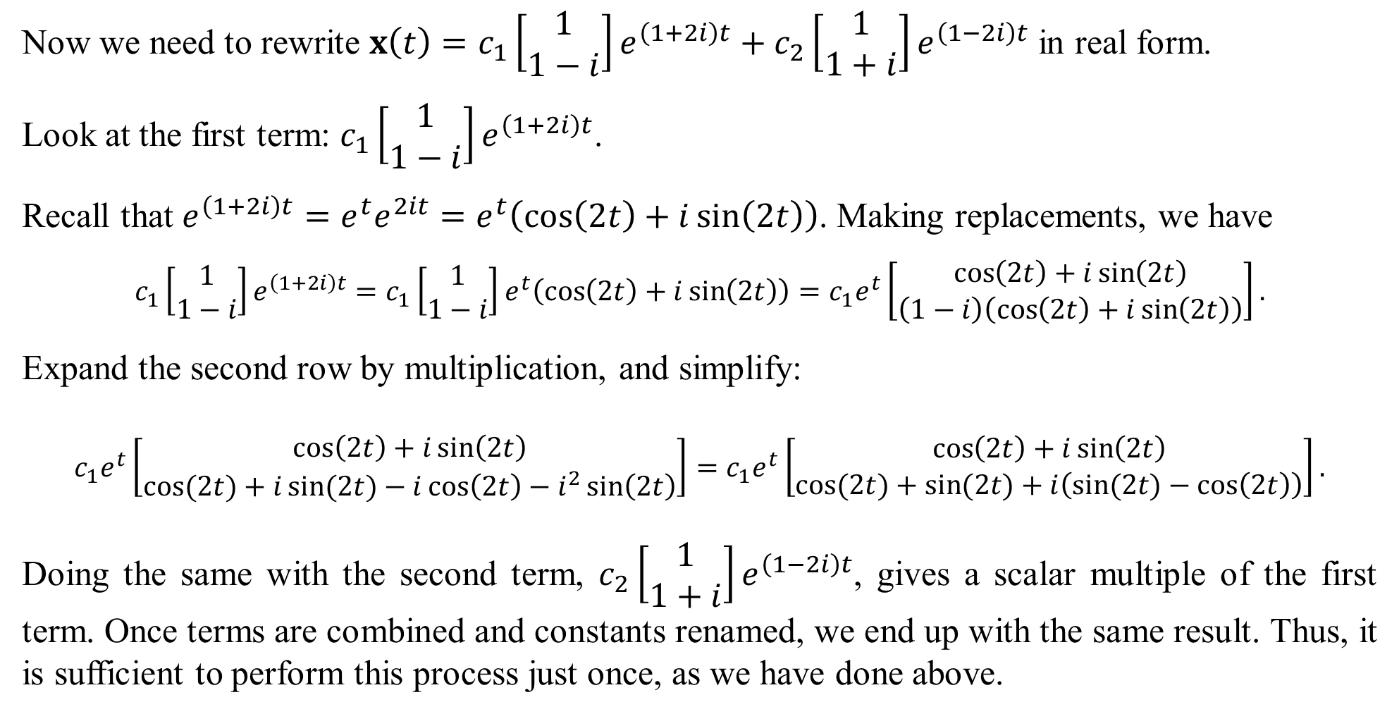
Now we need to rewrite $x\left(t\right)=c_{1}\left[\begin{matrix}1 \\ 1−i\end{matrix}\right]e^{\left(1+2i\right)t}+c_{2}\left[\begin{matrix}1 \\ 1+i\end{matrix}\right]e^{\left(1−2i\right)t}$ in real form.
Look at the first term: $c_{1}\left[\begin{matrix}1 \\ 1−i\end{matrix}\right]e^{\left(1+2i\right)t}$.
Recall that $e^{\left(1+2i\right)t}=e^{t}e^{2it}=e^{t}\left(\cos\left(2t\right)+i\sin\left(2t\right)\right)$. Making replacements, we have
$$c_{1}\left[\begin{matrix}1 \\ 1−i\end{matrix}\right]e^{\left(1+2i\right)t}=c_{1}\left[\begin{matrix}1 \\ 1−i\end{matrix}\right]e^{t}\left(\cos\left(2t\right)+i\sin\left(2t\right)\right)=c_{1}e^{t}\left[\begin{matrix}\cos\left(2t\right)+i\sin\left(2t\right) \\ \left(1−i\right)\left(\cos\left(2t\right)+i\sin\left(2t\right)\right)\end{matrix}\right].$$
Expand the second row by multiplication, and simplify:
$$c_{1}e^{t}\left[\begin{matrix}\cos\left(2t\right)+i\sin\left(2t\right) \\ \cos{(2t)}+i\sin{(2t)}−i\cos\left(2t\right)−i^{2}\sin\left(2t\right)\end{matrix}\right]=c_{1}e^{t}\left[\begin{matrix}\cos\left(2t\right)+i\sin\left(2t\right) \\ \cos{(2t)}+\sin{(2t)}+i\left(\sin{(2t)}−\cos\left(2t\right)\right)\end{matrix}\right].$$
Doing the same with the second term, $c_{2}\left[\begin{matrix}1 \\ 1+i\end{matrix}\right]e^{\left(1−2i\right)t}$, gives a scalar multiple of the first term. Once terms are combined and constants renamed, we end up with the same result. Thus, it is sufficient to perform this process just once, as we have done above.

Slide 5
From the last slide, we have $c_{1}e^{t}\left[\begin{matrix}\cos\left(2t\right)+i\sin\left(2t\right) \\ \cos{(2t)}+\sin{(2t)}+i\left(\sin{(2t)}−\cos\left(2t\right)\right)\end{matrix}\right]$.
Now, “stack” the terms into two columns, one real and one imaginary:
$$c_{1}e^{t}\left[\begin{matrix}\cos{(2t)} & + i\sin\left(2t\right) \\ \cos{(2t)}+\sin{(2t)} & + i\left(\sin{(2t)}−\cos\left(2t\right)\right)\end{matrix}\right].$$
Recall that if $u\left(t\right)+iv(t)$ are solutions of a homogeneous ODE, then so are $u(t)$ and $v(t)$. We can drop the imaginary coefficient now. The solution of $x^{′}=\left[\begin{matrix}3 & −2 \\ 4 & −1\end{matrix}\right]x$ is
$$x\left(t\right)=c_{1}e^{t}\left[\begin{matrix}\cos{(2t)} \\ \cos{(2t)}+\sin{(2t)}\end{matrix}\right]+c_{2}e^{t}\left[\begin{matrix}\sin\left(2t\right) \\ \sin{(2t)}−\cos\left(2t\right)\end{matrix}\right].$$
(Reminder: we’d get the same solution had we performed the tasks on the second term from the last slide.)

Slide 6
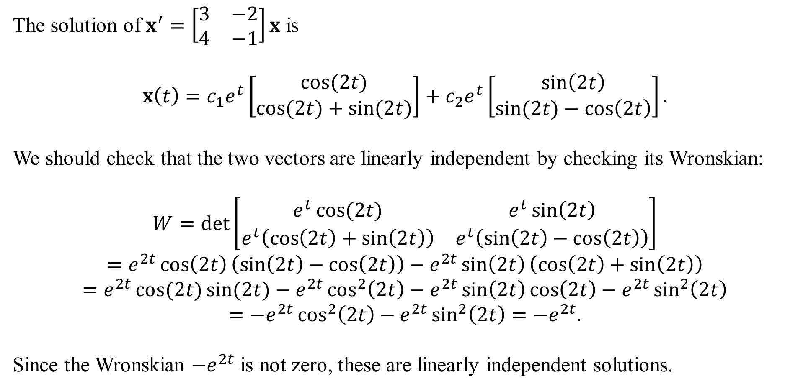
The solution of $x^{′}=\left[\begin{matrix}3 & −2 \\ 4 & −1\end{matrix}\right]x$ is
$$x\left(t\right)=c_{1}e^{t}\left[\begin{matrix}\cos{(2t)} \\ \cos{(2t)}+\sin{(2t)}\end{matrix}\right]+c_{2}e^{t}\left[\begin{matrix}\sin\left(2t\right) \\ \sin{(2t)}−\cos\left(2t\right)\end{matrix}\right].$$
We should check that the two vectors are linearly independent by checking its Wronskian:
$$W=\det\left[\begin{matrix}e^{t}\cos{(2t)} & e^{t}\sin\left(2t\right) \\ e^{t}\left(\cos\left(2t\right)+\sin\left(2t\right)\right) & e^{t}\left(\sin\left(2t\right)−\cos\left(2t\right)\right)\end{matrix}\right]$$
$$=e^{2t}\cos\left(2t\right)\left(\sin\left(2t\right)−\cos\left(2t\right)\right)−e^{2t}\sin\left(2t\right)\left(\cos\left(2t\right)+\sin\left(2t\right)\right)$$
$$=e^{2t}\cos{(2t)}\sin{(2t)}−e^{2t}\cos^{2}\left(2t\right)−e^{2t}\sin\left(2t\right)\cos\left(2t\right)−e^{2t}\sin^{2}\left(2t\right)$$
$$=−e^{2t}\cos^{2}\left(2t\right)−e^{2t}\sin^{2}\left(2t\right)=−e^{2t}.$$
Since the Wronskian ${−e}^{2t}$ is not zero, these are linearly independent solutions.

Slide 7
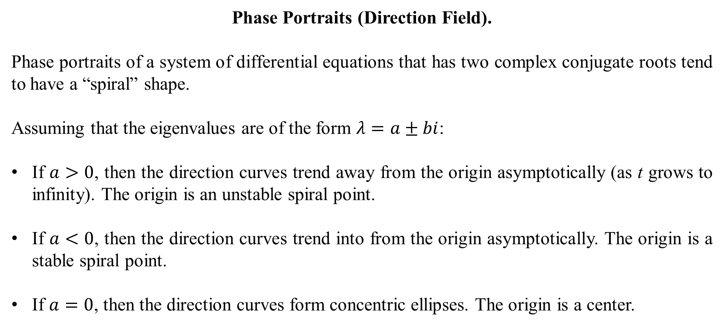
Phase Portraits (Direction Field).
Phase portraits of a system of differential equations that has two complex conjugate roots tend to have a “spiral” shape.
Assuming that the eigenvalues are of the form $λ=a±bi$:
If $a>0$, then the direction curves trend away from the origin asymptotically (as t grows to infinity). The origin is an unstable spiral point.
If $a<0$, then the direction curves trend into from the origin asymptotically. The origin is a stable spiral point.
If $a=0$, then the direction curves form concentric ellipses. The origin is a center.

Slide 8
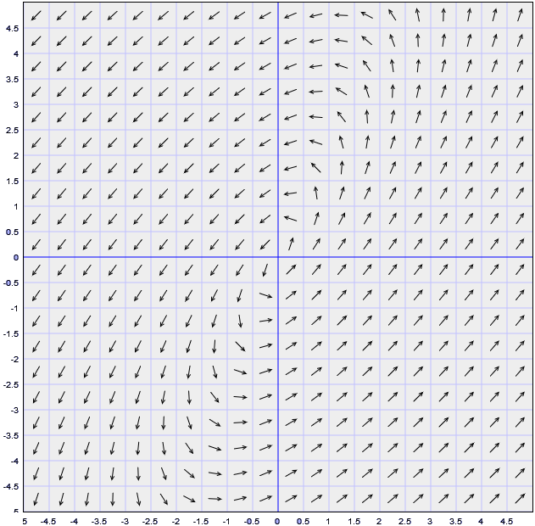
The phase portrait for $x^{′}=\left[\begin{matrix}3 & −2 \\ 4 & −1\end{matrix}\right]x$ is:
The eigenvalues are $λ=1±2i$.
Since a > 0, the direction lines flow
away from the origin.

Slide 9
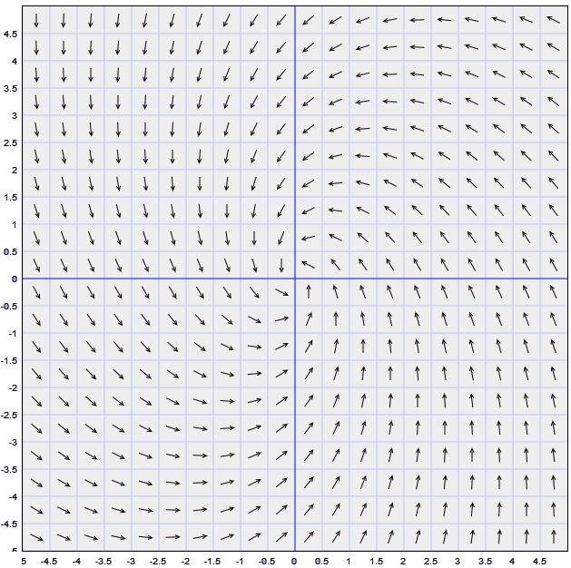
The phase portrait for $x^{′}=\left[\begin{matrix}−1 & −1 \\ 2 & −1\end{matrix}\right]x$ is:
The eigenvalues are $λ=−1±\sqrt{2}i$.
Since a < 0, the direction lines flow
into from the origin.
Compare this direction field to the
one on the previous slide. Do you
see the outward and inward effect
between the two?

Slide 10
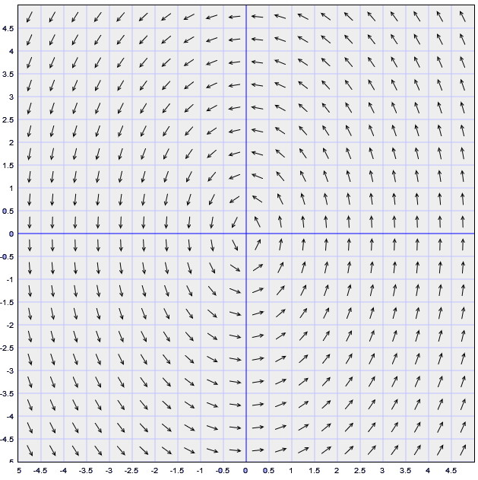
The phase portrait for $x^{′}=\left[\begin{matrix}0 & −2 \\ 4 & 0\end{matrix}\right]x$ is:
The eigenvalues are $λ=±2\sqrt{2}i$.
Since a = 0, the direction lines form ellipses.

