Slide 1
Systems of Ordinary Differential Equations Case I: real eigenvalues of multiplicity 1
MAT 275

Slide 2
Let $x_{1}(t)$ and $x_{2}(t)$ be two functions. A system of differential equations can have the form
$$\begin{matrix}x_{1}^{′}\left(t\right)=a_{1}x_{1}\left(t\right)+b_{1}x_{2}(t) \\ x_{2}^{′}\left(t\right)=a_{2}x_{1}\left(t\right)+b_{2}x_{2}\left(t\right)\end{matrix}$$
where $a_{1}, b_{1}, a_{2}$ and $b_{2}$ are constants. This is an example of a linear system of ODEs with constant coefficients.
Written as an equation using matrices, we have $\underset{x^{′}(t)}{\underbrace{\left[\begin{matrix}x_{1}^{′}\left(t\right) \\ x_{2}^{′}\left(t\right)\end{matrix}\right]}}=\underset{A}{\underbrace{\left[\begin{matrix}a_{1} & b_{1} \\ a_{2} & b_{2}\end{matrix}\right]}}\underset{x(t)}{\underbrace{\left[\begin{matrix}x_{1}\left(t\right) \\ x_{2}\left(t\right)\end{matrix}\right]}}.$
Such systems are written (short-hand) as $x^{′}=Ax$. It is first-order, linear and homogeneous.
The general solution is of the form $x\left(t\right)=c_{1}v_{1}e^{λ_{1}t}+c_{2}v_{2}e^{λ_{2}t}$, where $λ_{1}$ and $λ_{2}$ are the eigenvalues of $A$, and $v_{1}$ and $v_{2}$ are their eigenvectors, respectively.

Slide 3
Example: Solve $y^{′′}−2y^{′}−15y=0$ by first rewriting this second-order linear ODE as a first-order linear ODE in matrix form.
Solution: First, rename the variables: let $x_{1}\left(t\right)=y$ and $x_{2}\left(t\right)=x_{1}^{′}(t)=y′$. Note that $x_{2}^{′}\left(t\right)=y′′$. So now we have two equations:
$$\begin{matrix}x_{1}^{′}\left(t\right)=x_{2}(t) \\ x_{2}^{′}\left(t\right)−2x_{2}\left(t\right)−15x_{1}\left(t\right)=0\end{matrix}$$
Isolate the two derivatives to the left side:
$$x_{1}^{′}\left(t\right)= x_{2}\left(t\right)$$
$$x_{2}^{′}\left(t\right)=15x_{1}\left(t\right)+2x_{2}(t)$$
In matrix form, this is $\left[\begin{matrix}x_{1}^{′}\left(t\right) \\ x_{2}^{′}\left(t\right)\end{matrix}\right]=\left[\begin{matrix}0 & 1 \\ 15 & 2\end{matrix}\right]\left[\begin{matrix}x_{1}\left(t\right) \\ x_{2}\left(t\right)\end{matrix}\right]$.

Slide 4
We will use eigenvalues and eigenvectors to solve the system $\left[\begin{matrix}x_{1}^{′}\left(t\right) \\ x_{2}^{′}\left(t\right)\end{matrix}\right]=\left[\begin{matrix}0 & 1 \\ 15 & 2\end{matrix}\right]\left[\begin{matrix}x_{1}\left(t\right) \\ x_{2}\left(t\right)\end{matrix}\right]$.
First, find the eigenvalues of A:
Start with $det\left[\begin{matrix}0−λ & 1 \\ 15 & 2−λ\end{matrix}\right]=0$, which initially gives $−λ\left(2−λ\right)−15=0$.
This simplifies to $λ^{2}−2λ−15=0$, which factors as $\left(λ−5\right)\left(λ+3\right)=0$.
Thus, the two eigenvalues are $λ_{1}=5$ and $λ_{2}=−3$.
The eigenvectors are:
For $λ_{1}=5:$ we have $\left[\begin{matrix}−5 & 1 \\ 15 & −3\end{matrix}\right]\left[\begin{matrix}a \\ b\end{matrix}\right]=\left[\begin{matrix}0 \\ 0\end{matrix}\right]→−5a+b=0→\begin{matrix}let a=1 \\ so b=5\end{matrix}→v_{1}=\left[\begin{matrix}1 \\ 5\end{matrix}\right]$.
For $λ_{2}=−3:$ we have $\left[\begin{matrix}3 & 1 \\ 15 & 5\end{matrix}\right]\left[\begin{matrix}a \\ b\end{matrix}\right]=\left[\begin{matrix}0 \\ 0\end{matrix}\right]→3a+b=0→\begin{matrix}let a=1 \\ so b=−3\end{matrix}→v_{2}=\left[\begin{matrix}1 \\ −3\end{matrix}\right]$.

Slide 5
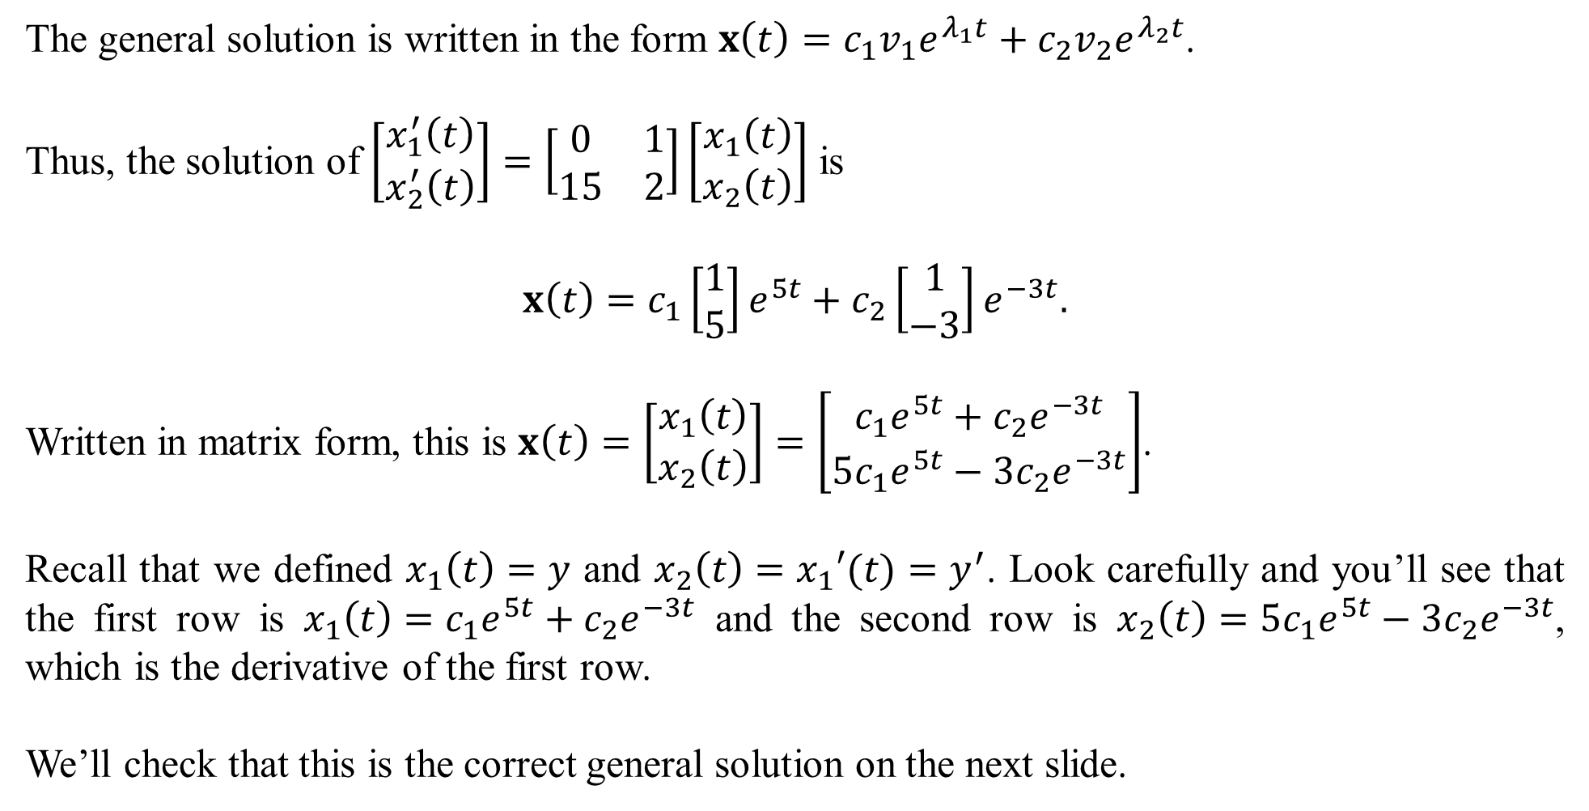
The general solution is written in the form $x\left(t\right)=c_{1}v_{1}e^{λ_{1}t}+c_{2}v_{2}e^{λ_{2}t}$.
Thus, the solution of $\left[\begin{matrix}x_{1}^{′}\left(t\right) \\ x_{2}^{′}\left(t\right)\end{matrix}\right]=\left[\begin{matrix}0 & 1 \\ 15 & 2\end{matrix}\right]\left[\begin{matrix}x_{1}\left(t\right) \\ x_{2}\left(t\right)\end{matrix}\right]$ is
$$x\left(t\right)=c_{1}\left[\begin{matrix}1 \\ 5\end{matrix}\right]e^{5t}+c_{2}\left[\begin{matrix}1 \\ −3\end{matrix}\right]e^{−3t}.$$
Written in matrix form, this is $x\left(t\right)=\left[\begin{matrix}x_{1}\left(t\right) \\ x_{2}\left(t\right)\end{matrix}\right]=\left[\begin{matrix}c_{1}e^{5t}+c_{2}e^{−3t} \\ 5c_{1}e^{5t}−3c_{2}e^{−3t}\end{matrix}\right]$.
Recall that we defined $x_{1}\left(t\right)=y$ and $x_{2}\left(t\right)=x_{1}′(t)=y^{′}$. Look carefully and you’ll see that the first row is $x_{1}\left(t\right)=c_{1}e^{5t}+c_{2}e^{−3t}$ and the second row is $x_{2}\left(t\right)=5c_{1}e^{5t}−3c_{2}e^{−3t}$, which is the derivative of the first row.
We’ll check that this is the correct general solution on the next slide.

Slide 6
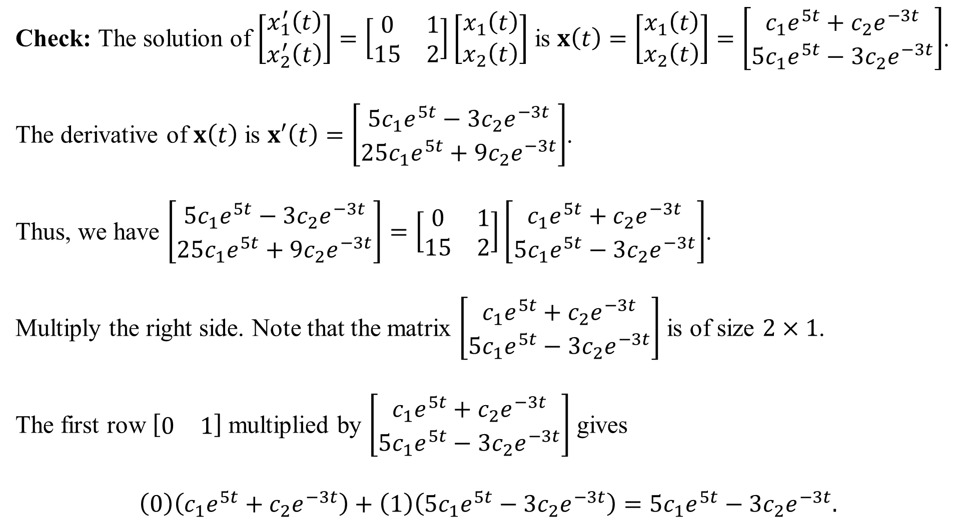
Check: The solution of $\left[\begin{matrix}x_{1}^{′}\left(t\right) \\ x_{2}^{′}\left(t\right)\end{matrix}\right]=\left[\begin{matrix}0 & 1 \\ 15 & 2\end{matrix}\right]\left[\begin{matrix}x_{1}\left(t\right) \\ x_{2}\left(t\right)\end{matrix}\right]$ is $x\left(t\right)=\left[\begin{matrix}x_{1}\left(t\right) \\ x_{2}\left(t\right)\end{matrix}\right]=\left[\begin{matrix}c_{1}e^{5t}+c_{2}e^{−3t} \\ 5c_{1}e^{5t}−3c_{2}e^{−3t}\end{matrix}\right]$.
The derivative of $x\left(t\right)$ is $x′\left(t\right)=\left[\begin{matrix}{5c}_{1}e^{5t}−3c_{2}e^{−3t} \\ 25c_{1}e^{5t}+9c_{2}e^{−3t}\end{matrix}\right]$.
Thus, we have $\left[\begin{matrix}{5c}_{1}e^{5t}−3c_{2}e^{−3t} \\ 25c_{1}e^{5t}+9c_{2}e^{−3t}\end{matrix}\right]=\left[\begin{matrix}0 & 1 \\ 15 & 2\end{matrix}\right]\left[\begin{matrix}c_{1}e^{5t}+c_{2}e^{−3t} \\ 5c_{1}e^{5t}−3c_{2}e^{−3t}\end{matrix}\right]$.
Multiply the right side. Note that the matrix $\left[\begin{matrix}c_{1}e^{5t}+c_{2}e^{−3t} \\ 5c_{1}e^{5t}−3c_{2}e^{−3t}\end{matrix}\right]$ is of size $2×1$.
The first row $\left[\begin{matrix}0 & 1\end{matrix}\right]$ multiplied by $\left[\begin{matrix}c_{1}e^{5t}+c_{2}e^{−3t} \\ 5c_{1}e^{5t}−3c_{2}e^{−3t}\end{matrix}\right]$ gives
$$\left(0\right)\left(c_{1}e^{5t}+c_{2}e^{−3t}\right)+\left(1\right)\left(5c_{1}e^{5t}−3c_{2}e^{−3t}\right)=5c_{1}e^{5t}−3c_{2}e^{−3t}.$$

Slide 7
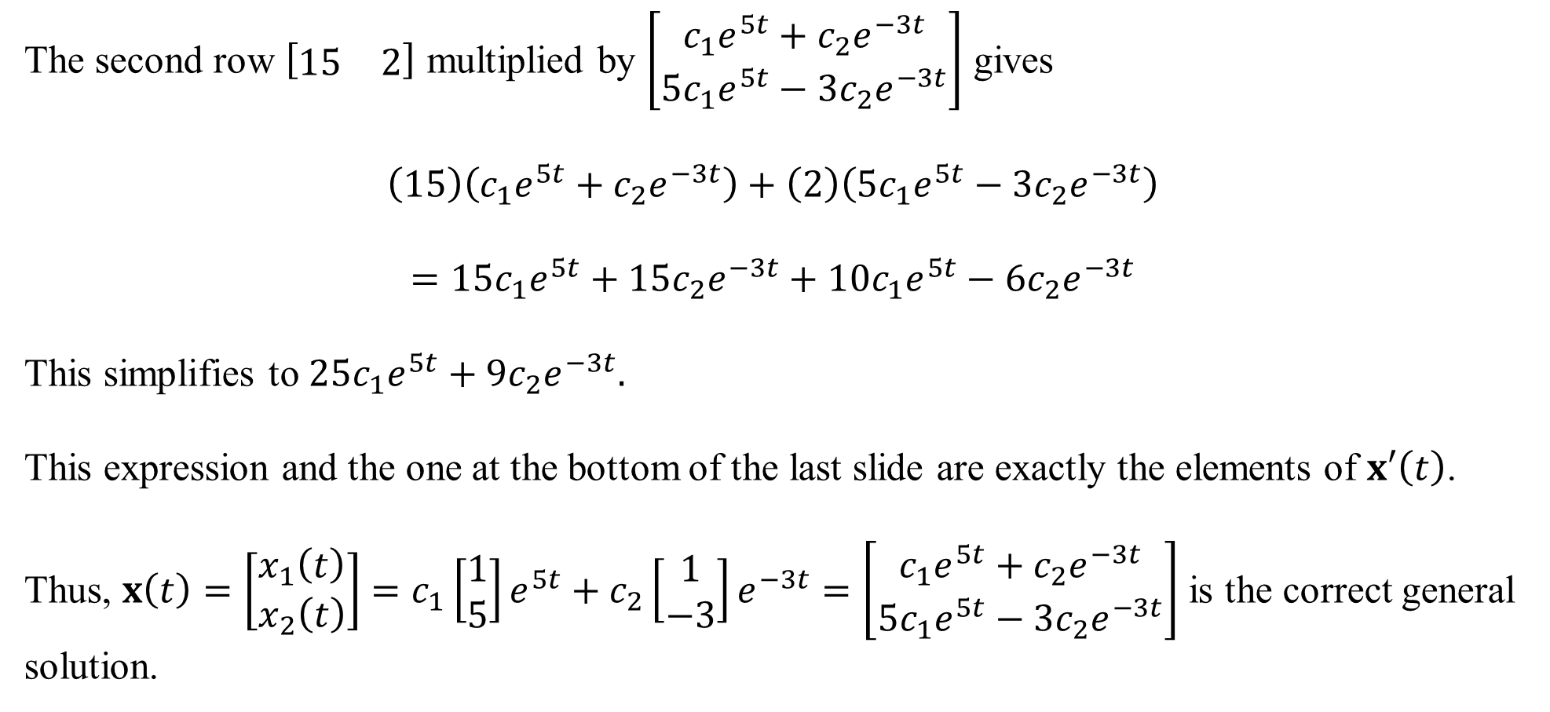
The second row $\left[\begin{matrix}15 & 2\end{matrix}\right]$ multiplied by $\left[\begin{matrix}c_{1}e^{5t}+c_{2}e^{−3t} \\ 5c_{1}e^{5t}−3c_{2}e^{−3t}\end{matrix}\right]$ gives
$$\left(15\right)\left(c_{1}e^{5t}+c_{2}e^{−3t}\right)+\left(2\right)\left(5c_{1}e^{5t}−3c_{2}e^{−3t}\right)$$
$$=15c_{1}e^{5t}+15c_{2}e^{−3t}+10c_{1}e^{5t}−6c_{2}e^{−3t}$$
This simplifies to $25c_{1}e^{5t}+9c_{2}e^{−3t}.$
This expression and the one at the bottom of the last slide are exactly the elements of $x′\left(t\right)$.
Thus, $x\left(t\right)=\left[\begin{matrix}x_{1}\left(t\right) \\ x_{2}\left(t\right)\end{matrix}\right]=c_{1}\left[\begin{matrix}1 \\ 5\end{matrix}\right]e^{5t}+c_{2}\left[\begin{matrix}1 \\ −3\end{matrix}\right]e^{−3t}=\left[\begin{matrix}c_{1}e^{5t}+c_{2}e^{−3t} \\ 5c_{1}e^{5t}−3c_{2}e^{−3t}\end{matrix}\right]$ is the correct general solution.

Slide 8
Phase Portraits
We can get a sense of the solutions of a system of ODEs by studying its phase portrait (direction field). The eigenvectors and eigenvalues play a significant role.
On a coordinate plane, sketch two lines corresponding to the two eigenvectors, each passing through the origin.
On each line, draw an arrow away from the origin if the eigenvalue is positive, and into the origin if the eigenvalue is negative.
If both eigenvalues are positive, the origin is an unstable node. Solutions will trend away from zero.
If both eigenvalues are negative, the origin is a stable node. Solutions will trend to 0.
If the eigenvalues are of different signs, the origin is a saddle, which is always unstable.

Slide 9
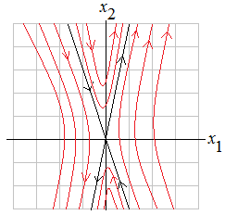
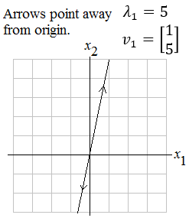
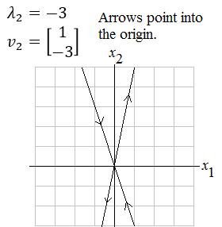
In the last example, the solution was $x\left(t\right)=\left[\begin{matrix}x_{1}\left(t\right) \\ x_{2}\left(t\right)\end{matrix}\right]=c_{1}\left[\begin{matrix}1 \\ 5\end{matrix}\right]e^{5t}+c_{2}\left[\begin{matrix}1 \\ −3\end{matrix}\right]e^{−3t}$. The eigenvalues are $λ_{1}=5$ and $λ_{2}=−3$ and the eigenvectors are $v_{1}=\left[\begin{matrix}1 \\ 5\end{matrix}\right]$ and $v_{2}=\left[\begin{matrix}1 \\ −3\end{matrix}\right]$.
A rough sketch of the phase portrait for this solution set. In this example, all curves trend away from the origin, or possibly come toward the origin then trend away. The origin here is a saddle (always unstable).

Slide 10
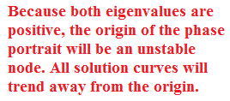
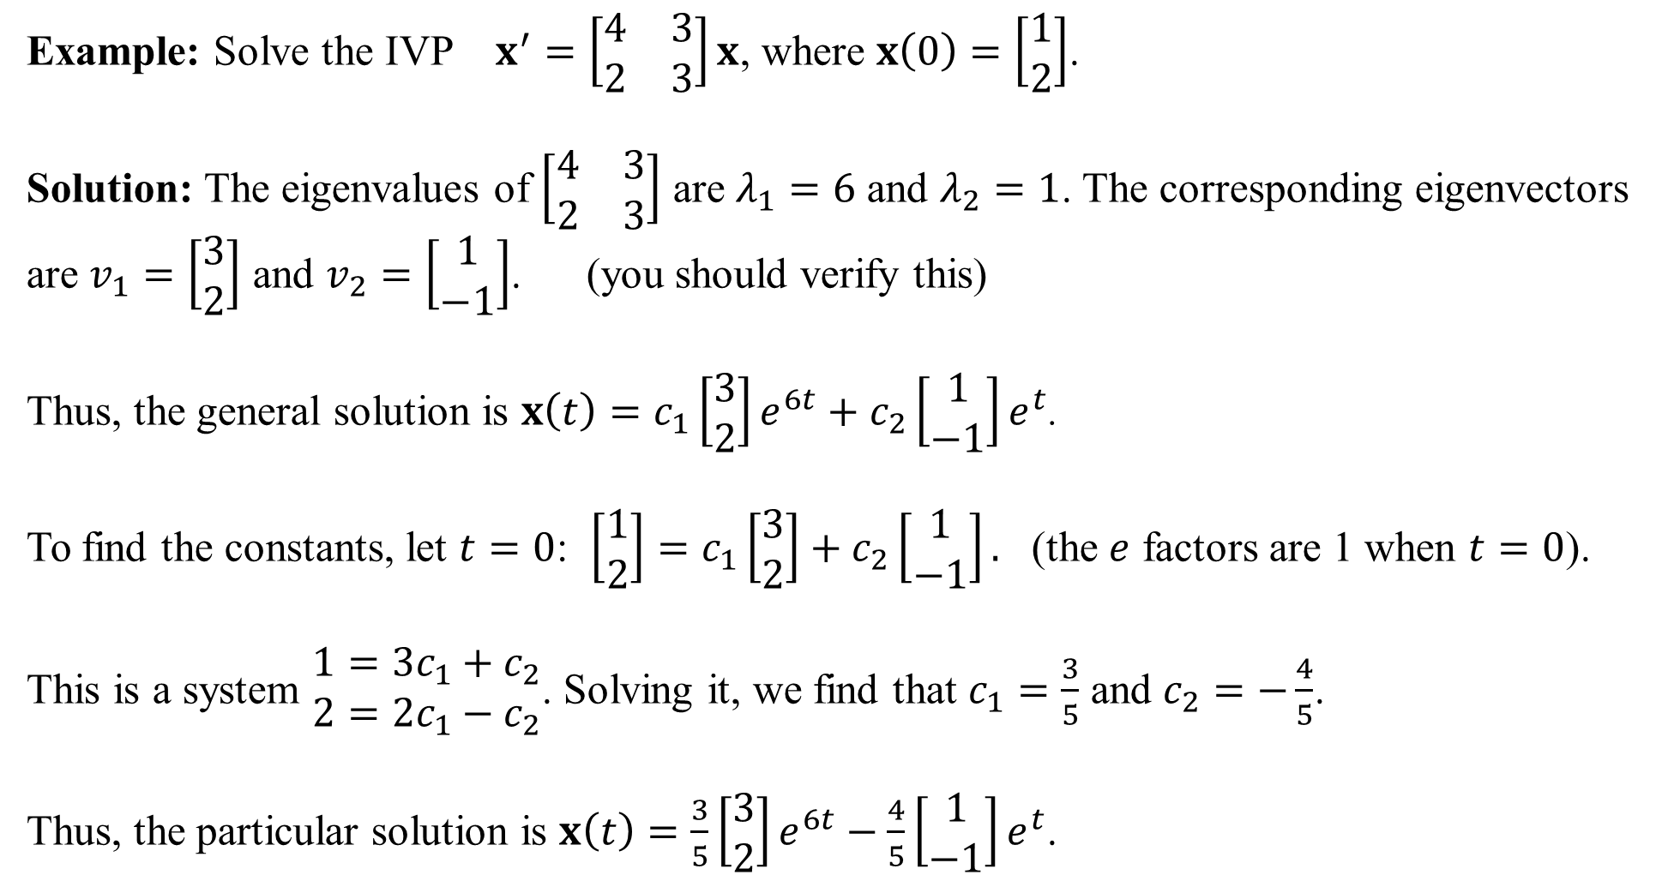
Example: Solve the IVP $x^{′}=\left[\begin{matrix}4 & 3 \\ 2 & 3\end{matrix}\right]x$, where $x\left(0\right)=\left[\begin{matrix}1 \\ 2\end{matrix}\right]$.
Solution: The eigenvalues of $\left[\begin{matrix}4 & 3 \\ 2 & 3\end{matrix}\right]$ are $λ_{1}=6$ and $λ_{2}=1$. The corresponding eigenvectors are $v_{1}=\left[\begin{matrix}3 \\ 2\end{matrix}\right]$ and $v_{2}=\left[\begin{matrix}1 \\ −1\end{matrix}\right]$. (you should verify this)
Thus, the general solution is $x\left(t\right)=c_{1}\left[\begin{matrix}3 \\ 2\end{matrix}\right]e^{6t}+c_{2}\left[\begin{matrix}1 \\ −1\end{matrix}\right]e^{t}$.
To find the constants, let $t=0$: $\left[\begin{matrix}1 \\ 2\end{matrix}\right]=c_{1}\left[\begin{matrix}3 \\ 2\end{matrix}\right]+c_{2}\left[\begin{matrix}1 \\ −1\end{matrix}\right].$ (the $e$ factors are 1 when $t=0$).
This is a system $\begin{matrix}1=3c_{1}+c_{2} \\ 2=2c_{1}−c_{2}\end{matrix}$. Solving it, we find that $c_{1}=\frac{3}{5}$ and $c_{2}=−\frac{4}{5}$.
Thus, the particular solution is $x\left(t\right)=\frac{3}{5}\left[\begin{matrix}3 \\ 2\end{matrix}\right]e^{6t}−\frac{4}{5}\left[\begin{matrix}1 \\ −1\end{matrix}\right]e^{t}$.

Slide 11
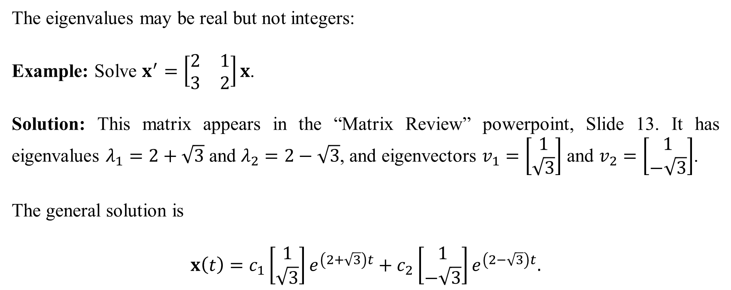
The eigenvalues may be real but not integers:
Example: Solve $x^{′}=\left[\begin{matrix}2 & 1 \\ 3 & 2\end{matrix}\right]x$.
Solution: This matrix appears in the “Matrix Review” powerpoint, Slide 13. It has eigenvalues $λ_{1}=2+\sqrt{3}$ and $λ_{2}=2−\sqrt{3}$, and eigenvectors $v_{1}=\left[\begin{matrix}1 \\ \sqrt{3}\end{matrix}\right]$ and $v_{2}=\left[\begin{matrix}1 \\ −\sqrt{3}\end{matrix}\right]$.
The general solution is
$$x\left(t\right)=c_{1}\left[\begin{matrix}1 \\ \sqrt{3}\end{matrix}\right]e^{\left(2+\sqrt{3}\right)t}+c_{2}\left[\begin{matrix}1 \\ −\sqrt{3}\end{matrix}\right]e^{\left(2−\sqrt{3}\right)t}.$$

Slide 12
Larger systems are solved the same way…
Example: Solve $x^{′}=\left[\begin{matrix}2 & 1 & −1 \\ 0 & 1 & 2 \\ 0 & 0 & 3\end{matrix}\right]x$. (This matrix is in the Matrix Review ppt, Slide 17)
Solution: The eigenvalues are $λ_{1}=2$, $λ_{2}=1$ and $λ_{3}=3$, and their corresponding eigenvectors are $v_{1}=\left[\begin{matrix}1 \\ 0 \\ 0\end{matrix}\right]$, $v_{2}=\left[\begin{matrix}1 \\ −1 \\ 0\end{matrix}\right]$ and $v_{3}=\left[\begin{matrix}0 \\ 1 \\ 1\end{matrix}\right]$.
The general solution is
$$x\left(t\right)=c_{1}\left[\begin{matrix}1 \\ 0 \\ 0\end{matrix}\right]e^{2t}+c_{2}\left[\begin{matrix}1 \\ −1 \\ 0\end{matrix}\right]e^{t}+c_{3}\left[\begin{matrix}0 \\ 1 \\ 1\end{matrix}\right]e^{3t}.$$

