Slide 1
Higher-order linear homogeneous ODEs: Repeated Roots
MAT 275

Slide 2
Consider the second-order differential equation $y^{′′}−6y^{′}+9y=0$.
Its auxiliary polynomial equation is $r^{2}−6r+9=0$, which factors as $\left(r−3\right)\left(r−3\right)=0.$ Thus, $r=3$ is a root with multiplicity 2.
One solution is $y_{1}={C_{1}e}^{3x}$. However, since 3 is a root with multiplicity 2, we cannot simply write the other solution as $y_{2}=C_{2}e^{3x}$. In other words, the general solution is not $y=C_{1}e^{3x}+C_{2}e^{3x}$. The two terms are not linearly independent.
There does exist another solution to this differential equation, one that is linearly independent of $y_{1}=e^{3x}$. It is $y_{2}=xe^{3x}$. We check it: Note that $y_{2}^{′}=3xe^{3x}+e^{3x}$ and $y_{2}^{′′}=9xe^{3x}+6e^{3x}$. Substitute:
$$\left(9xe^{3x}+6e^{3x}\right)−6\left(3xe^{3x}+e^{3x}\right)+9\left(xe^{3x}\right)=0$$
$$9xe^{3x}+6e^{3x}−18xe^{ex}−6e^{3x}+9xe^{3x}=0$$
$$\left(9xe^{3x}−18xe^{3x}+9xe^{3x}\right)+\left(6e^{3x}−6e^{3x}\right)=0, true.$$

Slide 3
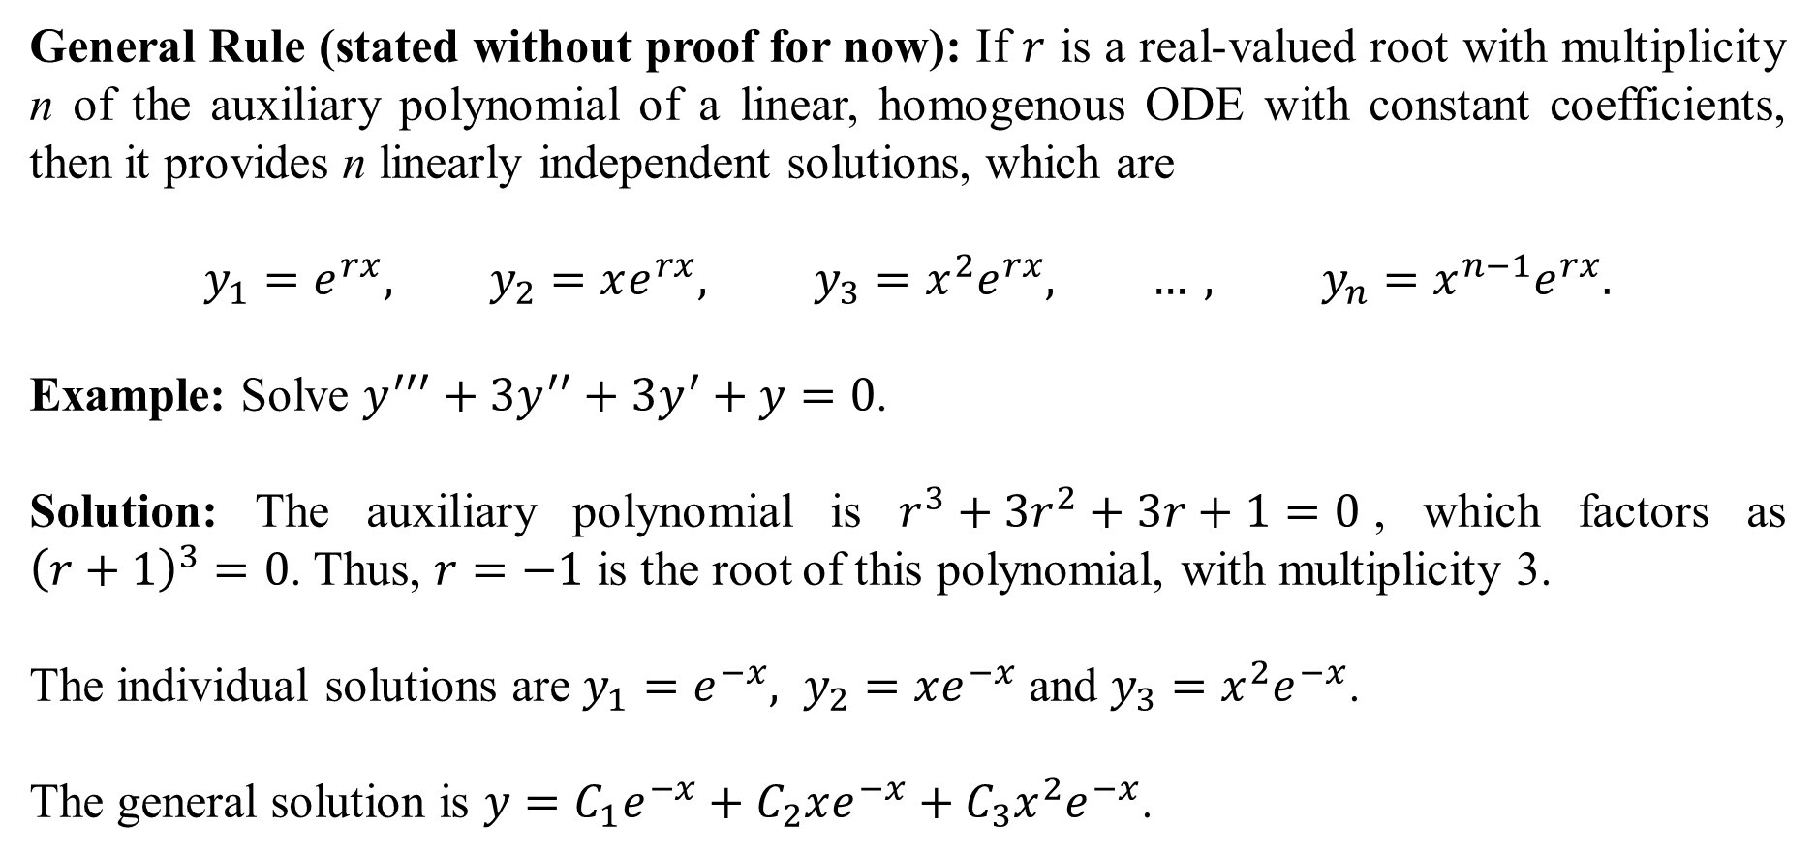
General Rule (stated without proof for now): If $r$ is a real-valued root with multiplicity n of the auxiliary polynomial of a linear, homogenous ODE with constant coefficients, then it provides n linearly independent solutions, which are
$$y_{1}=e^{rx}, y_{2}=xe^{rx}, y_{3}=x^{2}e^{rx}, …, y_{n}=x^{n−1}e^{rx}.$$
Example: Solve $y^{′′′}+3y^{′′}+3y^{′}+y=0$.
Solution: The auxiliary polynomial is $r^{3}+3r^{2}+3r+1=0$, which factors as ${\left(r+1\right)}^{3}=0$. Thus, $r=−1$ is the root of this polynomial, with multiplicity 3.
The individual solutions are $y_{1}=e^{−x}, y_{2}=xe^{−x}$ and $y_{3}=x^{2}e^{−x}$.
The general solution is $y=C_{1}e^{−x}+C_{2}xe^{−x}+C_{3}x^{2}e^{−x}$.

Slide 4
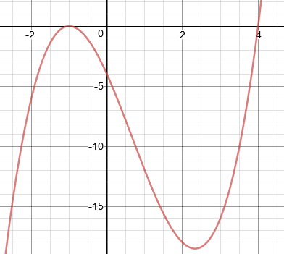
Example: Solve $y^{′′′}−2y^{′′}−7y^{′}−4y=0$.
Solution: The auxiliary polynomial is $r^{3}−2r^{2}−7r−4=0$. It’s difficult to factor a cubic, so we graph it to locate its roots:
The graph appears to pass through r = 4, and glance
the r-axis at r = –1, which suggests a root of
multiplicity 2.
The possible factorization is ${\left(r+1\right)}^{2}\left(r−4\right)=0$.
(You should expand this to verify that this is true.)
Thus, the roots are $r=4$, and $r=−1$ with mult. 2.
The general solution is $y=C_{1}e^{4x}+C_{2}e^{−x}+C_{3}xe^{−x}$. We check linear independence on the next slide.

Slide 5

From the last slide, we have $y=C_{1}e^{4x}+C_{2}e^{−x}+C_{3}xe^{−x}$ as the general solution of $y^{′′′}−2y^{′′}−7y^{′}−4y=0$. We now check that the individual solutions are linearly independent by finding the Wronskian:
Thus, the three individual solutions are linearly independent.

Slide 6
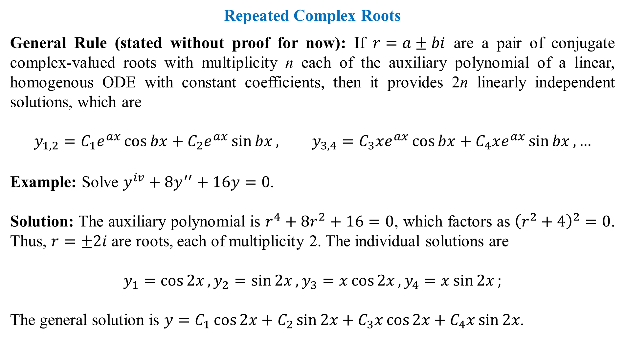
Repeated Complex Roots
General Rule (stated without proof for now): If $r=a±bi$ are a pair of conjugate complex-valued roots with multiplicity n each of the auxiliary polynomial of a linear, homogenous ODE with constant coefficients, then it provides 2n linearly independent solutions, which are
$$y_{1,2}=C_{1}e^{ax}\cos{bx}+C_{2}e^{ax}\sin{bx}, y_{3,4}=C_{3}xe^{ax}\cos{bx}+C_{4}xe^{ax}\sin{bx}, …$$
Example: Solve $y^{iv}+8y^{′′}+16y=0$.
Solution: The auxiliary polynomial is $r^{4}+8r^{2}+16=0$, which factors as ${\left(r^{2}+4\right)}^{2}=0$. Thus, $r=±2i$ are roots, each of multiplicity 2. The individual solutions are
$$y_{1}=\cos{2x}, y_{2}=\sin{2x}, y_{3}=x\cos{2x}, y_{4}=x\sin{2x};$$
The general solution is $y=C_{1}\cos{2x}+C_{2}\sin{2x}+C_{3}x\cos{2x}+C_{4}x\sin{2x}$.

Slide 7
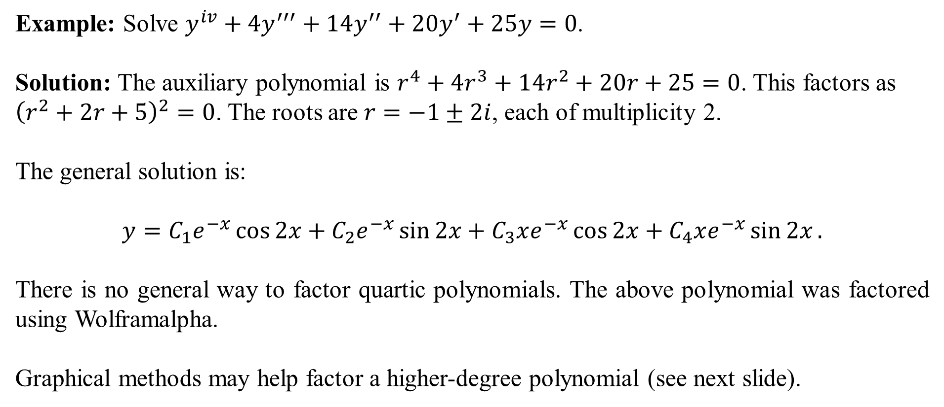
Example: Solve $y^{iv}+4y^{′′′}+14y^{′′}+20y^{′}+25y=0$.
Solution: The auxiliary polynomial is $r^{4}+4r^{3}+14r^{2}+20r+25=0$. This factors as ${\left(r^{2}+2r+5\right)}^{2}=0$. The roots are $r=−1±2i$, each of multiplicity 2.
The general solution is:
$$y=C_{1}e^{−x}\cos{2x}+C_{2}e^{−x}\sin{2x}+C_{3}xe^{−x}\cos{2x}+C_{4}xe^{−x}\sin{2x}.$$
There is no general way to factor quartic polynomials. The above polynomial was factored using Wolframalpha.
Graphical methods may help factor a higher-degree polynomial (see next slide).

Slide 8
Graphical Methods to Find Roots and Multiplicities
Look at the graph at right:
The roots of the graph are where it passes through (or glances) the horizontal axis. The way in which the graph meets the horizontal axis at each root can sometimes give clues about the multiplicities of the root.
If the graph passes through the horizontal axis “without pausing”, the root has multiplicity 1.
If the graph touches the horizontal axis tangentially but does not pass through, the root has multiplicity 2.
If the graph touches the horizontal axis tangentially and passes through, the root has multiplicity 3.
The above graph has root $−2$ with multiplicity 2, root 1 with multiplicity 1, and root 4 with multiplicity 3. Its polynomial has the form $y=k\left(r−1\right){\left(r+2\right)}^{2}{\left(r−4\right)}^{3}$.

Slide 9
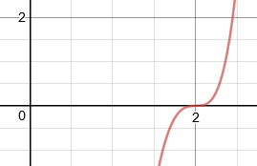
Example: Solve $y^{v}−2y^{iv}−5y^{′′′}−2y^{′′}+52y^{′}−56y=0.$
Solution: The auxiliary polynomial is $r^{5}−2r^{4}−5r^{3}−2r^{2}+52r−56$.
Its graph is shown at the right. Note that there appears to be a root at 2,
and that it passes tangentially through the horizontal axis, so the root
probably has multiplicity 3. However, we need to actually verify this
using synthetic division.

Slide 10
After showing that 2 is a root of multiplicity 3, the coefficients of the remaining factor are 1, 4 and 7. Thus, we have shown that $r^{5}−2r^{4}−5r^{3}−2r^{2}+52r−56$ factors as ${\left(r−2\right)}^{3}(r^{2}+4r+7)$.
Using the quadratic formula on the factor $r^{2}+4r+7$, its roots are $r=−2±i\sqrt{3}$.
The general solution of $y^{v}−2y^{iv}−5y^{′′′}−2y^{′′}+52y^{′}−56y=0$ is
$$y=C_{1}e^{2x}+C_{2}xe^{2x}+C_{3}x^{2}e^{2x}+C_{4}e^{−2x}\cos{\sqrt{3}x}+C_{5}e^{−2x}\sin{\sqrt{3}x}.$$
The reason why factors of $x$, $x^{2}$ and so on appear in terms when a root is repeated is discussed in the “Reduction of Order” lesson.

