Slide 1
Reduction of Order
MAT 275

Slide 2
Given a solution of a linear, homogeneous second-order ODE, it is possible to find another solution using a technique called reduction of order. The coefficients of y or its derivatives do not necessarily have to be constants.
Assume that the ODE has the form $a\left(x\right)y^{′′}+b\left(x\right)y^{′}+c\left(x\right)y=0$ and that $y_{1}(x)$ is a solution.
We define the other solution $y_{2}\left(x\right)=v\left(x\right)y_{1}(x)$, where $v(x)$ is to be determined. Using the product rule, we find $y_{2}′(x)$ and $y_{2}′′(x)$:
$$y_{2}^{′}\left(x\right)=v\left(x\right)y_{1}^{′}\left(x\right)+v^{′}\left(x\right)y_{1}\left(x\right),$$
$$y_{2}^{′′}\left(x\right)=v\left(x\right)y_{1}^{′′}\left(x\right)+2v^{′}\left(x\right)y_{1}^{′}\left(x\right)+v^{′′}\left(x\right)y_{1}\left(x\right).$$
These are substituted into the differential equation and simplified (next slide)

Slide 3
For the sake of space, we write $y_{2}=vy_{1}$, $y_{2}^{′}=vy_{1}^{′}+v^{′}y_{1}$ and $y_{2}^{′′}=vy_{1}^{′′}+2v^{′}y_{1}^{′}+vy_{1}^{′′}$:
$$a\left(x\right)\left(vy_{1}^{′′}+2v^{′}y_{1}^{′}+v^{′′}y_{1}\right)+b\left(x\right)\left(vy_{1}^{′}+v^{′}y_{1}\right)+c\left(x\right)vy_{1}=0$$
Distribute to clear parentheses and regroup according to degrees of $v$:
$$v^{′′}\left[a\left(x\right)y_{1}\right]+v^{′}\left[2a\left(x\right)y_{1}^{′}+b\left(x\right)y_{1}\right]+v\left[a\left(x\right)y_{1}^{′′}+b\left(x\right)y_{1}^{′}+c\left(x\right)y_{1}\right]=0$$
Notice that the expression multiplied to $v$ is 0: $y_{1}$ is a solution of the original differential equation so this expression is 0. We are left with
$$v^{′′}\left[a\left(x\right)y_{1}\right]+v^{′}\left[2a\left(x\right)y_{1}^{′}+b\left(x\right)y_{1}\right]=0.$$
Replacing $v′$ with $u$ (and $v′′$ with $u′$), we have a first-order ODE. Thus, we have reduced the order, and can be solved using separation of variables or integration factors.
$$u′\left[a\left(x\right)y_{1}\right]+u\left[2a\left(x\right)y_{1}^{′}+b\left(x\right)y_{1}\right]=0.$$

Slide 4
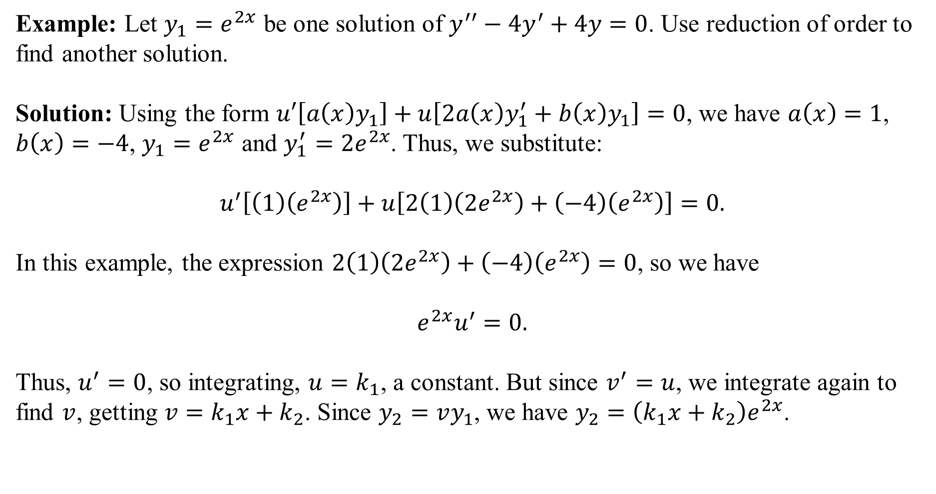
Example: Let $y_{1}=e^{2x}$ be one solution of $y^{′′}−4y^{′}+4y=0$. Use reduction of order to find another solution.
Solution: Using the form $u′\left[a\left(x\right)y_{1}\right]+u\left[2a\left(x\right)y_{1}^{′}+b\left(x\right)y_{1}\right]=0$, we have $a\left(x\right)=1$, $b\left(x\right)=−4$, $y_{1}=e^{2x}$ and $y_{1}^{′}=2e^{2x}$. Thus, we substitute:
$$u^{′}\left[\left(1\right)\left(e^{2x}\right)\right]+u\left[2\left(1\right)\left(2e^{2x}\right)+\left(−4\right)\left(e^{2x}\right)\right]=0.$$
In this example, the expression $2\left(1\right)\left(2e^{2x}\right)+\left(−4\right)\left(e^{2x}\right)=0$, so we have
$$e^{2x}u^{′}=0.$$
Thus, $u^{′}=0$, so integrating, $u=k_{1}$, a constant. But since $v^{′}=u$, we integrate again to find $v$, getting $v=k_{1}x+k_{2}$. Since $y_{2}=vy_{1}$, we have $y_{2}=\left(k_{1}x+k_{2}\right)e^{2x}$.

Slide 5
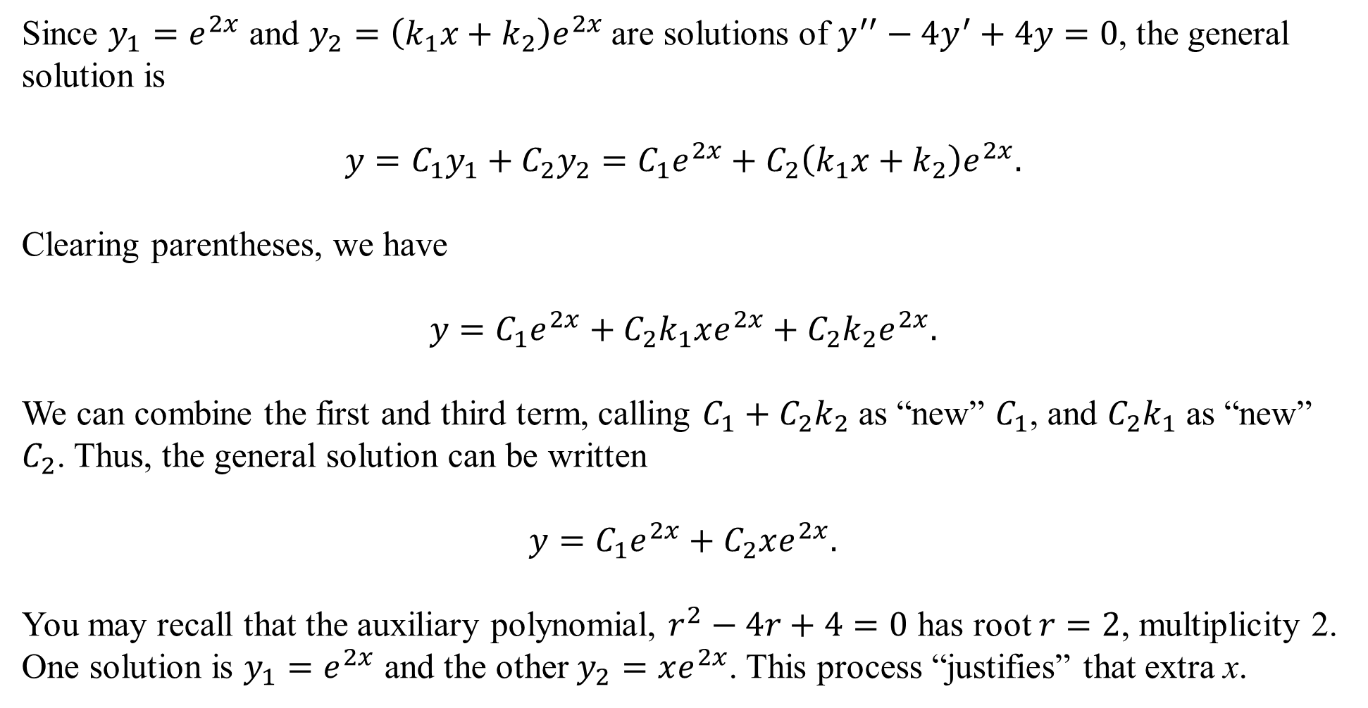
Since $y_{1}=e^{2x}$ and $y_{2}=\left(k_{1}x+k_{2}\right)e^{2x}$ are solutions of $y^{′′}−4y^{′}+4y=0$, the general solution is
$$y=C_{1}y_{1}+C_{2}y_{2}=C_{1}e^{2x}+C_{2}\left(k_{1}x+k_{2}\right)e^{2x}.$$
Clearing parentheses, we have
$$y=C_{1}e^{2x}+C_{2}k_{1}xe^{2x}+C_{2}k_{2}e^{2x}.$$
We can combine the first and third term, calling $C_{1}+C_{2}k_{2}$ as “new” $C_{1}$, and $C_{2}k_{1}$ as “new” $C_{2}$. Thus, the general solution can be written
$$y=C_{1}e^{2x}+C_{2}xe^{2x}.$$
You may recall that the auxiliary polynomial, $r^{2}−4r+4=0$ has root $r=2$, multiplicity 2. One solution is $y_{1}=e^{2x}$ and the other $y_{2}=xe^{2x}$. This process “justifies” that extra x.

Slide 6
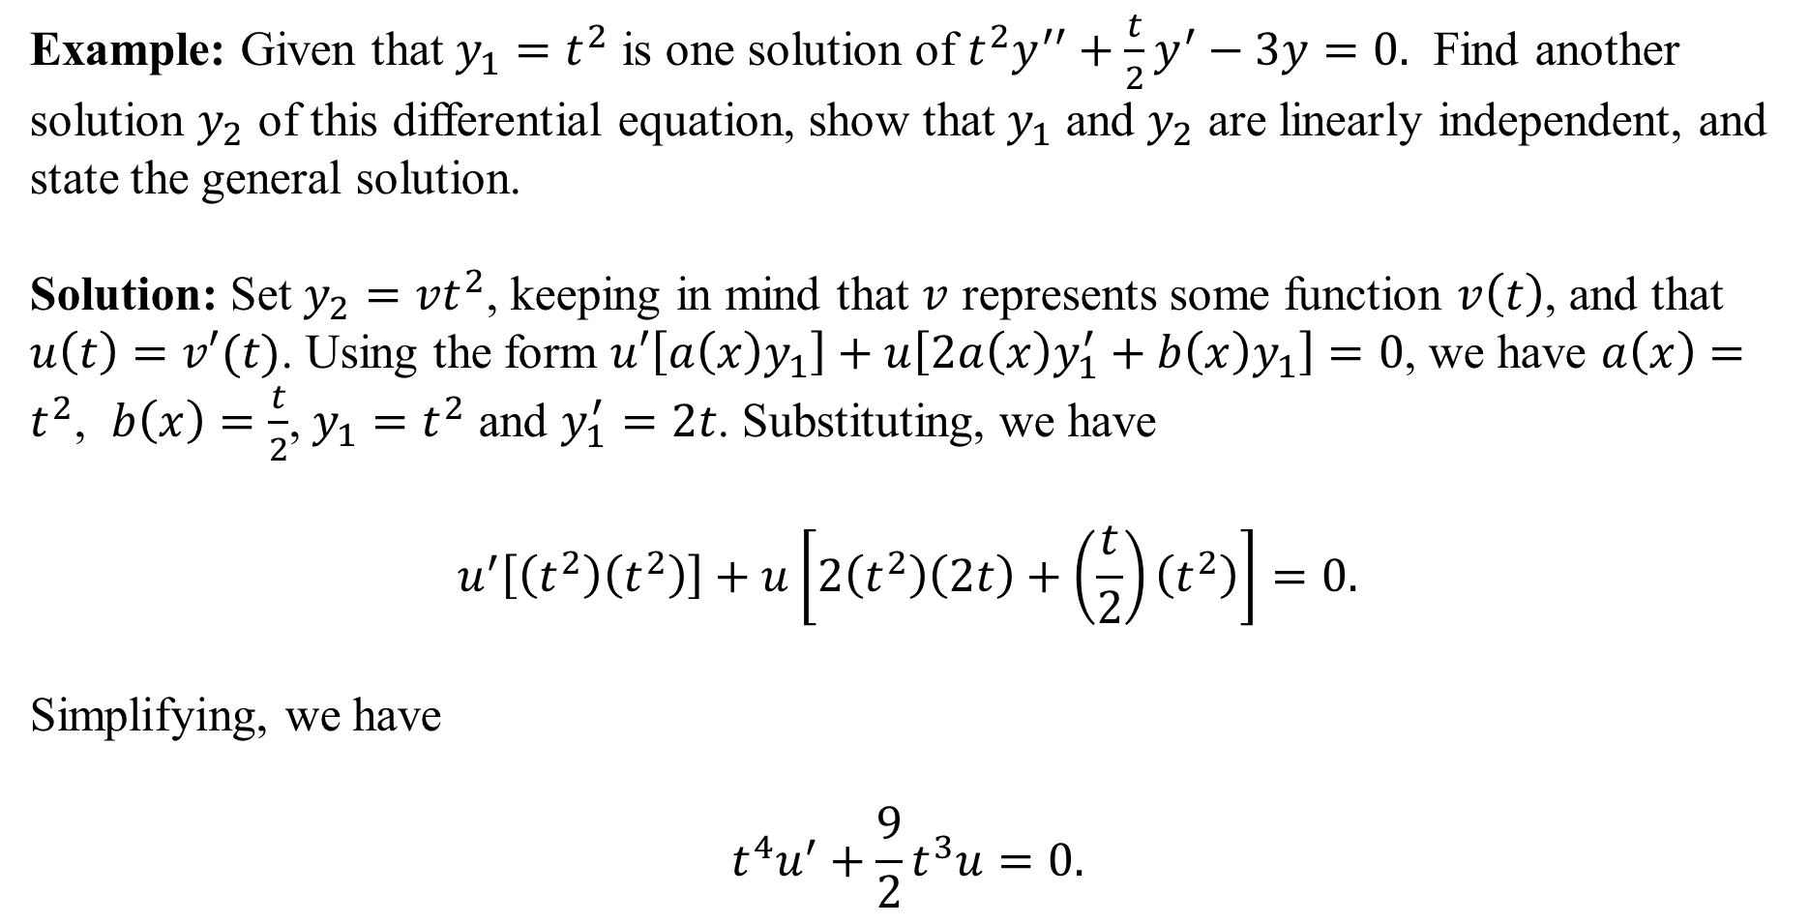
Example: Given that $y_{1}=t^{2}$ is one solution of $t^{2}y^{′′}+\frac{t}{2}y^{′}−3y=0.$ Find another solution $y_{2}$ of this differential equation, show that $y_{1}$ and $y_{2}$ are linearly independent, and state the general solution.
Solution: Set $y_{2}=vt^{2}$, keeping in mind that $v$ represents some function $v\left(t\right)$, and that $u\left(t\right)=v′(t)$. Using the form $u′\left[a\left(x\right)y_{1}\right]+u\left[2a\left(x\right)y_{1}^{′}+b\left(x\right)y_{1}\right]=0$, we have $a\left(x\right)=t^{2}$, $b\left(x\right)=\frac{t}{2}$, $y_{1}=t^{2}$ and $y_{1}^{′}=2t$. Substituting, we have
$$u^{′}\left[\left(t^{2}\right)\left(t^{2}\right)\right]+u\left[2\left(t^{2}\right)\left(2t\right)+\left(\frac{t}{2}\right)\left(t^{2}\right)\right]=0.$$
Simplifying, we have
$$t^{4}u^{′}+\frac{9}{2}t^{3}u=0.$$

Slide 7
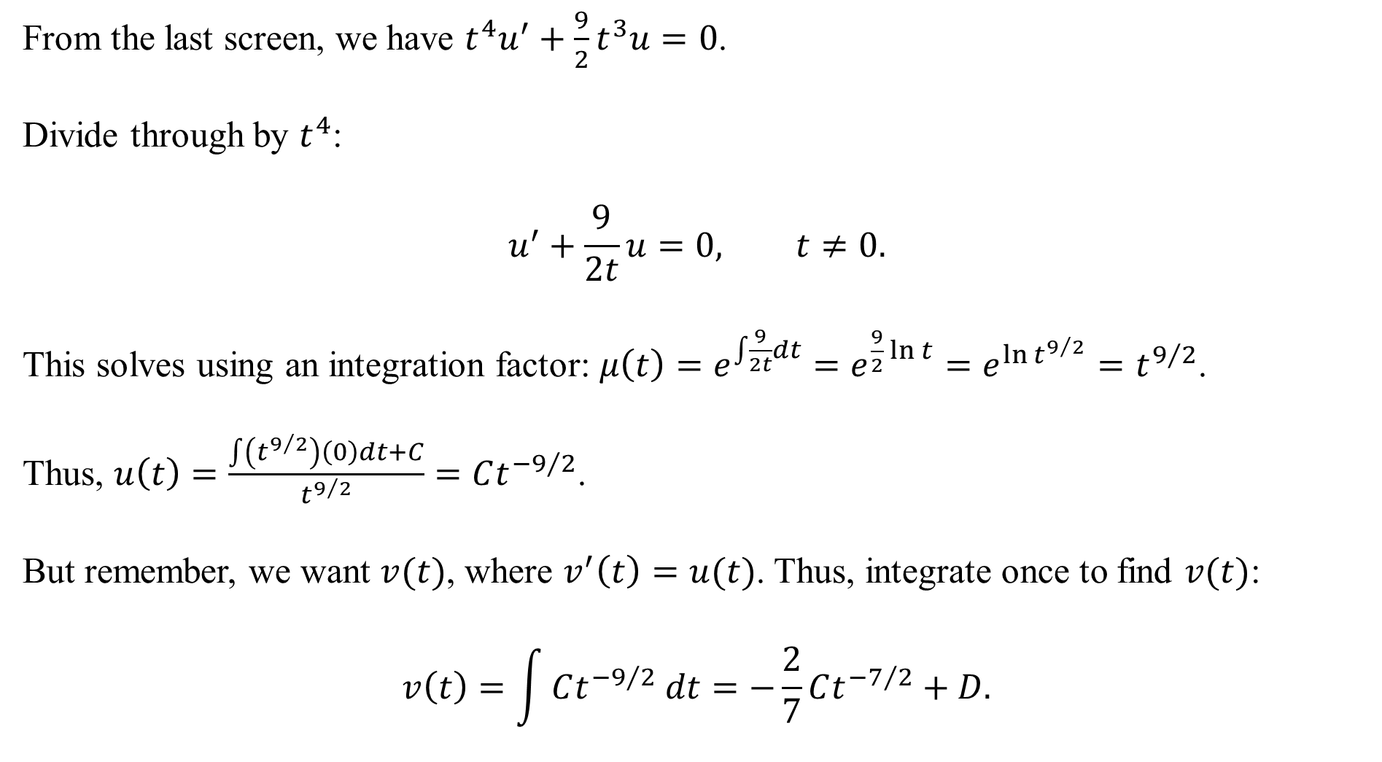
From the last screen, we have $t^{4}u^{′}+\frac{9}{2}t^{3}u=0$.
Divide through by $t^{4}$:
$$u^{′}+\frac{9}{2t}u=0, t≠0.$$
This solves using an integration factor: $μ\left(t\right)=e^{\int{\frac{9}{2t}dt}}=e^{\frac{9}{2}\ln{t}}=e^{\ln{t^{9/2}}}=t^{9/2}$.
Thus, $u\left(t\right)=\frac{\int{\left(t^{9/2}\right)\left(0\right)dt+C}}{t^{9/2}}=Ct^{−9/2}$.
But remember, we want $v(t)$, where $v^{′}\left(t\right)=u(t)$. Thus, integrate once to find $v(t)$:
$$v\left(t\right)=\int{Ct^{−9/2} dt}=−\frac{2}{7}Ct^{−7/2}+D.$$

Slide 8

Since $v\left(t\right)=−\frac{2}{7}Ct^{−7/2}+D$, then
The general solution is
We can combine $C_{1}t^{2}+C_{2}Dt^{2}$ as $C_{1}t^{2}$, where “new” $C_{1}=C_{1}+C_{2}D$, and we can let “new” $C_{2}=−\frac{2}{7}C_{2}C$, so that the general solution is (probably):
$$y=C_{1}t^{2}+C_{2}t^{−3/2}.$$

Slide 9
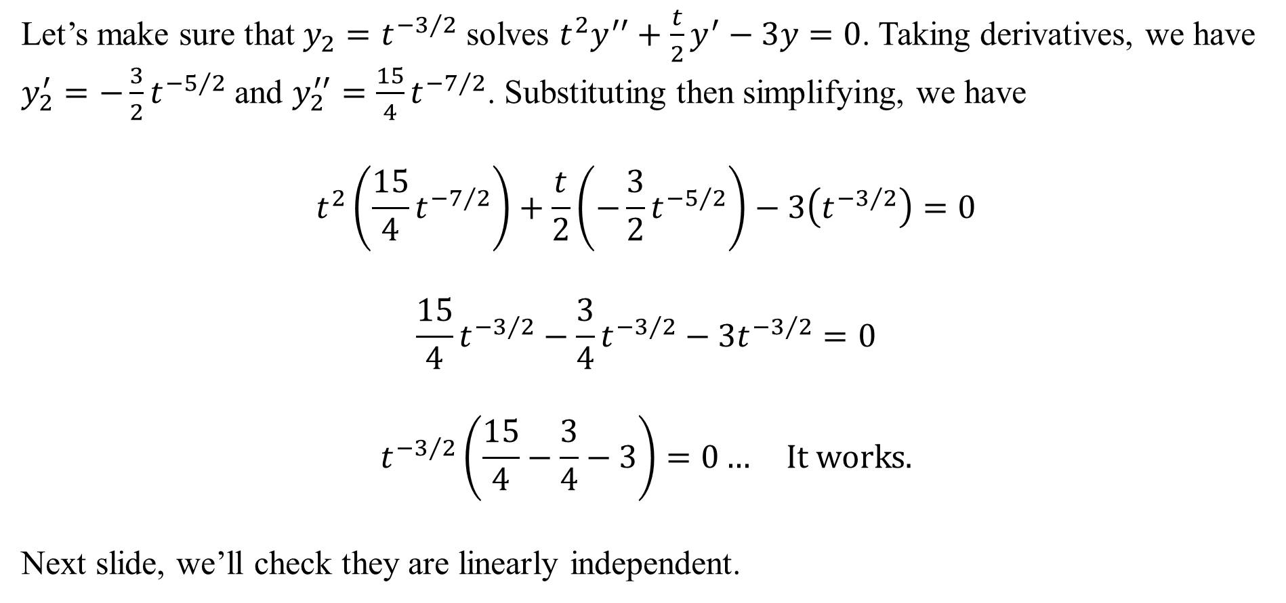
Let’s make sure that $y_{2}=t^{−3/2}$ solves $t^{2}y^{′′}+\frac{t}{2}y^{′}−3y=0$. Taking derivatives, we have $y_{2}^{′}=−\frac{3}{2}t^{−5/2}$ and $y_{2}^{′′}=\frac{15}{4}t^{−7/2}$. Substituting then simplifying, we have
$$t^{2}\left(\frac{15}{4}t^{−7/2}\right)+\frac{t}{2}\left(−\frac{3}{2}t^{−5/2}\right)−3\left(t^{−3/2}\right)=0$$
$$\frac{15}{4}t^{−3/2}−\frac{3}{4}t^{−3/2}−3t^{−3/2}=0$$
$$t^{−3/2}\left(\frac{15}{4}−\frac{3}{4}−3\right)=0… It works.$$
Next slide, we’ll check they are linearly independent.

Slide 10
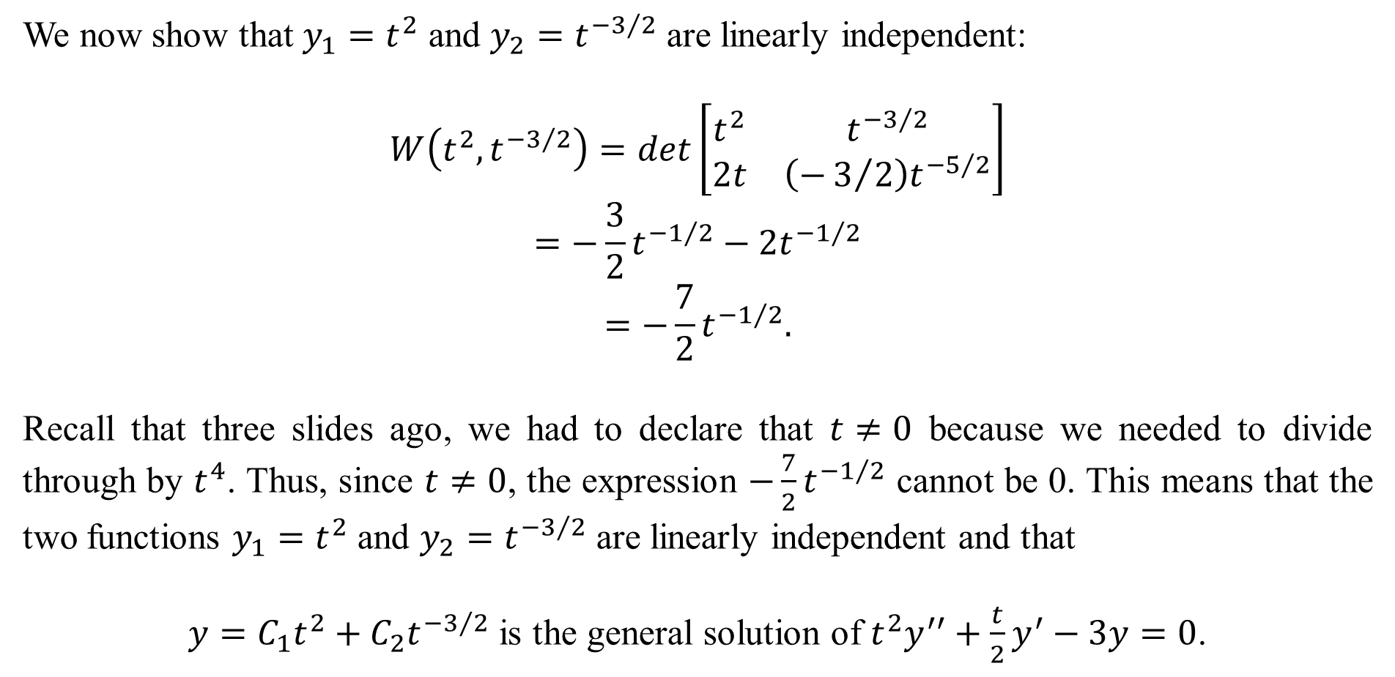
We now show that $y_{1}=t^{2}$ and $y_{2}=t^{−3/2}$ are linearly independent:
$$W\left(t^{2},t^{−3/2}\right)=det\left[\begin{matrix}t^{2} & t^{−3/2} \\ 2t & \left(−3/2\right)t^{−5/2}\end{matrix}\right]$$
$$=−\frac{3}{2}t^{−1/2}−2t^{−1/2}$$
$$=−\frac{7}{2}t^{−1/2}.$$
Recall that three slides ago, we had to declare that $t≠0$ because we needed to divide through by $t^{4}$. Thus, since $t≠0$, the expression $−\frac{7}{2}t^{−1/2}$ cannot be 0. This means that the two functions $y_{1}=t^{2}$ and $y_{2}=t^{−3/2}$ are linearly independent and that
$y=C_{1}t^{2}+C_{2}t^{−3/2}$ is the general solution of $t^{2}y^{′′}+\frac{t}{2}y^{′}−3y=0$.

