Slide 1
Laplace Transforms of Periodic Functions
MAT 275

Slide 2
Laplace Transform of Periodic Functions
A function $f$ is periodic with period $T$ if $f\left(t+T\right)=f(t)$ for all $t$, where $T$ is the smallest non-zero value for which $f\left(t+T\right)=f(t)$.
For example, $f\left(t\right)=\cos{(t)}$ is periodic with periods $nπ$, where $n$ is an even integer. The smallest such period is $2π$.
Suppose $y=f(t)$ is periodic with period $T$. Apply the Laplace Transform operator:
$$L\left\{f\left(t\right)\right\}=\int_{0}^{∞}{f\left(t\right)e^{−st} dt}.$$
Write the integral as a sum of two integrals, from $0≤t<T$ and $T≤t<∞$:
$$\int_{0}^{∞}{f\left(t\right)e^{−st} dt}=\int_{0}^{T}{f\left(t\right)e^{−st} dt}+\int_{T}^{∞}{f\left(t+T\right)e^{−st} dt}.$$

Slide 3
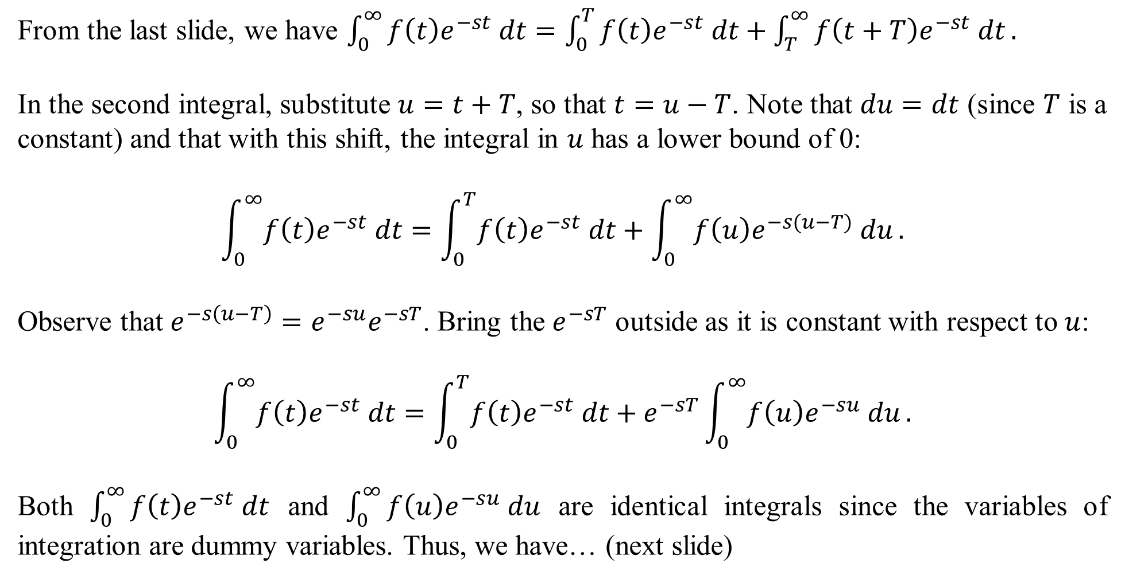
From the last slide, we have $\int_{0}^{∞}{f\left(t\right)e^{−st} dt}=\int_{0}^{T}{f\left(t\right)e^{−st} dt}+\int_{T}^{∞}{f\left(t+T\right)e^{−st} dt}.$
In the second integral, substitute $u=t+T$, so that $t=u−T$. Note that $du=dt$ (since $T$ is a constant) and that with this shift, the integral in $u$ has a lower bound of 0:
$$\int_{0}^{∞}{f\left(t\right)e^{−st} dt}=\int_{0}^{T}{f\left(t\right)e^{−st} dt}+\int_{0}^{∞}{f\left(u\right)e^{−s(u−T)} du}.$$
Observe that $e^{−s\left(u−T\right)}=e^{−su}e^{−sT}$. Bring the $e^{−sT}$ outside as it is constant with respect to $u$:
$$\int_{0}^{∞}{f\left(t\right)e^{−st} dt}=\int_{0}^{T}{f\left(t\right)e^{−st} dt}+e^{−sT}\int_{0}^{∞}{f\left(u\right)e^{−su} du}.$$
Both $\int_{0}^{∞}{f\left(t\right)e^{−st} dt}$ and $\int_{0}^{∞}{f\left(u\right)e^{−su} du}$ are identical integrals since the variables of integration are dummy variables. Thus, we have… (next slide)

Slide 4
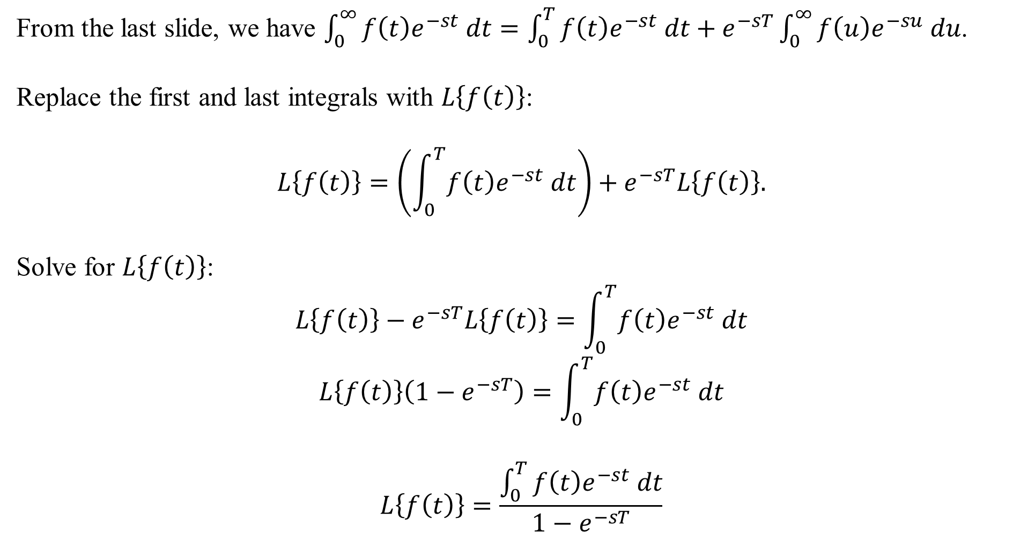
From the last slide, we have $\int_{0}^{∞}{f\left(t\right)e^{−st} dt}=\int_{0}^{T}{f\left(t\right)e^{−st} dt}+e^{−sT}\int_{0}^{∞}{f\left(u\right)e^{−su} du}$.
Replace the first and last integrals with $L\left\{f\left(t\right)\right\}$:
$$L\left\{f\left(t\right)\right\}=\left(\int_{0}^{T}{f\left(t\right)e^{−st} dt}\right)+e^{−sT}L\left\{f\left(t\right)\right\}.$$
Solve for $L\left\{f\left(t\right)\right\}$:
$$L\left\{f\left(t\right)\right\}−e^{−sT}L\left\{f\left(t\right)\right\}=\int_{0}^{T}{f\left(t\right)e^{−st} dt}$$
$$L\left\{f\left(t\right)\right\}\left(1−e^{−sT}\right)=\int_{0}^{T}{f\left(t\right)e^{−st} dt}$$
$$L\left\{f\left(t\right)\right\}=\frac{\int_{0}^{T}{f\left(t\right)e^{−st} dt}}{1−e^{−sT}}$$

Slide 5
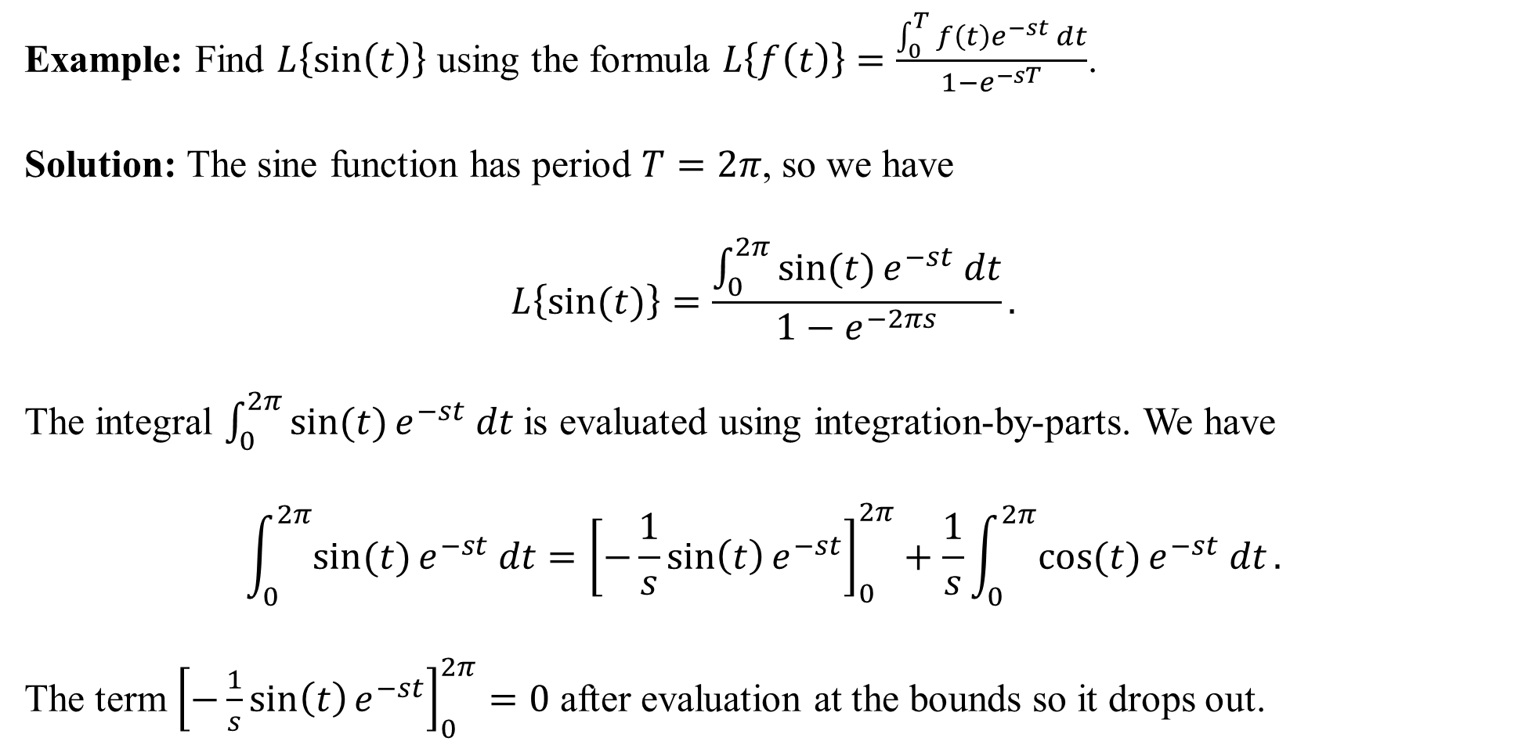
Example: Find $L\left\{\sin\left(t\right)\right\}$ using the formula $L\left\{f\left(t\right)\right\}=\frac{\int_{0}^{T}{f\left(t\right)e^{−st} dt}}{1−e^{−sT}}$.
Solution: The sine function has period $T=2π$, so we have
$$L\left\{\sin{(t)}\right\}=\frac{\int_{0}^{2π}{\sin{(t)}e^{−st} dt}}{1−e^{−2πs}}.$$
The integral $\int_{0}^{2π}{\sin{(t)}e^{−st} dt}$ is evaluated using integration-by-parts. We have
$$\int_{0}^{2π}{\sin{(t)}e^{−st} dt}={\left[−\frac{1}{s}\sin\left(t\right)e^{−st}\right]}_{0}^{2π}+\frac{1}{s}\int_{0}^{2π}{\cos{(t)}e^{−st} dt}.$$
The term ${\left[−\frac{1}{s}\sin\left(t\right)e^{−st}\right]}_{0}^{2π}=0$ after evaluation at the bounds so it drops out.

Slide 6
So we have $\int_{0}^{2π}{\sin{(t)}e^{−st} dt}=\frac{1}{s}\int_{0}^{2π}{\cos{(t)}e^{−st} dt}.$
Integrate by parts again on the right-most integral:
$$\int_{0}^{2π}{\cos{(t)}e^{−st} dt}={\left[−\frac{1}{s}e^{−st}\cos\left(t\right)\right]}_{0}^{2π}−\frac{1}{s}\int_{0}^{2π}{\sin\left(t\right)e^{−st} dt}.$$
The term ${\left[−\frac{1}{s}e^{−st}\cos\left(t\right)\right]}_{0}^{2π}=−\frac{1}{s}e^{−2πs}+\frac{1}{s}$ after evaluating the bounds. Making substitutions, we have
$$\int_{0}^{2π}{\sin{(t)}e^{−st} dt}=\frac{1}{s}\left[\left(−\frac{1}{s}e^{−2πs}+\frac{1}{s}\right)−\frac{1}{s}\int_{0}^{2π}{\sin\left(t\right)e^{−st} dt}\right].$$
The rest is just algebra… (next slide)

Slide 7
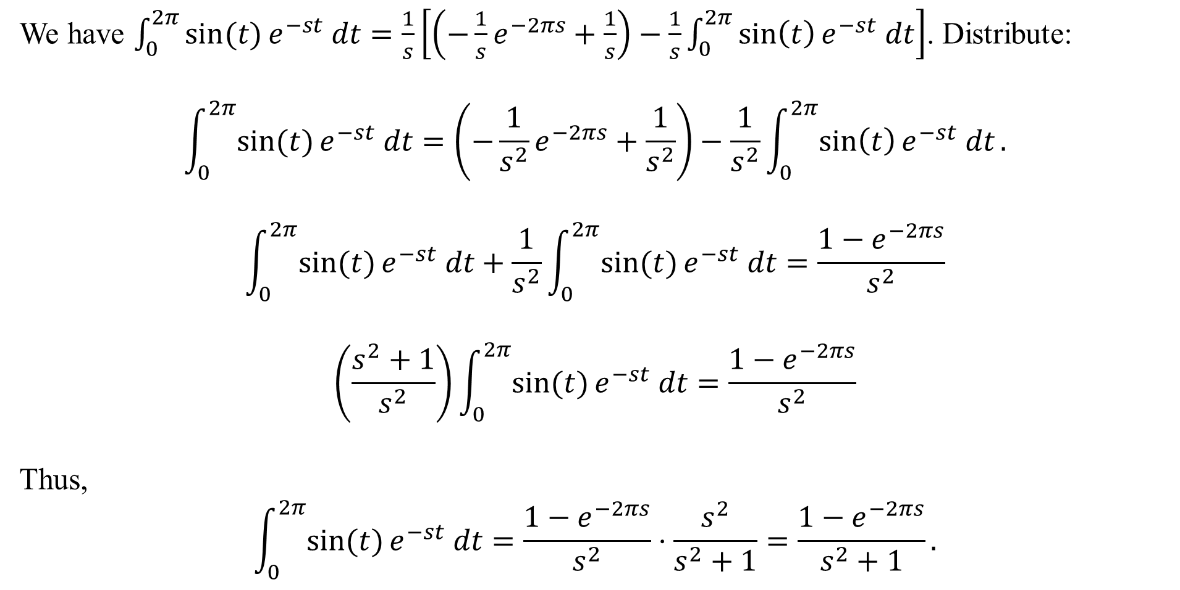
We have $\int_{0}^{2π}{\sin{(t)}e^{−st} dt}=\frac{1}{s}\left[\left(−\frac{1}{s}e^{−2πs}+\frac{1}{s}\right)−\frac{1}{s}\int_{0}^{2π}{\sin\left(t\right)e^{−st} dt}\right]$. Distribute:
$$\int_{0}^{2π}{\sin{(t)}e^{−st} dt}=\left(−\frac{1}{s^{2}}e^{−2πs}+\frac{1}{s^{2}}\right)−\frac{1}{s^{2}}\int_{0}^{2π}{\sin\left(t\right)e^{−st} dt}.$$
$$\int_{0}^{2π}{\sin{(t)}e^{−st} dt}+\frac{1}{s^{2}}\int_{0}^{2π}{\sin{(t)}e^{−st} dt}=\frac{1−e^{−2πs}}{s^{2}}$$
$$\left(\frac{s^{2}+1}{s^{2}}\right)\int_{0}^{2π}{\sin{(t)}e^{−st} dt}=\frac{1−e^{−2πs}}{s^{2}}$$
Thus,
$$\int_{0}^{2π}{\sin{(t)}e^{−st} dt}=\frac{1−e^{−2πs}}{s^{2}}⋅\frac{s^{2}}{s^{2}+1}=\frac{1−e^{−2πs}}{s^{2}+1}.$$

Slide 8

Recall that
$$L\left\{\sin{(t)}\right\}=\frac{\int_{0}^{2π}{\sin{(t)}e^{−st} dt}}{1−e^{−2πs}}.$$
From the last slide, we found that
$$\int_{0}^{2π}{\sin{(t)}e^{−st} dt}=\frac{1−e^{−2πs}}{s^{2}+1}.$$
Thus,
$$L\left\{\sin{(t)}\right\}=\frac{1}{1−e^{−2πs}}\left(\frac{1−e^{−2πs}}{s^{2}+1}\right)=\frac{1}{s^{2}+1} .$$

Slide 9
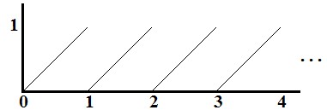
Example: Find the Laplace Transform of the sawtooth function shown below:
It is given by $f\left(t\right)=t$ for $0≤t<1$
and $f\left(t−1\right)=f(t)$ for $t≥1$.
Solution: The period is $T=1$, so we have $L\left\{f\left(t\right)\right\}=\frac{\int_{0}^{1}{te^{−st} dt}}{1−e^{−s(1)}}.$
The integral is evaluated using integration-by-parts:
$$\int_{0}^{1}{te^{−st} dt}={\left[−\frac{t}{s}e^{−st}\right]}_{0}^{1}+\frac{1}{s}\int_{0}^{1}{e^{−st} dt}=\frac{1}{s}e^{−s}−\frac{1}{s^{2}}e^{−s}+\frac{1}{s^{2}}=\frac{1−e^{−s}−se^{−s}}{s^{2}}.$$
Thus,
$$L\left\{f\left(t\right)\right\}=\frac{\int_{0}^{1}{te^{−st} dt}}{1−e^{−s(1)}}=\frac{1−e^{−s}−se^{−s}}{s^{2}}⋅\frac{1}{1−e^{−s}}=\frac{1−e^{−s}\left(s+1\right)}{s^{2}\left(1−e^{−s}\right)} .$$

