Slide 1
Numerical Methods: Euler’s and Advanced Euler’s (Heun’s) Methods
MAT 275

Slide 2
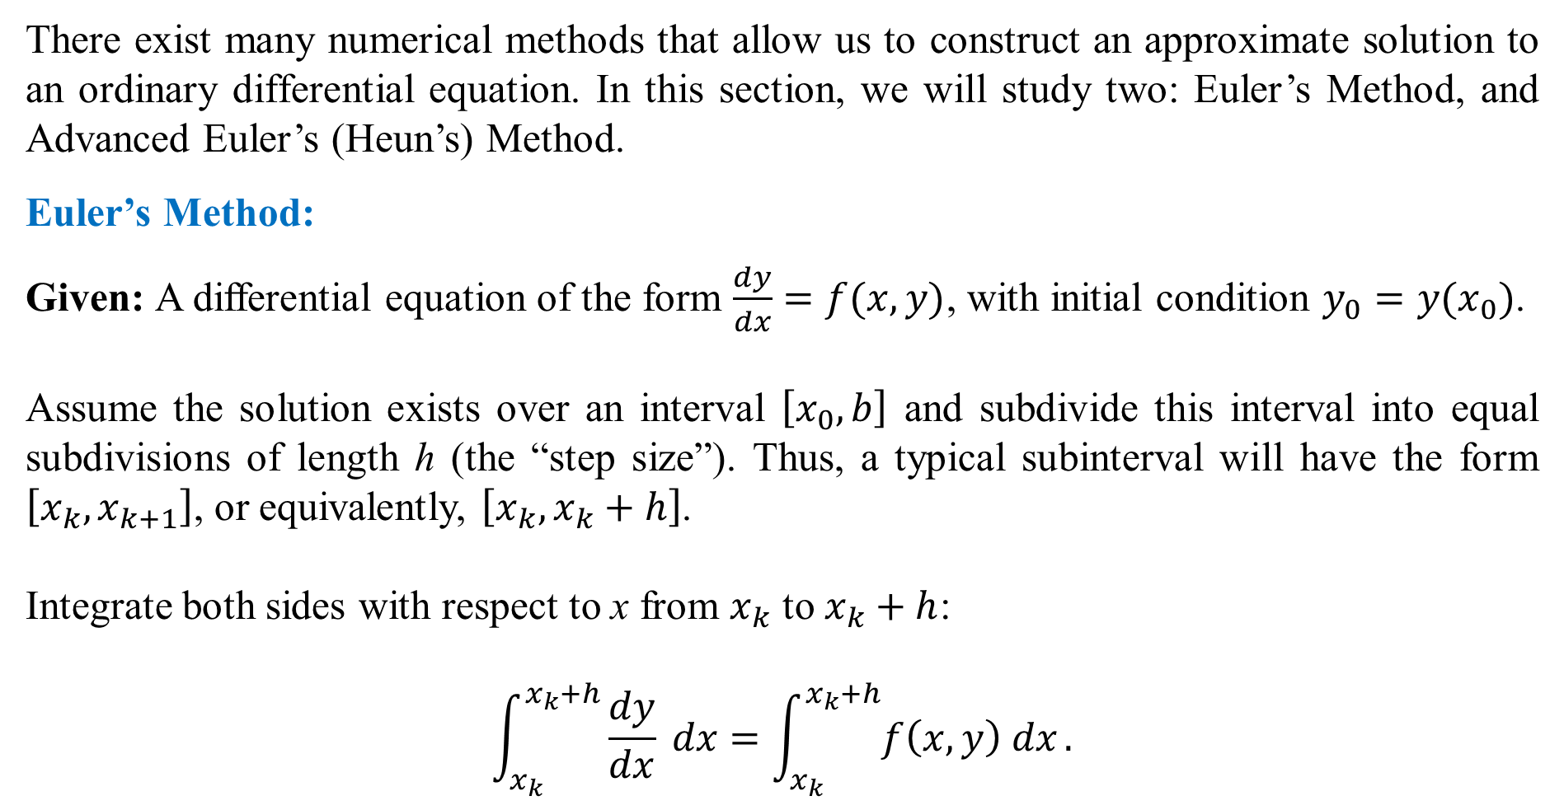
There exist many numerical methods that allow us to construct an approximate solution to an ordinary differential equation. In this section, we will study two: Euler’s Method, and Advanced Euler’s (Heun’s) Method.
Euler’s Method:
Given: A differential equation of the form $\frac{dy}{dx}=f(x,y)$, with initial condition $y_{0}=y(x_{0})$.
Assume the solution exists over an interval $\left[x_{0},b\right]$ and subdivide this interval into equal subdivisions of length h (the “step size”). Thus, a typical subinterval will have the form $\left[x_{k},x_{k+1}\right]$, or equivalently, $\left[x_{k},x_{k}+h\right]$.
Integrate both sides with respect to x from $x_{k}$ to $x_{k}+h$:
$$\int_{x_{k}}^{x_{k}+h}{\frac{dy}{dx} dx}=\int_{x_{k}}^{x_{k}+h}{f\left(x,y\right) dx}.$$

Slide 3
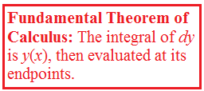
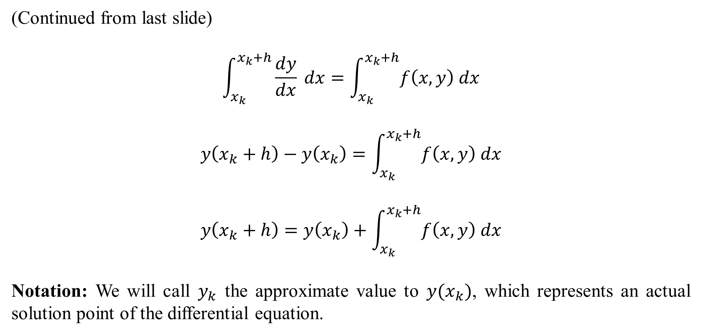
(Continued from last slide)
$$\int_{x_{k}}^{x_{k}+h}{\frac{dy}{dx} dx}=\int_{x_{k}}^{x_{k}+h}{f\left(x,y\right) dx}$$
$$y\left(x_{k}+h\right)−y\left(x_{k}\right)=\int_{x_{k}}^{x_{k}+h}{f\left(x,y\right) dx}$$
$$y\left(x_{k}+h\right)=y\left(x_{k}\right)+\int_{x_{k}}^{x_{k}+h}{f\left(x,y\right) dx}$$
Notation: We will call $y_{k}$ the approximate value to $y(x_{k})$, which represents an actual solution point of the differential equation.

Slide 4
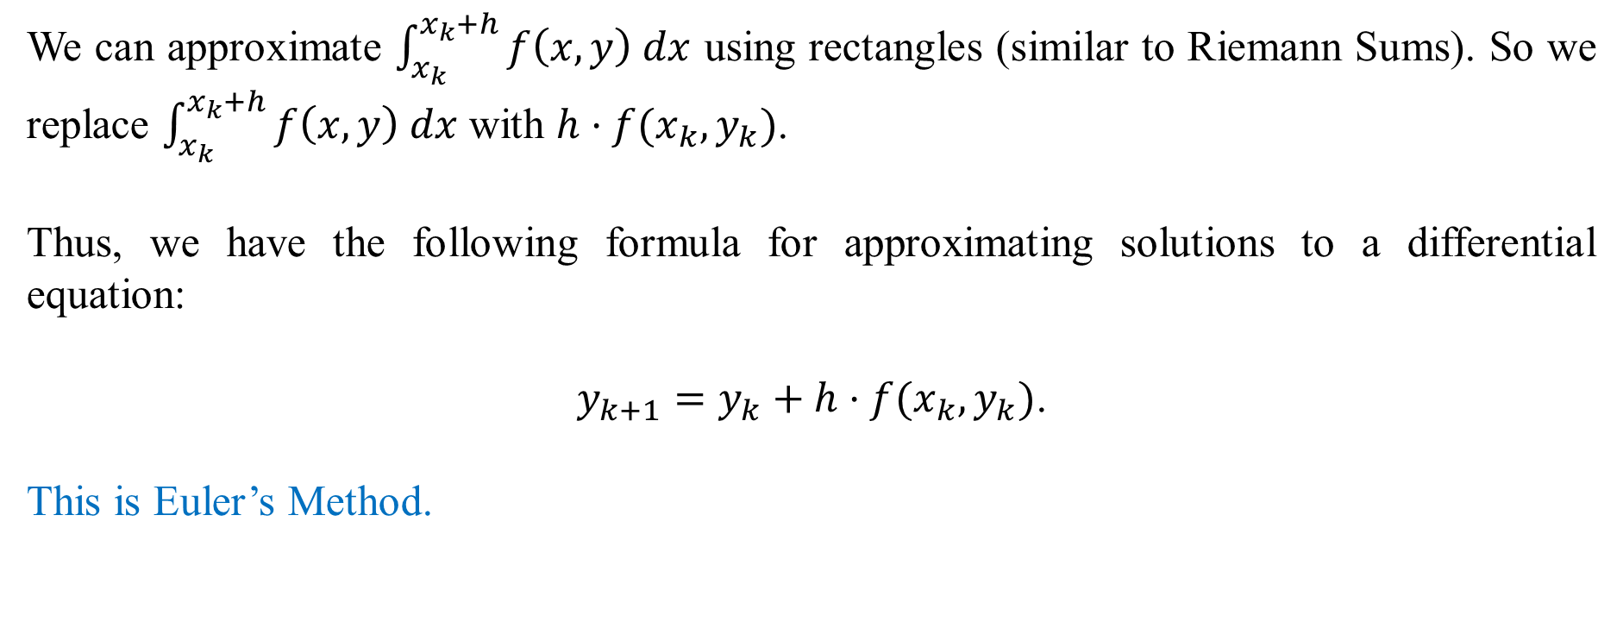
We can approximate $\int_{x_{k}}^{x_{k}+h}{f\left(x,y\right) dx}$ using rectangles (similar to Riemann Sums). So we replace $\int_{x_{k}}^{x_{k}+h}{f\left(x,y\right) dx}$ with $h⋅f(x_{k},y_{k})$.
Thus, we have the following formula for approximating solutions to a differential equation:
$$y_{k+1}=y_{k}+h⋅f(x_{k},y_{k})\text{.}$$
This is Euler’s Method.

Slide 5
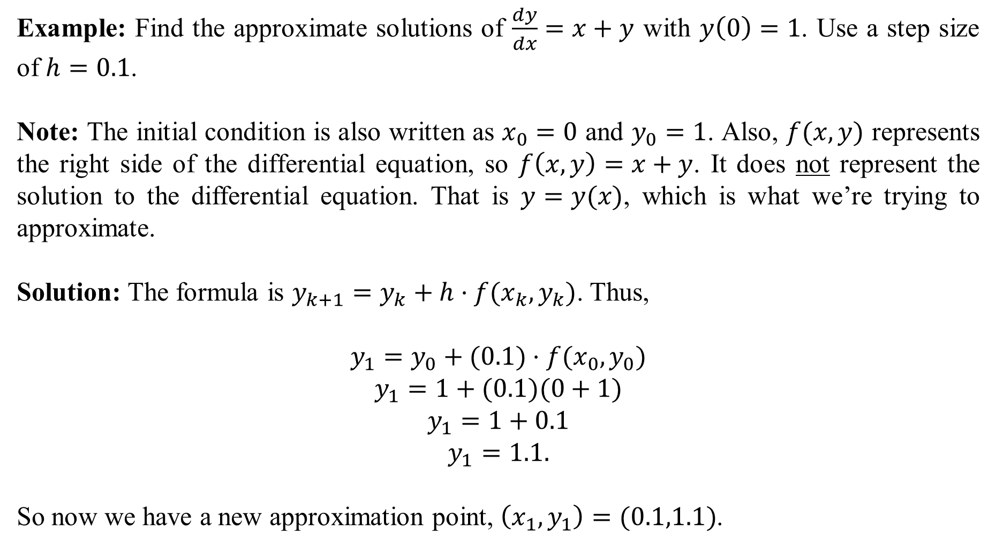
Example: Find the approximate solutions of $\frac{dy}{dx}=x+y$ with $y\left(0\right)=1$. Use a step size of $h=0.1$.
Note: The initial condition is also written as $x_{0}=0$ and $y_{0}=1$. Also, $f(x,y)$ represents the right side of the differential equation, so $f\left(x,y\right)=x+y$. It does not represent the solution to the differential equation. That is $y=y(x)$, which is what we’re trying to approximate.
Solution: The formula is $y_{k+1}=y_{k}+h⋅f(x_{k},y_{k})\text{.}$ Thus,
$$y_{1}=y_{0}+(0.1)⋅f(x_{0},y_{0})$$
$$y_{1}=1+(0.1)(0+1)$$
$$y_{1}=1+0.1$$
$$y_{1}=1.1.$$
So now we have a new approximation point, $\left(x_{1},y_{1}\right)=(0.1,1.1)$.

Slide 6

So we repeat the process:
$$y_{2}=y_{1}+0.1⋅f(x_{1},y_{1})$$
$$y_{2}=1.1+0.1(0.1+1.1)$$
$$y_{2}=1.1+0.1(1.2)$$
$$y_{2}=1.22$$
Now we have another approximation point, $\left(x_{2},y_{2}\right)=(0.2,1.22)$.
$$y_{3}=y_{2}+0.1⋅f\left(x_{2},y_{2}\right)$$
$$y_{3}=1.22+0.1(0.2+1.22)$$
$$y_{3}=1.362.$$
Now we have $\left(x_{3},y_{3}\right)=(0.3, 1.362)$.

Slide 7
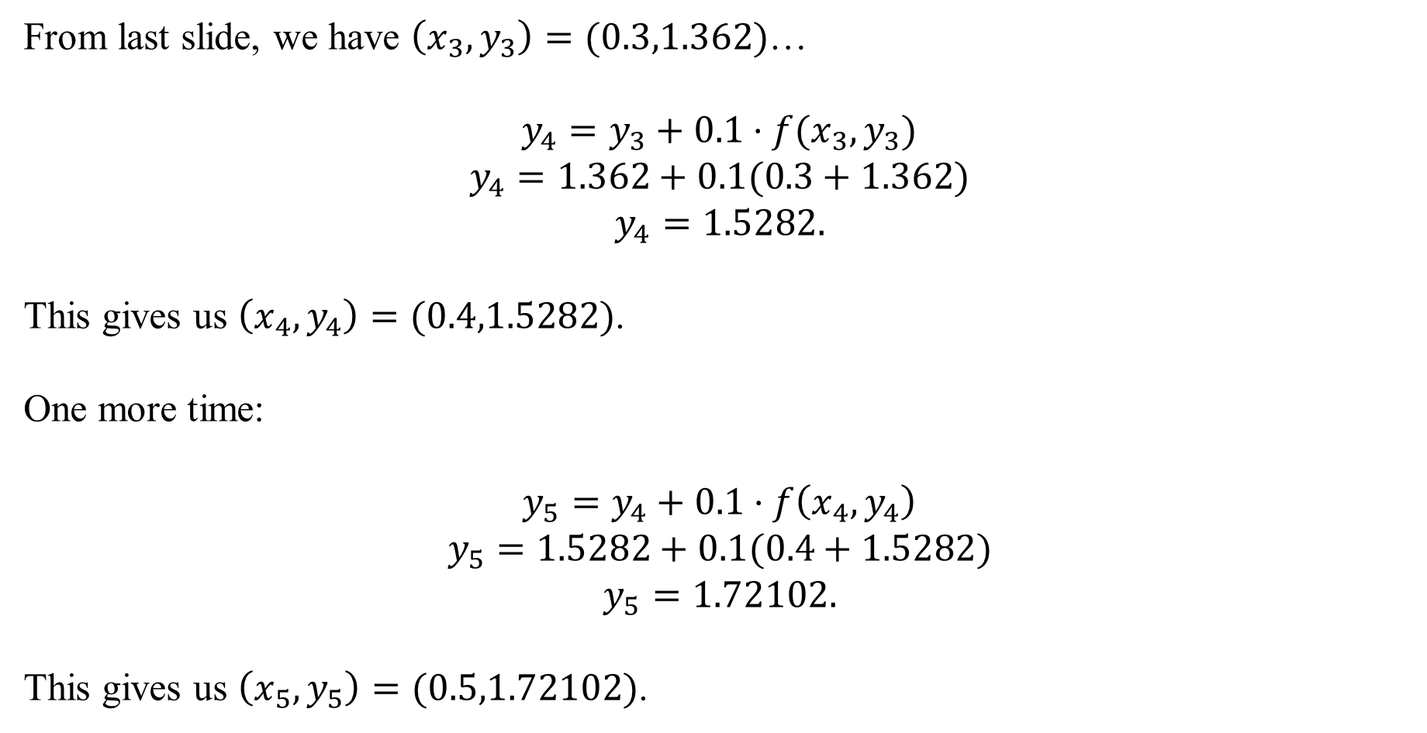
From last slide, we have $\left(x_{3},y_{3}\right)=(0.3,1.362)$…
$$y_{4}=y_{3}+0.1⋅f(x_{3},y_{3})$$
$$y_{4}=1.362+0.1(0.3+1.362)$$
$$y_{4}=1.5282.$$
This gives us $\left(x_{4},y_{4}\right)=(0.4,1.5282)$.
One more time:
$$y_{5}=y_{4}+0.1⋅f\left(x_{4},y_{4}\right)$$
$$y_{5}=1.5282+0.1(0.4+1.5282)$$
$$y_{5}=1.72102.$$
This gives us $\left(x_{5},y_{5}\right)=(0.5,1.72102)$.

Slide 8
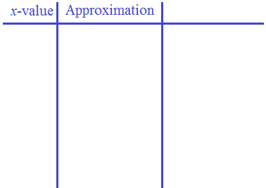
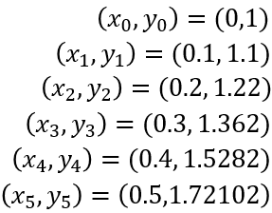
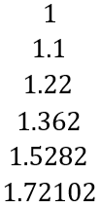
The five approximation points on the solution curve of $\frac{dy}{dx}=x+y, y\left(0\right)=1$ are:
The actual solution of $\frac{dy}{dx}=x+y, y\left(0\right)=1$ is found by using an integration factor. It is
$$y\left(x\right)=−x−1+2e^{x}.$$
This is used to generate actual solutions of $\frac{dy}{dx}=x+y, y\left(0\right)=1.$

Slide 9
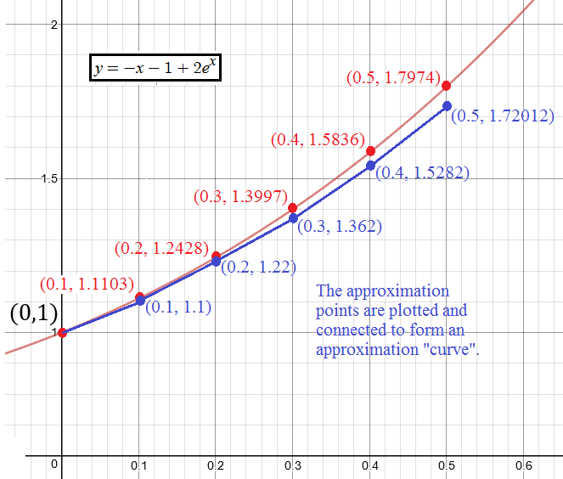
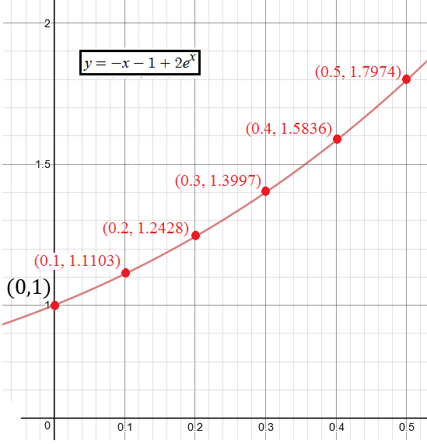
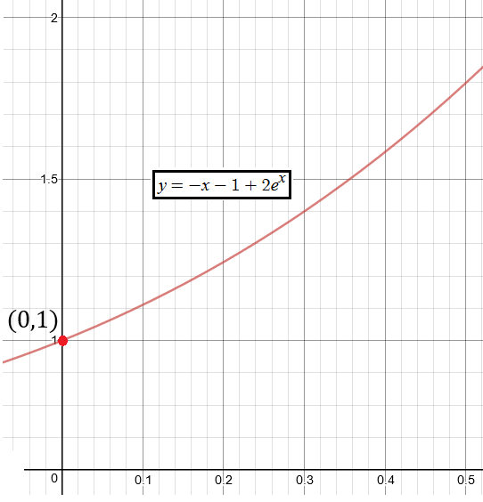
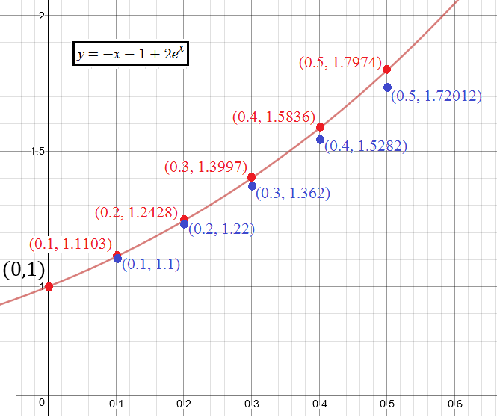
Here is the actual solution curve, $y\left(x\right)=−x−1+2e^{x}$:

Slide 10
Improved Euler’s Method (also called Heun’s Method)
Instead of using rectangles to approximate $\int_{x_{k}}^{x_{k}+h}{f\left(x,y\right) dx}$, we use trapezoids.
A trapezoid with base h and heights $f(x_{k},y_{k})$ and $f(x_{k+1},y_{k+1})$ has area
$$\frac{h}{2}\left[f\left(x_{k},y_{k}\right)+f\left(x_{k+1},y_{k+1}\right)\right].$$
Thus, the formula now becomes
$$y_{k+1}=y_{k}+\frac{h}{2}\left[f\left(x_{k},y_{k}\right)+f\left(x_{k+1},y_{k+1}\right)\right].$$
(but there’s a problem…)

Slide 11
From the last slide, we have
$$y_{k+1}=y_{k}+\frac{h}{2}\left[f\left(x_{k},y_{k}\right)+f\left(x_{k+1},y_{k+1}\right)\right].$$
The problem is … how do we approximate $y_{k+1}$ on the left side when it’s also part of the formula on the right side?
The answer is to replace it with the formula we used for Euler’s Method:
$$y_{k+1}=y_{k}+\frac{h}{2}\left[f\left(x_{k},y_{k}\right)+f\left(x_{k}+h,y_{k}+h⋅f\left(x_{k},y_{k}\right)\right)\right].$$
This is called the Improved Euler’s Formula.

Slide 12
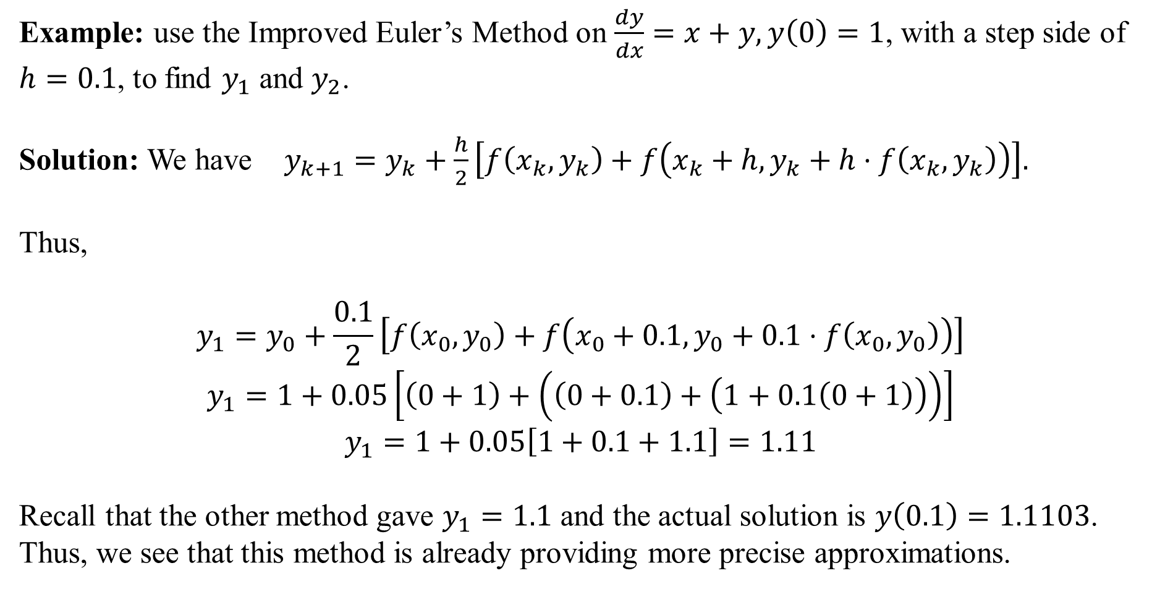
Example: use the Improved Euler’s Method on $\frac{dy}{dx}=x+y, y\left(0\right)=1$, with a step side of $h=0.1$, to find $y_{1}$ and $y_{2}$.
Solution: We have $y_{k+1}=y_{k}+\frac{h}{2}\left[f\left(x_{k},y_{k}\right)+f\left(x_{k}+h,y_{k}+h⋅f\left(x_{k},y_{k}\right)\right)\right].$
Thus,
$$y_{1}=y_{0}+\frac{0.1}{2}\left[f\left(x_{0},y_{0}\right)+f\left(x_{0}+0.1,y_{0}+0.1⋅f\left(x_{0},y_{0}\right)\right)\right]$$
$$y_{1}=1+0.05\left[\left(0+1\right)+\left(\left(0+0.1\right)+\left(1+0.1\left(0+1\right)\right)\right)\right]$$
$$y_{1}=1+0.05\left[1+0.1+1.1\right]=1.11$$
Recall that the other method gave $y_{1}=1.1$ and the actual solution is $y\left(0.1\right)=1.1103$.
Thus, we see that this method is already providing more precise approximations.

Slide 13
One more time… we have
$$y_{k+1}=y_{k}+\frac{h}{2}\left[f\left(x_{k},y_{k}\right)+f\left(x_{k}+h,y_{k}+h⋅f\left(x_{k},y_{k}\right)\right)\right]$$
$$y_{2}=y_{1}+0.05\left[\left(x_{1}+y_{1}\right)+\left(\left(x_{1}+0.1\right)+\left(y_{1}+0.1\left(x_{1}+y_{1}\right)\right)\right)\right]$$
Don’t forget that $\left(x_{1},y_{1}\right)=(0.1, 1.11)$ using the $y_{1}$ from the last slide.
Thus, we obtain
$$y_{2}=1.11+0.05\left[\left(0.1+1.11\right)+\left(\left(0.1+0.1\right)+\left(1.11+0.1\left(0.1+1.11\right)\right)\right)\right]$$
This works out to $y_{2}=1.24205.$ Recall that Euler’s Method gave an approximation of $y_{2}=1.22$, and that the actual solution was $y\left(0.2\right)=1.2428$. Again, we see better precision.

Slide 14
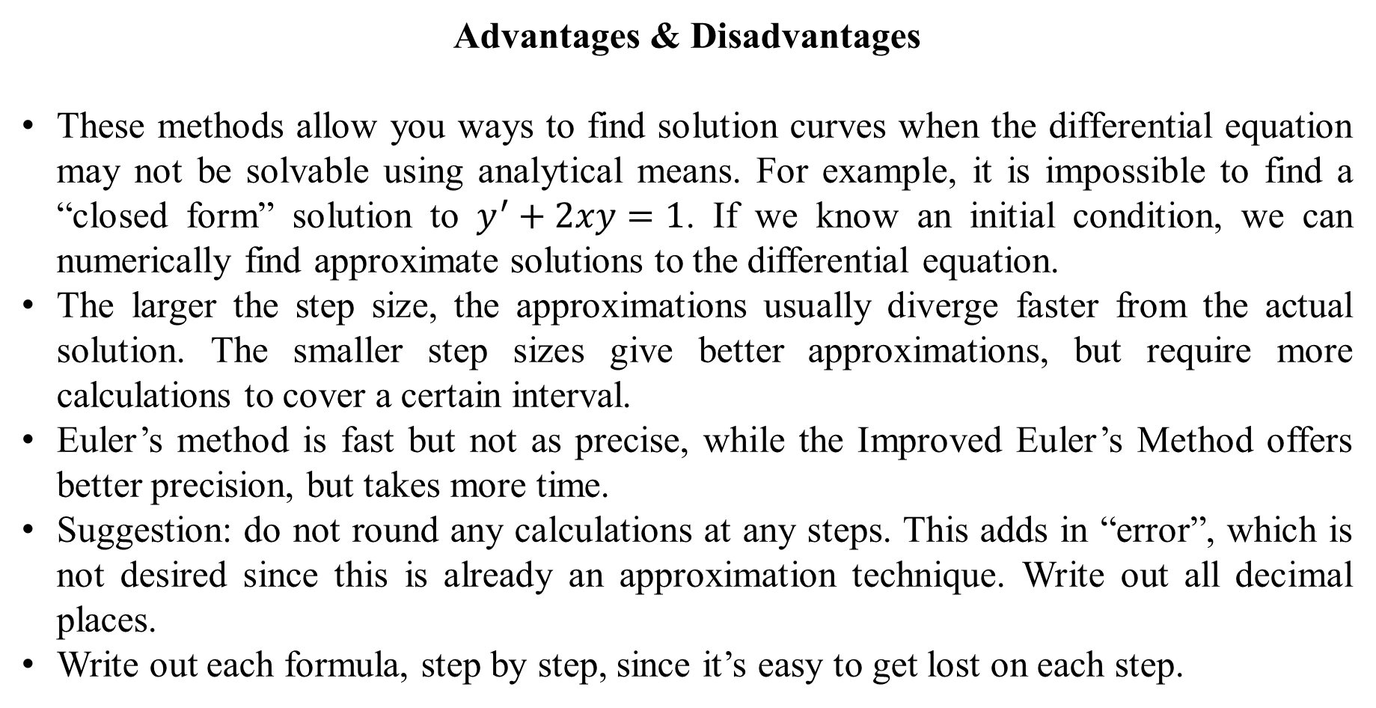
Advantages & Disadvantages
These methods allow you ways to find solution curves when the differential equation may not be solvable using analytical means. For example, it is impossible to find a “closed form” solution to $y^{′}+2xy=1$. If we know an initial condition, we can numerically find approximate solutions to the differential equation.
The larger the step size, the approximations usually diverge faster from the actual solution. The smaller step sizes give better approximations, but require more calculations to cover a certain interval.
Euler’s method is fast but not as precise, while the Improved Euler’s Method offers better precision, but takes more time.
Suggestion: do not round any calculations at any steps. This adds in “error”, which is not desired since this is already an approximation technique. Write out all decimal places.
Write out each formula, step by step, since it’s easy to get lost on each step.

