Slide 1
Mixture Problems
MAT 275

Slide 2
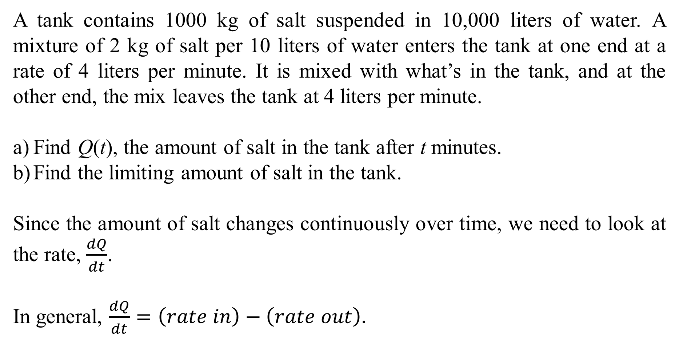
A tank contains 1000 kg of salt suspended in 10,000 liters of water. A mixture of 2 kg of salt per 10 liters of water enters the tank at one end at a rate of 4 liters per minute. It is mixed with what’s in the tank, and at the other end, the mix leaves the tank at 4 liters per minute.
Find Q(t), the amount of salt in the tank after t minutes.
Find the limiting amount of salt in the tank.
Since the amount of salt changes continuously over time, we need to look at the rate, $\frac{dQ}{dt}$.
In general, $\frac{dQ}{dt}=\left(rate in\right)−\left(rate out\right).$

Slide 3
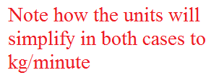
A tank contains 1000 kg of salt suspended in 10,000 liters of water. A mixture of 2 kg of salt per 10 liters of water enters the tank at one end at a rate of 4 liters per minute. It is mixed with what’s in the tank, and at the other end, the mix leaves the tank at 4 liters per minute.

Slide 4
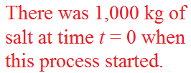
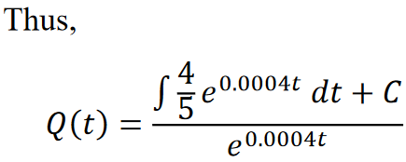

Slide 5
As $t→∞$, the term $e^{−0.0004t}→0$, so the limiting value of salt in the tank is 2000 kg.
This should make sense: In a 10,000-liter tank, with a mixture that is 1/5 salt per liter coming in for an extended period of time, we should expect that 1/5 of the total volume, or $\frac{1}{5}\left(10,000\right)=2,000$ kg, is salt.

Slide 6
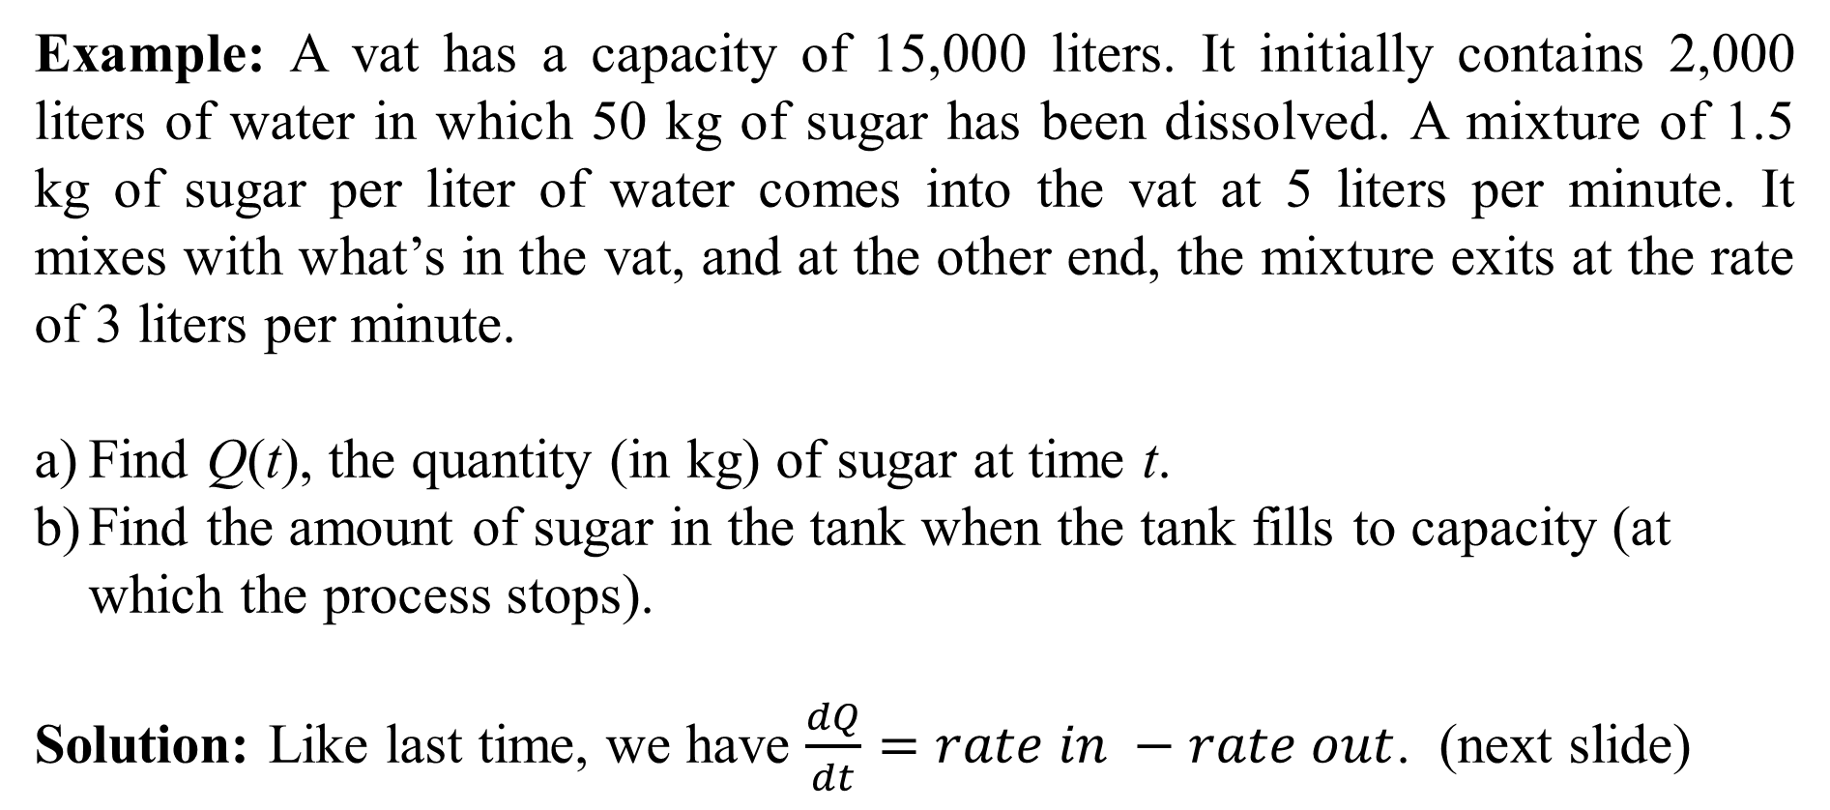
Example: A vat has a capacity of 15,000 liters. It initially contains 2,000 liters of water in which 50 kg of sugar has been dissolved. A mixture of 1.5 kg of sugar per liter of water comes into the vat at 5 liters per minute. It mixes with what’s in the vat, and at the other end, the mixture exits at the rate of 3 liters per minute.
Find Q(t), the quantity (in kg) of sugar at time t.
Find the amount of sugar in the tank when the tank fills to capacity (at which the process stops).
Solution: Like last time, we have $\frac{dQ}{dt}=rate in −rate out$. (next slide)

Slide 7
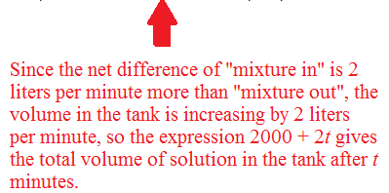

Example: A vat in the shape of a icosahedron has a capacity of 15,000 liters. It initially contains 2,000 liters of water in which 50 kg of sugar has been dissolved. A mixture of 1.5 kg of sugar per liter of water comes into the vat at 5 liters per minute. It mixes with what’s in the vat, and at the other end, the mixture exits at the rate of 3 liters per minute.
There are 13,000 liters available in the tank, and if the tank fills at 2 liters per minute, then the process will run for 13,000 ÷ 2 = 6,500 minutes. Thus, the bounds on t are $0≤t≤6500$ and the initial condition is $Q\left(0\right)=50$. (Next slide)

Slide 8

The differential equation simplified is
$$Q^{′}=7.5−\left(\frac{3}{2000+2t}\right)Q, 0≤t≤6500, Q\left(0\right)=50.$$
Write the differential equation as $Q^{′}+\left(\frac{3}{2000+2t}\right)Q=7.5$.
The integration factor is
The solution is
The general solution is $Q\left(t\right)=3000+3t+C{\left(2000+2t\right)}^{−1.5}$

Slide 9
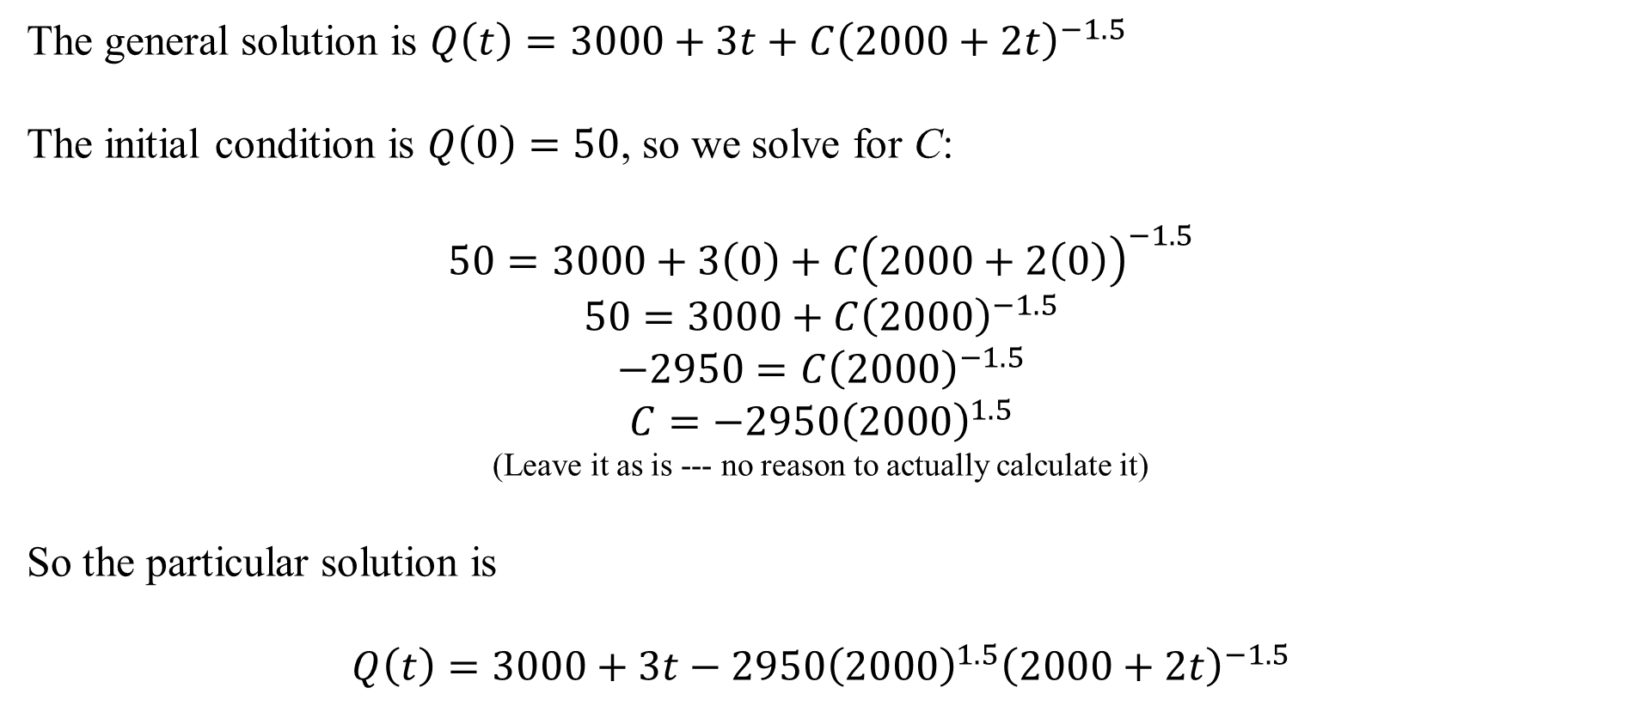
The general solution is $Q\left(t\right)=3000+3t+C{\left(2000+2t\right)}^{−1.5}$
The initial condition is $Q\left(0\right)=50$, so we solve for C:
$$50=3000+3\left(0\right)+C{\left(2000+2\left(0\right)\right)}^{−1.5}$$
$$50=3000+C{\left(2000\right)}^{−1.5}$$
$$−2950=C{\left(2000\right)}^{−1.5}$$
$$C=−2950{\left(2000\right)}^{1.5}$$
(Leave it as is --- no reason to actually calculate it)
So the particular solution is
$$Q\left(t\right)=3000+3t−2950{\left(2000\right)}^{1.5}{\left(2000+2t\right)}^{−1.5}$$

Slide 10
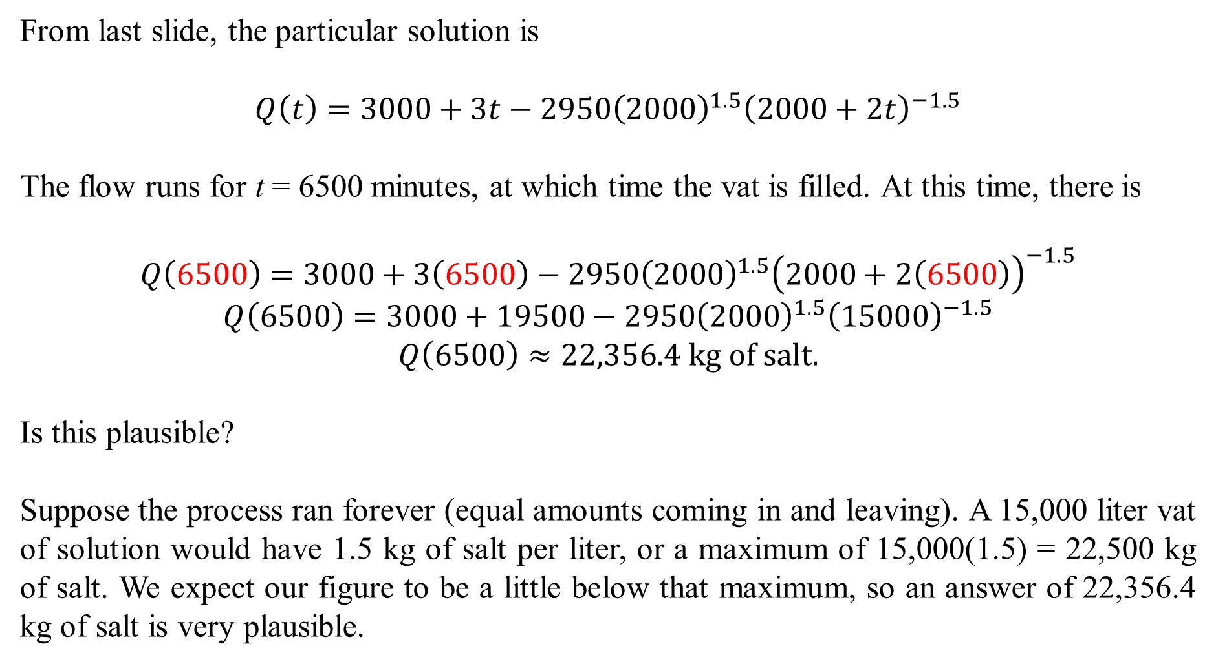
From last slide, the particular solution is
$$Q\left(t\right)=3000+3t−2950{\left(2000\right)}^{1.5}{\left(2000+2t\right)}^{−1.5}$$
The flow runs for t = 6500 minutes, at which time the vat is filled. At this time, there is
$$Q\left(6500\right)=3000+3\left(6500\right)−2950{\left(2000\right)}^{1.5}{\left(2000+2\left(6500\right)\right)}^{−1.5}$$
$$Q\left(6500\right)=3000+19500−2950{\left(2000\right)}^{1.5}{\left(15000\right)}^{−1.5}$$
$$Q\left(6500\right)≈22,356.4 kg of salt.$$
Is this plausible?
Suppose the process ran forever (equal amounts coming in and leaving). A 15,000 liter vat of solution would have 1.5 kg of salt per liter, or a maximum of 15,000(1.5) = 22,500 kg of salt. We expect our figure to be a little below that maximum, so an answer of 22,356.4 kg of salt is very plausible.

Slide 11
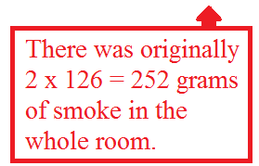
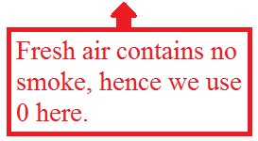
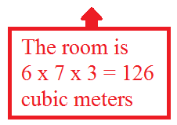
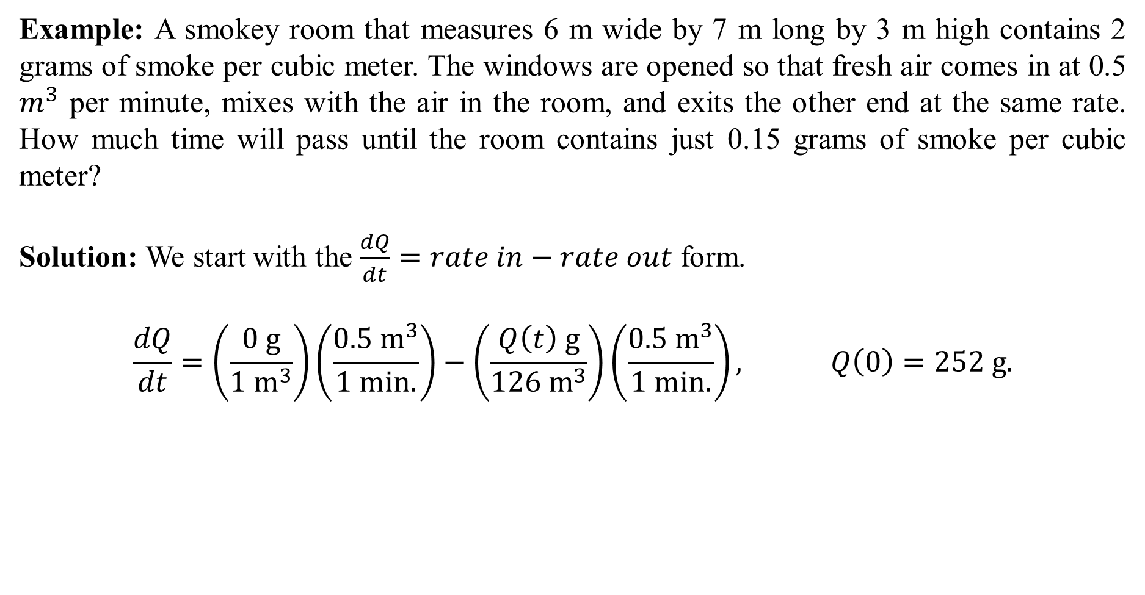
Example: A smokey room that measures 6 m wide by 7 m long by 3 m high contains 2 grams of smoke per cubic meter. The windows are opened so that fresh air comes in at 0.5 $m^{3}$ per minute, mixes with the air in the room, and exits the other end at the same rate. How much time will pass until the room contains just 0.15 grams of smoke per cubic meter?
Solution: We start with the $\frac{dQ}{dt}=rate in−rate out$ form.
$$\frac{dQ}{dt}=\left(\frac{0 g}{1 m^{3}}\right)\left(\frac{0.5 m^{3}}{1 min.}\right)−\left(\frac{Q\left(t\right) g}{126 m^{3}}\right)\left(\frac{0.5 m^{3}}{1 min.}\right), Q\left(0\right)=252 g.$$

Slide 12
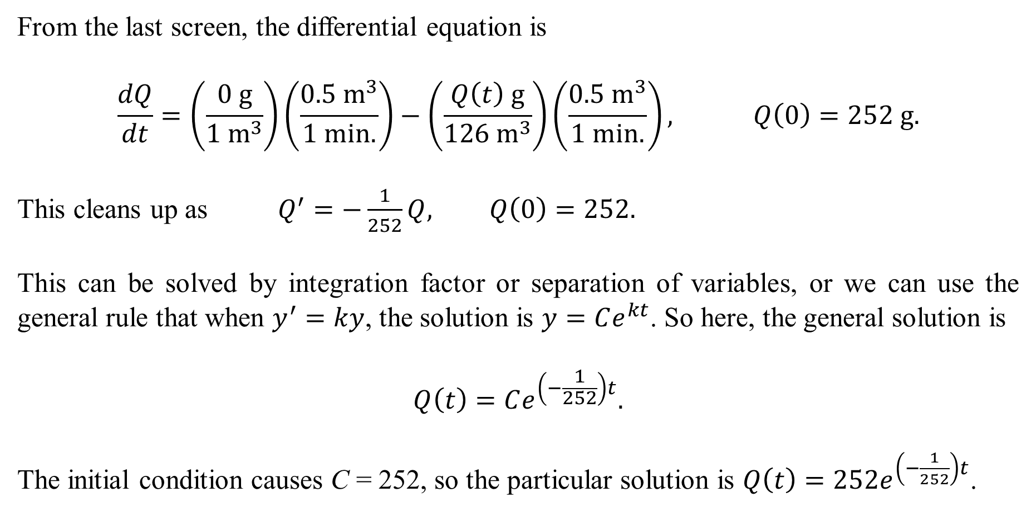
From the last screen, the differential equation is
$$\frac{dQ}{dt}=\left(\frac{0 g}{1 m^{3}}\right)\left(\frac{0.5 m^{3}}{1 min.}\right)−\left(\frac{Q\left(t\right) g}{126 m^{3}}\right)\left(\frac{0.5 m^{3}}{1 min.}\right), Q\left(0\right)=252 g.$$
This cleans up as $Q^{′}=−\frac{1}{252}Q, Q\left(0\right)=252.$
This can be solved by integration factor or separation of variables, or we can use the general rule that when $y^{′}=ky$, the solution is $y=Ce^{kt}$. So here, the general solution is
$$Q\left(t\right)=Ce^{\left(−\frac{1}{252}\right)t}.$$
The initial condition causes C = 252, so the particular solution is $Q\left(t\right)=252e^{\left(−\frac{1}{252}\right)t}$.

Slide 13
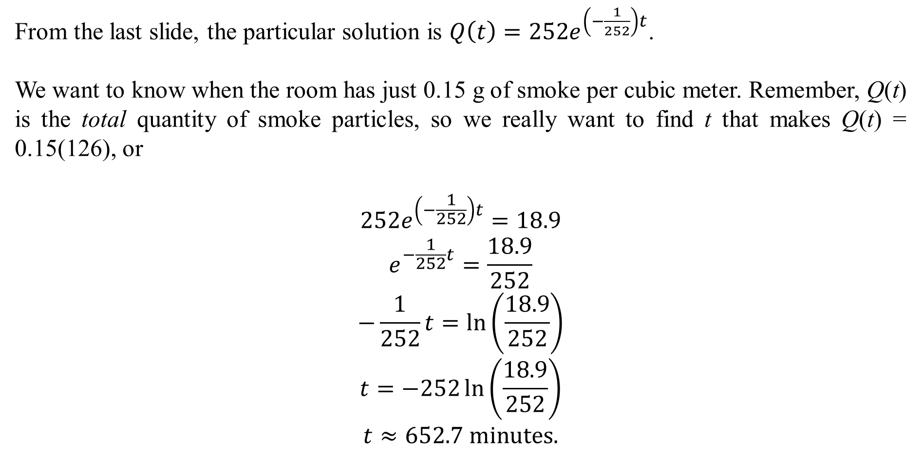
From the last slide, the particular solution is $Q\left(t\right)=252e^{\left(−\frac{1}{252}\right)t}$.
We want to know when the room has just 0.15 g of smoke per cubic meter. Remember, Q(t) is the total quantity of smoke particles, so we really want to find t that makes Q(t) = 0.15(126), or
$$252e^{\left(−\frac{1}{252}\right)t}=18.9$$
$$e^{−\frac{1}{252}t}=\frac{18.9}{252}$$
$$−\frac{1}{252}t=\ln\left(\frac{18.9}{252}\right)$$
$$t=−252\ln\left(\frac{18.9}{252}\right)$$
$$t≈652.7 minutes.$$

