Slide 1
Matrix Review: Determinants, Eigenvalues & Eigenvectors
MAT 275

Slide 2
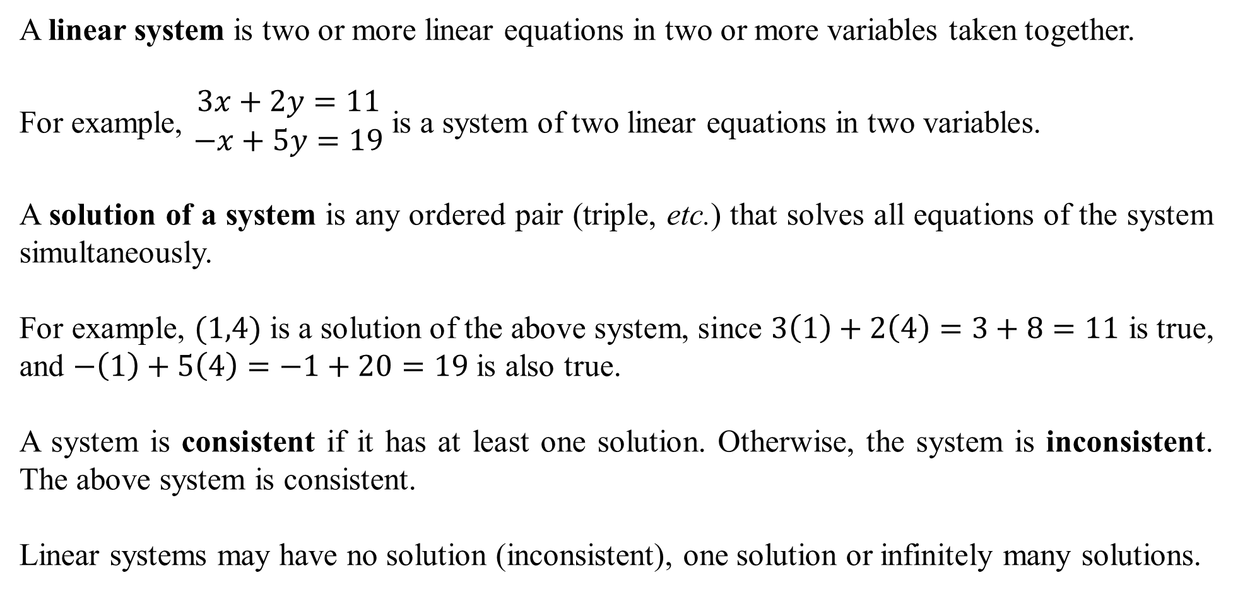
A linear system is two or more linear equations in two or more variables taken together.
For example, $\begin{matrix}3x+2y=11 \\ −x+5y=19\end{matrix}$ is a system of two linear equations in two variables.
A solution of a system is any ordered pair (triple, etc.) that solves all equations of the system simultaneously.
For example, $(1,4)$ is a solution of the above system, since $3\left(1\right)+2\left(4\right)=3+8=11$ is true, and $−\left(1\right)+5\left(4\right)=−1+20=19$ is also true.
A system is consistent if it has at least one solution. Otherwise, the system is inconsistent. The above system is consistent.
Linear systems may have no solution (inconsistent), one solution or infinitely many solutions.

Slide 3
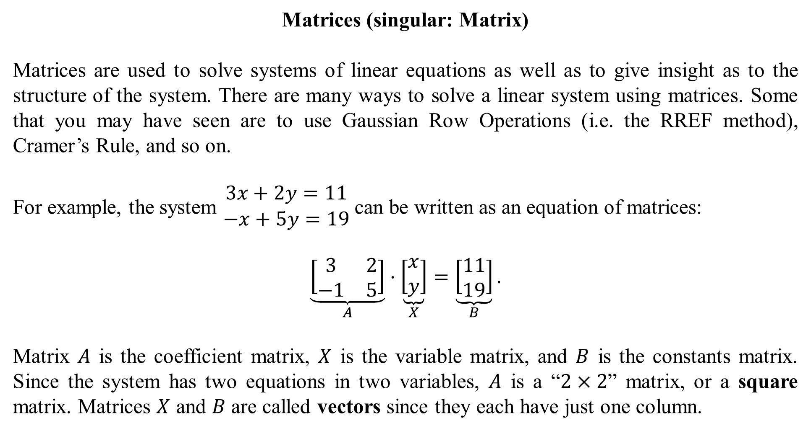
Matrices (singular: Matrix)
Matrices are used to solve systems of linear equations as well as to give insight as to the structure of the system. There are many ways to solve a linear system using matrices. Some that you may have seen are to use Gaussian Row Operations (i.e. the RREF method), Cramer’s Rule, and so on.
For example, the system $\begin{matrix}3x+2y=11 \\ −x+5y=19\end{matrix}$ can be written as an equation of matrices:
$$\underset{A}{\underbrace{\left[\begin{matrix}3 & 2 \\ −1 & 5\end{matrix}\right]}}⋅\underset{X}{\underbrace{\left[\begin{matrix}x \\ y\end{matrix}\right]}}=\underset{B}{\underbrace{\left[\begin{matrix}11 \\ 19\end{matrix}\right]}}.$$
Matrix $A$ is the coefficient matrix, $X$ is the variable matrix, and $B$ is the constants matrix. Since the system has two equations in two variables, $A$ is a “$2×2$” matrix, or a square matrix. Matrices $X$ and $B$ are called vectors since they each have just one column.

Slide 4
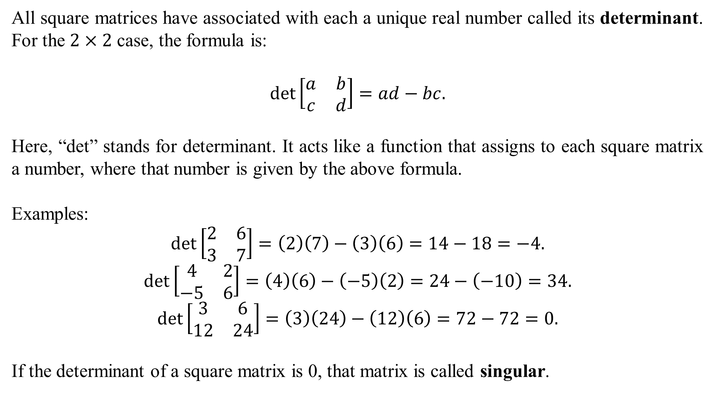
All square matrices have associated with each a unique real number called its determinant. For the $2×2$ case, the formula is:
$$\det\left[\begin{matrix}a & b \\ c & d\end{matrix}\right]=ad−bc.$$
Here, “det” stands for determinant. It acts like a function that assigns to each square matrix a number, where that number is given by the above formula.
Examples:
$$\det\left[\begin{matrix}2 & 6 \\ 3 & 7\end{matrix}\right]=\left(2\right)\left(7\right)−\left(3\right)\left(6\right)=14−18=−4.$$
$$\det\left[\begin{matrix}4 & 2 \\ −5 & 6\end{matrix}\right]=\left(4\right)\left(6\right)−\left(−5\right)\left(2\right)=24−\left(−10\right)=34.$$
$$\det\left[\begin{matrix}3 & 6 \\ 12 & 24\end{matrix}\right]=\left(3\right)\left(24\right)−\left(12\right)\left(6\right)=72−72=0.$$
If the determinant of a square matrix is 0, that matrix is called singular.

Slide 5
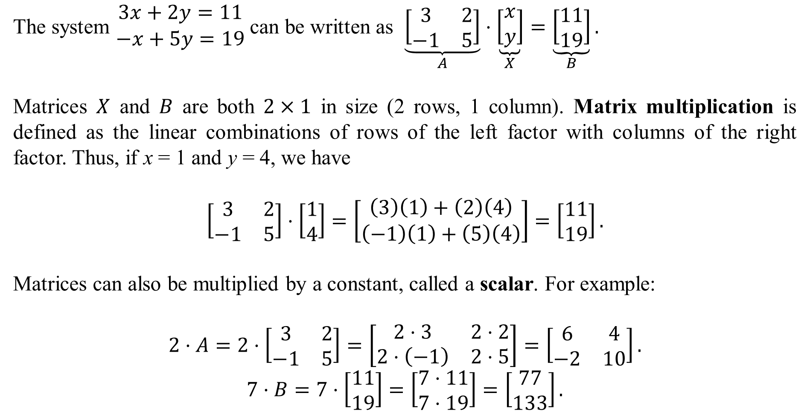
The system $\begin{matrix}3x+2y=11 \\ −x+5y=19\end{matrix}$ can be written as $\underset{A}{\underbrace{\left[\begin{matrix}3 & 2 \\ −1 & 5\end{matrix}\right]}}⋅\underset{X}{\underbrace{\left[\begin{matrix}x \\ y\end{matrix}\right]}}=\underset{B}{\underbrace{\left[\begin{matrix}11 \\ 19\end{matrix}\right]}}.$
Matrices $X$ and $B$ are both $2×1$ in size (2 rows, 1 column). Matrix multiplication is defined as the linear combinations of rows of the left factor with columns of the right factor. Thus, if x = 1 and y = 4, we have
$$\left[\begin{matrix}3 & 2 \\ −1 & 5\end{matrix}\right]⋅\left[\begin{matrix}1 \\ 4\end{matrix}\right]=\left[\begin{matrix}\left(3\right)\left(1\right)+\left(2\right)\left(4\right) \\ \left(−1\right)\left(1\right)+\left(5\right)\left(4\right)\end{matrix}\right]=\left[\begin{matrix}11 \\ 19\end{matrix}\right].$$
Matrices can also be multiplied by a constant, called a scalar. For example:
$$2⋅A=2⋅\left[\begin{matrix}3 & 2 \\ −1 & 5\end{matrix}\right]=\left[\begin{matrix}2⋅3 & 2⋅2 \\ 2⋅\left(−1\right) & 2⋅5\end{matrix}\right]=\left[\begin{matrix}6 & 4 \\ −2 & 10\end{matrix}\right].$$
$$7⋅B=7⋅\left[\begin{matrix}11 \\ 19\end{matrix}\right]=\left[\begin{matrix}7⋅11 \\ 7⋅19\end{matrix}\right]=\left[\begin{matrix}77 \\ 133\end{matrix}\right].$$

Slide 6
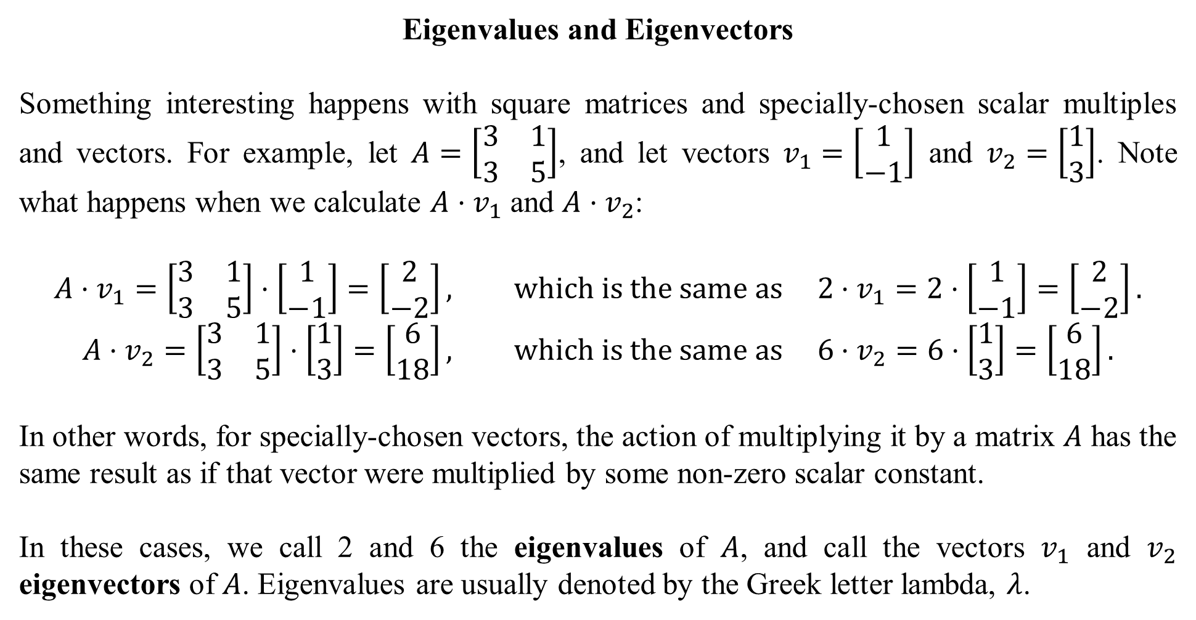
Eigenvalues and Eigenvectors
Something interesting happens with square matrices and specially-chosen scalar multiples and vectors. For example, let $A=\left[\begin{matrix}3 & 1 \\ 3 & 5\end{matrix}\right]$, and let vectors $v_{1}=\left[\begin{matrix}1 \\ −1\end{matrix}\right]$ and $v_{2}=\left[\begin{matrix}1 \\ 3\end{matrix}\right]$. Note what happens when we calculate $A⋅v_{1}$ and $A⋅v_{2}$:
$$A⋅v_{1}=\left[\begin{matrix}3 & 1 \\ 3 & 5\end{matrix}\right]⋅\left[\begin{matrix}1 \\ −1\end{matrix}\right]=\left[\begin{matrix}2 \\ −2\end{matrix}\right], which is the same as 2⋅v_{1}=2⋅\left[\begin{matrix}1 \\ −1\end{matrix}\right]=\left[\begin{matrix}2 \\ −2\end{matrix}\right].$$
$$A⋅v_{2}=\left[\begin{matrix}3 & 1 \\ 3 & 5\end{matrix}\right]⋅\left[\begin{matrix}1 \\ 3\end{matrix}\right]=\left[\begin{matrix}6 \\ 18\end{matrix}\right], which is the same as 6⋅v_{2}=6⋅\left[\begin{matrix}1 \\ 3\end{matrix}\right]=\left[\begin{matrix}6 \\ 18\end{matrix}\right].$$
In other words, for specially-chosen vectors, the action of multiplying it by a matrix $A$ has the same result as if that vector were multiplied by some non-zero scalar constant.
In these cases, we call 2 and 6 the eigenvalues of $A$, and call the vectors $v_{1}$ and $v_{2}$ eigenvectors of $A$. Eigenvalues are usually denoted by the Greek letter lambda, $λ$.

Slide 7
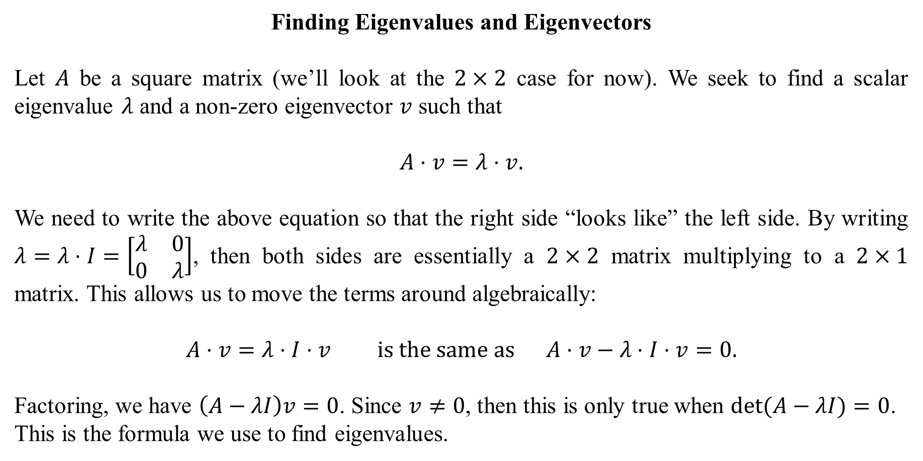
Finding Eigenvalues and Eigenvectors
Let $A$ be a square matrix (we’ll look at the $2×2$ case for now). We seek to find a scalar eigenvalue $λ$ and a non-zero eigenvector $v$ such that
$$A⋅v=λ⋅v.$$
We need to write the above equation so that the right side “looks like” the left side. By writing $λ=λ⋅I=\left[\begin{matrix}λ & 0 \\ 0 & λ\end{matrix}\right]$, then both sides are essentially a $2×2$ matrix multiplying to a $2×1$ matrix. This allows us to move the terms around algebraically:
$$A⋅v=λ⋅I⋅v is the same as A⋅v−λ⋅I⋅v=0.$$
Factoring, we have $\left(A−λI\right)v=0$. Since $v≠0$, then this is only true when $\det{(A−λI)}=0$. This is the formula we use to find eigenvalues.

Slide 8
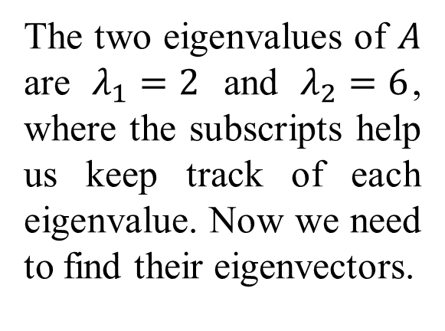

Example: Find the eigenvalues of $A=\left[\begin{matrix}3 & 1 \\ 3 & 5\end{matrix}\right]$.
Solution: Since $λ⋅I=\left[\begin{matrix}λ & 0 \\ 0 & λ\end{matrix}\right]$, we have
$$\det{(A−λI)}=\det\left[\begin{matrix}3−λ & 1 \\ 3 & 5−λ\end{matrix}\right]=\left(3−λ\right)\left(5−λ\right)−3.$$
This is set to 0 and solved for $λ$:
$$\left(3−λ\right)\left(5−λ\right)−3=0$$
$$λ^{2}−8λ+15−3=0$$
$$λ^{2}−8λ+12=0$$
$$\left(λ−2\right)\left(λ−6\right)=0$$
$$λ_{1}=2 and λ_{2}=6.$$
The two eigenvalues of $A$ are $λ_{1}=2$ and $λ_{2}=6$, where the subscripts help us keep track of each eigenvalue. Now we need to find their eigenvectors.

Slide 9
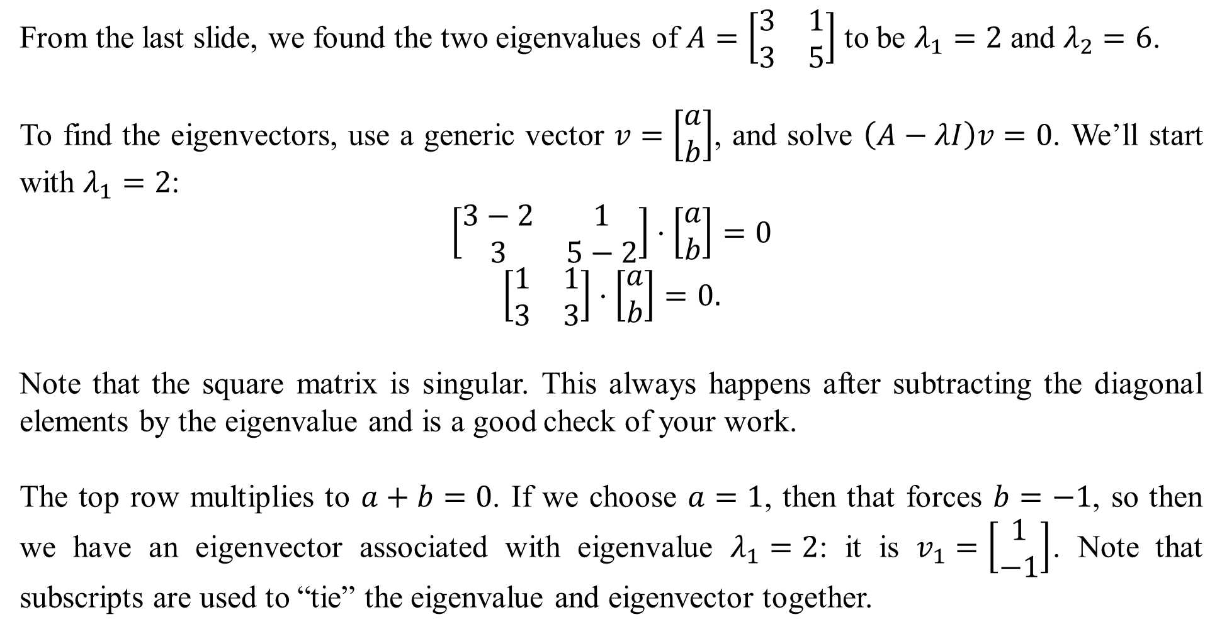
From the last slide, we found the two eigenvalues of $A=\left[\begin{matrix}3 & 1 \\ 3 & 5\end{matrix}\right]$ to be $λ_{1}=2$ and $λ_{2}=6$.
To find the eigenvectors, use a generic vector $v=\left[\begin{matrix}a \\ b\end{matrix}\right]$, and solve $\left(A−λI\right)v=0$. We’ll start with $λ_{1}=2$:
$$\left[\begin{matrix}3−2 & 1 \\ 3 & 5−2\end{matrix}\right]⋅\left[\begin{matrix}a \\ b\end{matrix}\right]=0$$
$$\left[\begin{matrix}1 & 1 \\ 3 & 3\end{matrix}\right]⋅\left[\begin{matrix}a \\ b\end{matrix}\right]=0.$$
Note that the square matrix is singular. This always happens after subtracting the diagonal elements by the eigenvalue and is a good check of your work.
The top row multiplies to $a+b=0$. If we choose $a=1$, then that forces $b=−1$, so then we have an eigenvector associated with eigenvalue $λ_{1}=2$: it is $v_{1}=\left[\begin{matrix}1 \\ −1\end{matrix}\right]$. Note that subscripts are used to “tie” the eigenvalue and eigenvector together.

Slide 10
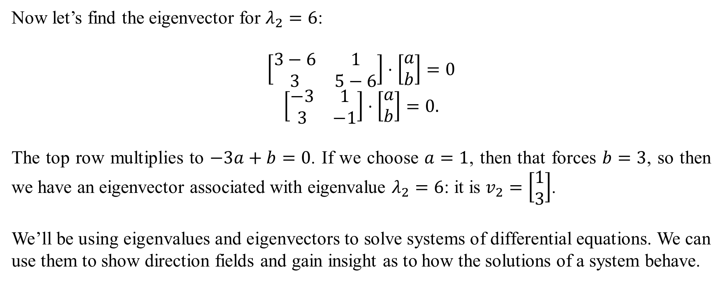
Now let’s find the eigenvector for $λ_{2}=6$:
$$\left[\begin{matrix}3−6 & 1 \\ 3 & 5−6\end{matrix}\right]⋅\left[\begin{matrix}a \\ b\end{matrix}\right]=0$$
$$\left[\begin{matrix}−3 & 1 \\ 3 & −1\end{matrix}\right]⋅\left[\begin{matrix}a \\ b\end{matrix}\right]=0.$$
The top row multiplies to $−3a+b=0$. If we choose $a=1$, then that forces $b=3$, so then we have an eigenvector associated with eigenvalue $λ_{2}=6$: it is $v_{2}=\left[\begin{matrix}1 \\ 3\end{matrix}\right]$.
We’ll be using eigenvalues and eigenvectors to solve systems of differential equations. We can use them to show direction fields and gain insight as to how the solutions of a system behave.

Slide 11
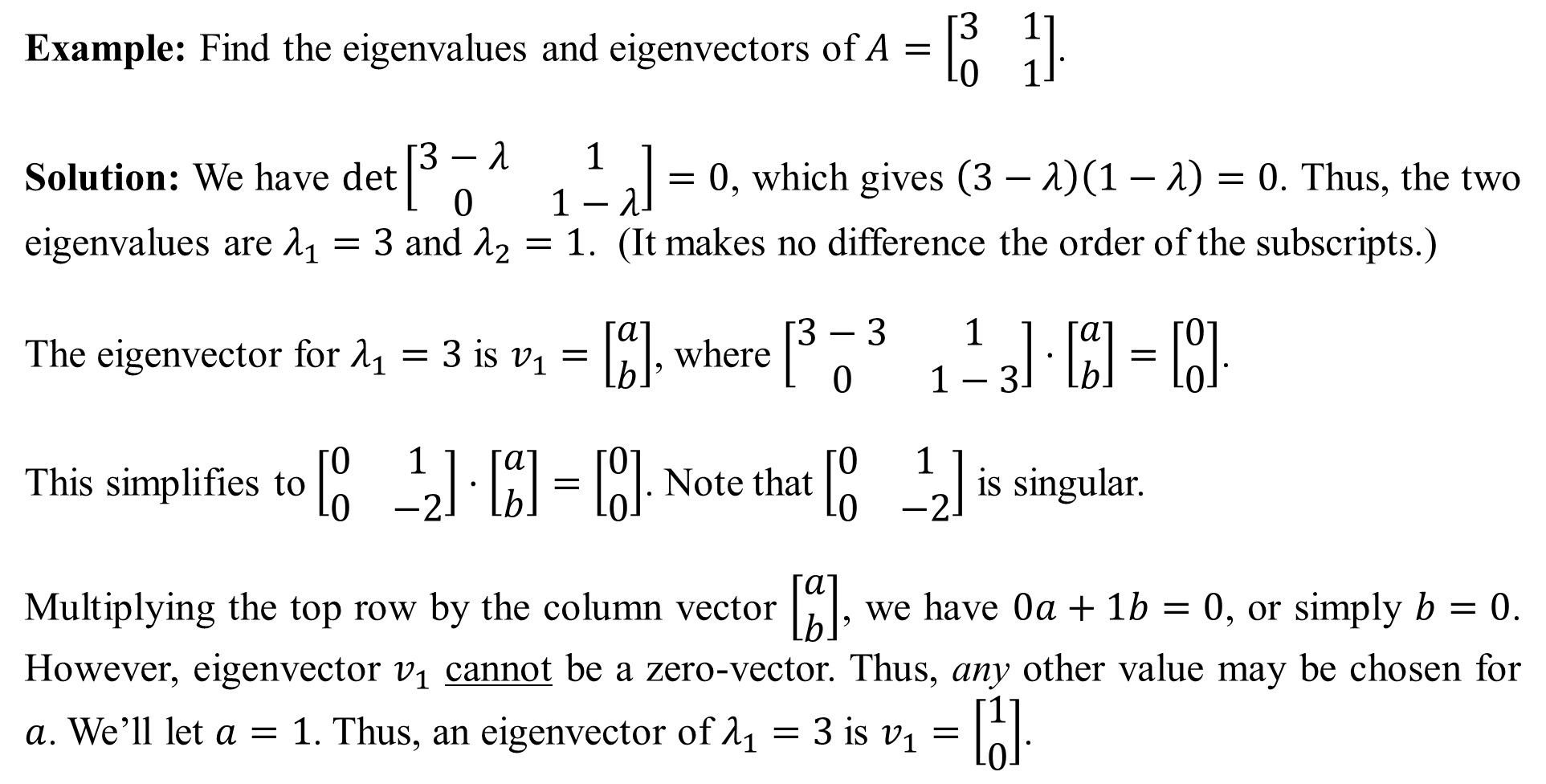
Example: Find the eigenvalues and eigenvectors of $A=\left[\begin{matrix}3 & 1 \\ 0 & 1\end{matrix}\right]$.
Solution: We have $det\left[\begin{matrix}3−λ & 1 \\ 0 & 1−λ\end{matrix}\right]=0$, which gives $\left(3−λ\right)\left(1−λ\right)=0$. Thus, the two eigenvalues are $λ_{1}=3$ and $λ_{2}=1$. (It makes no difference the order of the subscripts.)
The eigenvector for $λ_{1}=3$ is $v_{1}=\left[\begin{matrix}a \\ b\end{matrix}\right]$, where $\left[\begin{matrix}3−3 & 1 \\ 0 & 1−3\end{matrix}\right]⋅\left[\begin{matrix}a \\ b\end{matrix}\right]=\left[\begin{matrix}0 \\ 0\end{matrix}\right]$.
This simplifies to $\left[\begin{matrix}0 & 1 \\ 0 & −2\end{matrix}\right]⋅\left[\begin{matrix}a \\ b\end{matrix}\right]=\left[\begin{matrix}0 \\ 0\end{matrix}\right]$. Note that $\left[\begin{matrix}0 & 1 \\ 0 & −2\end{matrix}\right]$ is singular.
Multiplying the top row by the column vector $\left[\begin{matrix}a \\ b\end{matrix}\right]$, we have $0a+1b=0$, or simply $b=0$. However, eigenvector $v_{1}$ cannot be a zero-vector. Thus, any other value may be chosen for $a$. We’ll let $a=1$. Thus, an eigenvector of $λ_{1}=3$ is $v_{1}=\left[\begin{matrix}1 \\ 0\end{matrix}\right]$.

Slide 12
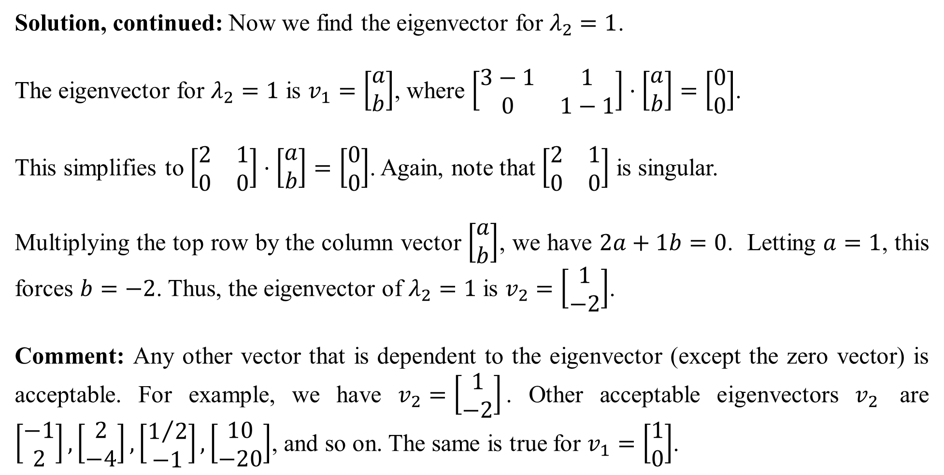
Solution, continued: Now we find the eigenvector for $λ_{2}=1$.
The eigenvector for $λ_{2}=1$ is $v_{1}=\left[\begin{matrix}a \\ b\end{matrix}\right]$, where $\left[\begin{matrix}3−1 & 1 \\ 0 & 1−1\end{matrix}\right]⋅\left[\begin{matrix}a \\ b\end{matrix}\right]=\left[\begin{matrix}0 \\ 0\end{matrix}\right]$.
This simplifies to $\left[\begin{matrix}2 & 1 \\ 0 & 0\end{matrix}\right]⋅\left[\begin{matrix}a \\ b\end{matrix}\right]=\left[\begin{matrix}0 \\ 0\end{matrix}\right]$. Again, note that $\left[\begin{matrix}2 & 1 \\ 0 & 0\end{matrix}\right]$ is singular.
Multiplying the top row by the column vector $\left[\begin{matrix}a \\ b\end{matrix}\right]$, we have $2a+1b=0$. Letting $a=1$, this forces $b=−2$. Thus, the eigenvector of $λ_{2}=1$ is $v_{2}=\left[\begin{matrix}1 \\ −2\end{matrix}\right]$.
Comment: Any other vector that is dependent to the eigenvector (except the zero vector) is acceptable. For example, we have $v_{2}=\left[\begin{matrix}1 \\ −2\end{matrix}\right]$. Other acceptable eigenvectors $v_{2}$ are $\left[\begin{matrix}−1 \\ 2\end{matrix}\right],\left[\begin{matrix}2 \\ −4\end{matrix}\right],\left[\begin{matrix}1/2 \\ −1\end{matrix}\right],\left[\begin{matrix}10 \\ −20\end{matrix}\right]$, and so on. The same is true for $v_{1}=\left[\begin{matrix}1 \\ 0\end{matrix}\right]$.

Slide 13
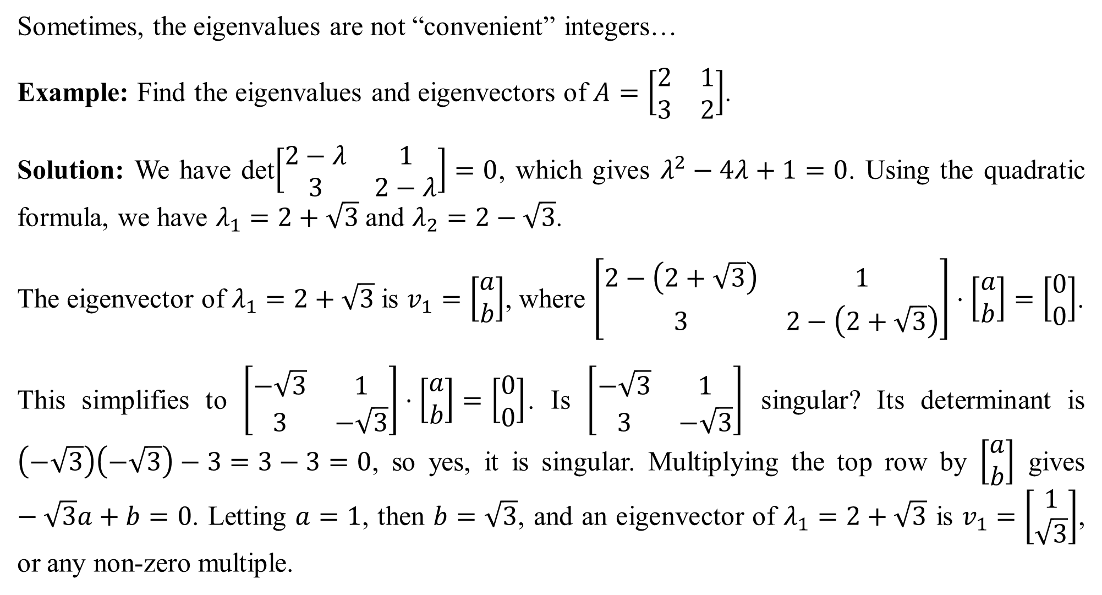
Sometimes, the eigenvalues are not “convenient” integers…
Example: Find the eigenvalues and eigenvectors of $A=\left[\begin{matrix}2 & 1 \\ 3 & 2\end{matrix}\right]$.
Solution: We have det$\left[\begin{matrix}2−λ & 1 \\ 3 & 2−λ\end{matrix}\right]=0$, which gives $λ^{2}−4λ+1=0$. Using the quadratic formula, we have $λ_{1}=2+\sqrt{3}$ and $λ_{2}=2−\sqrt{3}$.
The eigenvector of $λ_{1}=2+\sqrt{3}$ is $v_{1}=\left[\begin{matrix}a \\ b\end{matrix}\right]$, where $\left[\begin{matrix}2−\left(2+\sqrt{3}\right) & 1 \\ 3 & 2−\left(2+\sqrt{3}\right)\end{matrix}\right]⋅\left[\begin{matrix}a \\ b\end{matrix}\right]=\left[\begin{matrix}0 \\ 0\end{matrix}\right]$.
This simplifies to $\left[\begin{matrix}−\sqrt{3} & 1 \\ 3 & −\sqrt{3}\end{matrix}\right]⋅\left[\begin{matrix}a \\ b\end{matrix}\right]=\left[\begin{matrix}0 \\ 0\end{matrix}\right]$. Is $\left[\begin{matrix}−\sqrt{3} & 1 \\ 3 & −\sqrt{3}\end{matrix}\right]$ singular? Its determinant is $\left(−\sqrt{3}\right)\left(−\sqrt{3}\right)−3=3−3=0$, so yes, it is singular. Multiplying the top row by $\left[\begin{matrix}a \\ b\end{matrix}\right]$ gives $−\sqrt{3}a+b=0$. Letting $a=1$, then $b=\sqrt{3}$, and an eigenvector of $λ_{1}=2+\sqrt{3}$ is $v_{1}=\left[\begin{matrix}1 \\ \sqrt{3}\end{matrix}\right]$, or any non-zero multiple.

Slide 14
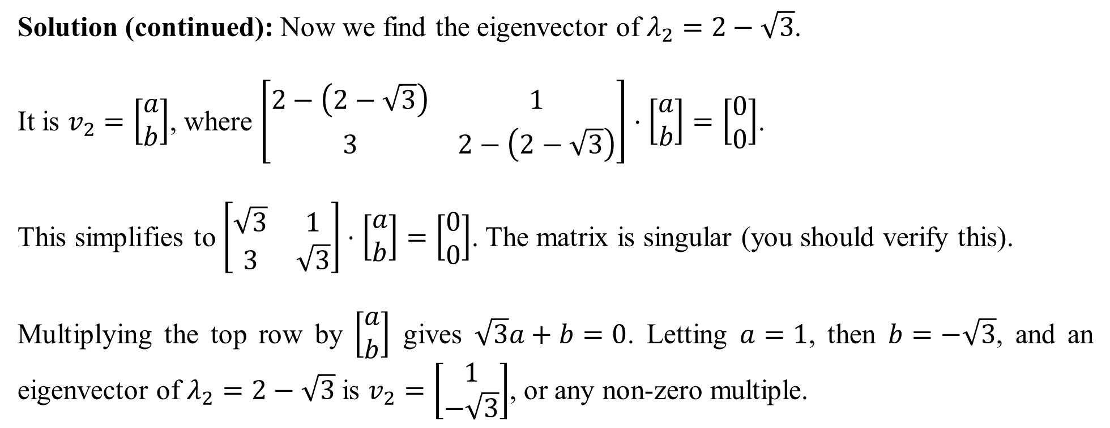
Solution (continued): Now we find the eigenvector of $λ_{2}=2−\sqrt{3}$.
It is $v_{2}=\left[\begin{matrix}a \\ b\end{matrix}\right]$, where $\left[\begin{matrix}2−\left(2−\sqrt{3}\right) & 1 \\ 3 & 2−\left(2−\sqrt{3}\right)\end{matrix}\right]⋅\left[\begin{matrix}a \\ b\end{matrix}\right]=\left[\begin{matrix}0 \\ 0\end{matrix}\right]$.
This simplifies to $\left[\begin{matrix}\sqrt{3} & 1 \\ 3 & \sqrt{3}\end{matrix}\right]⋅\left[\begin{matrix}a \\ b\end{matrix}\right]=\left[\begin{matrix}0 \\ 0\end{matrix}\right]$. The matrix is singular (you should verify this).
Multiplying the top row by $\left[\begin{matrix}a \\ b\end{matrix}\right]$ gives $\sqrt{3}a+b=0$. Letting $a=1$, then $b=−\sqrt{3}$, and an eigenvector of $λ_{2}=2−\sqrt{3}$ is $v_{2}=\left[\begin{matrix}1 \\ −\sqrt{3}\end{matrix}\right]$, or any non-zero multiple.

Slide 15
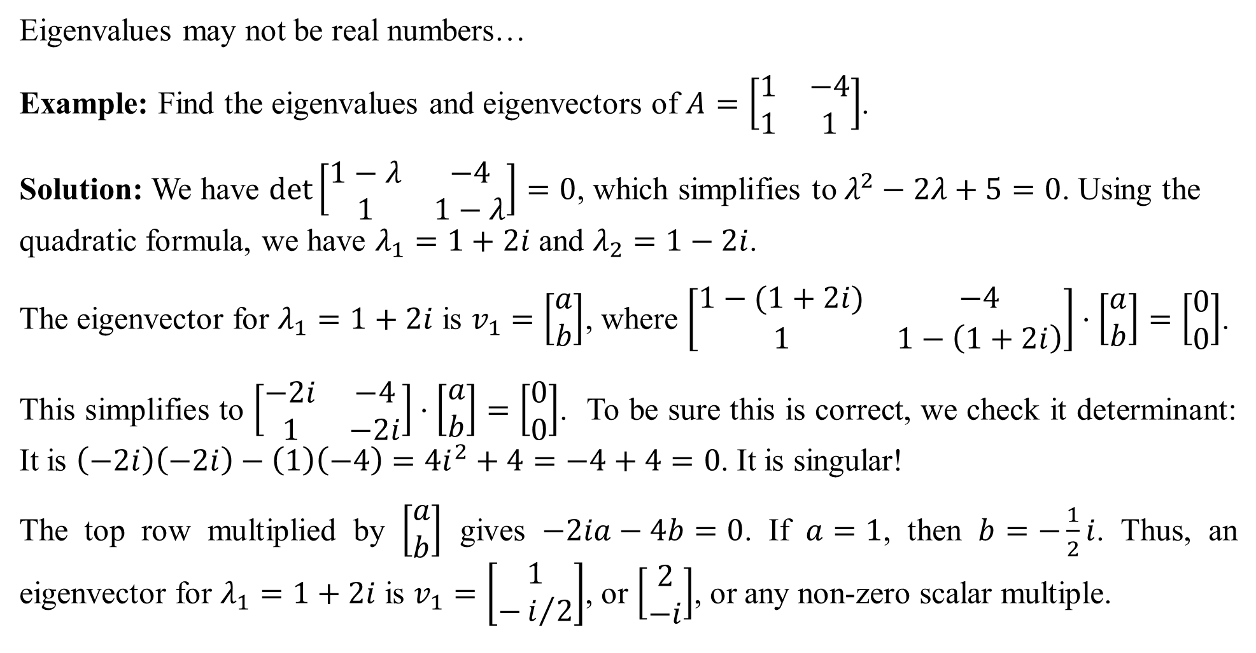
Eigenvalues may not be real numbers…
Example: Find the eigenvalues and eigenvectors of $A=\left[\begin{matrix}1 & −4 \\ 1 & 1\end{matrix}\right]$.
Solution: We have $\det\left[\begin{matrix}1−λ & −4 \\ 1 & 1−λ\end{matrix}\right]=0$, which simplifies to $λ^{2}−2λ+5=0$. Using the quadratic formula, we have $λ_{1}=1+2i$ and $λ_{2}=1−2i$.
The eigenvector for $λ_{1}=1+2i$ is $v_{1}=\left[\begin{matrix}a \\ b\end{matrix}\right]$, where $\left[\begin{matrix}1−(1+2i) & −4 \\ 1 & 1−\left(1+2i\right)\end{matrix}\right]⋅\left[\begin{matrix}a \\ b\end{matrix}\right]=\left[\begin{matrix}0 \\ 0\end{matrix}\right]$.
This simplifies to $\left[\begin{matrix}−2i & −4 \\ 1 & −2i\end{matrix}\right]⋅\left[\begin{matrix}a \\ b\end{matrix}\right]=\left[\begin{matrix}0 \\ 0\end{matrix}\right]$. To be sure this is correct, we check it determinant: It is $\left(−2i\right)\left(−2i\right)−\left(1\right)\left(−4\right)=4i^{2}+4=−4+4=0$. It is singular!
The top row multiplied by $\left[\begin{matrix}a \\ b\end{matrix}\right]$ gives $−2ia−4b=0$. If $a=1$, then $b=−\frac{1}{2}i$. Thus, an eigenvector for $λ_{1}=1+2i$ is $v_{1}=\left[\begin{matrix}1 \\ −i/2\end{matrix}\right]$, or $\left[\begin{matrix}2 \\ −i\end{matrix}\right]$, or any non-zero scalar multiple.

Slide 16
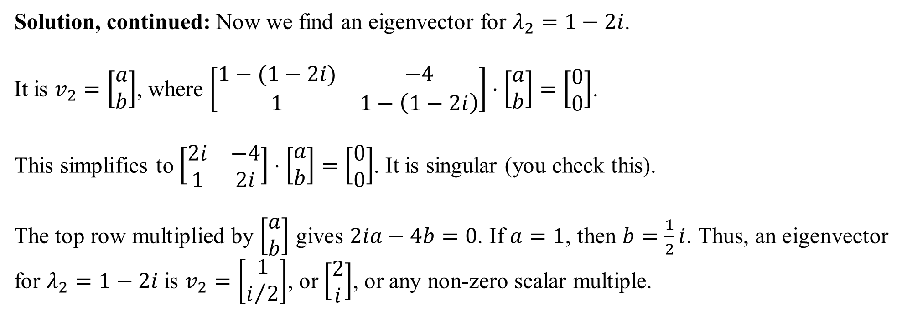
Solution, continued: Now we find an eigenvector for $λ_{2}=1−2i$.
It is $v_{2}=\left[\begin{matrix}a \\ b\end{matrix}\right]$, where $\left[\begin{matrix}1−(1−2i) & −4 \\ 1 & 1−\left(1−2i\right)\end{matrix}\right]⋅\left[\begin{matrix}a \\ b\end{matrix}\right]=\left[\begin{matrix}0 \\ 0\end{matrix}\right]$.
This simplifies to $\left[\begin{matrix}2i & −4 \\ 1 & 2i\end{matrix}\right]⋅\left[\begin{matrix}a \\ b\end{matrix}\right]=\left[\begin{matrix}0 \\ 0\end{matrix}\right]$. It is singular (you check this).
The top row multiplied by $\left[\begin{matrix}a \\ b\end{matrix}\right]$ gives $2ia−4b=0$. If $a=1$, then $b=\frac{1}{2}i$. Thus, an eigenvector for $λ_{2}=1−2i$ is $v_{2}=\left[\begin{matrix}1 \\ i/2\end{matrix}\right]$, or $\left[\begin{matrix}2 \\ i\end{matrix}\right]$, or any non-zero scalar multiple.

Slide 17
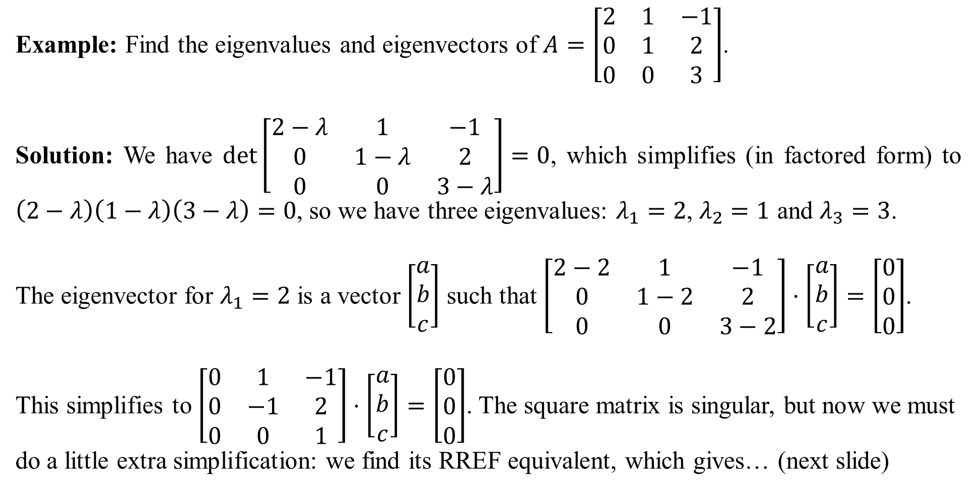
Example: Find the eigenvalues and eigenvectors of $A=\left[\begin{matrix}2 & 1 & −1 \\ 0 & 1 & 2 \\ 0 & 0 & 3\end{matrix}\right]$.
Solution: We have $\det\left[\begin{matrix}2−λ & 1 & −1 \\ 0 & 1−λ & 2 \\ 0 & 0 & 3−λ\end{matrix}\right]=0$, which simplifies (in factored form) to $\left(2−λ\right)\left(1−λ\right)\left(3−λ\right)=0$, so we have three eigenvalues: $λ_{1}=2$, $λ_{2}=1$ and $λ_{3}=3$.
The eigenvector for $λ_{1}=2$ is a vector $\left[\begin{matrix}a \\ b \\ c\end{matrix}\right]$ such that $\left[\begin{matrix}2−2 & 1 & −1 \\ 0 & 1−2 & 2 \\ 0 & 0 & 3−2\end{matrix}\right]⋅\left[\begin{matrix}a \\ b \\ c\end{matrix}\right]=\left[\begin{matrix}0 \\ 0 \\ 0\end{matrix}\right]$.
This simplifies to $\left[\begin{matrix}0 & 1 & −1 \\ 0 & −1 & 2 \\ 0 & 0 & 1\end{matrix}\right]⋅\left[\begin{matrix}a \\ b \\ c\end{matrix}\right]=\left[\begin{matrix}0 \\ 0 \\ 0\end{matrix}\right]$. The square matrix is singular, but now we must do a little extra simplification: we find its RREF equivalent, which gives… (next slide)

Slide 18
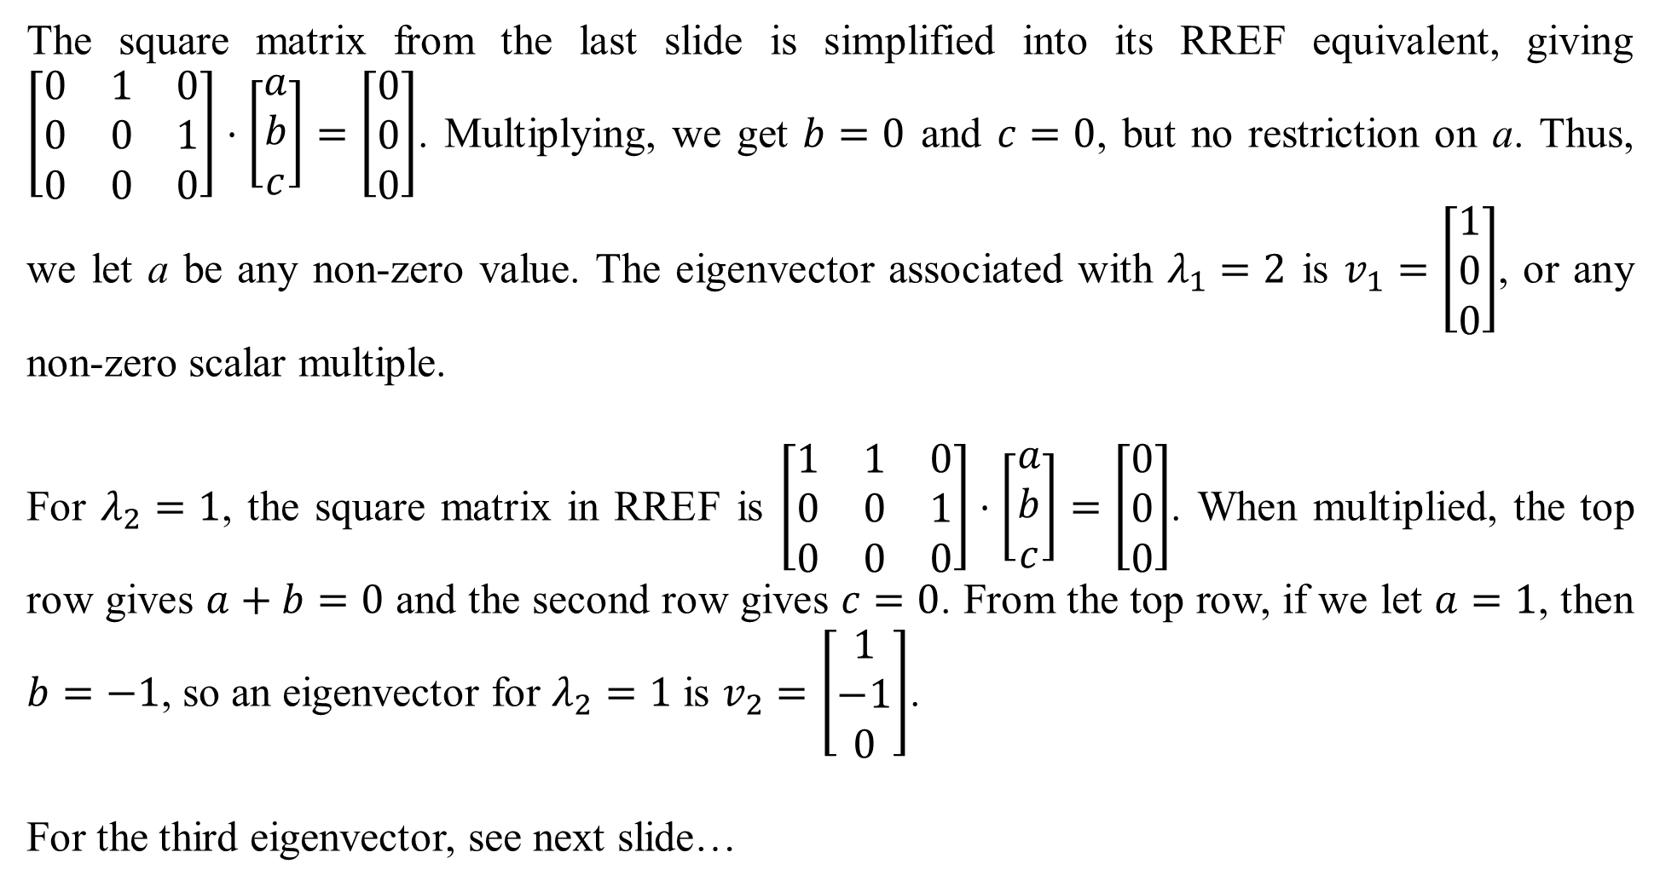
The square matrix from the last slide is simplified into its RREF equivalent, giving $\left[\begin{matrix}0 & 1 & 0 \\ 0 & 0 & 1 \\ 0 & 0 & 0\end{matrix}\right]⋅\left[\begin{matrix}a \\ b \\ c\end{matrix}\right]=\left[\begin{matrix}0 \\ 0 \\ 0\end{matrix}\right]$. Multiplying, we get $b=0$ and $c=0$, but no restriction on a. Thus, we let a be any non-zero value. The eigenvector associated with $λ_{1}=2$ is $v_{1}=\left[\begin{matrix}1 \\ 0 \\ 0\end{matrix}\right]$, or any non-zero scalar multiple.
For $λ_{2}=1$, the square matrix in RREF is $\left[\begin{matrix}1 & 1 & 0 \\ 0 & 0 & 1 \\ 0 & 0 & 0\end{matrix}\right]⋅\left[\begin{matrix}a \\ b \\ c\end{matrix}\right]=\left[\begin{matrix}0 \\ 0 \\ 0\end{matrix}\right]$. When multiplied, the top row gives $a+b=0$ and the second row gives $c=0$. From the top row, if we let $a=1$, then $b=−1$, so an eigenvector for $λ_{2}=1$ is $v_{2}=\left[\begin{matrix}1 \\ −1 \\ 0\end{matrix}\right]$.
For the third eigenvector, see next slide…

Slide 19
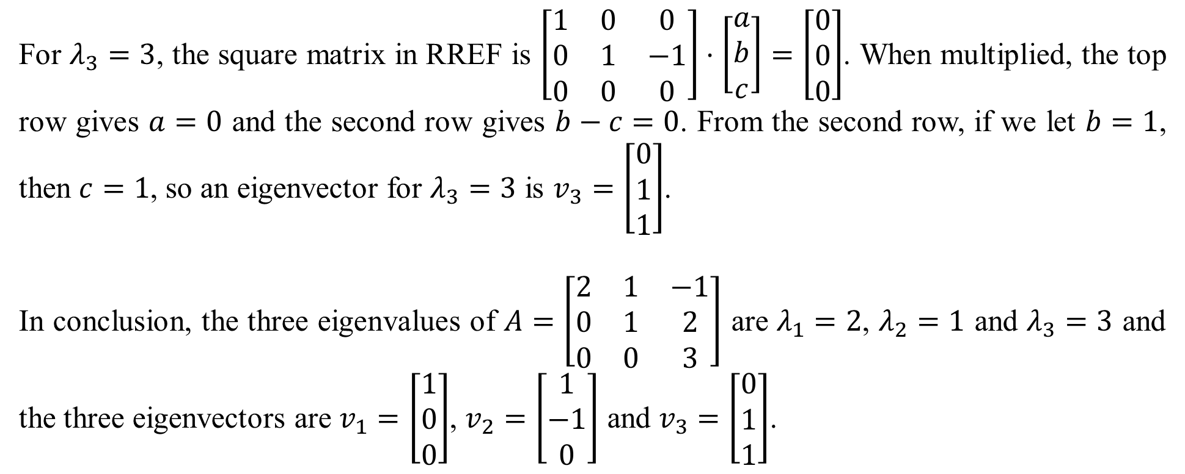
For $λ_{3}=3$, the square matrix in RREF is $\left[\begin{matrix}1 & 0 & 0 \\ 0 & 1 & −1 \\ 0 & 0 & 0\end{matrix}\right]⋅\left[\begin{matrix}a \\ b \\ c\end{matrix}\right]=\left[\begin{matrix}0 \\ 0 \\ 0\end{matrix}\right]$. When multiplied, the top row gives $a=0$ and the second row gives $b−c=0$. From the second row, if we let $b=1$, then $c=1$, so an eigenvector for $λ_{3}=3$ is $v_{3}=\left[\begin{matrix}0 \\ 1 \\ 1\end{matrix}\right]$.
In conclusion, the three eigenvalues of $A=\left[\begin{matrix}2 & 1 & −1 \\ 0 & 1 & 2 \\ 0 & 0 & 3\end{matrix}\right]$ are $λ_{1}=2$, $λ_{2}=1$ and $λ_{3}=3$ and the three eigenvectors are $v_{1}=\left[\begin{matrix}1 \\ 0 \\ 0\end{matrix}\right]$, $v_{2}=\left[\begin{matrix}1 \\ −1 \\ 0\end{matrix}\right]$ and $v_{3}=\left[\begin{matrix}0 \\ 1 \\ 1\end{matrix}\right]$.

