Slide 1
Laplace Transforms: Special Cases Derivative Rule, Shift Rule, Gamma Function & f(ct) Rule
MAT 275

Slide 2
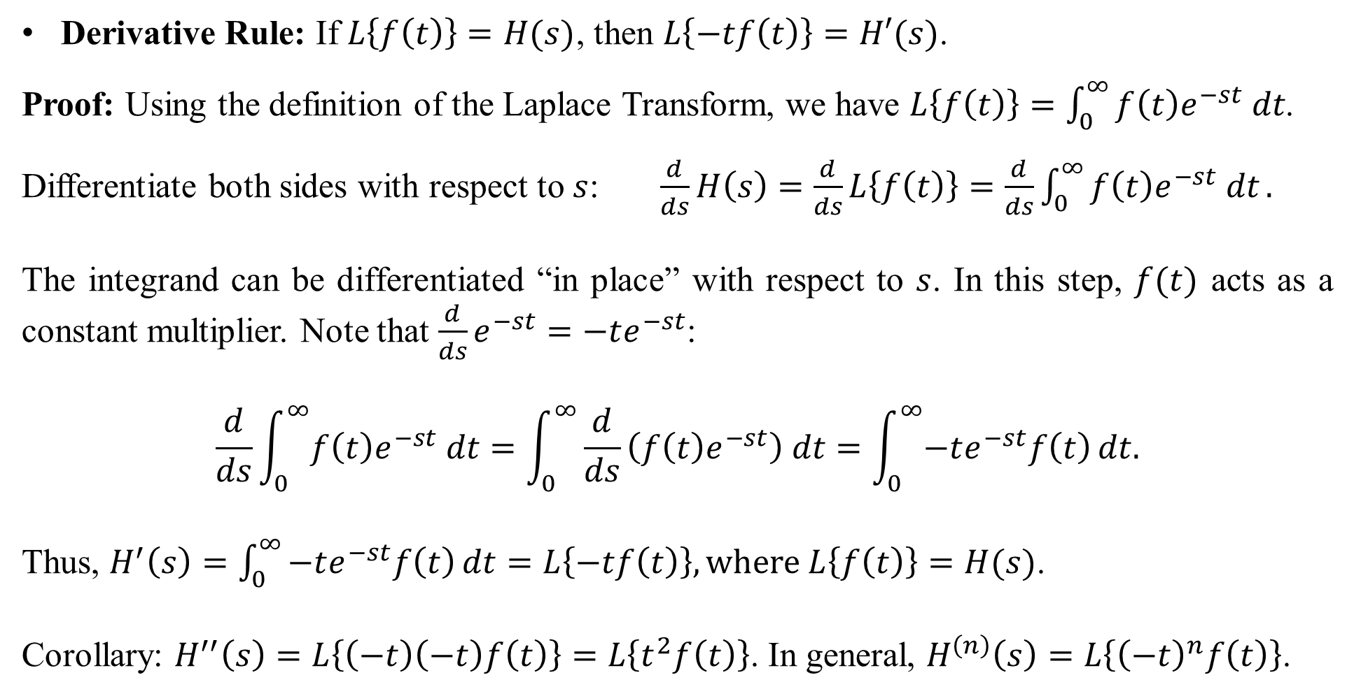
Derivative Rule: If $L\left\{f\left(t\right)\right\}=H(s)$, then $L\left\{−tf\left(t\right)\right\}=H′(s)$.
Proof: Using the definition of the Laplace Transform, we have $L\left\{f\left(t\right)\right\}=\int_{0}^{∞}{f\left(t\right)e^{−st} dt}$.
Differentiate both sides with respect to $s$: $\frac{d}{ds}H\left(s\right)=\frac{d}{ds}L\left\{f\left(t\right)\right\}=\frac{d}{ds}\int_{0}^{∞}{f\left(t\right)e^{−st} dt}.$
The integrand can be differentiated “in place” with respect to $s$. In this step, $f(t)$ acts as a constant multiplier. Note that $\frac{d}{ds}e^{−st}=−te^{−st}$:
$$\frac{d}{ds}\int_{0}^{∞}{f\left(t\right)e^{−st} dt}=\int_{0}^{∞}{\frac{d}{ds}\left(f\left(t\right)e^{−st}\right) dt}=\int_{0}^{∞}{−te^{−st}f\left(t\right)}dt.$$
Thus, $H^{′}\left(s\right)=\int_{0}^{∞}{−te^{−st}f\left(t\right)}dt=L\left\{−tf\left(t\right)\right\}, where L\left\{f\left(t\right)\right\}=H(s)$.
Corollary: $H^{′′}\left(s\right)=L\left\{\left(−t\right)\left(−t\right)f\left(t\right)\right\}=L\left\{t^{2}f\left(t\right)\right\}$. In general, $H^{\left(n\right)}\left(s\right)=L\left\{{\left(−t\right)}^{n}f\left(t\right)\right\}$.

Slide 3
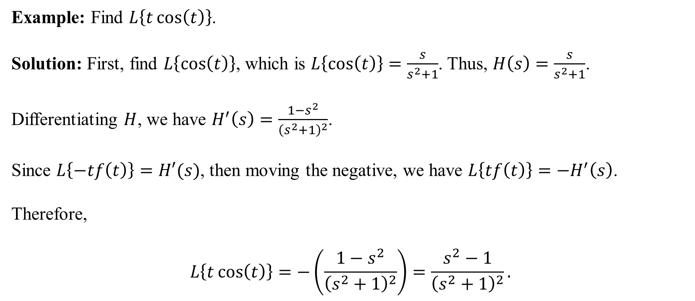
Example: Find $L\left\{t\cos\left(t\right)\right\}$.
Solution: First, find $L\left\{\cos\left(t\right)\right\}$, which is $L\left\{\cos\left(t\right)\right\}=\frac{s}{s^{2}+1}$. Thus, $H\left(s\right)=\frac{s}{s^{2}+1}$.
Differentiating $H$, we have $H^{′}\left(s\right)=\frac{1−s^{2}}{{\left(s^{2}+1\right)}^{2}}$.
Since $L\left\{−tf\left(t\right)\right\}=H′(s)$, then moving the negative, we have $L\left\{tf\left(t\right)\right\}=−H^{′}\left(s\right)$.
Therefore,
$$L\left\{t\cos\left(t\right)\right\}=−\left(\frac{1−s^{2}}{{\left(s^{2}+1\right)}^{2}}\right)=\frac{s^{2}−1}{{\left(s^{2}+1\right)}^{2}}.$$

Slide 4
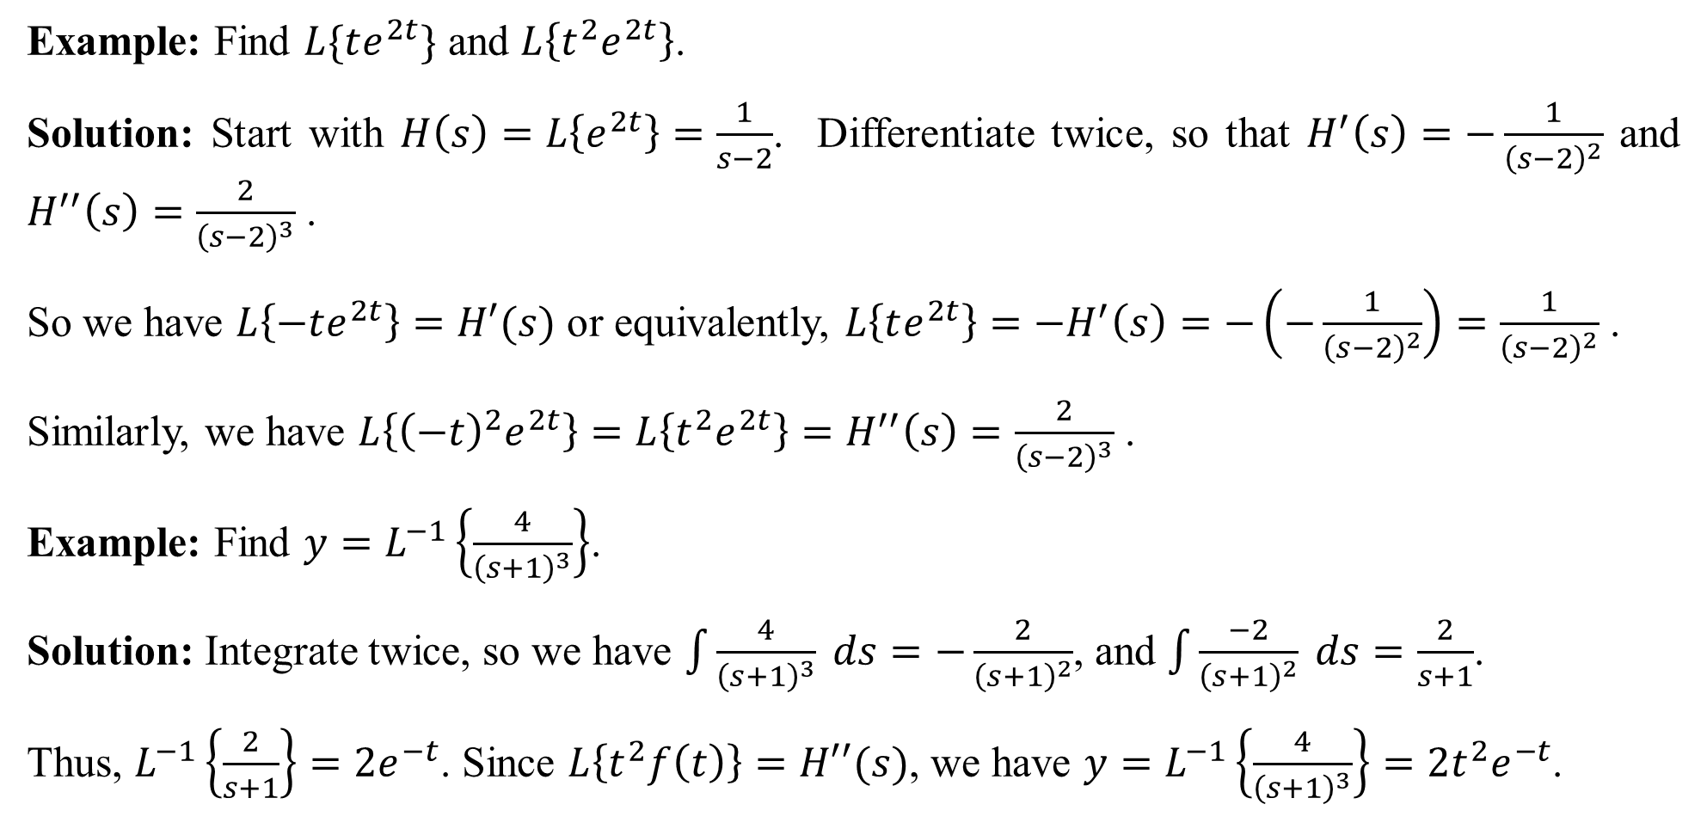
Example: Find $L\{te^{2t}\}$ and $L\left\{t^{2}e^{2t}\right\}$.
Solution: Start with $H\left(s\right)=L\left\{e^{2t}\right\}=\frac{1}{s−2}$. Differentiate twice, so that $H^{′}\left(s\right)=−\frac{1}{{\left(s−2\right)}^{2}}$ and $H^{′′}\left(s\right)=\frac{2}{{\left(s−2\right)}^{3}}$ .
So we have $L\left\{−te^{2t}\right\}=H′(s)$ or equivalently, $L\left\{te^{2t}\right\}=−H^{′}\left(s\right)=−\left(−\frac{1}{{\left(s−2\right)}^{2}}\right)=\frac{1}{{\left(s−2\right)}^{2}}$ .
Similarly, we have $L\left\{{\left(−t\right)}^{2}e^{2t}\right\}=L\left\{t^{2}e^{2t}\right\}=H^{′′}\left(s\right)=\frac{2}{{\left(s−2\right)}^{3}}$ .
Example: Find $y=L^{−1}\left\{\frac{4}{{\left(s+1\right)}^{3}}\right\}$.
Solution: Integrate twice, so we have $\int{\frac{4}{{\left(s+1\right)}^{3}} ds}=−\frac{2}{{\left(s+1\right)}^{2}}$, and $\int{\frac{−2}{{\left(s+1\right)}^{2}} ds}=\frac{2}{s+1}$.
Thus, $L^{−1}\left\{\frac{2}{s+1}\right\}=2e^{−t}$. Since $L\left\{t^{2}f\left(t\right)\right\}=H′′(s)$, we have $y=L^{−1}\left\{\frac{4}{{\left(s+1\right)}^{3}}\right\}=2t^{2}e^{−t}$.

Slide 5
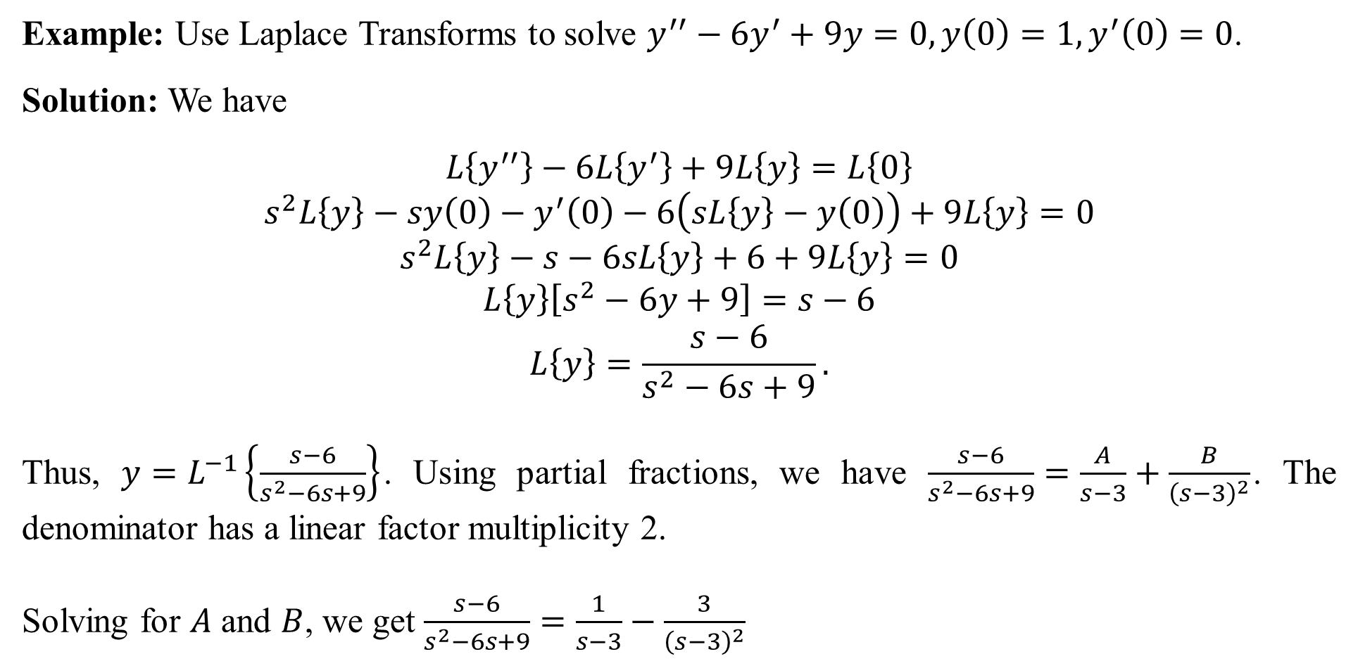
Example: Use Laplace Transforms to solve $y^{′′}−6y^{′}+9y=0, y\left(0\right)=1, y^{′}\left(0\right)=0$.
Solution: We have
$$L\left\{y^{′′}\right\}−6L\left\{y^{′}\right\}+9L\left\{y\right\}=L\left\{0\right\}$$
$$s^{2}L\left\{y\right\}−sy\left(0\right)−y^{′}\left(0\right)−6\left(sL\left\{y\right\}−y\left(0\right)\right)+9L\left\{y\right\}=0$$
$$s^{2}L\left\{y\right\}−s−6sL\left\{y\right\}+6+9L\left\{y\right\}=0$$
$$L\left\{y\right\}\left[s^{2}−6y+9\right]=s−6$$
$$L\left\{y\right\}=\frac{s−6}{s^{2}−6s+9}.$$
Thus, $y=L^{−1}\left\{\frac{s−6}{s^{2}−6s+9}\right\}$. Using partial fractions, we have $\frac{s−6}{s^{2}−6s+9}=\frac{A}{s−3}+\frac{B}{{\left(s−3\right)}^{2}}$. The denominator has a linear factor multiplicity 2.
Solving for $A$ and $B$, we get $\frac{s−6}{s^{2}−6s+9}=\frac{1}{s−3}−\frac{3}{{\left(s−3\right)}^{2}}$

Slide 6
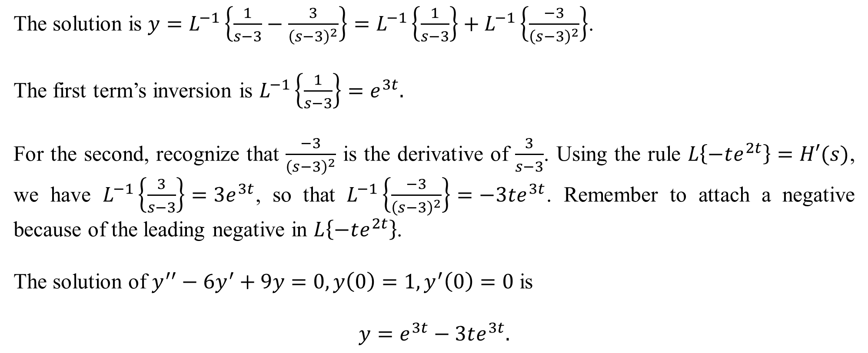
The solution is $y=L^{−1}\left\{\frac{1}{s−3}−\frac{3}{{\left(s−3\right)}^{2}}\right\}=L^{−1}\left\{\frac{1}{s−3}\right\}+L^{−1}\left\{\frac{−3}{{\left(s−3\right)}^{2}}\right\}$.
The first term’s inversion is $L^{−1}\left\{\frac{1}{s−3}\right\}=e^{3t}.$
For the second, recognize that $\frac{−3}{{\left(s−3\right)}^{2}}$ is the derivative of $\frac{3}{s−3}$. Using the rule $L\left\{−te^{2t}\right\}=H′(s)$, we have $L^{−1}\left\{\frac{3}{s−3}\right\}=3e^{3t}$, so that $L^{−1}\left\{\frac{−3}{{\left(s−3\right)}^{2}}\right\}=−3te^{3t}$. Remember to attach a negative because of the leading negative in $L\left\{−te^{2t}\right\}$.
The solution of $y^{′′}−6y^{′}+9y=0, y\left(0\right)=1, y^{′}\left(0\right)=0$ is
$$y=e^{3t}−3te^{3t}.$$

Slide 7
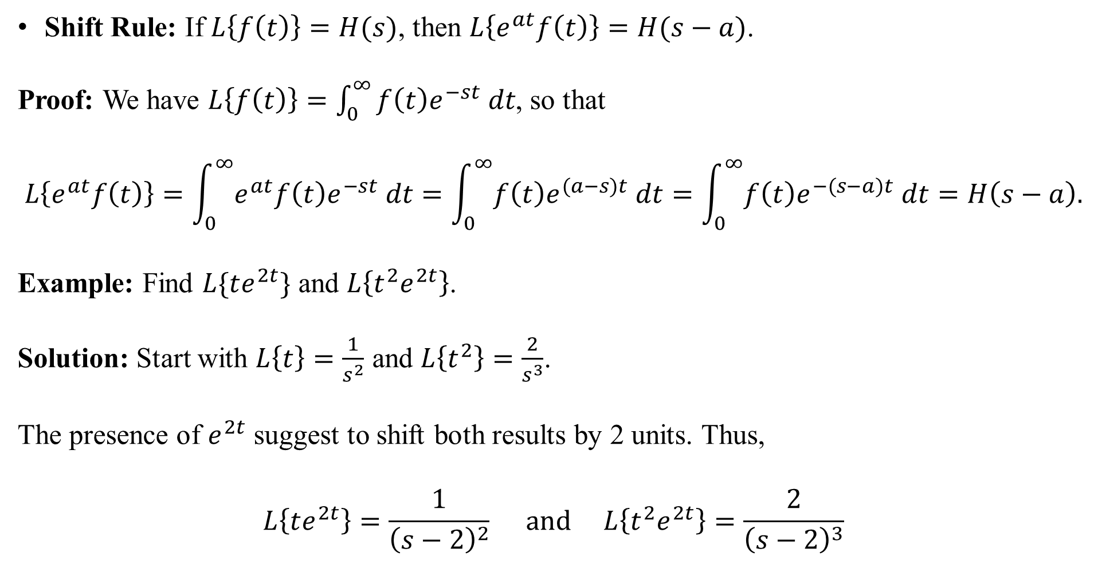
Shift Rule: If $L\left\{f\left(t\right)\right\}=H(s)$, then $L\left\{e^{at}f\left(t\right)\right\}=H(s−a)$.
Proof: We have $L\left\{f\left(t\right)\right\}=\int_{0}^{∞}{f\left(t\right)e^{−st} dt}$, so that
$$L\left\{e^{at}f\left(t\right)\right\}=\int_{0}^{∞}{e^{at}f\left(t\right)e^{−st} dt}=\int_{0}^{∞}{f\left(t\right)e^{(a−s)t} dt}=\int_{0}^{∞}{f\left(t\right)e^{−(s−a)t} dt}=H\left(s−a\right).$$
Example: Find $L\{te^{2t}\}$ and $L\left\{t^{2}e^{2t}\right\}$.
Solution: Start with $L\left\{t\right\}=\frac{1}{s^{2}}$ and $L\left\{t^{2}\right\}=\frac{2}{s^{3}}$.
The presence of $e^{2t}$ suggest to shift both results by 2 units. Thus,
$$L\left\{te^{2t}\right\}=\frac{1}{{\left(s−2\right)}^{2}} and L\left\{t^{2}e^{2t}\right\}=\frac{2}{{\left(s−2\right)}^{3}}$$

Slide 8
Example: Find $L\left\{e^{−3t}\cos\left(5t\right)\right\}$.
Solution: We have $L\left\{\cos\left(5t\right)\right\}=\frac{s}{s^{2}+25}$. Now, shift the result by $−3$ units:
$$L\left\{e^{−3t}\cos\left(5t\right)\right\}=\frac{s−(−3)}{{\left(s−\left(−3\right)\right)}^{2}+25}=\frac{s+3}{{\left(s+3\right)}^{2}+25}.$$
Example: Find $L\left\{te^{3t}\cos\left(5t\right)\right\}$.
Solution: Start with $H\left(s\right)=L\left\{\cos\left(5t\right)\right\}=\frac{s}{s^{2}+25}$. Differentiate $H$, so we get $H^{′}\left(s\right)=\frac{25−s^{2}}{{\left(s^{2}+25\right)}^{2}}$.
Since $L\left\{−tf\left(t\right)\right\}=H′(s)$, we have $L\left\{t\cos\left(t\right)\right\}=\frac{s^{2}−25}{{\left(s^{2}+25\right)}^{2}}$. (The negative was moved to the right side and distributed into the numerator).
Then, the $e^{3t}$ suggests to shift the result 3 units: $L\left\{te^{3t}\cos\left(5t\right)\right\}=\frac{{(s−3)}^{2}−25}{{\left(({s−3)}^{2}+25\right)}^{2}}=\frac{s^{2}−6s−16}{{\left(s^{2}−6s+34\right)}^{2}}$.

Slide 9
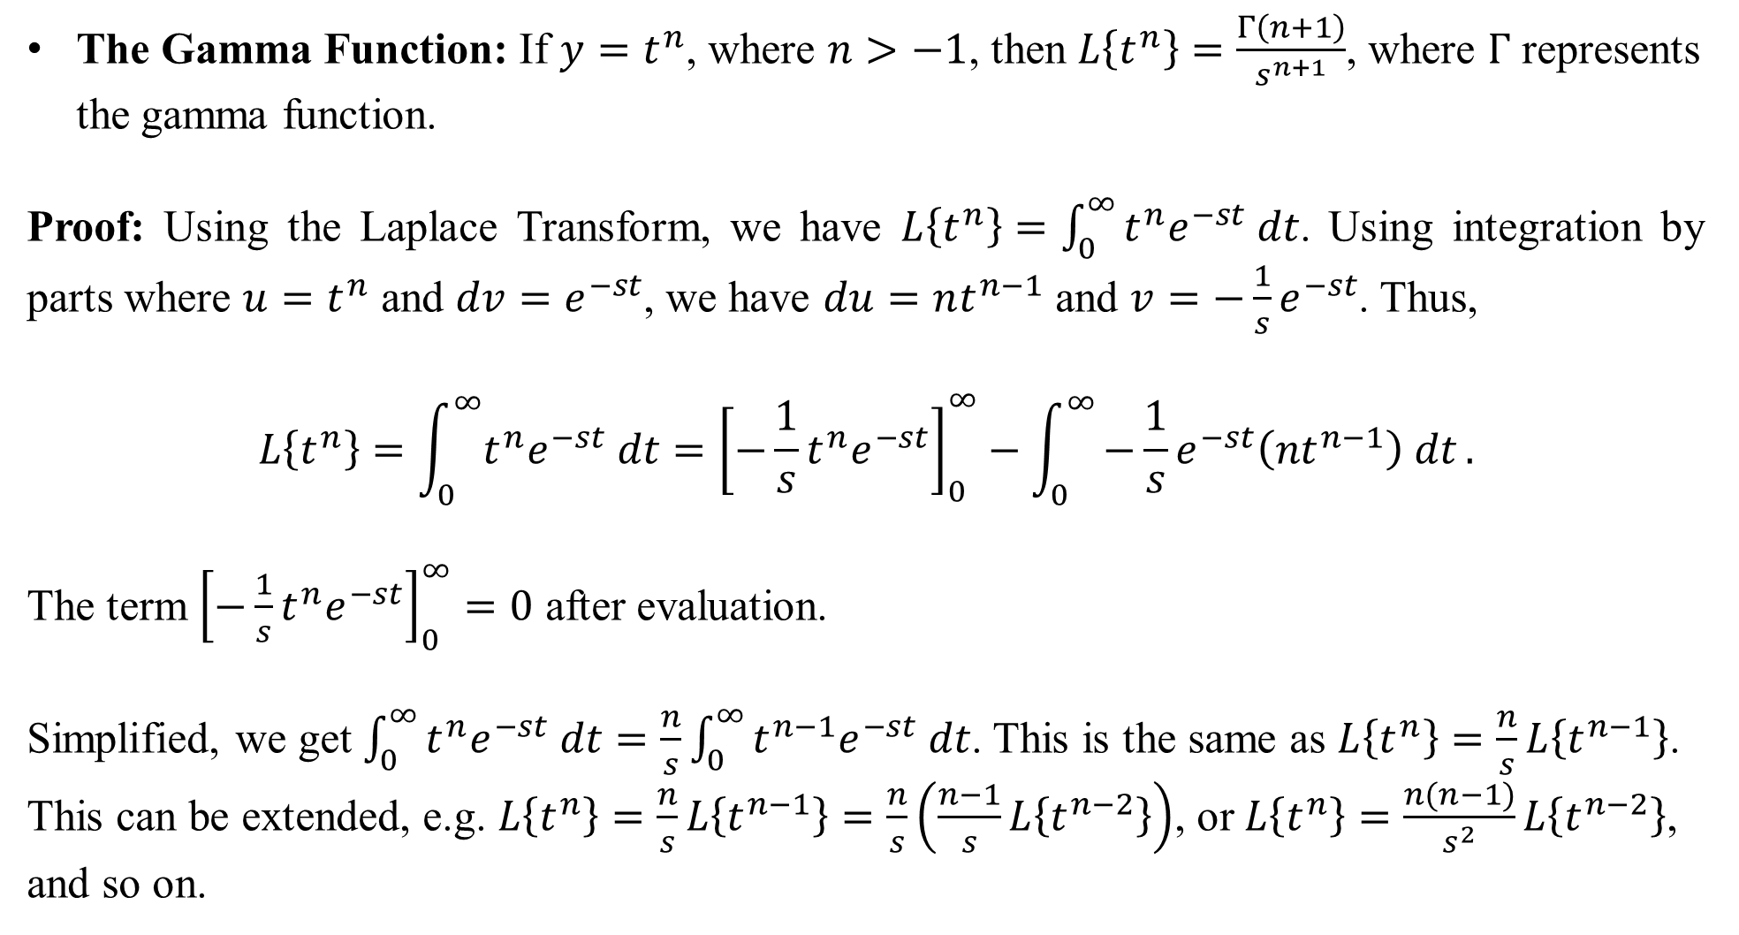
The Gamma Function: If $y=t^{n}$, where $n>−1$, then $L\left\{t^{n}\right\}=\frac{Γ\left(n+1\right)}{s^{n+1}}$, where $Γ$ represents the gamma function.
Proof: Using the Laplace Transform, we have $L\left\{t^{n}\right\}=\int_{0}^{∞}{t^{n}e^{−st} dt}$. Using integration by parts where $u=t^{n}$ and $dv=e^{−st}$, we have $du=nt^{n−1}$ and $v=−\frac{1}{s}e^{−st}$. Thus,
$$L\left\{t^{n}\right\}=\int_{0}^{∞}{t^{n}e^{−st} dt}={\left[−\frac{1}{s}t^{n}e^{−st}\right]}_{0}^{∞}−\int_{0}^{∞}{−\frac{1}{s}e^{−st}\left(nt^{n−1}\right) dt}.$$
The term ${\left[−\frac{1}{s}t^{n}e^{−st}\right]}_{0}^{∞}=0$ after evaluation.
Simplified, we get $\int_{0}^{∞}{t^{n}e^{−st} dt}=\frac{n}{s}\int_{0}^{∞}{t^{n−1}e^{−st} dt}$. This is the same as $L\left\{t^{n}\right\}=\frac{n}{s}L\left\{t^{n−1}\right\}$. This can be extended, e.g. $L\left\{t^{n}\right\}=\frac{n}{s}L\left\{t^{n−1}\right\}=\frac{n}{s}\left(\frac{n−1}{s}L\left\{t^{n−2}\right\}\right)$, or $L\left\{t^{n}\right\}=\frac{n(n−1)}{s^{2}}L\left\{t^{n−2}\right\}$, and so on.

Slide 10
From the last slide, we showed that $L\left\{t^{n}\right\}=\frac{n}{s}L\left\{t^{n−1}\right\}=\frac{n\left(n−1\right)}{s^{2}}L\left\{t^{n−2}\right\}$ and so on.
If n is an integer such that $n≥0$, then this formula is the same as $L\left\{t^{n}\right\}=\frac{n!}{s^{n+1}}$ (Try it for n = 3, for example).
If n is not an integer such that $n>−1$, then the numerator is given by the gamma function $Γ(n+1)$, where $Γ\left(n+1\right)=\int_{0}^{∞}{t^{n}e^{−t} dt}$. The gamma function has the property that when n is a non-negative integer, then $Γ\left(n+1\right)=n!$, but it “extends” the notion of factorial to include non-integers greater that –1. The integral $\int_{0}^{∞}{t^{n}e^{−t} dt}$ is usually evaluated using numerical methods (e.g. a calculator).
Example: Find $L\left\{\sqrt{t}\right\}$.
Solution: We have $L\left\{\sqrt{t}\right\}=L\left\{t^{1/2}\right\}=\frac{Γ\left(3/2\right)}{s^{1/2+1}}=\frac{Γ\left(3/2\right)}{s^{3/2}}≈\frac{0.88623}{s^{3/2}}$.
Using the relationship $Γ\left(n+1\right)=n!$, then $Γ\left(\frac{3}{2}\right)=\left(\frac{1}{2}\right)!$, which is found by evaluating $\int_{0}^{∞}{t^{1/2}e^{−t} dt}$. A calculator shows that this is about 0.88623. Using substitutions and integrating in polar coordinates, it can be shown that $\left(\frac{1}{2}\right)!=\int_{0}^{∞}{t^{1/2}e^{−t} dt}=\frac{1}{2}\sqrt{π}$. Try it on your calculator!

Slide 11
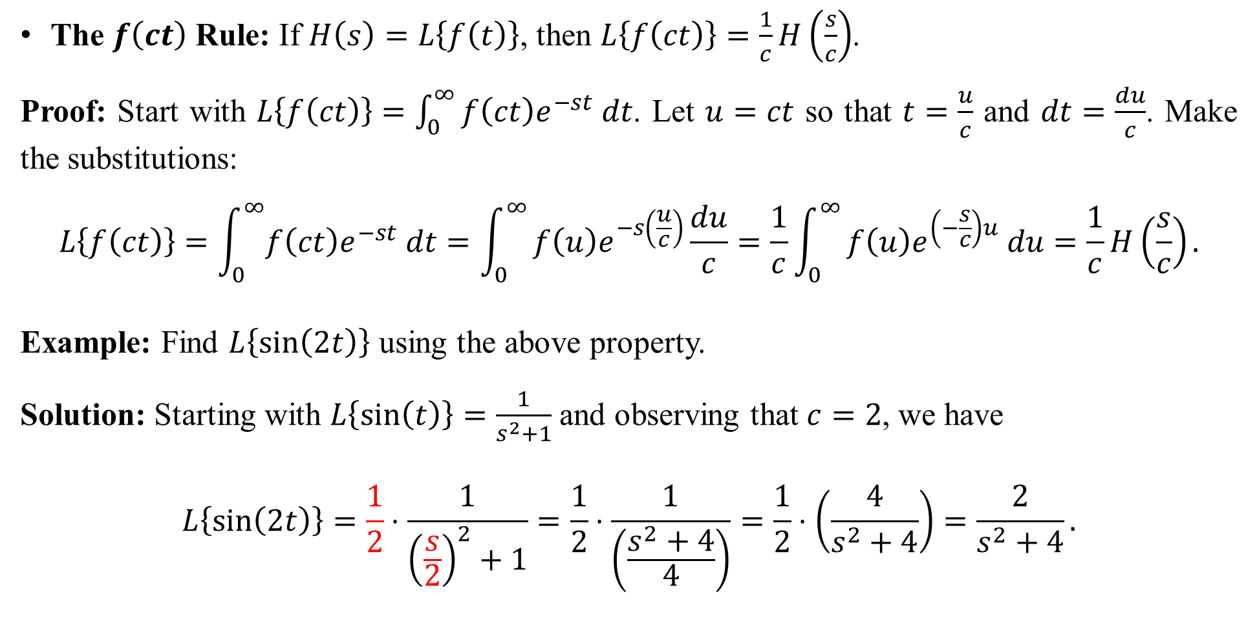
The $f\left(ct\right)$ Rule: If $H\left(s\right)=L\left\{f\left(t\right)\right\}$, then $L\left\{f\left(ct\right)\right\}=\frac{1}{c}H\left(\frac{s}{c}\right)$.
Proof: Start with $L\left\{f\left(ct\right)\right\}=\int_{0}^{∞}{f\left(ct\right)e^{−st} dt}$. Let $u=ct$ so that $t=\frac{u}{c}$ and $dt=\frac{du}{c}$. Make the substitutions:
$$L\left\{f\left(ct\right)\right\}=\int_{0}^{∞}{f\left(ct\right)e^{−st} dt}=\int_{0}^{∞}{f\left(u\right)e^{−s\left(\frac{u}{c}\right)}\frac{du}{c}}=\frac{1}{c}\int_{0}^{∞}{f\left(u\right)e^{\left(−\frac{s}{c}\right)u} du}=\frac{1}{c}H\left(\frac{s}{c}\right).$$
Example: Find $L\left\{\sin\left(2t\right)\right\}$ using the above property.
Solution: Starting with $L\left\{\sin\left(t\right)\right\}=\frac{1}{s^{2}+1}$ and observing that $c=2$, we have
$$L\left\{\sin\left(2t\right)\right\}=\frac{1}{2}⋅\frac{1}{{\left(\frac{s}{2}\right)}^{2}+1}=\frac{1}{2}⋅\frac{1}{\left(\frac{s^{2}+4}{4}\right)}=\frac{1}{2}⋅\left(\frac{4}{s^{2}+4}\right)=\frac{2}{s^{2}+4}.$$

