Slide 1
Solving IVPs using Laplace Transforms
MAT 275

Slide 2
Advantages of using Laplace Transforms to Solve IVPs
It converts an IVP into an algebraic process in which the solution of the equation is the solution of the IVP.
It handles initial conditions up front, not at the end of the process.
It is “algorithmic” in that it follows a set process.
It handles non-homogeneous forcing functions, and is especially useful when the forcing function is discontinuous or an impulse.
It is cool.

Slide 3
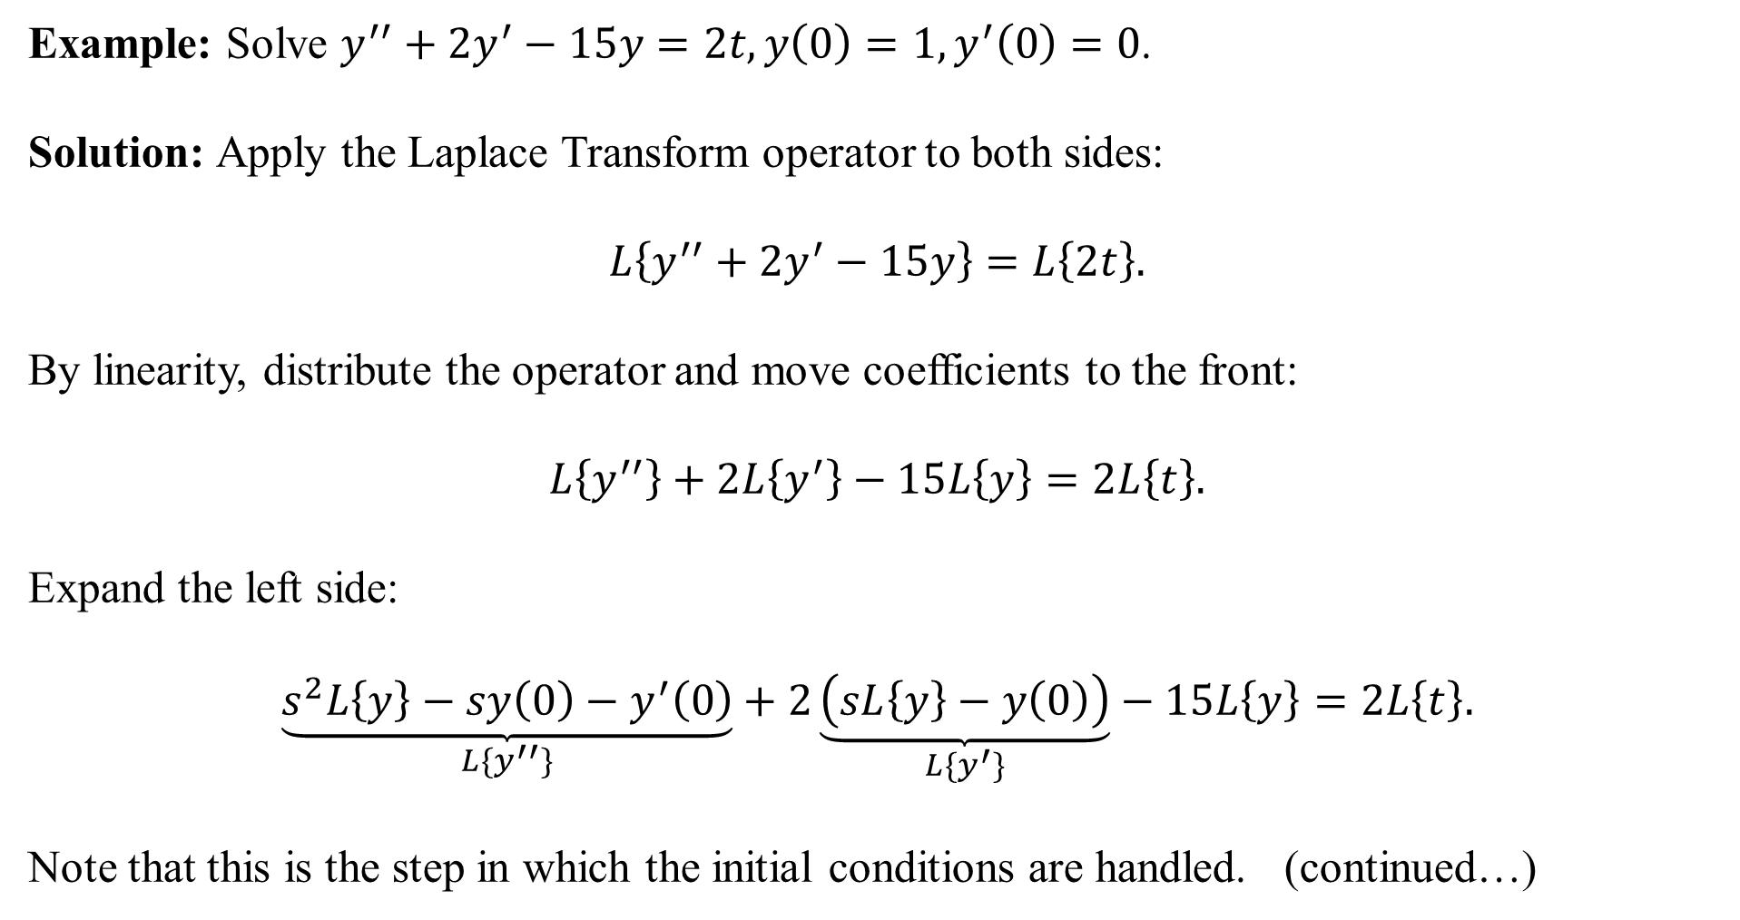
Example: Solve $y^{′′}+2y^{′}−15y=2t, y\left(0\right)=1, y^{′}\left(0\right)=0$.
Solution: Apply the Laplace Transform operator to both sides:
$$L\left\{y^{′′}+2y^{′}−15y\right\}=L\left\{2t\right\}.$$
By linearity, distribute the operator and move coefficients to the front:
$$L\left\{y^{′′}\right\}+2L\left\{y^{′}\right\}−15L\left\{y\right\}=2L\left\{t\right\}.$$
Expand the left side:
$$\underset{L\{y^{′′}\}}{\underbrace{s^{2}L\left\{y\right\}−sy\left(0\right)−y^{′}\left(0\right)}}+2\underset{L\{y^{′}\}}{\underbrace{\left(sL\left\{y\right\}−y\left(0\right)\right)}}−15L\left\{y\right\}=2L\left\{t\right\}.$$
Note that this is the step in which the initial conditions are handled. (continued…)

Slide 4
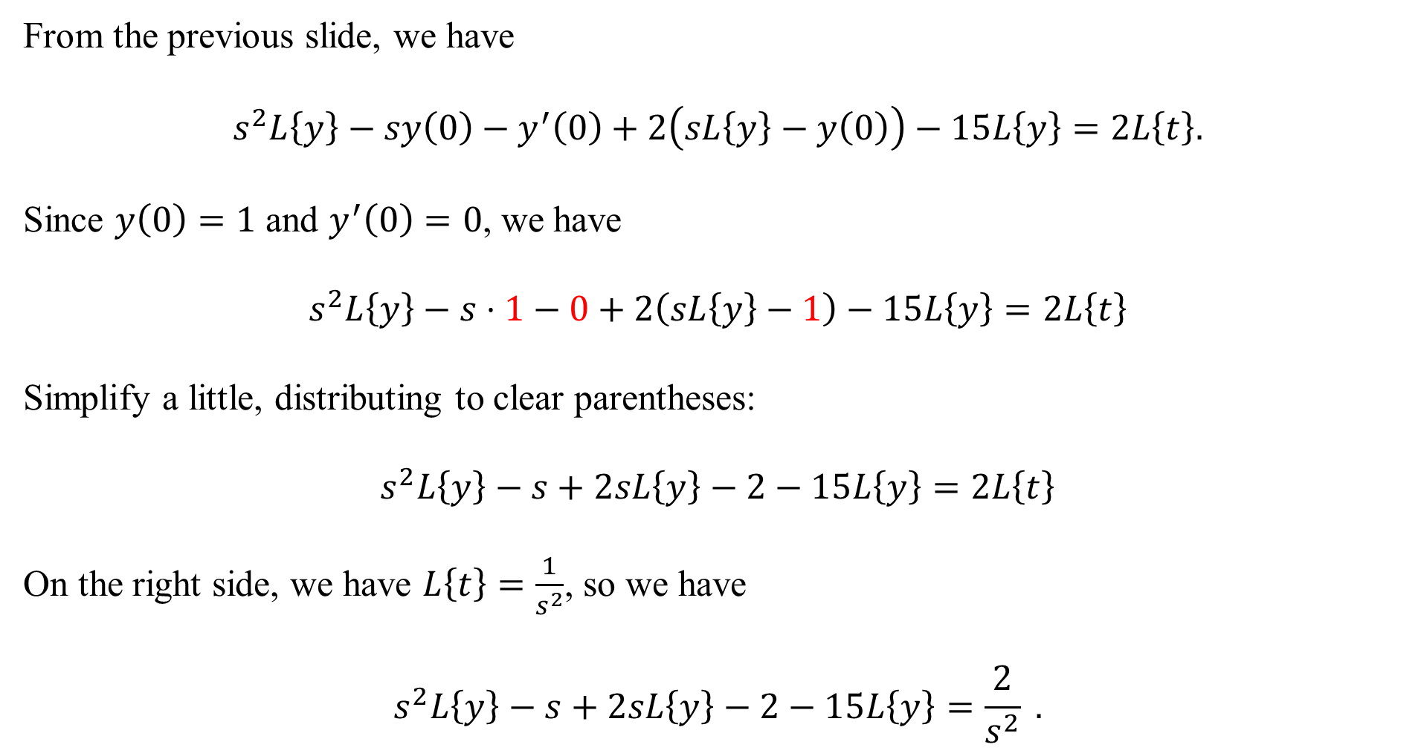
From the previous slide, we have
$$s^{2}L\left\{y\right\}−sy\left(0\right)−y^{′}\left(0\right)+2\left(sL\left\{y\right\}−y\left(0\right)\right)−15L\left\{y\right\}=2L\left\{t\right\}.$$
Since $y\left(0\right)=1$ and $y^{′}\left(0\right)=0$, we have
$$s^{2}L\left\{y\right\}−s⋅1−0+2\left(sL\left\{y\right\}−1\right)−15L\left\{y\right\}=2L\left\{t\right\}$$
Simplify a little, distributing to clear parentheses:
$$s^{2}L\left\{y\right\}−s+2sL\left\{y\right\}−2−15L\left\{y\right\}=2L\left\{t\right\}$$
On the right side, we have $L\left\{t\right\}=\frac{1}{s^{2}}$, so we have
$$s^{2}L\left\{y\right\}−s+2sL\left\{y\right\}−2−15L\left\{y\right\}=\frac{2}{s^{2}} .$$

Slide 5
From the last slide, we have $s^{2}L\left\{y\right\}−s+2sL\left\{y\right\}−2−15L\left\{y\right\}=\frac{2}{s^{2}} .$
Now we start to isolate $L\{y\}$:
$$L\left\{y\right\}\left(s^{2}+2s−15\right)=\frac{2}{s^{2}}+s+2.$$
Get a common denominator on the right side:
$$L\left\{y\right\}\left(s^{2}+2s−15\right)=\frac{s^{3}+2s^{2}+2}{s^{2}} .$$
Divide, and we have isolated $L\{y\}$:
$$L\left\{y\right\}=\frac{s^{3}+2s^{2}+2}{s^{2}\left(s^{2}+2s−15\right)} .$$

Slide 6
From the last slide, we have $L\left\{y\right\}=\frac{s^{3}+2s^{2}+2}{s^{2}\left(s^{2}+2s−15\right)}$ .
The solution to the differential equation is found by inverting the right side. In other words,
$$y=L^{−1}\left\{\frac{s^{3}+2s^{2}+2}{s^{2}\left(s^{2}+2s−15\right)}\right\} .$$
We need to “break apart” the big expression into smaller summands. The denominator factors:
$$\frac{s^{3}+2s^{2}+2}{s^{2}\left(s^{2}+2s−15\right)}=\frac{s^{3}+2s^{2}+2}{s^{2}(s+5)(s−3)} .$$
We’ll use partial fractions, starting next slide…

Slide 7
We need to decompose $\frac{s^{3}+2s^{2}+2}{s^{2}(s+5)(s−3)}$ using partial fractions.
The factor $s^{2}$ is a linear factor of multiplicity 2 so it results in two fractional summands, while the factors $(s+5)$ and $(s−3)$ are each multiplicity 1, so they result in one summand each:
$$\frac{s^{3}+2s^{2}+2}{s^{2}(s+5)(s−3)}=\frac{A}{s}+\frac{B}{s^{2}}+\frac{C}{s+5}+\frac{D}{s−3} .$$
Now get a common denominator and recompose:
$$\frac{A}{s}+\frac{B}{s^{2}}+\frac{C}{s+5}+\frac{D}{s−3}=\frac{As\left(s+5\right)\left(s−3\right)+B\left(s+5\right)\left(s−3\right)+Cs^{2}\left(s−3\right)+Ds^{2}(s+5)}{s^{2}(s+5)(s−3)}$$
Then equate numerators:
$$s^{3}+2s^{2}+2=As\left(s+5\right)\left(s−3\right)+B\left(s+5\right)\left(s−3\right)+Cs^{2}\left(s−3\right)+Ds^{2}(s+5)$$

Slide 8
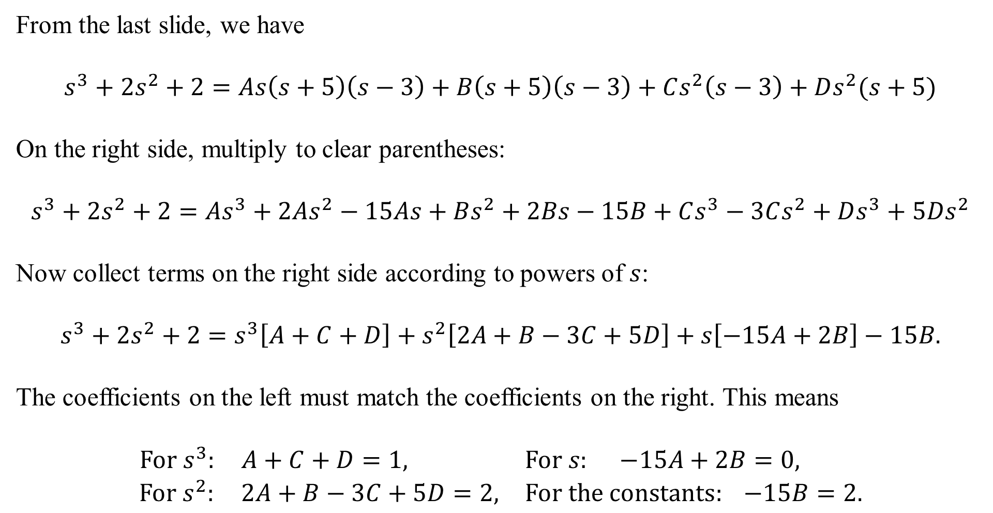
From the last slide, we have
$$s^{3}+2s^{2}+2=As\left(s+5\right)\left(s−3\right)+B\left(s+5\right)\left(s−3\right)+Cs^{2}\left(s−3\right)+Ds^{2}(s+5)$$
On the right side, multiply to clear parentheses:
$$s^{3}+2s^{2}+2=As^{3}+2As^{2}−15As+Bs^{2}+2Bs−15B+Cs^{3}−3Cs^{2}+Ds^{3}+5Ds^{2}$$
Now collect terms on the right side according to powers of $s$:
$$s^{3}+2s^{2}+2=s^{3}\left[A+C+D\right]+s^{2}\left[2A+B−3C+5D\right]+s\left[−15A+2B\right]−15B.$$
The coefficients on the left must match the coefficients on the right. This means
$$\begin{matrix}For s^{3}: A+C+D=1, & For s: −15A+2B=0, \\ For s^{2}: 2A+B−3C+5D=2, & For the constants: −15B=2.\end{matrix}$$

Slide 9
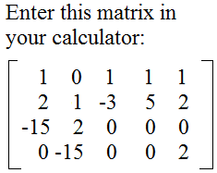
The four equations from the last slide form a system: $\begin{matrix}\begin{matrix}A+C+D=1 \\ 2A+B−3C+5D=2 \end{matrix} \\ \begin{matrix}−15A+2B=0 \\ −15B=2 \end{matrix}\end{matrix}$
Zero-filling, we have $\begin{matrix}\begin{matrix}A+0B+C+D=1 \\ 2A+B−3C+5D=2 \end{matrix} \\ \begin{matrix}−15A+2B+0C+0D=0 \\ 0A−15B+0C+0D=2 \end{matrix}\end{matrix}$
Using the RREF feature on a calculator, we find that
$$A=−\frac{4}{225}, B=−\frac{2}{15}, C=\frac{73}{200}, D=\frac{47}{72} .$$
Believe it or not, we’re almost done!

Slide 10
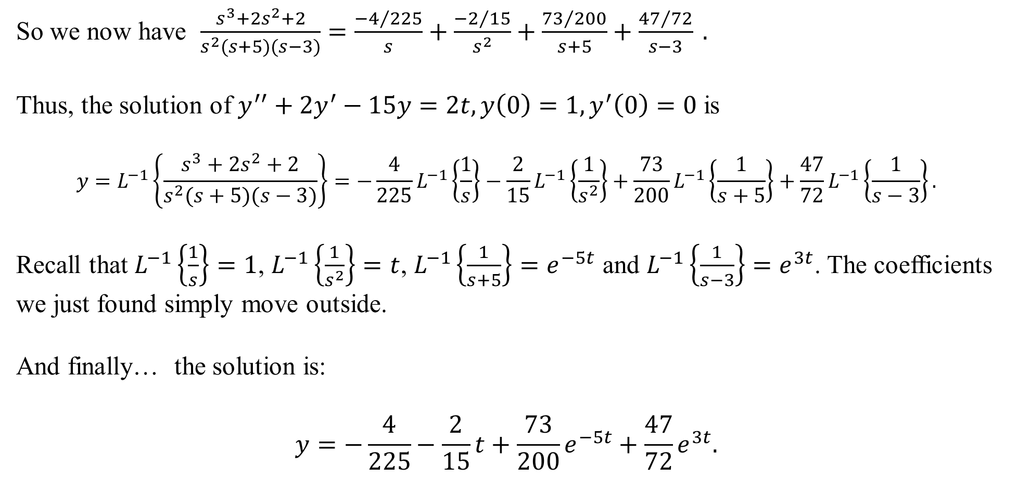
So we now have $\frac{s^{3}+2s^{2}+2}{s^{2}(s+5)(s−3)}=\frac{{−4}/{225}}{s}+\frac{{−2}/{15}}{s^{2}}+\frac{{73}/{200}}{s+5}+\frac{{47}/{72}}{s−3} .$
Thus, the solution of $y^{′′}+2y^{′}−15y=2t, y\left(0\right)=1, y^{′}\left(0\right)=0$ is
$$y=L^{−1}\left\{\frac{s^{3}+2s^{2}+2}{s^{2}(s+5)(s−3)}\right\}=−\frac{4}{225}L^{−1}\left\{\frac{1}{s}\right\}−\frac{2}{15}L^{−1}\left\{\frac{1}{s^{2}}\right\}+\frac{73}{200}L^{−1}\left\{\frac{1}{s+5}\right\}+\frac{47}{72}L^{−1}\left\{\frac{1}{s−3}\right\}.$$
Recall that $L^{−1}\left\{\frac{1}{s}\right\}=1$, $L^{−1}\left\{\frac{1}{s^{2}}\right\}=t$, $L^{−1}\left\{\frac{1}{s+5}\right\}=e^{−5t}$ and $L^{−1}\left\{\frac{1}{s−3}\right\}=e^{3t}$. The coefficients we just found simply move outside.
And finally… the solution is:
$$y=−\frac{4}{225}−\frac{2}{15}t+\frac{73}{200}e^{−5t}+\frac{47}{72}e^{3t}.$$

Slide 11
(In the previous example, every step was shown. In this example, some steps will be combined)
Example: Solve the IVP $y^{′′}+2y^{′}+10y=t^{2}, y\left(0\right)=1, y^{′}\left(0\right)=−2$.
Solution: Apply the Laplace Transform operator to both sides and simplify:
$$L\left\{y^{′′}+2y^{′}+10y\right\}=L\{t^{2}\}$$
$$L\left\{y^{′′}\right\}+2L\left\{y^{′}\right\}+10L\left\{y\right\}=L\{t^{2}\}$$
$$s^{2}L\left\{y\right\}−sy\left(0\right)−y^{′}\left(0\right)+2\left(sL\left\{y\right\}−y\left(0\right)\right)+10L\left\{y\right\}=\frac{2}{s^{3}}$$
$$s^{2}L\left\{y\right\}−s+2+2sL\left\{y\right\}−2+10L\left\{y\right\}=\frac{2}{s^{3}}$$
$$L\left\{y\right\}\left(s^{2}+2s+10\right)=\frac{s^{4}+2}{s^{3}} so that L\left\{y\right\}=\frac{s^{4}+2}{s^{3}\left(s^{2}+2s+10\right)} .$$

Slide 12
From the previous slide, we have $L\left\{y\right\}=\frac{s^{4}+2}{s^{3}\left(s^{2}+2s+10\right)}$ .
We need to find $y=L^{−1}\left\{\frac{s^{4}+2}{s^{3}\left(s^{2}+2s+10\right)}\right\}$. Using partial fractions, the expression $s^{3}$ is a linear factor $s$ with multiplicity 3, so it results in three partial fraction summands. The expression $s^{2}+2s+10$ is an irreducible quadratic. Thus, the partial fraction decomposition is
$$\frac{s^{4}+2}{s^{3}\left(s^{2}+2s+10\right)}=\frac{A}{s}+\frac{B}{s^{2}}+\frac{C}{s^{3}}+\frac{Ds+E}{s^{2}+2s+10} .$$
Now, recompose by getting a common denominator on the right side:
$$\frac{As^{2}\left(s^{2}+2s+10\right)+Bs\left(s^{2}+2s+10\right)+C\left(s^{2}+2s+10\right)+\left(Ds+E\right)s^{3}}{s^{3}(s^{2}+2s+10)}$$

Slide 13
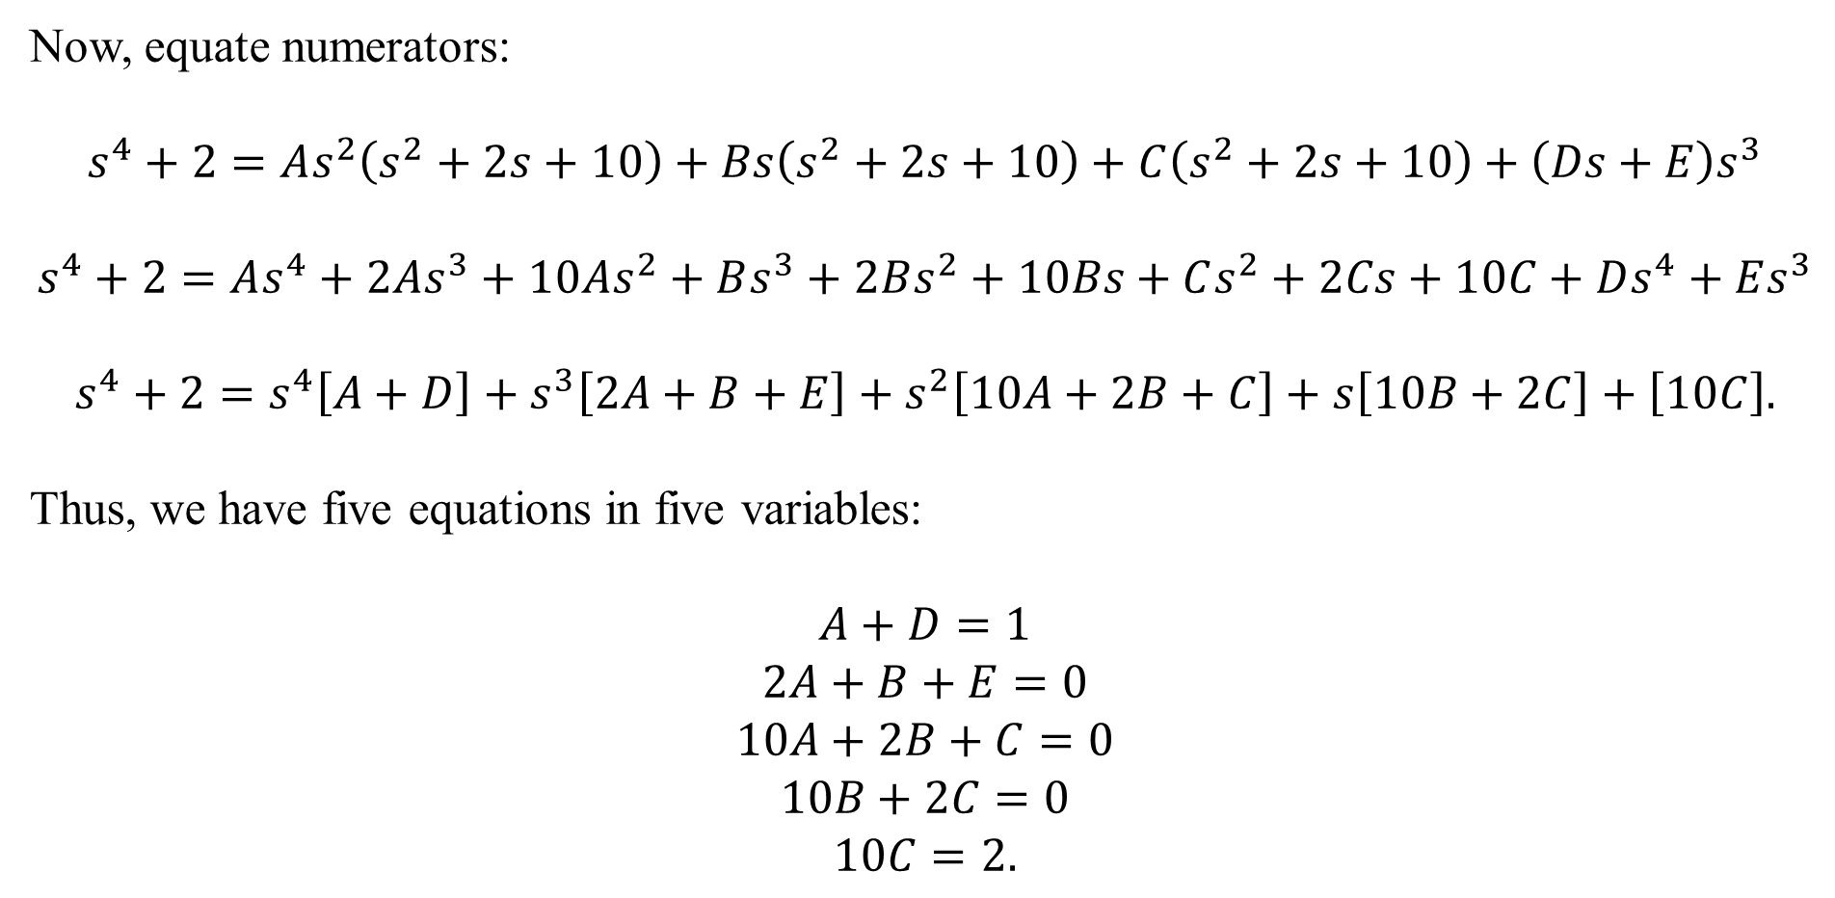
Now, equate numerators:
$$s^{4}+2=As^{2}\left(s^{2}+2s+10\right)+Bs\left(s^{2}+2s+10\right)+C\left(s^{2}+2s+10\right)+\left(Ds+E\right)s^{3}$$
$$s^{4}+2=As^{4}+2As^{3}+10As^{2}+Bs^{3}+2Bs^{2}+10Bs+Cs^{2}+2Cs+10C+Ds^{4}+Es^{3}$$
$$s^{4}+2=s^{4}\left[A+D\right]+s^{3}\left[2A+B+E\right]+s^{2}\left[10A+2B+C\right]+s\left[10B+2C\right]+\left[10C\right].$$
Thus, we have five equations in five variables:
$$A+D=1$$
$$2A+B+E=0$$
$$10A+2B+C=0$$
$$10B+2C=0$$
$$10C=2.$$

Slide 14
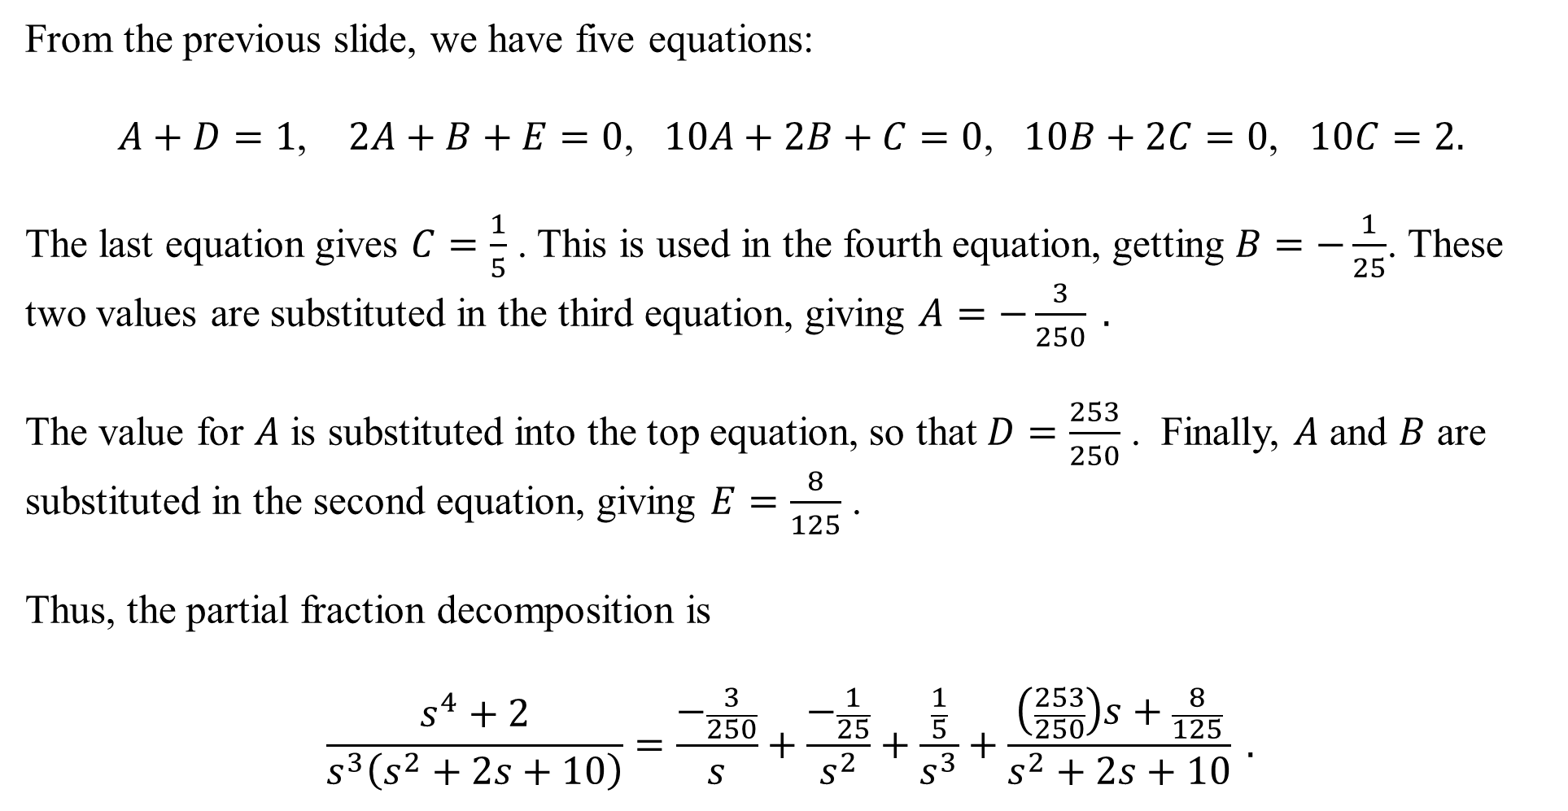
From the previous slide, we have five equations:
$A+D=1$, $2A+B+E=0$, $10A+2B+C=0$, $10B+2C=0$, $10C=2.$
The last equation gives $C=\frac{1}{5}$ . This is used in the fourth equation, getting $B=−\frac{1}{25}$. These two values are substituted in the third equation, giving $A=−\frac{3}{250} .$
The value for $A$ is substituted into the top equation, so that $D=\frac{253}{250}$ . Finally, $A$ and $B$ are substituted in the second equation, giving $E=\frac{8}{125}$ .
Thus, the partial fraction decomposition is
$$\frac{s^{4}+2}{s^{3}\left(s^{2}+2s+10\right)}=\frac{−\frac{3}{250}}{s}+\frac{−\frac{1}{25}}{s^{2}}+\frac{\frac{1}{5}}{s^{3}}+\frac{\left(\frac{253}{250}\right)s+\frac{8}{125}}{s^{2}+2s+10} .$$

Slide 15
We have $\frac{s^{4}+2}{s^{3}\left(s^{2}+2s+10\right)}=\frac{−\frac{3}{250}}{s}+\frac{−\frac{1}{25}}{s^{2}}+\frac{\frac{1}{5}}{s^{3}}+\frac{\left(\frac{253}{250}\right)s+\frac{8}{125}}{s^{2}+2s+10} .$
We’ll concentrate on the last term for now. Complete the square:
$$\frac{\left(\frac{253}{250}\right)s+\frac{8}{125}}{s^{2}+2s+10}=\frac{\left(\frac{253}{250}\right)s+\frac{8}{125}}{{\left(s+1\right)}^{2}+9} .$$
We intend to use the Laplace Transforms $L\left\{e^{at}\cos\left(bt\right)\right\}=\frac{s−a}{{\left(s−a\right)}^{2}+b^{2}}$ and $L\left\{e^{at}\sin\left(bt\right)\right\}=\frac{b}{{\left(s−a\right)}^{2}+b^{2}}$ . Thus, we “need” an $(s+1)$ in the numerator:
$$\frac{\frac{253}{250}s+\frac{8}{125}}{{\left(s+1\right)}^{2}+9}=\frac{\frac{253}{250} (s+1−1)+\frac{8}{125}}{{\left(s+1\right)}^{2}+9}=\frac{\frac{253}{250}\left(s+1\right)−\frac{253}{250}+\frac{8}{125}}{{\left(s+1\right)}^{2}+9}=\frac{\frac{253}{250}\left(s+1\right)−\frac{237}{250}}{{\left(s+1\right)}^{2}+9}$$

Slide 16
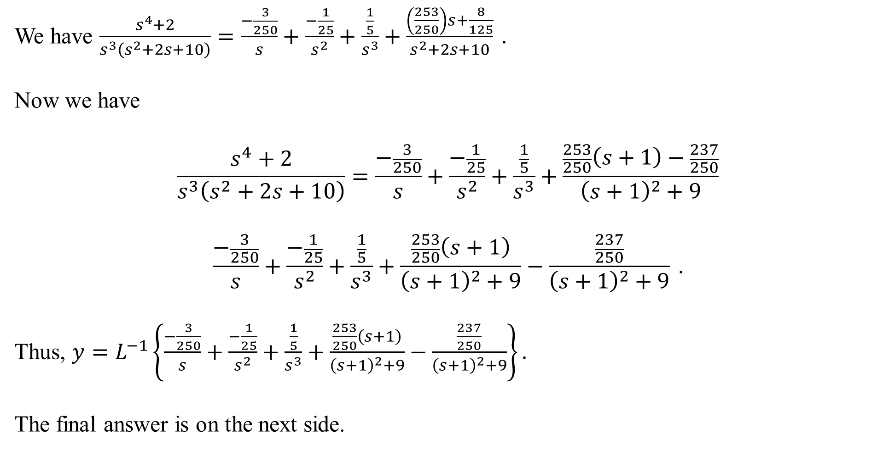
We have $\frac{s^{4}+2}{s^{3}\left(s^{2}+2s+10\right)}=\frac{−\frac{3}{250}}{s}+\frac{−\frac{1}{25}}{s^{2}}+\frac{\frac{1}{5}}{s^{3}}+\frac{\left(\frac{253}{250}\right)s+\frac{8}{125}}{s^{2}+2s+10} .$
Now we have
$$\frac{s^{4}+2}{s^{3}\left(s^{2}+2s+10\right)}=\frac{−\frac{3}{250}}{s}+\frac{−\frac{1}{25}}{s^{2}}+\frac{\frac{1}{5}}{s^{3}}+\frac{\frac{253}{250}\left(s+1\right)−\frac{237}{250}}{{\left(s+1\right)}^{2}+9}$$
$$\frac{−\frac{3}{250}}{s}+\frac{−\frac{1}{25}}{s^{2}}+\frac{\frac{1}{5}}{s^{3}}+\frac{\frac{253}{250}\left(s+1\right)}{{\left(s+1\right)}^{2}+9}−\frac{\frac{237}{250}}{{\left(s+1\right)}^{2}+9} .$$
Thus, $y=L^{−1}\left\{\frac{−\frac{3}{250}}{s}+\frac{−\frac{1}{25}}{s^{2}}+\frac{\frac{1}{5}}{s^{3}}+\frac{\frac{253}{250}\left(s+1\right)}{{\left(s+1\right)}^{2}+9}−\frac{\frac{237}{250}}{{\left(s+1\right)}^{2}+9}\right\}.$
The final answer is on the next side.

Slide 17
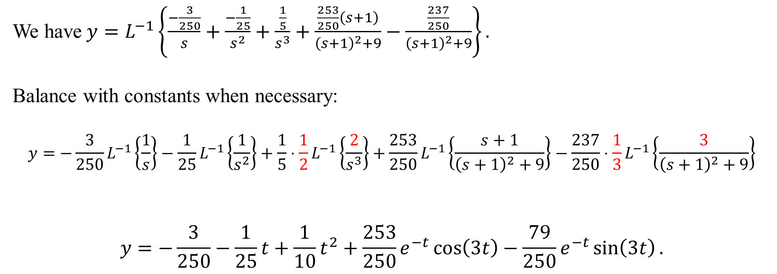
We have$y=L^{−1}\left\{\frac{−\frac{3}{250}}{s}+\frac{−\frac{1}{25}}{s^{2}}+\frac{\frac{1}{5}}{s^{3}}+\frac{\frac{253}{250}\left(s+1\right)}{{\left(s+1\right)}^{2}+9}−\frac{\frac{237}{250}}{{\left(s+1\right)}^{2}+9}\right\}.$
Balance with constants when necessary:
$$y=−\frac{3}{250}L^{−1}\left\{\frac{1}{s}\right\}−\frac{1}{25}L^{−1}\left\{\frac{1}{s^{2}}\right\}+\frac{1}{5}⋅\frac{1}{2}L^{−1}\left\{\frac{2}{s^{3}}\right\}+\frac{253}{250}L^{−1}\left\{\frac{s+1}{{\left(s+1\right)}^{2}+9}\right\}−\frac{237}{250}⋅\frac{1}{3}L^{−1}\left\{\frac{3}{{\left(s+1\right)}^{2}+9}\right\}$$
$$y=−\frac{3}{250}−\frac{1}{25}t+\frac{1}{10}t^{2}+\frac{253}{250}e^{−t}\cos\left(3t\right)−\frac{79}{250}e^{−t}\sin\left(3t\right).$$

