Slide 1
Using Laplace Transforms to Solve IVPs with Discontinuous Forcing Functions
MAT 275

Slide 2
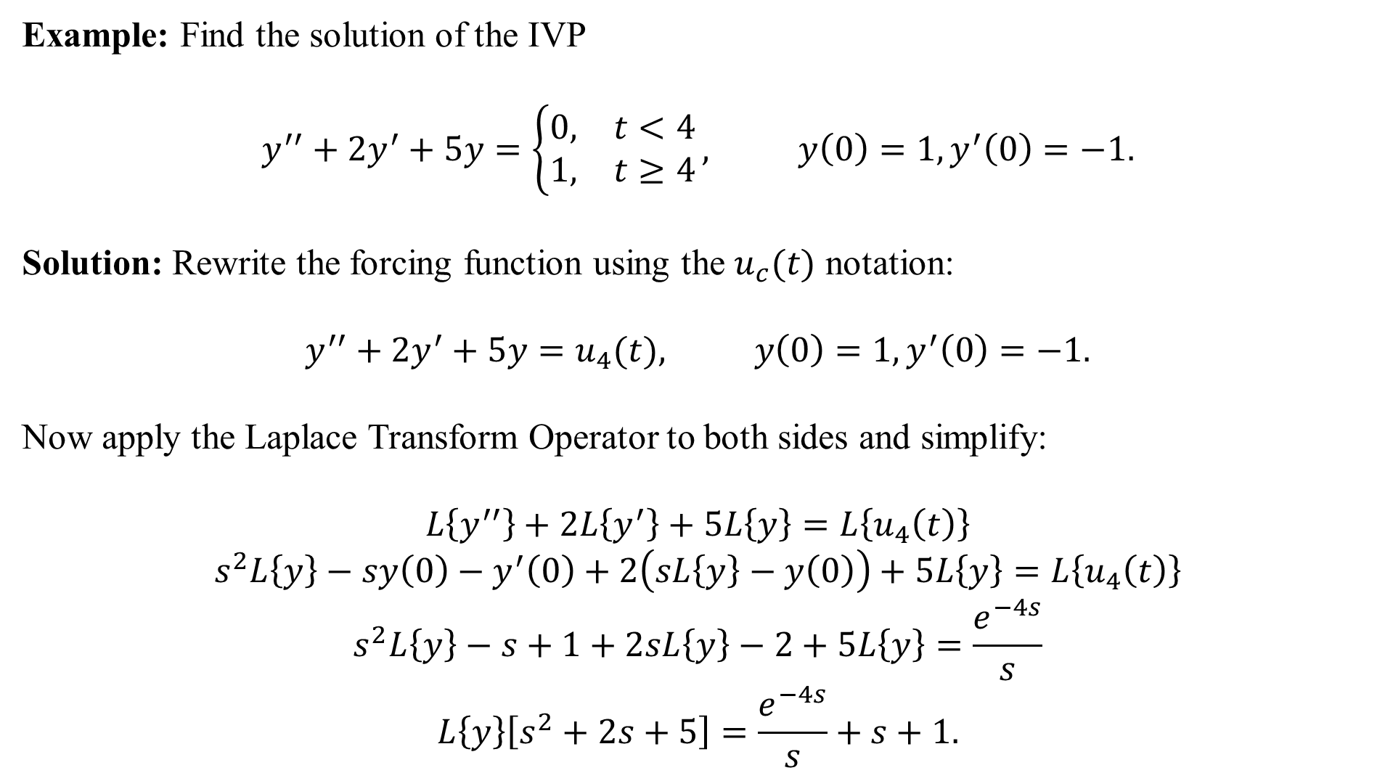
Example: Find the solution of the IVP
$$y^{′′}+2y^{′}+5y=\left\{\begin{matrix}0, & t<4 \\ 1, & t≥4\end{matrix}\right., y\left(0\right)=1, y^{′}\left(0\right)=−1.$$
Solution: Rewrite the forcing function using the $u_{c}(t)$ notation:
$$y^{′′}+2y^{′}+5y=u_{4}(t), y\left(0\right)=1, y^{′}\left(0\right)=−1.$$
Now apply the Laplace Transform Operator to both sides and simplify:
$$L\left\{y^{′′}\right\}+2L\left\{y^{′}\right\}+5L\left\{y\right\}=L\left\{u_{4}\left(t\right)\right\}$$
$$s^{2}L\left\{y\right\}−sy\left(0\right)−y^{′}\left(0\right)+2\left(sL\left\{y\right\}−y\left(0\right)\right)+5L\left\{y\right\}=L\left\{u_{4}\left(t\right)\right\}$$
$$s^{2}L\left\{y\right\}−s+1+2sL\left\{y\right\}−2+5L\left\{y\right\}=\frac{e^{−4s}}{s}$$
$$L\left\{y\right\}\left[s^{2}+2s+5\right]=\frac{e^{−4s}}{s}+s+1.$$

Slide 3
Now isolate $L\{y\}$:
$$L\left\{y\right\}=\frac{e^{−4s}}{s\left(s^{2}+2s+5\right)}+\frac{s+1}{s^{2}+2s+5}.$$
The solution is the inversion of the above expressions:
$$y=L^{−1}\left\{\frac{e^{−4s}}{s\left(s^{2}+2s+5\right)}+\frac{s+1}{s^{2}+2s+5}\right\}.$$
We’ll work on the term without the $e^{−4s}$ first. Note that the denominator $s^{2}+2s+5$ is an irreducible quadratic over the reals, so we complete the square:
$$\frac{s+1}{s^{2}+2s+5}=\frac{s+1}{{\left(s+1\right)}^{2}+4}.$$
This form exactly fits $L\left\{e^{at}\cos\left(bt\right)\right\}=\frac{s−a}{{\left(s−a\right)}^{2}+b^{2}}$. Thus, $L^{−1}\left\{\frac{s+1}{{\left(s+1\right)}^{2}+4}\right\}=e^{−t}\cos{(2t)}$.

Slide 4
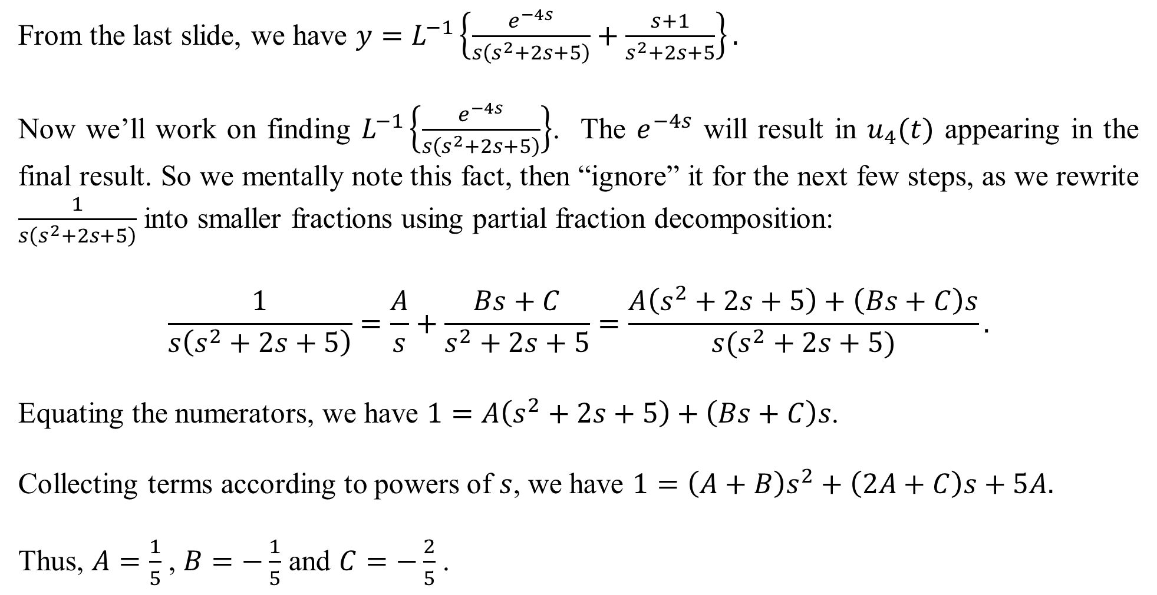
From the last slide, we have $y=L^{−1}\left\{\frac{e^{−4s}}{s\left(s^{2}+2s+5\right)}+\frac{s+1}{s^{2}+2s+5}\right\}.$
Now we’ll work on finding $L^{−1}\left\{\frac{e^{−4s}}{s\left(s^{2}+2s+5\right)}\right\}$. The $e^{−4s}$ will result in $u_{4}(t)$ appearing in the final result. So we mentally note this fact, then “ignore” it for the next few steps, as we rewrite $\frac{1}{s\left(s^{2}+2s+5\right)}$ into smaller fractions using partial fraction decomposition:
$$\frac{1}{s\left(s^{2}+2s+5\right)}=\frac{A}{s}+\frac{Bs+C}{s^{2}+2s+5}=\frac{A\left(s^{2}+2s+5\right)+\left(Bs+C\right)s}{s(s^{2}+2s+5)}.$$
Equating the numerators, we have $1=A\left(s^{2}+2s+5\right)+\left(Bs+C\right)s$.
Collecting terms according to powers of $s$, we have $1=\left(A+B\right)s^{2}+\left(2A+C\right)s+5A.$
Thus, $A=\frac{1}{5}$ , $B=−\frac{1}{5}$ and $C=−\frac{2}{5}$ .

Slide 5
So now we have
$$\frac{1}{s\left(s^{2}+2s+5\right)}=\frac{\frac{1}{5}}{s}−\frac{\frac{1}{5}s+\frac{2}{5}}{s^{2}+2s+5}.$$
Completing the square on the second term, we have $s^{2}+2s+5={\left(s+1\right)}^{2}+4$. Thus, we need to have $s+1$ in the numerator:
$$\frac{\frac{1}{5}s+\frac{2}{5}}{s^{2}+2s+5}=\frac{\frac{1}{5}(s+1−1)+\frac{2}{5}}{{\left(s+1\right)}^{2}+4}=\frac{\frac{1}{5}(s+1)+\frac{1}{5}}{{\left(s+1\right)}^{2}+4}=\frac{\frac{1}{5}(s+1)}{{\left(s+1\right)}^{2}+4}+\frac{1}{2}⋅\frac{\frac{1}{5}\left(2\right)}{{\left(s+1\right)}^{2}+4}.$$
Finally, we have that $L^{−1}\left\{\frac{e^{−4s}}{s\left(s^{2}+2s+5\right)}\right\}=L^{−1}\left\{e^{−4s}\left(\frac{\frac{1}{5}}{s}−\frac{\frac{1}{5}\left(s+1\right)}{{\left(s+1\right)}^{2}+4}−\frac{1}{2}⋅\frac{\frac{1}{5}\left(2\right)}{{\left(s+1\right)}^{2}+4}\right)\right\}$.
The whole solution is pieced together on the next slide.

Slide 6
We have $y=L^{−1}\left\{\frac{e^{−4s}}{s\left(s^{2}+2s+5\right)}+\frac{s+1}{s^{2}+2s+5}\right\}$.
From slide 3, we had $L^{−1}\left\{\frac{s+1}{s^{2}+2s+5}\right\}=L^{−1}\left\{\frac{s+1}{{\left(s+1\right)}^{2}+4}\right\}=e^{−t}\cos{(2t)}$.
From the last slide, we had $L^{−1}\left\{\frac{e^{−4s}}{s\left(s^{2}+2s+5\right)}\right\}=L^{−1}\left\{e^{−4s}\left(\frac{\frac{1}{5}}{s}−\frac{\frac{1}{5}\left(s+1\right)}{{\left(s+1\right)}^{2}+4}−\frac{1}{2}⋅\frac{\frac{1}{5}\left(2\right)}{{\left(s+1\right)}^{2}+4}\right)\right\}$.
Note that $L^{−1}\left\{\frac{\frac{1}{5}\left(s+1\right)}{{\left(s+1\right)}^{2}+4}\right\}=\frac{1}{5}e^{−t}\cos{(2t)}$ and $L^{−1}\left\{\frac{1}{10}⋅\frac{2}{{\left(s+1\right)}^{2}+4}\right\}=\frac{1}{10}e^{−t}\sin{(2t)}$.
This gives $u_{4}\left(t\right)\left(\frac{1}{5}−\frac{1}{5}e^{−\left(t−4\right)}\cos\left(2\left(t−4\right)\right)−\frac{1}{10}e^{−\left(t−4\right)}\sin\left(2\left(t−4\right)\right)\right)$, where we must state the shift of 4 units to the right. The entire solution is
$y=e^{−t}\cos{(2t)}+u_{4}\left(t\right)\left(\frac{1}{5}−\frac{1}{5}e^{−\left(t−4\right)}\cos\left(2\left(t−4\right)\right)−\frac{1}{10}e^{−\left(t−4\right)}\sin\left(2\left(t−4\right)\right)\right)$.

Slide 7
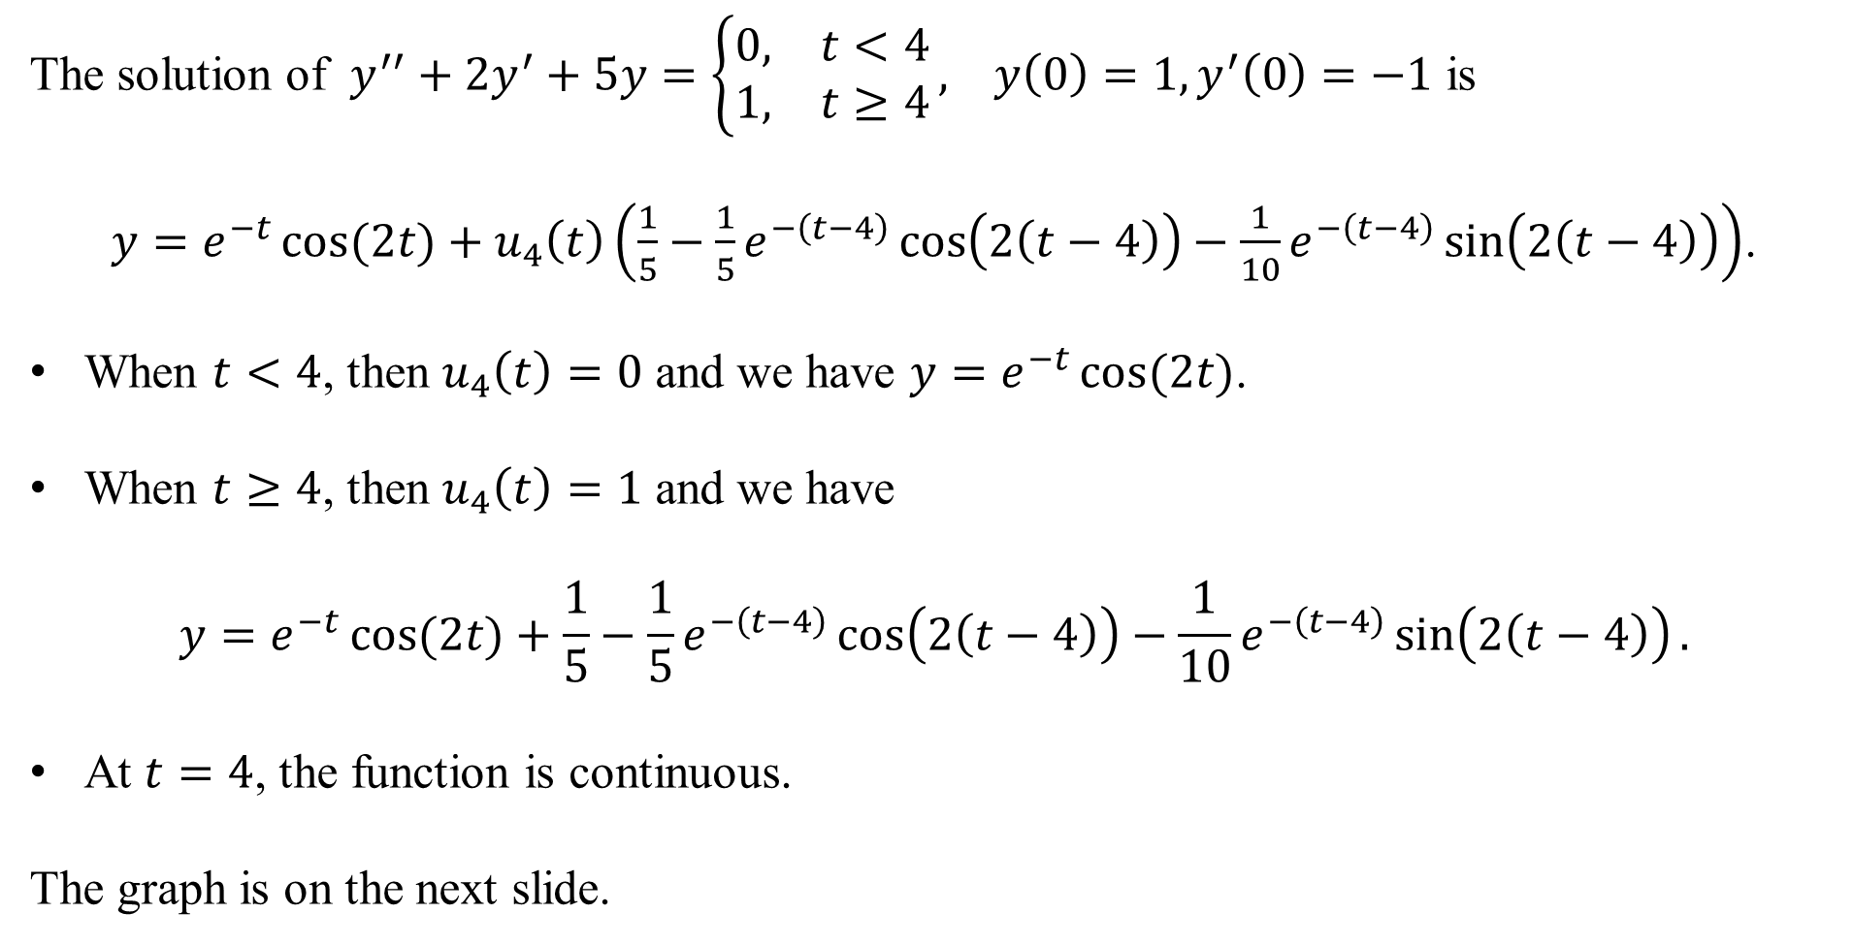
The solution of $y^{′′}+2y^{′}+5y=\left\{\begin{matrix}0, & t<4 \\ 1, & t≥4\end{matrix}\right., y\left(0\right)=1, y^{′}\left(0\right)=−1$ is
$y=e^{−t}\cos{(2t)}+u_{4}\left(t\right)\left(\frac{1}{5}−\frac{1}{5}e^{−\left(t−4\right)}\cos\left(2\left(t−4\right)\right)−\frac{1}{10}e^{−\left(t−4\right)}\sin\left(2\left(t−4\right)\right)\right)$.
When $t<4$, then $u_{4}\left(t\right)=0$ and we have $y=e^{−t}\cos{(2t)}$.
When $t≥4$, then $u_{4}\left(t\right)=1$ and we have
$$y=e^{−t}\cos{(2t)}+\frac{1}{5}−\frac{1}{5}e^{−\left(t−4\right)}\cos\left(2\left(t−4\right)\right)−\frac{1}{10}e^{−\left(t−4\right)}\sin\left(2\left(t−4\right)\right).$$
At $t=4$, the function is continuous.
The graph is on the next slide.

Slide 8
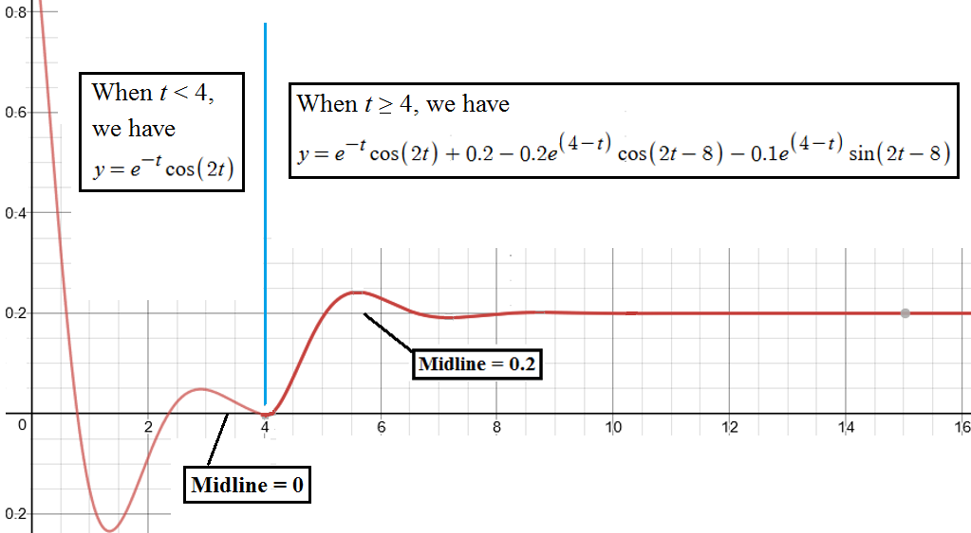
Graph of: $y=e^{−t}\cos{(2t)}+u_{4}\left(t\right)\left(\frac{1}{5}−\frac{1}{5}e^{−\left(t−4\right)}\cos\left(2\left(t−4\right)\right)−\frac{1}{10}e^{−\left(t−4\right)}\sin\left(2\left(t−4\right)\right)\right)$

Slide 9
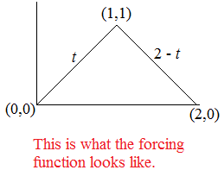
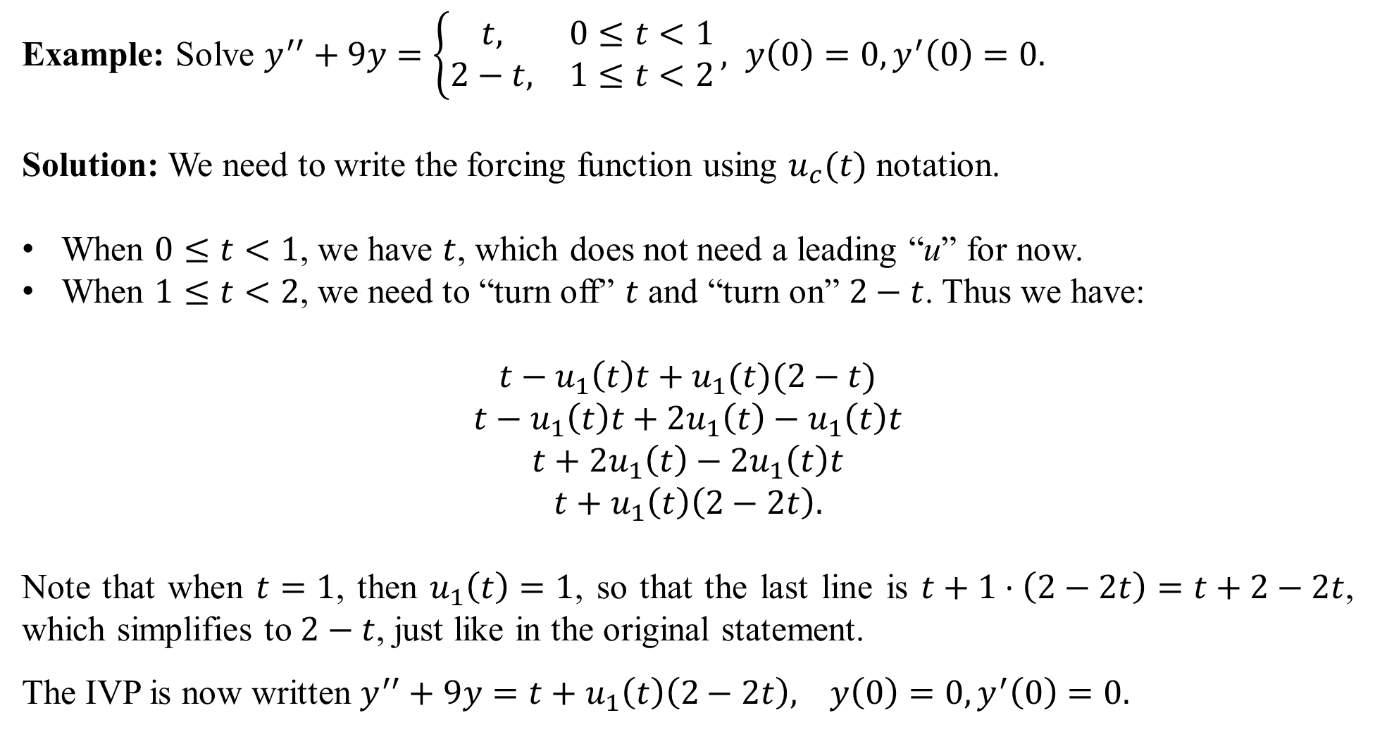
Example: Solve $y^{′′}+9y=\left\{\begin{matrix}t, & 0≤t<1 \\ 2−t, & 1≤t<2\end{matrix}\right., y\left(0\right)=0, y^{′}\left(0\right)=0.$
Solution: We need to write the forcing function using $u_{c}(t)$ notation.
When $0≤t<1$, we have $t$, which does not need a leading “u” for now.
When $1≤t<2$, we need to “turn off” $t$ and “turn on” $2−t$. Thus we have:
$$t−u_{1}\left(t\right)t+u_{1}(t)(2−t)$$
$$t−u_{1}\left(t\right)t+2u_{1}\left(t\right)−u_{1}\left(t\right)t$$
$$t+{2u}_{1}\left(t\right)−2u_{1}\left(t\right)t$$
$$t+u_{1}\left(t\right)\left(2−2t\right).$$
Note that when $t=1$, then $u_{1}\left(t\right)=1$, so that the last line is $t+1⋅\left(2−2t\right)=t+2−2t$, which simplifies to $2−t$, just like in the original statement.
The IVP is now written $y^{′′}+9y=t+u_{1}\left(t\right)\left(2−2t\right), y\left(0\right)=0, y^{′}\left(0\right)=0.$

Slide 10
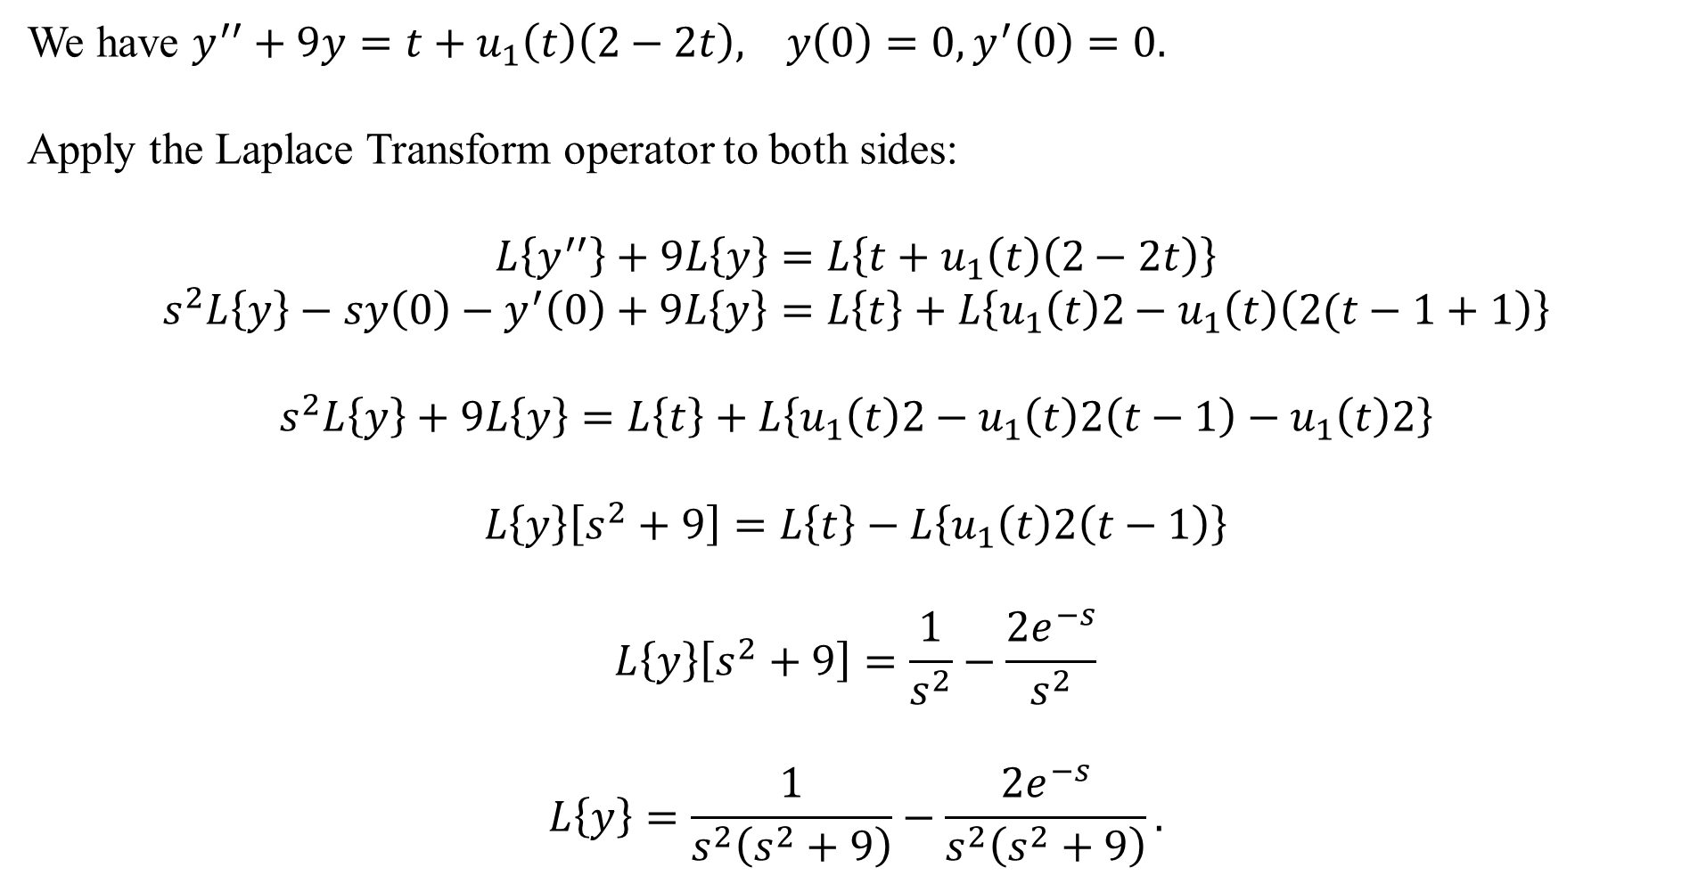
We have $y^{′′}+9y=t+u_{1}\left(t\right)\left(2−2t\right), y\left(0\right)=0, y^{′}\left(0\right)=0.$
Apply the Laplace Transform operator to both sides:
$$L\left\{y^{′′}\right\}+9L\left\{y\right\}=L\left\{t+u_{1}\left(t\right)\left(2−2t\right)\right\}$$
$$s^{2}L\left\{y\right\}−sy\left(0\right)−y^{′}\left(0\right)+9L\left\{y\right\}=L\left\{t\right\}+L\left\{u_{1}\left(t\right)2−u_{1}\left(t\right)\left(2(t−1+1\right)\right\}$$
$$s^{2}L\left\{y\right\}+9L\left\{y\right\}=L\left\{t\right\}+L\left\{u_{1}\left(t\right)2−u_{1}\left(t\right)2\left(t−1\right)−u_{1}\left(t\right)2\right\}$$
$$L\left\{y\right\}\left[s^{2}+9\right]=L\left\{t\right\}−L\left\{u_{1}\left(t\right)2\left(t−1\right)\right\}$$
$$L\left\{y\right\}\left[s^{2}+9\right]=\frac{1}{s^{2}}−\frac{2e^{−s}}{s^{2}}$$
$$L\left\{y\right\}=\frac{1}{s^{2}\left(s^{2}+9\right)}−\frac{{2e}^{−s}}{s^{2}\left(s^{2}+9\right)}.$$

Slide 11
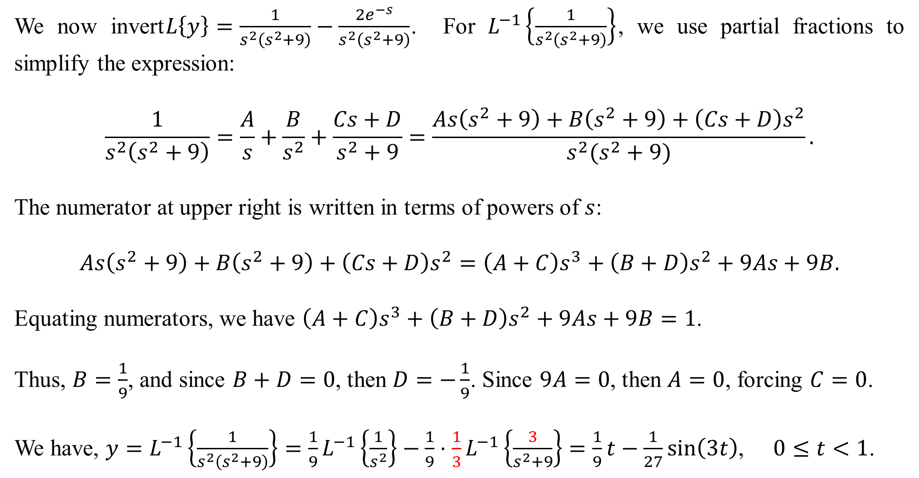
We now invert$L\left\{y\right\}=\frac{1}{s^{2}\left(s^{2}+9\right)}−\frac{{2e}^{−s}}{s^{2}\left(s^{2}+9\right)}$. For $L^{−1}\left\{\frac{1}{s^{2}\left(s^{2}+9\right)}\right\}$, we use partial fractions to simplify the expression:
$$\frac{1}{s^{2}\left(s^{2}+9\right)}=\frac{A}{s}+\frac{B}{s^{2}}+\frac{Cs+D}{s^{2}+9}=\frac{As\left(s^{2}+9\right)+B\left(s^{2}+9\right)+\left(Cs+D\right)s^{2}}{s^{2}(s^{2}+9)}.$$
The numerator at upper right is written in terms of powers of $s$:
$$As\left(s^{2}+9\right)+B\left(s^{2}+9\right)+\left(Cs+D\right)s^{2}=\left(A+C\right)s^{3}+\left(B+D\right)s^{2}+9As+9B.$$
Equating numerators, we have $\left(A+C\right)s^{3}+\left(B+D\right)s^{2}+9As+9B=1$.
Thus, $B=\frac{1}{9}$, and since $B+D=0$, then $D=−\frac{1}{9}$. Since $9A=0$, then $A=0$, forcing $C=0$.
We have, $y=L^{−1}\left\{\frac{1}{s^{2}\left(s^{2}+9\right)}\right\}={\frac{1}{9}L}^{−1}\left\{\frac{1}{s^{2}}\right\}−\frac{1}{9}⋅\frac{1}{3}L^{−1}\left\{\frac{3}{s^{2}+9}\right\}=\frac{1}{9}t−\frac{1}{27}\sin\left(3t\right)$, $0≤t<1$.

Slide 12
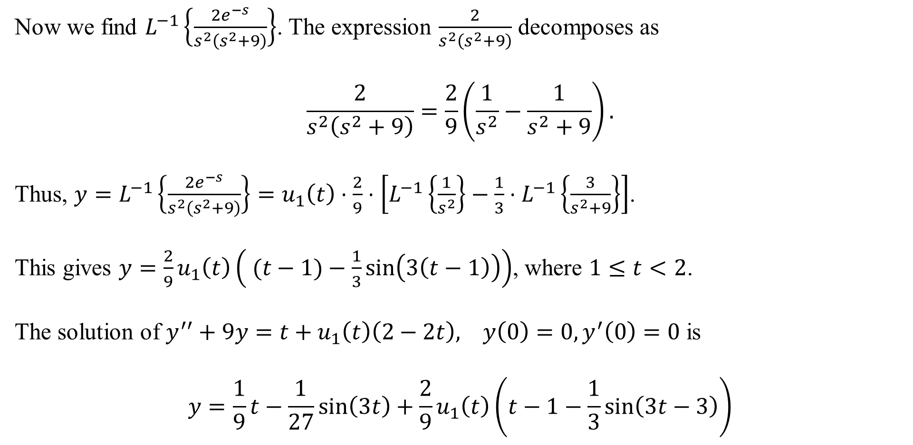
Now we find $L^{−1}\left\{\frac{{2e}^{−s}}{s^{2}\left(s^{2}+9\right)}\right\}$. The expression $\frac{2}{s^{2}\left(s^{2}+9\right)}$ decomposes as
$$\frac{2}{s^{2}\left(s^{2}+9\right)}=\frac{2}{9}\left(\frac{1}{s^{2}}−\frac{1}{s^{2}+9}\right).$$
Thus, ${y=L}^{−1}\left\{\frac{{2e}^{−s}}{s^{2}\left(s^{2}+9\right)}\right\}=u_{1}\left(t\right)⋅\frac{2}{9}⋅\left[L^{−1}\left\{\frac{1}{s^{2}}\right\}−\frac{1}{3}⋅L^{−1}\left\{\frac{3}{s^{2}+9}\right\}\right]$.
This gives $y=\frac{2}{9}u_{1}\left(t\right)\left( (t−1)−\frac{1}{3}\sin\left(3\left(t−1\right)\right)\right)$, where $1≤t<2$.
The solution of $y^{′′}+9y=t+u_{1}\left(t\right)\left(2−2t\right), y\left(0\right)=0, y^{′}\left(0\right)=0$ is
$$y=\frac{1}{9}t−\frac{1}{27}\sin\left(3t\right)+\frac{2}{9}u_{1}\left(t\right)\left(t−1−\frac{1}{3}\sin\left(3t−3\right)\right)$$

Slide 13

The graph of$y=\frac{1}{9}t−\frac{1}{27}\sin\left(3t\right)+\frac{2}{9}u_{1}\left(t\right)\left(t−1−\frac{1}{3}\sin\left(3t−3\right)\right)$ is

