Slide 1
Laplace Transforms
MAT 275

Slide 2
Let $y=f(t)$ be a function. Its Laplace Transform, written $H\left(s\right)=L\left\{y\left(t\right)\right\}$, is a function in variable s, defined by
$$H\left(s\right)=L\left\{y\left(t\right)\right\}=\int_{0}^{∞}{f\left(t\right)e^{−st} dt}.$$
Case 1 (Constants). Let $f(t)=c$, where c is any constant. Then
$$H\left(s\right)=L\left\{c\right\}=\int_{0}^{∞}{ce^{−st} dt}=c\int_{0}^{∞}{e^{−st} dt}.$$
The integral $\int_{0}^{∞}{e^{−st} dt}$ is found using limits:
$$\lim_{b→∞}{\int_{0}^{b}{e^{−st} dt}}=\lim_{b→∞}{{\left[−\frac{1}{s}e^{−st}\right]}_{0}^{b}}=\lim_{b→∞}\left[−\frac{1}{s}\left(e^{−sb}−\left(e^{0}\right)\right)\right]=\frac{1}{s}.$$
Thus, when $f\left(t\right)=c$, then $H\left(s\right)=L\left\{c\right\}=\frac{c}{s}$ .

Slide 3
Case 2 (exponential, base-e): Let $f\left(t\right)=e^{at}$. Then
$$H\left(s\right)=L\left\{e^{at}\right\}=\int_{0}^{∞}{e^{at}e^{−st} dt}=\int_{0}^{∞}{e^{(a−s)t} dt}.$$
The integral is evaluated using limits:
$$\lim_{b→∞}{\int_{0}^{b}{e^{(a−s)t} dt}}=\lim_{b→∞}{\left[\frac{1}{a−s}e^{\left(a−s\right)t}\right]}_{0}^{b}=\lim_{b→∞}\left[\frac{1}{a−s}\left(e^{\left(a−s\right)b}−\left(e^{0}\right)\right)\right].$$
When $s>a$, then$\lim_{b→∞}\left[e^{\left(a−s\right)b}\right]=0$ since the coefficient of b is negative. Also, $e^{0}=1$. So we’re left with $\frac{1}{a−s}\left(0−1\right)=\frac{1}{s−a} .$
Thus, when $f\left(t\right)=e^{at}$, we have $H\left(s\right)=L\left\{e^{at}\right\}=\frac{1}{s−a}$ .

Slide 4
Laplace Transforms for other types of function
Usually, we do not bother to calculate Laplace Transforms by hand for most functions. Instead, we make up a table for the most common functions. For example, if $y=t^{n}$, where n is a positive integer, then
$$H\left(s\right)=L\left\{t^{n}\right\}=\frac{n!}{s^{n+1}} .$$
If $y=\sin{(bt)}$, then
$$H\left(s\right)=L\left\{\sin\left(bt\right)\right\}=\frac{b}{s^{2}+b^{2}} .$$
If $y=\cos{(bt)}$, then
$$H\left(s\right)=L\left\{\cos\left(bt\right)\right\}=\frac{s}{s^{2}+b^{2}} .$$

Slide 5
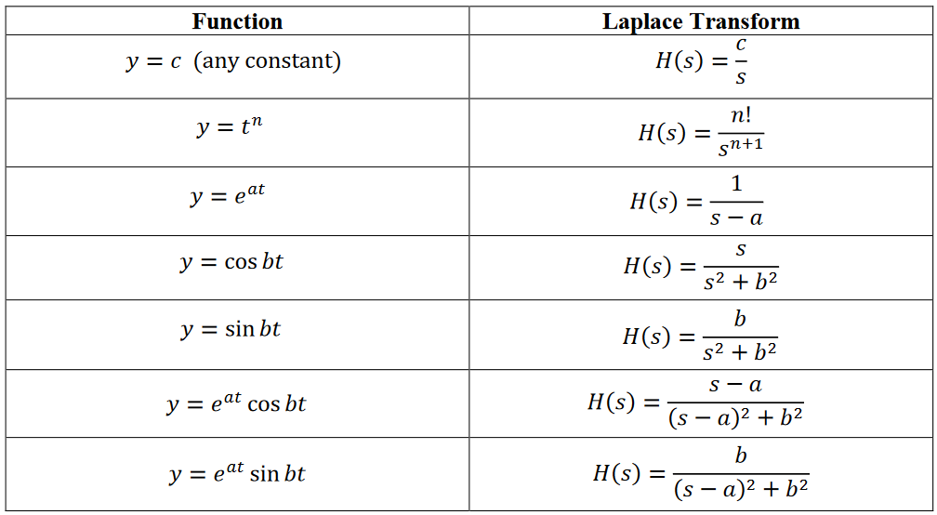
List of Common Laplace Transforms
Memorize this table!

Slide 6
Laplace Transforms of Derivatives
Let $y=f(t)$ and suppose initial conditions $y=f(0)$ and $y^{′}=f′(0)$ are given. Then it is possible to find the Laplace Transform of a derivative. These are two that are most common:
For $y^{′}=f′(t)$, we have $H\left(s\right)=L\left\{y^{′}\right\}=sL\left\{y\right\}−y\left(0\right).$
For $y^{′′}=f′′(t)$, we have $H\left(s\right)=L\left\{y^{′′}\right\}=s^{2}L\left\{y\right\}−sy\left(0\right)−y^{′}\left(0\right).$
The notation $y(0)$ is the same as $y=f(0)$ and $y′(0)$ is the same as $y^{′}=f′(0)$.
Linearity of the Laplace Transform
The operator can be distributed and any coefficients move to the front.
$$L\left\{c_{1}f_{1}\left(t\right)+c_{2}f_{2}\left(t\right)\right\}=c_{1}L\left\{f_{1}\left(t\right)\right\}+c_{2}L\left\{f_{2}\left(t\right)\right\}.$$

Slide 7
Example: Find $L\left\{t^{4}\right\}$.
Solution: Using the form $L\left\{t^{n}\right\}=\frac{n!}{s^{n+1}}$, we have $L\left\{t^{4}\right\}=\frac{4!}{s^{4+1}}=\frac{24}{s^{5}}$ .
Example: Find $L\left\{e^{5t}\right\}$.
Solution: Using the form $L\left\{e^{at}\right\}=\frac{1}{s−a}$, we have $L\left\{e^{5t}\right\}=\frac{1}{s−5}$ .
Example: Find $L\left\{\sin\left(7t\right)\right\}$.
Solution: Using the form $L\left\{\sin\left(bt\right)\right\}=\frac{b}{s^{2}+b^{2}}$, we have $L\left\{\sin\left(7t\right)\right\}=\frac{7}{s^{2}+49}$ .
Example: Find $L\left\{e^{−2t}\cos\left(3t\right)\right\}$.
Solution: Using the form $L\left\{e^{at}\cos\left(bt\right)\right\}=\frac{s−a}{{\left(s−a\right)}^{2}+b^{2}}$, we have $L\left\{e^{−2t}\cos\left(3t\right)\right\}=\frac{s+2}{{\left(s+2\right)}^{2}+9}$ .

Slide 8
Use algebra when appropriate…
Example: Find $L\left\{{\left(t+3\right)}^{2}\right\}$.
Solution: Multiply the binomial: $L\left\{{\left(t+3\right)}^{2}\right\}=L\left\{t^{2}+6t+9\right\}$. Now, using the linearity of the operator, we have
$$L\left\{{\left(t+3\right)}^{2}\right\}=L\left\{t^{2}+6t+9\right\}$$
$$=L\left\{t^{2}\right\}+6L\left\{t\right\}+L\left\{9\right\}$$
$$=\frac{2!}{s^{2+1}}+6\left(\frac{1!}{s^{1+1}}\right)+9\left(\frac{1}{s}\right)$$
$$=\frac{2}{s^{3}}+\frac{6}{s^{2}}+\frac{9}{s} .$$

Slide 9
Use trigonometric identities also…
Example: Find $L\left\{\sin^{2}\left(3t\right)\right\}$.
Solution: We use the identity $\sin^{2}{θ}=\frac{1}{2}−\frac{1}{2}\cos\left(2θ\right)$. Thus,
$$L\left\{\sin^{2}\left(3t\right)\right\}=L\left\{\frac{1}{2}−\frac{1}{2}\cos\left(6t\right)\right\}$$
$$=L\left\{\frac{1}{2}\right\}−L\left\{\frac{1}{2}\cos\left(6t\right)\right\}$$
$$=\frac{1}{2s}−\frac{1}{2}\left(\frac{s}{s^{2}+36}\right).$$

Slide 10
Inverting the Laplace Transform
As part of the solution process, we will need to invert the Laplace Transform, to find the function $f(t)$ such that
$$L^{−1}\left\{H\left(s\right)\right\}=f\left(t\right).$$
Some are easy to do by “inspection”:
Example: Find $L^{−1}\left\{\frac{7}{s}\right\}$.
Solution: Since we know that $L\left\{c\right\}=\frac{c}{s}$ , then it follows that $L^{−1}\left\{\frac{7}{s}\right\}=7$.
Example: Find $L^{−1}\left\{\frac{s}{s^{2}+25}\right\}$.
Solution: Sine we know that $L\left\{\cos\left(bt\right)\right\}=\frac{s}{s^{2}+b^{2}}$ , then it follows that $L^{−1}\left\{\frac{s}{s^{2}+25}\right\}=\cos{(5t)}$.

Slide 11
Inversions, continued…
Some cases, we need to “balance” the expression with constants and their reciprocals.
Example: Find $L^{−1}\left\{\frac{1}{s^{6}}\right\}$.
Solution: We know that $L\left\{t^{n}\right\}=\frac{n!}{s^{n+1}}$ , so we conclude that n = 5 in this example. However, we need 5! = 120 in the numerator to fully agree with the form. So we multiply inside by 120, and outside by $\frac{1}{120}$, and we have
$$L^{−1}\left\{\frac{1}{s^{6}}\right\}=\frac{1}{120}L^{−1}\left\{\frac{120}{s^{6}}\right\}=\frac{1}{120}t^{5}.$$

Slide 12
Example: Find $L^{−1}\left\{\frac{3}{s^{2}+21}\right\}$.
Solution: This looks closest to the form $L\left\{\sin\left(bt\right)\right\}=\frac{b}{s^{2}+b^{2}}$ . The 3 in the numerator can be moved to the front, and from the denominator, we infer that since $b^{2}=21$, we must have $b=\sqrt{21}$.
However, the form “needs” the b value in the numerator. So we multiply inside by $\sqrt{21}$ and outside by $\frac{1}{\sqrt{21}}$ :
$$L^{−1}\left\{\frac{3}{s^{2}+21}\right\}=3L^{−1}\left\{\frac{1}{s^{2}+21}\right\}=3\left(\frac{1}{\sqrt{21}}\right)L^{−1}\left\{\frac{\sqrt{21}}{s^{2}+21}\right\}=\frac{3}{\sqrt{21}}\sin\left(\sqrt{21}t\right).$$
Rationalizing the denominator, an equivalent form is $L^{−1}\left\{\frac{3}{s^{2}+21}\right\}=\frac{\sqrt{21}}{7}\sin\left(\sqrt{21}t\right)$.

Slide 13
Example: Find $L^{−1}\left\{\frac{s}{s^{2}+4s+9}\right\}$.
Solution: The denominator does not factor over the Reals, so we complete the square:
$$\frac{s}{s^{2}+4s+9}=\frac{s}{{\left(s+2\right)}^{2}+5} .$$
This looks closest to $L\left\{e^{at}\cos\left(bt\right)\right\}=\frac{s−a}{{\left(s−a\right)}^{2}+b^{2}}$ . We can conclude that $a=−2$ and $b=\sqrt{5}$.
But the numerator is not in the right form. We “need” ($s+2$) in the numerator in order to agree with the form. So we add in 2 then subtract it back out, then split the numerator by grouping $s+2$ and $−2$ as separate terms:
$$\frac{s}{{\left(s+2\right)}^{2}+5}=\frac{s+2−2}{{\left(s+2\right)}^{2}+5}=\frac{s+2}{{\left(s+2\right)}^{2}+5}−\frac{2}{{\left(s+2\right)}^{2}+5}.$$
(continued…)

Slide 14
From the last screen, we have
$\frac{s}{s^{2}+4s+9}=\frac{s}{{\left(s+2\right)}^{2}+5}=\frac{s+2−2}{{\left(s+2\right)}^{2}+5}=\frac{s+2}{{\left(s+2\right)}^{2}+5}−\frac{2}{{\left(s+2\right)}^{2}+5}$.
The expression $\frac{s+2}{{\left(s+2\right)}^{2}+5}$ now exactly matches the form for $L\left\{e^{at}\cos\left(bt\right)\right\}=\frac{s−a}{{\left(s−a\right)}^{2}+b^{2}}$ .
The expression $\frac{2}{{\left(s+2\right)}^{2}+5}$ almost matches the form for $L\left\{e^{at}\sin\left(bt\right)\right\}=\frac{b}{{\left(s−a\right)}^{2}+b^{2}}$ . To make it match exactly, multiply inside by $\sqrt{5}$ and outside by $\frac{1}{\sqrt{5}}$ , getting $\frac{2}{\sqrt{5}}\left(\frac{\sqrt{5}}{{\left(s+2\right)}^{2}+5}\right)$. Note that we moved the numerator 2 to the outside. Now everything matches. Thus,
$L^{−1}\left\{\frac{s}{s^{2}+4s+9}\right\}=L^{−1}\left\{\frac{s+2}{{\left(s+2\right)}^{2}+5}\right\}−\frac{2}{\sqrt{5}}L^{−1}\left\{\frac{\sqrt{5}}{{\left(s+2\right)}^{2}+5}\right\}=e^{−2t}\cos\left(\sqrt{5}t\right)−\frac{2}{\sqrt{5}}e^{−2t}\sin\left(\sqrt{5}t\right).$

Slide 15
Example: Find $L^{−1}\left\{\frac{1}{s\left(s^{2}+s−12\right)}\right\}$.
Solution: The denominator factors into linear factors:
$$\frac{1}{s\left(s^{2}+s−12\right)}=\frac{1}{s\left(s+4\right)\left(s−3\right)}.$$
We now use partial fraction decomposition:
$$\frac{1}{s\left(s+4\right)\left(s−3\right)}=\frac{A}{s}+\frac{B}{s+4}+\frac{C}{s−3}.$$
Recomposing, we have
$$\frac{1}{s\left(s+4\right)\left(s−3\right)}=\frac{A}{s}+\frac{B}{s+4}+\frac{C}{s−3}=\frac{A\left(s+4\right)\left(s−3\right)+Bs\left(s−3\right)+Cs(s+4)}{s(s+4)(s−3)} .$$

Slide 16
From the last screen, we have
$$\frac{1}{s\left(s+4\right)\left(s−3\right)}=\frac{A}{s}+\frac{B}{s+4}+\frac{C}{\left(s−3\right)}=\frac{A\left(s+4\right)\left(s−3\right)+Bs\left(s−3\right)+Cs(s+4)}{s(s+4)(s−3)} .$$
Now, equate the two numerators:
$$1=A\left(s+4\right)\left(s−3\right)+Bs\left(s−3\right)+Cs\left(s+4\right).$$
We can find values for $A$, $B$ and $C$ by choosing “convenient” values for $s$:
If $s=0$, then the terms containing $B$ and $C$ vanish. We have
$1=A\left(\left(0\right)+4\right)\left(\left(0\right)−3\right)→1=−12A$, so that $A=−\frac{1}{12}$ .
(continued…)

Slide 17
From the last screen, we have $1=A\left(s+4\right)\left(s−3\right)+Bs\left(s−3\right)+Cs\left(s+4\right).$
If $s=−4$, then the $A$ and $C$ terms vanish, and we have
$1=B\left(−4\right)\left(\left(−4\right)−3\right)→1=28B$, so that $B=\frac{1}{28}$ .
If $s=3$, then the $A$ and $B$ terms vanish, and we have
$1=C\left(3\right)\left(\left(3\right)+4\right)→1=21C$, so that $C=\frac{1}{21}$ .
Finally, we have that $L^{−1}\left\{\frac{1}{s\left(s^{2}+s−12\right)}\right\}=L^{−1}\left\{\frac{{−1}/{12}}{s}+\frac{1/{28}}{s+4}+\frac{1/{21}}{s−3}\right\}$. Thus,
$$y=−\frac{1}{12}+\frac{1}{28}e^{−4t}+\frac{1}{21}e^{3t}.$$

