Slide 1
Impulse Forcing Functions
MAT 275

Slide 2
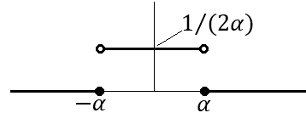
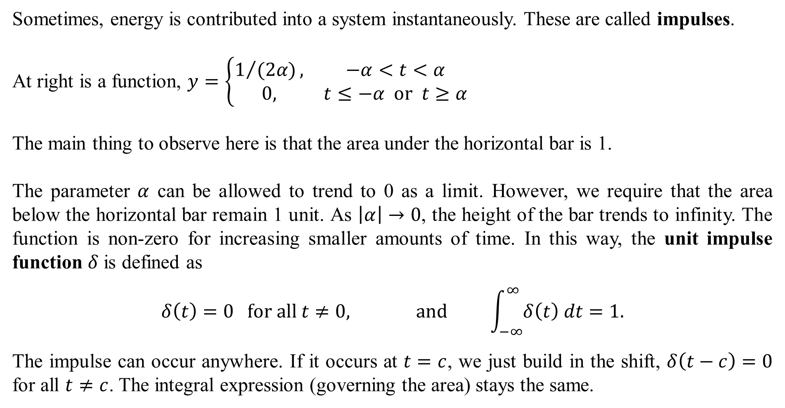
Sometimes, energy is contributed into a system instantaneously. These are called impulses.
At right is a function, $y=\left\{\begin{matrix}1/{(2α)}, & −α<t<α \\ 0, & t≤−α or t≥α\end{matrix}\right.$
The main thing to observe here is that the area under the horizontal bar is 1.
The parameter $α$ can be allowed to trend to 0 as a limit. However, we require that the area below the horizontal bar remain 1 unit. As $\left|α\right|→0$, the height of the bar trends to infinity. The function is non-zero for increasing smaller amounts of time. In this way, the unit impulse function $δ$is defined as
$$δ\left(t\right)=0 for all t≠0, and \int_{−∞}^{∞}{δ\left(t\right) dt}=1.$$
The impulse can occur anywhere. If it occurs at $t=c$, we just build in the shift, $δ\left(t−c\right)=0$ for all $t≠c$. The integral expression (governing the area) stays the same.

Slide 3
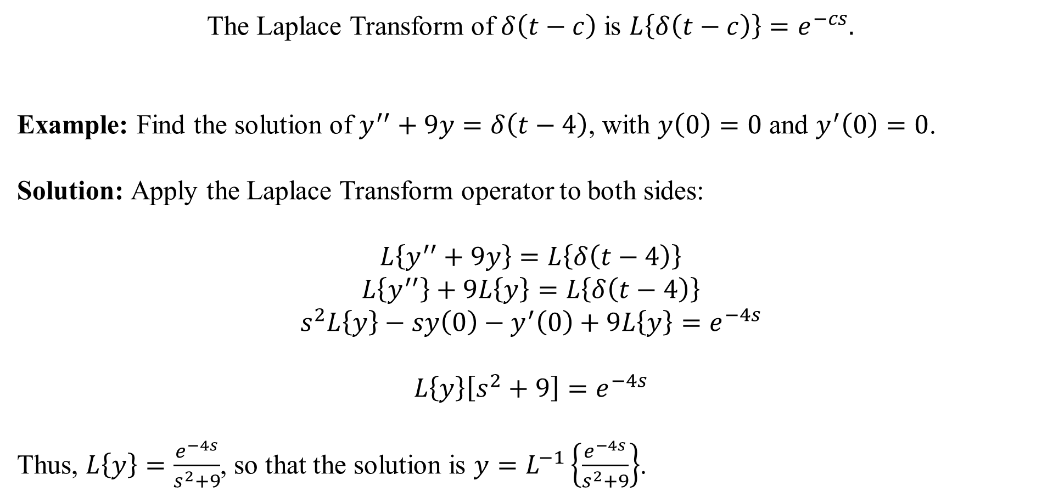
The Laplace Transform of $δ\left(t−c\right)$ is $L\left\{δ\left(t−c\right)\right\}=e^{−cs}.$
Example: Find the solution of $y^{′′}+9y=δ\left(t−4\right)$, with $y\left(0\right)=0$ and $y^{′}\left(0\right)=0$.
Solution: Apply the Laplace Transform operator to both sides:
$$L\left\{y^{′′}+9y\right\}=L\left\{δ\left(t−4\right)\right\}$$
$$L\left\{y^{′′}\right\}+9L\left\{y\right\}=L\left\{δ\left(t−4\right)\right\}$$
$$s^{2}L\left\{y\right\}−sy\left(0\right)−y^{′}\left(0\right)+9L\left\{y\right\}=e^{−4s}$$
$$L\left\{y\right\}\left[s^{2}+9\right]=e^{−4s}$$
Thus, $L\left\{y\right\}=\frac{e^{−4s}}{s^{2}+9}$, so that the solution is $y=L^{−1}\left\{\frac{e^{−4s}}{s^{2}+9}\right\}$.

Slide 4
From the last slide, we have that the solution is $y=L^{−1}\left\{\frac{e^{−4s}}{s^{2}+9}\right\}$.
The $e^{−4s}$ inverts back to $u_{4}(t)$ … not back to the impulse function!
The $\frac{1}{s^{2}+9}$ inverts as follows: $L^{−1}\left\{\frac{1}{s^{2}+9}\right\}=\frac{1}{3}L^{−1}\left\{\frac{3}{s^{2}+9}\right\}=\frac{1}{3}\sin{(3t)}$.
Thus, the solution is $y=\frac{1}{3}u_{4}\left(t\right)\sin\left(3\left(t−4\right)\right)$.
This can be interpreted as follows: When $t<4$, the factor $u_{4}\left(t\right)=0$, so $y=0$, so “nothing is happening”. Then at $t=4$, an impulse of energy is instantaneously applied to the system, setting in motion the solution, $y=\frac{1}{3}\sin\left(3t−12\right)$, which “starts” at $t=4$ and continues forever as $t>4$.
The graph is:

Slide 5
Example: Solve $y^{′′}+5y^{′}+6y=δ\left(t−3\right)+δ(t−6)$, where $y\left(0\right)=0, y^{′}\left(0\right)=0$.
Solution: We have:
$$L\{y^{′′}\}+5L\{y^{′}\}+6L\{y\}=L\{δ\left(t−3\right)\}+L\left\{δ\left(t−6\right)\right\}$$
$$s^{2}L\left\{y\right\}−sy\left(0\right)−y^{′}\left(0\right)+5\left(sL\left\{y\right\}−y\left(0\right)\right)+6L\left\{y\right\}=e^{−3s}+e^{−6s}$$
$$L\left\{y\right\}\left[s^{2}+5s+6\right]=e^{−3s}+e^{−6s}$$
Thus,
$$L\left\{y\right\}=\frac{e^{−3s}+e^{−6s}}{s^{2}+5s+6}, so that y=L^{−1}\left\{\frac{e^{−3s}+e^{−6s}}{s^{2}+5s+6}\right\}.$$
Ignoring the e terms for the moment, we have $\frac{1}{s^{2}+5s+6}=\frac{1}{\left(s+2\right)\left(s+3\right)}=\frac{1}{s+2}−\frac{1}{s+3}$.
Next slide…

Slide 6
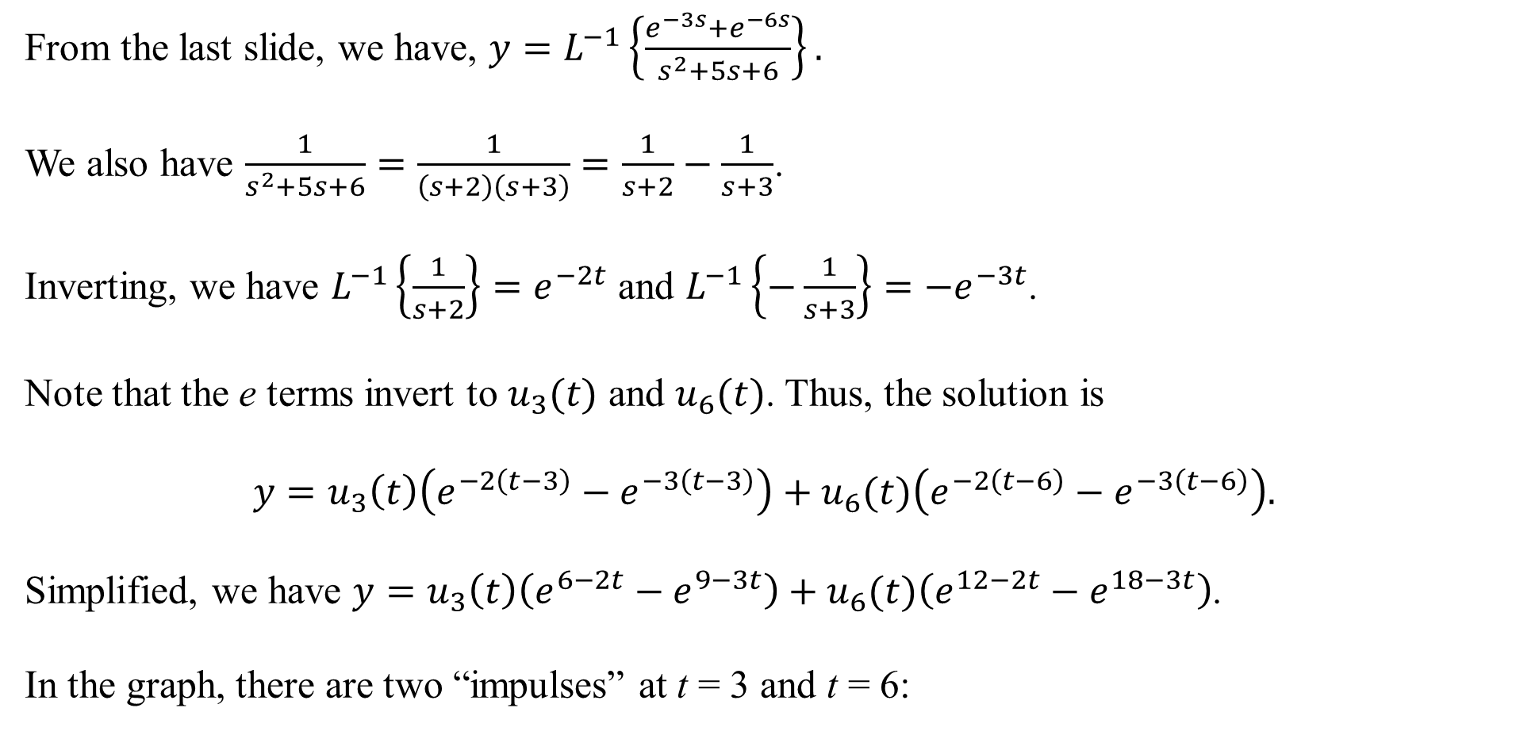
From the last slide, we have, $y=L^{−1}\left\{\frac{e^{−3s}+e^{−6s}}{s^{2}+5s+6}\right\}.$
We also have $\frac{1}{s^{2}+5s+6}=\frac{1}{\left(s+2\right)\left(s+3\right)}=\frac{1}{s+2}−\frac{1}{s+3}$.
Inverting, we have $L^{−1}\left\{\frac{1}{s+2}\right\}=e^{−2t}$ and $L^{−1}\left\{−\frac{1}{s+3}\right\}={−e}^{−3t}$.
Note that the e terms invert to $u_{3}(t)$ and $u_{6}(t)$. Thus, the solution is
$$y=u_{3}\left(t\right)\left(e^{−2\left(t−3\right)}−e^{−3\left(t−3\right)}\right)+u_{6}(t)\left(e^{−2\left(t−6\right)}−e^{−3\left(t−6\right)}\right).$$
Simplified, we have $y=u_{3}\left(t\right)\left(e^{6−2t}−e^{9−3t}\right)+u_{6}(t)\left(e^{12−2t}−e^{18−3t}\right)$.
In the graph, there are two “impulses” at t = 3 and t = 6:

