Slide 1
Higher-Order Linear Homogeneous & Autonomic Differential Equations with Constant Coefficients
MAT 275

Slide 2
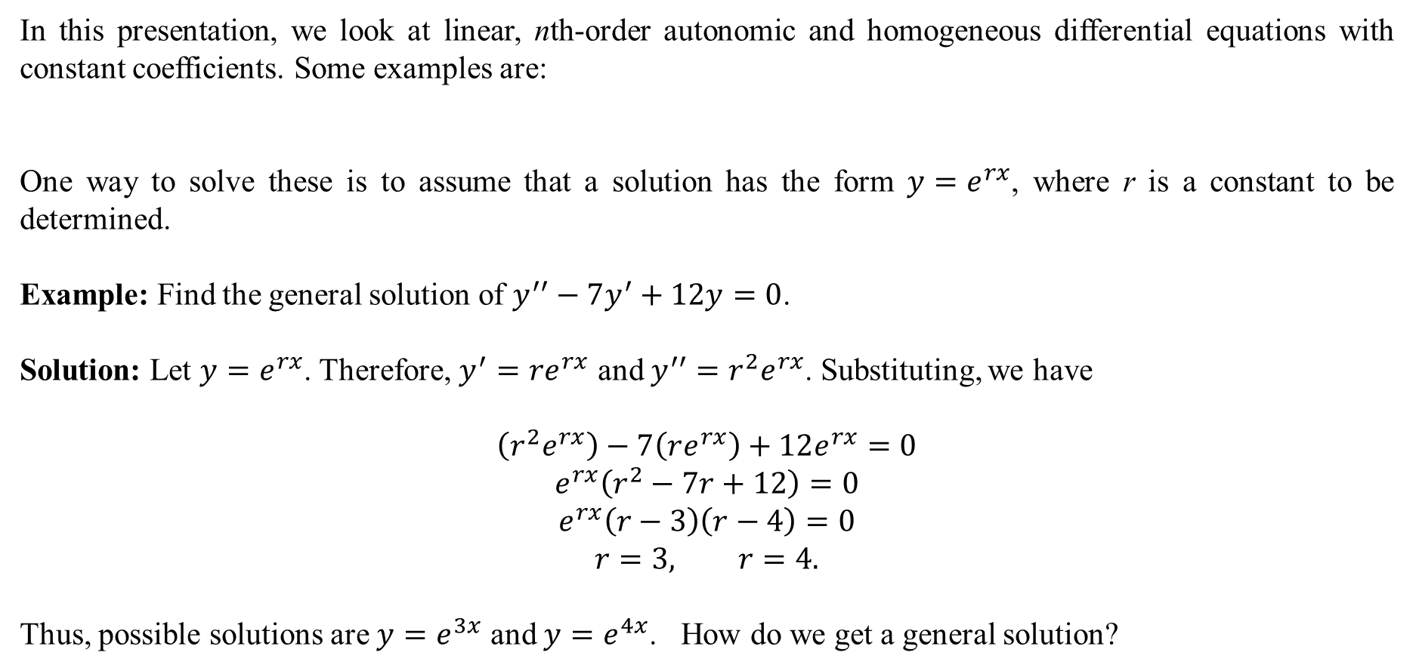
In this presentation, we look at linear, nth-order autonomic and homogeneous differential equations with constant coefficients. Some examples are:
One way to solve these is to assume that a solution has the form $y=e^{rx}$, where r is a constant to be determined.
Example: Find the general solution of $y^{′′}−7y^{′}+12y=0$.
Solution: Let $y=e^{rx}$. Therefore, $y^{′}=re^{rx}$ and $y^{′′}=r^{2}e^{rx}$. Substituting, we have
$$\left(r^{2}e^{rx}\right)−7\left(re^{rx}\right)+12e^{rx}=0$$
$$e^{rx}\left(r^{2}−7r+12\right)=0$$
$$e^{rx}\left(r−3\right)\left(r−4\right)=0$$
$$r=3, r=4.$$
Thus, possible solutions are $y=e^{3x}$ and $y=e^{4x}$. How do we get a general solution?

Slide 3
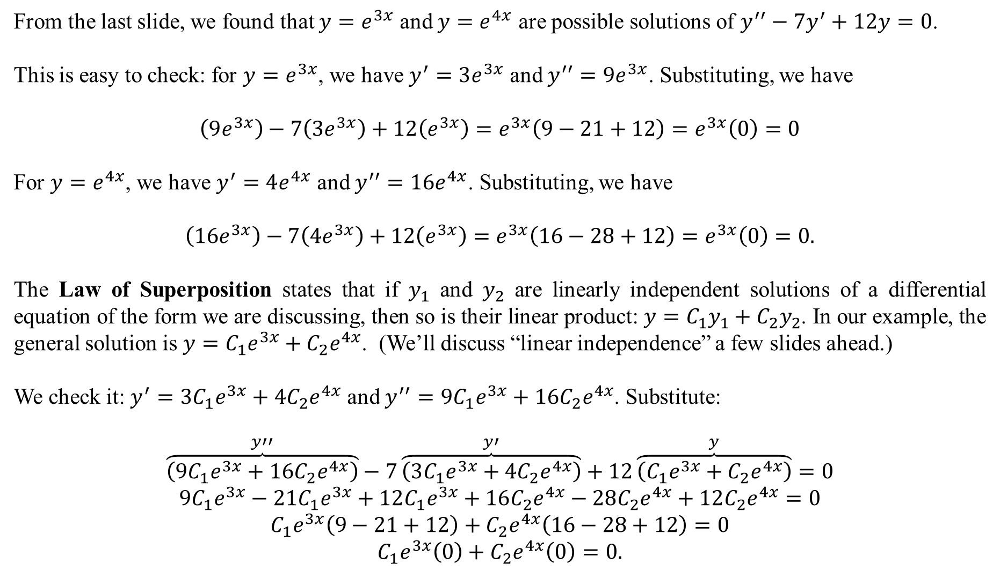
From the last slide, we found that $y=e^{3x}$ and $y=e^{4x}$ are possible solutions of $y^{′′}−7y^{′}+12y=0$.
This is easy to check: for $y=e^{3x}$, we have $y^{′}=3e^{3x}$ and $y^{′′}=9e^{3x}$. Substituting, we have
$$\left(9e^{3x}\right)−7\left(3e^{3x}\right)+12\left(e^{3x}\right)=e^{3x}\left(9−21+12\right)=e^{3x}\left(0\right)=0$$
For $y=e^{4x}$, we have $y^{′}=4e^{4x}$ and $y^{′′}=16e^{4x}$. Substituting, we have
$$\left(16e^{3x}\right)−7\left(4e^{3x}\right)+12\left(e^{3x}\right)=e^{3x}\left(16−28+12\right)=e^{3x}\left(0\right)=0.$$
The Law of Superposition states that if $y_{1}$ and $y_{2}$ are linearly independent solutions of a differential equation of the form we are discussing, then so is their linear product: $y=C_{1}y_{1}+C_{2}y_{2}$. In our example, the general solution is $y=C_{1}e^{3x}+C_{2}e^{4x}$. (We’ll discuss “linear independence” a few slides ahead.)
We check it: $y^{′}=3C_{1}e^{3x}+4C_{2}e^{4x}$ and $y^{′′}=9C_{1}e^{3x}+16C_{2}e^{4x}$. Substitute:
$$\overset{y′′}{\overbrace{\left(9C_{1}e^{3x}+16C_{2}e^{4x}\right)}}−7\overset{y′}{\overbrace{\left(3C_{1}e^{3x}+4C_{2}e^{4x}\right)}}+12\overset{y}{\overbrace{\left(C_{1}e^{3x}+C_{2}e^{4x}\right)}}=0$$
$$9C_{1}e^{3x}−21C_{1}e^{3x}+12C_{1}e^{3x}+16C_{2}e^{4x}−28C_{2}e^{4x}+12C_{2}e^{4x}=0$$
$$C_{1}e^{3x}\left(9−21+12\right)+C_{2}e^{4x}\left(16−28+12\right)=0$$
$$C_{1}e^{3x}\left(0\right)+C_{2}e^{4x}\left(0\right)=0.$$

Slide 4
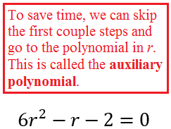
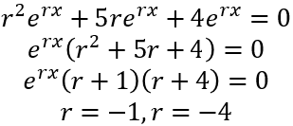
You solve these:
$$y^{′′}+5y^{′}+4y=0 6y^{′′}−y^{′}−2y=0 y^{′′}−16y=0$$
Solutions:

Slide 5
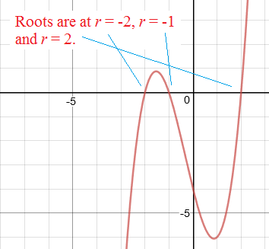
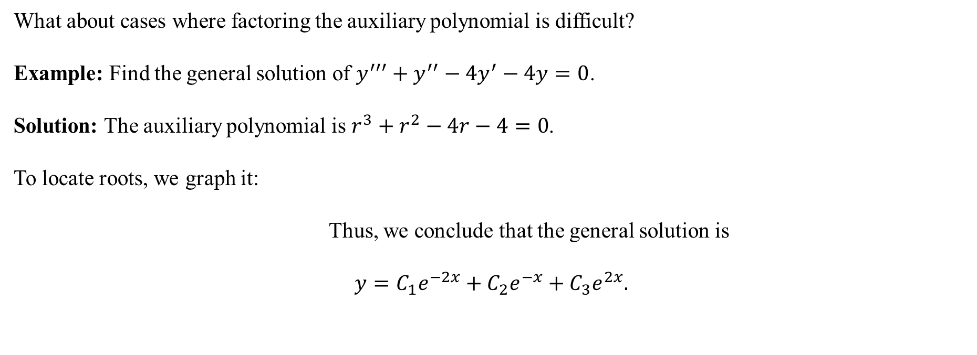
What about cases where factoring the auxiliary polynomial is difficult?
Example: Find the general solution of $y^{′′′}+y^{′′}−4y^{′}−4y=0$.
Solution: The auxiliary polynomial is $r^{3}+r^{2}−4r−4=0$.
To locate roots, we graph it:
Thus, we conclude that the general solution is
$$y=C_{1}e^{−2x}+C_{2}e^{−x}+C_{3}e^{2x}.$$

Slide 6
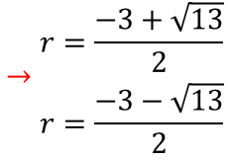

Example: Find the general solution of $y^{′′}+3y^{′}−y=0$.
Solution: The auxiliary polynomial is $r^{2}+3r−1=0$. It does not factor “easily”. We use the quadratic formula:
Thus, the general solution is
$$y=C_{1}e^{\left(\frac{−3+\sqrt{13}}{2}\right)x}+C_{2}e^{\left(\frac{−3−\sqrt{13}}{2}\right)x}.$$

Slide 7
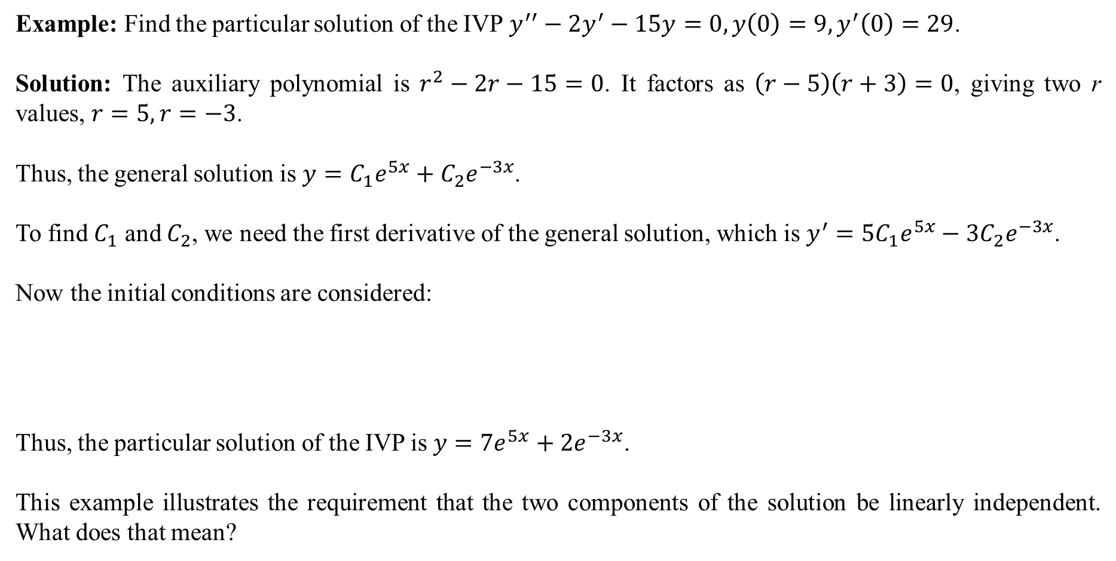
Example: Find the particular solution of the IVP $y^{′′}−2y^{′}−15y=0, y\left(0\right)=9,y^{′}\left(0\right)=29$.
Solution: The auxiliary polynomial is $r^{2}−2r−15=0$. It factors as $\left(r−5\right)\left(r+3\right)=0$, giving two r values, $r=5,r=−3$.
Thus, the general solution is $y=C_{1}e^{5x}+C_{2}e^{−3x}$.
To find $C_{1}$ and $C_{2}$, we need the first derivative of the general solution, which is $y^{′}=5C_{1}e^{5x}−3C_{2}e^{−3x}$.
Now the initial conditions are considered:
Thus, the particular solution of the IVP is $y=7e^{5x}+2e^{−3x}$.
This example illustrates the requirement that the two components of the solution be linearly independent. What does that mean?

Slide 8
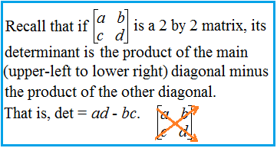
Linear Independence and the Wronskian
Let $y=C_{1}f\left(x\right)+C_{2}g(x)$ be the general solution of a linear second-order homogeneous differential equation, and assume it has initial conditions $y\left(x_{0}\right)=A$ and $y^{′}\left(x_{0}\right)=B$, where A and B are any two real numbers.
To find A and B, we need the derivative, like in the last slide: $y^{′}=C_{1}f^{′}\left(x_{0}\right)+C_{2}g^{′}\left(x_{0}\right)$. Now the initial conditions are considered:
$$\begin{matrix}y\left(x_{0}\right)=A \\ y^{′}\left(x_{0}\right)=B\end{matrix}→\begin{matrix}A=C_{1}f\left(x_{0}\right)+C_{2}g(x_{0}) \\ B=C_{1}f^{′}\left(x_{0}\right)+C_{2}g′(x_{0})\end{matrix}.$$
We write this as an equation in matrix form:
$$\left[\begin{matrix}A \\ B\end{matrix}\right]=\left[\begin{matrix}f(x_{0}) & g(x_{0}) \\ f′(x_{0}) & g′(x_{0})\end{matrix}\right]⋅\left[\begin{matrix}C_{1} \\ C_{2}\end{matrix}\right]$$
For this to work, the $2×2$ matrix $\left[\begin{matrix}f(x_{0}) & g(x_{0}) \\ f′(x_{0}) & g′(x_{0})\end{matrix}\right]$ cannot be singular.
That is, its determinant cannot be 0.

Slide 9
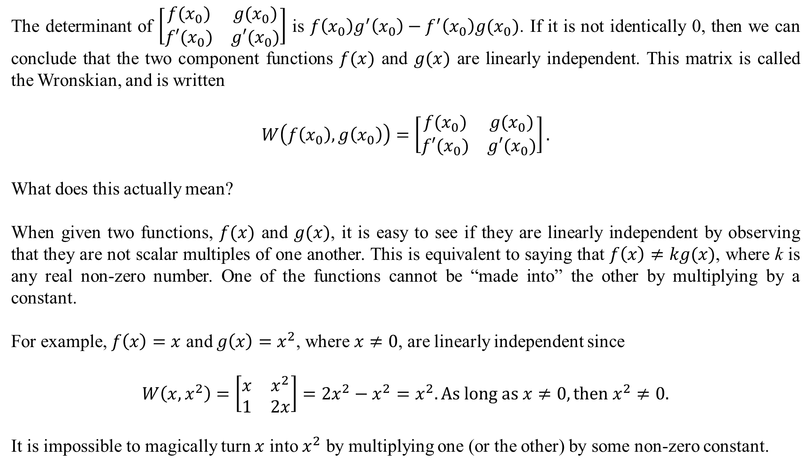
The determinant of $\left[\begin{matrix}f(x_{0}) & g(x_{0}) \\ f′(x_{0}) & g′(x_{0})\end{matrix}\right]$ is $f\left(x_{0}\right)g^{′}\left(x_{0}\right)−f^{′}\left(x_{0}\right)g(x_{0})$. If it is not identically 0, then we can conclude that the two component functions $f(x)$ and $g(x)$ are linearly independent. This matrix is called the Wronskian, and is written
$$W\left(f\left(x_{0}\right),g\left(x_{0}\right)\right)=\left[\begin{matrix}f(x_{0}) & g(x_{0}) \\ f′(x_{0}) & g′(x_{0})\end{matrix}\right].$$
What does this actually mean?
When given two functions, $f(x)$ and $g(x)$, it is easy to see if they are linearly independent by observing that they are not scalar multiples of one another. This is equivalent to saying that $f\left(x\right)≠kg(x)$, where k is any real non-zero number. One of the functions cannot be “made into” the other by multiplying by a constant.
For example, $f\left(x\right)=x$ and $g\left(x\right)=x^{2}$, where $x≠0$, are linearly independent since
$$W\left(x,x^{2}\right)=\left[\begin{matrix}x & x^{2} \\ 1 & 2x\end{matrix}\right]=2x^{2}−x^{2}=x^{2}. As long as x≠0, then x^{2}≠0.$$
It is impossible to magically turn $x$ into $x^{2}$ by multiplying one (or the other) by some non-zero constant.

Slide 10
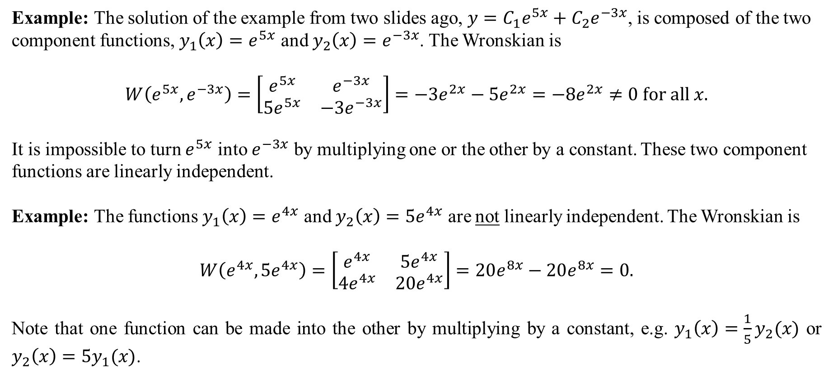
Example: The solution of the example from two slides ago, $y=C_{1}e^{5x}+C_{2}e^{−3x}$, is composed of the two component functions, $y_{1}\left(x\right)=e^{5x}$ and $y_{2}\left(x\right)=e^{−3x}$. The Wronskian is
$$W\left(e^{5x},e^{−3x}\right)=\left[\begin{matrix}e^{5x} & e^{−3x} \\ 5e^{5x} & −3e^{−3x}\end{matrix}\right]=−3e^{2x}−5e^{2x}=−8e^{2x}≠0 for all x.$$
It is impossible to turn $e^{5x}$ into $e^{−3x}$ by multiplying one or the other by a constant. These two component functions are linearly independent.
Example: The functions $y_{1}\left(x\right)=e^{4x}$ and $y_{2}\left(x\right)=5e^{4x}$ are not linearly independent. The Wronskian is
$$W\left(e^{4x},5e^{4x}\right)=\left[\begin{matrix}e^{4x} & {5e}^{4x} \\ 4e^{4x} & 20e^{4x}\end{matrix}\right]=20e^{8x}−20e^{8x}=0.$$
Note that one function can be made into the other by multiplying by a constant, e.g. $y_{1}\left(x\right)=\frac{1}{5}y_{2}(x)$ or $y_{2}\left(x\right)=5y_{1}(x)$.

Slide 11

In cases of three or more component functions, the Wronskian is the most efficient way to show linear independence. It usually is not possible to make this determination “just by looking”. For example, consider
$$y_{1}\left(x\right)=x^{2}+2x, y_{2}\left(x\right)=3x+1, y_{3}\left(x\right)=2x^{2}+x−1.$$
The Wronskian is
Would you have been able to know that these three functions are not linearly independent “just by looking”?

Slide 12
In general, if given n functions $y_{1}\left(x\right), y_{2}\left(x\right), y_{3}\left(x\right), …, y_{n}(x)$, they are linearly independent if it is impossible to write one as some linear combination of any subset of the others.
From the last slide, we had $y_{1}\left(x\right)=x^{2}+2x, y_{2}\left(x\right)=3x+1, y_{3}\left(x\right)=2x^{2}+x−1$, and we showed they are not linearly independent. This means that it is possible to express one of these as some linear combination of the other two. Did you notice that $y_{3}\left(x\right)=2y_{1}\left(x\right)−y_{2}(x)$? Probably not. That is why the Wronskian is so useful.
Typically, solutions to linear, homogeneous, autonomic nth-order differential equations appear in the following ways:
As functions of the form $e^{r_{1}x}, e^{r_{2}x},…,e^{r_{n}x}$, where $r_{1}, r_{2},…, r_{n}$ are all different real numbers. These will always be linearly independent.
As functions of the form $e^{rx},xe^{rx},x^{2}e^{rx},…$. These will also be linearly independent. (We have not seen a case like this yet. We will.)
As trigonometric functions $\sin\left(bx\right),\cos{(bx)}$ or $e^{ax}\sin{(bx)}, e^{ax}\cos{(bx)}$. These will also be linearly independent. (We haven’t seen anything like this yet either. We will).

