Slide 1
Second-order homogeneous ODEs with constant coefficients: Complex Roots of the Auxiliary Polynomial
MAT 275

Slide 2
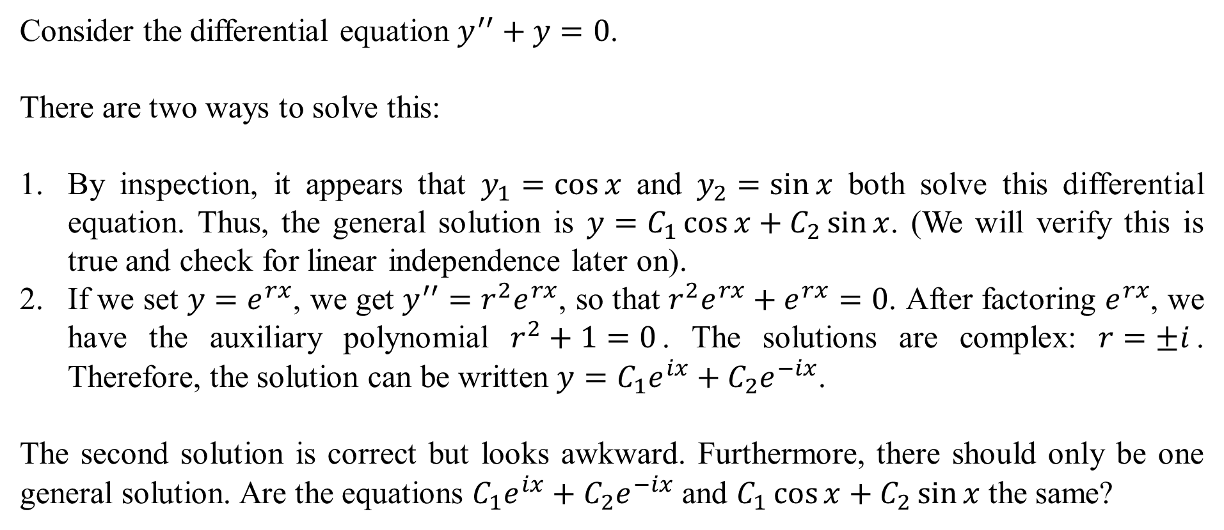
Consider the differential equation $y^{′′}+y=0$.
There are two ways to solve this:
By inspection, it appears that $y_{1}=\cos{x}$ and $y_{2}=\sin{x}$ both solve this differential equation. Thus, the general solution is $y=C_{1}\cos{x}+C_{2}\sin{x}$. (We will verify this is true and check for linear independence later on).
If we set $y=e^{rx}$, we get $y^{′′}=r^{2}e^{rx}$, so that $r^{2}e^{rx}+e^{rx}=0$. After factoring $e^{rx}$, we have the auxiliary polynomial $r^{2}+1=0$. The solutions are complex: $r=±i$. Therefore, the solution can be written $y=C_{1}e^{ix}+C_{2}e^{−ix}$.
The second solution is correct but looks awkward. Furthermore, there should only be one general solution. Are the equations $C_{1}e^{ix}+C_{2}e^{−ix}$ and $C_{1}\cos{x}+C_{2}\sin{x}$ the same?

Slide 3
Review of Maclaurin Series
Recall that
$$e^{x}=1+x+\frac{1}{2!}x^{2}+\frac{1}{3!}x^{3}+\frac{1}{4!}x^{4}+\frac{1}{5!}x^{5}+\frac{1}{6!}x^{6}+\frac{1}{7!}x^{7}+\frac{1}{8!}x^{8}+…,$$
$$\cos{x}=1−\frac{1}{2!}x^{2}+\frac{1}{4!}x^{4}−\frac{1}{6!}x^{6}+\frac{1}{8!}x^{8}−…,$$
$$\sin{x}=x−\frac{1}{3!}x^{3}+\frac{1}{5!}x^{5}−\frac{1}{7!}x^{7}+\frac{1}{9!}x^{9}−….$$
They look similar. Could these be related?

Slide 4
From the last slide, we have
$$e^{x}=1+x+\frac{1}{2!}x^{2}+\frac{1}{3!}x^{3}+\frac{1}{4!}x^{4}+\frac{1}{5!}x^{5}+\frac{1}{6!}x^{6}+\frac{1}{7!}x^{7}+\frac{1}{8!}x^{8}+….$$
Now, replace $x$ with $ix$:
$$e^{ix}=1+ix+\frac{1}{2!}{(ix)}^{2}+\frac{1}{3!}(i{x)}^{3}+\frac{1}{4!}(i{x)}^{4}+\frac{1}{5!}(i{x)}^{5}+\frac{1}{6!}(i{x)}^{6}+\frac{1}{7!}(i{x)}^{7}+\frac{1}{8!}(i{x)}^{8}+….$$
Remember that $i^{2}=−1, i^{3}=−i,i^{4}=1, i^{5}=i$, and so on, repeating the pattern. Thus, the above line is now:
$$e^{ix}=1+ix−\frac{1}{2!}x^{2}−\frac{1}{3!}ix^{3}+\frac{1}{4!}x^{4}+\frac{1}{5!}ix^{5}−\frac{1}{6!}x^{6}−\frac{1}{7!}ix^{7}+\frac{1}{8!}x^{8}+….$$
The even-powered terms no longer contain $i$, while the odd-power terms do.

Slide 5
From the last slide, we had $e^{ix}=1+ix−\frac{1}{2!}x^{2}−\frac{1}{3!}ix^{3}+\frac{1}{4!}x^{4}+\frac{1}{5!}ix^{5}−\frac{1}{6!}x^{6}−\frac{1}{7!}ix^{7}+\frac{1}{8!}x^{8}+….$
Now, regroup them and simplify:
$$e^{ix}=\left(1−\frac{1}{2!}x^{2}+\frac{1}{4!}x^{4}−\frac{1}{6!}x^{6}+\frac{1}{8!}x^{8}−…\right)+i\left(x−\frac{1}{3!}x^{3}+\frac{1}{5!}x^{5}−\frac{1}{7!}x^{7}+\frac{1}{9!}x^{9}−…\right)$$
$$e^{ix}=\cos{x}+i\sin{x}.$$
Note that $e^{−ix}=\cos{x}−i\sin{x}$. Thus, it is reasonable to replace $y=C_{1}e^{ix}+C_{2}e^{−ix}$ with $y=C_{1}\left(\cos{x}+i\sin{x}\right)+C_{2}\left(\cos{x}−i\sin{x}\right)$. This simplifies to
$$y=\left(C_{1}+C_{2}\right)\cos{x}+i\left(C_{1}−C_{2}\right)\sin{x}.$$
Since $C_{1}$ and $C_{2}$ have no meaning yet, we can replace $C_{1}+C_{2}$ with “new” $C_{1}$ and $C_{1}−C_{2}$ with “new” $C_{2}$. Now we have $y=C_{1}\cos{x}+iC_{2}\sin{x}$.

Slide 6
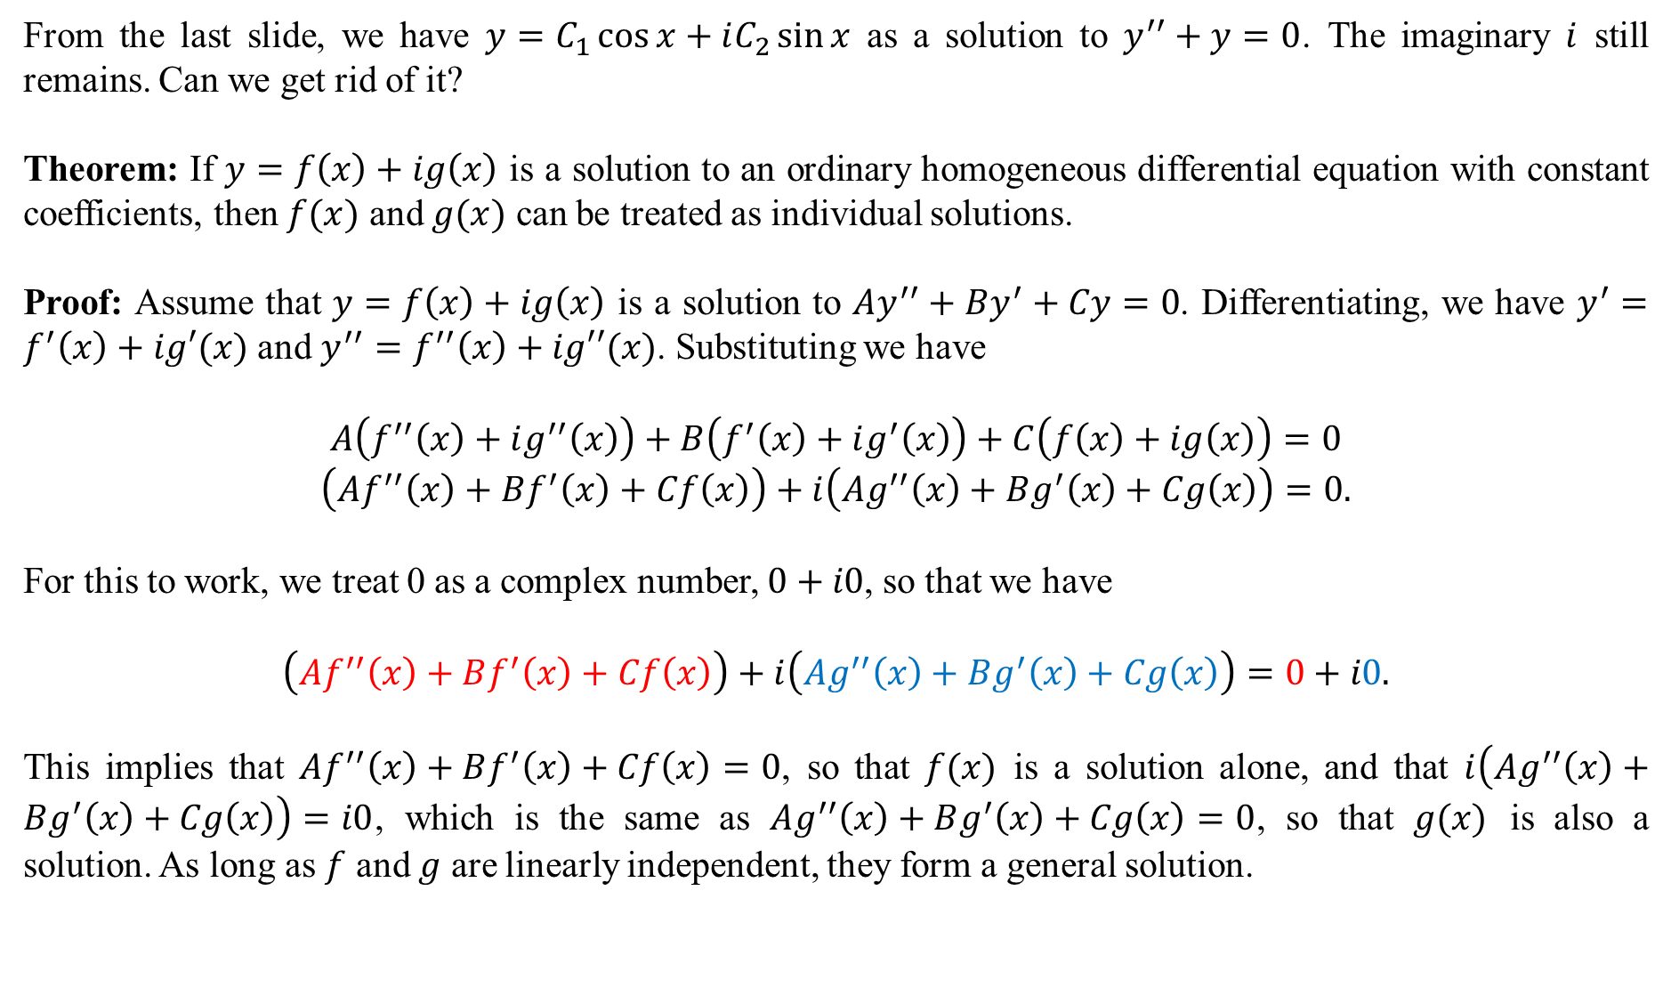
From the last slide, we have $y=C_{1}\cos{x}+iC_{2}\sin{x}$ as a solution to $y^{′′}+y=0$. The imaginary $i$ still remains. Can we get rid of it?
Theorem: If $y=f\left(x\right)+ig\left(x\right)$ is a solution to an ordinary homogeneous differential equation with constant coefficients, then $f(x)$ and $g(x)$ can be treated as individual solutions.
Proof: Assume that $y=f\left(x\right)+ig\left(x\right)$ is a solution to $Ay^{′′}+By^{′}+Cy=0$. Differentiating, we have $y^{′}=f^{′}\left(x\right)+ig′(x)$ and $y^{′′}=f^{′′}\left(x\right)+ig′′(x)$. Substituting we have
$$A\left(f^{′′}\left(x\right)+ig^{′′}\left(x\right)\right)+B\left(f^{′}\left(x\right)+ig^{′}\left(x\right)\right)+C\left(f\left(x\right)+ig\left(x\right)\right)=0$$
$$\left(Af^{′′}\left(x\right)+Bf^{′}\left(x\right)+Cf\left(x\right)\right)+i\left(Ag^{′′}\left(x\right)+Bg^{′}\left(x\right)+Cg\left(x\right)\right)=0.$$
For this to work, we treat 0 as a complex number, $0+i0$, so that we have
$$\left(Af^{′′}\left(x\right)+Bf^{′}\left(x\right)+Cf\left(x\right)\right)+i\left(Ag^{′′}\left(x\right)+Bg^{′}\left(x\right)+Cg\left(x\right)\right)=0+i0.$$
This implies that $Af^{′′}\left(x\right)+Bf^{′}\left(x\right)+Cf\left(x\right)=0$, so that $f(x)$ is a solution alone, and that $i\left(Ag^{′′}\left(x\right)+Bg^{′}\left(x\right)+Cg\left(x\right)\right)=i0$, which is the same as $Ag^{′′}\left(x\right)+Bg^{′}\left(x\right)+Cg\left(x\right)=0$, so that $g(x)$ is also a solution. As long as $f$ and $g$ are linearly independent, they form a general solution.

Slide 7
General rule: If an ODE is of second order, homogeneous and with constant coefficients, and its auxiliary polynomial has complex roots $x=a±bi$, then the general solution is
$$y=C_{1}e^{ax}\cos{(bx)}+C_{2}e^{ax}\sin{(bx)}.$$
Example: Find the general solution of $y^{′′}+2y^{′}+5y=0$.
Solution: The auxiliary polynomial is $r^{2}+2r+5=0$. Using the quadratic formula, the roots are $y=−1±2i$, which gives $a=−1$ and $b=2$. Thus, the general solution is
$$y=C_{1}e^{−x}\cos{(2x)}+C_{2}e^{−x}\sin{(2x)}.$$
Two things: (1) Assume b is positive so you can ignore the plus-minus, and (2) you no longer need to write the i.
Are they linearly independent? We check the Wronskian (next slide).

Slide 8
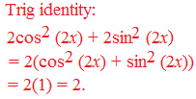
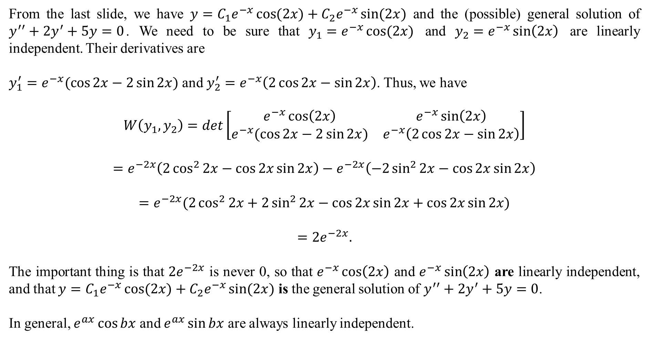
From the last slide, we have $y=C_{1}e^{−x}\cos{(2x)}+C_{2}e^{−x}\sin{(2x)}$ and the (possible) general solution of $y^{′′}+2y^{′}+5y=0$. We need to be sure that ${y_{1}=e}^{−x}\cos{(2x})$ and $y_{2}=e^{−x}\sin\left(2x\right)$ are linearly independent. Their derivatives are
$y_{1}^{′}=e^{−x}(\cos{2x}−2\sin{2x})$ and $y_{2}^{′}=e^{−x}\left(2\cos{2x}−\sin{2x}\right)$. Thus, we have
$$W\left(y_{1},y_{2}\right)=det\left[\begin{matrix}e^{−x}\cos\left(2x\right) & e^{−x}\sin\left(2x\right) \\ e^{−x}(\cos{2x}−2\sin{2x}) & e^{−x}\left(2\cos{2x}−\sin{2x}\right)\end{matrix}\right]$$
$$=e^{−2x}\left(2\cos^{2}{2x}−\cos{2x}\sin{2x}\right)−e^{−2x}\left(−2\sin^{2}{2x}−\cos{2x}\sin{2x}\right)$$
$$=e^{−2x}(2\cos^{2}{2x}+2\sin^{2}{2x}−\cos{2x}\sin{2x}+\cos{2x}\sin{2x})$$
$$=2e^{−2x}.$$
The important thing is that $2e^{−2x}$ is never 0, so that $e^{−x}\cos\left(2x\right)$ and $e^{−x}\sin\left(2x\right)$ are linearly independent, and that $y=C_{1}e^{−x}\cos{(2x)}+C_{2}e^{−x}\sin{(2x)}$ is the general solution of $y^{′′}+2y^{′}+5y=0$.
In general, $e^{ax}\cos{bx}$ and $e^{ax}\sin{bx}$ are always linearly independent.

Slide 9
Example: Find the general solution of $y^{′′′}−8y=0$.
Solution: The auxiliary polynomial is $r^{3}−8=0$. The standard factor form of $r^{3}−k^{3}$ is $(r−k)(r^{2}+rk+k^{2})$. Thus, we can simplify $r^{3}−8=0$ as $\left(r−2\right)\left(r^{2}+2r+4\right)=0$.
The factor $(r−2)$ gives a root of $r=2$, so that $y=e^{2x}$ is one solution.
The roots of the factor $\left(r^{2}+2r+4\right)$ are found by the quadratic formula. The roots are $r=−1±i\sqrt{3}$ (Remember, you can ignore the plus-minus). Thus, we have $a=−1$ and $b=\sqrt{3}$, and another solution is $y=e^{−x}\cos{(\sqrt{3}x)}+e^{−x}\sin{(\sqrt{3}x)}$.
Combined, the general solution is
$$y=C_{1}e^{2x}+C_{2}e^{−x}\cos{(\sqrt{3}x)}+C_{3}e^{−x}\sin{(\sqrt{3}x)}.$$

Slide 10
Example: Find the solution to the IVP $y^{iv}−y=0,$ with initial conditions
$y\left(0\right)=1, y^{′}\left(0\right)=2, y^{′′}\left(0\right)=−1, and y^{′′′}\left(0\right)=1$.
Solution: The auxiliary polynomial is $r^{4}−1$, which factors to $(r^{2}−1)(r^{2}+1)$ and then again to $(r+1)(r−1)(r^{2}+1)$.
From $(r+1)$, we get a root $r=−1$, so that $y=e^{−x}$ is a solution.
From $(r−1)$, we get a root $r=1$, so that $y=e^{x}$ is a solution.
From $(r^{2}+1)$, we get the complex solutions $y=±i$, or $0±1i$, so that $a=0$ and $b=1$. Thus, we get $y=e^{0x}\cos{(1x)}+e^{0x}\sin{(1x)}$ as solutions, which can be simplified to $y=\cos{x}+\sin{x}$.
Thus, the general solution is
$$y=C_{1}e^{−x}+C_{2}e^{x}+C_{3}\cos{x}+C_{4}\sin{x}.$$

Slide 11
From the last slide, we have $y=C_{1}e^{−x}+C_{2}e^{x}+C_{3}\cos{x}+C_{4}\sin{x}$ as the general solution of the IVP $y^{iv}−y=0,$ with initial conditions $y\left(0\right)=1, y^{′}\left(0\right)=2, y^{′′}\left(0\right)=−1, and y^{′′′}\left(0\right)=1$.
To find the particular solution, we need to differentiate three times:
$$y^{′}=−C_{1}e^{−x}+C_{2}e^{x}−C_{3}\sin{x}+C_{4}\cos{x},$$
$$y^{′′}=C_{1}e^{−x}+C_{2}e^{x}−C_{3}\cos{x}−C_{4}\sin{x},$$
$$y^{′′′}=−C_{1}e^{−x}+C_{2}e^{x}+C_{3}\sin{x}−C_{4}\cos{x}.$$
The initial conditions are now considered:
$$y\left(0\right)=1→C_{1}e^{−0}+C_{2}e^{0}+C_{3}\cos{0}+C_{4}\sin{0}=1,$$
$$y^{′}\left(0\right)=2→−C_{1}e^{−0}+C_{2}e^{0}−C_{3}\sin{0}+C_{4}\cos{0}=2,$$
$$y^{′′}\left(0\right)=−1→C_{1}e^{−0}+C_{2}e^{0}−C_{3}\cos{0}−C_{4}\sin{0}=−1,$$
$$y^{′′′}\left(0\right)=1→−C_{1}e^{−0}+C_{2}e^{0}+C_{3}\sin{0}−C_{4}\cos{0=1.}$$

Slide 12
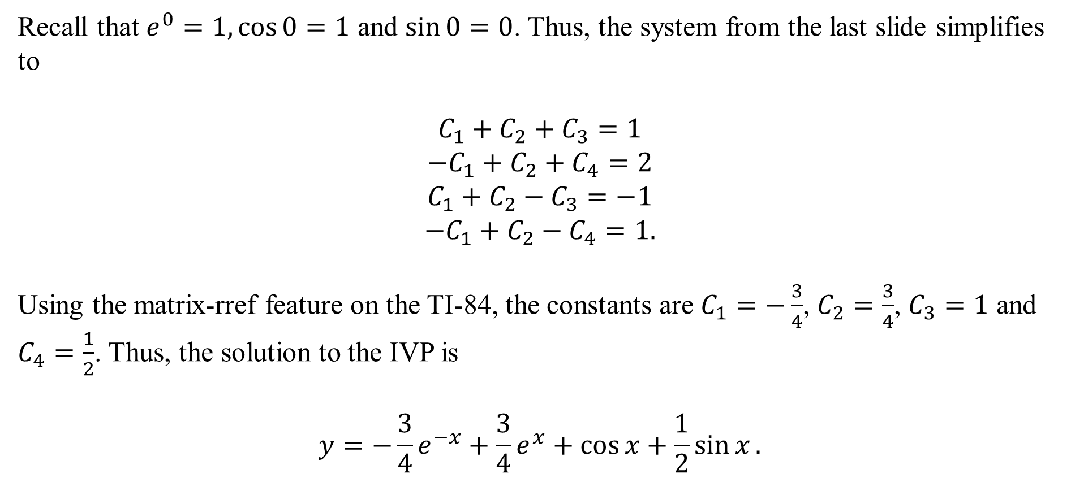
Recall that $e^{0}=1,\cos{0}=1$ and $\sin{0}=0$. Thus, the system from the last slide simplifies to
$$C_{1}+C_{2}+C_{3}=1$$
$$−C_{1}+C_{2}+C_{4}=2$$
$$C_{1}+C_{2}−C_{3}=−1$$
$$−C_{1}+C_{2}−C_{4}=1.$$
Using the matrix-rref feature on the TI-84, the constants are $C_{1}=−\frac{3}{4}$, $C_{2}=\frac{3}{4}$, $C_{3}=1$ and $C_{4}=\frac{1}{2}$. Thus, the solution to the IVP is
$$y=−\frac{3}{4}e^{−x}+\frac{3}{4}e^{x}+\cos{x}+\frac{1}{2}\sin{x}.$$

