Slide 1
Classification of Differential Equations
MAT 275

Slide 2
Ordinary vs. Partial
If the differential equation consists of a function of the form y = f (x) and some combination of its derivatives, then the differential equation is ordinary. Note that y = f (x) is a function of a single variable, not a multivariable function.
All differential equations in this class are ordinary.
In later courses, you may see differential equations with more than one independent variable. These are called partial differential equations.

Slide 3
Order
The order of a differential equation is the “highest” derivative of y = f (x) present in the diff. eq.
Examples:
$y^{′}+2y=0$
This is first order.
$y^{′′}+2y^{′}−6y=1$
This is second order.
For higher derivatives, we use the notation $y^{\left(n\right)}$ to represent the nth derivative of y, rather than write out n prime symbols.

Slide 4
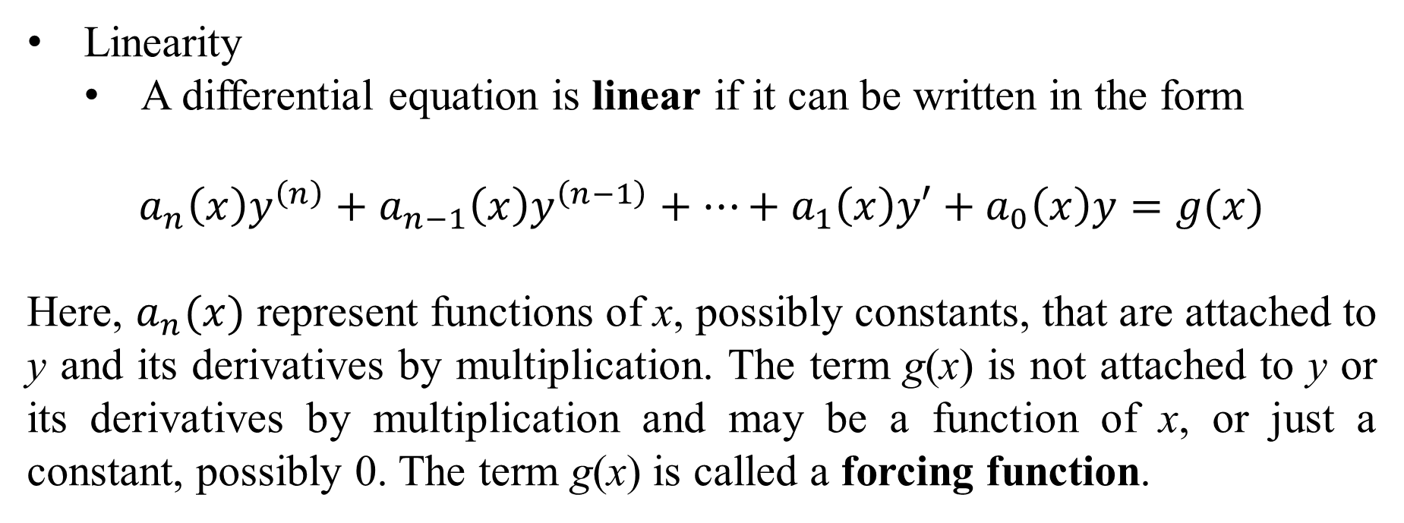
Linearity
A differential equation is linear if it can be written in the form
$$a_{n}\left(x\right)y^{\left(n\right)}+a_{n−1}\left(x\right)y^{\left(n−1\right)}+…+a_{1}\left(x\right)y′+a_{0}\left(x\right)y=g(x)$$
Here, $a_{n}(x)$ represent functions of x, possibly constants, that are attached to y and its derivatives by multiplication. The term g(x) is not attached to y or its derivatives by multiplication and may be a function of x, or just a constant, possibly 0. The term g(x) is called a forcing function.

Slide 5
Linearity (continued)
A linear differential equation does not combine y or any of its derivatives through multiplication.
Nor does it treat y or any of its derivatives as an argument within another operator.
Examples:
$y^{′}+2y=6$ is linear.
$y^{′′′}+3y^{′}=−5$ is linear.
${\left(y^{′}\right)}^{2}+2y=e^{x}$ is not linear. Why?
Because the $y′$ is being raised to a power other than 1.
$y^{′′}∙y=3x$ is not linear. Why?
We are multiplying y and one of its derivatives.

Slide 6
Homogeneous (homogeneity)
A linear differential equation is homogeneous is the forcing function g(x) is 0.
Homogeneity only applies to linear differential equations.
Examples:
$y^{′′}+2y^{′}=3y$
This is homogeneous because it can be written as
$y^{′′}+2y^{′}−3y=0$.
$y^{′′}−4xy+2x=0$
This is not homogeneous because is can be rewritten as
$y^{′′}−4xy=−2x$. The forcing function is $g\left(x\right)=−2x$.

Slide 7
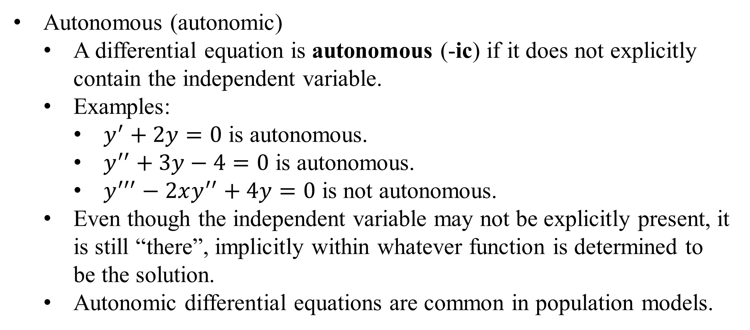
Autonomous (autonomic)
A differential equation is autonomous (-ic) if it does not explicitly contain the independent variable.
Examples:
$y^{′}+2y=0$ is autonomous.
$y^{′′}+3y−4=0$ is autonomous.
$y^{′′′}−2xy^{′′}+4y=0$ is not autonomous.
Even though the independent variable may not be explicitly present, it is still “there”, implicitly within whatever function is determined to be the solution.
Autonomic differential equations are common in population models.

Slide 8
Examples
$$y^{′}+2xy=4x$$
It is ordinary. It is first order. It is linear. It is not homogeneous. It is not autonomic.
$$y^{′′}\left(1−y\right)=2x^{2}$$
It is ordinary. It is second order. It is not linear. Homogeneity is not a concern. It is not autonomic.

Slide 9
Direction Fields
We plot small lines representing slopes at each coordinate (x,y) in the xy-plane. From this, we can infer solution curves.
Example: Sketch a direction field for $y^{′}=x+y$.
At each (x,y) coordinate, we determine $y^{′}$. Some examples are:
At (1,1) we have $y^{′}=2$.
At (2,-3), we have $y^{′}=−1$. And so on.
We do this for “all” possible points in the plane. We get…

Slide 10
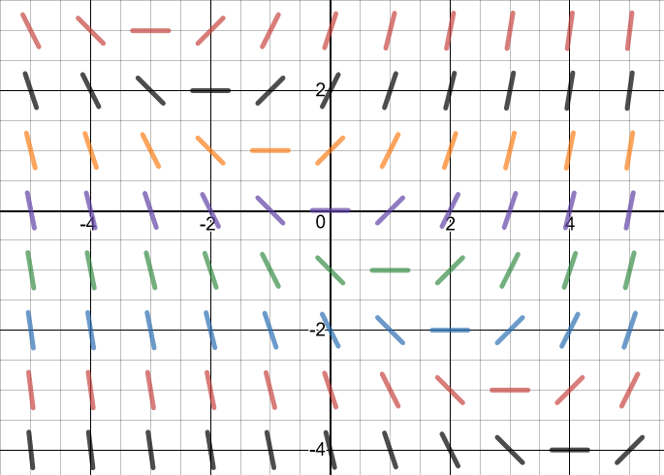
Direction field for $y^{′}=x+y$:

Slide 11
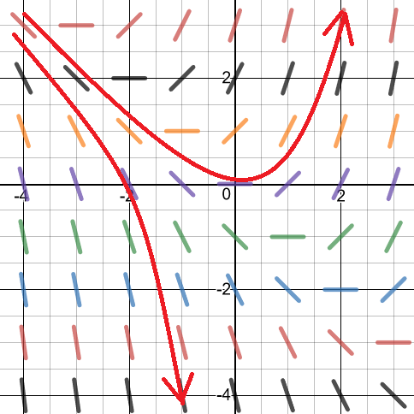
We can infer possible solution curves. If you know a point on a particular curve, the rest of the curve can be inferred by “following” the direction field. (We always read left to right, i.e. x is increasing).

Slide 12
Example: Sketch the direction field for $y^{′}=y^{3}−4y$.
Hint: note that this only depends on y. Thus, if we find one slope-line for a particular y-value, we can extend it left and right.
Another hint: Note that $y^{′}=0$ represents a horizontal slope-line and this occurs when $y^{3}−4y=0$. Factoring, we have
$$y\left(y^{2}−4\right)=y\left(y+2\right)\left(y−2\right)=0.$$
Thus, when $y=2, −2 or 0$, then $y^{′}=0$.

Slide 13
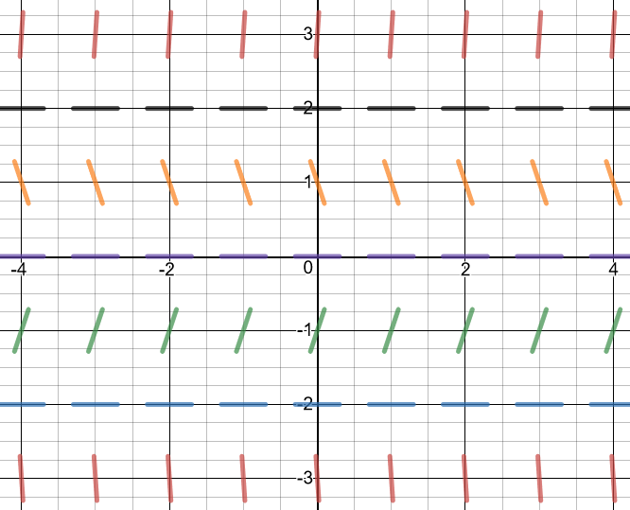
The direction field for $y^{′}=y^{3}−4y$ is:
Note the horizontal slopes when y = -2, y = 0 or y = 2. These are equilibrium solutions.

Slide 14
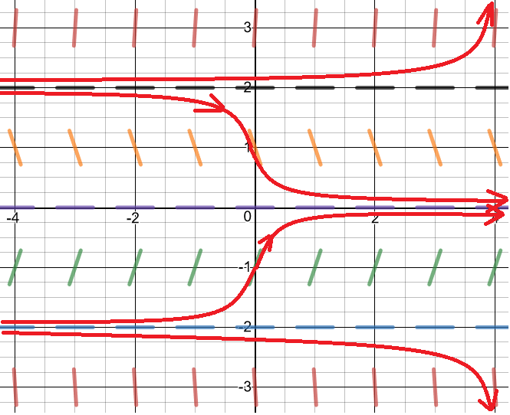
Note how the flow lines (representing possible solution curves) veer towards the equilibrium solution $y=0$. Thus, $y=0$ is a stable equilibrium.

Slide 15
The flow lines veer away from the equilibriums $y=2$ and $y=−2$. These are unstable equilibriums.

Slide 16
A third type of equilibrium is semi-stable, in which the solution curves approach the equilibrium asymptotically from one side, yet veer away from the other.

