Slide 1
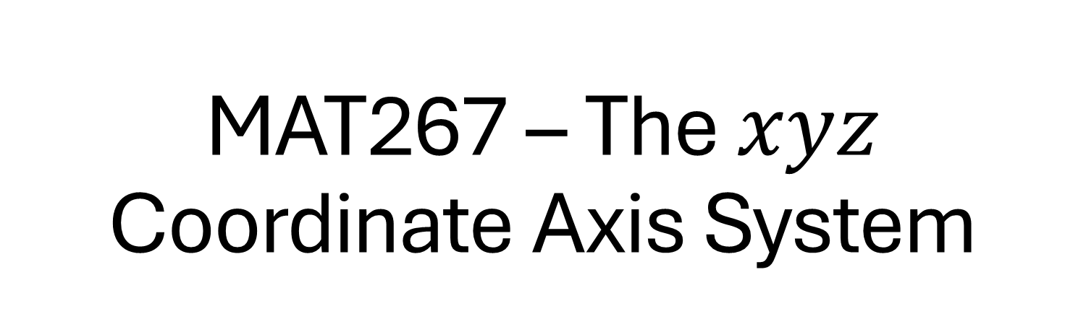
MAT267 – The $xyz$ Coordinate Axis System
Scott Surgent

Slide 2
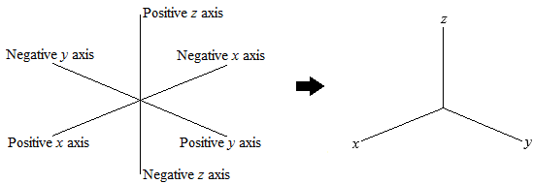
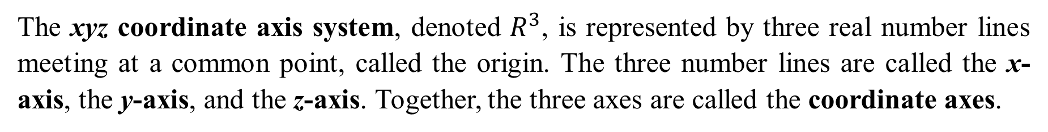
The xyz coordinate axis system, denoted $R^{3}$, is represented by three real number lines meeting at a common point, called the origin. The three number lines are called the x-axis, the y-axis, and the z-axis. Together, the three axes are called the coordinate axes.
The three axes divide $R^{3}$ into eight regions, called octants. The region in which x, y and z are positive is called the first octant or the positive octant.

Slide 3
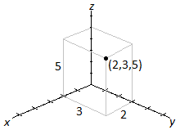
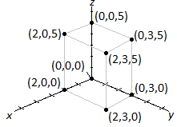
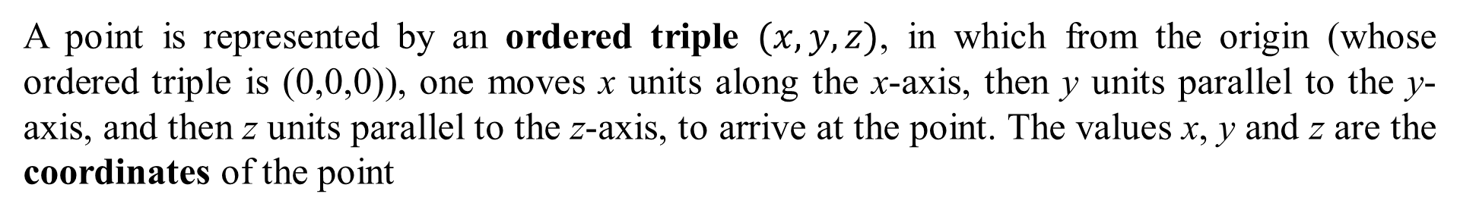
A point is represented by an ordered triple $(x,y,z)$, in which from the origin (whose ordered triple is (0,0,0)), one moves x units along the x-axis, then y units parallel to the y-axis, and then z units parallel to the z-axis, to arrive at the point. The values x, y and z are the coordinates of the point
Example 1: Represent the point (2,3,5) on an xyz-coordinate axis system.
The point (2,3,0) is called a projection of (2,3,5) onto the xy-plane, found by setting $z=0$. Other projections can be found similarly.

Slide 4
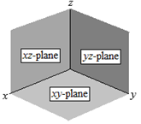
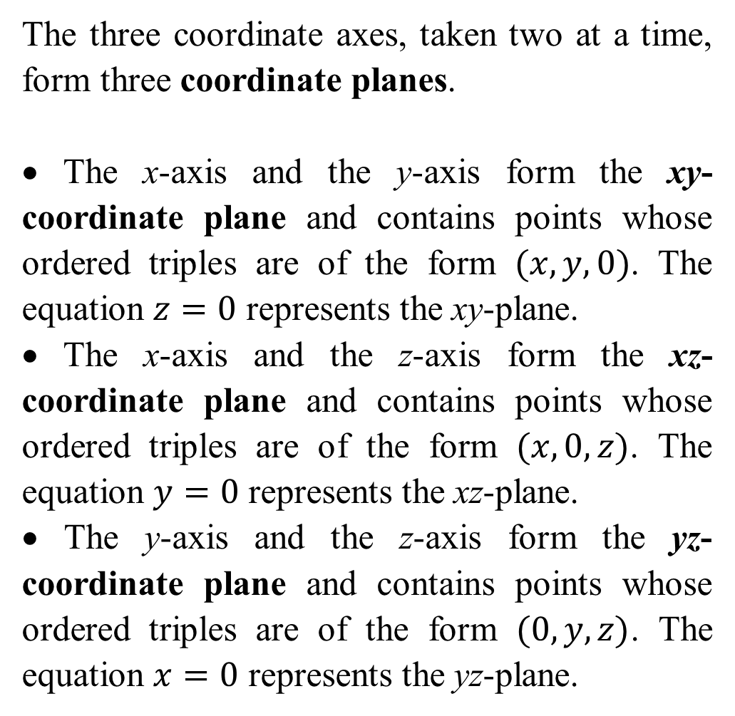
The three coordinate axes, taken two at a time, form three coordinate planes.
• The x-axis and the y-axis form the xy-coordinate plane and contains points whose ordered triples are of the form $(x,y,0)$. The equation $z=0$ represents the xy-plane.
• The x-axis and the z-axis form the xz-coordinate plane and contains points whose ordered triples are of the form $(x,0,z)$. The equation $y=0$ represents the xz-plane.
• The y-axis and the z-axis form the yz-coordinate plane and contains points whose ordered triples are of the form $(0,y,z)$. The equation $x=0$ represents the yz-plane.

Slide 5
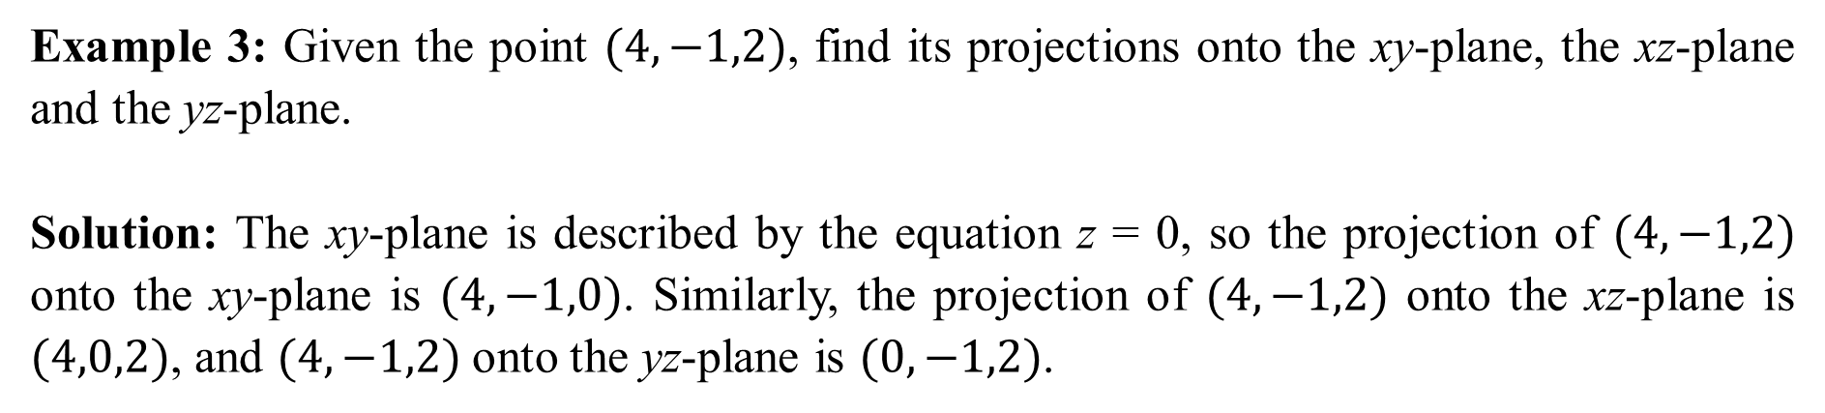
Example 2: The point (100,6,4) is closest to which coordinate plane?
Solution: Since the z-value of 4 is the smallest of the three coordinates, the point (100,6,4) is closest to the xy coordinate plane.
Example 3: Given the point $(4,−1,2)$, find its projections onto the xy-plane, the xz-plane and the yz-plane.
Solution: The xy-plane is described by the equation z = 0, so the projection of $(4,−1,2)$ onto the xy-plane is $(4,−1,0)$. Similarly, the projection of $(4,−1,2)$ onto the xz-plane is $(4,0,2)$, and $(4,−1,2)$ onto the yz-plane is $(0,−1,2)$.

Slide 6
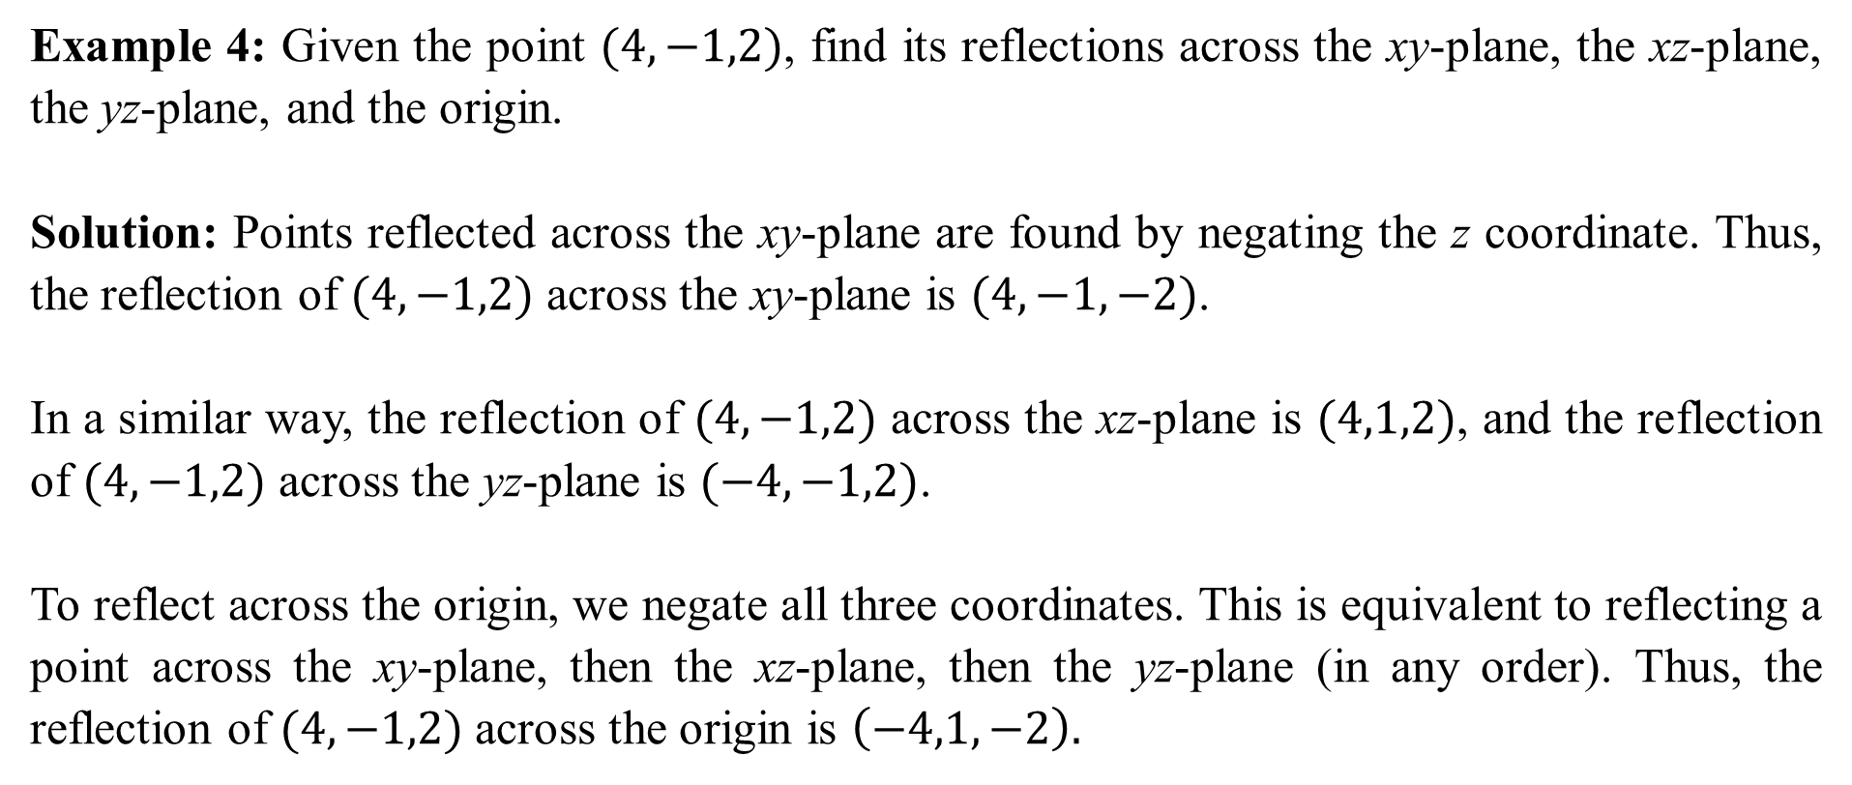
Example 4: Given the point $(4,−1,2)$, find its reflections across the xy-plane, the xz-plane, the yz-plane, and the origin.
Solution: Points reflected across the xy-plane are found by negating the z coordinate. Thus, the reflection of $(4,−1,2)$ across the xy-plane is $(4,−1,−2)$.
In a similar way, the reflection of $(4,−1,2)$ across the xz-plane is $(4,1,2)$, and the reflection of $(4,−1,2)$ across the yz-plane is $(−4,−1,2)$.
To reflect across the origin, we negate all three coordinates. This is equivalent to reflecting a point across the xy-plane, then the xz-plane, then the yz-plane (in any order). Thus, the reflection of $(4,−1,2)$ across the origin is $\left(−4,1,−2\right).$

Slide 7
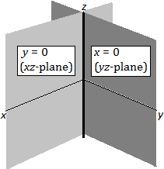
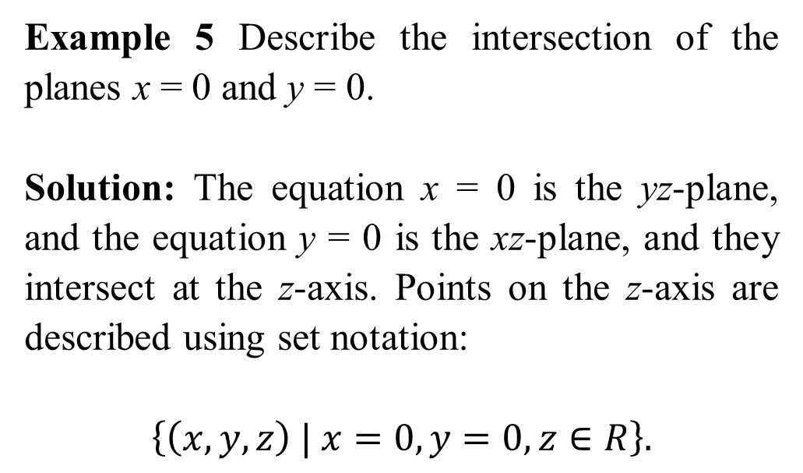
Example 5 Describe the intersection of the planes x = 0 and y = 0.
Solution: The equation x = 0 is the yz-plane, and the equation y = 0 is the xz-plane, and they intersect at the z-axis. Points on the z-axis are described using set notation:
$$\left\{\left(x,y,z\right) | x=0, y=0,z∈R\right\}.$$

Slide 8
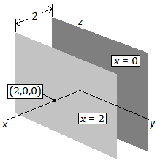
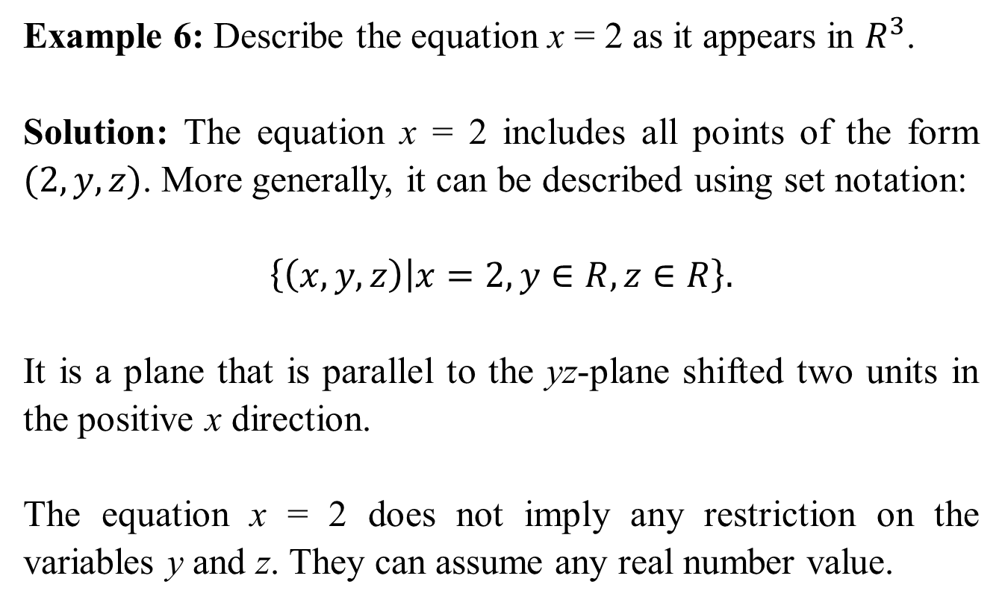
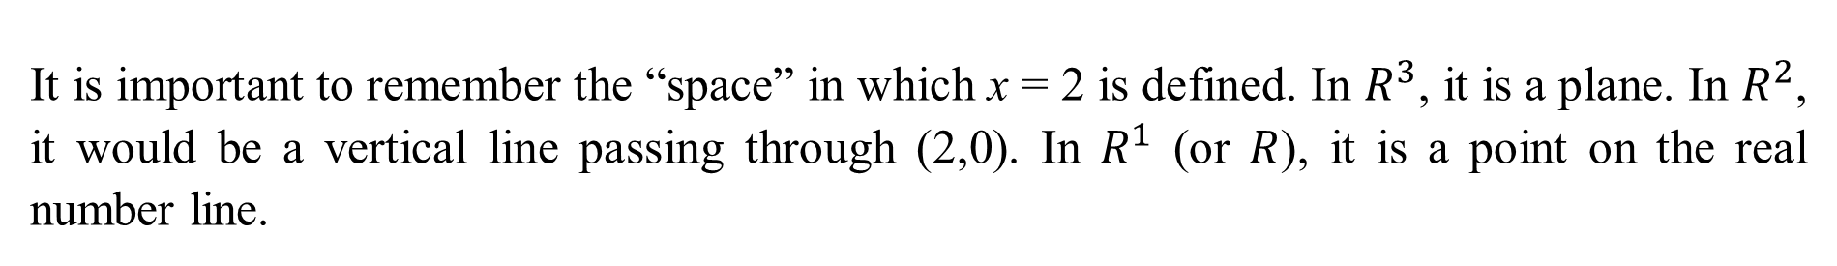
Example 6: Describe the equation x = 2 as it appears in $R^{3}$.
Solution: The equation x = 2 includes all points of the form $(2,y,z)$. More generally, it can be described using set notation:
$$\left\{\left(x,y,z\right) | x=2,y∈R, z∈R\right\}.$$
It is a plane that is parallel to the yz-plane shifted two units in the positive x direction.
The equation x = 2 does not imply any restriction on the variables y and z. They can assume any real number value.
It is important to remember the “space” in which x = 2 is defined. In $R^{3}$, it is a plane. In $R^{2}$, it would be a vertical line passing through (2,0). In $R^{1}$ (or $R$), it is a point on the real number line.

Slide 9
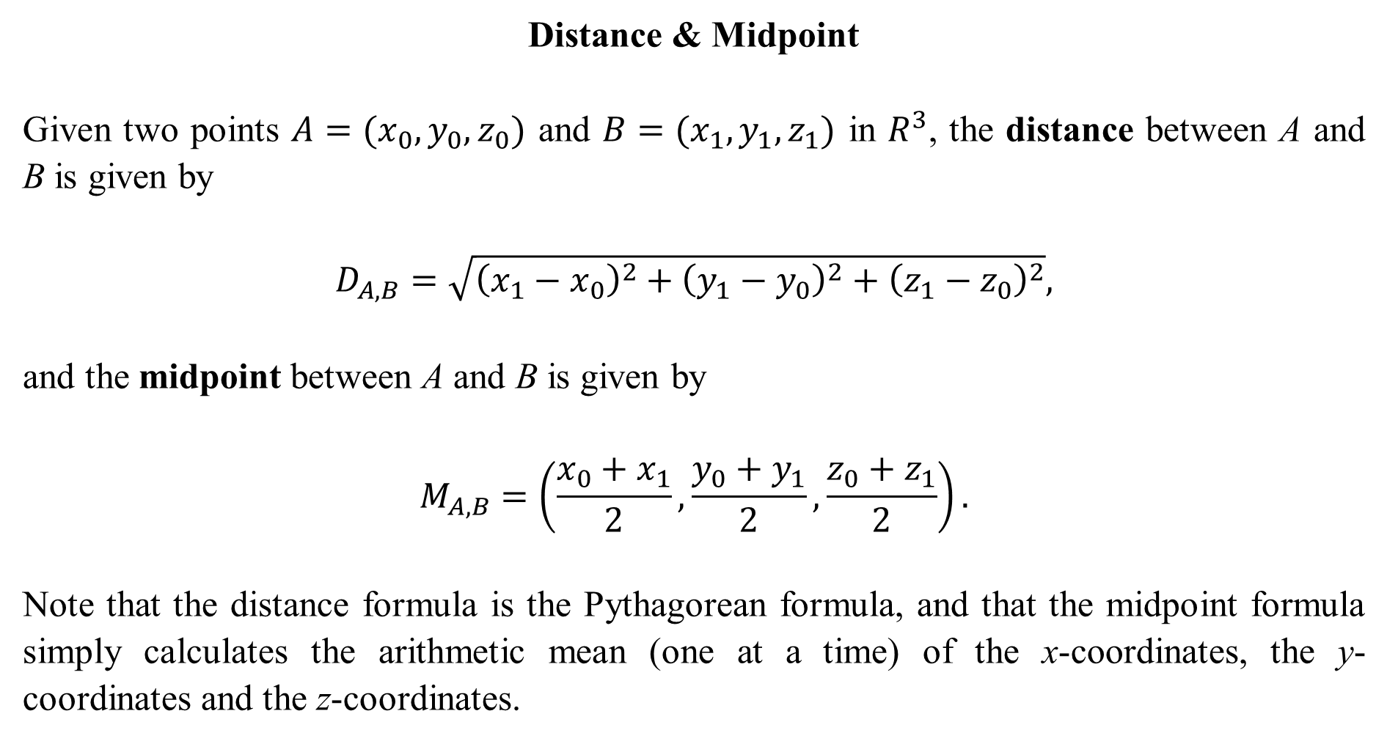
Distance & Midpoint
Given two points $A=(x_{0},y_{0},z_{0})$ and $B=(x_{1},y_{1},z_{1})$ in $R^{3}$, the distance between A and B is given by
$$D_{A,B}=\sqrt{{\left(x_{1}−x_{0}\right)}^{2}+{\left(y_{1}−y_{0}\right)}^{2}+{\left(z_{1}−z_{0}\right)}^{2}},$$
and the midpoint between A and B is given by
$$M_{A,B}=\left(\frac{x_{0}+x_{1}}{2},\frac{y_{0}+y_{1}}{2},\frac{z_{0}+z_{1}}{2}\right).$$
Note that the distance formula is the Pythagorean formula, and that the midpoint formula simply calculates the arithmetic mean (one at a time) of the x-coordinates, the y-coordinates and the z-coordinates.

Slide 10
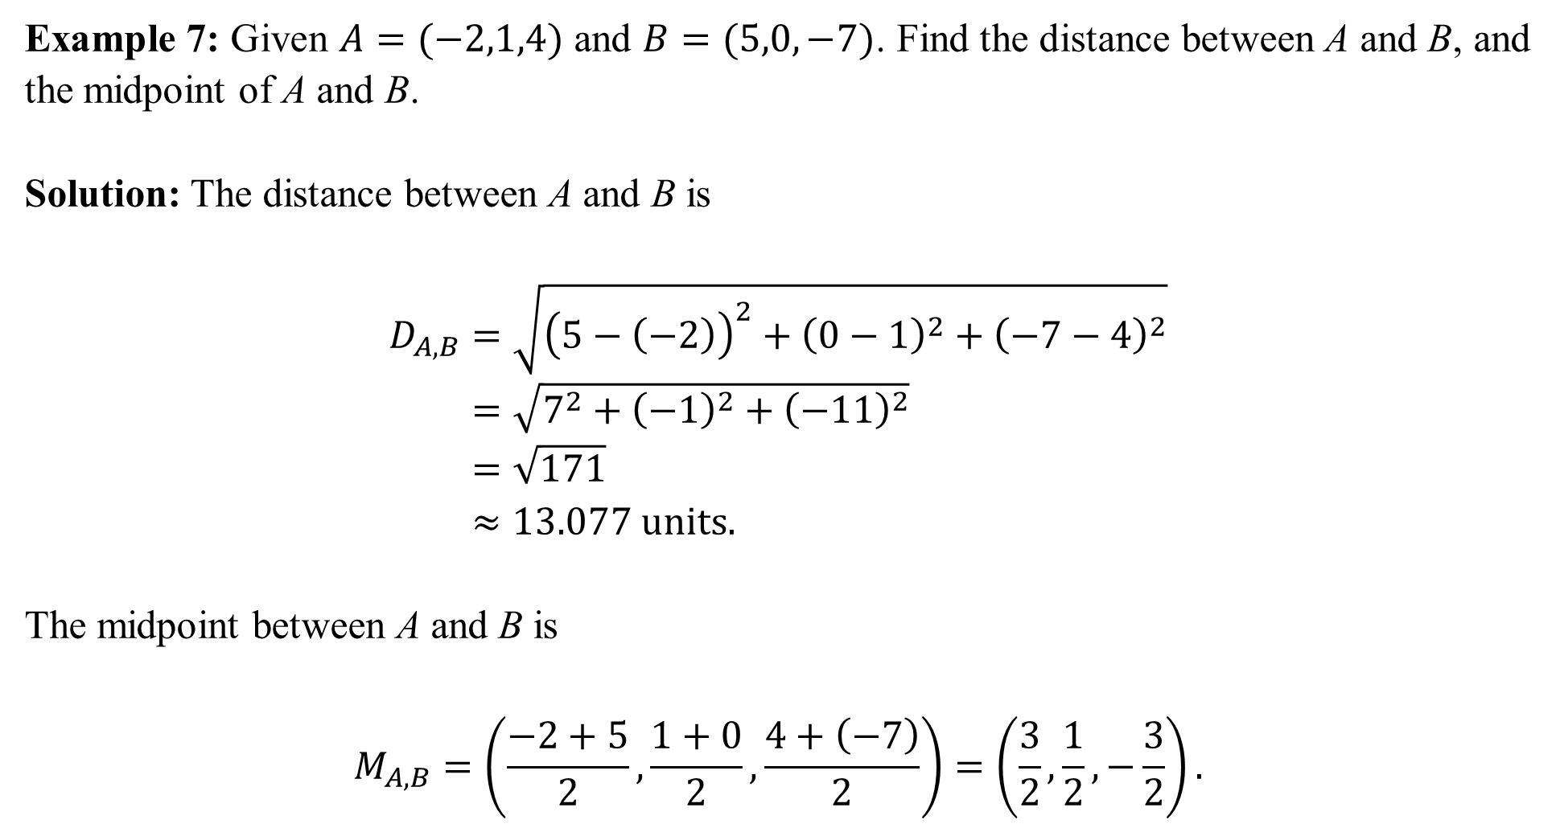
Example 7: Given $A=(−2,1,4)$ and $B=(5,0,−7)$. Find the distance between A and B, and the midpoint of A and B.
Solution: The distance between A and B is
$$D_{A,B}=\sqrt{{\left(5−\left(−2\right)\right)}^{2}+{\left(0−1\right)}^{2}+{\left(−7−4\right)}^{2}} \\ =\sqrt{7^{2}+{\left(−1\right)}^{2}+{\left(−11\right)}^{2}} \\ =\sqrt{171} \\ ≈13.077 units.$$
The midpoint between A and B is
$$M_{A,B}=\left(\frac{−2+5}{2},\frac{1+0}{2},\frac{4+\left(−7\right)}{2}\right)=\left(\frac{3}{2},\frac{1}{2},−\frac{3}{2}\right).$$

Slide 11
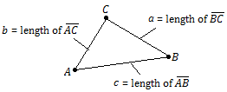
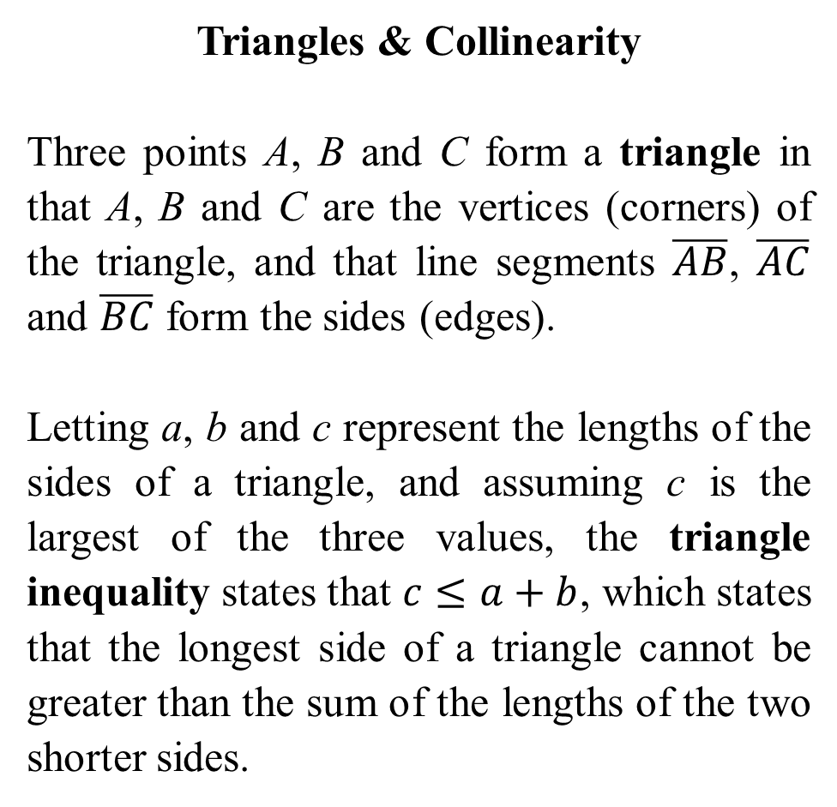
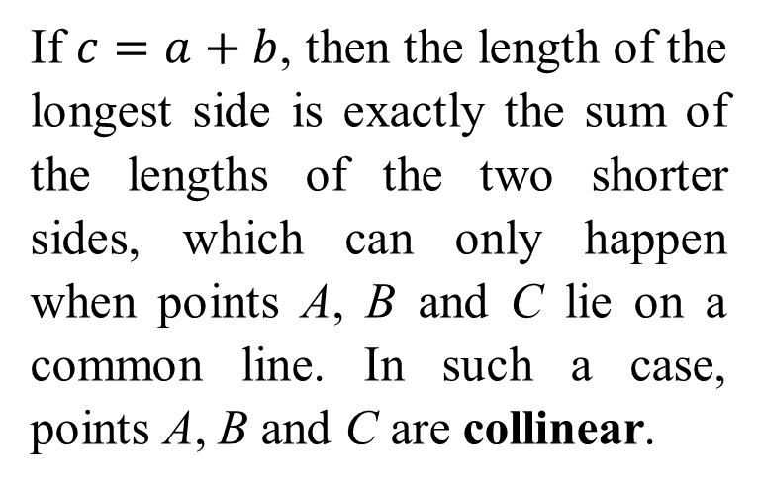
Triangles & Collinearity
Three points A, B and C form a triangle in that A, B and C are the vertices (corners) of the triangle, and that line segments $\overline{AB}$, $\overline{AC}$ and $\overline{BC}$ form the sides (edges).
Letting a, b and c represent the lengths of the sides of a triangle, and assuming c is the largest of the three values, the triangle inequality states that $c≤a+b$, which states that the longest side of a triangle cannot be greater than the sum of the lengths of the two shorter sides.
If $c=a+b$, then the length of the longest side is exactly the sum of the lengths of the two shorter sides, which can only happen when points A, B and C lie on a common line. In such a case, points A, B and C are collinear.

Slide 12
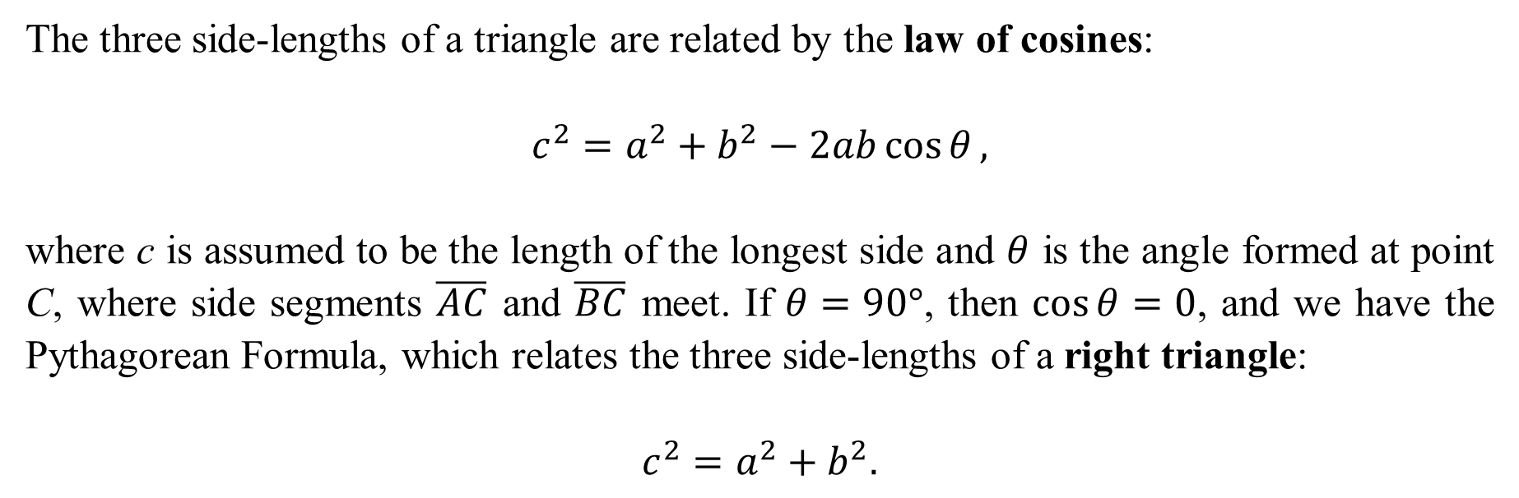
The three side-lengths of a triangle are related by the law of cosines:
$$c^{2}=a^{2}+b^{2}−2ab\cos{θ},$$
where c is assumed to be the length of the longest side and $θ$ is the angle formed at point C, where side segments $\overline{AC}$ and $\overline{BC}$ meet. If $θ=90°$, then $\cos{θ}=0$, and we have the Pythagorean Formula, which relates the three side-lengths of a right triangle:
$$c^{2}=a^{2}+b^{2}.$$

Slide 13
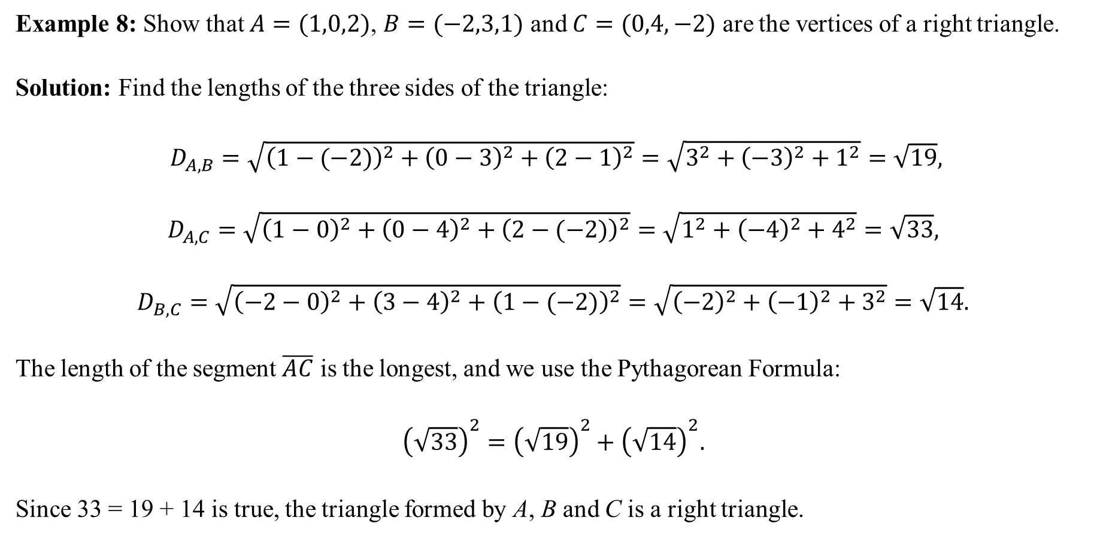
Example 8: Show that $A=(1,0,2)$, $B=(−2,3,1)$ and $C=(0,4,−2)$ are the vertices of a right triangle.
Solution: Find the lengths of the three sides of the triangle:
$D_{A,B}=\sqrt{{\left(1−(−2)\right)}^{2}+{\left(0−3\right)}^{2}+{\left(2−1\right)}^{2}}=\sqrt{3^{2}+{\left(−3\right)}^{2}+1^{2}}=\sqrt{19},$
$$D_{A,C}=\sqrt{{\left(1−0\right)}^{2}+{\left(0−4\right)}^{2}+{\left(2−(−2)\right)}^{2}}=\sqrt{1^{2}+{\left(−4\right)}^{2}+4^{2}}=\sqrt{33},$$
$$D_{B,C}=\sqrt{{\left(−2−0\right)}^{2}+{\left(3−4\right)}^{2}+{\left(1−(−2)\right)}^{2}}=\sqrt{{\left(−2\right)}^{2}+{\left(−1\right)}^{2}+3^{2}}=\sqrt{14}.$$
The length of the segment $\overline{AC}$ is the longest, and we use the Pythagorean Formula:
$${\left(\sqrt{33}\right)}^{2}={\left(\sqrt{19}\right)}^{2}+{\left(\sqrt{14}\right)}^{2}.$$
Since 33 = 19 + 14 is true, the triangle formed by A, B and C is a right triangle.

Slide 14
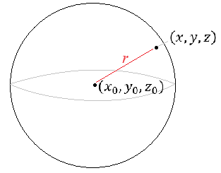
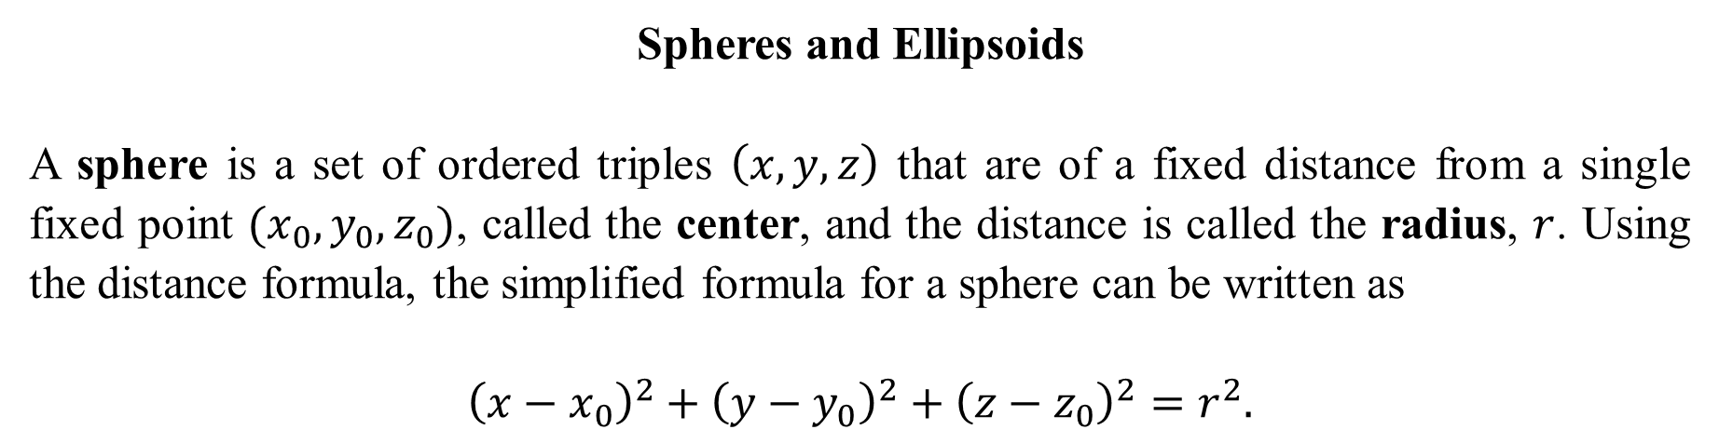
Spheres and Ellipsoids
A sphere is a set of ordered triples $\left(x,y,z\right)$ that are of a fixed distance from a single fixed point $(x_{0},y_{0},z_{0})$, called the center, and the distance is called the radius, $r$. Using the distance formula, the simplified formula for a sphere can be written as
$${\left(x−x_{0}\right)}^{2}+{\left(y−y_{0}\right)}^{2}+{\left(z−z_{0}\right)}^{2}=r^{2}.$$

Slide 15
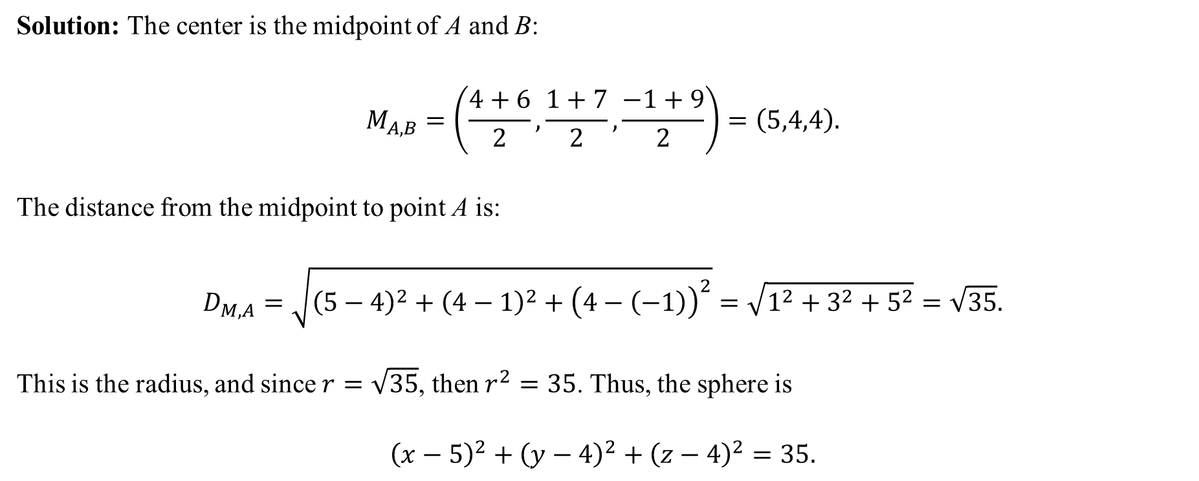
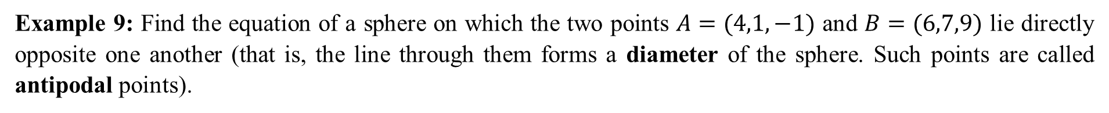
Example 9: Find the equation of a sphere on which the two points $A=(4,1,−1)$ and $B=(6,7,9)$ lie directly opposite one another (that is, the line through them forms a diameter of the sphere. Such points are called antipodal points).
Solution: The center is the midpoint of A and B:
$$M_{A,B}=\left(\frac{4+6}{2},\frac{1+7}{2},\frac{−1+9}{2}\right)=\left(5,4,4\right).$$
The distance from the midpoint to point A is:
$$D_{M,A}=\sqrt{{\left(5−4\right)}^{2}+{\left(4−1\right)}^{2}+{\left(4−\left(−1\right)\right)}^{2}}=\sqrt{1^{2}+3^{2}+5^{2}}=\sqrt{35}.$$
This is the radius, and since $r=\sqrt{35}$, then $r^{2}=35$. Thus, the sphere is
$${\left(x−5\right)}^{2}+{\left(y−4\right)}^{2}+{\left(z−4\right)}^{2}=35.$$

Slide 16
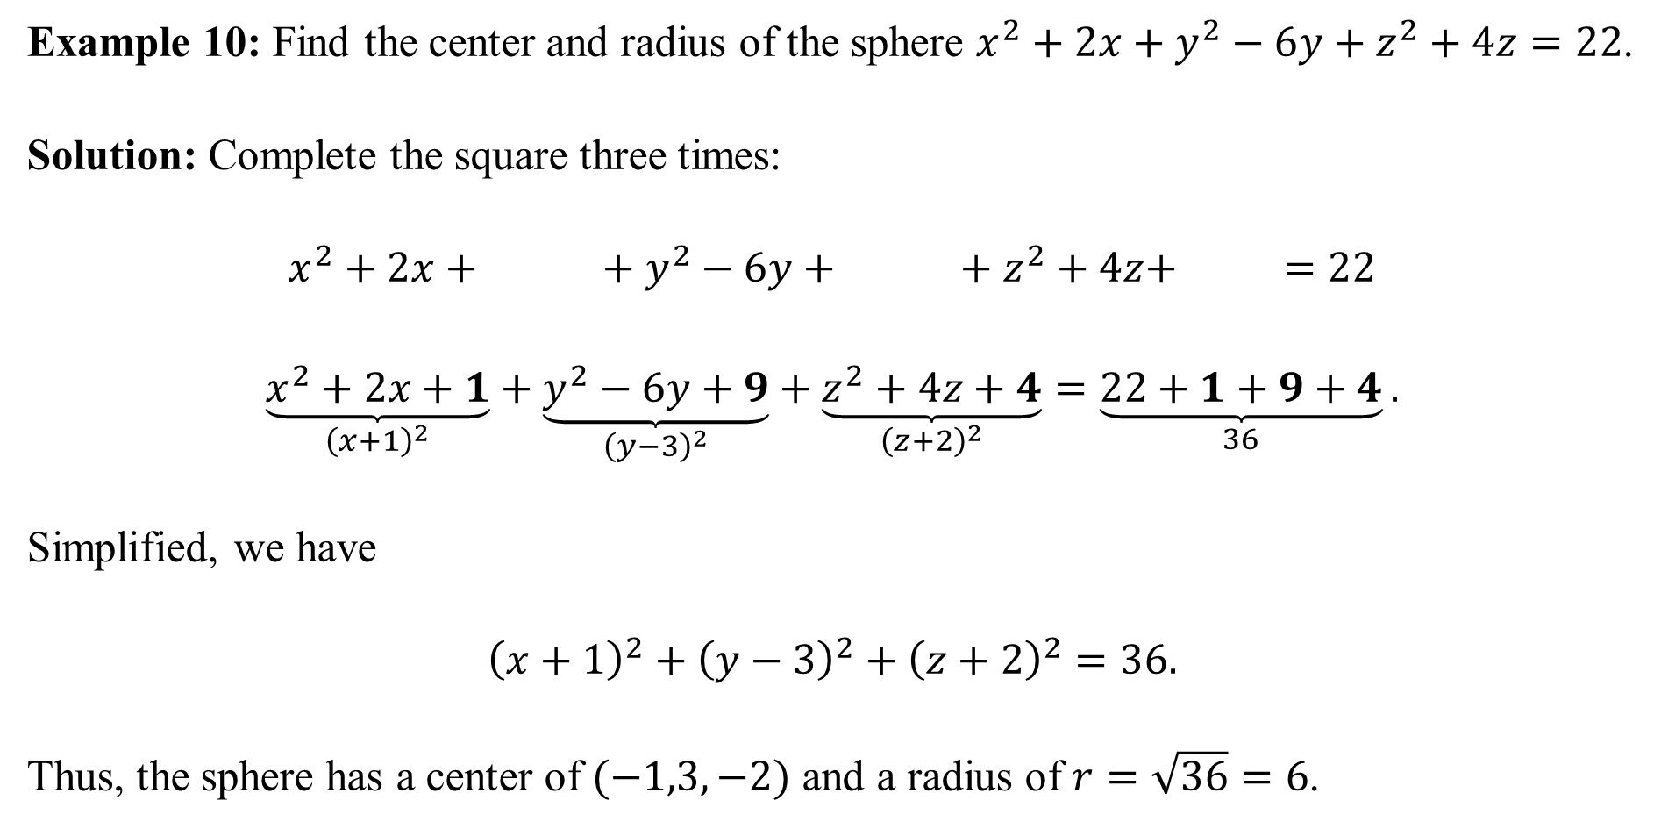
Example 10: Find the center and radius of the sphere $x^{2}+2x+y^{2}−6y+z^{2}+4z=22$.
Solution: Complete the square three times:
$$x^{2}+2x+ + y^{2}−6y+ + z^{2}+4z+ =22$$
$$\underset{{\left(x+1\right)}^{2}}{\underbrace{x^{2}+2x+1}}+\underset{{\left(y−3\right)}^{2}}{\underbrace{y^{2}−6y+9}}+\underset{{\left(z+2\right)}^{2}}{\underbrace{z^{2}+4z+4}}=\underset{36}{\underbrace{22+1+9+4}}.$$
Simplified, we have
$${\left(x+1\right)}^{2}+{\left(y−3\right)}^{2}+{\left(z+2\right)}^{2}=36.$$
Thus, the sphere has a center of $(−1,3,−2)$ and a radius of $r=\sqrt{36}=6$.

