Slide 1
Vector Functions &
Space Curves
Scott Surgent

Slide 2
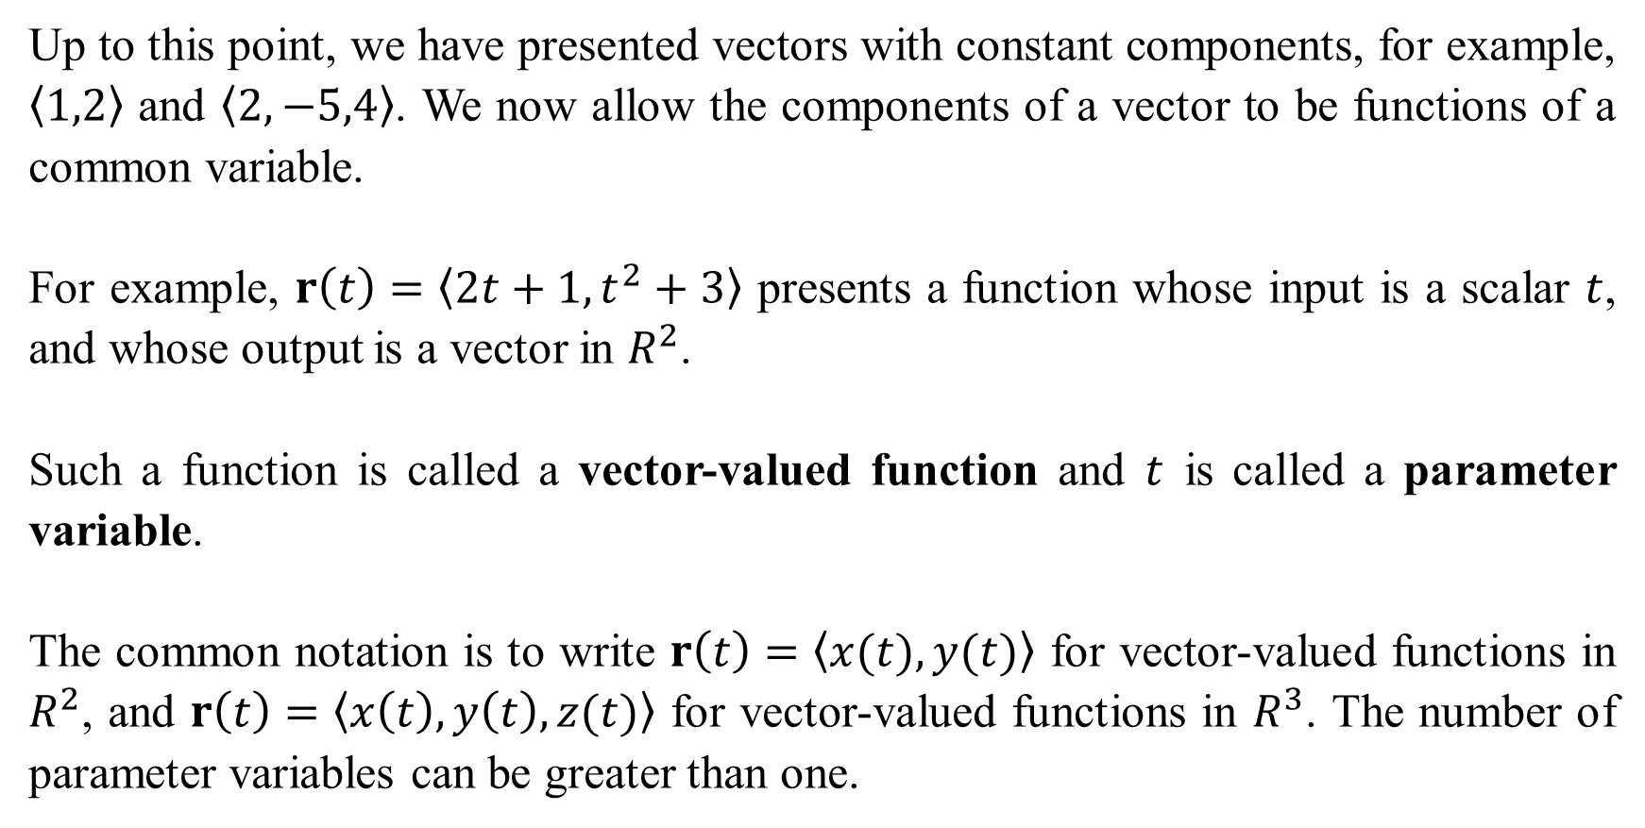
Up to this point, we have presented vectors with constant components, for example, $〈1,2〉$ and $〈2,−5,4〉$. We now allow the components of a vector to be functions of a common variable.
For example, $r\left(t\right)=〈2t+1, t^{2}+3〉$ presents a function whose input is a scalar $t$, and whose output is a vector in $R^{2}$.
Such a function is called a vector-valued function and $t$ is called a parameter variable.
The common notation is to write $r\left(t\right)=〈x(t), y(t)〉$ for vector-valued functions in $R^{2}$, and $r\left(t\right)=〈x\left(t\right), y\left(t\right),z(t)〉$ for vector-valued functions in $R^{3}$. The number of parameter variables can be greater than one.

Slide 3
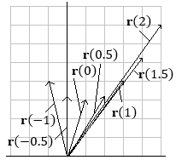
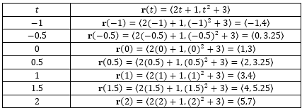
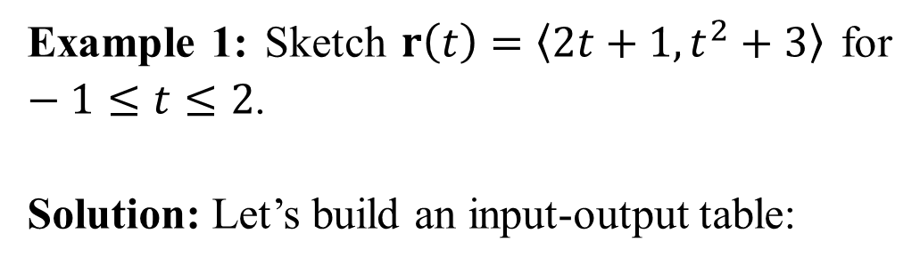
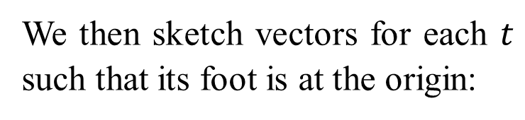
Example 1: Sketch $r\left(t\right)=〈2t+1,t^{2}+3〉$ for $−1≤t≤2$.
Solution: Let’s build an input-output table:
We then sketch vectors for each $t$ such that its foot is at the origin:

Slide 4
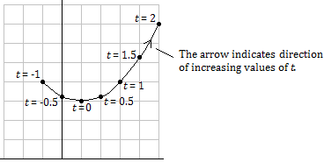
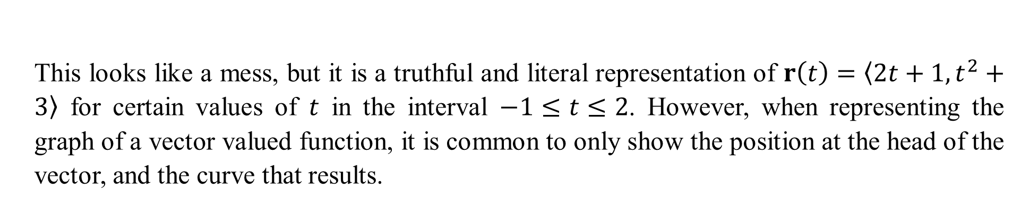
This looks like a mess, but it is a truthful and literal representation of $r\left(t\right)=〈2t+1,t^{2}+3〉$ for certain values of $t$ in the interval $−1≤t≤2$. However, when representing the graph of a vector valued function, it is common to only show the position at the head of the vector, and the curve that results.

Slide 5
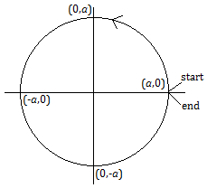
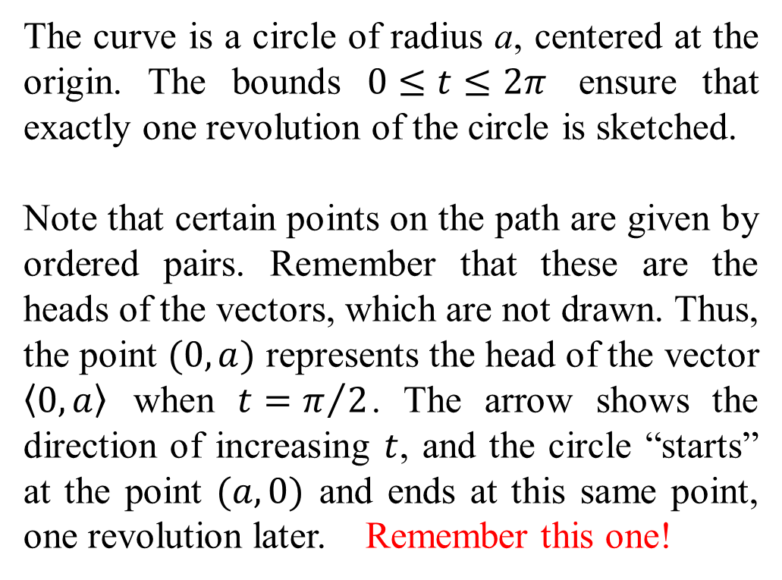
Example 2: Sketch $r\left(t\right)=〈a\cos{t},a\sin{t}〉$, for $0≤t≤2π$, and describe the curve that is traced out by the vectors.
The curve is a circle of radius a, centered at the origin. The bounds $0≤t≤2π$ ensure that exactly one revolution of the circle is sketched.
Note that certain points on the path are given by ordered pairs. Remember that these are the heads of the vectors, which are not drawn. Thus, the point $(0,a)$ represents the head of the vector $〈0,a〉$ when $t=π/2$. The arrow shows the direction of increasing $t$, and the circle “starts” at the point $(a,0)$ and ends at this same point, one revolution later. Remember this one!

Slide 6
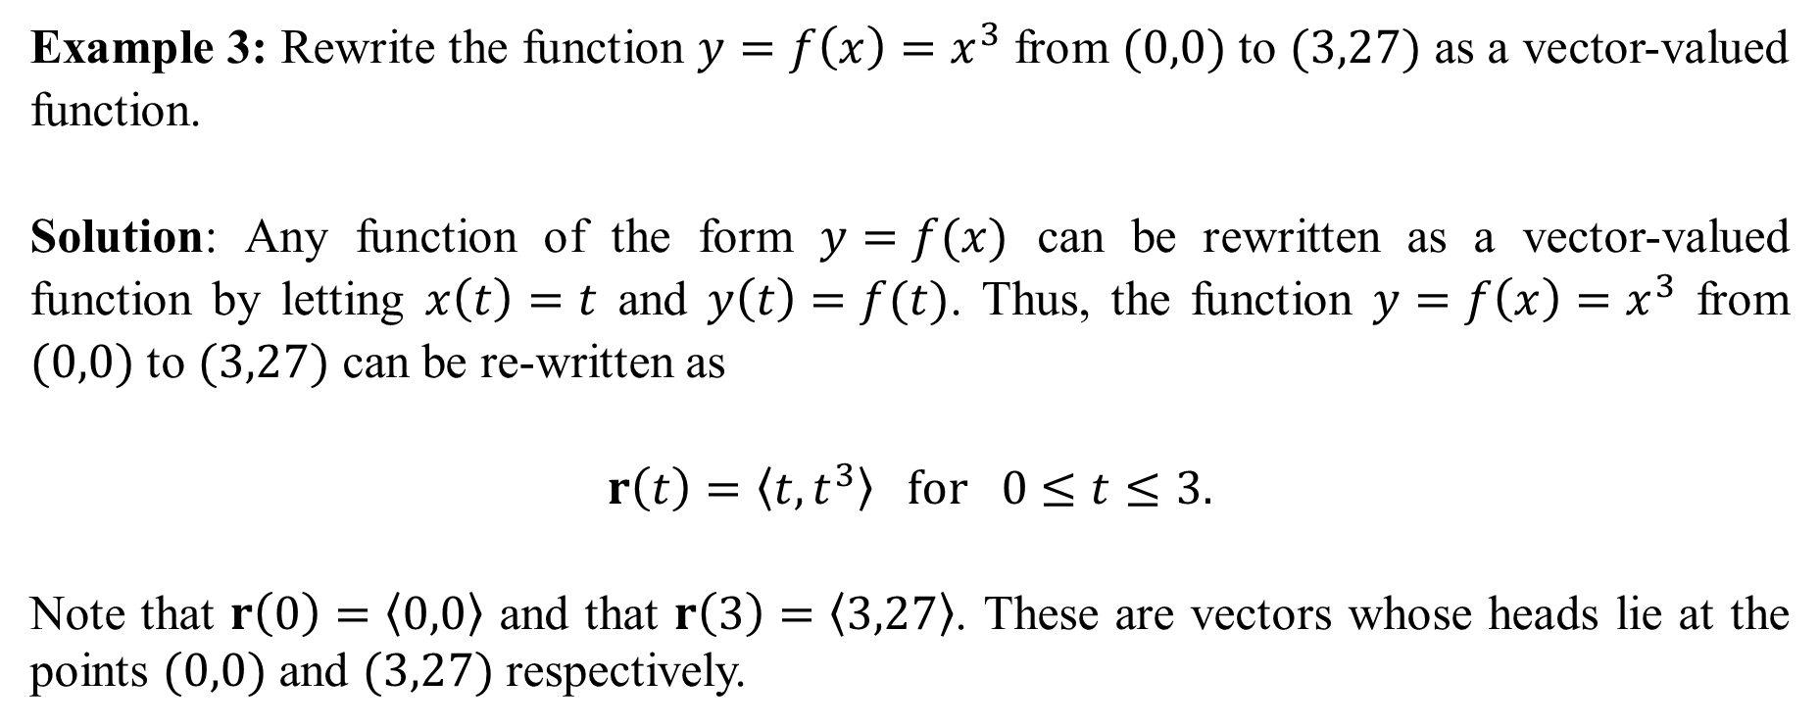
Example 3: Rewrite the function $y=f\left(x\right)=x^{3}$ from $(0,0)$ to $(3,27)$ as a vector-valued function.
Solution: Any function of the form $y=f(x)$ can be rewritten as a vector-valued function by letting $x\left(t\right)=t$ and $y\left(t\right)=f(t)$. Thus, the function $y=f\left(x\right)=x^{3}$ from $(0,0)$ to $(3,27)$ can be re-written as
$$r\left(t\right)=〈t,t^{3}〉 for 0≤t≤3.$$
Note that $r\left(0\right)=〈0,0〉$ and that $r\left(3\right)=〈3,27〉$. These are vectors whose heads lie at the points $(0,0)$ and $(3,27)$ respectively.

Slide 7
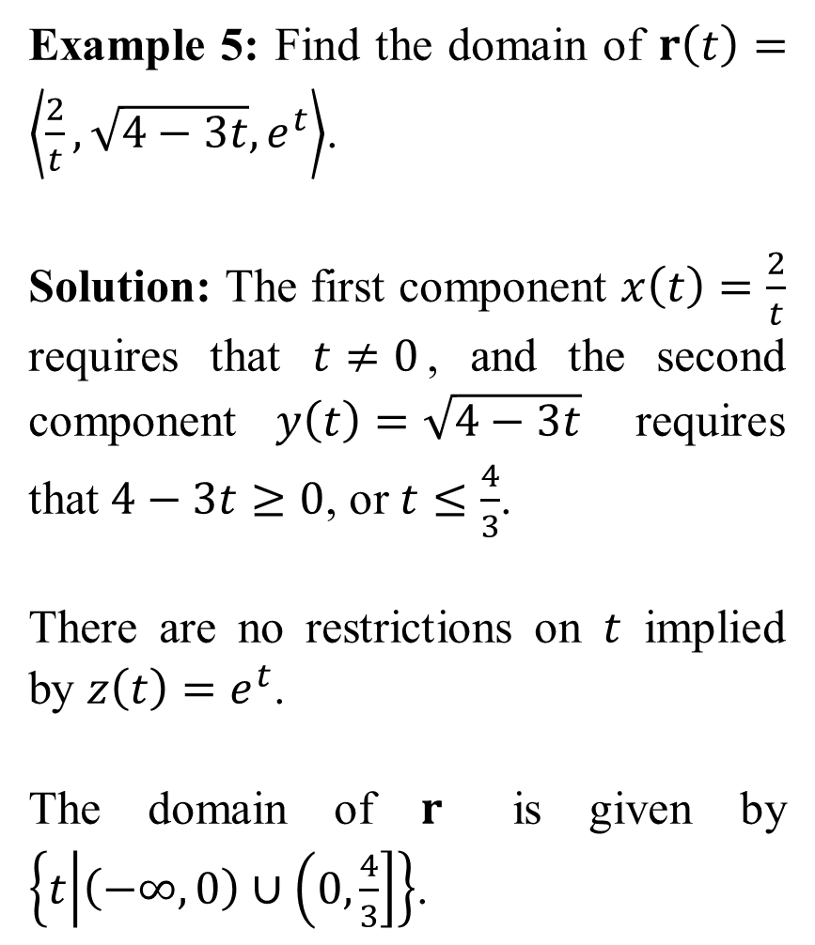
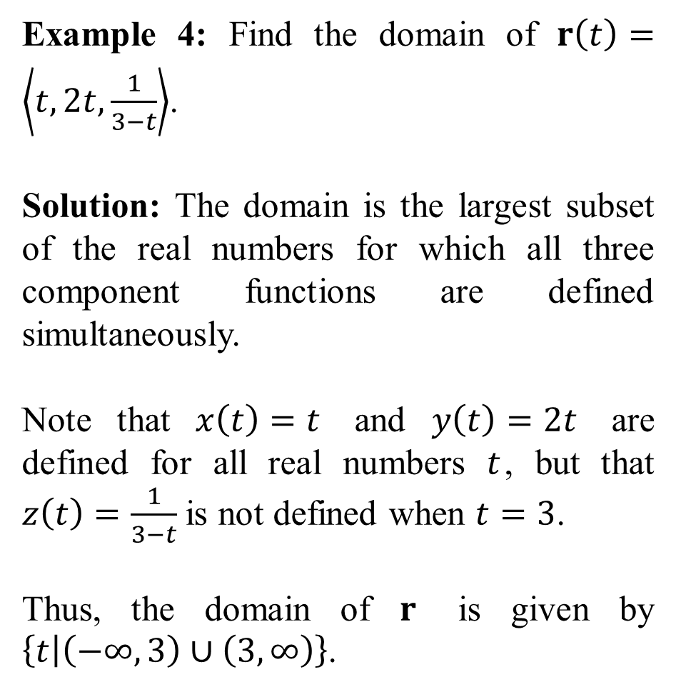
Example 4: Find the domain of $r\left(t\right)=\left\langle t,2t,\frac{1}{3−t}\right\rangle$.
Solution: The domain is the largest subset of the real numbers for which all three component functions are defined simultaneously.
Note that $x\left(t\right)=t$ and $y\left(t\right)=2t$ are defined for all real numbers $t$, but that $z\left(t\right)=\frac{1}{3−t}$ is not defined when $t=3$.
Thus, the domain of $r$ is given by $\left\{t | \left(−∞,3\right)∪\left(3,∞\right)\right\}$.
Example 5: Find the domain of $r\left(t\right)=\left\langle \frac{2}{t}, \sqrt{4−3t}, e^{t}\right\rangle$.
Solution: The first component $x\left(t\right)=\frac{2}{t}$ requires that $t≠0$, and the second component $y\left(t\right)=\sqrt{4−3t}$ requires that $4−3t≥0$, or $t≤\frac{4}{3}$.
There are no restrictions on $t$ implied by $z\left(t\right)=e^{t}$.
The domain of $r$ is given by $\left\{t | \left(−∞,0\right)∪\left(0,\frac{4}{3}\right]\right\}$.

Slide 8
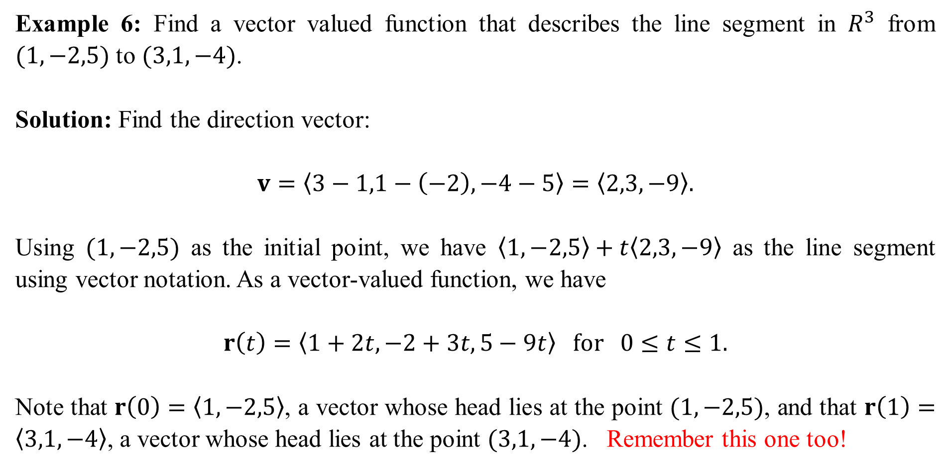
Example 6: Find a vector valued function that describes the line segment in $R^{3}$ from $(1,−2,5)$ to $(3,1,−4)$.
Solution: Find the direction vector:
$$v=〈3−1,1−\left(−2\right),−4−5〉=〈2,3,−9〉.$$
Using $(1,−2,5)$ as the initial point, we have $〈1,−2,5〉+t〈2,3,−9〉$ as the line segment using vector notation. As a vector-valued function, we have
$$r\left(t\right)=〈1+2t, −2+3t,5−9t〉 for 0≤t≤1.$$
Note that $r\left(0\right)=〈1,−2,5〉$, a vector whose head lies at the point $(1,−2,5)$, and that $r\left(1\right)=〈3,1,−4〉$, a vector whose head lies at the point $(3,1,−4)$. Remember this one too!

Slide 9
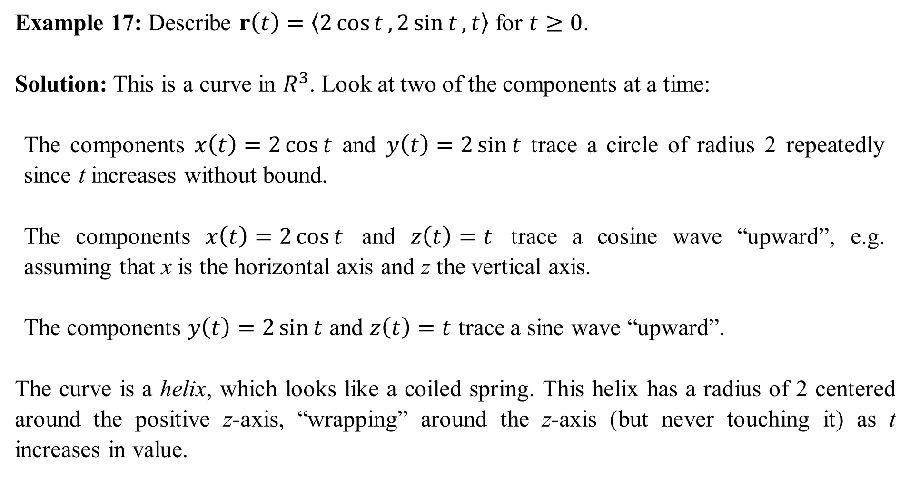
Example 17: Describe $r\left(t\right)=〈2\cos{t}, 2\sin{t}, t〉$ for $t≥0$.
Solution: This is a curve in $R^{3}$. Look at two of the components at a time:
The components $x\left(t\right)=2\cos{t}$ and $y\left(t\right)=2\sin{t}$ trace a circle of radius 2 repeatedly since t increases without bound.
The components $x\left(t\right)=2\cos{t}$ and $z\left(t\right)=t$ trace a cosine wave “upward”, e.g. assuming that x is the horizontal axis and z the vertical axis.
The components $y\left(t\right)=2\sin{t}$ and $z\left(t\right)=t$ trace a sine wave “upward”.
The curve is a helix, which looks like a coiled spring. This helix has a radius of 2 centered around the positive z-axis, “wrapping” around the z-axis (but never touching it) as t increases in value.

Slide 10
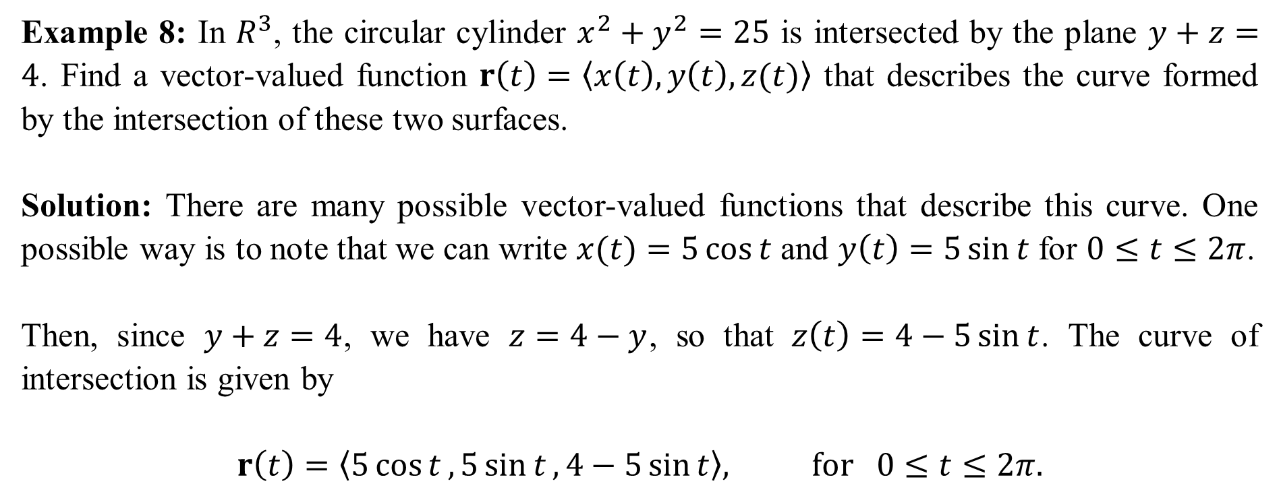
Example 8: In $R^{3}$, the circular cylinder $x^{2}+y^{2}=25$ is intersected by the plane $y+z=4$. Find a vector-valued function $r\left(t\right)=〈x\left(t\right), y\left(t\right),z(t)〉$ that describes the curve formed by the intersection of these two surfaces.
Solution: There are many possible vector-valued functions that describe this curve. One possible way is to note that we can write $x(t)=5\cos{t}$ and $y\left(t\right)=5\sin{t}$ for $0≤t≤2π$.
Then, since $y+z=4$, we have $z=4−y$, so that $z\left(t\right)=4−5\sin{t}$. The curve of intersection is given by
$$r\left(t\right)=〈5\cos{t}, 5\sin{t}, 4−5\sin{t}〉, for 0≤t≤2π.$$

Slide 11
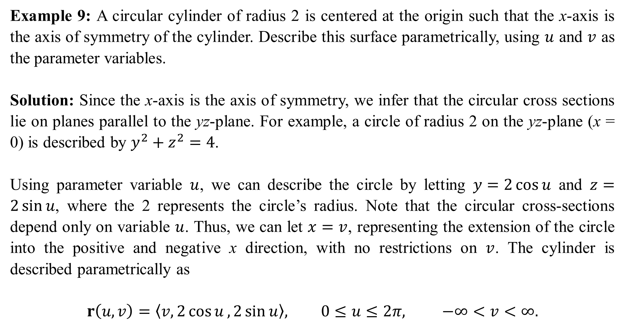
Example 9: A circular cylinder of radius 2 is centered at the origin such that the x-axis is the axis of symmetry of the cylinder. Describe this surface parametrically, using $u$ and $v$ as the parameter variables.
Solution: Since the x-axis is the axis of symmetry, we infer that the circular cross sections lie on planes parallel to the yz-plane. For example, a circle of radius 2 on the yz-plane (x = 0) is described by $y^{2}+z^{2}=4$.
Using parameter variable $u$, we can describe the circle by letting $y=2\cos{u}$ and $z=2\sin{u}$, where the 2 represents the circle’s radius. Note that the circular cross-sections depend only on variable $u$. Thus, we can let $x=v$, representing the extension of the circle into the positive and negative x direction, with no restrictions on $v$. The cylinder is described parametrically as
$$r\left(u,v\right)=〈v,2\cos{u},2\sin{u}〉, 0≤u≤2π, −∞<v<∞.$$

Slide 12
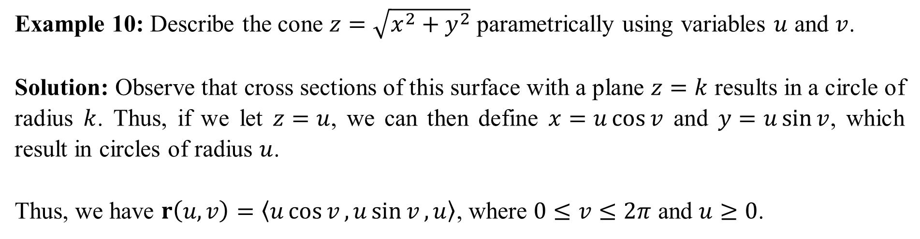
Example 10: Describe the cone $z=\sqrt{x^{2}+y^{2}}$ parametrically using variables $u$ and $v$.
Solution: Observe that cross sections of this surface with a plane $z=k$ results in a circle of radius $k$. Thus, if we let $z=u$, we can then define $x=u\cos{v}$ and $y=u\sin{v}$, which result in circles of radius $u$.
Thus, we have $r\left(u,v\right)=〈u\cos{v},u\sin{v},u〉$, where $0≤v≤2π$ and $u≥0$.

Slide 13
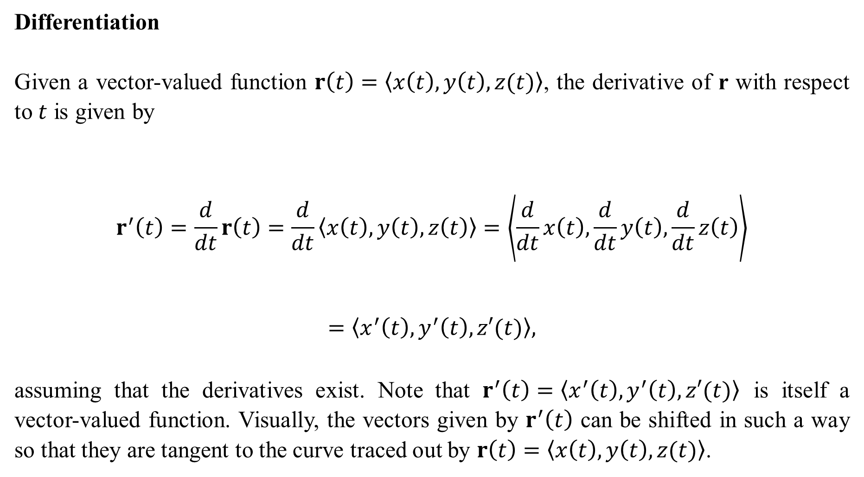
Differentiation
Given a vector-valued function $r\left(t\right)=〈x\left(t\right), y\left(t\right),z(t)〉$, the derivative of r with respect to $t$ is given by
$$r^{′}\left(t\right)=\frac{d}{dt}r\left(t\right)=\frac{d}{dt}〈x\left(t\right), y\left(t\right),z\left(t\right)〉=\left\langle \frac{d}{dt}x\left(t\right),\frac{d}{dt}y\left(t\right),\frac{d}{dt}z\left(t\right)\right\rangle$$
$$=\left\langle x^{′}\left(t\right),y^{′}\left(t\right),z′(t)\right\rangle ,$$
assuming that the derivatives exist. Note that $r^{′}\left(t\right)=〈x^{′}\left(t\right),y^{′}\left(t\right),z′(t)〉$ is itself a vector-valued function. Visually, the vectors given by $r^{′}\left(t\right)$ can be shifted in such a way so that they are tangent to the curve traced out by $r\left(t\right)=〈x\left(t\right), y\left(t\right),z(t)〉$.

Slide 14
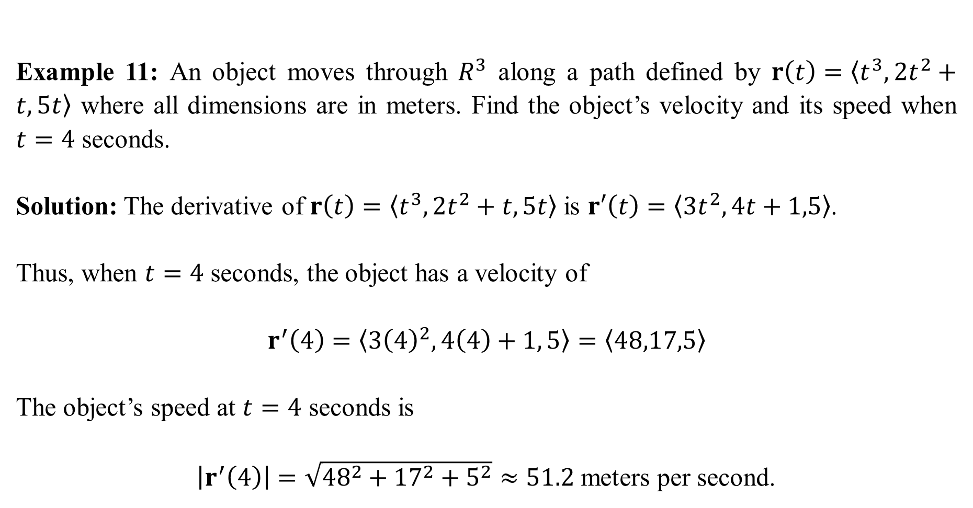
Example 11: An object moves through $R^{3}$ along a path defined by $r\left(t\right)=〈t^{3},2t^{2}+t,5t〉$ where all dimensions are in meters. Find the object’s velocity and its speed when $t=4$ seconds.
Solution: The derivative of $r\left(t\right)=〈t^{3},2t^{2}+t,5t〉$ is $r′\left(t\right)=〈3t^{2},4t+1,5〉$.
Thus, when $t=4$ seconds, the object has a velocity of
$$r^{′}\left(4\right)=〈3{\left(4\right)}^{2}, 4\left(4\right)+1, 5〉=〈48,17,5〉$$
The object’s speed at $t=4$ seconds is
$\left|r^{′}\left(4\right)\right|=\sqrt{{48}^{2}+{17}^{2}+5^{2}}≈51.2$ meters per second.

Slide 15
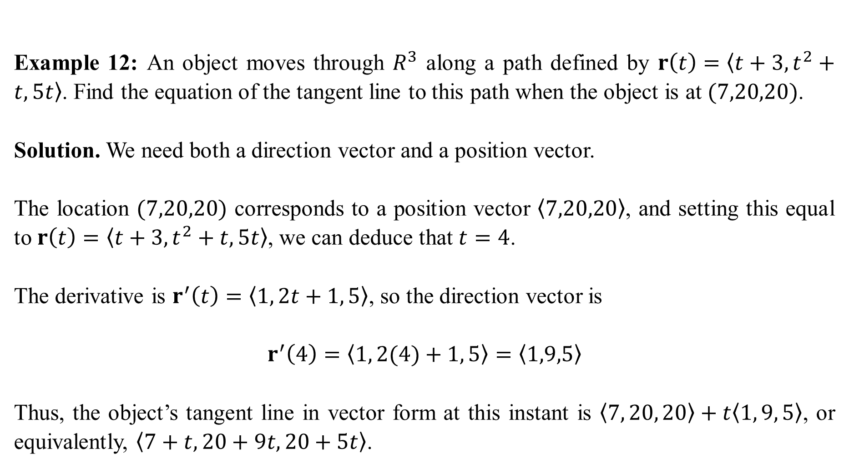
Example 12: An object moves through $R^{3}$ along a path defined by $r\left(t\right)=〈t+3, t^{2}+t, 5t〉$. Find the equation of the tangent line to this path when the object is at $(7,20,20)$.
Solution. We need both a direction vector and a position vector.
The location $(7,20,20)$ corresponds to a position vector $〈7,20,20〉$, and setting this equal to $r\left(t\right)=〈t+3, t^{2}+t, 5t〉$, we can deduce that $t=4$.
The derivative is $r^{′}\left(t\right)=〈1, 2t+1, 5〉$, so the direction vector is
$$r^{′}\left(4\right)=〈1, 2(4)+1, 5〉=〈1,9,5〉$$
Thus, the object’s tangent line in vector form at this instant is $〈7, 20, 20〉+t〈1, 9, 5〉$, or equivalently, $〈7+t, 20+9t, 20+5t〉$.

Slide 16
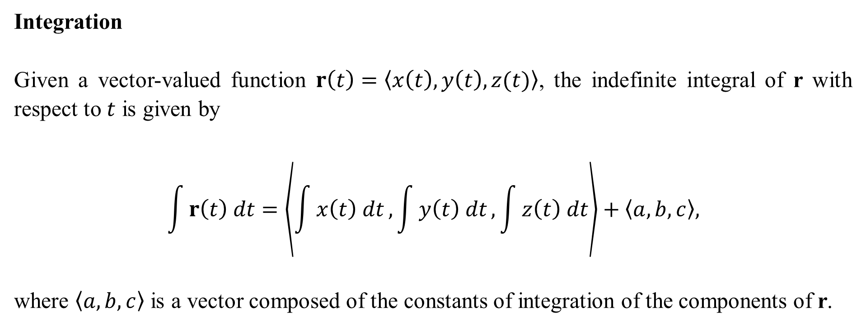
Integration
Given a vector-valued function $r\left(t\right)=〈x\left(t\right), y\left(t\right),z(t)〉$, the indefinite integral of r with respect to $t$ is given by
$$\int{r\left(t\right) dt}=\left\langle \int{x\left(t\right) dt}, \int{y\left(t\right) dt}, \int{z\left(t\right) dt}\right\rangle +〈a,b,c〉,$$
where $〈a,b,c〉$ is a vector composed of the constants of integration of the components of r.

Slide 17
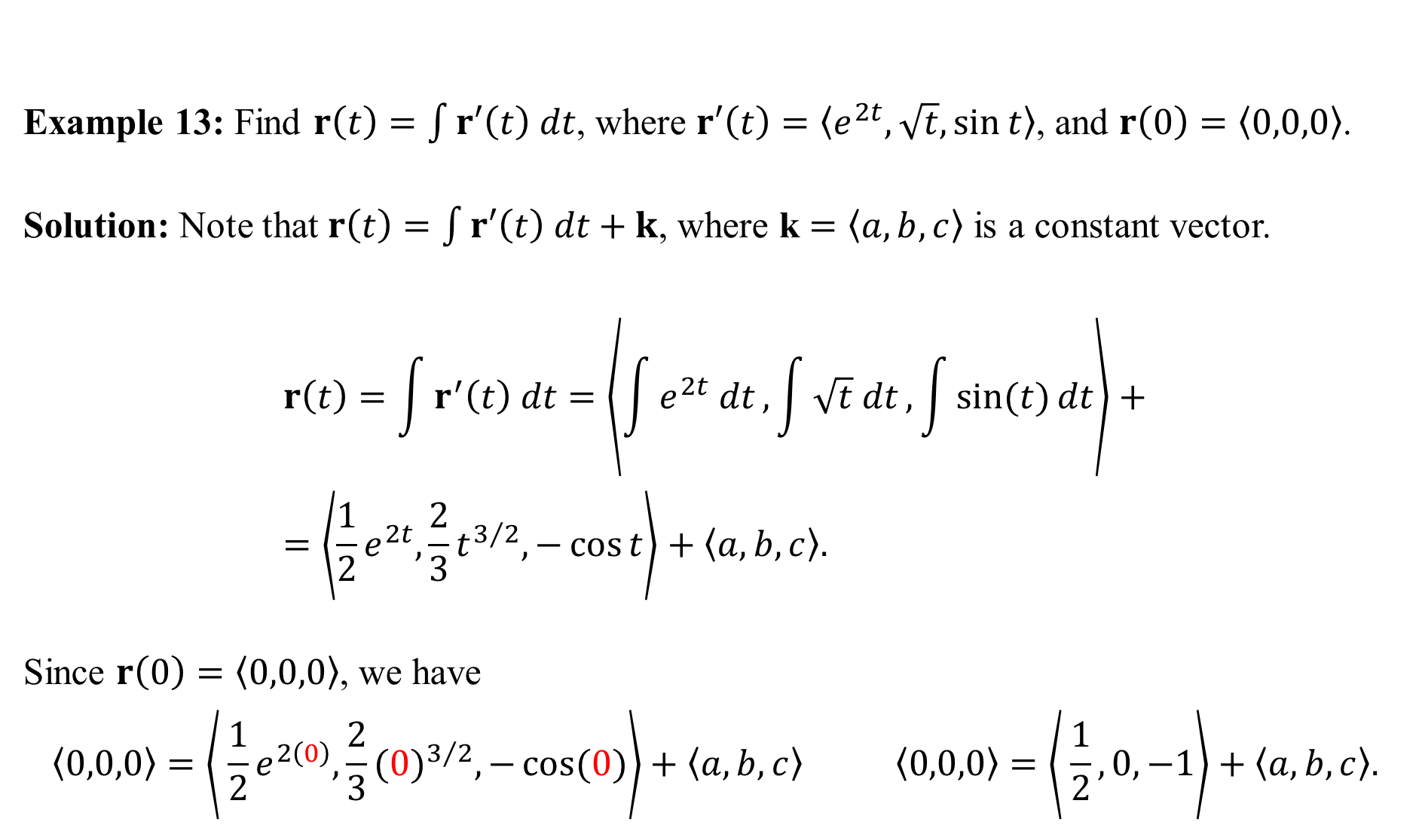
Example 13: Find $r\left(t\right)=\int{r′\left(t\right) dt}$, where $r′\left(t\right)=〈e^{2t}, \sqrt{t},\sin{t}〉$, and $r\left(0\right)=〈0,0,0〉$.
Solution: Note that $r\left(t\right)=\int{r′\left(t\right) dt}+k$, where k $=〈a,b,c〉$ is a constant vector.
$$r\left(t\right)=\int{r^{′}\left(t\right) dt}=\left\langle \int{e^{2t} dt}, \int{\sqrt{t} dt}, \int{\sin{(t)}dt}\right\rangle +=\left\langle \frac{1}{2}e^{2t},\frac{2}{3}t^{3/2},−\cos{t}\right\rangle +〈a,b,c〉.$$
Since $r\left(0\right)=〈0,0,0〉$, we have
$$〈0,0,0〉=\left\langle \frac{1}{2}e^{2\left(0\right)},\frac{2}{3}{(0)}^{3/2},−\cos{(0)}\right\rangle +〈a,b,c〉 〈0,0,0〉=\left\langle \frac{1}{2},0,−1\right\rangle +〈a,b,c〉.$$

Slide 18

This forces $a=−\frac{1}{2}$, $b=0$ and $c=1$. Thus,
$$r\left(t\right)=\left\langle \frac{1}{2}e^{2t},\frac{2}{3}t^{3/2},−\cos{t}\right\rangle +〈−\frac{1}{2},0,1〉$$
or simplified as
$$r\left(t\right)=\left\langle \frac{1}{2}(e^{2t}−1),\frac{2}{3}t^{3/2},1−\cos{t}\right\rangle$$
Don’t confuse $r\left(0\right)=〈0,0,0〉$ as being the constant vector $〈a,b,c〉$.

