Slide 1
Vector Fields
& Gradient Fields
Scott Surgent

Slide 2
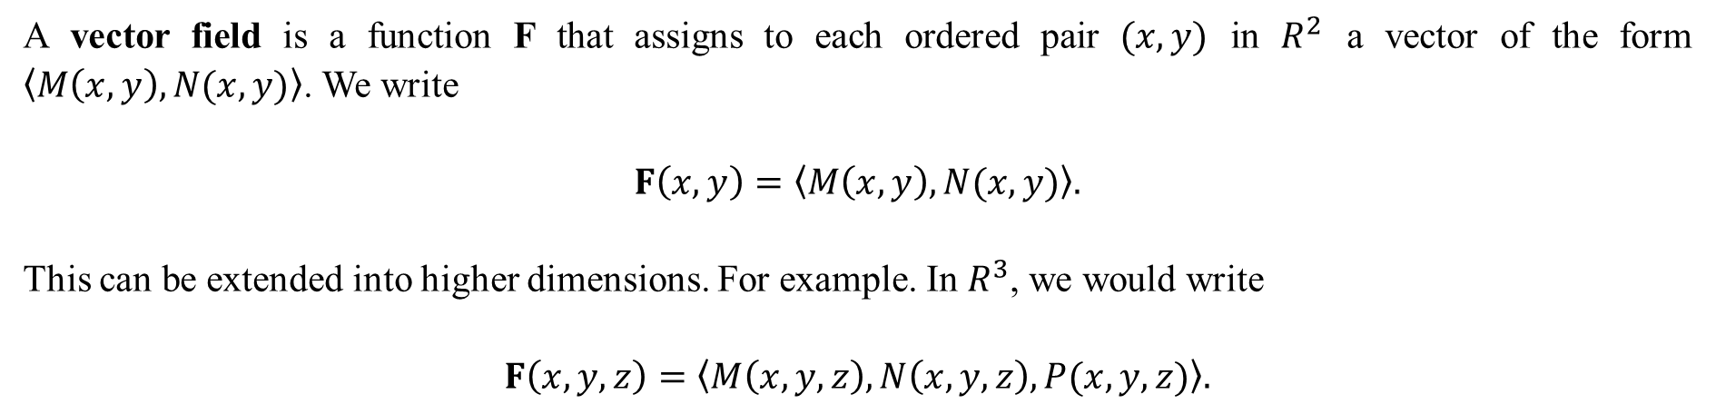
A vector field is a function F that assigns to each ordered pair $(x,y)$ in $R^{2}$ a vector of the form $〈M\left(x,y\right),N(x,y)〉$. We write
$$F\left(x,y\right)=〈M\left(x,y\right),N(x,y)〉.$$
This can be extended into higher dimensions. For example. In $R^{3}$, we would write
$$F\left(x,y,z\right)=〈M\left(x,y,z\right),N\left(x,y,z\right),P(x,y,z)〉.$$

Slide 3
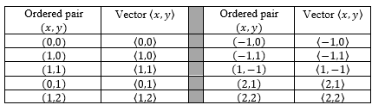
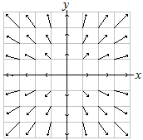
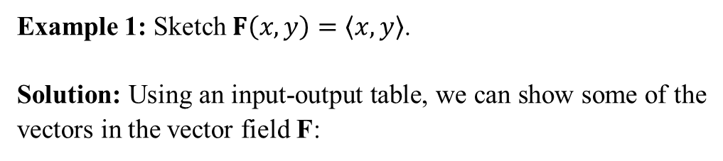
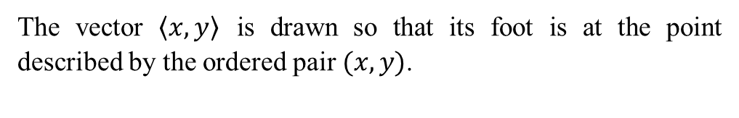
Example 1: Sketch $F\left(x,y\right)=〈x,y〉$.
Solution: Using an input-output table, we can show some of the vectors in the vector field F:
In this example, the vectors point radially (along straight lines) away from the origin.
The vector $〈x,y〉$ is drawn so that its foot is at the point described by the ordered pair $(x,y)$.

Slide 4
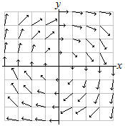
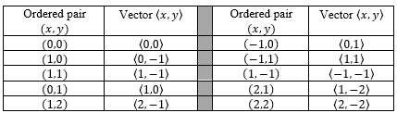
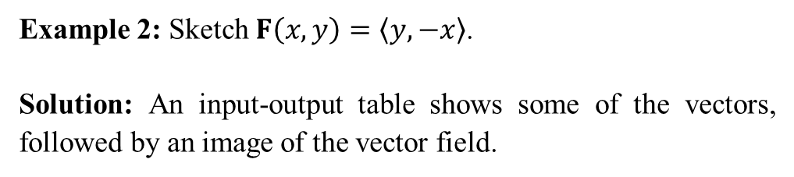
Example 2: Sketch $F\left(x,y\right)=〈y,−x〉$.
Solution: An input-output table shows some of the vectors, followed by an image of the vector field.
The vectors suggest a clockwise rotation around the origin.

Slide 5
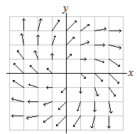
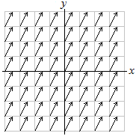
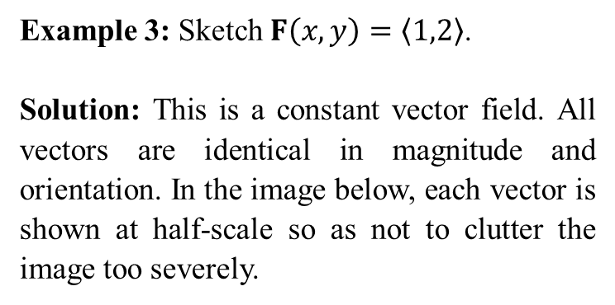
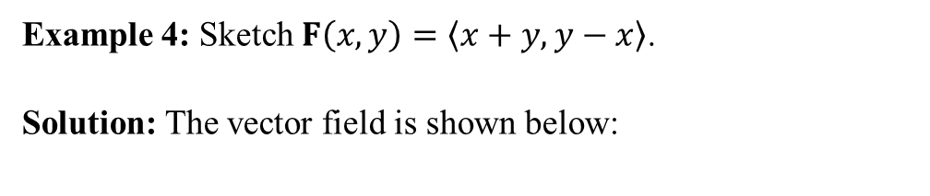
Example 3: Sketch $F\left(x,y\right)=〈1,2〉$.
Solution: This is a constant vector field. All vectors are identical in magnitude and orientation. In the image below, each vector is shown at half-scale so as not to clutter the image too severely.
Example 4: Sketch $F\left(x,y\right)=〈x+y,y−x〉$.
Solution: The vector field is shown below:
This vector field appears to have both radial and rotational aspects in its appearance.
This vector field is not radial nor does it suggest any rotation.

Slide 6
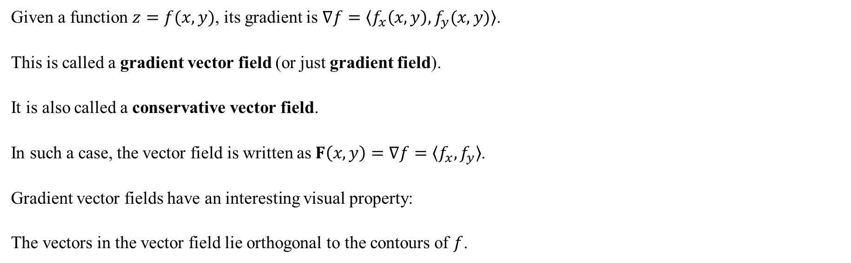
Given a function $z=f(x,y)$, its gradient is $∇f=〈f_{x}\left(x,y\right),f_{y}(x,y)〉$.
This is called a gradient vector field (or just gradient field).
It is also called a conservative vector field.
In such a case, the vector field is written as $F\left(x,y\right)=∇f=〈f_{x},f_{y}〉$.
Gradient vector fields have an interesting visual property:
The vectors in the vector field lie orthogonal to the contours of $f$.

Slide 7
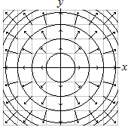
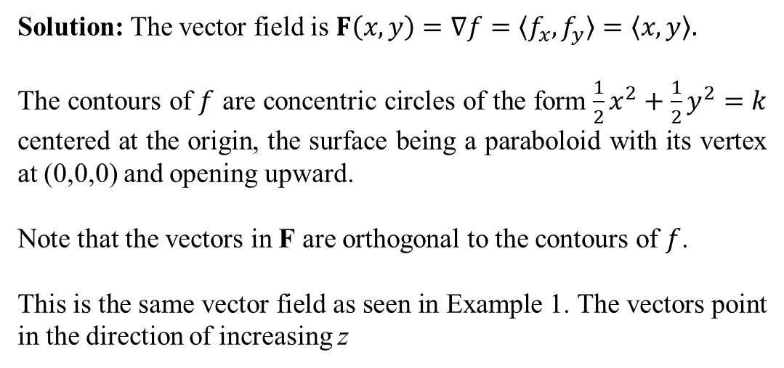
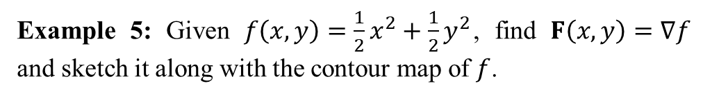
Example 5: Given $f\left(x,y\right)=\frac{1}{2}x^{2}+\frac{1}{2}y^{2}$, find $F\left(x,y\right)=∇f$ and sketch it along with the contour map of $f$.
Solution: The vector field is $F\left(x,y\right)=∇f=〈f_{x},f_{y}〉=〈x,y〉.$
The contours of $f$ are concentric circles of the form $\frac{1}{2}x^{2}+\frac{1}{2}y^{2}=k$ centered at the origin, the surface being a paraboloid with its vertex at (0,0,0) and opening upward.
Note that the vectors in F are orthogonal to the contours of $f$.
This is the same vector field as seen in Example 1. The vectors point in the direction of increasing z

Slide 8
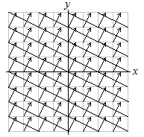
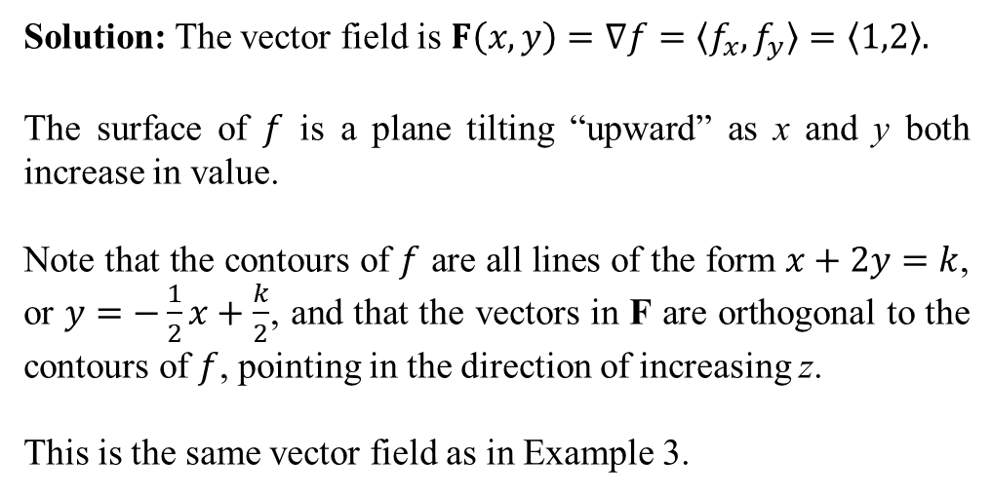
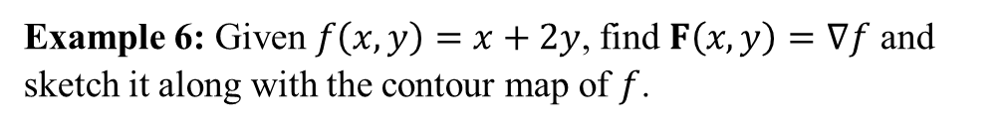
Example 6: Given $f\left(x,y\right)=x+2y$, find $F\left(x,y\right)=∇f$ and sketch it along with the contour map of $f$.
Solution: The vector field is $F\left(x,y\right)=∇f=〈f_{x},f_{y}〉=〈1,2〉.$
The surface of $f$ is a plane tilting “upward” as x and y both increase in value.
Note that the contours of $f$ are all lines of the form $x+2y=k$, or $y=−\frac{1}{2}x+\frac{k}{2}$, and that the vectors in F are orthogonal to the contours of $f$, pointing in the direction of increasing z.
This is the same vector field as in Example 3.

Slide 9
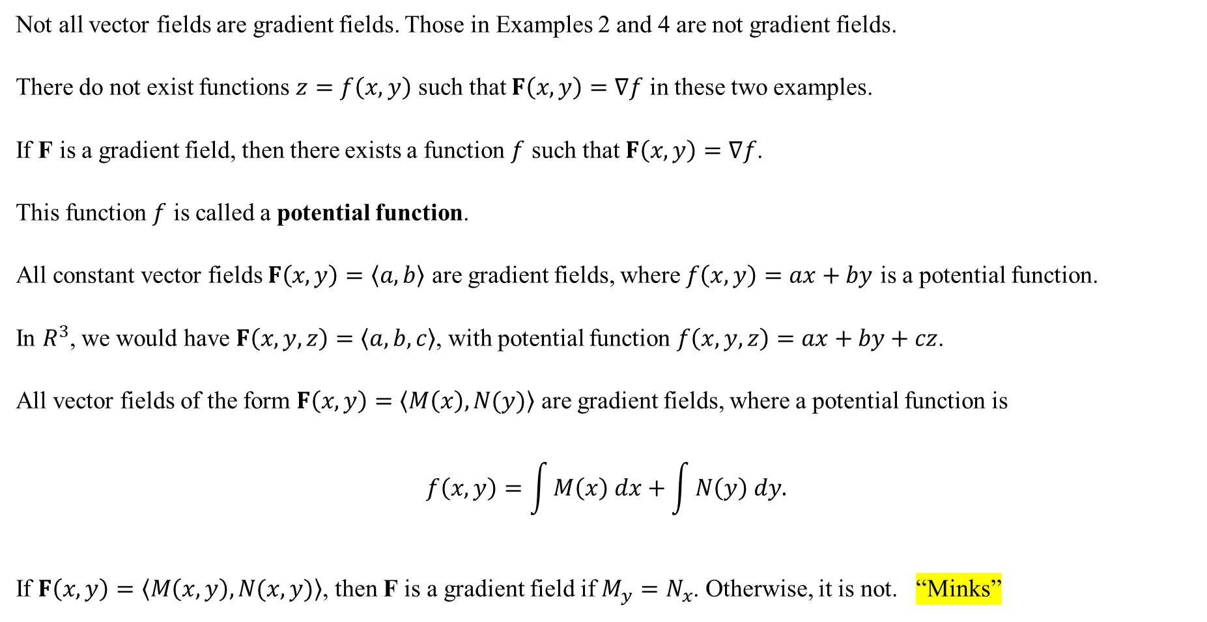
Not all vector fields are gradient fields. Those in Examples 2 and 4 are not gradient fields.
There do not exist functions $z=f\left(x,y\right)$ such that $F\left(x,y\right)=∇f$ in these two examples.
If F is a gradient field, then there exists a function $f$ such that $F\left(x,y\right)=∇f$.
This function $f$ is called a potential function.
All constant vector fields $F\left(x,y\right)=〈a,b〉$ are gradient fields, where $f\left(x,y\right)=ax+by$ is a potential function.
In $R^{3}$, we would have $F\left(x,y,z\right)=〈a,b,c〉$, with potential function $f\left(x,y,z\right)=ax+by+cz$.
All vector fields of the form $F\left(x,y\right)=〈M\left(x\right),N(y)〉$ are gradient fields, where a potential function is
$$f\left(x,y\right)=\int{M\left(x\right) dx}+\int{N\left(y\right) dy.}$$
If $F\left(x,y\right)=〈M\left(x,y\right),N(x,y)〉$, then F is a gradient field if $M_{y}=N_{x}$. Otherwise, it is not. “Minks”

Slide 10
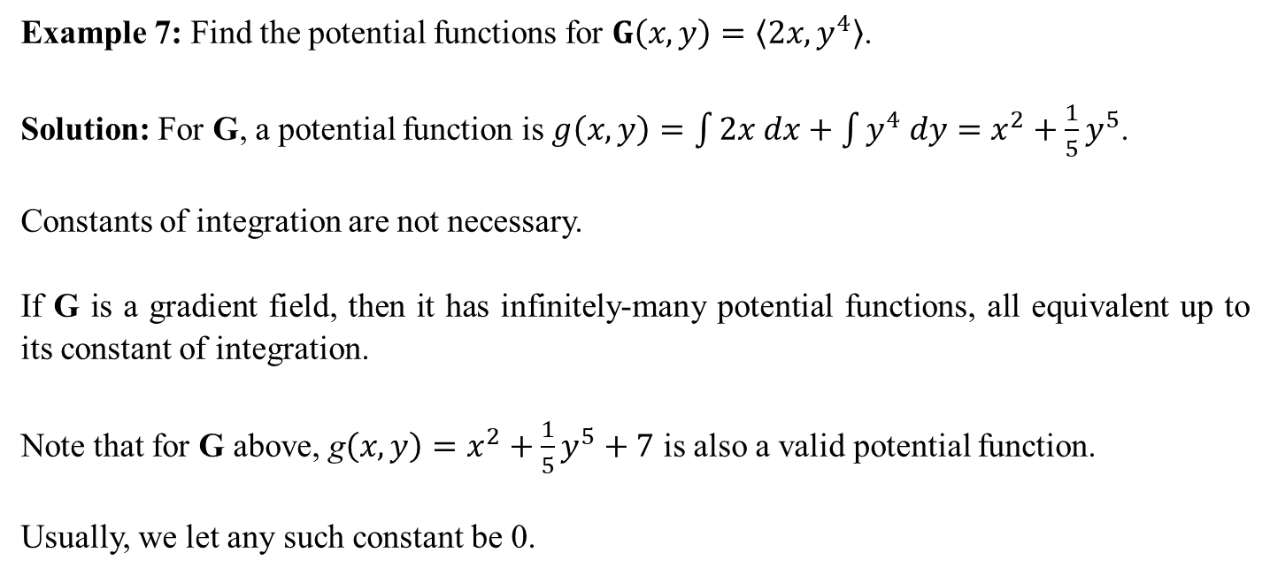
Example 7: Find the potential functions for $G\left(x,y\right)=〈2x,y^{4}〉$.
Solution: For G, a potential function is $g\left(x,y\right)=\int{2x dx}+\int{y^{4} dy}=x^{2}+\frac{1}{5}y^{5}$.
Constants of integration are not necessary.
If G is a gradient field, then it has infinitely-many potential functions, all equivalent up to its constant of integration.
Note that for G above, g$\left(x,y\right)=x^{2}+\frac{1}{5}y^{5}+7$ is also a valid potential function.
Usually, we let any such constant be 0.

Slide 11
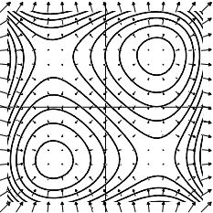
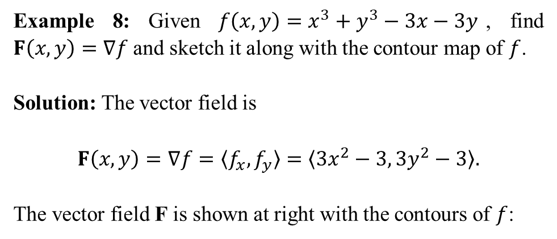
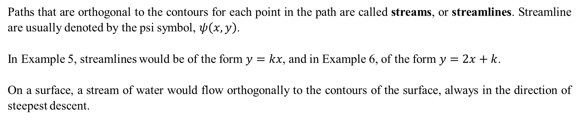
Paths that are orthogonal to the contours for each point in the path are called streams, or streamlines. Streamline are usually denoted by the psi symbol, $ψ\left(x,y\right)$.
In Example 5, streamlines would be of the form $y=kx$, and in Example 6, of the form $y=2x+k$.
On a surface, a stream of water would flow orthogonally to the contours of the surface, always in the direction of steepest descent.
Example 8: Given $f\left(x,y\right)=x^{3}+y^{3}−3x−3y$, find $F\left(x,y\right)=∇f$ and sketch it along with the contour map of $f$.
Solution: The vector field is
$$F\left(x,y\right)=∇f=〈f_{x},f_{y}〉=〈3x^{2}−3, 3y^{2}−3〉.$$
The vector field F is shown at right with the contours of $f$:

Slide 12
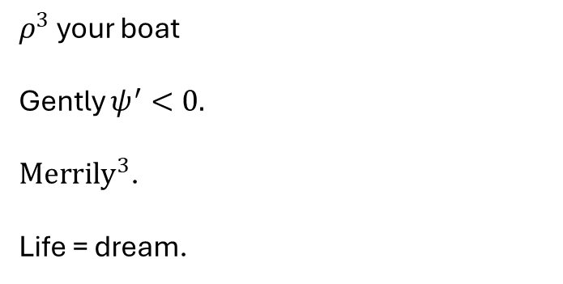
$ρ^{3}$ your boat
Gently $ψ^{′}<0.$
$Merrily^{3}$.
Life = dream.

