Slide 1
Triple Integration
Scott Surgent

Slide 2
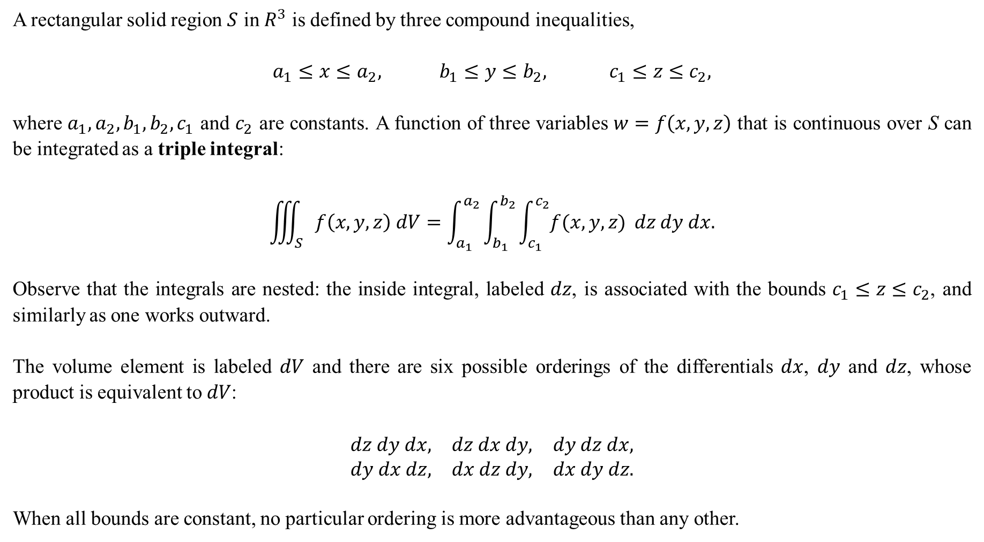
A rectangular solid region $S$ in $R^{3}$ is defined by three compound inequalities,
$$a_{1}≤x≤a_{2}, b_{1}≤y≤b_{2}, c_{1}≤z≤c_{2},$$
where $a_{1},a_{2},b_{1},b_{2},c_{1}$ and $c_{2}$ are constants. A function of three variables $w=f\left(x,y,z\right)$ that is continuous over S can be integrated as a triple integral:
$$\iiint_{S}{f\left(x,y,z\right) dV}=\int_{a_{1}}^{a_{2}}{\int_{b_{1}}^{b_{2}}{\int_{c_{1}}^{c_{2}}{f(x,y,z)}}} dz dy dx.$$
Observe that the integrals are nested: the inside integral, labeled $dz$, is associated with the bounds $c_{1}≤z≤c_{2}$, and similarly as one works outward.
The volume element is labeled $dV$ and there are six possible orderings of the differentials $dx$, $dy$ and $dz$, whose product is equivalent to $dV$:
$$\begin{matrix}dz dy dx, & dz dx dy, & dy dz dx, \\ dy dx dz, & dx dz dy, & dx dy dz.\end{matrix}$$
When all bounds are constant, no particular ordering is more advantageous than any other.

Slide 3

Example 1: Evaluate
$$\int_{−1}^{2}{\int_{1}^{3}{\int_{−2}^{4}{\left(x+2yz^{2}\right) dz}}dy}dx.$$
Solution: The inner-most integral is evaluated. Since the integrand is being antidifferentiated with respect to z, the variables x and y are treated as constants or coefficients for the moment:
$$\int_{−2}^{4}{\left(x+2yz^{2}\right) dz}={\left[xz+\frac{2}{3}yz^{3}\right]}_{−2}^{4}$$
$$=\left(x\left(4\right)+\frac{2}{3}y{\left(4\right)}^{3}\right)−\left(x\left(−2\right)+\frac{2}{3}y{\left(−2\right)}^{3}\right)$$
$$=\left(4x+\frac{128}{3}y\right)−\left(−2x−\frac{16}{3}y\right)$$
$$=6x+48y.$$

Slide 4

This is now integrated with respect to y (the “middle” integral). The x is still treated as a constant or coefficient in this step:
$$\int_{1}^{3}{\left(6x+48y\right) dy}={\left[6xy+24y^{2}\right]}_{1}^{3}$$
$$=\left(6x\left(3\right)+24{\left(3\right)}^{2}\right)−(6x\left(1\right)+24{\left(1\right)}^{2})$$
$$=12x+192.$$
Lastly, this is integrated with respect to x, the “outer” integral:
$$\int_{−1}^{2}{\left(12x+192\right) dx}={\left[6x^{2}+192x\right]}_{−1}^{2}$$
$$=\left(6{\left(2\right)}^{2}+192\left(2\right)\right)−\left(6{\left(−1\right)}^{2}+192\left(−1\right)\right)$$
$$=594.$$

Slide 5
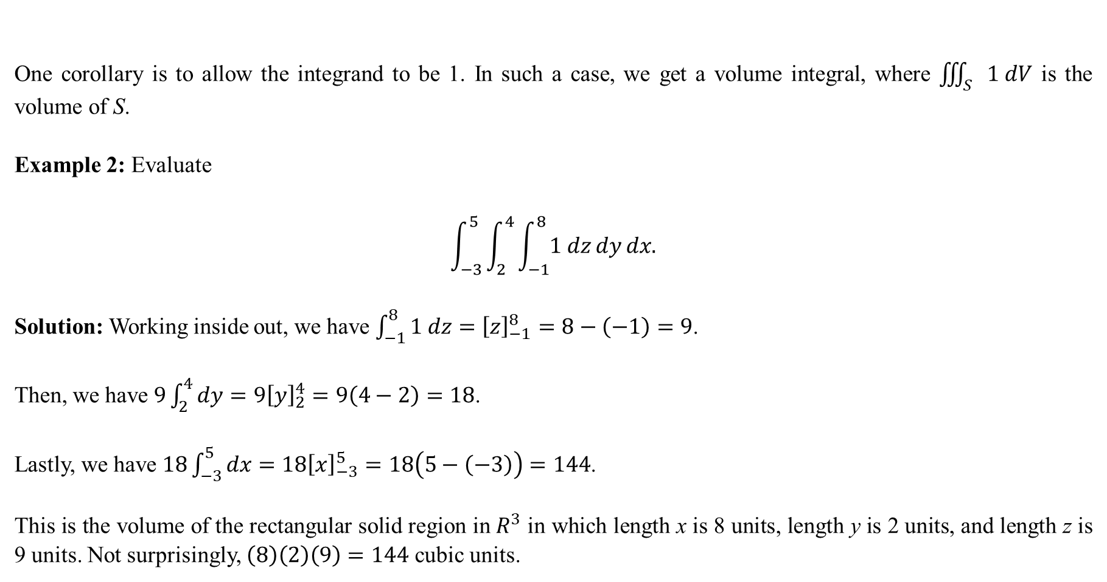
One corollary is to allow the integrand to be 1. In such a case, we get a volume integral, where $\iiint_{S}{1 dV}$ is the volume of S.
Example 2: Evaluate
$$\int_{−3}^{5}{\int_{2}^{4}{\int_{−1}^{8}{1 dz}}dy}dx.$$
Solution: Working inside out, we have $\int_{−1}^{8}{1 dz}={\left[z\right]}_{−1}^{8}=8−\left(−1\right)=9$.
Then, we have $9\int_{2}^{4}{dy}=9{\left[y\right]}_{2}^{4}=9\left(4−2\right)=18$.
Lastly, we have $18\int_{−3}^{5}{dx}=18{\left[x\right]}_{−3}^{5}=18\left(5−\left(−3\right)\right)=144$.
This is the volume of the rectangular solid region in $R^{3}$ in which length x is 8 units, length y is 2 units, and length z is 9 units. Not surprisingly, $\left(8\right)\left(2\right)\left(9\right)=144$ cubic units.

Slide 6
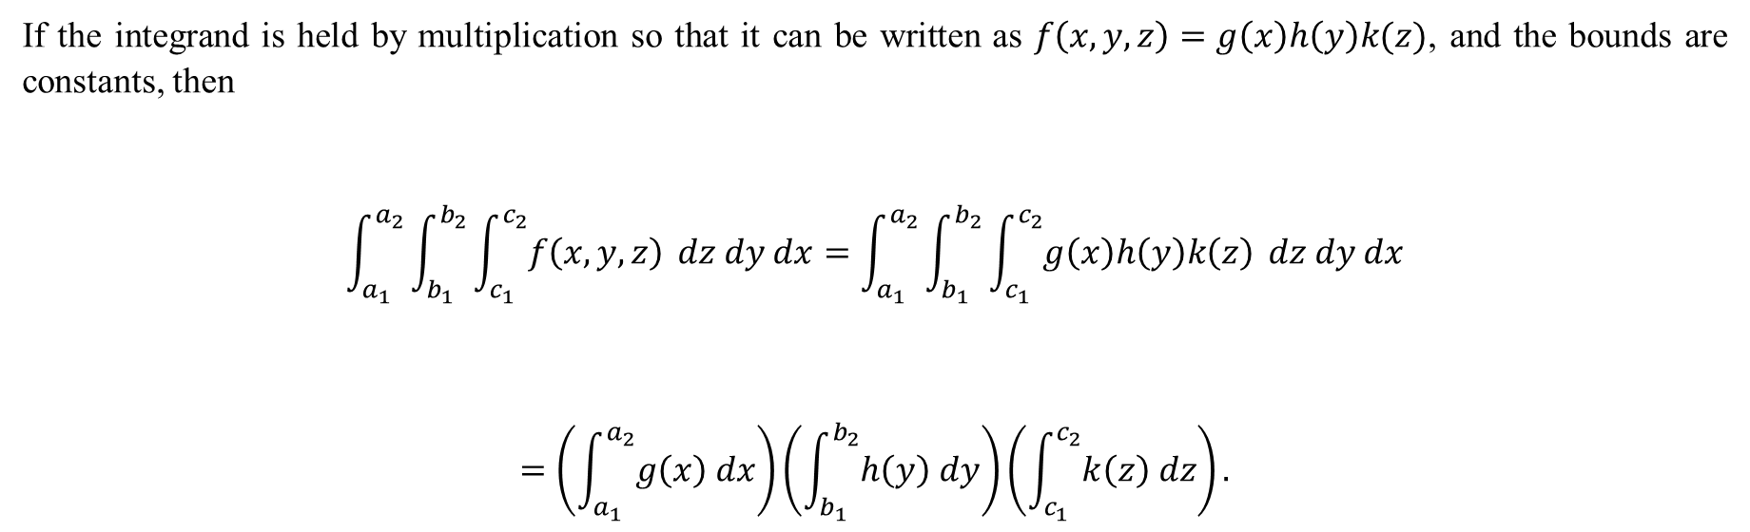
If the integrand is held by multiplication so that it can be written as $f\left(x,y,z\right)=g\left(x\right)h\left(y\right)k(z)$, and the bounds are constants, then
$$\int_{a_{1}}^{a_{2}}{\int_{b_{1}}^{b_{2}}{\int_{c_{1}}^{c_{2}}{f\left(x,y,z\right)}}} dz dy dx=\int_{a_{1}}^{a_{2}}{\int_{b_{1}}^{b_{2}}{\int_{c_{1}}^{c_{2}}{g\left(x\right)h\left(y\right)k\left(z\right)}}} dz dy dx$$
$$=\left(\int_{a_{1}}^{a_{2}}{g\left(x\right) dx}\right)\left(\int_{b_{1}}^{b_{2}}{h\left(y\right) dy}\right)\left(\int_{c_{1}}^{c_{2}}{k\left(z\right) dz}\right).$$

Slide 7
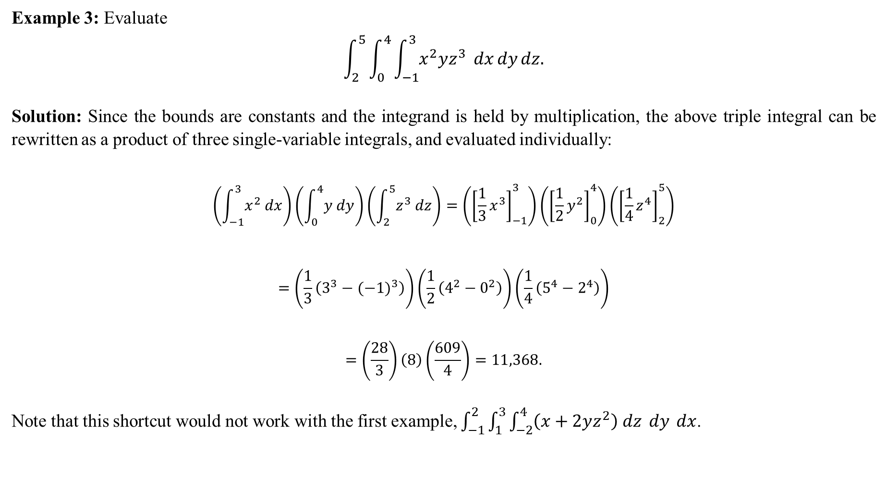
Example 3: Evaluate
$$\int_{2}^{5}{\int_{0}^{4}{\int_{−1}^{3}{x^{2}yz^{3}} dx}dy}dz.$$
Solution: Since the bounds are constants and the integrand is held by multiplication, the above triple integral can be rewritten as a product of three single-variable integrals, and evaluated individually:
$$\left(\int_{−1}^{3}{x^{2} dx}\right)\left(\int_{0}^{4}{y dy}\right)\left(\int_{2}^{5}{z^{3} dz}\right)=\left({\left[\frac{1}{3}x^{3}\right]}_{−1}^{3}\right)\left({\left[\frac{1}{2}y^{2}\right]}_{0}^{4}\right)\left({\left[\frac{1}{4}z^{4}\right]}_{2}^{5}\right)$$
$$=\left(\frac{1}{3}\left(3^{3}−{(−1)}^{3}\right)\right)\left(\frac{1}{2}\left(4^{2}−0^{2}\right)\right)\left(\frac{1}{4}\left(5^{4}−2^{4}\right)\right)$$
$$=\left(\frac{28}{3}\right)\left(8\right)\left(\frac{609}{4}\right)=11,368.$$
Note that this shortcut would not work with the first example, $\int_{−1}^{2}{\int_{1}^{3}{\int_{−2}^{4}{\left(x+2yz^{2}\right) dz}} dy} dx$.

Slide 8
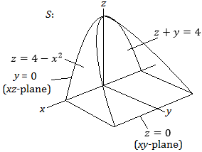
Example 4: Solid S is shown below. Let $f(x,y,z)$ be a generic integrand.
Set up a triple integral over S in the dy dz dx ordering.
Set up a triple integral over S in the dx dy dz ordering.

Slide 9
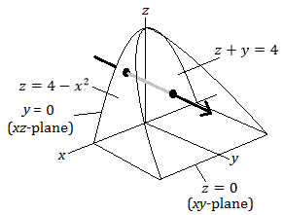
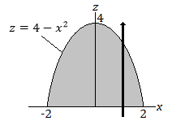
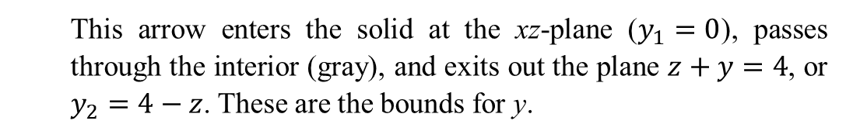
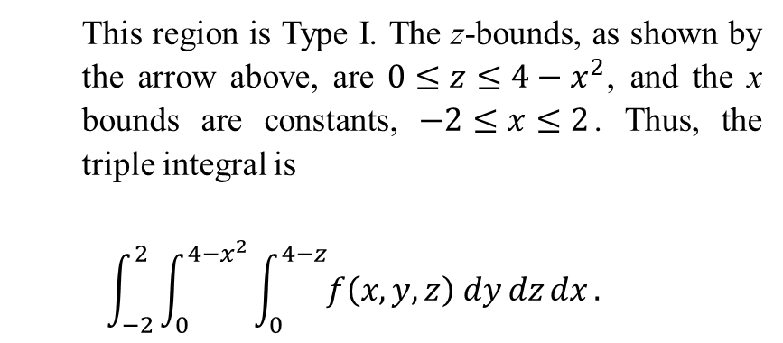
Solution:
Sketch an arrow in the positive y direction:
Next, we look at the footprint of the solid as projected onto the xz-plane. Variable y is no longer needed.
This region is Type I. The z-bounds, as shown by the arrow above, are $0≤z≤4−x^{2}$, and the x bounds are constants, $−2≤x≤2$. Thus, the triple integral is
$$\int_{−2}^{2}{\int_{0}^{4−x^{2}}{\int_{0}^{4−z}{f\left(x,y,z\right) dy}dz}dx}.$$
This arrow enters the solid at the xz-plane ($y_{1}=0$), passes through the interior (gray), and exits out the plane $z+y=4$, or $y_{2}=4−z$. These are the bounds for y.

Slide 10
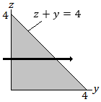
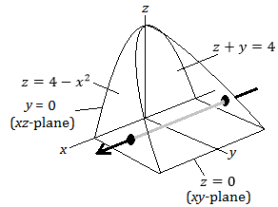

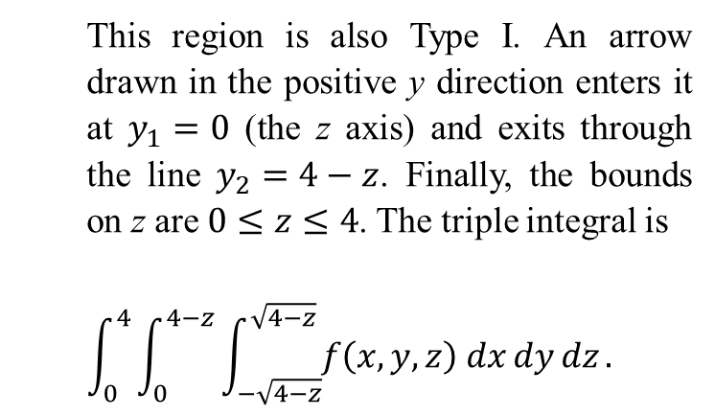
b) For the dx dy dz ordering, draw an arrow in the positive x direction. It enters the region through the parabolic sheet $x_{1}=−\sqrt{4−z}$ and exits through $x_{2}=\sqrt{4−z}$.
This region is also Type I. An arrow drawn in the positive y direction enters it at $y_{1}=0$ (the z axis) and exits through the line $y_{2}=4−z$. Finally, the bounds on z are $0≤z≤4$. The triple integral is
$$\int_{0}^{4}{\int_{0}^{4−z}{\int_{−\sqrt{4−z}}^{\sqrt{4−z}}{f\left(x,y,z\right) dx}dy}dz}.$$
Variable x is “done”. We now look at the footprint of the solid projected onto the yz plane, and since the middle integral will be with respect to y, we sketch an arrow in the positive y direction.

Slide 11
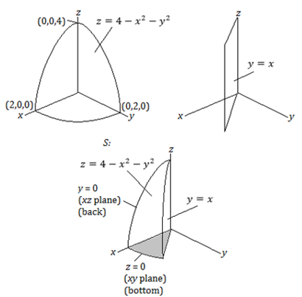
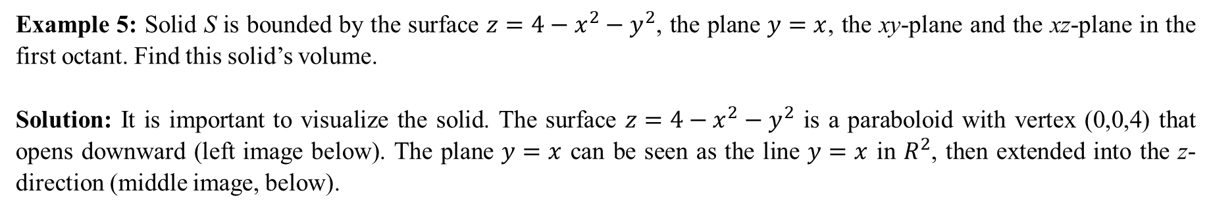
Example 5: Solid S is bounded by the surface $z=4−x^{2}−y^{2}$, the plane $y=x$, the xy-plane and the xz-plane in the first octant. Find this solid’s volume.
Solution: It is important to visualize the solid. The surface $z=4−x^{2}−y^{2}$ is a paraboloid with vertex (0,0,4) that opens downward (left image below). The plane $y=x$ can be seen as the line $y=x$ in $R^{2}$, then extended into the z-direction (middle image, below).

Slide 12
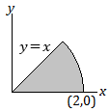
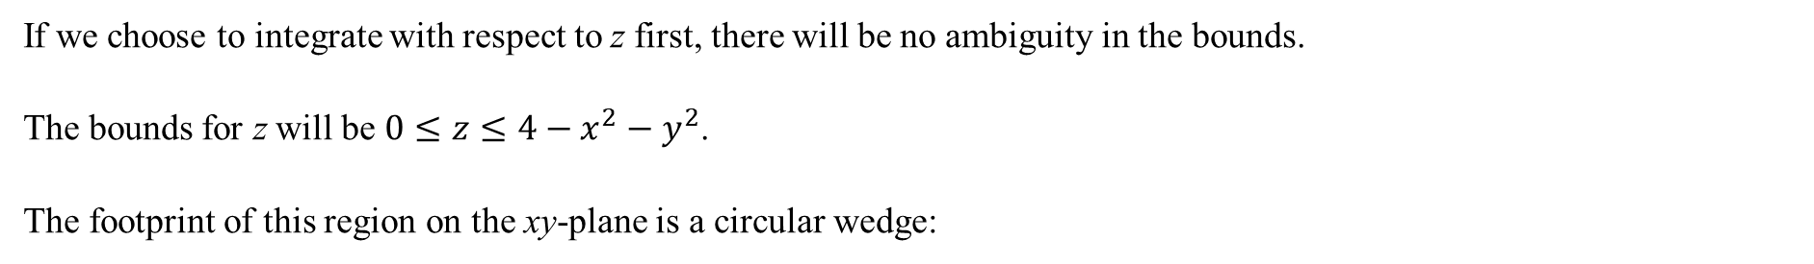


If we choose to integrate with respect to z first, there will be no ambiguity in the bounds.
The bounds for z will be $0≤z≤4−x^{2}−y^{2}$.
The footprint of this region on the xy-plane is a circular wedge:
We use polar coordinates to describe this region.
Recalling that $x=r\cos{θ}$ and $y=r\sin{θ}$, then this region’s bounds are $0≤r≤2$ and $0≤θ≤\frac{π}{4}$.
However, since we have replaced variables x and y with $r$ and $θ$, the top bound for z, which is $4−x^{2}−y^{2}$, is rewritten as $4−\left(x^{2}+y^{2}\right)=4−r^{2}$.
Thus, the volume is given by the triple integral below, with 1 as the integrand. Note the Jacobian $r$ is also present in the integral.
$$\int_{0}^{π/4}{\int_{0}^{2}{\int_{0}^{4−r^{2}}{1 }}}dz r dr dθ.$$

Slide 13

The inside integral is evaluated first:
$$\int_{0}^{4−r^{2}}{1 }dz=4−r^{2}.$$
This is then integrated with respect to $r$:
$$\int_{0}^{2}{\left(4−r^{2}\right)r dr}=\int_{0}^{2}{\left(4r−r^{3}\right) dr}={\left[2r^{2}−\frac{1}{4}r^{4}\right]}_{0}^{2}=8−4=4.$$
Lastly, the outside integral is evaluated:
$$\int_{0}^{π/4}{4 dθ}=4\left(\frac{π}{4}\right)=π.$$
The solid has a volume of $π$ cubic units.

Slide 14
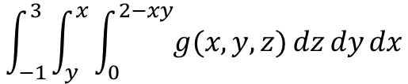
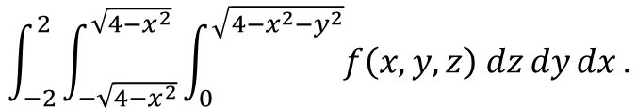
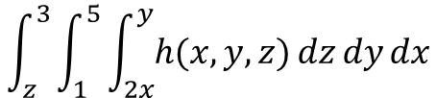
Legal or not?
$$\int_{−2}^{2}{\int_{−\sqrt{4−x^{2}}}^{\sqrt{4−x^{2}}}{\int_{0}^{\sqrt{4−x^{2}−y^{2}}}{f\left(x,y,z\right) dz}dy}dx}.$$
Yes, this is a legal integral. The bounds represents a hemisphere of radius 2.
$$\int_{−1}^{3}{\int_{y}^{x}{\int_{0}^{2−xy}{g(x,y,z)}dz}dy}dx$$
No, this is not legal. Variable y cannot appear as a bound in its own integral.
$$\int_{z}^{3}{\int_{1}^{5}{\int_{2x}^{y}{h(x,y,z)}dz}dy}dx$$
No, this is totally not legal. Outermost bounds must be constant.

