Slide 1
Surface Integrals
Scott Surgent

Slide 2
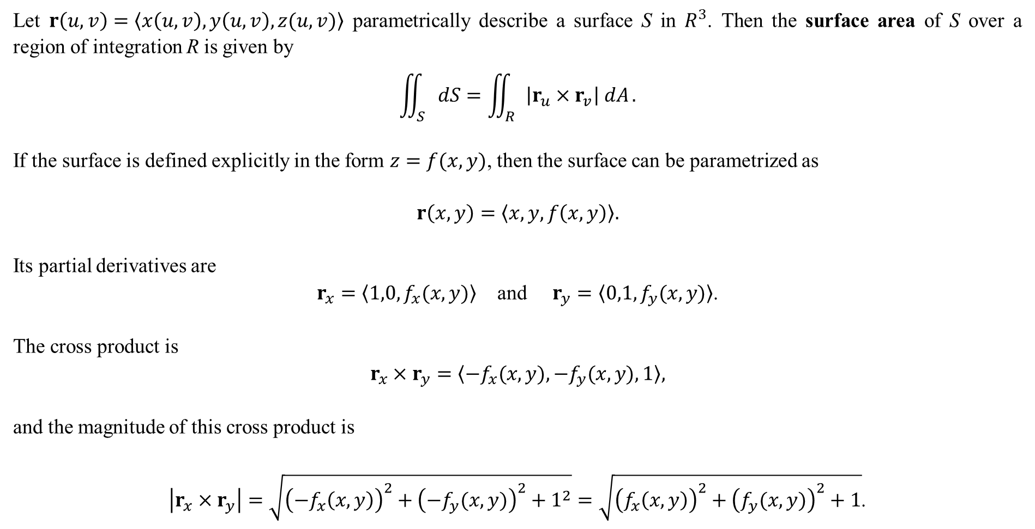
Let $r\left(u,v\right)=〈x\left(u,v\right),y\left(u,v\right),z(u,v)〉$ parametrically describe a surface S in $R^{3}$. Then the surface area of S over a region of integration R is given by
$$\iint_{S}{dS}=\iint_{R}{\left|r_{u}×r_{v}\right| dA}.$$
If the surface is defined explicitly in the form $z=f(x,y)$, then the surface can be parametrized as
$$r\left(x,y\right)=〈x,y,f\left(x,y\right)〉.$$
Its partial derivatives are
$r_{x}=〈1,0,f_{x}(x,y)〉$ and $r_{y}=〈0,1,f_{y}(x,y)〉$.
The cross product is
$$r_{x}×r_{y}=〈−f_{x}(x,y),−f_{y}(x,y),1〉,$$
and the magnitude of this cross product is
$\left|r_{x}×r_{y}\right|=\sqrt{{\left(−f_{x}\left(x,y\right)\right)}^{2}+{\left({−f}_{y}(x,y)\right)}^{2}+1^{2}}=\sqrt{{\left(f_{x}\left(x,y\right)\right)}^{2}+{\left(f_{y}(x,y)\right)}^{2}+1}$.

Slide 3
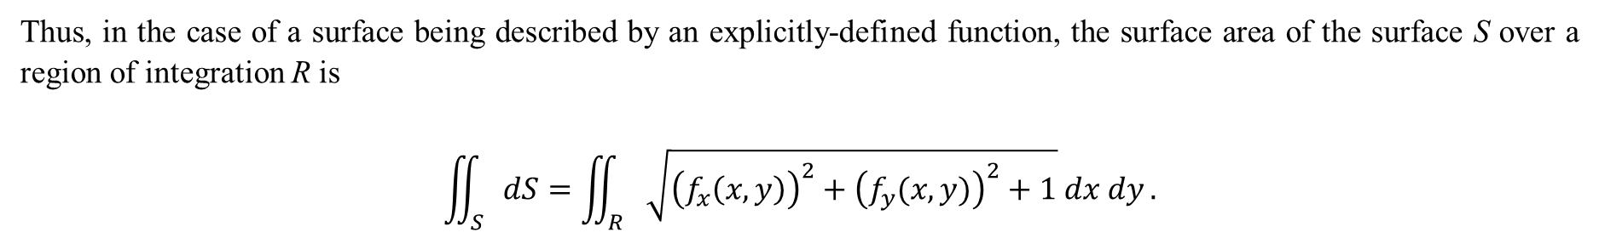
Thus, in the case of a surface being described by an explicitly-defined function, the surface area of the surface S over a region of integration R is
$$\iint_{S}{dS}=\iint_{R}{\sqrt{{\left(f_{x}\left(x,y\right)\right)}^{2}+{\left(f_{y}(x,y)\right)}^{2}+1} dx dy}.$$

Slide 4
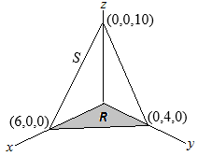
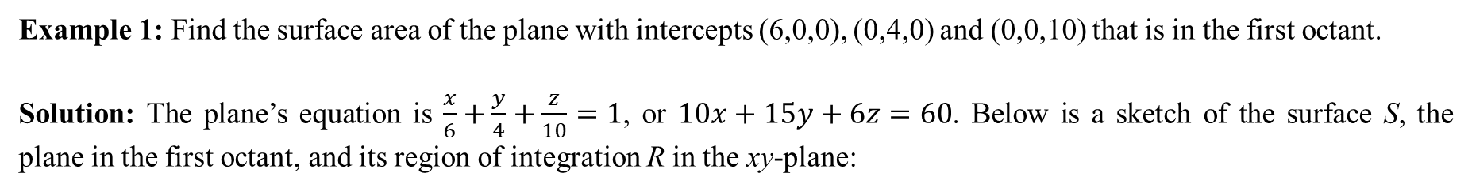
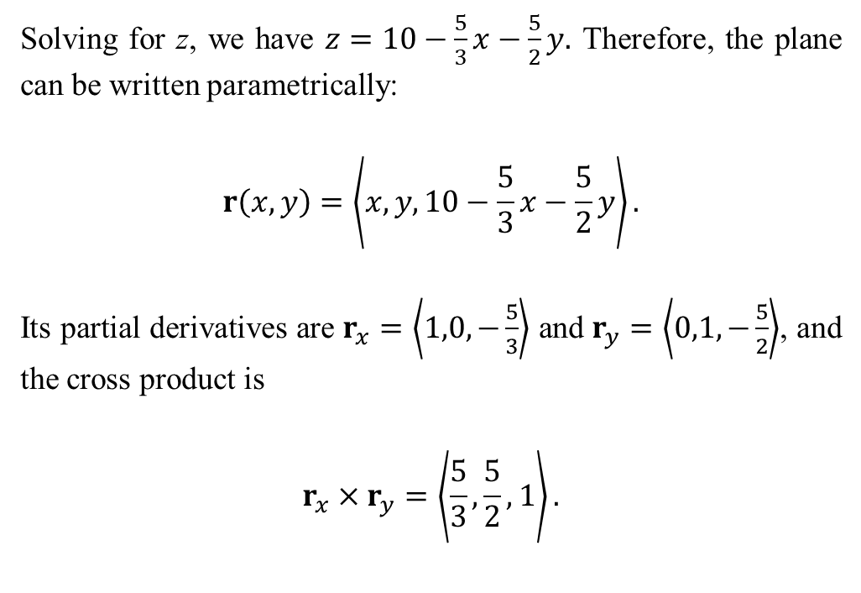
Example 1: Find the surface area of the plane with intercepts (6,0,0), (0,4,0) and (0,0,10) that is in the first octant.
Solution: The plane’s equation is $\frac{x}{6}+\frac{y}{4}+\frac{z}{10}=1$, or $10x+15y+6z=60$. Below is a sketch of the surface S, the plane in the first octant, and its region of integration R in the xy-plane:
Solving for z, we have $z=10−\frac{5}{3}x−\frac{5}{2}y.$ Therefore, the plane can be written parametrically:
$$r\left(x,y\right)=\left\langle x,y,10−\frac{5}{3}x−\frac{5}{2}y\right\rangle .$$
Its partial derivatives are $r_{x}=\left\langle 1,0,−\frac{5}{3}\right\rangle$ and $r_{y}=\left\langle 0,1,−\frac{5}{2}\right\rangle$, and the cross product is
$$r_{x}×r_{y}=\left\langle \frac{5}{3},\frac{5}{2},1\right\rangle .$$

Slide 5
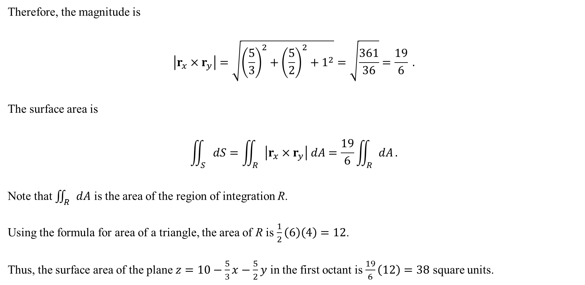
Therefore, the magnitude is
$$\left|r_{x}×r_{y}\right|=\sqrt{{\left(\frac{5}{3}\right)}^{2}+{\left(\frac{5}{2}\right)}^{2}+1^{2}}=\sqrt{\frac{361}{36}}=\frac{19}{6} .$$
The surface area is
$$\iint_{S}{dS}=\iint_{R}{\left|r_{x}×r_{y}\right| dA}=\frac{19}{6}\iint_{R}{dA}.$$
Note that $\iint_{R}{dA}$ is the area of the region of integration R.
Using the formula for area of a triangle, the area of R is $\frac{1}{2}\left(6\right)\left(4\right)=12$.
Thus, the surface area of the plane $z=10−\frac{5}{3}x−\frac{5}{2}y$ in the first octant is $\frac{19}{6}\left(12\right)=38$ square units.

Slide 6
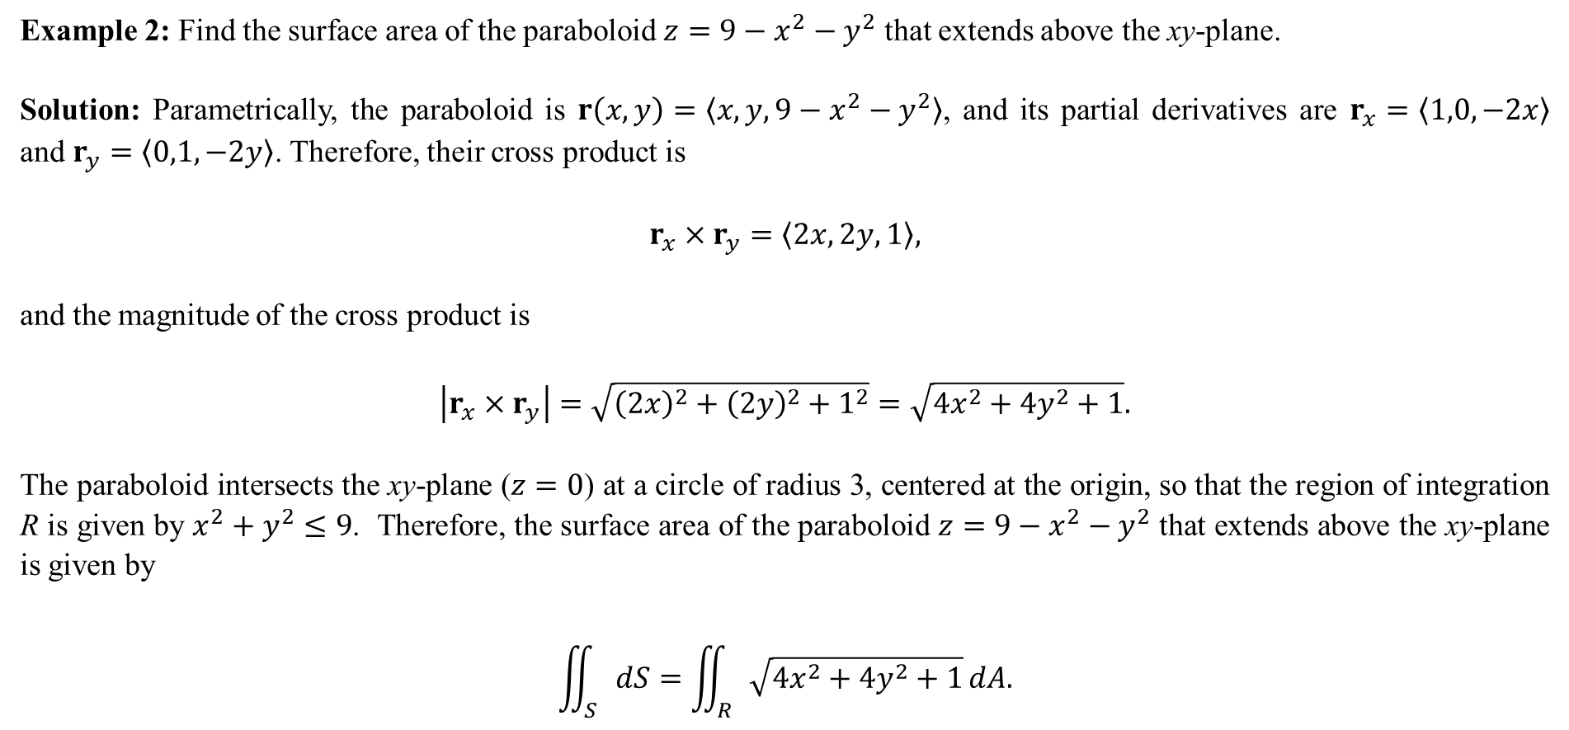
Example 2: Find the surface area of the paraboloid $z=9−x^{2}−y^{2}$ that extends above the xy-plane.
Solution: Parametrically, the paraboloid is $r\left(x,y\right)=〈x,y,9−x^{2}−y^{2}〉$, and its partial derivatives are $r_{x}=〈1,0,−2x〉$ and $r_{y}=〈0,1,−2y〉$. Therefore, their cross product is
$$r_{x}×r_{y}=〈2x,2y,1〉,$$
and the magnitude of the cross product is
$$\left|r_{x}×r_{y}\right|=\sqrt{{\left(2x\right)}^{2}+{\left(2y\right)}^{2}+1^{2}}=\sqrt{4x^{2}+4y^{2}+1}.$$
The paraboloid intersects the xy-plane ($z=0$) at a circle of radius 3, centered at the origin, so that the region of integration R is given by $x^{2}+y^{2}≤9$. Therefore, the surface area of the paraboloid $z=9−x^{2}−y^{2}$ that extends above the xy-plane is given by
$$\iint_{S}{dS}=\iint_{R}{\sqrt{4x^{2}+4y^{2}+1}}dA.$$

Slide 7
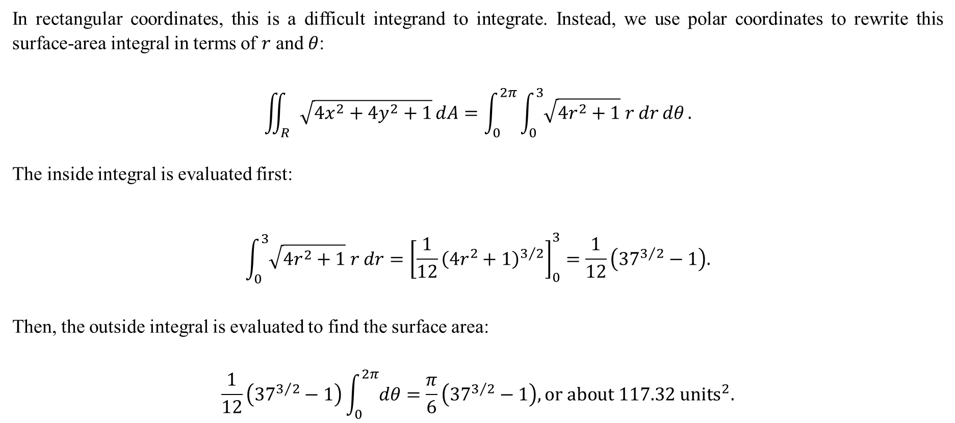
In rectangular coordinates, this is a difficult integrand to integrate. Instead, we use polar coordinates to rewrite this surface-area integral in terms of $r$ and $θ$:
$$\iint_{R}{\sqrt{4x^{2}+4y^{2}+1}}dA=\int_{0}^{2π}{\int_{0}^{3}{\sqrt{4r^{2}+1} r dr}dθ}.$$
The inside integral is evaluated first:
$$\int_{0}^{3}{\sqrt{4r^{2}+1} r dr}={\left[\frac{1}{12}{\left(4r^{2}+1\right)}^{3/2}\right]}_{0}^{3}=\frac{1}{12}\left({37}^{3/2}−1\right).$$
Then, the outside integral is evaluated to find the surface area:
$$\frac{1}{12}\left({37}^{3/2}−1\right)\int_{0}^{2π}{dθ}=\frac{π}{6}\left({37}^{3/2}−1\right), or about 117.32 units^{2}.$$

Slide 8
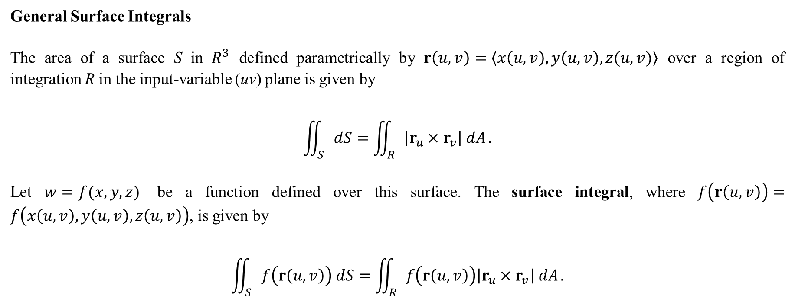
General Surface Integrals
The area of a surface S in $R^{3}$ defined parametrically by $r\left(u,v\right)=〈x\left(u,v\right),y\left(u,v\right),z(u,v)〉$ over a region of integration R in the input-variable (uv) plane is given by
$$\iint_{S}{dS}=\iint_{R}{\left|r_{u}×r_{v}\right| dA}.$$
Let $w=f(x,y,z)$ be a function defined over this surface. The surface integral, where $f\left(r\left(u,v\right)\right)=f\left(x\left(u,v\right),y\left(u,v\right),z\left(u,v\right)\right)$, is given by
$$\iint_{S}{f\left(r\left(u,v\right)\right) dS}=\iint_{R}{f\left(r\left(u,v\right)\right)\left|r_{u}×r_{v}\right| dA}.$$

Slide 9
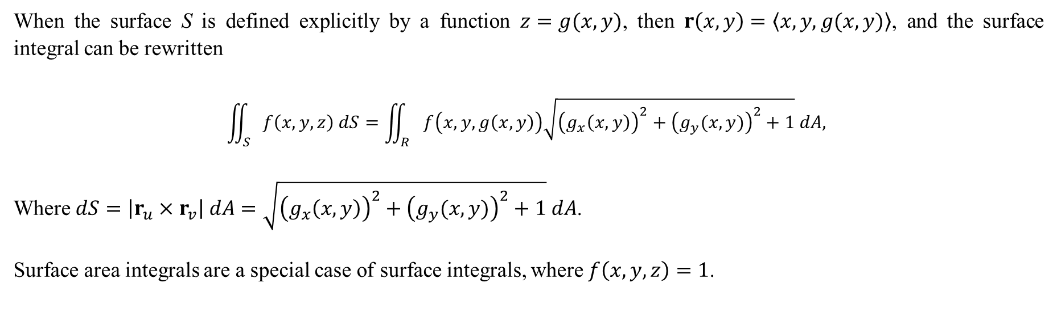
When the surface S is defined explicitly by a function $z=g(x,y)$, then $r\left(x,y\right)=〈x,y,g(x,y)〉$, and the surface integral can be rewritten
$$\iint_{S}{f\left(x,y,z\right) dS}=\iint_{R}{f\left(x,y,g\left(x,y\right)\right)\sqrt{{\left(g_{x}\left(x,y\right)\right)}^{2}+{\left(g_{y}(x,y)\right)}^{2}+1} dA, }$$
Where $dS=\left|r_{u}×r_{v}\right| dA=\sqrt{{\left(g_{x}\left(x,y\right)\right)}^{2}+{\left(g_{y}(x,y)\right)}^{2}+1} dA$.
Surface area integrals are a special case of surface integrals, where $f\left(x,y,z\right)=1$.

Slide 10
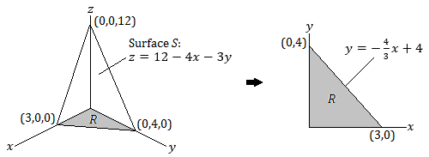
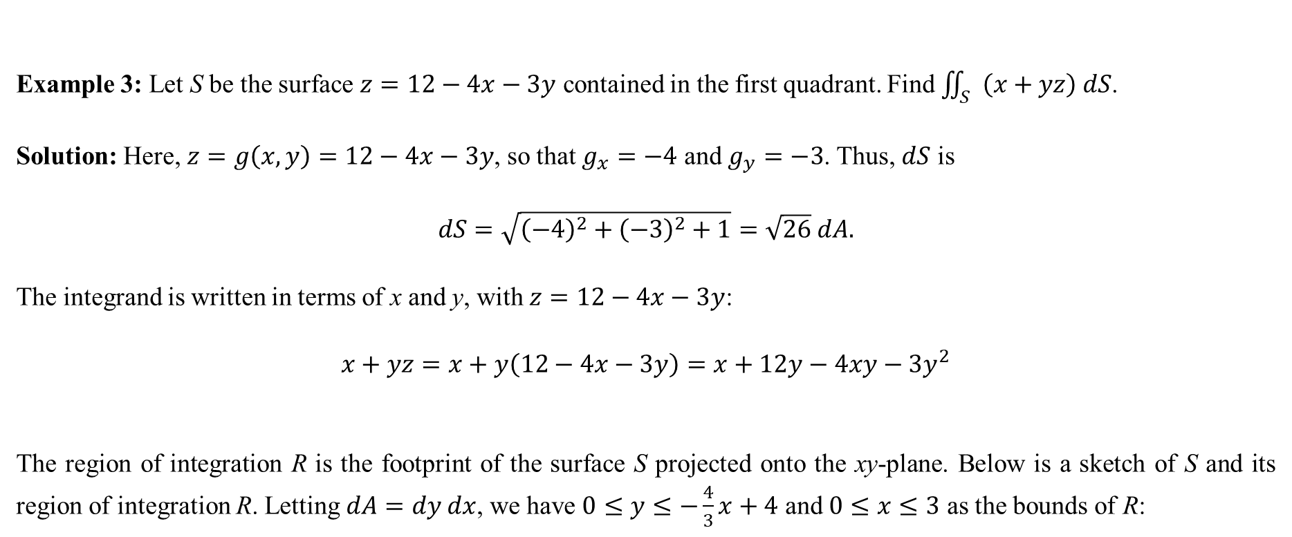
Example 3: Let S be the surface $z=12−4x−3y$ contained in the first quadrant. Find $\iint_{S}{\left(x+yz\right) dS}$.
Solution: Here, $z=g\left(x,y\right)=12−4x−3y$, so that $g_{x}=−4$ and $g_{y}=−3$. Thus, $dS$ is
$$dS=\sqrt{{\left(−4\right)}^{2}+{\left(−3\right)}^{2}+1}=\sqrt{26} dA.$$
The integrand is written in terms of x and y, with $z=12−4x−3y$:
$$x+yz=x+y\left(12−4x−3y\right)=x+12y−4xy−3y^{2}$$
The region of integration R is the footprint of the surface S projected onto the xy-plane. Below is a sketch of S and its region of integration R. Letting $dA=dy dx$, we have $0≤y≤−\frac{4}{3}x+4$ and $0≤x≤3$ as the bounds of R:

Slide 11
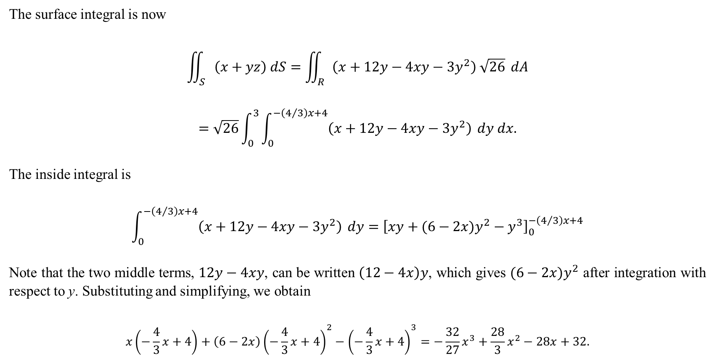
The surface integral is now
$$\iint_{S}{\left(x+yz\right) dS}=\iint_{R}{\left(x+12y−4xy−3y^{2}\right) \sqrt{26}} dA$$
$$=\sqrt{26}\int_{0}^{3}{\int_{0}^{−\left(4/3\right)x+4}{\left(x+12y−4xy−3y^{2}\right)}} dy dx.$$
The inside integral is
$$\int_{0}^{−\left(4/3\right)x+4}{\left(x+12y−4xy−3y^{2}\right)} dy={\left[xy+(6−2x)y^{2}−y^{3}\right]}_{0}^{−\left(4/3\right)x+4}$$
Note that the two middle terms, $12y−4xy$, can be written $\left(12−4x\right)y$, which gives $(6−2x)y^{2}$ after integration with respect to y. Substituting and simplifying, we obtain
$$x\left(−\frac{4}{3}x+4\right)+\left(6−2x\right){\left(−\frac{4}{3}x+4\right)}^{2}−{\left(−\frac{4}{3}x+4\right)}^{3}=−\frac{32}{27}x^{3}+\frac{28}{3}x^{2}−28x+32.$$

Slide 12
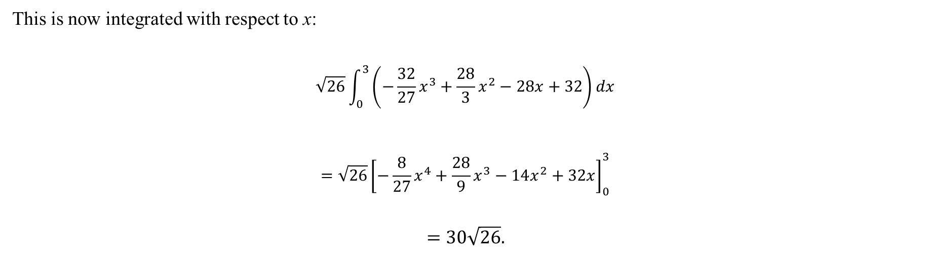
This is now integrated with respect to x:
$$\sqrt{26}\int_{0}^{3}{\left(−\frac{32}{27}x^{3}+\frac{28}{3}x^{2}−28x+32\right)dx}$$
$$=\sqrt{26}{\left[−\frac{8}{27}x^{4}+\frac{28}{9}x^{3}−14x^{2}+32x\right]}_{0}^{3}$$
$$=30\sqrt{26}.$$

