Slide 1
Stokes Theorem
Scott Surgent

Slide 2
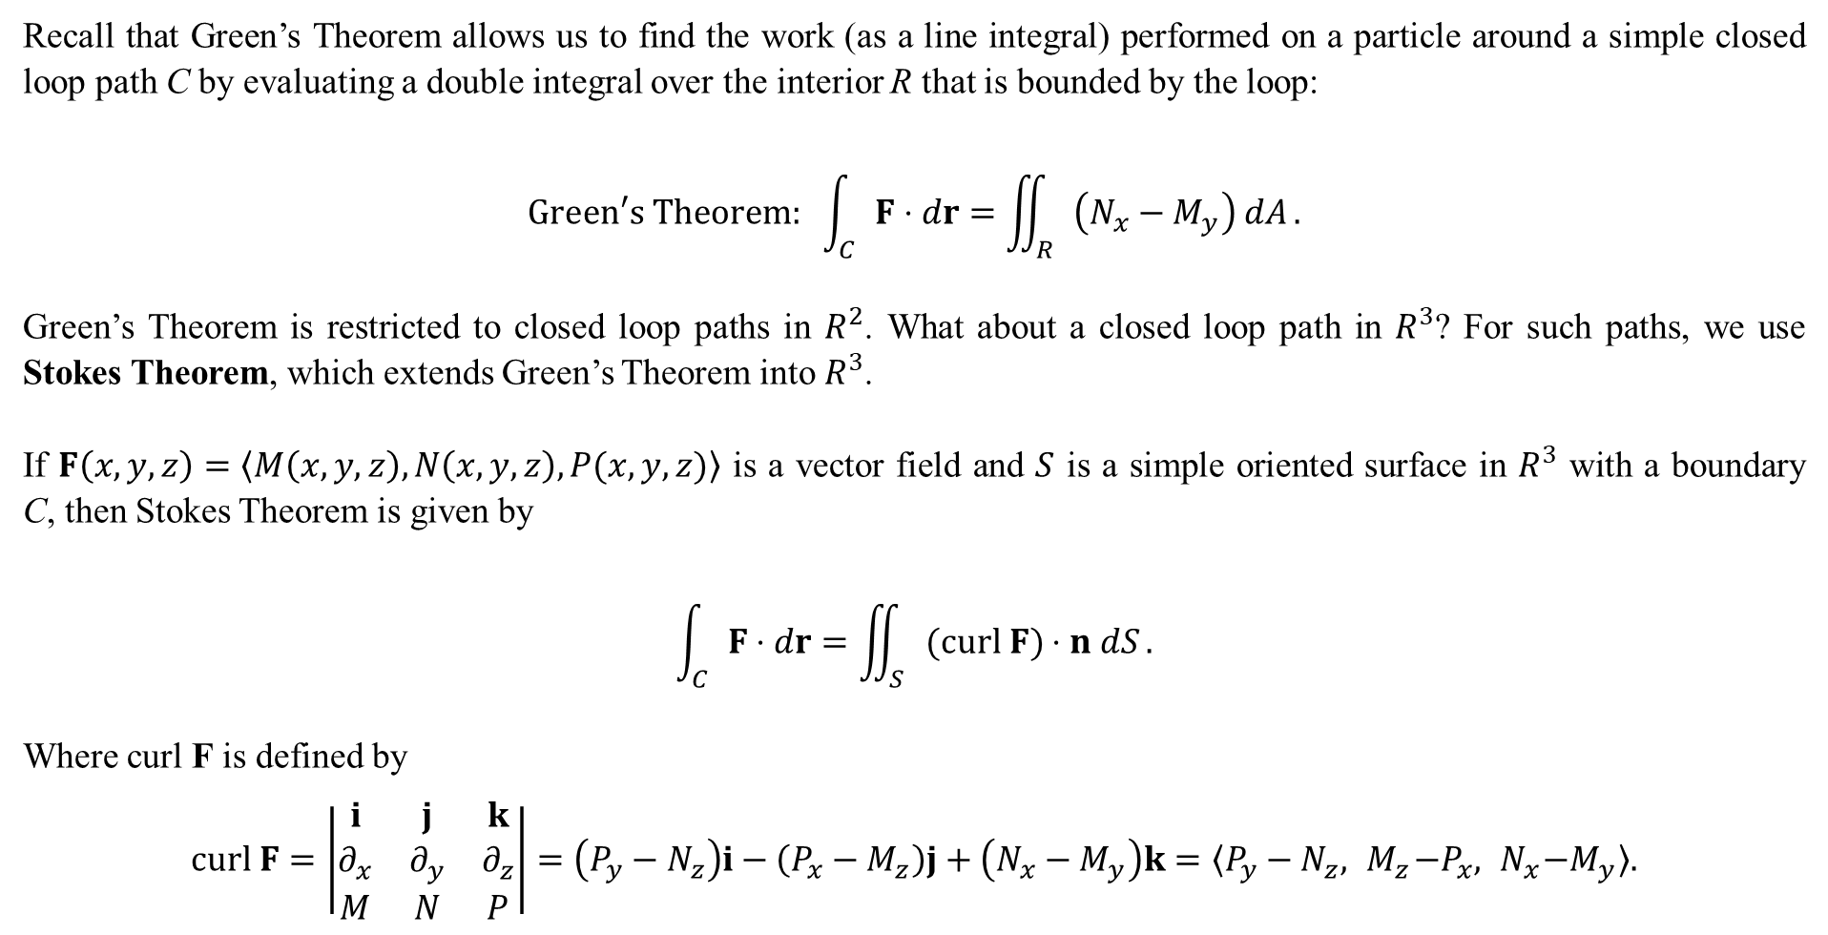
Recall that Green’s Theorem allows us to find the work (as a line integral) performed on a particle around a simple closed loop path C by evaluating a double integral over the interior R that is bounded by the loop:
$$Green′s Theorem: \int_{C}{F⋅dr}=\iint_{R}{\left(N_{x}−M_{y}\right) dA}.$$
Green’s Theorem is restricted to closed loop paths in $R^{2}$. What about a closed loop path in $R^{3}$? For such paths, we use Stokes Theorem, which extends Green’s Theorem into $R^{3}$.
If $F\left(x,y,z\right)=〈M\left(x,y,z\right),N\left(x,y,z\right),P(x,y,z)〉$ is a vector field and $S$ is a simple oriented surface in $R^{3}$ with a boundary C, then Stokes Theorem is given by
$$\int_{C}{F⋅dr}=\iint_{S}{(curl F)⋅n dS}.$$
Where curl F is defined by
$$curl F=\left|\begin{matrix}i & j & k \\ ∂_{x} & ∂_{y} & ∂_{z} \\ M & N & P\end{matrix}\right|=\left(P_{y}−N_{z}\right)i−\left(P_{x}−M_{z}\right)j+\left(N_{x}−M_{y}\right)k=〈P_{y}−N_{z},{ M}_{z}−P_{x},{ N}_{x}−M_{y}〉.$$

Slide 3
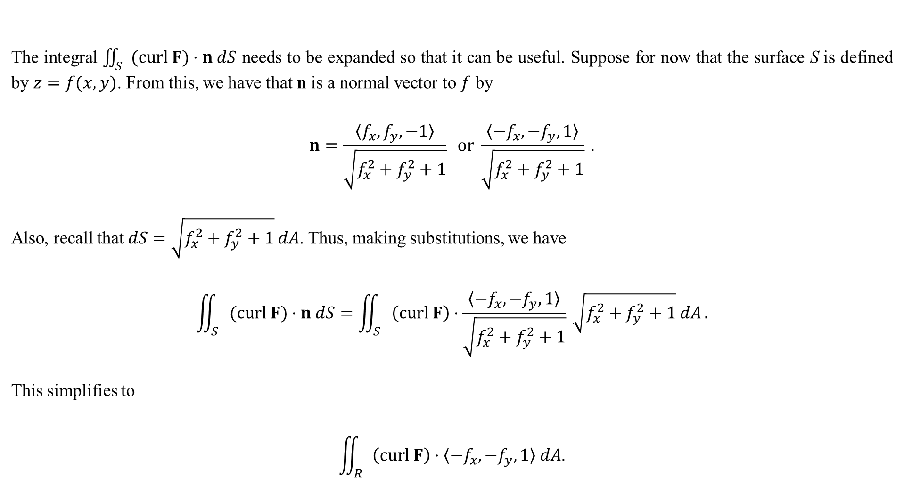
The integral $\iint_{S}{(curl F)⋅n dS}$ needs to be expanded so that it can be useful. Suppose for now that the surface S is defined by $z=f(x,y)$. From this, we have that n is a normal vector to $f$ by
$$n=\frac{〈f_{x},f_{y},−1〉}{\sqrt{f_{x}^{2}+f_{y}^{2}+1}} or \frac{〈−f_{x},−f_{y},1〉}{\sqrt{f_{x}^{2}+f_{y}^{2}+1}} .$$
Also, recall that $dS=\sqrt{f_{x}^{2}+f_{y}^{2}+1} dA$. Thus, making substitutions, we have
$$\iint_{S}{(curl F)⋅n dS}=\iint_{S}{\left(curl F\right)⋅\frac{〈−f_{x},−f_{y},1〉}{\sqrt{f_{x}^{2}+f_{y}^{2}+1}} \sqrt{f_{x}^{2}+f_{y}^{2}+1} dA}.$$
This simplifies to
$$\iint_{R}{\left(curl F\right)⋅〈−f_{x},−f_{y},1〉 dA.}$$
Usually, “up” is positive z, so we usually choose this version of n.

Slide 4
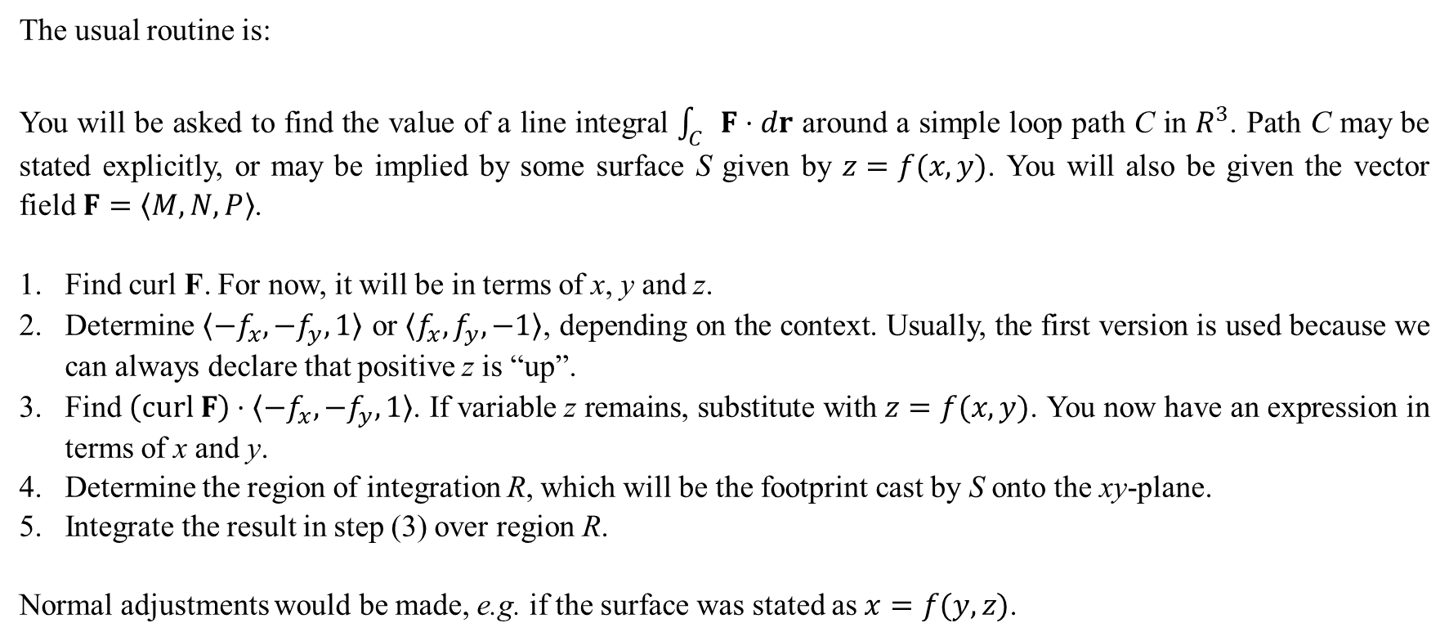
The usual routine is:
You will be asked to find the value of a line integral $\int_{C}{F⋅dr}$ around a simple loop path C in $R^{3}$. Path C may be stated explicitly, or may be implied by some surface S given by $z=f(x,y)$. You will also be given the vector field $F=〈M,N,P〉$.
Find curl F. For now, it will be in terms of x, y and z.
Determine $〈−f_{x},−f_{y},1〉$ or $〈f_{x},f_{y},−1〉$, depending on the context. Usually, the first version is used because we can always declare that positive z is “up”.
Find $\left(curl F\right)⋅〈−f_{x},−f_{y},1〉$. If variable z remains, substitute with $z=f(x,y)$. You now have an expression in terms of x and y.
Determine the region of integration R, which will be the footprint cast by S onto the xy-plane.
Integrate the result in step (3) over region R.
Normal adjustments would be made, e.g. if the surface was stated as $x=f(y,z)$.

Slide 5
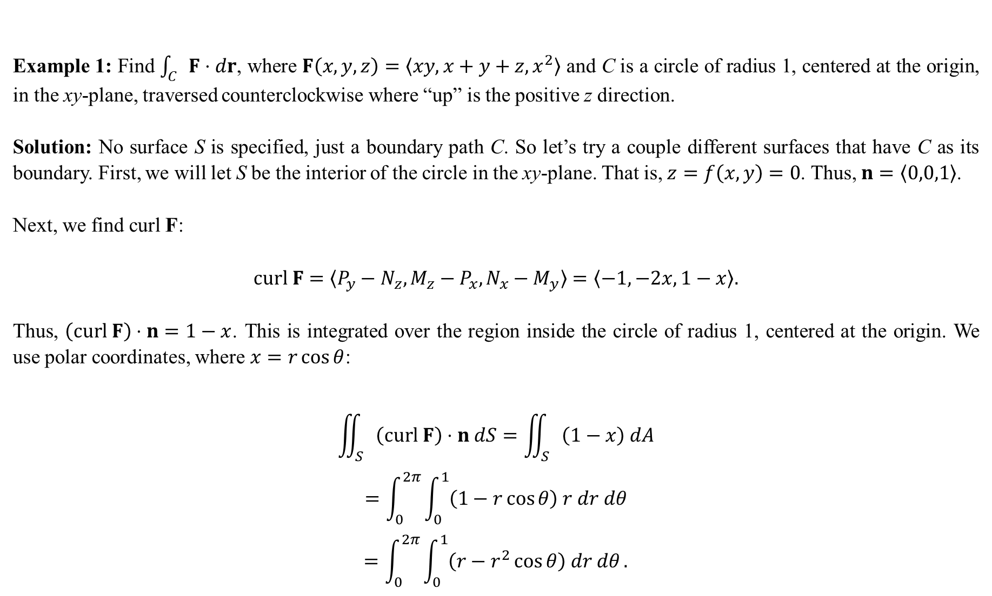
Example 1: Find $\int_{C}{F⋅dr}$, where $F\left(x,y,z\right)=〈xy,x+y+z,x^{2}〉$ and C is a circle of radius 1, centered at the origin, in the xy-plane, traversed counterclockwise where “up” is the positive z direction.
Solution: No surface S is specified, just a boundary path C. So let’s try a couple different surfaces that have C as its boundary. First, we will let S be the interior of the circle in the xy-plane. That is, $z=f\left(x,y\right)=0$. Thus, $n=〈0,0,1〉$.
Next, we find curl F:
$$curl F=〈P_{y}−N_{z},M_{z}−P_{x},N_{x}−M_{y}〉=〈−1,−2x,1−x〉.$$
Thus, $\left(curl F\right)⋅n=1−x$. This is integrated over the region inside the circle of radius 1, centered at the origin. We use polar coordinates, where $x=r\cos{θ}$:
$$\iint_{S}{\left(curl F\right)⋅n dS}=\iint_{S}{\left(1−x\right) dA}$$
$$=\int_{0}^{2π}{\int_{0}^{1}{\left(1−r\cos{θ}\right) r dr dθ}}$$
$$=\int_{0}^{2π}{\int_{0}^{1}{\left(r−r^{2}\cos{θ}\right) dr dθ}}.$$

Slide 6

The inner integral is
$$\int_{0}^{1}{\left(r−r^{2}\cos{θ}\right) dr}={\left[\frac{1}{2}r^{2}−\frac{1}{3}r^{3}\cos{θ}\right]}_{0}^{1}=\frac{1}{2}−\frac{1}{3}\cos{θ} .$$
Then, the outer integral is
$$\int_{0}^{2π}{\left(\frac{1}{2}−\frac{1}{3}\cos{θ}\right) dθ}={\left[\frac{1}{2}θ−\frac{1}{3}\sin{θ}\right]}_{0}^{2π}=π.$$
Therefore, with S as the portion of the xy-plane inside the circle of radius 1 centered at the origin, we have
$$\int_{C}{F⋅dr}=π.$$

Slide 7
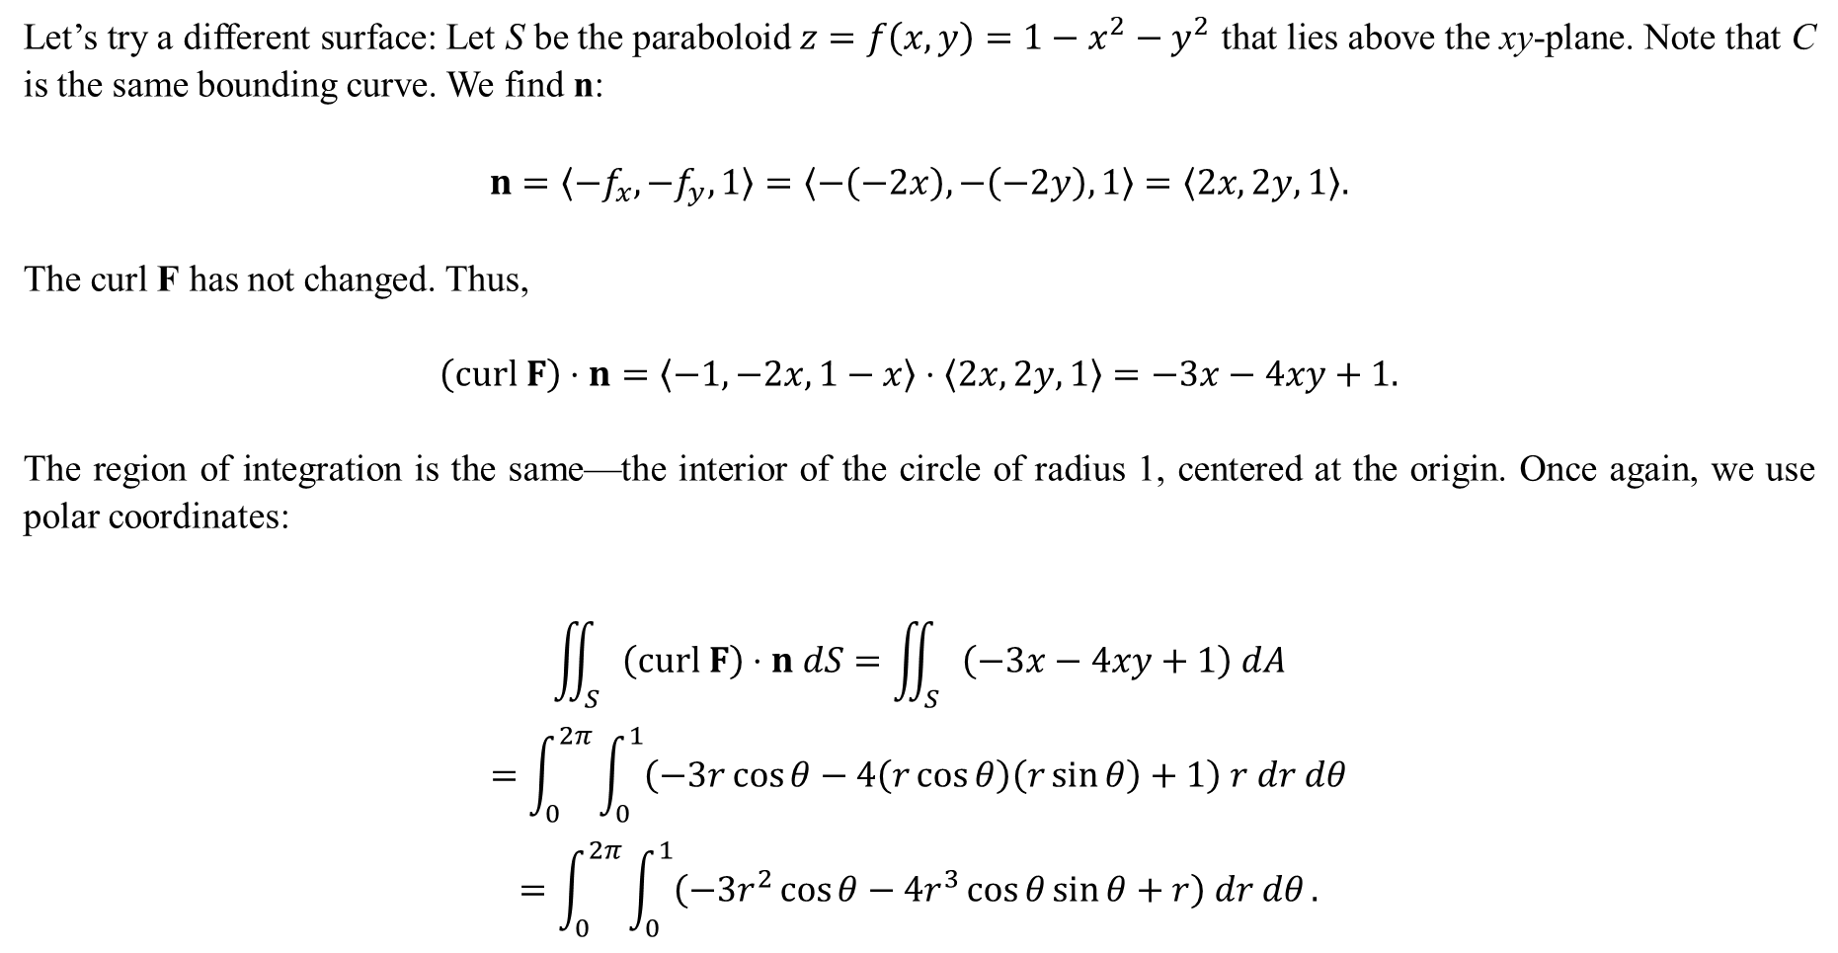
Let’s try a different surface: Let S be the paraboloid $z=f\left(x,y\right)=1−x^{2}−y^{2}$ that lies above the xy-plane. Note that C is the same bounding curve. We find n:
$$n=〈−f_{x},−f_{y},1〉=〈−\left(−2x\right),−\left(−2y\right),1〉=〈2x,2y,1〉.$$
The curl F has not changed. Thus,
$$\left(curl F\right)⋅n=〈−1,−2x,1−x〉⋅〈2x,2y,1〉=−3x−4xy+1.$$
The region of integration is the same—the interior of the circle of radius 1, centered at the origin. Once again, we use polar coordinates:
$$\iint_{S}{\left(curl F\right)⋅n dS}=\iint_{S}{\left(−3x−4xy+1\right) dA}$$
$$=\int_{0}^{2π}{\int_{0}^{1}{\left(−3r\cos{θ}−4\left(r\cos{θ}\right)\left(r\sin{θ}\right)+1\right) r dr dθ}}$$
$$=\int_{0}^{2π}{\int_{0}^{1}{\left(−3r^{2}\cos{θ}−4r^{3}\cos{θ}\sin{θ}+r\right) dr dθ}}.$$

Slide 8

The inside integral, evaluated with respect to r, is
$$\int_{0}^{1}{\left(−3r^{2}\cos{θ}−4r^{3}\cos{θ}\sin{θ}+r\right) dr dθ}$$
$$={\left[−r^{3}\cos{θ}−r^{4}\cos{θ}\sin{θ}+\frac{1}{2}r^{2}\right]}_{0}^{1}$$
$$=−\cos{θ}−\cos{θ}\sin{θ}+\frac{1}{2} .$$
Then this is integrated with respect to $θ$:
$$\int_{0}^{2π}{\left(−\cos{θ}−\cos{θ}\sin{θ}+\frac{1}{2}\right) dθ}$$
$$={\left[−\sin{θ}−\frac{1}{2}\sin^{2}{θ}+\frac{1}{2}θ\right]}_{0}^{2π}$$
$$=π.$$
We got the same result!

Slide 9
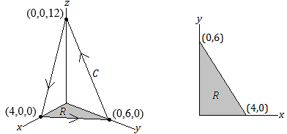
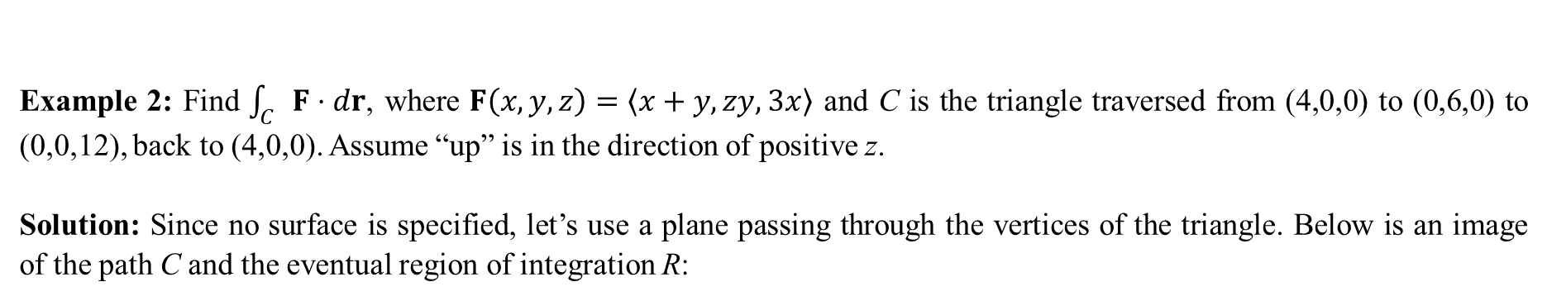
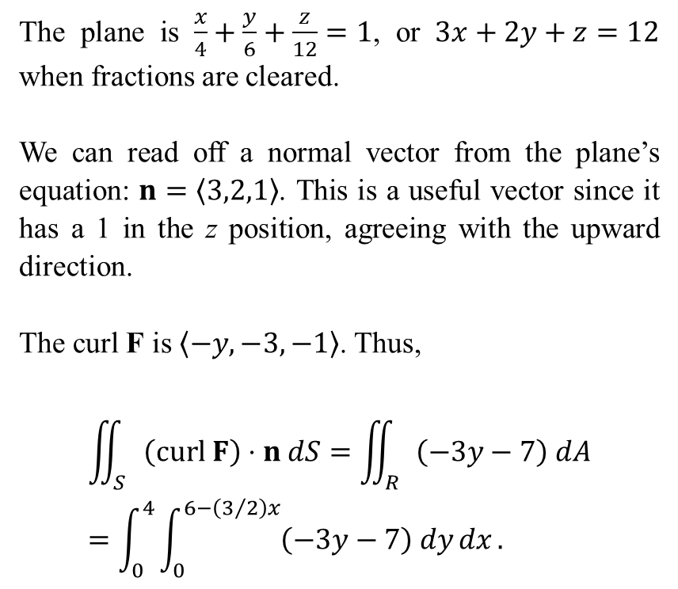
Example 2: Find $\int_{C}{F⋅dr}$, where $F\left(x,y,z\right)=〈x+y,zy,3x〉$ and C is the triangle traversed from (4,0,0) to (0,6,0) to (0,0,12), back to (4,0,0). Assume “up” is in the direction of positive z.
Solution: Since no surface is specified, let’s use a plane passing through the vertices of the triangle. Below is an image of the path C and the eventual region of integration R:
The plane is $\frac{x}{4}+\frac{y}{6}+\frac{z}{12}=1$, or $3x+2y+z=12$ when fractions are cleared.
We can read off a normal vector from the plane’s equation: $n=〈3,2,1〉$. This is a useful vector since it has a 1 in the z position, agreeing with the upward direction.
The curl F is $〈−y,−3,−1〉$. Thus,
$$\iint_{S}{\left(curl F\right)⋅n dS}=\iint_{R}{\left(−3y−7\right) dA}=\int_{0}^{4}{\int_{0}^{6−\left(3/2\right)x}{\left(−3y−7\right) dy}dx}.$$

Slide 10
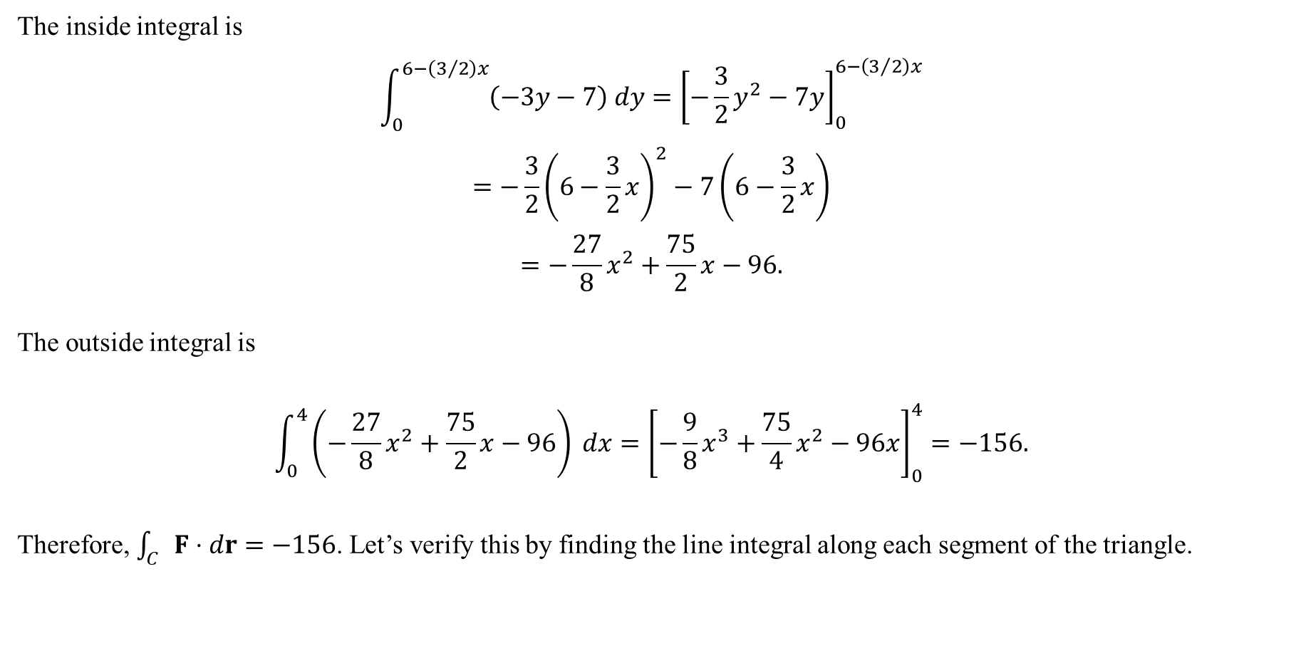
The inside integral is
$$\int_{0}^{6−\left(3/2\right)x}{\left(−3y−7\right) dy}={\left[−\frac{3}{2}y^{2}−7y\right]}_{0}^{6−\left(3/2\right)x}$$
$$=−\frac{3}{2}{\left(6−\frac{3}{2}x\right)}^{2}−7\left(6−\frac{3}{2}x\right)$$
$$=−\frac{27}{8}x^{2}+\frac{75}{2}x−96.$$
The outside integral is
$$\int_{0}^{4}{\left(−\frac{27}{8}x^{2}+\frac{75}{2}x−96\right) dx}={\left[−\frac{9}{8}x^{3}+\frac{75}{4}x^{2}−96x\right]}_{0}^{4}=−156.$$
Therefore, $\int_{C}{F⋅dr}=−156$. Let’s verify this by finding the line integral along each segment of the triangle.

Slide 11
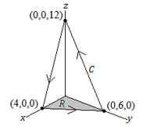




From (0,0,12) to (4,0,0), we have $r\left(t\right)=〈4t,0,12−12t〉$ for $0≤t≤1$. This gives $dr=〈4,0,−12〉$. Also, $F\left(t\right)=〈4t,0,12t〉$. Therefore,
$$F⋅dr=4\left(4t\right)−12\left(12t\right)=16t−144t=−128t.$$
Finally, the line integral is
$$\int_{0}^{1}{−128t dt}={−128\left[\frac{1}{2}t^{2}\right]}_{0}^{1}=−64.$$
From (0,6,0) to (0,0,12), we have $r\left(t\right)=〈0,6−6t,12t〉$ for $0≤t≤1$, so that $dr=〈0,−6,12〉$. Meanwhile, $F\left(t\right)=〈6−6t,72t−72t^{2},0〉$.
Thus, $F⋅dr=−6\left(72t−72t^{2}\right)=−432\left(t−t^{2}\right),$and the line integral is
$$\int_{0}^{1}{−432(t−t^{2}) dt}={−432\left[\frac{1}{2}t^{2}−\frac{1}{3}t^{3}\right]}_{0}^{1}=−72$$
From (4,0,0) to (0,6,0), we have $r\left(t\right)=〈4−4t,6t,0〉$ for $0≤t≤1$, so that $dr=〈−4,6,0〉$. Meanwhile,
$$F\left(t\right)=〈x+y,zy,3x〉 \\ =〈(4−4t)+(6t),(0)(6t),3(4−4t)〉 \left\{\begin{matrix}x=4−4t \\ y=6t \\ z=0\end{matrix}\right.$$
or after simplification, $F\left(t\right)=〈4+2t,0,12−12t〉$. The dot product is $F⋅dr=−4\left(4+2t\right)=−16−8t$, and the line integral is
$$\int_{0}^{1}{\left(−16−8t\right) dt}={\left[−16t−4t^{2}\right]}_{0}^{1}=−20.$$
The sum of these three line integrals is
$−20−72−64=−156$,
agreeing with the result found by Stokes Theorem.

