Slide 1
Integration in Spherical Coordinates
Scott Surgent

Slide 2
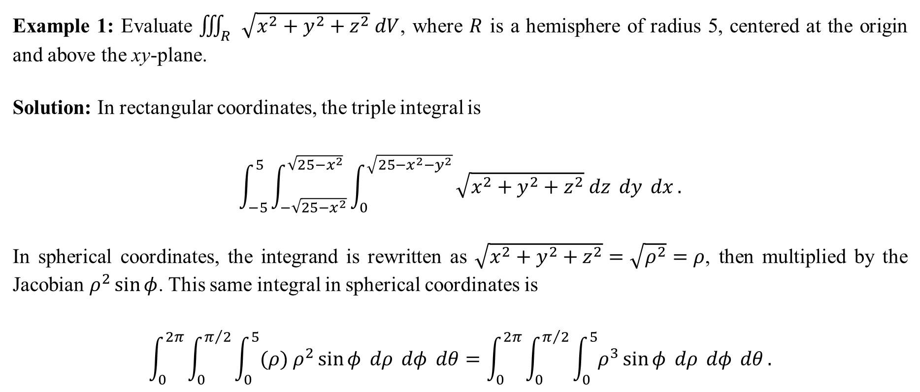
Example 1: Evaluate $\iiint_{R}{\sqrt{x^{2}+y^{2}+z^{2}} dV}$, where $R$ is a hemisphere of radius 5, centered at the origin and above the xy-plane.
Solution: In rectangular coordinates, the triple integral is
$$\int_{−5}^{5}{\int_{−\sqrt{25−x^{2}}}^{\sqrt{25−x^{2}}}{\int_{0}^{\sqrt{25−x^{2}−y^{2}}}{\sqrt{x^{2}+y^{2}+z^{2}} dz} dy} dx}.$$
In spherical coordinates, the integrand is rewritten as $\sqrt{x^{2}+y^{2}+z^{2}}=\sqrt{ρ^{2}}=ρ$, then multiplied by the Jacobian $ρ^{2}\sin{φ}$. This same integral in spherical coordinates is
$$\int_{0}^{2π}{\int_{0}^{π/2}{\int_{0}^{5}{(ρ) ρ^{2}\sin{φ} dρ} dφ} dθ}=\int_{0}^{2π}{\int_{0}^{π/2}{\int_{0}^{5}{ρ^{3}\sin{φ} dρ} dφ} dθ}.$$

Slide 3
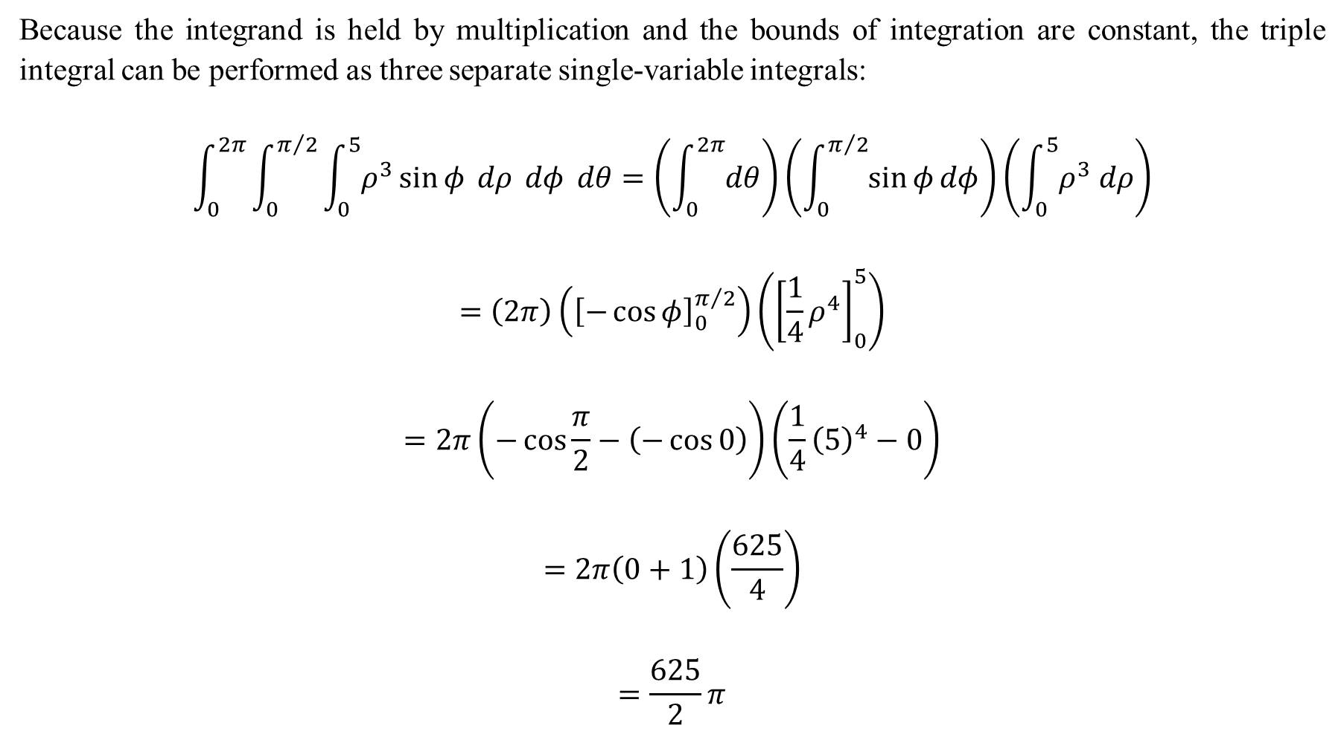
Because the integrand is held by multiplication and the bounds of integration are constant, the triple integral can be performed as three separate single-variable integrals:
$$\int_{0}^{2π}{\int_{0}^{π/2}{\int_{0}^{5}{ρ^{3}\sin{φ} dρ} dφ} dθ=\left(\int_{0}^{2π}{dθ}\right)}\left(\int_{0}^{π/2}{\sin{φ}dφ}\right)\left(\int_{0}^{5}{ρ^{3} dρ}\right)$$
$$=\left(2π\right)\left({\left[−\cos{φ}\right]}_{0}^{π/2}\right)\left({\left[\frac{1}{4}ρ^{4}\right]}_{0}^{5}\right)$$
$$=2π\left(−\cos{\frac{π}{2}}−\left(−\cos{0}\right)\right)\left(\frac{1}{4}{\left(5\right)}^{4}−0\right)$$
$$=2π\left(0+1\right)\left(\frac{625}{4}\right)$$
$$=\frac{625}{2}π$$

Slide 4
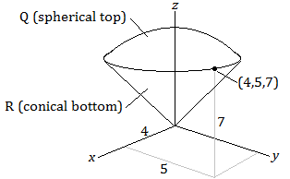
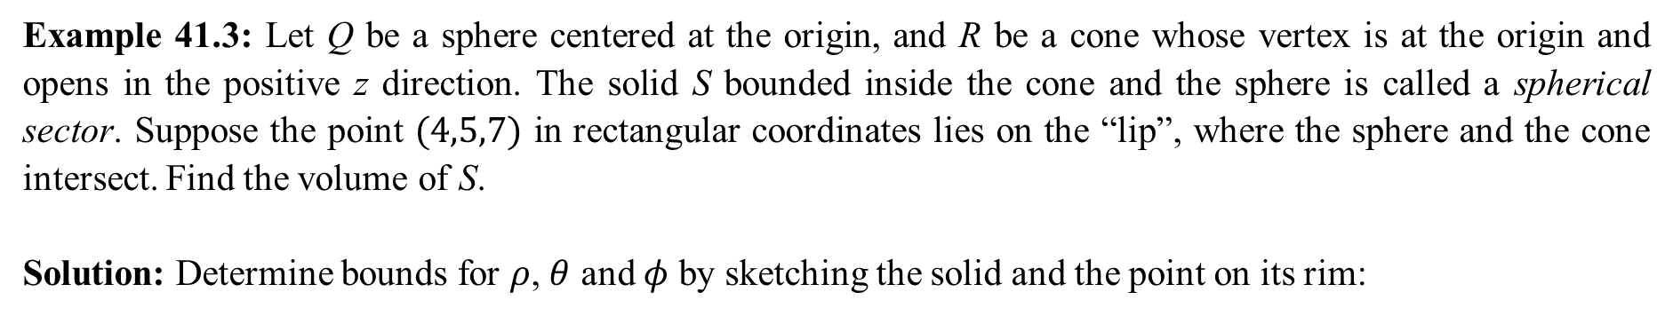
Example 41.3: Let Q be a sphere centered at the origin, and R be a cone whose vertex is at the origin and opens in the positive z direction. The solid S bounded inside the cone and the sphere is called a spherical sector. Suppose the point $(4,5,7)$ in rectangular coordinates lies on the “lip”, where the sphere and the cone intersect. Find the volume of S.
Solution: Determine bounds for $ρ$, $θ$ and $φ$ by sketching the solid and the point on its rim:

Slide 5
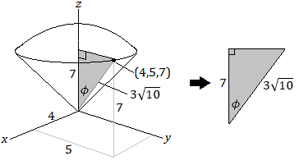
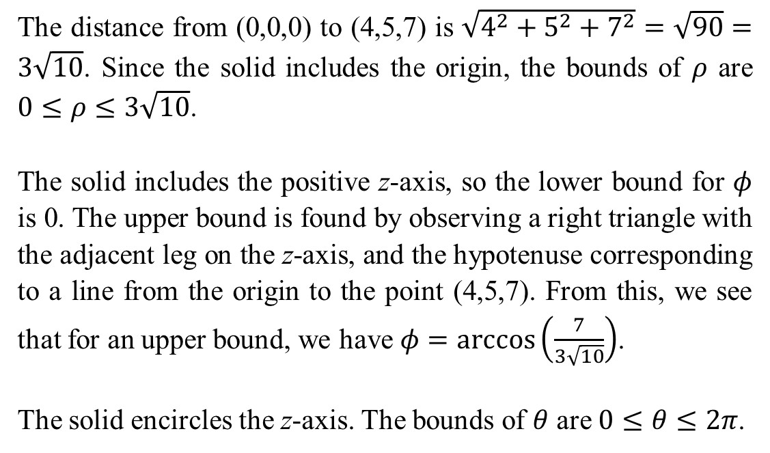
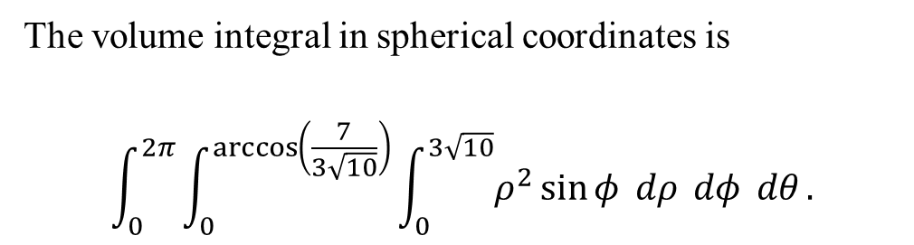
The distance from (0,0,0) to (4,5,7) is $\sqrt{4^{2}+5^{2}+7^{2}}=\sqrt{90}=3\sqrt{10}$. Since the solid includes the origin, the bounds of $ρ$ are $0≤ρ≤3\sqrt{10}$.
The solid includes the positive z-axis, so the lower bound for $φ$ is 0. The upper bound is found by observing a right triangle with the adjacent leg on the z-axis, and the hypotenuse corresponding to a line from the origin to the point (4,5,7). From this, we see that for an upper bound, we have $φ=\arccos\left(\frac{7}{3\sqrt{10}}\right)$.
The solid encircles the z-axis. The bounds of $θ$ are $0≤θ≤2π$.
The volume integral in spherical coordinates is
$$\int_{0}^{2π}{\int_{0}^{\arccos\left(\frac{7}{3\sqrt{10}}\right)}{\int_{0}^{3\sqrt{10}}{ρ^{2}\sin{φ} dρ} dφ} dθ}.$$

Slide 6
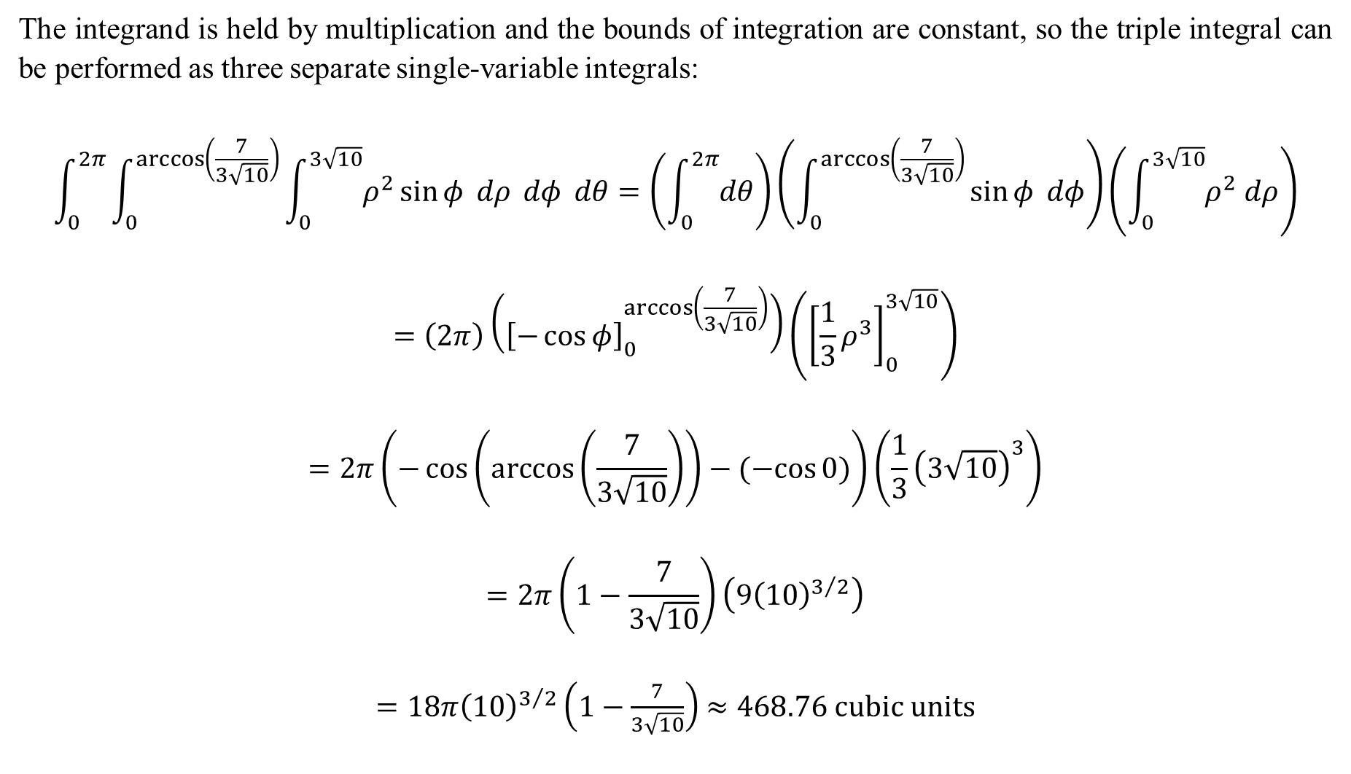
The integrand is held by multiplication and the bounds of integration are constant, so the triple integral can be performed as three separate single-variable integrals:
$$\int_{0}^{2π}{\int_{0}^{\arccos\left(\frac{7}{3\sqrt{10}}\right)}{\int_{0}^{3\sqrt{10}}{ρ^{2}\sin{φ} dρ} dφ} dθ}=\left(\int_{0}^{2π}{dθ}\right)\left(\int_{0}^{\arccos\left(\frac{7}{3\sqrt{10}}\right)}{\sin{φ} dφ}\right)\left(\int_{0}^{3\sqrt{10}}{ρ^{2} dρ}\right)$$
$$=\left(2π\right)\left({\left[−\cos{φ}\right]}_{0}^{\arccos\left(\frac{7}{3\sqrt{10}}\right)}\right)\left({\left[\frac{1}{3}ρ^{3}\right]}_{0}^{3\sqrt{10}}\right)$$
$$=2π\left(−\cos\left(\arccos\left(\frac{7}{3\sqrt{10}}\right)\right)−(−cos{0)}\right)\left(\frac{1}{3}{\left(3\sqrt{10}\right)}^{3}\right)$$
$$=2π\left(1−\frac{7}{3\sqrt{10}}\right)\left(9{\left(10\right)}^{3/2}\right)$$
$=18π{\left(10\right)}^{3/2}\left(1−\frac{7}{3\sqrt{10}}\right)$ $≈468.76 cubic units$

Slide 7
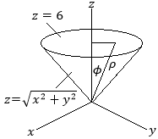
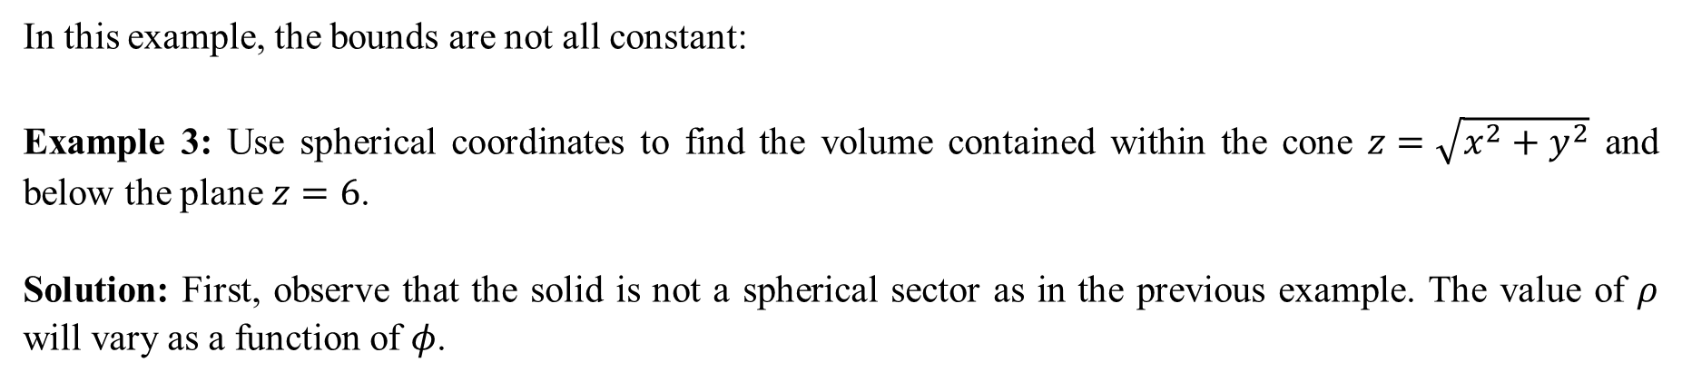
In this example, the bounds are not all constant:
Example 3: Use spherical coordinates to find the volume contained within the cone $z=\sqrt{x^{2}+y^{2}}$ and below the plane $z=6$.
Solution: First, observe that the solid is not a spherical sector as in the previous example. The value of $ρ$ will vary as a function of $φ$.

Slide 8
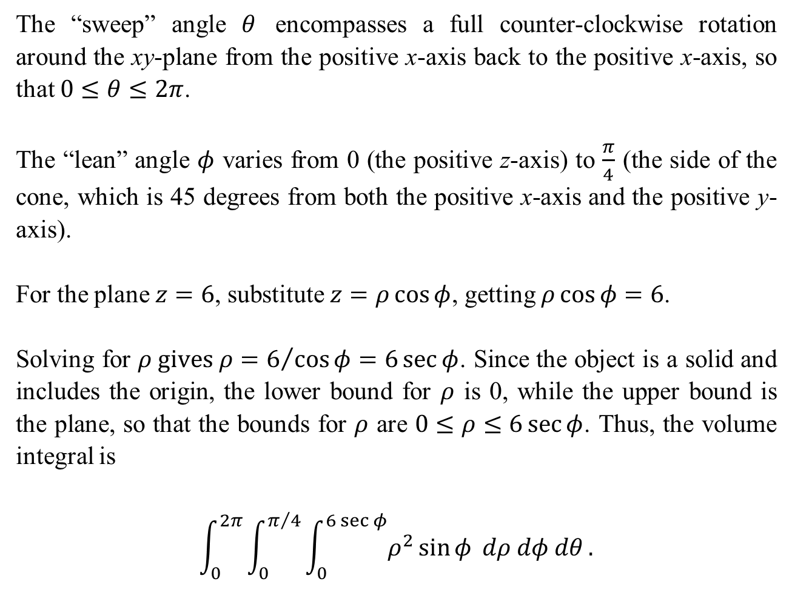
The “sweep” angle $θ$ encompasses a full counter-clockwise rotation around the xy-plane from the positive x-axis back to the positive x-axis, so that $0≤θ≤2π$.
The “lean” angle $φ$ varies from 0 (the positive z-axis) to $\frac{π}{4}$ (the side of the cone, which is 45 degrees from both the positive x-axis and the positive y-axis).
For the plane $z=6$, substitute $z=ρ\cos{φ}$, getting $ρ\cos{φ}=6$.
Solving for $ρ gives ρ=6/{\cos{φ}}=6\sec{φ}$. Since the object is a solid and includes the origin, the lower bound for $ρ$ is 0, while the upper bound is the plane, so that the bounds for $ρ$ are $0≤ρ≤6\sec{φ}$. Thus, the volume integral is
$$\int_{0}^{2π}{\int_{0}^{π/4}{\int_{0}^{6\sec{φ}}{ρ^{2}\sin{φ} dρ dφ dθ}}}.$$

Slide 9

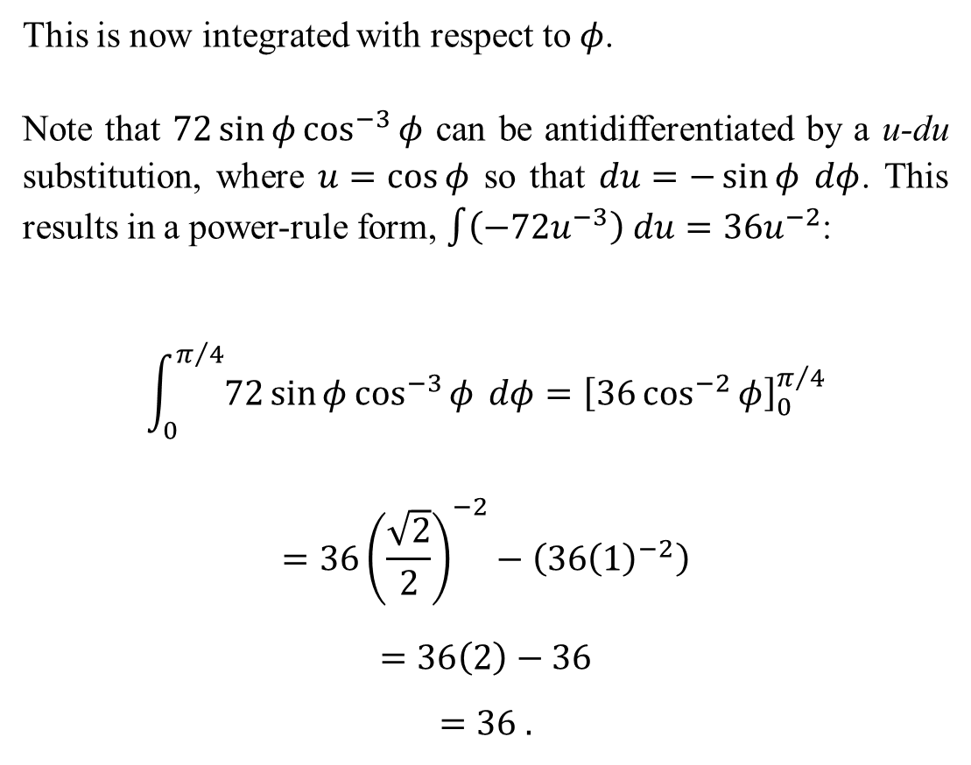
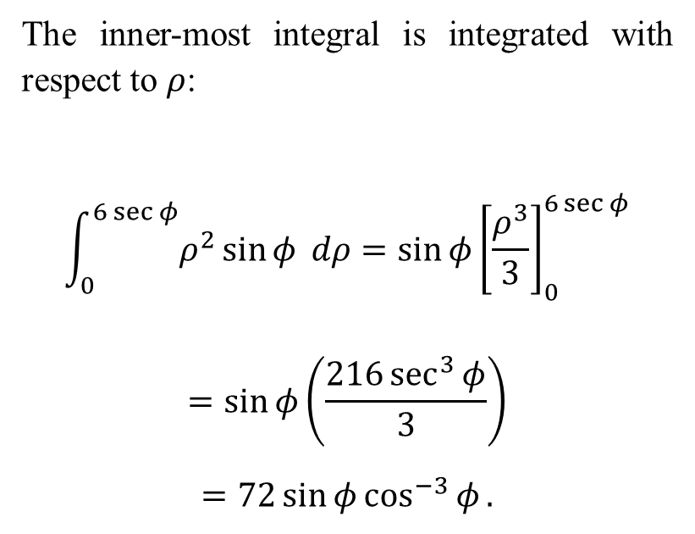
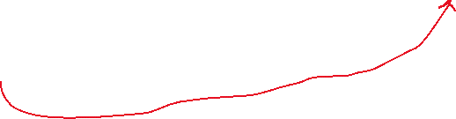

The inner-most integral is integrated with respect to $ρ$:
$$\int_{0}^{6\sec{φ}}{ρ^{2}\sin{φ} dρ}=\sin{φ}{\left[\frac{ρ^{3}}{3}\right]}_{0}^{6\sec{φ}}$$
$$=\sin{φ}\left(\frac{216\sec^{3}{φ}}{3}\right)$$
$$=72\sin{φ}\cos^{−3}{φ}.$$
This is now integrated with respect to $φ$.
Note that $72\sin{φ}\cos^{−3}{φ}$ can be antidifferentiated by a u-du substitution, where $u=\cos{φ}$ so that $du=−\sin{φ} dφ$. This results in a power-rule form, $\int{\left(−72u^{−3}\right) du=36u^{−2}}$:
$$\int_{0}^{π/4}{72\sin{φ}\cos^{−3}{φ}} dφ={\left[36\cos^{−2}{φ}\right]}_{0}^{π/4}$$
$$=36{\left(\frac{\sqrt{2}}{2}\right)}^{−2}−\left(36{\left(1\right)}^{−2}\right)$$
$$=36\left(2\right)−36$$
$$=36 .$$
Lastly, we integrate with respect to $θ$:
$$\int_{0}^{2π}{\left(36\right) dθ}=36\left(2π\right)=72π cubic units.$$

