Slide 1
Projectile Motion
Scott Surgent

Slide 2
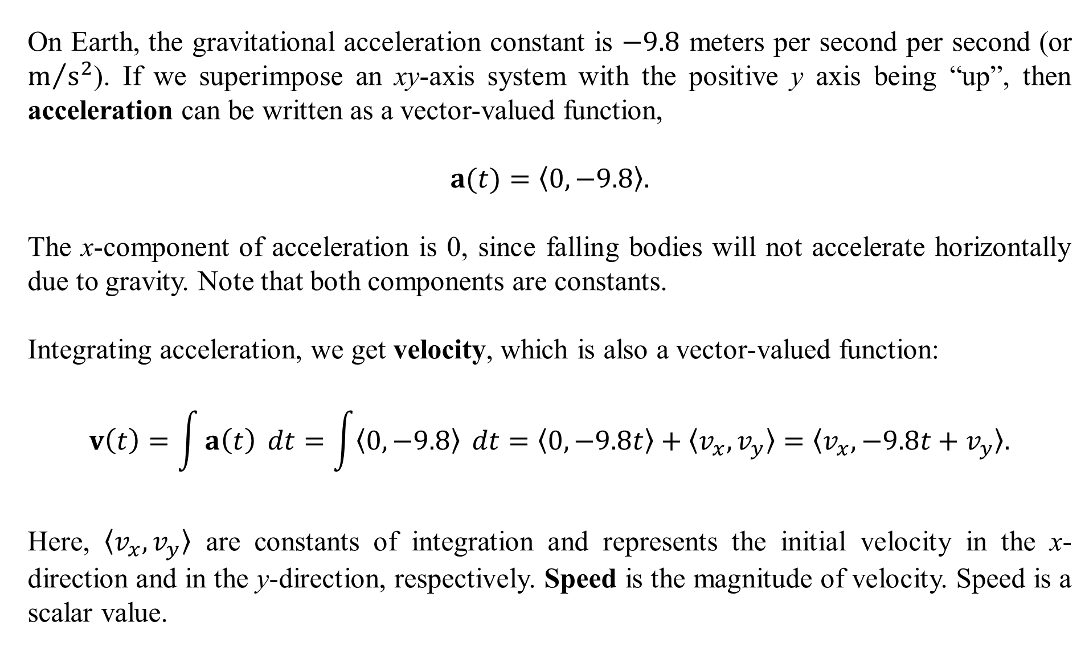
On Earth, the gravitational acceleration constant is $−9.8$ meters per second per second (or $m/{s^{2}}$). If we superimpose an xy-axis system with the positive y axis being “up”, then acceleration can be written as a vector-valued function,
$$a(t)=〈0,−9.8〉.$$
The x-component of acceleration is 0, since falling bodies will not accelerate horizontally due to gravity. Note that both components are constants.
Integrating acceleration, we get velocity, which is also a vector-valued function:
$$v\left(t\right)=\int{a\left(t\right)} dt=\int{〈0,−9.8〉} dt=〈0, −9.8t〉+〈v_{x},v_{y}〉=〈v_{x}, −9.8t+v_{y}〉.$$
Here, $〈v_{x}, v_{y}〉$ are constants of integration and represents the initial velocity in the x-direction and in the y-direction, respectively. Speed is the magnitude of velocity. Speed is a scalar value.

Slide 3
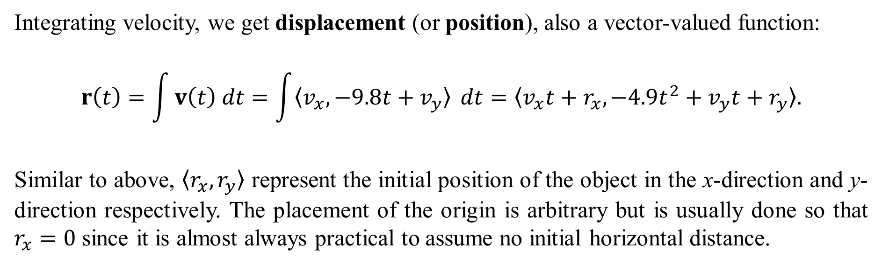
Integrating velocity, we get displacement (or position), also a vector-valued function:
$$r\left(t\right)=\int{v\left(t\right) dt}=\int{〈v_{x}, −9.8t+v_{y}〉} dt=〈v_{x}t+r_{x}, −4.9t^{2}+v_{y}t+r_{y}〉.$$
Similar to above, $〈r_{x},r_{y}〉$ represent the initial position of the object in the x-direction and y-direction respectively. The placement of the origin is arbitrary but is usually done so that $r_{x}=0$ since it is almost always practical to assume no initial horizontal distance.

Slide 4
Example 1: A ball is propelled off a 100 m tall cliff at an initial speed of 50 meters per second at an angle of 30 degrees above the horizontal.
Find the maximum height of the ball.
Find the range of the ball when hits the ground for the first time.
How fast is the ball travelling when it impacts the ground for the first time?
At what angle does the ball impact the ground for the first time?

Slide 5

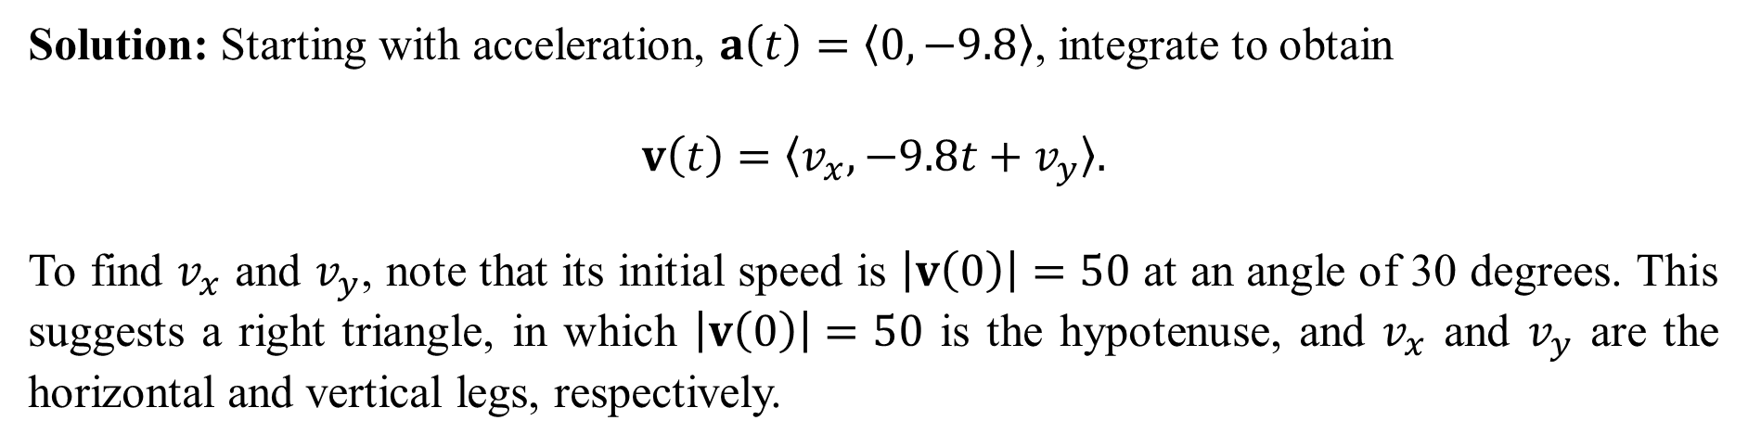
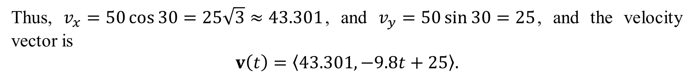
Solution: Starting with acceleration, $a\left(t\right)=〈0, −9.8〉$, integrate to obtain
$$v\left(t\right)=〈v_{x}, −9.8t+v_{y}〉.$$
To find $v_{x}$ and $v_{y}$, note that its initial speed is $\left|v\left(0\right)\right|=50$ at an angle of 30 degrees. This suggests a right triangle, in which $\left|v\left(0\right)\right|=50$ is the hypotenuse, and $v_{x}$ and $v_{y}$ are the horizontal and vertical legs, respectively.
Thus, $v_{x}=50\cos{30}=25\sqrt{3}≈43.301$, and $v_{y}=50\sin{30}=25$, and the velocity vector is
$$v\left(t\right)=〈43.301, −9.8t+25〉.$$

Slide 6
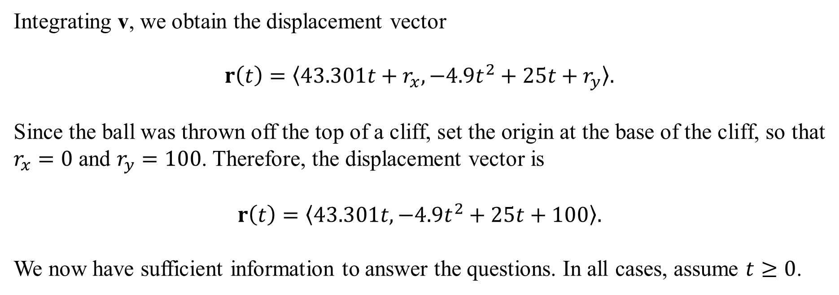
Integrating v, we obtain the displacement vector
$$r\left(t\right)=〈43.301t+r_{x},−4.9t^{2}+25t+r_{y}〉.$$
Since the ball was thrown off the top of a cliff, set the origin at the base of the cliff, so that $r_{x}=0$ and $r_{y}=100$. Therefore, the displacement vector is
$$r\left(t\right)=〈43.301t,−4.9t^{2}+25t+100〉.$$
We now have sufficient information to answer the questions. In all cases, assume $t≥0$.

Slide 7
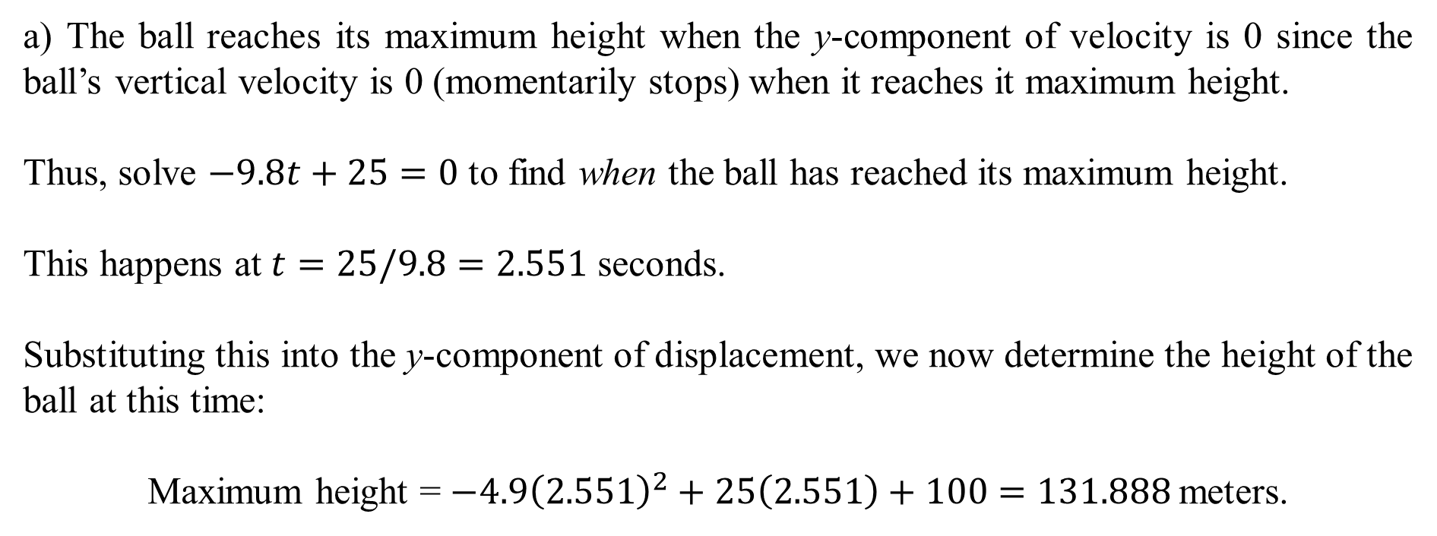
a) The ball reaches its maximum height when the y-component of velocity is 0 since the ball’s vertical velocity is 0 (momentarily stops) when it reaches it maximum height.
Thus, solve $−9.8t+25=0$ to find when the ball has reached its maximum height.
This happens at $t=25/9.8=2.551$ seconds.
Substituting this into the y-component of displacement, we now determine the height of the ball at this time:
Maximum height = $−4.9{\left(2.551\right)}^{2}+25\left(2.551\right)+100=131.888$meters.

Slide 8
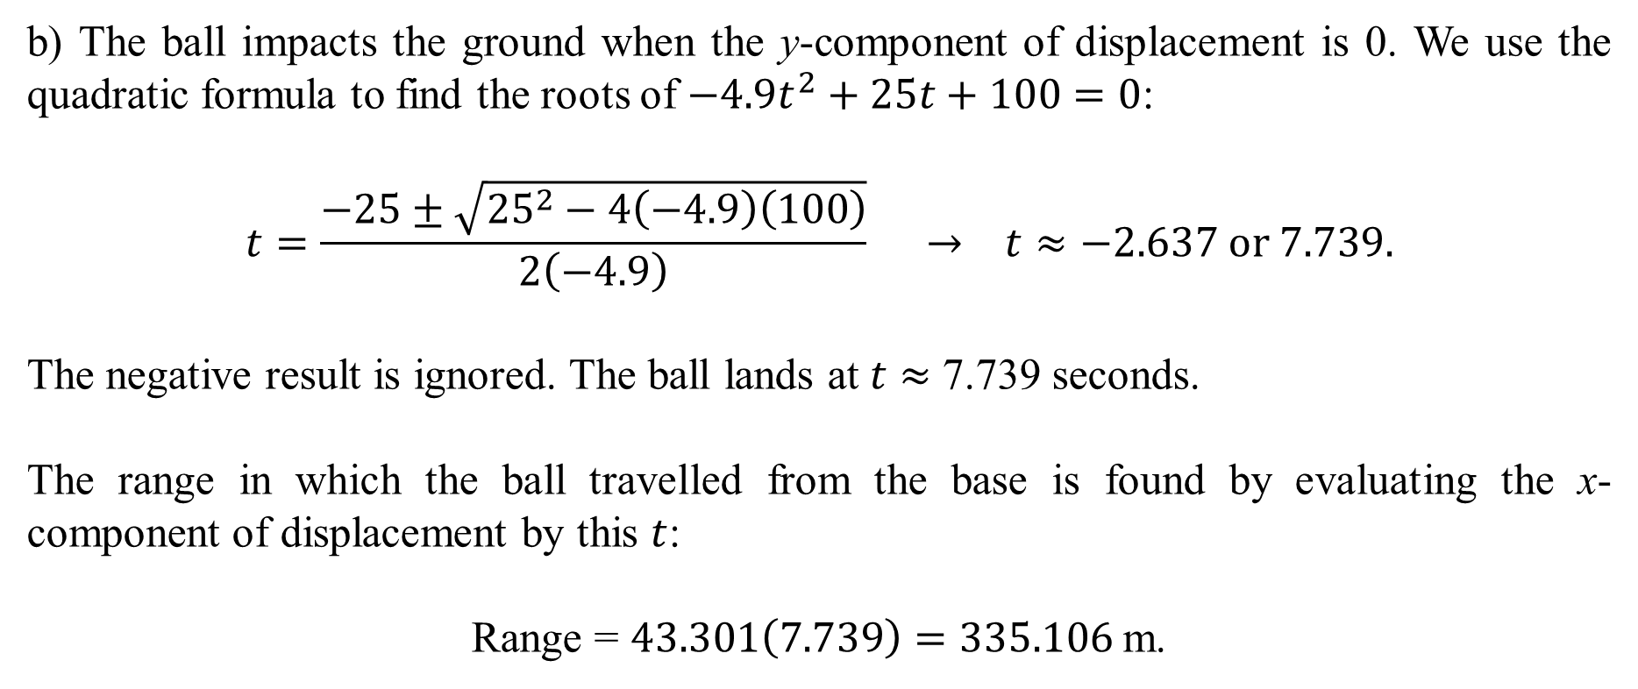
b) The ball impacts the ground when the y-component of displacement is 0. We use the quadratic formula to find the roots of $−4.9t^{2}+25t+100=0$:
$$t=\frac{−25±\sqrt{{25}^{2}−4\left(−4.9\right)\left(100\right)}}{2\left(−4.9\right)} → t≈−2.637 or 7.739.$$
The negative result is ignored. The ball lands at $t$ $≈$ 7.739 seconds.
The range in which the ball travelled from the base is found by evaluating the x-component of displacement by this $t$:
Range = $43.301\left(7.739\right)=335.106$m.

Slide 9
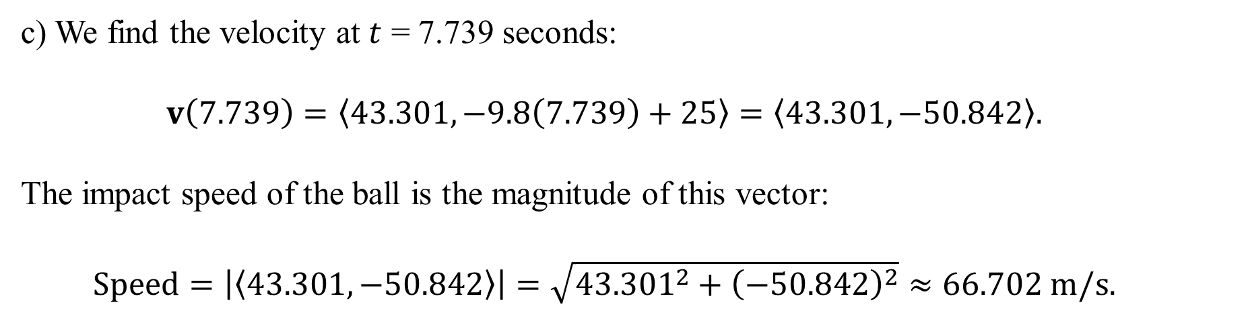
c) We find the velocity at $t$ = 7.739 seconds:
$$v\left(7.739\right)=〈43.301,−9.8\left(7.739\right)+25〉=〈43.301,−50.842〉.$$
The impact speed of the ball is the magnitude of this vector:
$$Speed=\left|〈43.301,−50.842〉\right|=\sqrt{{43.301}^{2}+{\left(−50.842\right)}^{2}}≈66.702 m/s.$$

Slide 10
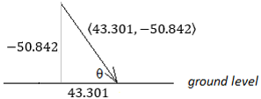
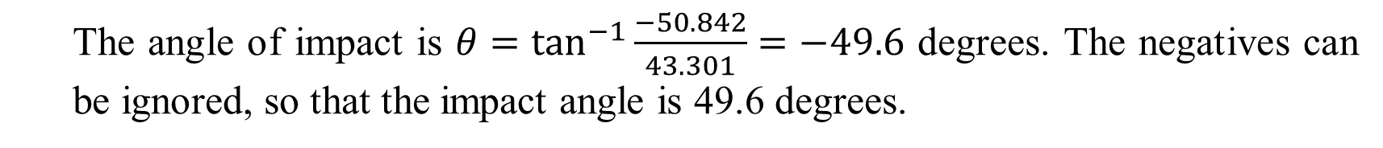
d) To find the angle at which the ball impacts the ground, sketch a diagram to be sure that the components of velocity are properly in place:
The angle of impact is $θ=\tan^{−1}{\frac{−50.842}{43.301}}=−49.6$ degrees. The negatives can be ignored, so that the impact angle is 49.6 degrees.

Slide 11
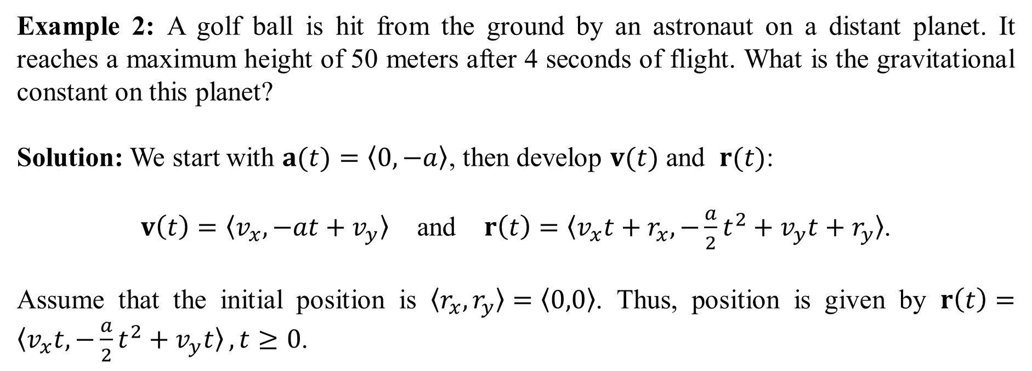
Example 2: A golf ball is hit from the ground by an astronaut on a distant planet. It reaches a maximum height of 50 meters after 4 seconds of flight. What is the gravitational constant on this planet?
Solution: We start with $a(t)=〈0,−a〉$, then develop $v(t)$ and $r(t)$:
$v\left(t\right)=〈v_{x},−at+v_{y}〉$ and $r\left(t\right)=〈v_{x}t+r_{x},−\frac{a}{2}t^{2}+v_{y}t+r_{y}〉$.
Assume that the initial position is $〈r_{x},r_{y}〉=〈0,0〉$. Thus, position is given by $r\left(t\right)=〈v_{x}t,−\frac{a}{2}t^{2}+v_{y}t〉, t≥0$.

Slide 12
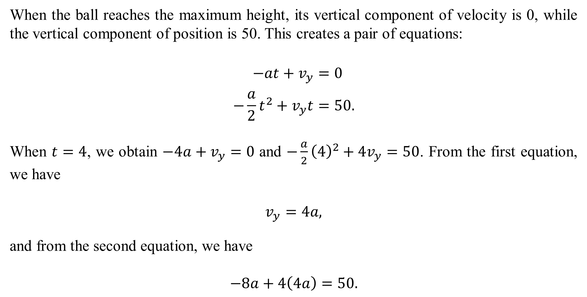
When the ball reaches the maximum height, its vertical component of velocity is 0, while the vertical component of position is 50. This creates a pair of equations:
$$−at+v_{y}=0 \\ −\frac{a}{2}t^{2}+v_{y}t=50.$$
When $t=4$, we obtain $−4a+v_{y}=0$ and $−\frac{a}{2}{\left(4\right)}^{2}+4v_{y}=50$. From the first equation, we have
$$v_{y}=4a,$$
and from the second equation, we have
$$−8a+4\left(4a\right)=50.$$

Slide 13

Solving for $a$, we obtain
$$−8a+16a=50$$
$$8a=50$$
$$a=\frac{50}{8}=6.25.$$
Evidently, objects on this planet fall at a rate of 6.25 meters per second².

