Slide 1
Double Integrals using
Polar Coordinates
Scott Surgent

Slide 2
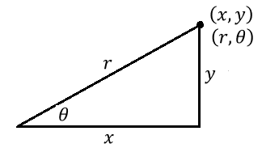
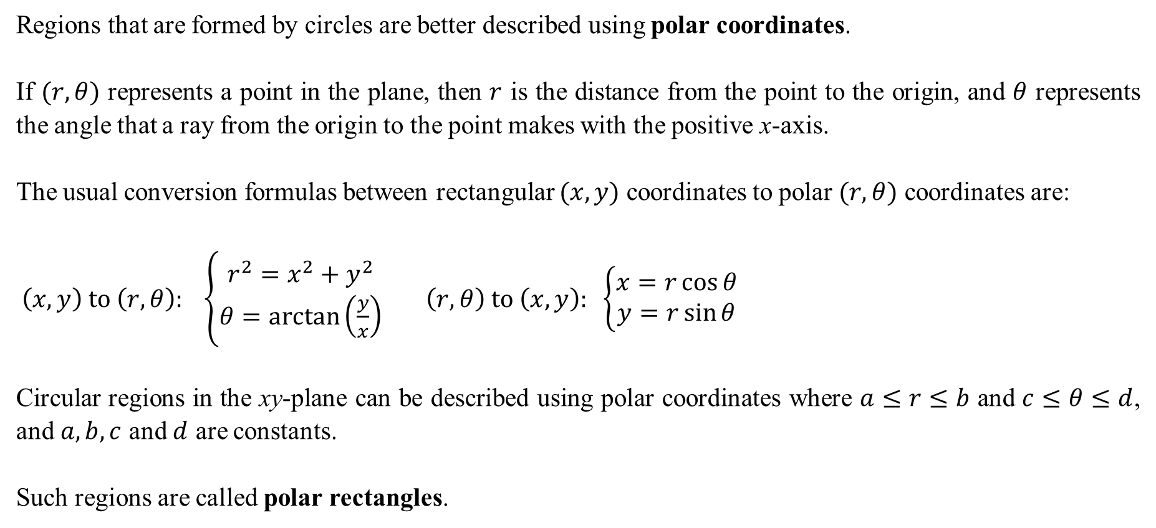
Regions that are formed by circles are better described using polar coordinates.
If $(r,θ)$ represents a point in the plane, then $r$ is the distance from the point to the origin, and $θ$ represents the angle that a ray from the origin to the point makes with the positive x-axis.
The usual conversion formulas between rectangular $(x,y)$ coordinates to polar $(r,θ)$ coordinates are:
$\left(x,y\right) to \left(r,θ\right): \left\{\begin{matrix}r^{2}=x^{2}+y^{2} \\ θ=\arctan\left(\frac{y}{x}\right)\end{matrix}\right. \left(r,θ\right) to \left(x,y\right): \left\{\begin{matrix}x=r\cos{θ} \\ y=r\sin{θ}\end{matrix}\right.$
Circular regions in the xy-plane can be described using polar coordinates where $a≤r≤b$ and $c≤θ≤d$, and $a, b, c$ and $d$ are constants.
Such regions are called polar rectangles.

Slide 3
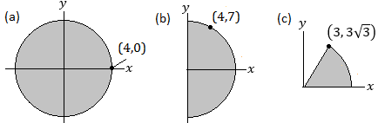
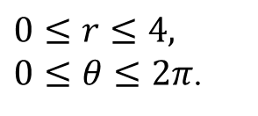
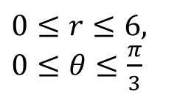
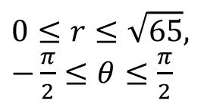
Example 1: Describe the following regions using polar coordinates.
$$0≤r≤6,$$
$0≤θ≤\frac{π}{3}$
$0≤r≤4,$
$0≤θ≤2π$.
$$0≤r≤\sqrt{65},$$
$−\frac{π}{2}≤θ≤\frac{π}{2}$

Slide 4
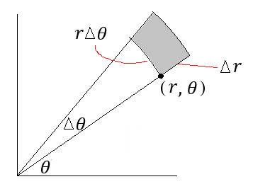
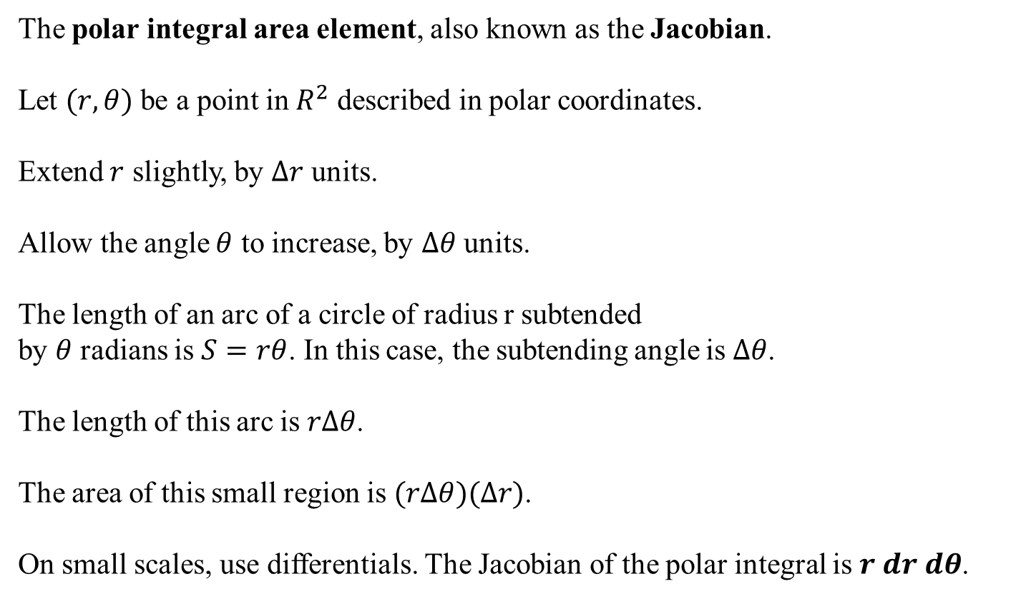
The polar integral area element, also known as the Jacobian.
Let $(r,θ)$ be a point in $R^{2}$ described in polar coordinates.
Extend $r$ slightly, by $Δr$ units.
Allow the angle $θ$ to increase, by $Δθ$ units.
The length of an arc of a circle of radius r subtended
by $θ$ radians is $S=rθ$. In this case, the subtending angle is $Δθ$.
The length of this arc is $rΔθ$.
The area of this small region is $(rΔθ)(Δr)$.
On small scales, use differentials. The Jacobian of the polar integral is $r dr dθ$.

Slide 5

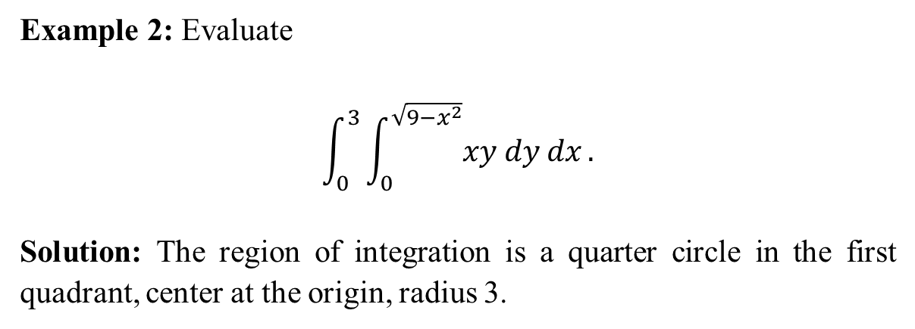

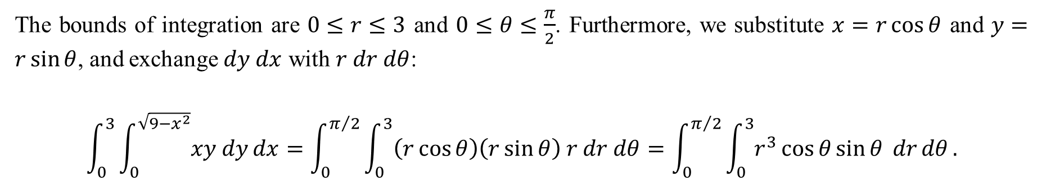
Example 2: Evaluate
$$\int_{0}^{3}{\int_{0}^{\sqrt{9−x^{2}}}{xy dy}dx}.$$
Solution: The region of integration is a quarter circle in the first quadrant, center at the origin, radius 3.
The bounds of integration are $0≤r≤3$ and $0≤θ≤\frac{π}{2}$. Furthermore, we substitute $x=r\cos{θ}$ and $y=r\sin{θ}$, and exchange $dy dx$ with $r dr dθ$:
$$\int_{0}^{3}{\int_{0}^{\sqrt{9−x^{2}}}{xy dy}dx}=\int_{0}^{π/2}{\int_{0}^{3}{\left(r\cos{θ}\right)\left(r\sin{θ}\right) r dr dθ}}=\int_{0}^{π/2}{\int_{0}^{3}{r^{3}\cos{θ}\sin{θ} dr}dθ}.$$
The inside integral is evaluated first:
$$\int_{0}^{3}{r^{3}\cos{θ}\sin{θ} dr}=\cos{θ}\sin{θ}{\left[\frac{1}{4}r^{4}\right]}_{0}^{3}=\frac{81}{4}\cos{θ}\sin{θ}.$$

Slide 6
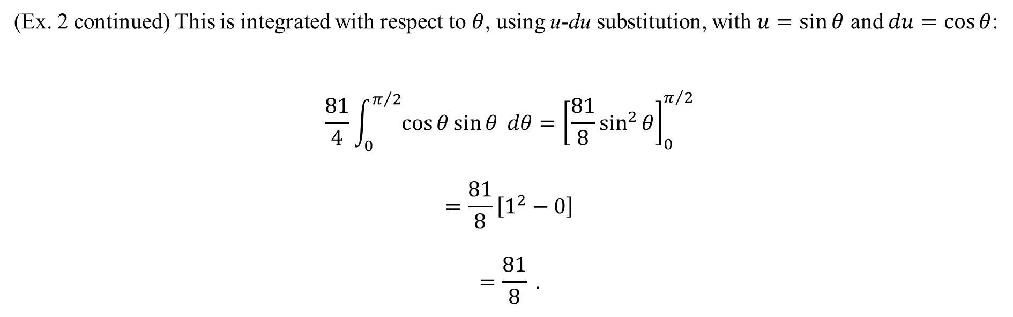
(Ex. 2 continued) This is integrated with respect to $θ$, using u-du substitution, with $u=\sin{θ}$ and $du=\cos{θ}$:
$$\frac{81}{4}\int_{0}^{π/2}{\cos{θ}\sin{θ} dθ}={\left[\frac{81}{8}\sin^{2}{θ}\right]}_{0}^{π/2}$$
$$=\frac{81}{8}\left[1^{2}−0\right]$$
$$=\frac{81}{8} .$$

Slide 7
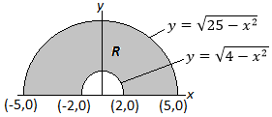

Example 3: Evaluate
$$\int_{−5}^{−2}{\int_{0}^{\sqrt{25−x^{2}}}{x^{2} dy}dx}+\int_{−2}^{2}{\int_{\sqrt{4−x^{2}}}^{\sqrt{25−x^{2}}}{x^{2} dy}dx}+\int_{2}^{5}{\int_{0}^{\sqrt{25−x^{2}}}{x^{2} dy}dx}.$$
Solution: The region of integration as suggested by the bounds in the three integrals is shown below

Slide 8
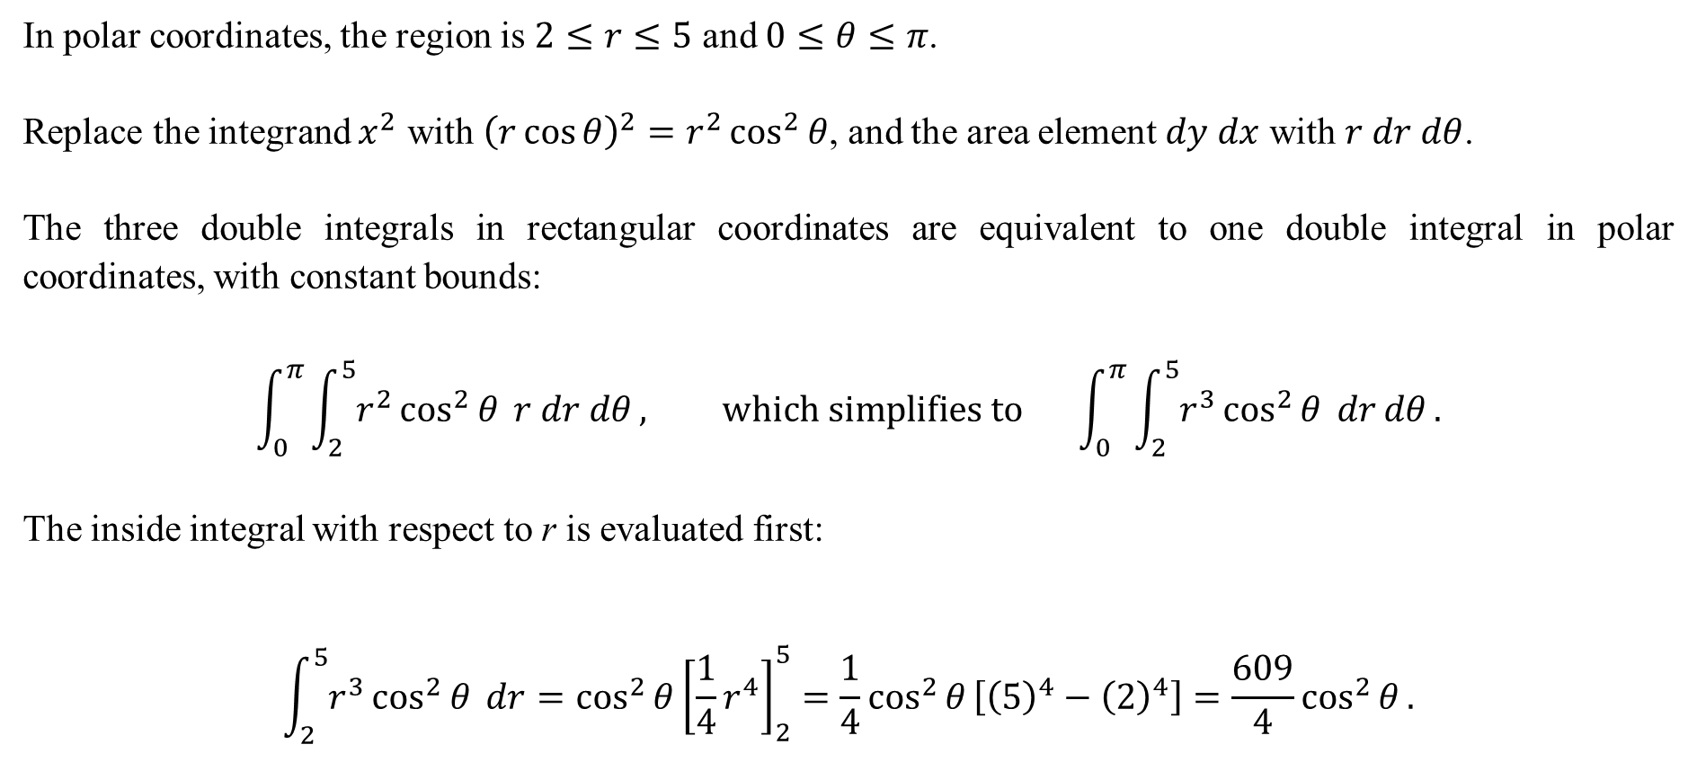
In polar coordinates, the region is $2≤r≤5$ and $0≤θ≤π$.
Replace the integrand $x^{2}$ with ${\left(r\cos{θ}\right)}^{2}=r^{2}\cos^{2}{θ}$, and the area element $dy dx$ with $r dr dθ$.
The three double integrals in rectangular coordinates are equivalent to one double integral in polar coordinates, with constant bounds:
$$\int_{0}^{π}{\int_{2}^{5}{r^{2}\cos^{2}{θ} }r dr dθ}, which simplifies to \int_{0}^{π}{\int_{2}^{5}{r^{3}\cos^{2}{θ} dr}dθ}.$$
The inside integral with respect to r is evaluated first:
$$\int_{2}^{5}{r^{3}\cos^{2}{θ} dr}=\cos^{2}{θ}{\left[\frac{1}{4}r^{4}\right]}_{2}^{5}=\frac{1}{4}\cos^{2}{θ}\left[{\left(5\right)}^{4}−{\left(2\right)}^{4}\right]=\frac{609}{4}\cos^{2}{θ}.$$

Slide 9

This expression is next integrated with respect to $θ$.
To antidifferentiate $\cos^{2}{θ}$, use the identity $\cos^{2}{θ}=\frac{1}{2}\left(1+\cos{2θ}\right)$:
$$\int_{0}^{π}{\frac{609}{4}\cos^{2}{θ}dθ}=\frac{609}{4}\int_{0}^{π}{\left(\frac{1}{2}\left(1+\cos{2θ}\right)\right)dθ}$$
$$=\frac{609}{8}\int_{0}^{π}{1+\cos{2θ} dθ}$$
$$=\frac{609}{8}{\left[θ+\frac{1}{2}\sin{2θ}\right]}_{0}^{π}$$
$$=\frac{609}{8}\left[\left(π+\frac{1}{2}\sin{2\left(π\right)}\right)−\left(0+\frac{1}{2}\sin{2\left(0\right)}\right)\right]$$
$$=\frac{609}{8}π .$$

Slide 10
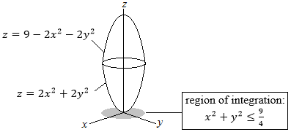
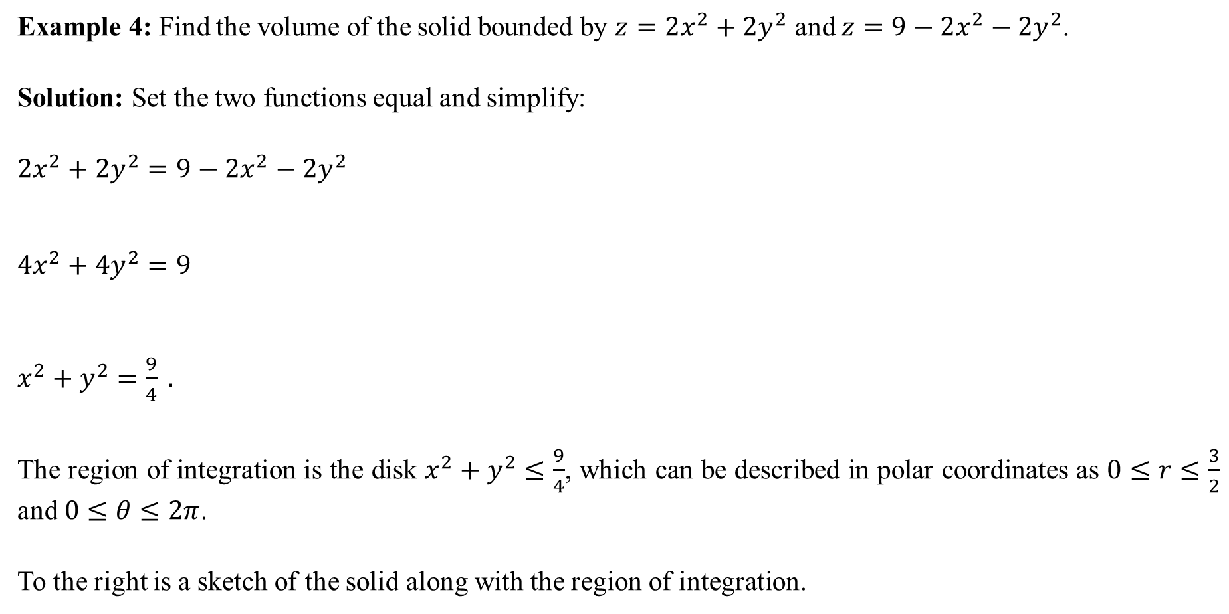
Example 4: Find the volume of the solid bounded by $z=2x^{2}+2y^{2}$ and $z=9−2x^{2}−2y^{2}$.
Solution: Set the two functions equal and simplify:
$2x^{2}+2y^{2}=9−2x^{2}−2y^{2}$
$4x^{2}+4y^{2}=9$
$x^{2}+y^{2}=\frac{9}{4} .$
The region of integration is the disk $x^{2}+y^{2}≤\frac{9}{4}$, which can be described in polar coordinates as $0≤r≤\frac{3}{2}$ and $0≤θ≤2π$.
To the right is a sketch of the solid along with the region of integration.

Slide 11
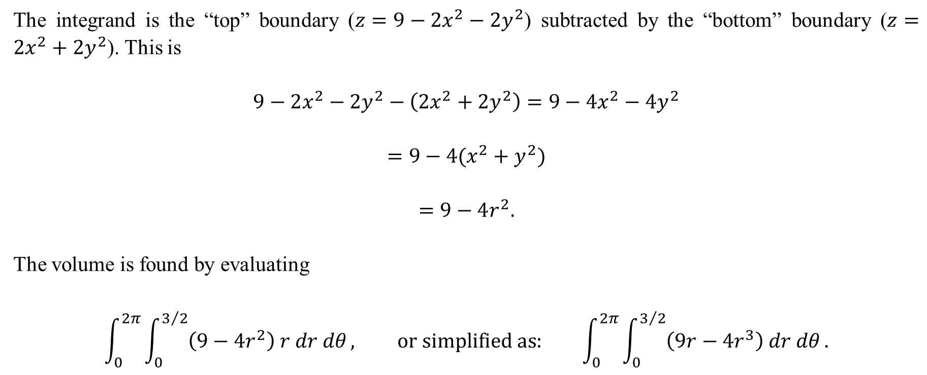
The integrand is the “top” boundary ($z=9−2x^{2}−2y^{2}$) subtracted by the “bottom” boundary ($z=2x^{2}+2y^{2}$). This is
$$9−2x^{2}−2y^{2}−\left(2x^{2}+2y^{2}\right)=9−4x^{2}−4y^{2}$$
$$=9−4(x^{2}+y^{2})$$
$$=9−4r^{2}.$$
The volume is found by evaluating
$$\int_{0}^{2π}{\int_{0}^{3/2}{\left(9−4r^{2}\right) r dr dθ}}, or simplified as: \int_{0}^{2π}{\int_{0}^{3/2}{\left(9r−4r^{3}\right) dr dθ}}.$$

Slide 12

For the inner integral, we have
$$\int_{0}^{3/2}{\left(9r−4r^{3}\right) dr}={\left[\frac{9}{2}r^{2}−r^{4}\right]}_{0}^{3/2}$$
$$=\frac{9}{2}{\left(\frac{3}{2}\right)}^{2}−{\left(\frac{3}{2}\right)}^{4}−0$$
$$=\frac{243}{16}.$$
Finally, the volume is
$$\int_{0}^{2π}{\frac{243}{16} dθ}=\frac{243}{16}\int_{0}^{2π}{dθ}$$
$$=\frac{243}{16}\left(2π\right)$$
$$=\frac{243π}{8} units^{3}.$$

