Slide 1
Partial Differentiation
Scott Surgent

Slide 2
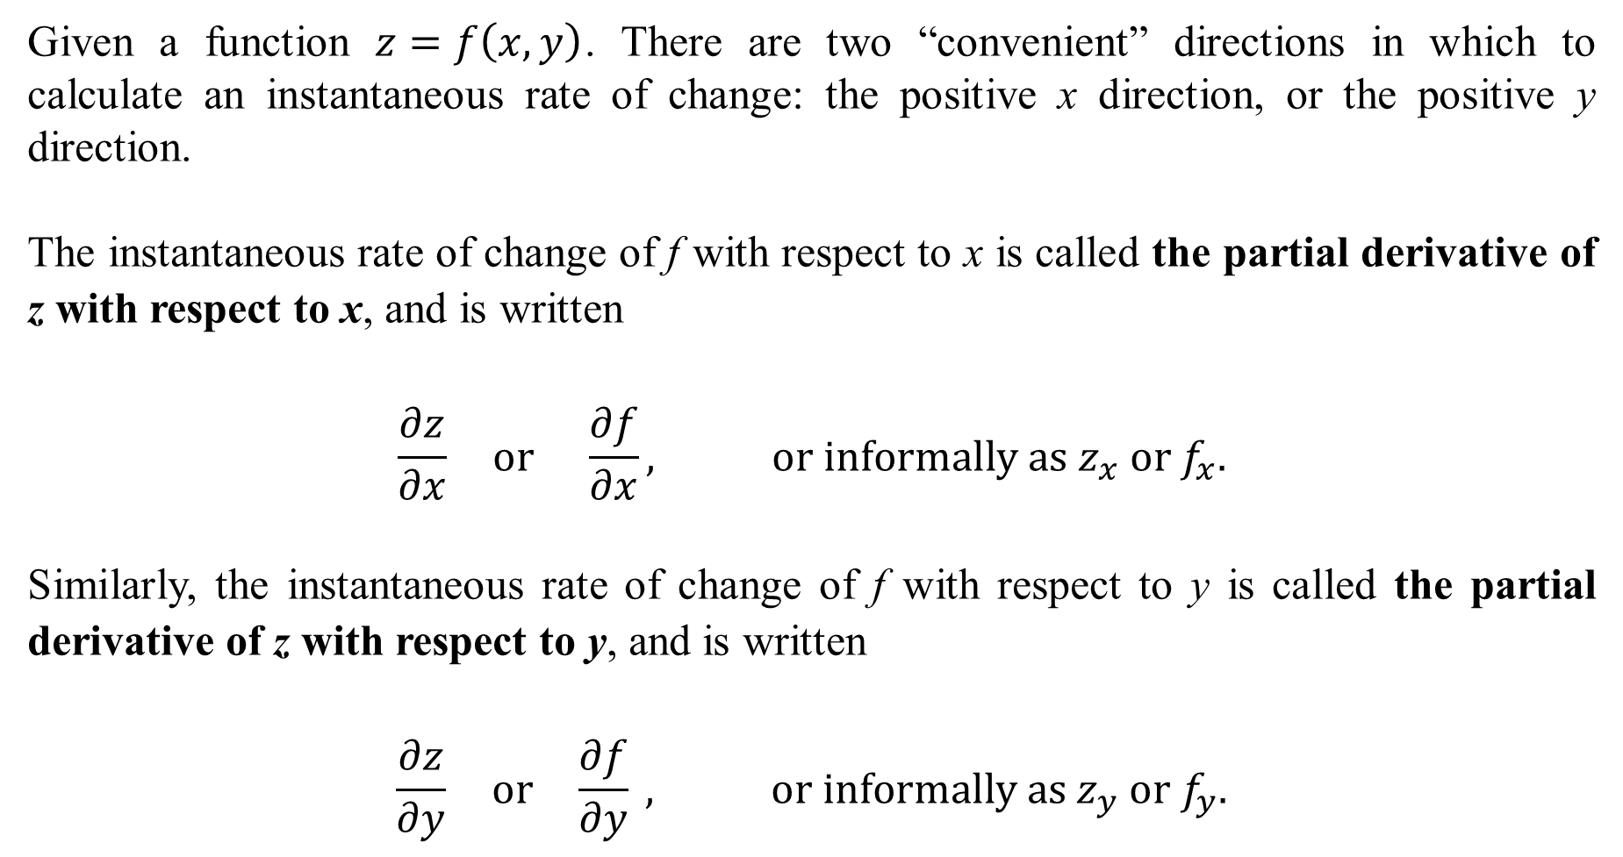
Given a function $z=f\left(x,y\right)$. There are two “convenient” directions in which to calculate an instantaneous rate of change: the positive x direction, or the positive y direction.
The instantaneous rate of change of f with respect to x is called the partial derivative of z with respect to x, and is written
$$\frac{∂z}{∂x} or \frac{∂f}{∂x}, or informally as z_{x} or f_{x}.$$
Similarly, the instantaneous rate of change of f with respect to y is called the partial derivative of z with respect to y, and is written
$$\frac{∂z}{∂y} or \frac{∂f}{∂y} , or informally as z_{y} or f_{y}.$$

Slide 3
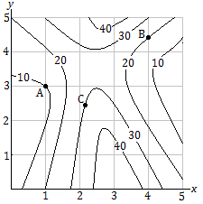

Example 1: Use the contour map below, representing $z=f(x,y)$. Assume that $f$ is smooth and continuous. Give the sign of $f_{x}(A)$, $f_{y}(A)$, $f_{x}(B)$, $f_{y}(B)$, $f_{x}(C)$, and $f_{y}\left(C\right).$
$$f_{x}\left(A\right): +$$
$$f_{y}\left(A\right): +$$
$$f_{x}\left(B\right): −$$
$$f_{y}\left(B\right): +$$
$$f_{x}\left(C\right): +$$
$$f_{y}\left(C\right):−$$

Slide 4
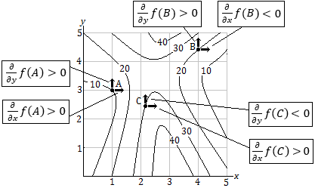

Slide 5
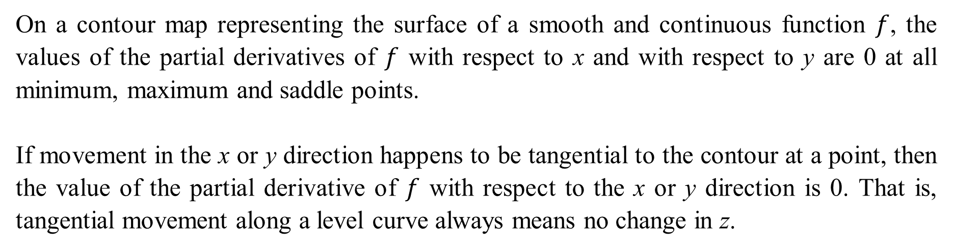
On a contour map representing the surface of a smooth and continuous function $f$, the values of the partial derivatives of $f$ with respect to x and with respect to y are 0 at all minimum, maximum and saddle points.
If movement in the x or y direction happens to be tangential to the contour at a point, then the value of the partial derivative of $f$ with respect to the x or y direction is 0. That is, tangential movement along a level curve always means no change in z.

Slide 6
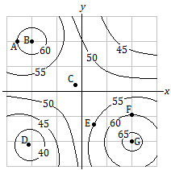
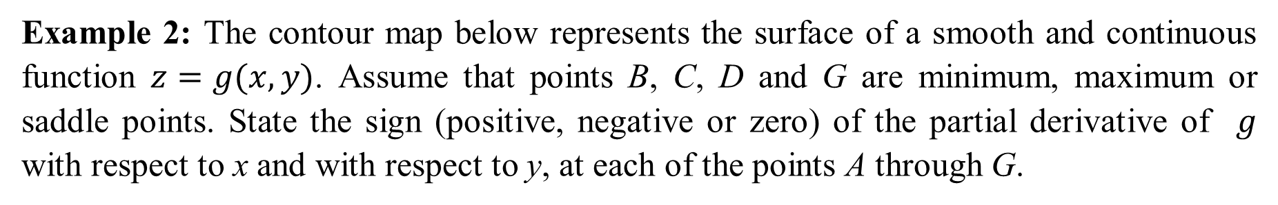
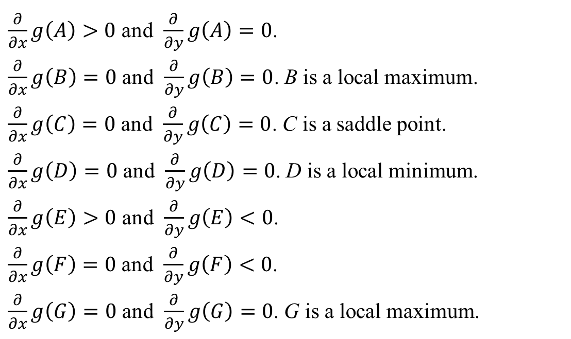
Example 2: The contour map below represents the surface of a smooth and continuous function $z=g(x,y)$. Assume that points B, C, D and G are minimum, maximum or saddle points. State the sign (positive, negative or zero) of the partial derivative of $g$ with respect to x and with respect to y, at each of the points A through G.
$\frac{∂}{∂x}g\left(A\right)>0$ and $\frac{∂}{∂y}g\left(A\right)=0$.
$\frac{∂}{∂x}g\left(B\right)=0$ and $\frac{∂}{∂y}g\left(B\right)=0$. B is a local maximum.
$\frac{∂}{∂x}g\left(C\right)=0$ and $\frac{∂}{∂y}g\left(C\right)=0$. C is a saddle point.
$\frac{∂}{∂x}g\left(D\right)=0$ and $\frac{∂}{∂y}g\left(D\right)=0$. D is a local minimum.
$\frac{∂}{∂x}g\left(E\right)>0$ and $\frac{∂}{∂y}g\left(E\right)<0$.
$\frac{∂}{∂x}g\left(F\right)=0$ and $\frac{∂}{∂y}g\left(F\right)<0$.
$\frac{∂}{∂x}g\left(G\right)=0$ and $\frac{∂}{∂y}g\left(G\right)=0$. G is a local maximum.

Slide 7
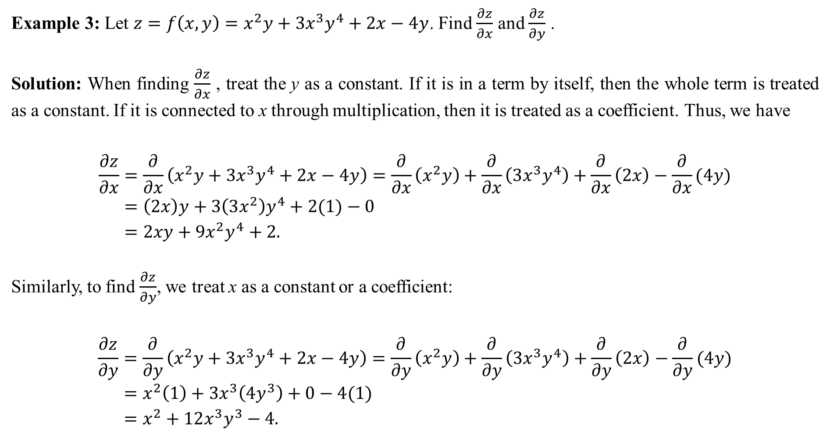
Example 3: Let $z=f\left(x,y\right)=x^{2}y+3x^{3}y^{4}+2x−4y$. Find $\frac{∂z}{∂x}$ and $\frac{∂z}{∂y}$ .
Solution: When finding $\frac{∂z}{∂x}$ , treat the y as a constant. If it is in a term by itself, then the whole term is treated as a constant. If it is connected to x through multiplication, then it is treated as a coefficient. Thus, we have
$$\frac{∂z}{∂x}=\frac{∂}{∂x}\left(x^{2}y+3x^{3}y^{4}+2x−4y\right)=\frac{∂}{∂x}\left(x^{2}y\right)+\frac{∂}{∂x}\left(3x^{3}y^{4}\right)+\frac{∂}{∂x}\left(2x\right)−\frac{∂}{∂x}(4y) \\ =\left(2x\right)y+3\left(3x^{2}\right)y^{4}+2(1)−0 \\ =2xy+9x^{2}y^{4}+2.$$
Similarly, to find $\frac{∂z}{∂y}$, we treat x as a constant or a coefficient:
$$\frac{∂z}{∂y}=\frac{∂}{∂y}\left(x^{2}y+3x^{3}y^{4}+2x−4y\right)=\frac{∂}{∂y}\left(x^{2}y\right)+\frac{∂}{∂y}\left(3x^{3}y^{4}\right)+\frac{∂}{∂y}\left(2x\right)−\frac{∂}{∂y}(4y) \\ =x^{2}\left(1\right)+3x^{3}\left(4y^{3}\right)+0−4(1) \\ =x^{2}+12x^{3}y^{3}−4.$$

Slide 8
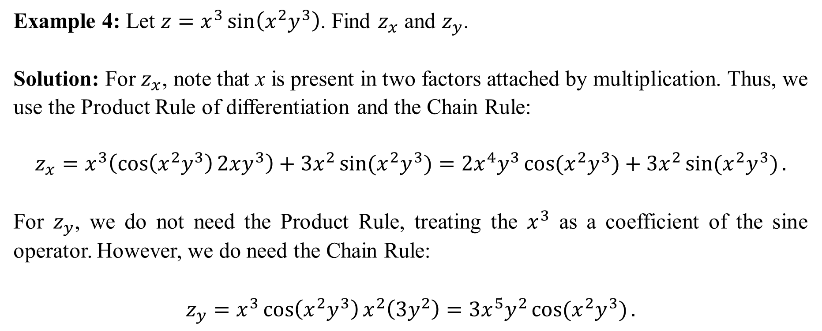
Example 4: Let $z=x^{3}\sin\left(x^{2}y^{3}\right)$. Find $z_{x}$ and $z_{y}$.
Solution: For $z_{x}$, note that x is present in two factors attached by multiplication. Thus, we use the Product Rule of differentiation and the Chain Rule:
$$z_{x}=x^{3}\left(\cos\left(x^{2}y^{3}\right)2xy^{3}\right)+3x^{2}\sin{(x^{2}y^{3})}=2x^{4}y^{3}\cos{(x^{2}y^{3})}+3x^{2}\sin{(x^{2}y^{3})}.$$
For $z_{y}$, we do not need the Product Rule, treating the $x^{3}$ as a coefficient of the sine operator. However, we do need the Chain Rule:
$$z_{y}=x^{3}\cos\left(x^{2}y^{3}\right)x^{2}\left(3y^{2}\right)=3x^{5}y^{2}\cos{(x^{2}y^{3})}.$$

Slide 9
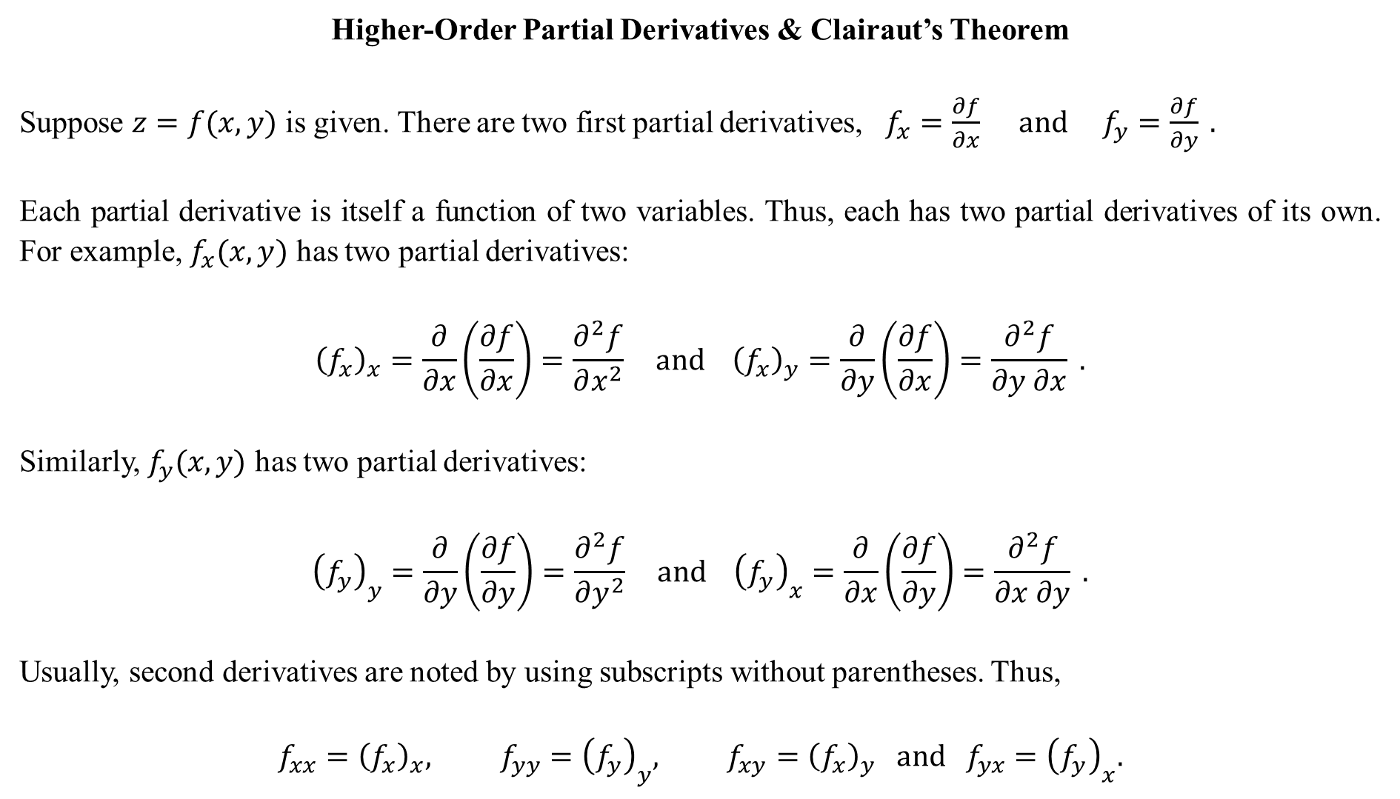
Higher-Order Partial Derivatives & Clairaut’s Theorem
Suppose $z=f(x,y)$ is given. There are two first partial derivatives, $f_{x}=\frac{∂f}{∂x} and f_{y}=\frac{∂f}{∂y} .$
Each partial derivative is itself a function of two variables. Thus, each has two partial derivatives of its own. For example, $f_{x}(x,y)$ has two partial derivatives:
$${\left(f_{x}\right)}_{x}=\frac{∂}{∂x}\left(\frac{∂f}{∂x}\right)=\frac{∂^{2}f}{∂x^{2}} and {\left(f_{x}\right)}_{y}=\frac{∂}{∂y}\left(\frac{∂f}{∂x}\right)=\frac{∂^{2}f}{∂y ∂x} .$$
Similarly, $f_{y}(x,y)$ has two partial derivatives:
$${\left(f_{y}\right)}_{y}=\frac{∂}{∂y}\left(\frac{∂f}{∂y}\right)=\frac{∂^{2}f}{∂y^{2}} and {\left(f_{y}\right)}_{x}=\frac{∂}{∂x}\left(\frac{∂f}{∂y}\right)=\frac{∂^{2}f}{∂x ∂y} .$$
Usually, second derivatives are noted by using subscripts without parentheses. Thus,
$$f_{xx}={\left(f_{x}\right)}_{x}, f_{yy}={\left(f_{y}\right)}_{y}, f_{xy}={\left(f_{x}\right)}_{y} and f_{yx}={\left(f_{y}\right)}_{x}.$$

Slide 10
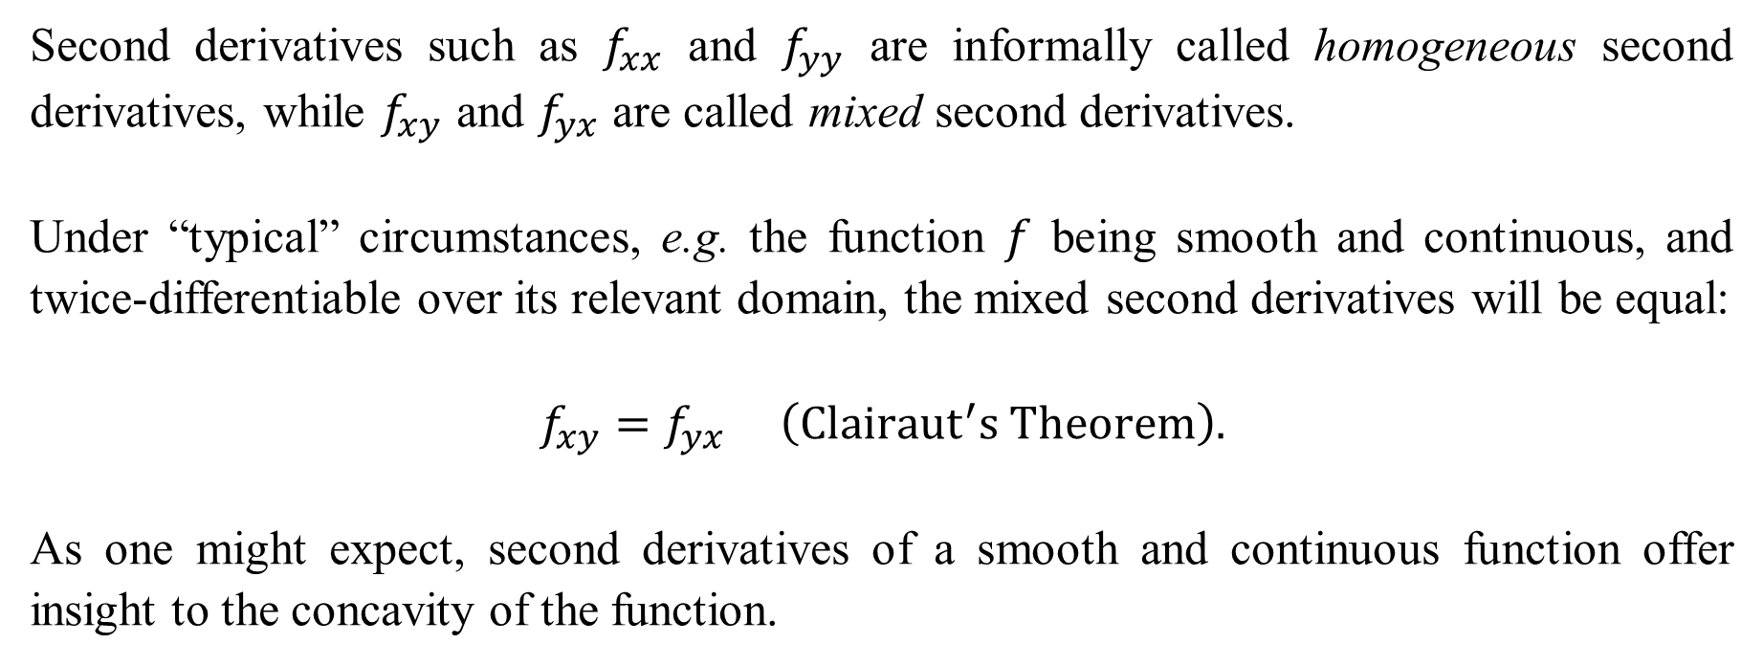
Second derivatives such as $f_{xx}$ and $f_{yy}$ are informally called homogeneous second derivatives, while $f_{xy}$ and $f_{yx}$ are called mixed second derivatives.
Under “typical” circumstances, e.g. the function $f$ being smooth and continuous, and twice-differentiable over its relevant domain, the mixed second derivatives will be equal:
$$f_{xy}=f_{yx} \left(Clairaut^{′}s Theorem\right).$$
As one might expect, second derivatives of a smooth and continuous function offer insight to the concavity of the function.

Slide 11
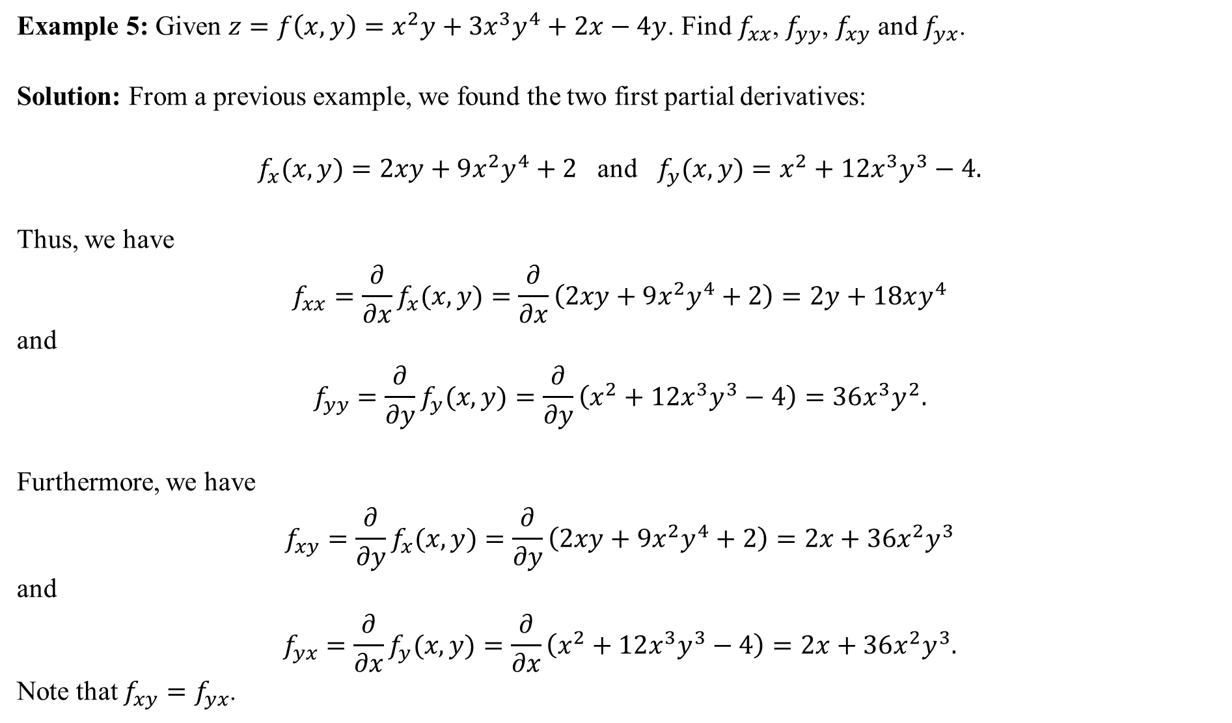
Example 5: Given $z=f\left(x,y\right)=x^{2}y+3x^{3}y^{4}+2x−4y$. Find $f_{xx}$, $f_{yy}$, $f_{xy}$ and $f_{yx}$.
Solution: From a previous example, we found the two first partial derivatives:
$f_{x}(x,y)=2xy+9x^{2}y^{4}+2$ and $f_{y}(x,y)=x^{2}+12x^{3}y^{3}−4.$
Thus, we have
$$f_{xx}=\frac{∂}{∂x}f_{x}(x,y)=\frac{∂}{∂x}\left(2xy+9x^{2}y^{4}+2\right)=2y+18xy^{4}$$
and
$$f_{yy}=\frac{∂}{∂y}f_{y}(x,y)=\frac{∂}{∂y}\left(x^{2}+12x^{3}y^{3}−4\right)=36x^{3}y^{2}.$$
Furthermore, we have
$$f_{xy}=\frac{∂}{∂y}f_{x}(x,y)=\frac{∂}{∂y}\left(2xy+9x^{2}y^{4}+2\right)=2x+36x^{2}y^{3}$$
and
$$f_{yx}=\frac{∂}{∂x}f_{y}(x,y)=\frac{∂}{∂x}\left(x^{2}+12x^{3}y^{3}−4\right)=2x+36x^{2}y^{3}.$$
Note that $f_{xy}=f_{yx}$.

Slide 12
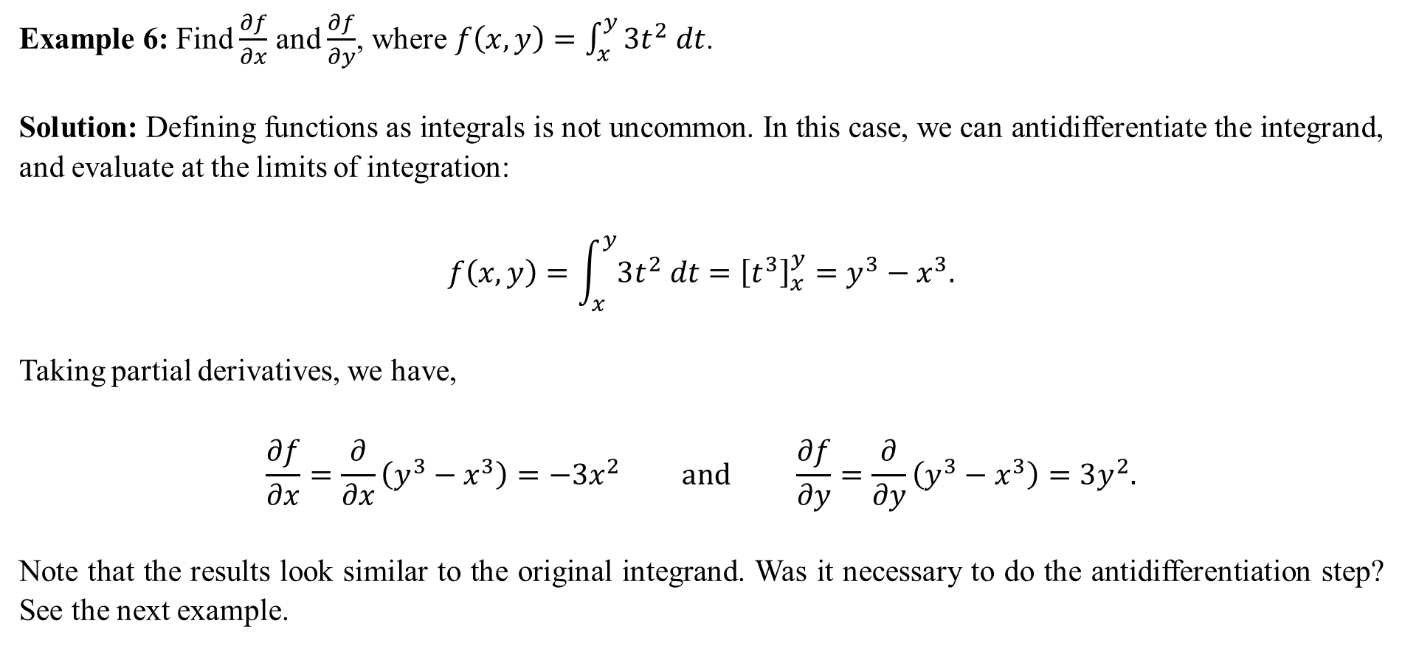
Example 6: Find $\frac{∂f}{∂x}$ and $\frac{∂f}{∂y}$, where $f\left(x,y\right)=\int_{x}^{y}{3t^{2} dt}$.
Solution: Defining functions as integrals is not uncommon. In this case, we can antidifferentiate the integrand, and evaluate at the limits of integration:
$$f\left(x,y\right)=\int_{x}^{y}{3t^{2} dt}={\left[t^{3}\right]}_{x}^{y}=y^{3}−x^{3}.$$
Taking partial derivatives, we have,
$$\frac{∂f}{∂x}=\frac{∂}{∂x}\left(y^{3}−x^{3}\right)=−3x^{2} and \frac{∂f}{∂y}=\frac{∂}{∂y}\left(y^{3}−x^{3}\right)=3y^{2}.$$
Note that the results look similar to the original integrand. Was it necessary to do the antidifferentiation step? See the next example.

Slide 13
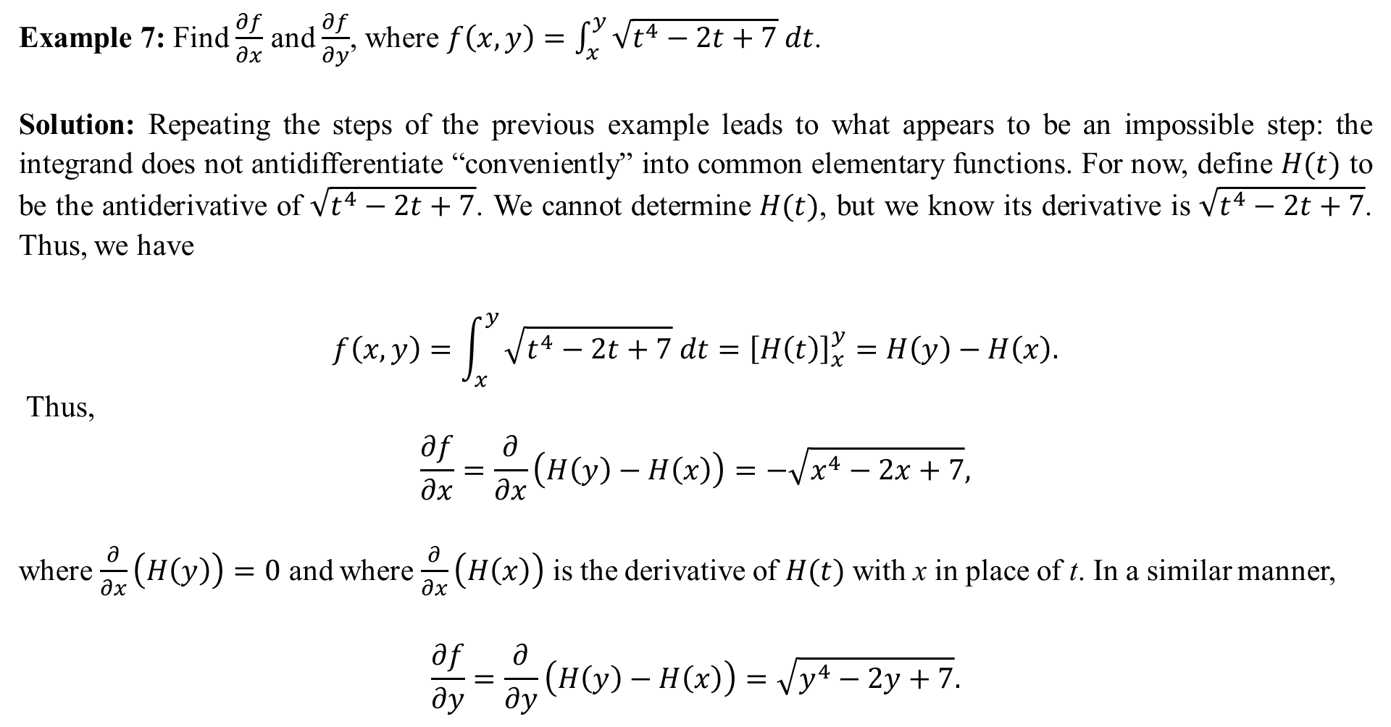
Example 7: Find $\frac{∂f}{∂x}$ and $\frac{∂f}{∂y}$, where $f\left(x,y\right)=\int_{x}^{y}{\sqrt{t^{4}−2t+7} dt}$.
Solution: Repeating the steps of the previous example leads to what appears to be an impossible step: the integrand does not antidifferentiate “conveniently” into common elementary functions. For now, define $H(t)$ to be the antiderivative of $\sqrt{t^{4}−2t+7}$. We cannot determine $H(t)$, but we know its derivative is $\sqrt{t^{4}−2t+7}$. Thus, we have
$$f\left(x,y\right)=\int_{x}^{y}{\sqrt{t^{4}−2t+7} dt}={\left[H\left(t\right)\right]}_{x}^{y}=H\left(y\right)−H\left(x\right).$$
Thus,
$$\frac{∂f}{∂x}=\frac{∂}{∂x}\left(H\left(y\right)−H\left(x\right)\right)=−\sqrt{x^{4}−2x+7},$$
where $\frac{∂}{∂x}\left(H\left(y\right)\right)=0$ and where $\frac{∂}{∂x}\left(H\left(x\right)\right)$ is the derivative of $H(t)$ with x in place of t. In a similar manner,
$$\frac{∂f}{∂y}=\frac{∂}{∂y}\left(H\left(y\right)−H\left(x\right)\right)=\sqrt{y^{4}−2y+7}.$$

