Slide 1
Multivariable Functions
Scott Surgent

Slide 2
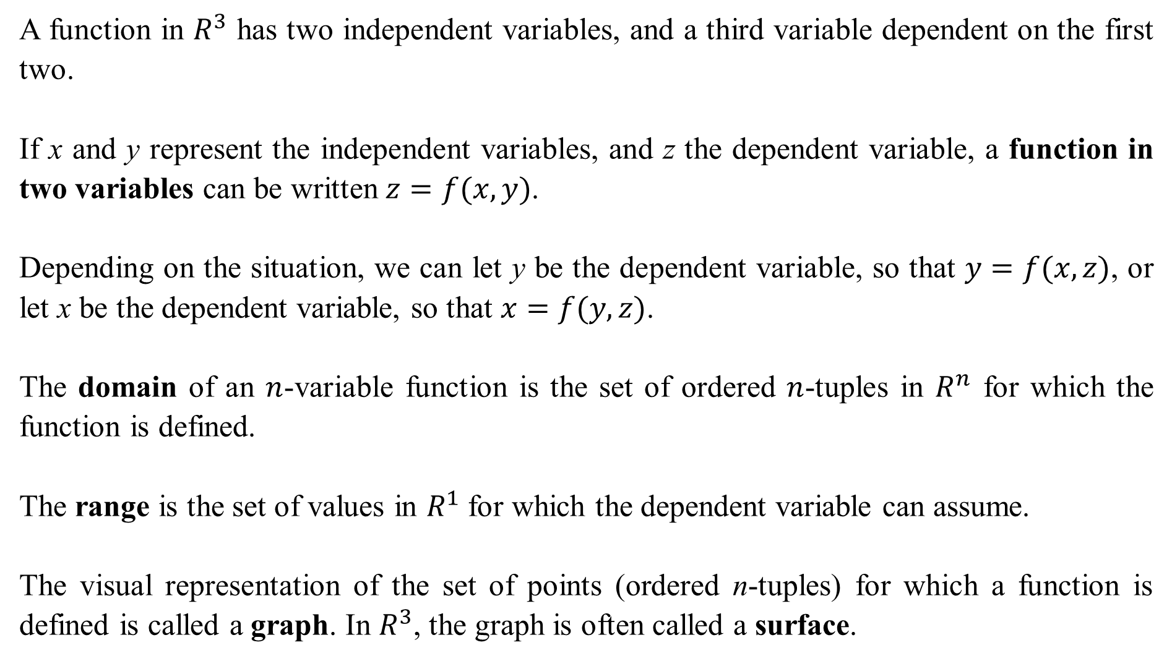
A function in $R^{3}$ has two independent variables, and a third variable dependent on the first two.
If x and y represent the independent variables, and z the dependent variable, a function in two variables can be written $z=f(x,y)$.
Depending on the situation, we can let y be the dependent variable, so that $y=f(x,z)$, or let x be the dependent variable, so that $x=f(y,z)$.
The domain of an $n$-variable function is the set of ordered $n$-tuples in $R^{n}$ for which the function is defined.
The range is the set of values in $R^{1}$ for which the dependent variable can assume.
The visual representation of the set of points (ordered n-tuples) for which a function is defined is called a graph. In $R^{3}$, the graph is often called a surface.

Slide 3
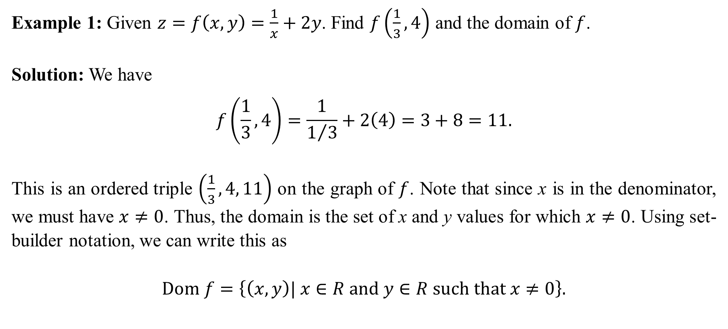
Example 1: Given $z=f\left(x,y\right)=\frac{1}{x}+2y$. Find $f\left(\frac{1}{3}, 4\right)$ and the domain of $f$.
Solution: We have
$$f\left(\frac{1}{3}, 4\right)=\frac{1}{1/3}+2\left(4\right)=3+8=11.$$
This is an ordered triple $\left(\frac{1}{3}, 4, 11\right)$ on the graph of $f$. Note that since x is in the denominator, we must have $x≠0$. Thus, the domain is the set of x and y values for which $x≠0$. Using set-builder notation, we can write this as
$$Dom f=\left\{\left(x,y\right)| x∈R and y∈R such that x≠0\right\}.$$

Slide 4
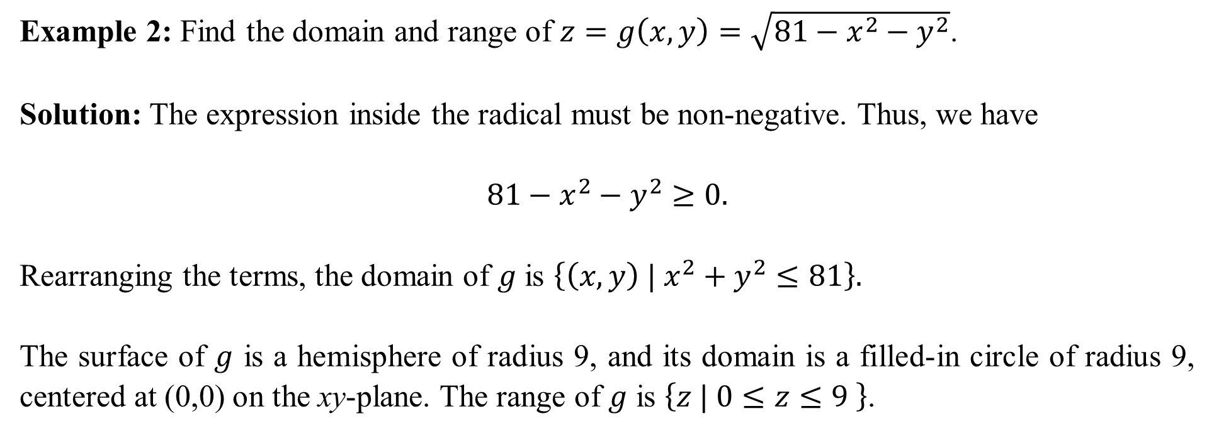
Example 2: Find the domain and range of $z=g\left(x,y\right)=\sqrt{81−x^{2}−y^{2}}$.
Solution: The expression inside the radical must be non-negative. Thus, we have
$$81−x^{2}−y^{2}≥0.$$
Rearranging the terms, the domain of $g$ is $\left\{\left(x,y\right) | x^{2}+y^{2}≤81\right\}.$
The surface of $g$ is a hemisphere of radius 9, and its domain is a filled-in circle of radius 9, centered at (0,0) on the xy-plane. The range of $g$ is $\left\{z | 0≤z≤9 \right\}$.

Slide 5
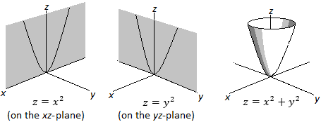
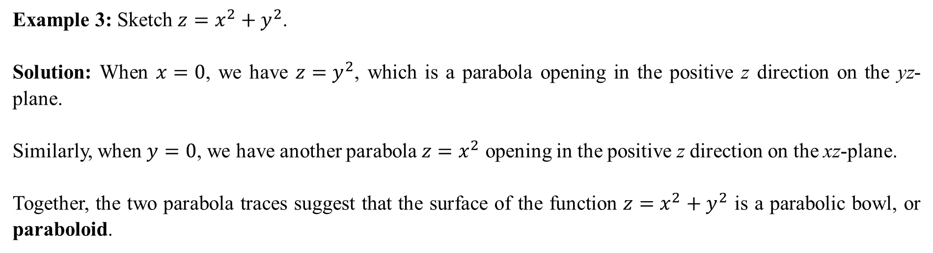
Example 3: Sketch $z=x^{2}+y^{2}$.
Solution: When $x=0$, we have $z=y^{2}$, which is a parabola opening in the positive z direction on the yz-plane.
Similarly, when $y=0$, we have another parabola $z=x^{2}$ opening in the positive z direction on the xz-plane.
Together, the two parabola traces suggest that the surface of the function $z=x^{2}+y^{2}$ is a parabolic bowl, or paraboloid.
Note that this paraboloid has a vertex at (0,0,0). If positive z is considered “up”, then we say this paraboloid opens upward. The domain is $\left\{\left(x,y\right)|x∈R, y∈R\right\}$, and the range is $\left\{z|z≥0\right\}$.

Slide 6
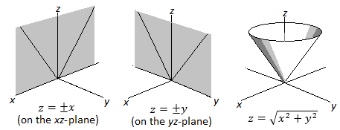
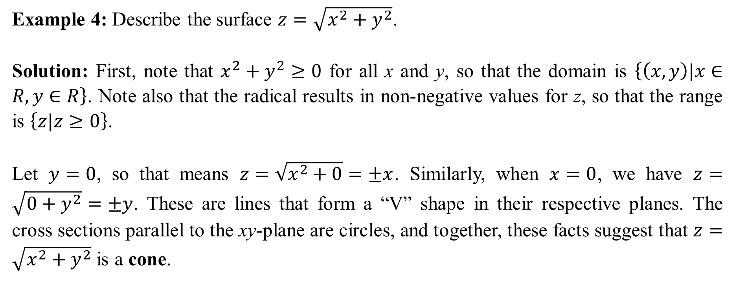
Example 4: Describe the surface $z=\sqrt{x^{2}+y^{2}}$.
Solution: First, note that $x^{2}+y^{2}≥0$ for all x and y, so that the domain is $\left\{\left(x,y\right)|x∈R, y∈R\right\}$. Note also that the radical results in non-negative values for z, so that the range is $\left\{z|z≥0\right\}$.
Let $y=0$, so that means $z=\sqrt{x^{2}+0}=±x$. Similarly, when $x=0$, we have $z=\sqrt{0+y^{2}}=±y$. These are lines that form a “V” shape in their respective planes. The cross sections parallel to the xy-plane are circles, and together, these facts suggest that $z=\sqrt{x^{2}+y^{2}}$ is a cone.

Slide 7
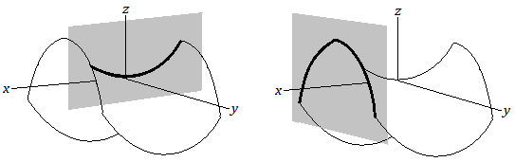
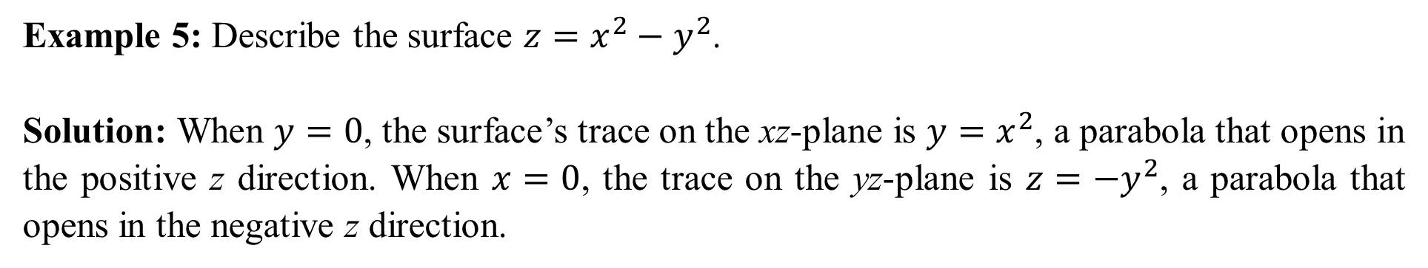
Example 5: Describe the surface $z=x^{2}−y^{2}$.
Solution: When $y=0$, the surface’s trace on the xz-plane is $y=x^{2}$, a parabola that opens in the positive z direction. When $x=0$, the trace on the yz-plane is $z=−y^{2}$, a parabola that opens in the negative z direction.

Slide 8
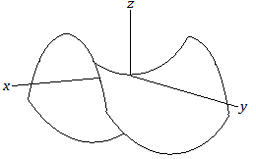
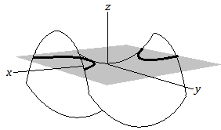
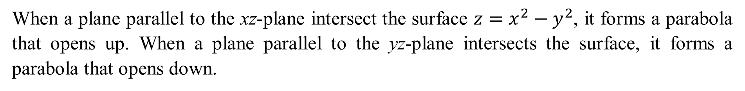
When a plane parallel to the xz-plane intersect the surface $z=x^{2}−y^{2}$, it forms a parabola that opens up. When a plane parallel to the yz-plane intersects the surface, it forms a parabola that opens down.
The surface is called a hyperbolic paraboloid. It is shaped like a saddle and is informally called a saddle. The origin in this case is the saddle point.

Slide 9
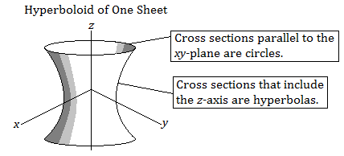
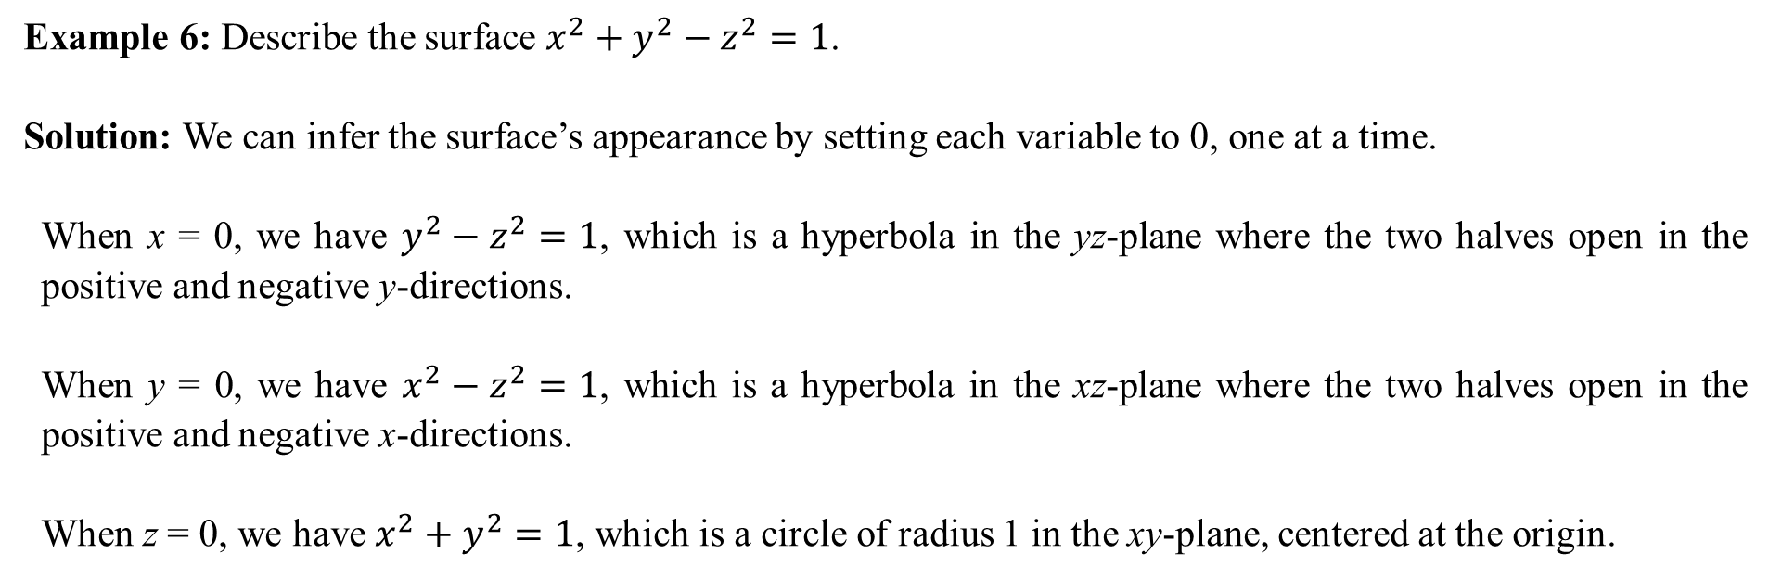
Example 6: Describe the surface $x^{2}+y^{2}−z^{2}=1$.
Solution: We can infer the surface’s appearance by setting each variable to 0, one at a time.
When x = 0, we have $y^{2}−z^{2}=1$, which is a hyperbola in the yz-plane where the two halves open in the positive and negative y-directions.
When y = 0, we have $x^{2}−z^{2}=1$, which is a hyperbola in the xz-plane where the two halves open in the positive and negative x-directions.
When z = 0, we have $x^{2}+y^{2}=1$, which is a circle of radius 1 in the xy-plane, centered at the origin.
The resulting shape is called a hyperboloid of one sheet. Note that it does not intersect the z-axis (the z-axis is the axis of symmetry of this surface).

Slide 10
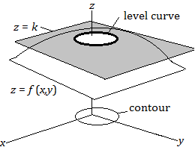
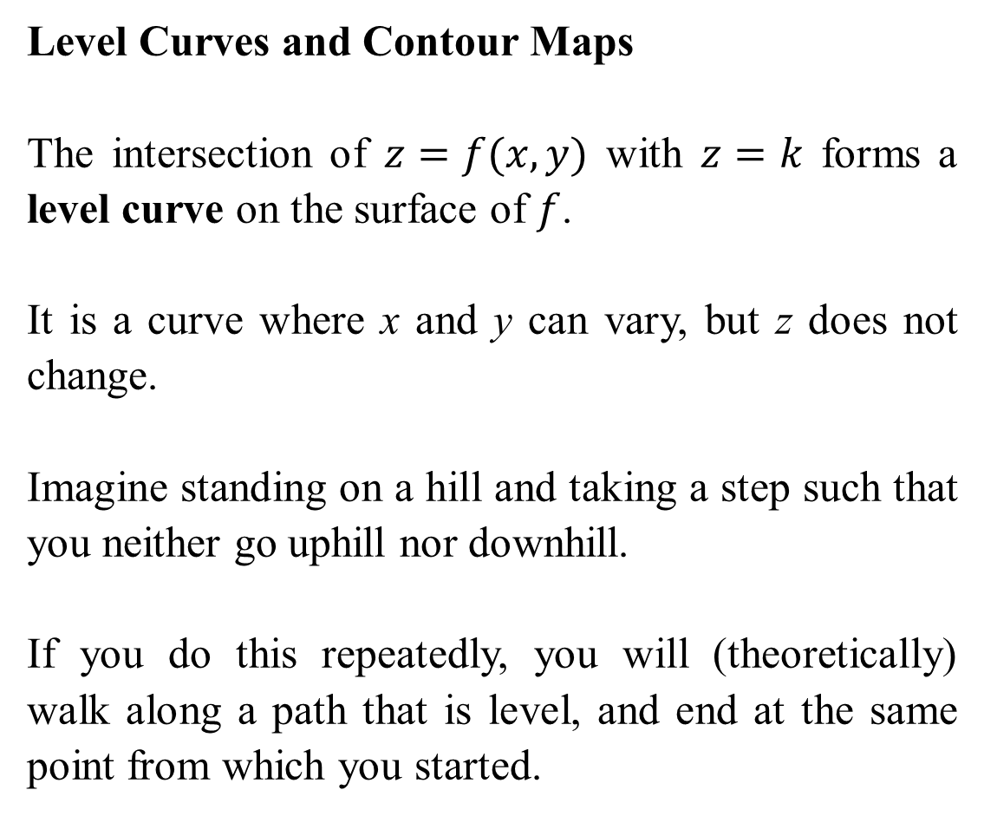
Level Curves and Contour Maps
The intersection of $z=f(x,y)$ with $z=k$ forms a level curve on the surface of $f$.
It is a curve where x and y can vary, but z does not change.
Imagine standing on a hill and taking a step such that you neither go uphill nor downhill.
If you do this repeatedly, you will (theoretically) walk along a path that is level, and end at the same point from which you started.

Slide 11
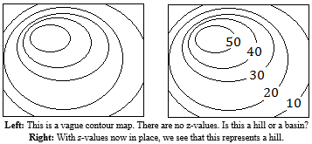
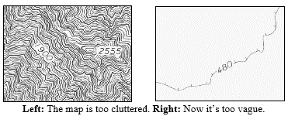
The contours are marked by the z-values for reference. For complicated surfaces, the z-values may differ by some set value, e.g. by multiples of 10. Too many contours, and the map is cluttered, while too few contours, important details may be lost.

Slide 12
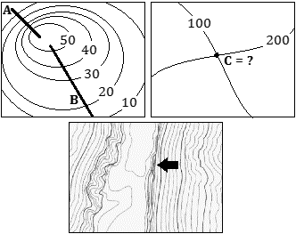
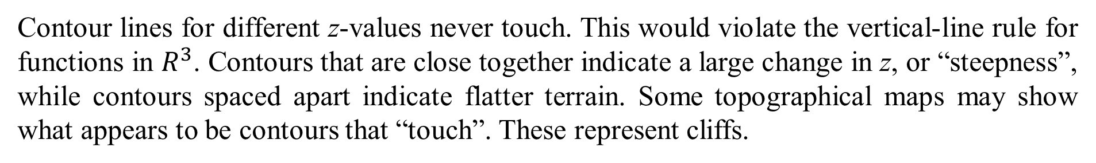
Contour lines for different z-values never touch. This would violate the vertical-line rule for functions in $R^{3}$. Contours that are close together indicate a large change in z, or “steepness”, while contours spaced apart indicate flatter terrain. Some topographical maps may show what appears to be contours that “touch”. These represent cliffs.

Slide 13
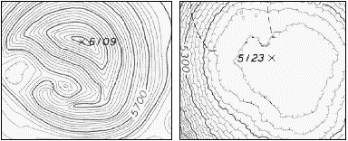
Contours can form closed loops and nest (and or may be nested within) other contours. Hills are found where the nested contours increase in values of z. Basins are found where the nested contours decrease in values of z.

Slide 14
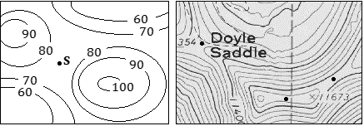
Saddle points are locations where the point may be a minimum along some paths crossing through the point, and a maximum for other paths passing through the point.
On most contour maps, a saddle is usually inferred where a contour “pinches” in, then widens again.

Slide 15
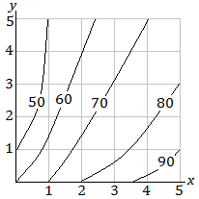
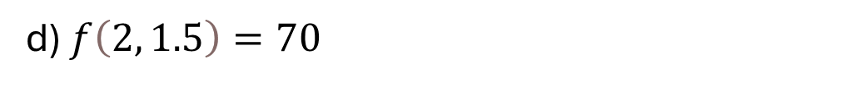
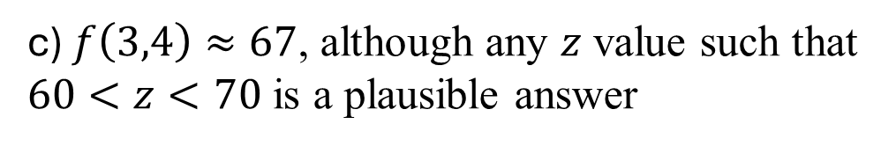
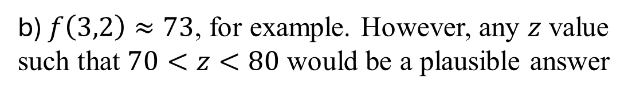
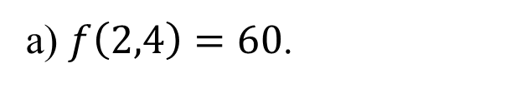
Example 7: Given the contour map below for $z=f(x,y)$ where $0≤x≤5$ and $0≤y≤5$. Find the following: (a) $f(2,4)$; (b) $f(3,2)$; (c) $f(3,4)$; (d) $f\left(2,y\right)=70$.
a) $f\left(2,4\right)=60$.
b) $f\left(3,2\right)≈73$, for example. However, any $z$ value such that $70<z<80$ would be a plausible answer
c) $f\left(3,4\right)≈67$, although any $z$ value such that $60<z<70$ is a plausible answer
d) $f\left(2, 1.5\right)=70$

Slide 16
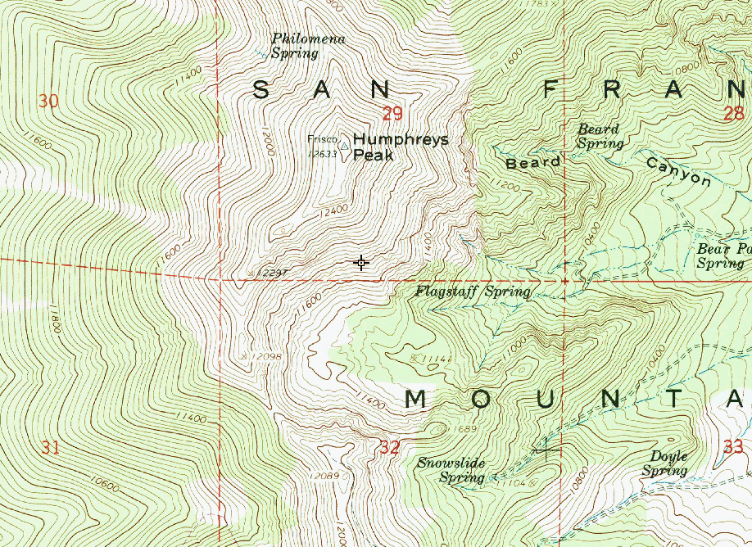

Slide 17
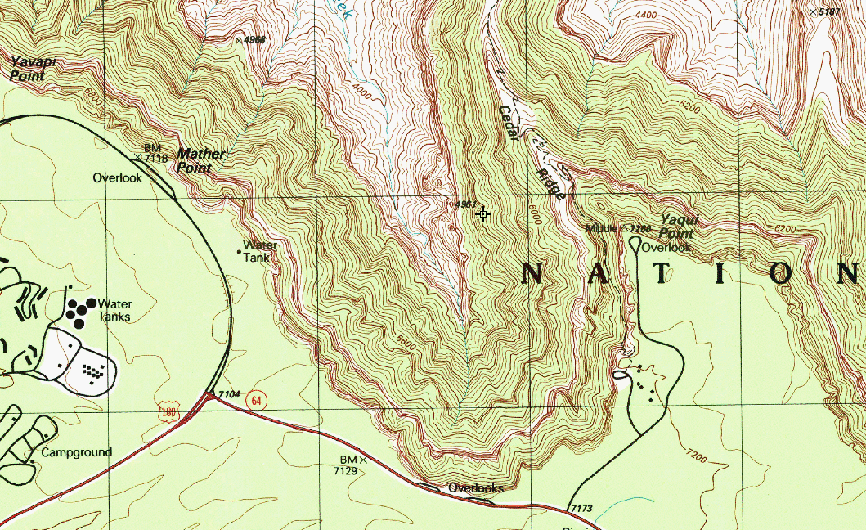

Slide 18
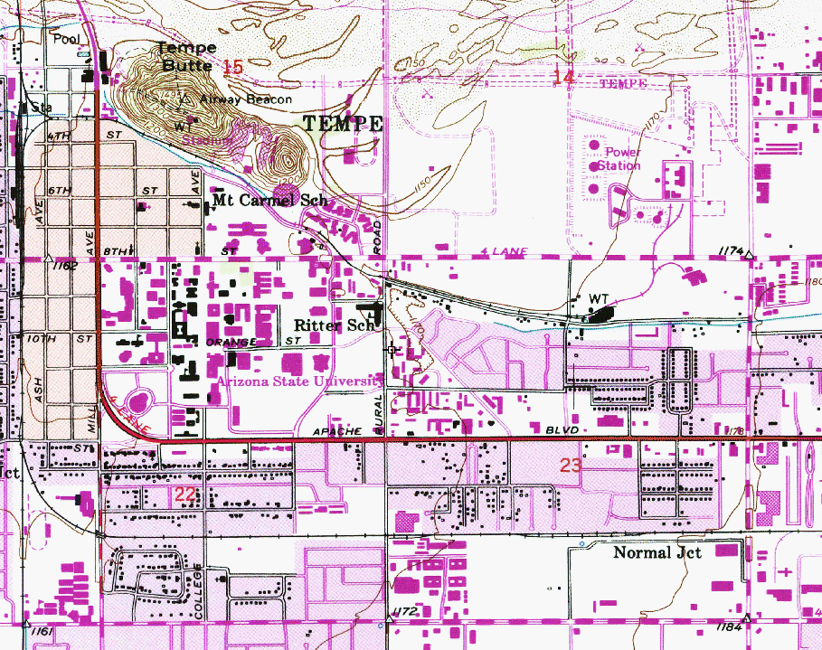

Slide 19
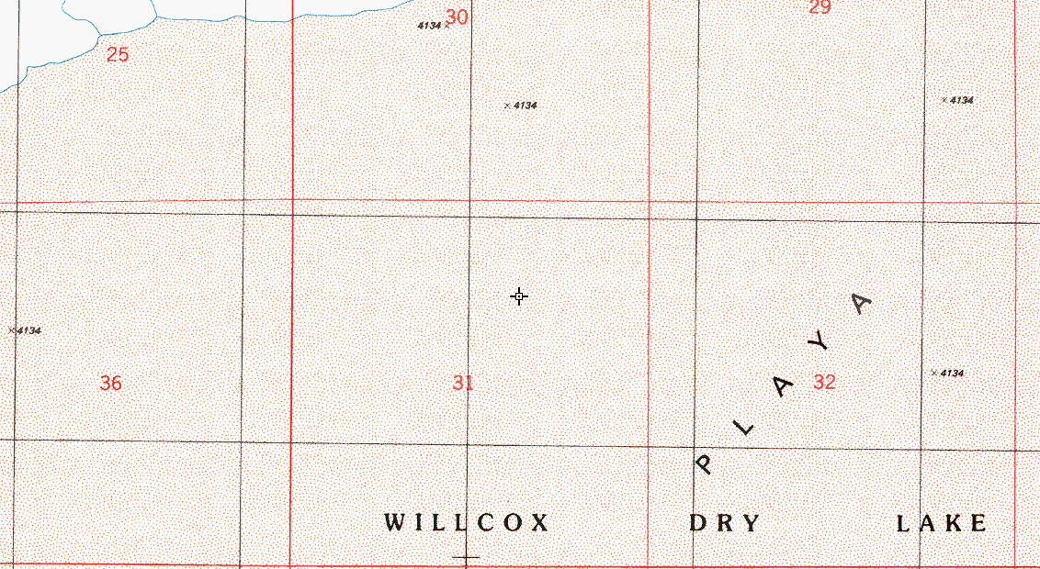

Slide 20
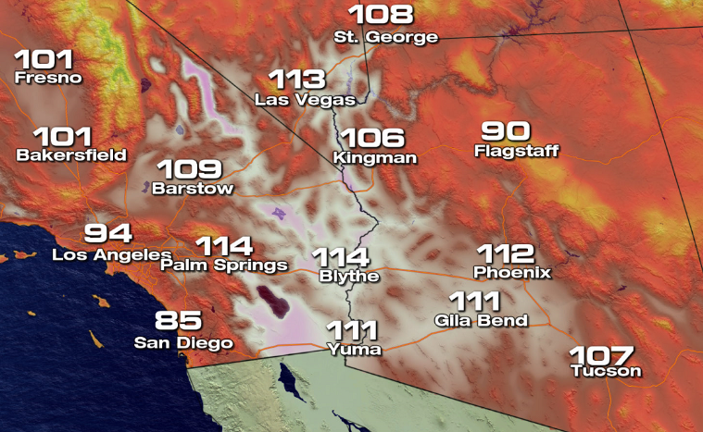

Slide 21
