Slide 1
Equations of Lines & Planes
Scott Surgent

Slide 2
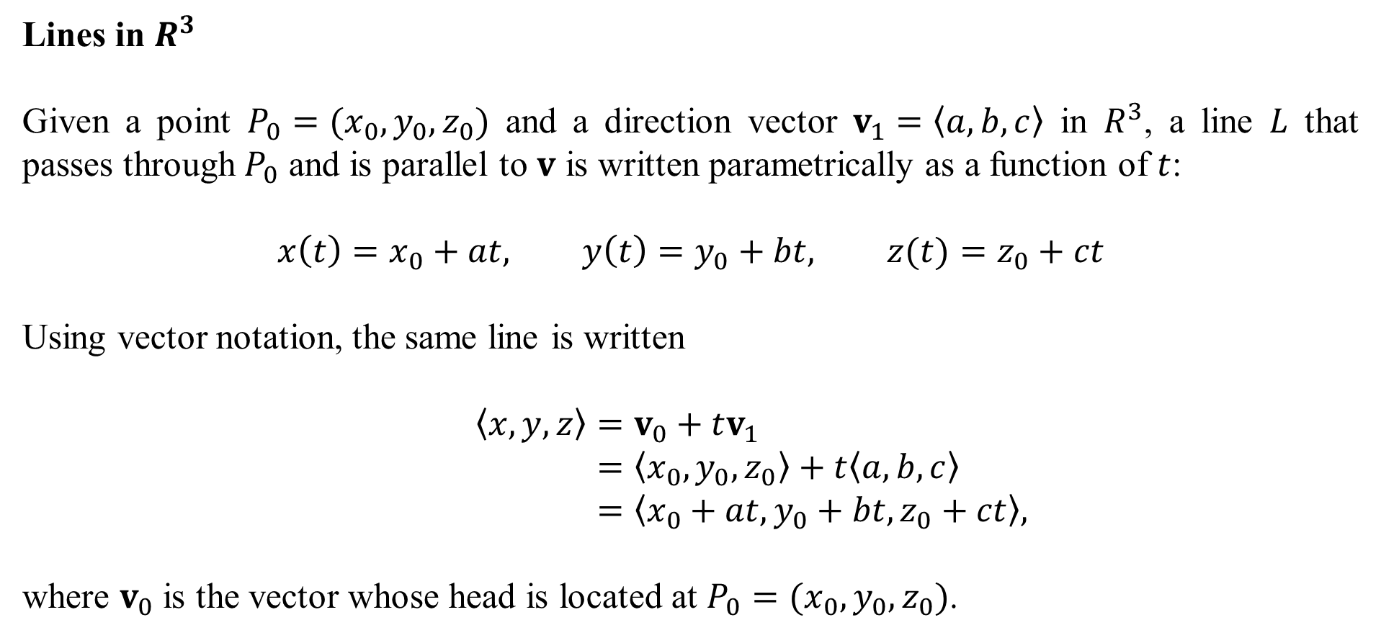
Lines in $R^{3}$
Given a point $P_{0}=(x_{0},y_{0},z_{0})$ and a direction vector $v_{1}=〈a,b,c〉$ in $R^{3}$, a line $L$ that passes through $P_{0}$ and is parallel to $v$ is written parametrically as a function of $t$:
$$x\left(t\right)=x_{0}+at, y\left(t\right)=y_{0}+bt, z(t)=z_{0}+ct$$
Using vector notation, the same line is written
$$〈x,y,z〉=v_{0}+tv_{1} \\ =〈x_{0},y_{0},z_{0}〉+t〈a,b,c〉 \\ =〈x_{0}+at,y_{0}+bt,z_{0}+ct〉,$$
where $v_{0}$ is the vector whose head is located at $P_{0}=(x_{0},y_{0},z_{0})$.

Slide 3
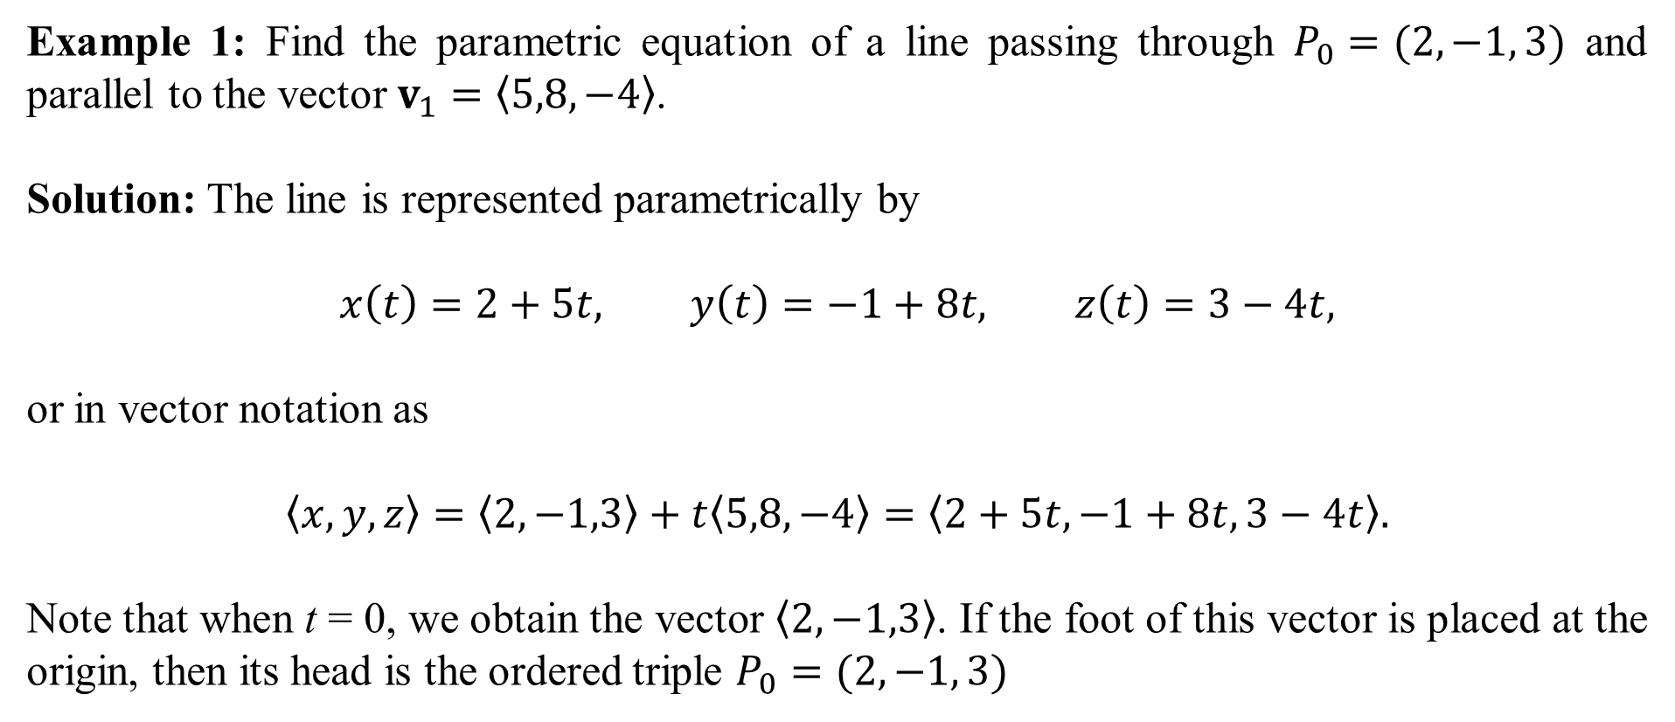
Example 1: Find the parametric equation of a line passing through $P_{0}=(2, −1, 3)$ and parallel to the vector $v_{1}=〈5,8,−4〉$.
Solution: The line is represented parametrically by
$$x\left(t\right)=2+5t, y\left(t\right)=−1+8t, z\left(t\right)=3−4t,$$
or in vector notation as
$$〈x,y,z〉=〈2,−1,3〉+t〈5,8,−4〉=〈2+5t,−1+8t,3−4t〉.$$
Note that when t = 0, we obtain the vector $〈2,−1,3〉$. If the foot of this vector is placed at the origin, then its head is the ordered triple $P_{0}=(2, −1, 3)$

Slide 4
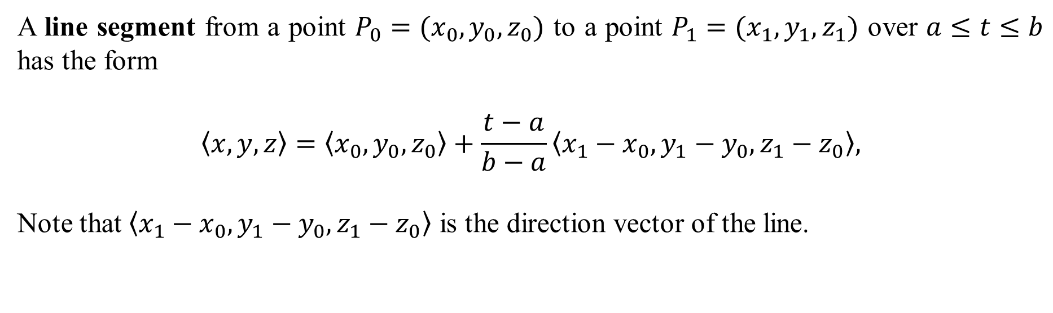
A line segment from a point $P_{0}=(x_{0},y_{0},z_{0})$ to a point $P_{1}=(x_{1},y_{1},z_{1})$ over $a≤t≤b$ has the form
$$〈x,y,z〉=〈x_{0},y_{0},z_{0}〉+\frac{t−a}{b−a}〈x_{1}−x_{0},y_{1}−y_{0},z_{1}−z_{0}〉,$$
Note that $〈x_{1}−x_{0},y_{1}−y_{0},z_{1}−z_{0}〉$ is the direction vector of the line.

Slide 5
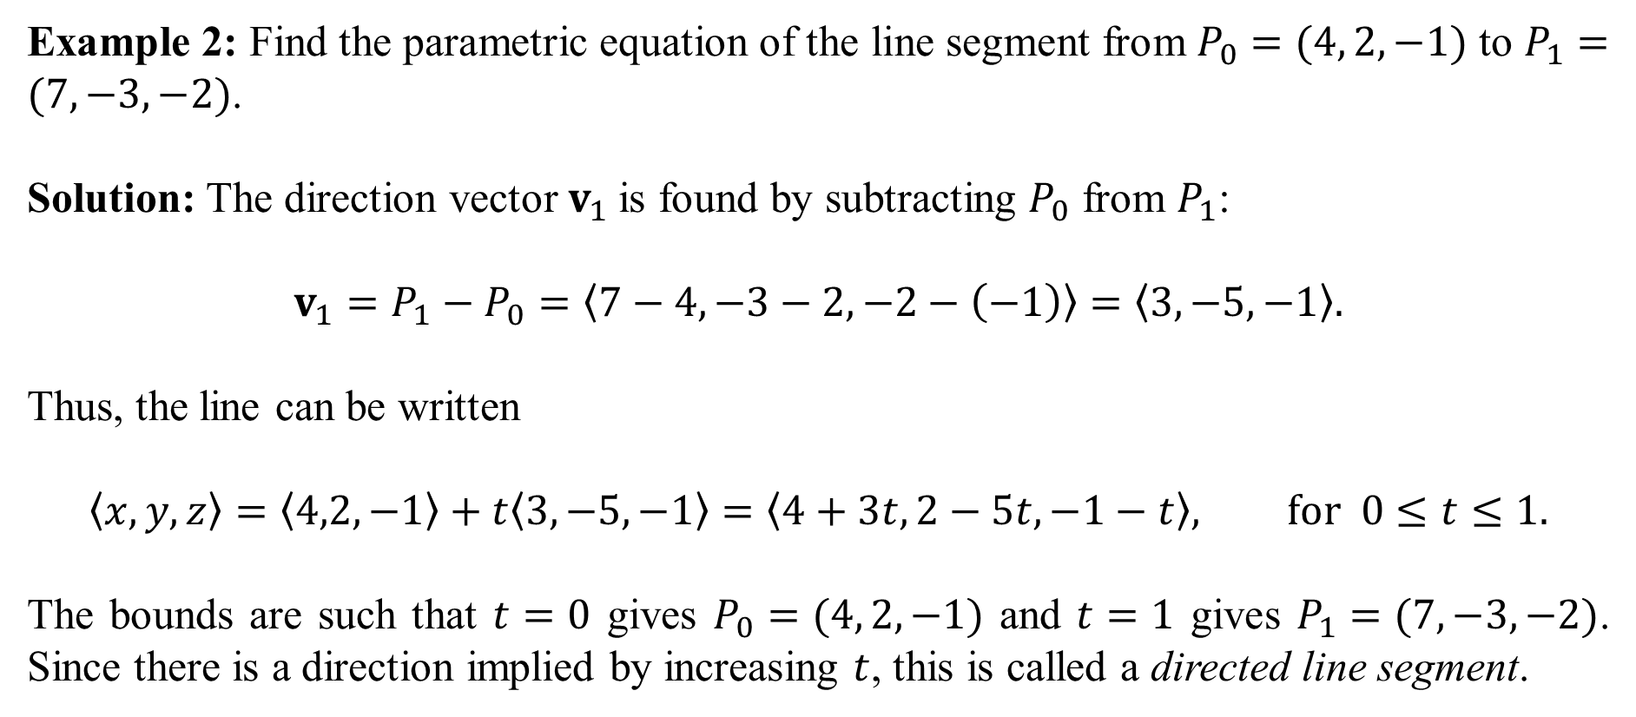
Example 2: Find the parametric equation of the line segment from $P_{0}=(4, 2, −1)$ to $P_{1}=(7,−3,−2)$.
Solution: The direction vector $v_{1}$is found by subtracting $P_{0}$ from $P_{1}$:
$$v_{1}=P_{1}−P_{0}=〈7−4,−3−2,−2−\left(−1\right)〉=〈3,−5,−1〉.$$
Thus, the line can be written
$$〈x,y,z〉=〈4,2,−1〉+t〈3,−5,−1〉=〈4+3t,2−5t,−1−t〉, for 0≤t≤1.$$
The bounds are such that $t=0$ gives $P_{0}=(4, 2, −1)$ and $t=1$ gives $P_{1}=(7,−3,−2)$. Since there is a direction implied by increasing $t$, this is called a directed line segment.
When a line segment between two points is constructed in this manner, the bounds on $t$ are always $0≤t≤1$.

Slide 6
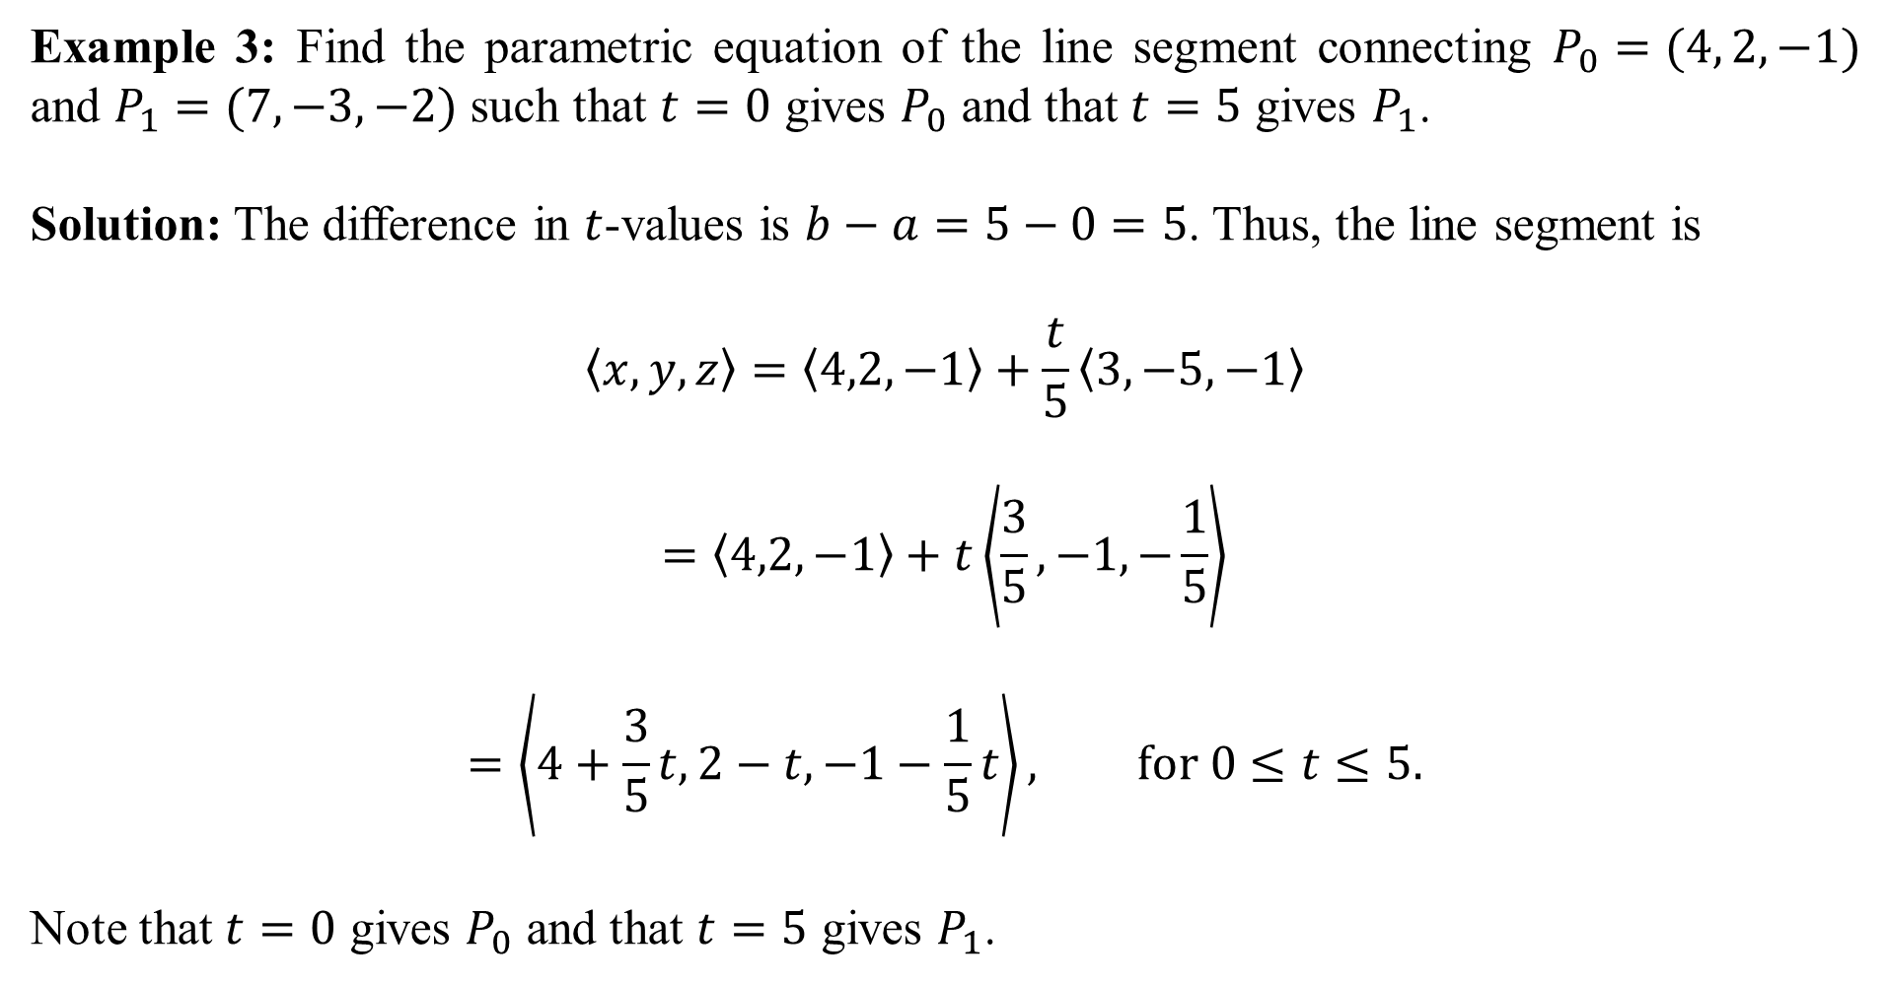
Example 3: Find the parametric equation of the line segment connecting $P_{0}=(4, 2, −1)$ and $P_{1}=(7,−3,−2)$ such that $t=0$ gives $P_{0}$ and that $t=5$ gives $P_{1}$.
Solution: The difference in $t$-values is $b−a=5−0=5$. Thus, the line segment is
$$〈x,y,z〉=〈4,2,−1〉+\frac{t}{5}〈3,−5,−1〉$$
$$=〈4,2,−1〉+t\left\langle \frac{3}{5},−1,−\frac{1}{5}\right\rangle$$
$$=\left\langle 4+\frac{3}{5}t,2−t,−1−\frac{1}{5}t\right\rangle , for 0≤t≤5.$$
Note that $t=0$ gives $P_{0}$ and that $t=5$ gives $P_{1}$.

Slide 7
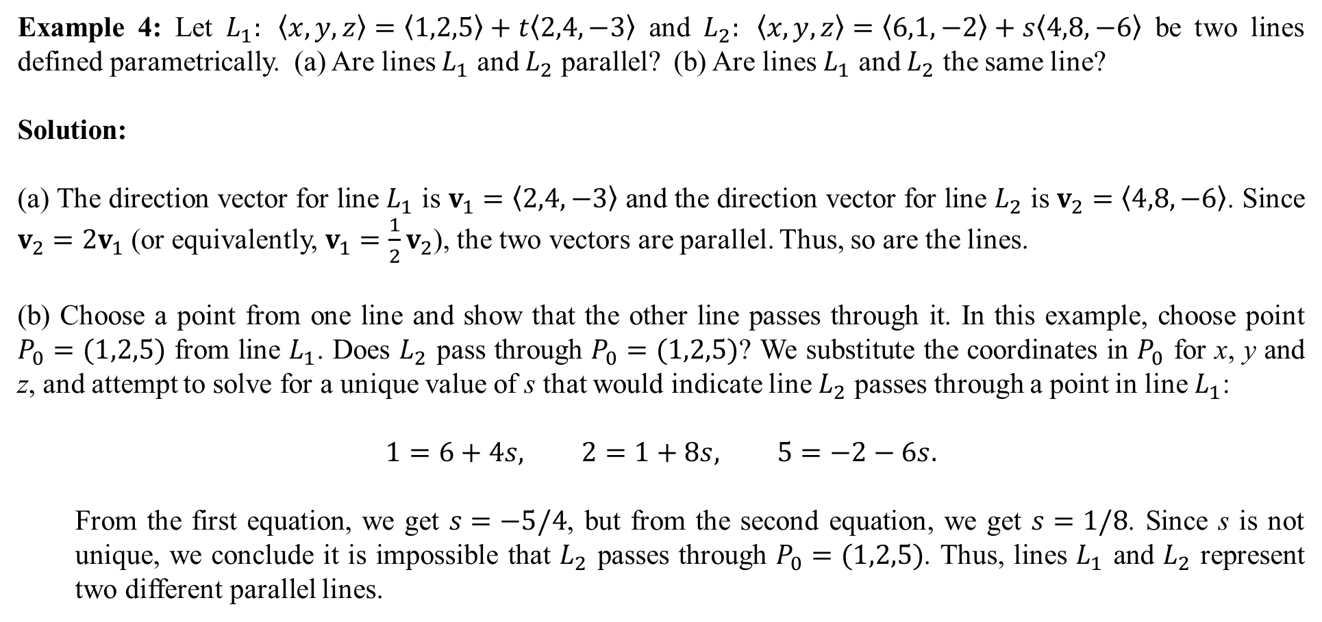
Example 4: Let $L_{1}: 〈x,y,z〉=〈1,2,5〉+t〈2,4,−3〉$ and $L_{2}: 〈x,y,z〉=〈6,1,−2〉+s〈4,8,−6〉$ be two lines defined parametrically. (a) Are lines $L_{1}$ and $L_{2}$ parallel? (b) Are lines $L_{1}$ and $L_{2}$ the same line?
Solution:
(a) The direction vector for line $L_{1}$ is $v_{1}=〈2,4,−3〉$ and the direction vector for line $L_{2}$ is $v_{2}=〈4,8,−6〉$. Since $v_{2}=2v_{1}$ (or equivalently, $v_{1}=\frac{1}{2}v_{2}$), the two vectors are parallel. Thus, so are the lines.
(b) Choose a point from one line and show that the other line passes through it. In this example, choose point $P_{0}=(1,2,5)$ from line $L_{1}$. Does $L_{2}$ pass through $P_{0}=(1,2,5)$? We substitute the coordinates in $P_{0}$ for x, y and z, and attempt to solve for a unique value of s that would indicate line $L_{2}$ passes through a point in line $L_{1}$:
$$1=6+4s, 2=1+8s, 5=−2−6s.$$
From the first equation, we get $s=−5/4$, but from the second equation, we get $s=1/8$. Since s is not unique, we conclude it is impossible that $L_{2}$ passes through $P_{0}=(1,2,5)$. Thus, lines $L_{1}$ and $L_{2}$ represent two different parallel lines.

Slide 8
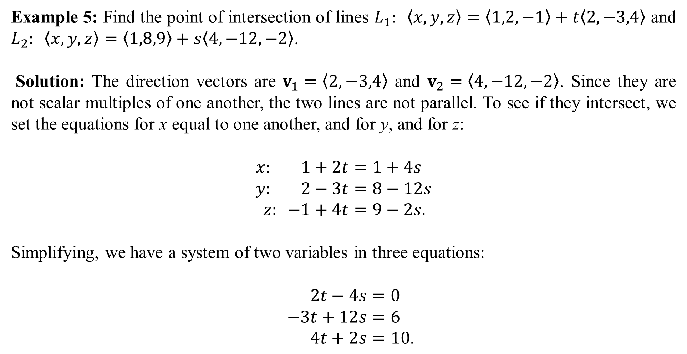
Example 5: Find the point of intersection of lines $L_{1}: 〈x,y,z〉=〈1,2,−1〉+t〈2,−3,4〉$ and $L_{2}: 〈x,y,z〉=〈1,8,9〉+s〈4,−12,−2〉$.
Solution: The direction vectors are $v_{1}=〈2,−3,4〉$ and $v_{2}=〈4,−12,−2〉$. Since they are not scalar multiples of one another, the two lines are not parallel. To see if they intersect, we set the equations for x equal to one another, and for y, and for z:
$$x: 1+2t=1+4s \\ y: 2−3t=8−12s \\ z: −1+4t=9−2s.$$
Simplifying, we have a system of two variables in three equations:
$$2t−4s=0 \\ −3t+12s=6 \\ 4t+2s=10.$$

Slide 9
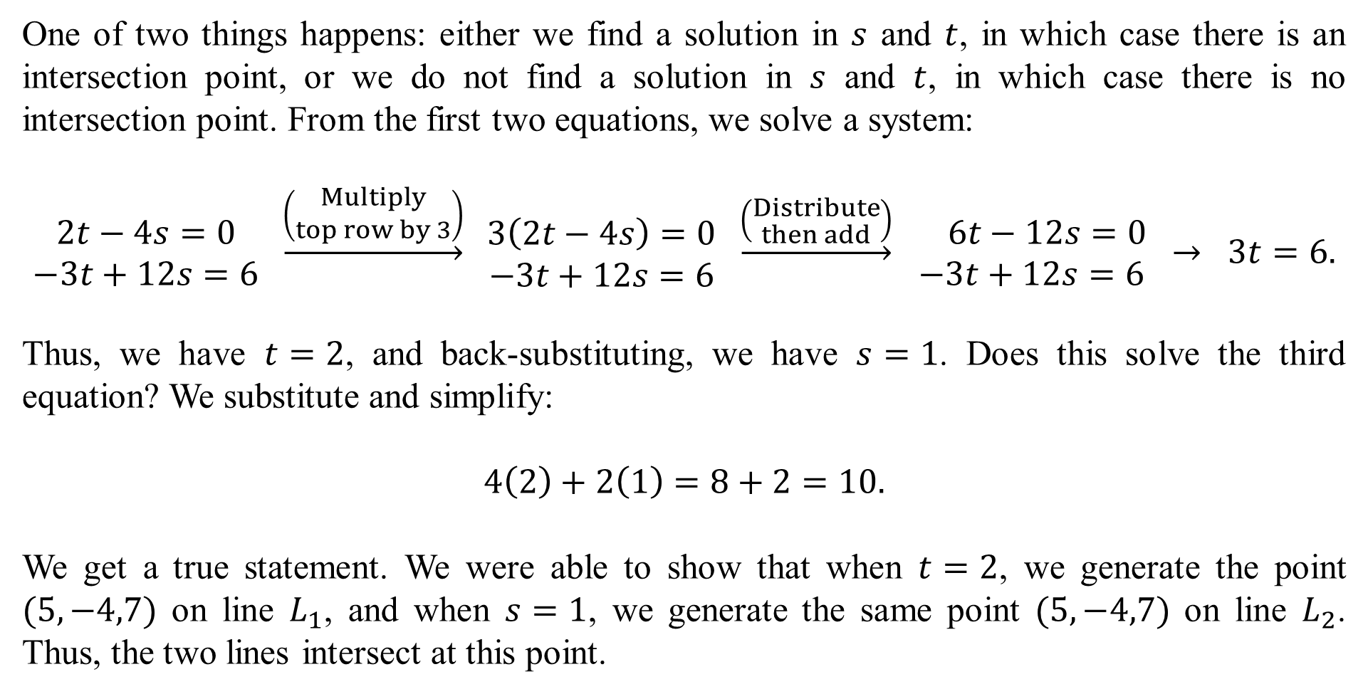
One of two things happens: either we find a solution in $s$ and $t$, in which case there is an intersection point, or we do not find a solution in $s$ and $t$, in which case there is no intersection point. From the first two equations, we solve a system:
$$\begin{matrix}2t−4s=0 \\ −3t+12s=6\end{matrix} \underset{→}{\left(\begin{aligned}Multiply \\ top row by 3\end{aligned}\right)} \begin{matrix}3\left(2t−4s\right)=0 \\ −3t+12s=6\end{matrix} \underset{→}{\left(\begin{aligned}Distribute \\ then add\end{aligned}\right)} \begin{matrix} 6t−12s=0 \\ −3t+12s=6\end{matrix} → 3t=6.$$
Thus, we have $t=2$, and back-substituting, we have $s=1$. Does this solve the third equation? We substitute and simplify:
$$4\left(2\right)+2\left(1\right)=8+2=10.$$
We get a true statement. We were able to show that when $t=2$, we generate the point $(5,−4,7)$ on line $L_{1}$, and when $s=1$, we generate the same point $(5,−4,7)$ on line $L_{2}$. Thus, the two lines intersect at this point.

Slide 10
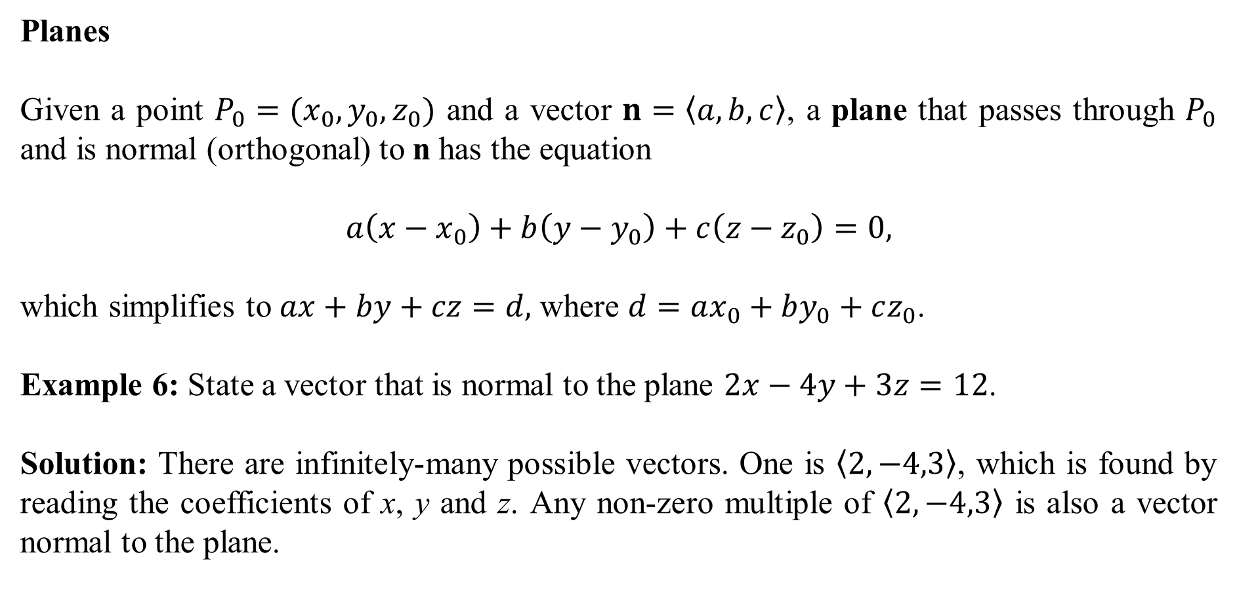
Planes
Given a point $P_{0}=(x_{0},y_{0},z_{0})$ and a vector $n=〈a,b,c〉$, a plane that passes through $P_{0}$ and is normal (orthogonal) to n has the equation
$$a\left(x−x_{0}\right)+b\left(y−y_{0}\right)+c\left(z−z_{0}\right)=0,$$
which simplifies to $ax+by+cz=d,$ where $d=ax_{0}+by_{0}+cz_{0}$.
Example 6: State a vector that is normal to the plane $2x−4y+3z=12$.
Solution: There are infinitely-many possible vectors. One is $〈2,−4,3〉$, which is found by reading the coefficients of x, y and z. Any non-zero multiple of $〈2,−4,3〉$ is also a vector normal to the plane.

Slide 11
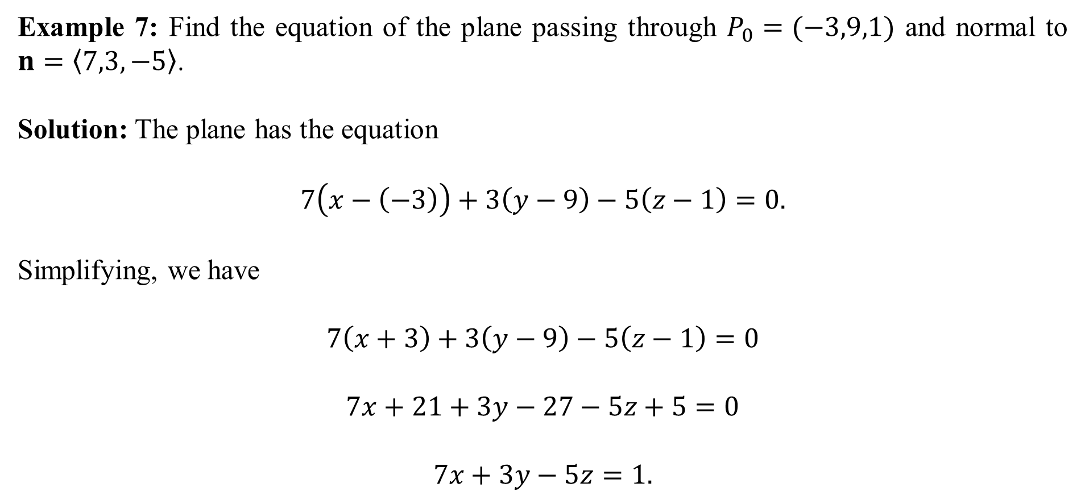
Example 7: Find the equation of the plane passing through $P_{0}=(−3,9,1)$ and normal to $n=〈7,3,−5〉$.
Solution: The plane has the equation
$$7\left(x−\left(−3\right)\right)+3\left(y−9\right)−5\left(z−1\right)=0.$$
Simplifying, we have
$$7\left(x+3\right)+3\left(y−9\right)−5\left(z−1\right)=0$$
$$7x+21+3y−27−5z+5=0$$
$$7x+3y−5z=1.$$

Slide 12
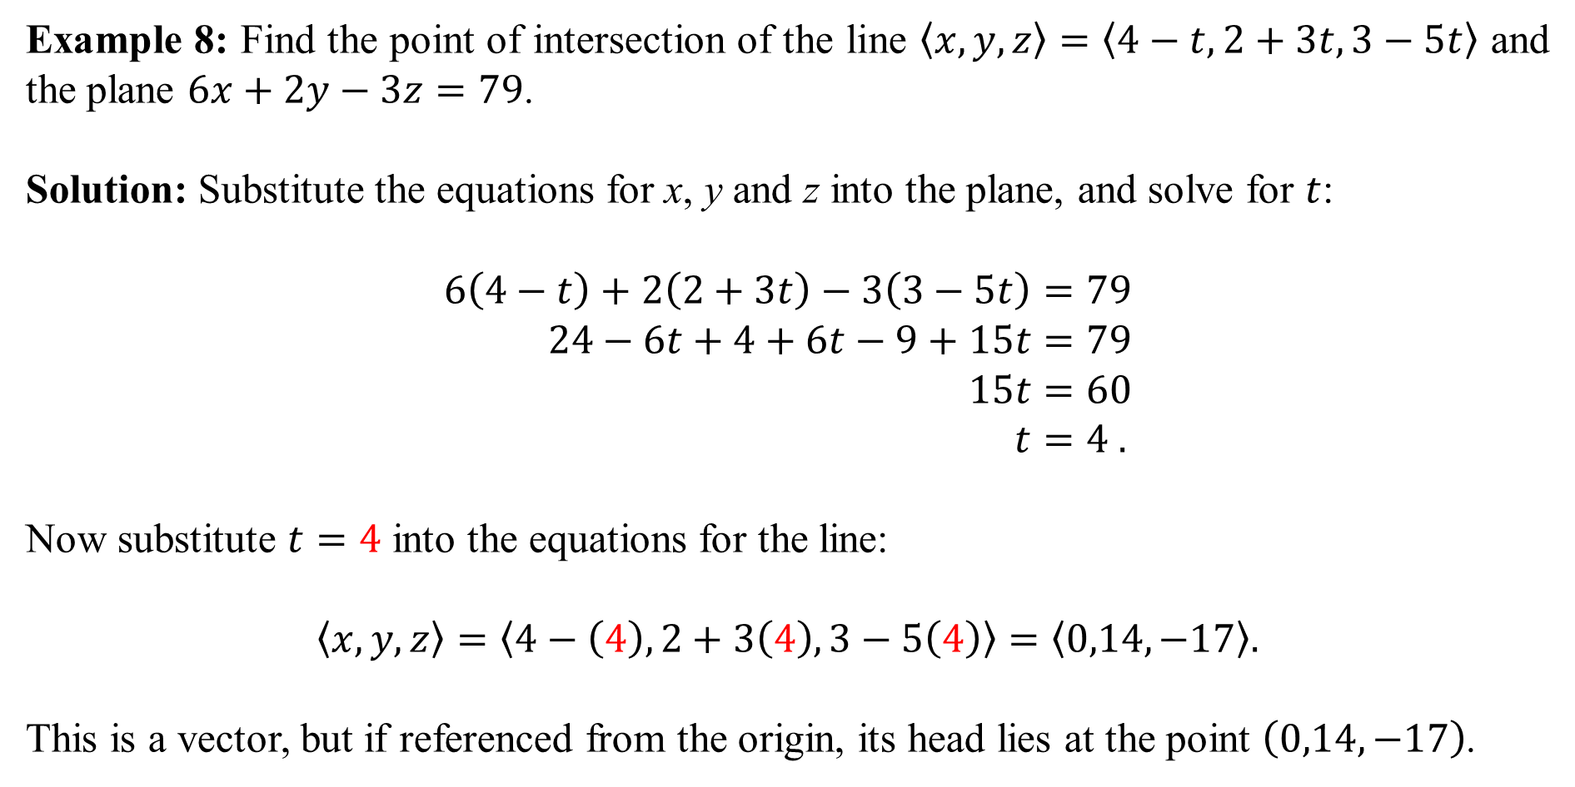
Example 8: Find the point of intersection of the line $〈x,y,z〉=〈4−t,2+3t,3−5t〉$ and the plane $6x+2y−3z=79$.
Solution: Substitute the equations for x, y and z into the plane, and solve for $t$:
$$6\left(4−t\right)+2\left(2+3t\right)−3\left(3−5t\right)=79 \\ 24−6t+4+6t−9+15t=79 \\ 15t=60 \\ t=4 .$$
Now substitute $t=4$ into the equations for the line:
$$〈x,y,z〉=\left\langle 4−\left(4\right),2+3\left(4\right),3−5\left(4\right)\right\rangle =\left\langle 0,14,−17\right\rangle .$$
This is a vector, but if referenced from the origin, its head lies at the point $\left(0,14,−17\right)$.

Slide 13
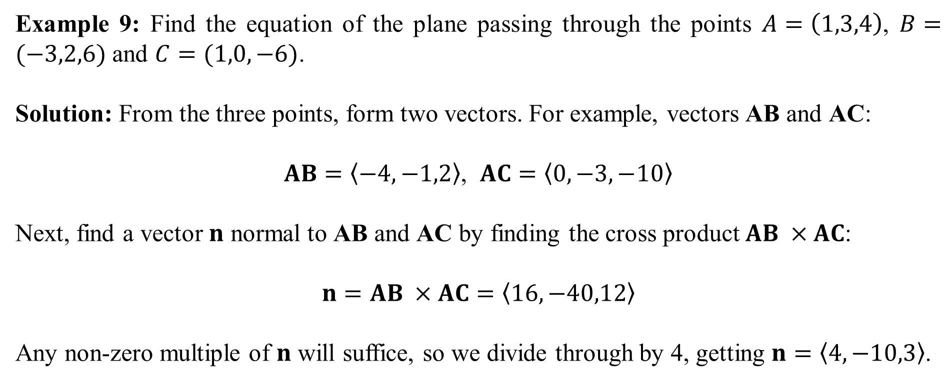
Example 9: Find the equation of the plane passing through the points $A=\left(1,3,4\right)$, $B=(−3,2,6)$ and $C=(1,0,−6)$.
Solution: From the three points, form two vectors. For example, vectors AB and AC:
$AB=〈−4,−1,2〉$, $AC=〈0,−3,−10〉$
Next, find a vector $n$ normal to AB and AC by finding the cross product $AB ×AC$:
$$n=AB ×AC=〈16,−40,12〉$$
Any non-zero multiple of $n$ will suffice, so we divide through by 4, getting $n=〈4,−10,3〉$.

Slide 14
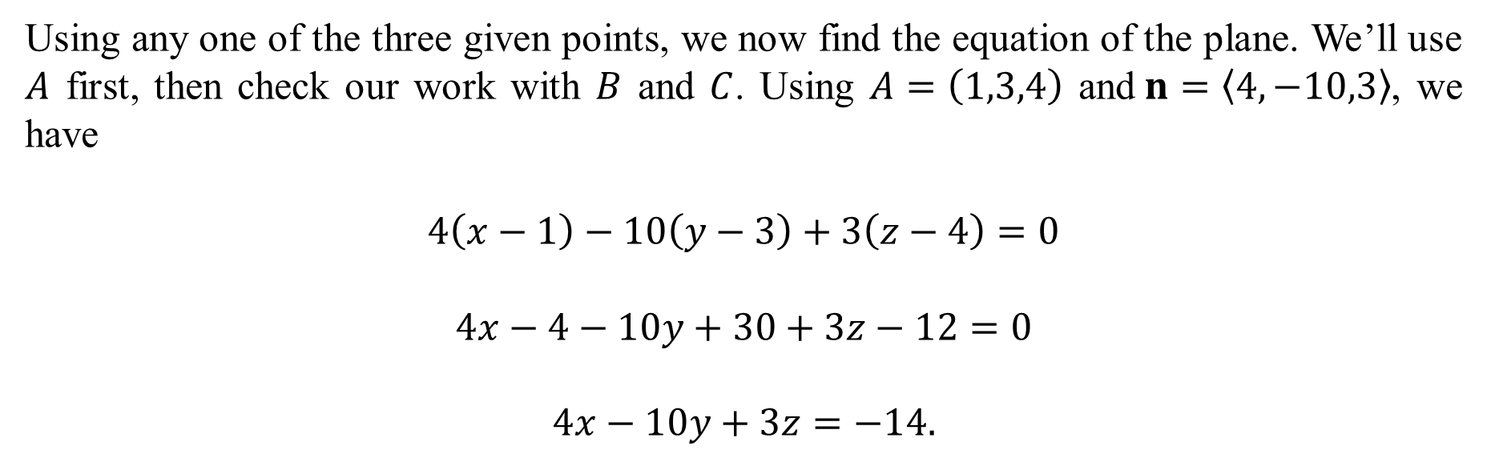
Using any one of the three given points, we now find the equation of the plane. We’ll use $A$ first, then check our work with $B$ and $C$. Using $A=\left(1,3,4\right)$ and$n=〈4,−10,3〉$, we have
$$4\left(x−1\right)−10\left(y−3\right)+3\left(z−4\right)=0$$
$$4x−4−10y+30+3z−12=0$$
$$4x−10y+3z=−14.$$

Slide 15
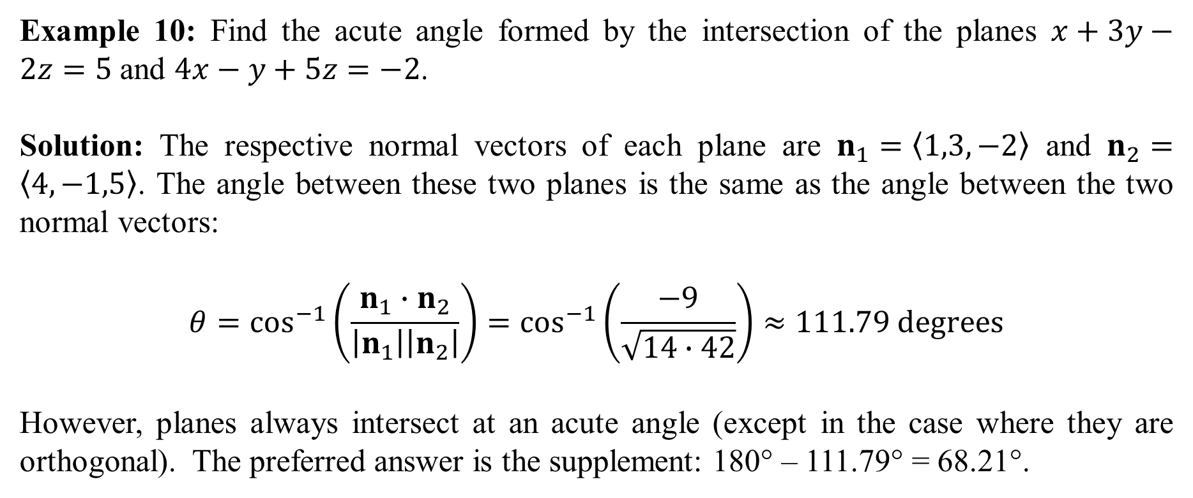
Example 10: Find the acute angle formed by the intersection of the planes $x+3y−2z=5$ and $4x−y+5z=−2$.
Solution: The respective normal vectors of each plane are $n_{1}=〈1,3,−2〉$ and $n_{2}=〈4,−1,5〉$. The angle between these two planes is the same as the angle between the two normal vectors:
$$θ=\cos^{−1}\left(\frac{n_{1}∙n_{2}}{\left|n_{1}\right|\left|n_{2}\right|}\right)=\cos^{−1}\left(\frac{−9}{\sqrt{14∙42}}\right)≈111.79 degrees$$
However, planes always intersect at an acute angle (except in the case where they are orthogonal). The preferred answer is the supplement: 180° – 111.79° = 68.21°.

Slide 16
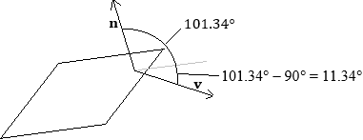
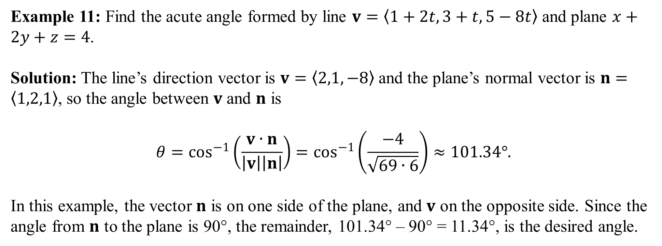
Example 11: Find the acute angle formed by line $v=〈1+2t,3+t,5−8t〉$ and plane $x+2y+z=4$.
Solution: The line’s direction vector is $v=〈2,1,−8〉$and the plane’s normal vector is $n=〈1,2,1〉$, so the angle between $v$ and $n$ is
$$θ=\cos^{−1}\left(\frac{v∙n}{\left|v\right|\left|n\right|}\right)=\cos^{−1}\left(\frac{−4}{\sqrt{69∙6}}\right)≈101.34°.$$
In this example, the vector $n$ is on one side of the plane, and $v$ on the opposite side. Since the angle from $n$ to the plane is 90°, the remainder, 101.34° – 90° = 11.34°, is the desired angle.

Slide 17
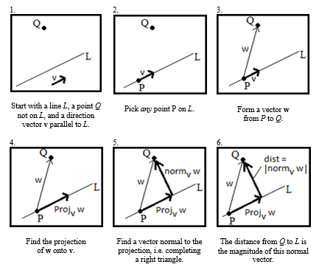
A Pictorial Guide to Finding the Shortest Distance Between a Point and a Line

Slide 18
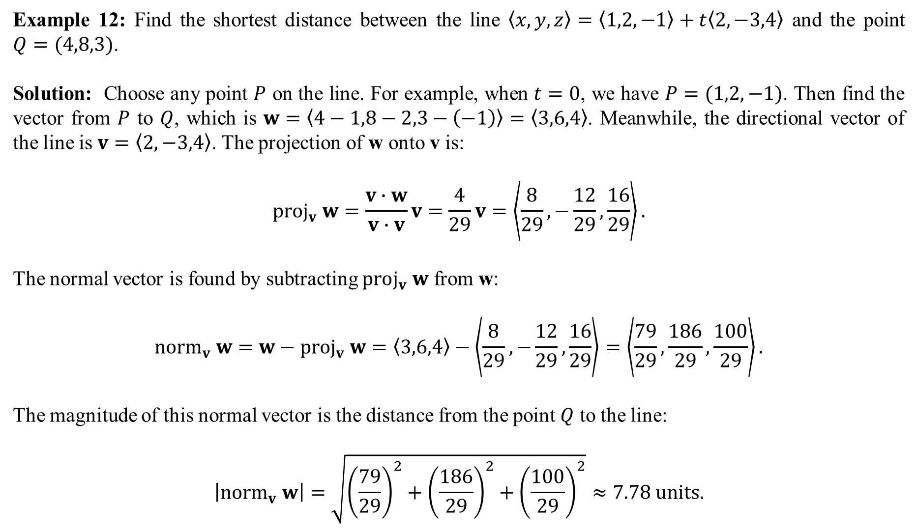
Example 12: Find the shortest distance between the line $〈x,y,z〉=〈1,2,−1〉+t〈2,−3,4〉$ and the point $Q=(4,8,3)$.
Solution: Choose any point $P$ on the line. For example, when $t=0$, we have $P=(1,2,−1)$. Then find the vector from $P$ to $Q$, which is $w=〈4−1,8−2,3−\left(−1\right)〉=〈3,6,4〉$. Meanwhile, the directional vector of the line is $v=〈2,−3,4〉$. The projection of w onto v is:
$$proj_{v} w=\frac{v∙w}{v∙v}v=\frac{4}{29}v=\left\langle \frac{8}{29}, −\frac{12}{29},\frac{16}{29}\right\rangle .$$
The normal vector is found by subtracting $proj_{v} w$ from w:
$${norm}_{v} w=w−proj_{v} w=〈3,6,4〉−\left\langle \frac{8}{29}, −\frac{12}{29},\frac{16}{29}\right\rangle =\left\langle \frac{79}{29},\frac{186}{29},\frac{100}{29}\right\rangle .$$
The magnitude of this normal vector is the distance from the point $Q$ to the line:
$$\left|{norm}_{v} w\right|=\sqrt{{\left(\frac{79}{29}\right)}^{2}+{\left(\frac{186}{29}\right)}^{2}+{\left(\frac{100}{29}\right)}^{2}}≈7.78 units.$$

Slide 19
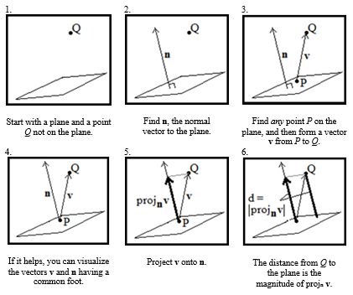
A Pictorial Guide to Finding the Shortest Distance Between a Point and a Plane

Slide 20
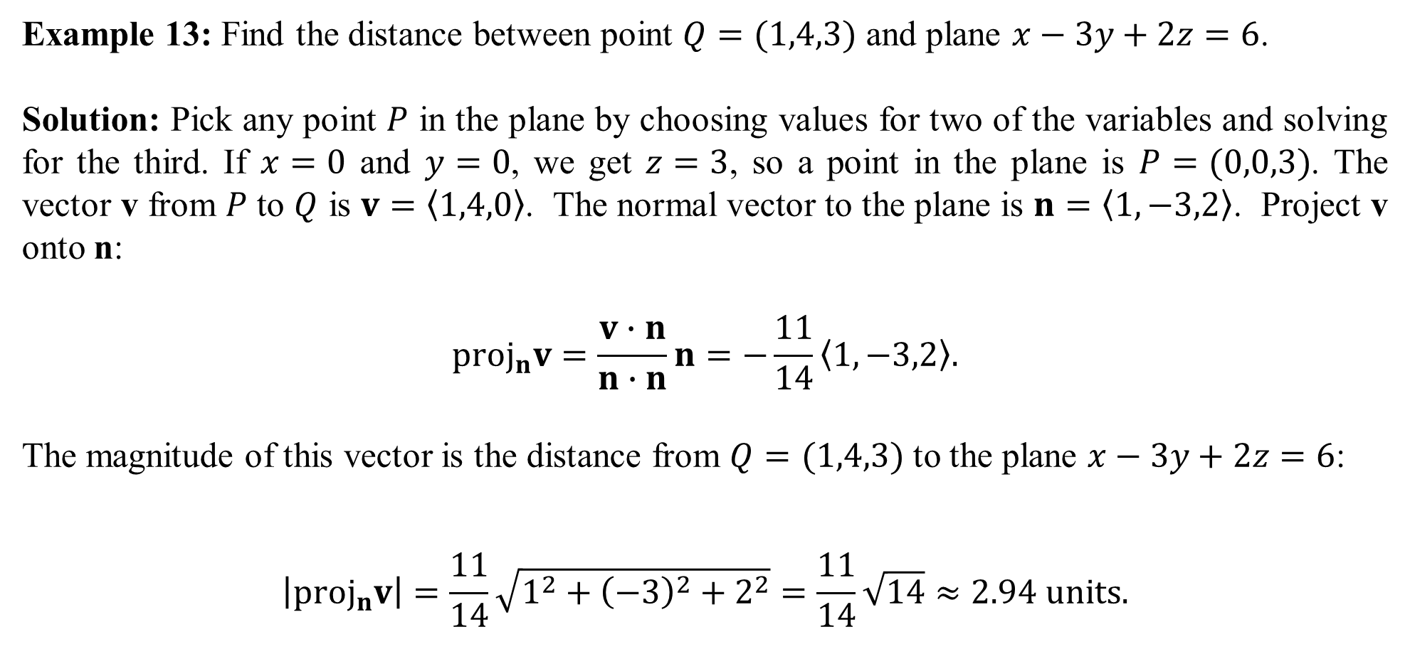
Example 13: Find the distance between point $Q=(1,4,3)$ and plane $x−3y+2z=6$.
Solution: Pick any point $P$ in the plane by choosing values for two of the variables and solving for the third. If $x=0$ and $y=0$, we get $z=3$, so a point in the plane is $P=(0,0,3)$. The vector v from $P$ to $Q$ is $v=〈1,4,0〉$. The normal vector to the plane is $n=〈1,−3,2〉$. Project v onto n:
$$proj_{n}v=\frac{v∙n}{n∙n}n=−\frac{11}{14}〈1,−3,2〉.$$
The magnitude of this vector is the distance from $Q=(1,4,3)$ to the plane $x−3y+2z=6$:
$$\left|proj_{n}v\right|=\frac{11}{14}\sqrt{1^{2}+{\left(−3\right)}^{2}+2^{2}}=\frac{11}{14}\sqrt{14}≈2.94 units.$$

