Slide 1
Line Integrals
Scott Surgent

Slide 2
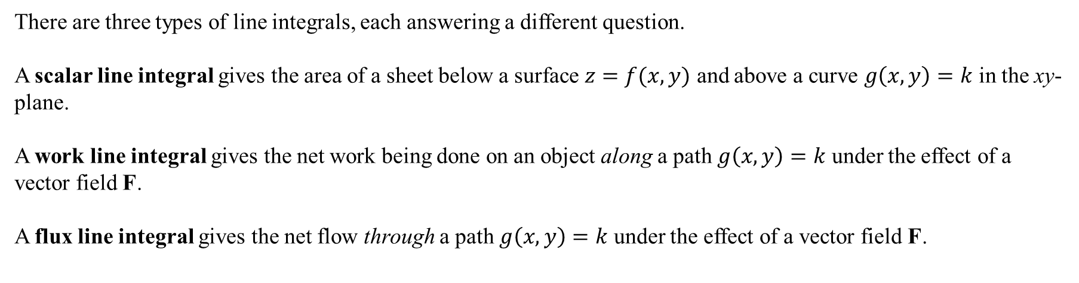
There are three types of line integrals, each answering a different question.
A scalar line integral gives the area of a sheet below a surface $z=f(x,y)$ and above a curve $g\left(x,y\right)=k$ in the xy-plane.
A work line integral gives the net work being done on an object along a path $g\left(x,y\right)=k$ under the effect of a vector field F.
A flux line integral gives the net flow through a path $g\left(x,y\right)=k$ under the effect of a vector field F.

Slide 3
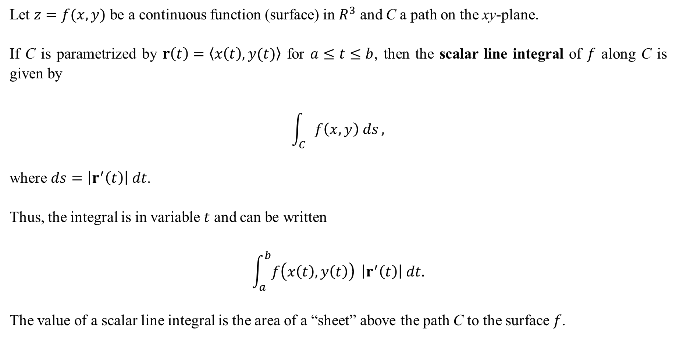
Let $z=f(x,y)$ be a continuous function (surface) in $R^{3}$ and C a path on the xy-plane.
If C is parametrized by $r\left(t\right)=〈x\left(t\right),y(t)〉$ for $a≤t≤b$, then the scalar line integral of $f$ along C is given by
$$\int_{C}{f\left(x,y\right) ds},$$
where $ds=\left|r^{′}\left(t\right)\right| dt$.
Thus, the integral is in variable $t$ and can be written
$$\int_{a}^{b}{f\left(x\left(t\right),y\left(t\right)\right) }\left|r^{′}\left(t\right)\right| dt.$$
The value of a scalar line integral is the area of a “sheet” above the path C to the surface $f$.

Slide 4
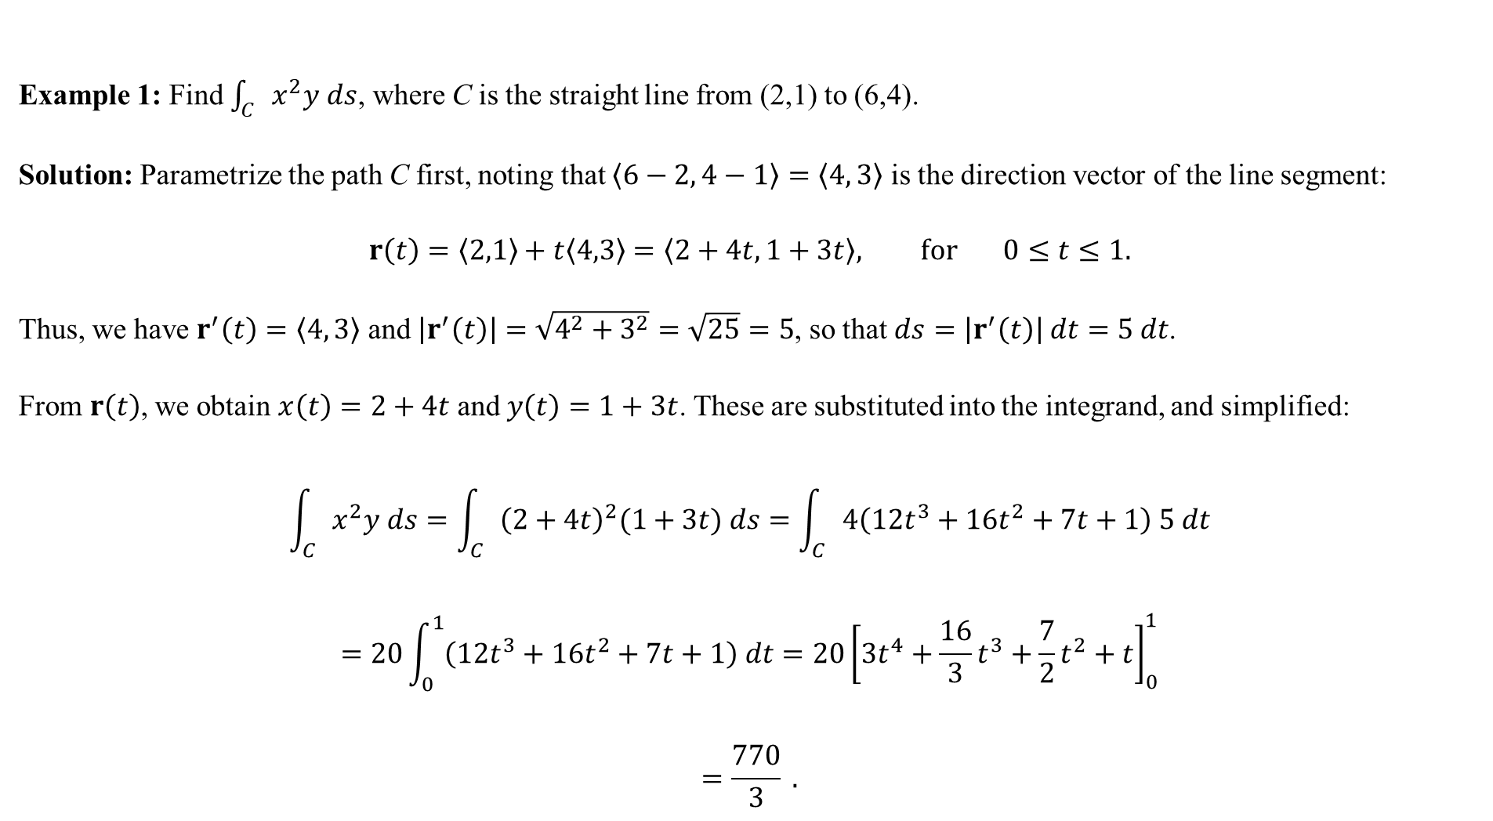
Example 1: Find $\int_{C}{x^{2}y ds}$, where C is the straight line from (2,1) to (6,4).
Solution: Parametrize the path C first, noting that $〈6−2, 4−1〉=〈4, 3〉$ is the direction vector of the line segment:
$$r\left(t\right)=〈2,1〉+t〈4,3〉=〈2+4t,1+3t〉, for 0≤t≤1.$$
Thus, we have $r^{′}\left(t\right)=〈4, 3〉$ and $\left|r^{′}\left(t\right)\right|=\sqrt{4^{2}+3^{2}}=\sqrt{25}=5$, so that $ds=\left|r^{′}\left(t\right)\right| dt=5 dt$.
From $r\left(t\right)$, we obtain $x\left(t\right)=2+4t$ and $y\left(t\right)=1+3t$. These are substituted into the integrand, and simplified:
$$\int_{C}{x^{2}y ds}=\int_{C}{{\left(2+4t\right)}^{2}(1+3t) ds}=\int_{C}{4\left(12t^{3}+16t^{2}+7t+1\right) 5 dt}$$
$$=20\int_{0}^{1}{\left(12t^{3}+16t^{2}+7t+1\right) dt}=20{\left[3t^{4}+\frac{16}{3}t^{3}+\frac{7}{2}t^{2}+t\right]}_{0}^{1}$$
$$=\frac{770}{3} .$$

Slide 5
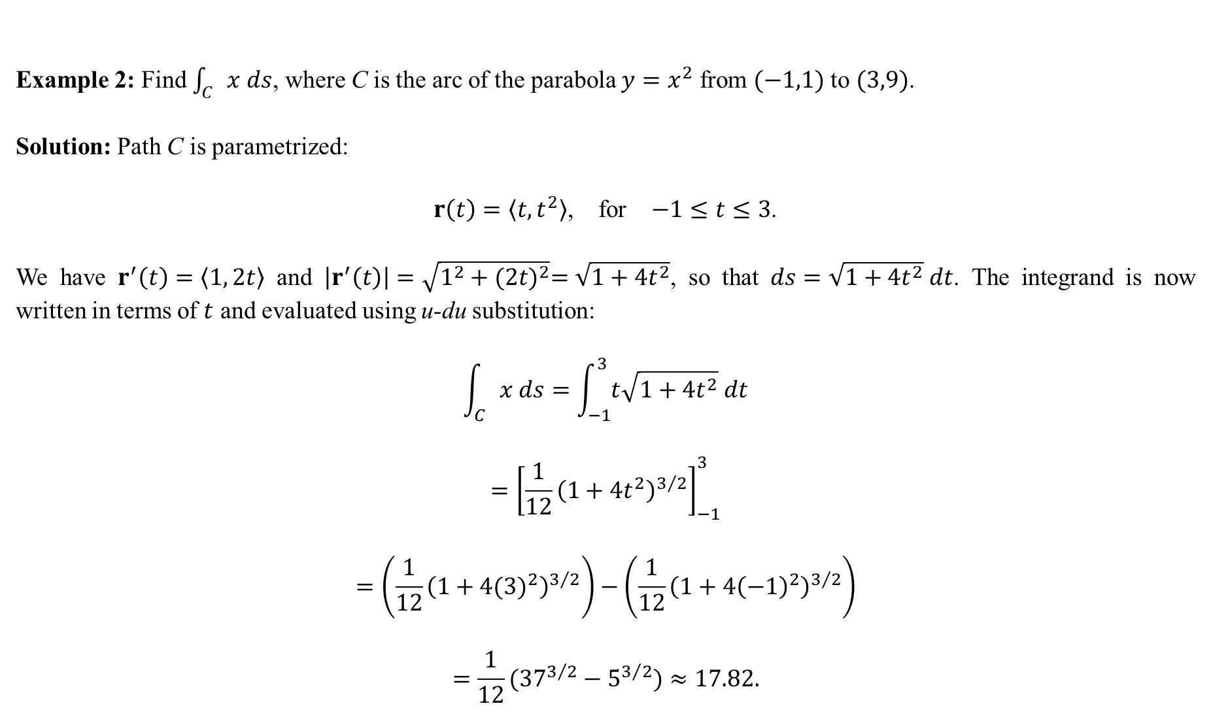
Example 2: Find $\int_{C}{x ds}$, where C is the arc of the parabola $y=x^{2}$ from $(−1,1)$ to $(3,9)$.
Solution: Path C is parametrized:
$r\left(t\right)=〈t,t^{2}〉$, for $−1≤t≤3$.
We have $r^{′}\left(t\right)=〈1, 2t〉$ and $\left|r^{′}\left(t\right)\right|=\sqrt{1^{2}+{(2t)}^{2}}=\sqrt{1+4t^{2}}$, so that $ds=\sqrt{1+4t^{2}} dt$. The integrand is now written in terms of $t$ and evaluated using u-du substitution:
$$\int_{C}{x ds}=\int_{−1}^{3}{t\sqrt{1+4t^{2}} dt}$$
$$={\left[\frac{1}{12}{\left(1+4t^{2}\right)}^{3/2}\right]}_{−1}^{3}$$
$$=\left(\frac{1}{12}{\left(1+4{(3)}^{2}\right)}^{3/2}\right)−\left(\frac{1}{12}{\left(1+4{\left(−1\right)}^{2}\right)}^{3/2}\right)$$
$$=\frac{1}{12}({37}^{3/2}−5^{3/2})≈17.82.$$

Slide 6
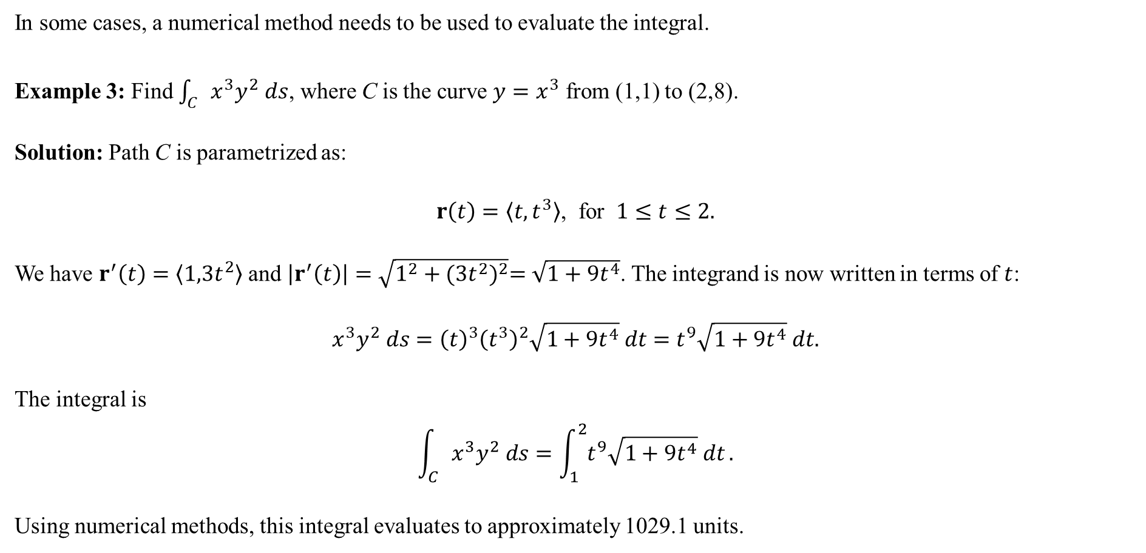
In some cases, a numerical method needs to be used to evaluate the integral.
Example 3: Find $\int_{C}{x^{3}y^{2} ds}$, where C is the curve $y=x^{3}$ from (1,1) to (2,8).
Solution: Path C is parametrized as:
$r\left(t\right)=〈t,t^{3}〉$, for $1≤t≤2.$
We have $r^{′}\left(t\right)=〈1,3t^{2}〉$ and $\left|r^{′}\left(t\right)\right|=\sqrt{1^{2}+{(3t^{2})}^{2}}=\sqrt{1+9t^{4}}$. The integrand is now written in terms of $t$:
$$x^{3}y^{2} ds={\left(t\right)}^{3}{\left(t^{3}\right)}^{2}\sqrt{1+9t^{4}} dt=t^{9}\sqrt{1+9t^{4}} dt.$$
The integral is
$$\int_{C}{x^{3}y^{2} ds}=\int_{1}^{2}{t^{9}\sqrt{1+9t^{4}} dt}.$$
Using numerical methods, this integral evaluates to approximately 1029.1 units.

Slide 7
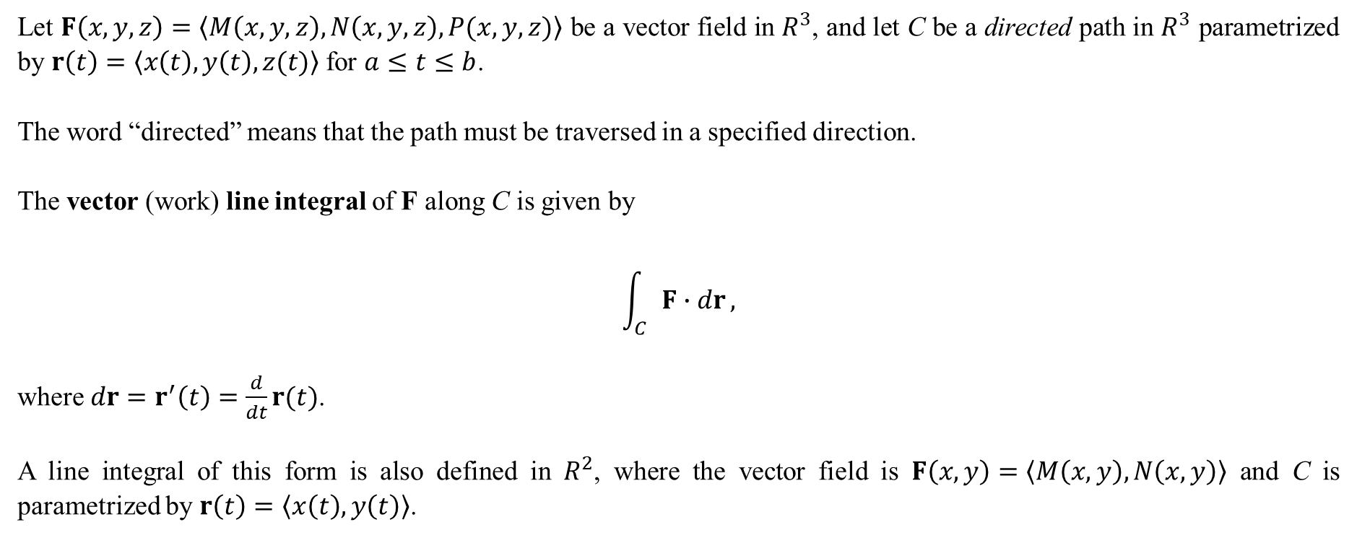
Let $F\left(x,y,z\right)=〈M\left(x,y,z\right),N\left(x,y,z\right),P(x,y,z)〉$ be a vector field in $R^{3}$, and let C be a directed path in $R^{3}$ parametrized by $r\left(t\right)=〈x\left(t\right),y\left(t\right),z(t)〉$ for $a≤t≤b$.
The word “directed” means that the path must be traversed in a specified direction.
The vector (work) line integral of F along C is given by
$$\int_{C}{F∙dr},$$
where $dr=r^{′}\left(t\right)=\frac{d}{dt}r(t)$.
A line integral of this form is also defined in $R^{2}$, where the vector field is $F\left(x,y\right)=〈M\left(x,y\right),N\left(x,y\right)〉$ and C is parametrized by $r\left(t\right)=〈x\left(t\right),y\left(t\right)〉$.

Slide 8
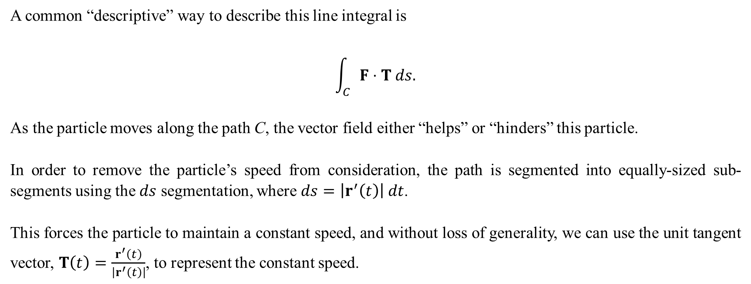
A common “descriptive” way to describe this line integral is
$$\int_{C}{F⋅T ds.}$$
As the particle moves along the path C, the vector field either “helps” or “hinders” this particle.
In order to remove the particle’s speed from consideration, the path is segmented into equally-sized sub-segments using the $ds$ segmentation, where $ds=\left|r^{′}\left(t\right)\right| dt$.
This forces the particle to maintain a constant speed, and without loss of generality, we can use the unit tangent vector, $T\left(t\right)=\frac{r^{′}\left(t\right)}{\left|r^{′}\left(t\right)\right|}$, to represent the constant speed.

Slide 9
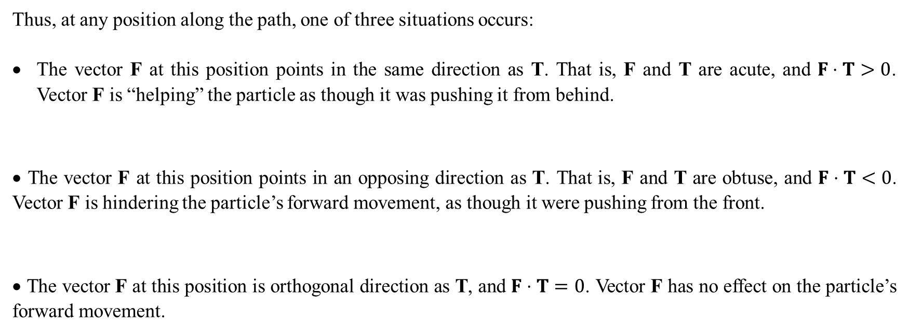
Thus, at any position along the path, one of three situations occurs:
The vector F at this position points in the same direction as T. That is, F and T are acute, and $F⋅T>0$. Vector F is “helping” the particle as though it was pushing it from behind.
• The vector F at this position points in an opposing direction as T. That is, F and T are obtuse, and $F⋅T<0$. Vector F is hindering the particle’s forward movement, as though it were pushing from the front.
• The vector F at this position is orthogonal direction as T, and $F⋅T=0$. Vector F has no effect on the particle’s forward movement.

Slide 10
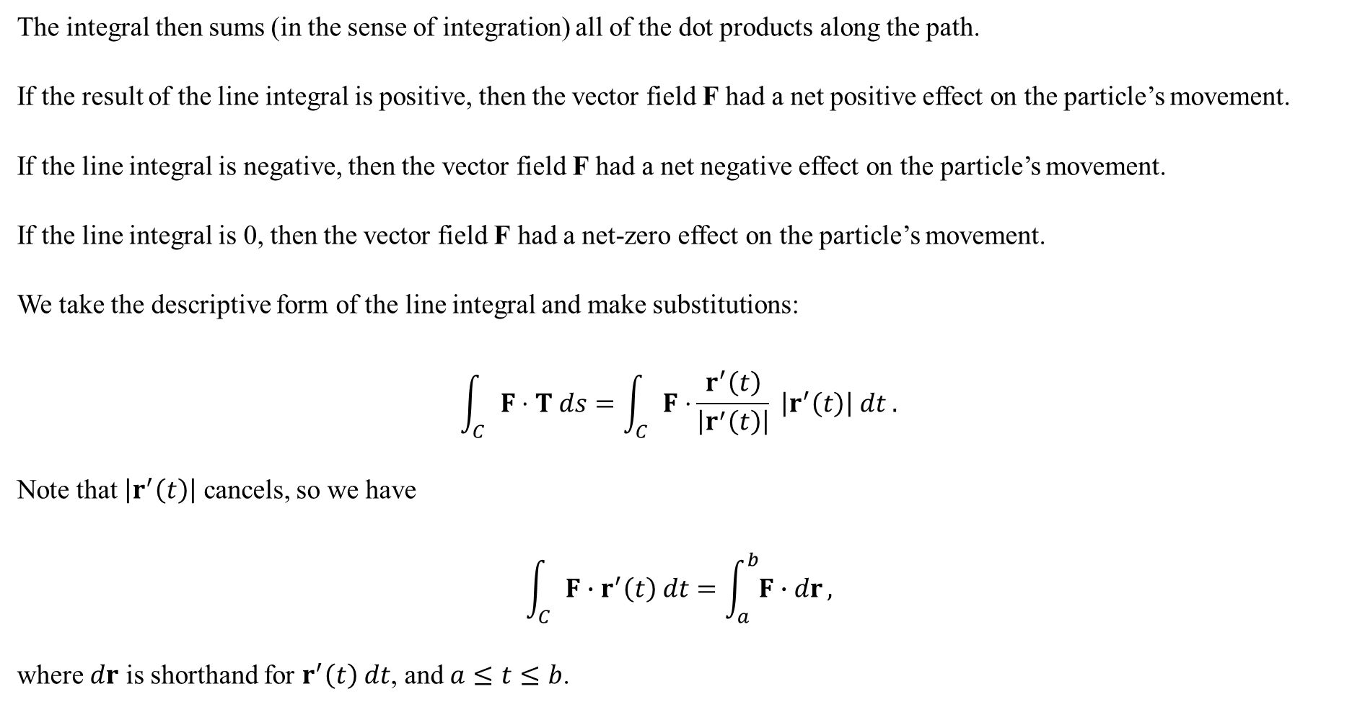
The integral then sums (in the sense of integration) all of the dot products along the path.
If the result of the line integral is positive, then the vector field F had a net positive effect on the particle’s movement.
If the line integral is negative, then the vector field F had a net negative effect on the particle’s movement.
If the line integral is 0, then the vector field F had a net-zero effect on the particle’s movement.
We take the descriptive form of the line integral and make substitutions:
$$\int_{C}{F⋅T ds}=\int_{C}{F⋅}\frac{r^{′}\left(t\right)}{\left|r^{′}\left(t\right)\right|} \left|r^{′}\left(t\right)\right| dt .$$
Note that $\left|r^{′}\left(t\right)\right|$ cancels, so we have
$$\int_{C}{F∙r^{′}\left(t\right) dt}=\int_{a}^{b}{F∙dr},$$
where $dr$ is shorthand for $r^{′}\left(t\right) dt$, and $a≤t≤b$.

Slide 11
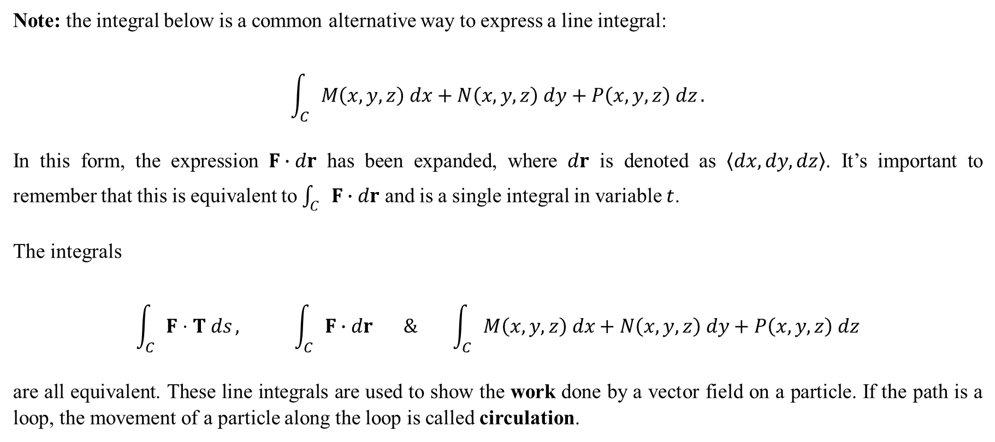
Note: the integral below is a common alternative way to express a line integral:
$$\int_{C}{M\left(x,y,z\right) dx+N\left(x,y,z\right) dy+P\left(x,y,z\right) dz}.$$
In this form, the expression $F∙dr$ has been expanded, where $dr$ is denoted as $〈dx,dy,dz〉$. It’s important to remember that this is equivalent to $\int_{C}{F∙dr}$ and is a single integral in variable $t$.
The integrals
$$\int_{C}{F⋅T ds}, \int_{C}{F∙dr} \& \int_{C}{M\left(x,y,z\right) dx+N\left(x,y,z\right) dy+P\left(x,y,z\right) dz}$$
are all equivalent. These line integrals are used to show the work done by a vector field on a particle. If the path is a loop, the movement of a particle along the loop is called circulation.

Slide 12
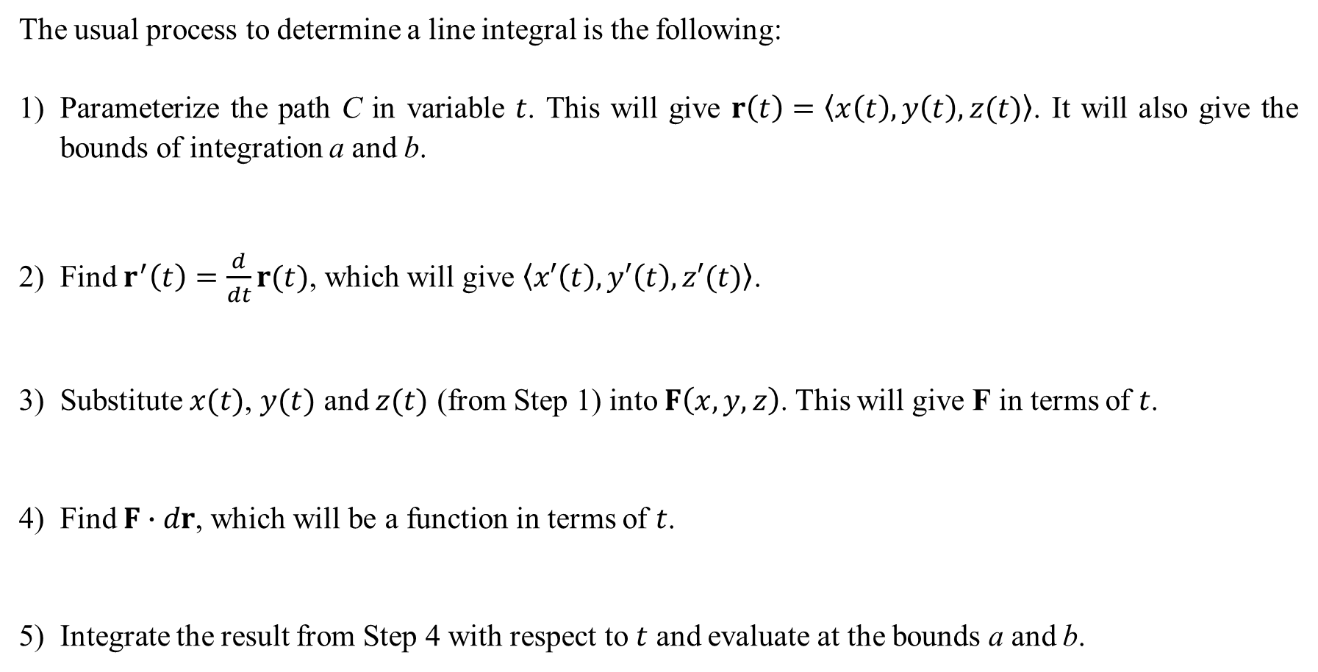
The usual process to determine a line integral is the following:
Parameterize the path C in variable $t$. This will give $r\left(t\right)=〈x\left(t\right),y\left(t\right),z(t)〉$. It will also give the bounds of integration a and b.
2) Find $r^{′}\left(t\right)=\frac{d}{dt}r(t)$, which will give $〈x′\left(t\right),y′\left(t\right),z′(t)〉$.
3) Substitute $x(t)$, $y(t)$ and $z(t)$ (from Step 1) into $F\left(x,y,z\right)$. This will give F in terms of $t$.
4) Find $F∙dr$, which will be a function in terms of $t$.
5) Integrate the result from Step 4 with respect to $t$ and evaluate at the bounds a and b.

Slide 13
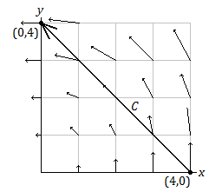
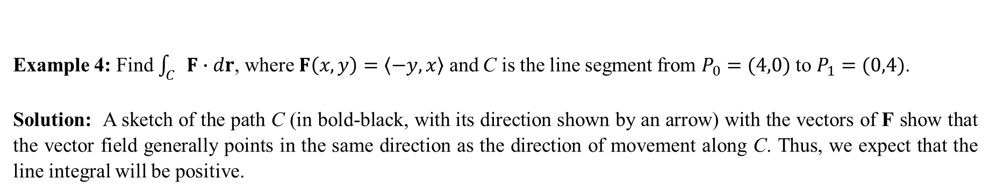
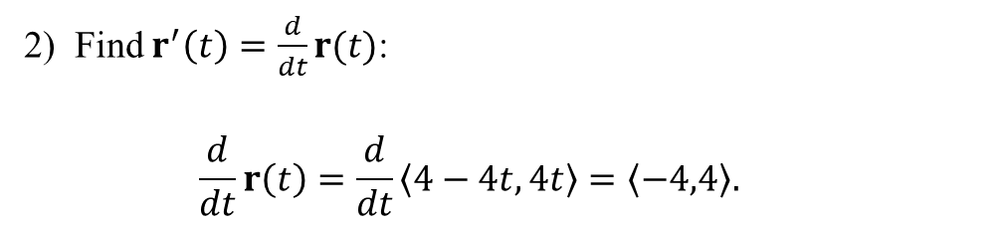
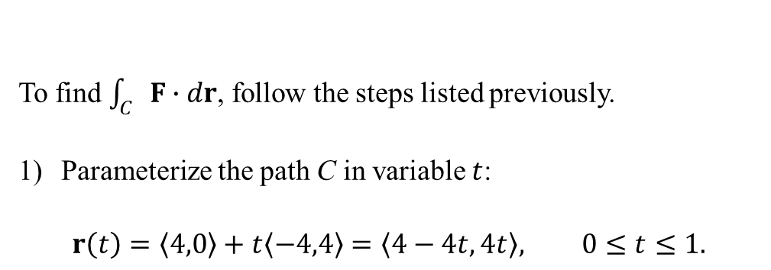
Example 4: Find $\int_{C}{F∙dr}$, where $F\left(x,y\right)=〈−y,x〉$ and C is the line segment from $P_{0}=(4,0)$ to $P_{1}=(0,4)$.
Solution: A sketch of the path C (in bold-black, with its direction shown by an arrow) with the vectors of F show that the vector field generally points in the same direction as the direction of movement along C. Thus, we expect that the line integral will be positive.
To find $\int_{C}{F∙dr}$, follow the steps listed previously.
Parameterize the path C in variable $t$:
$$r\left(t\right)=〈4,0〉+t〈−4,4〉=〈4−4t, 4t〉, 0≤t≤1.$$
2) Find $r^{′}\left(t\right)=\frac{d}{dt}r(t)$:
$$\frac{d}{dt}r\left(t\right)=\frac{d}{dt}〈4−4t, 4t〉=〈−4,4〉.$$

Slide 14
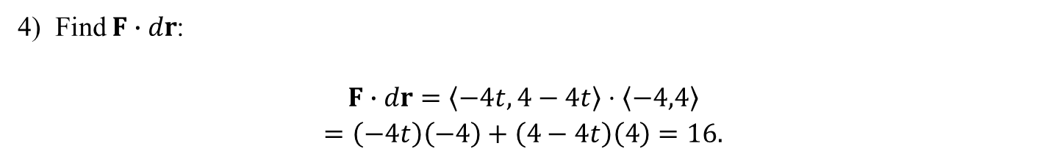
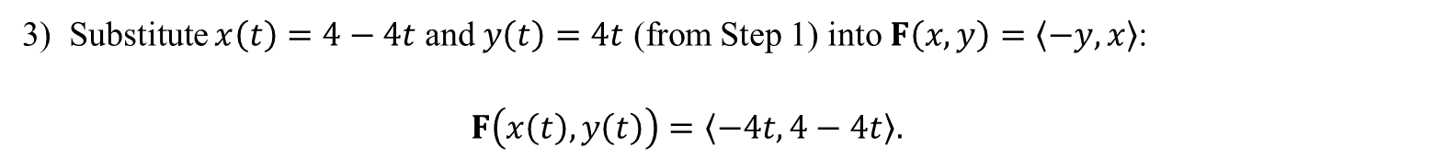
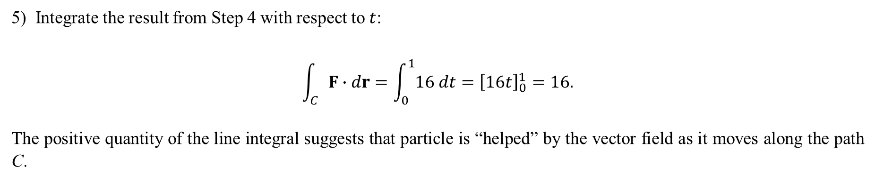
3) Substitute $x\left(t\right)=4−4t$ and $y\left(t\right)=4t$ (from Step 1) into $F\left(x,y\right)=\left\langle −y,x\right\rangle$:
$$F\left(x\left(t\right),y\left(t\right)\right)=〈−4t,4−4t〉.$$
4) Find $F∙dr$:
$$F∙dr=〈−4t,4−4t〉⋅〈−4,4〉$$
$$=\left(−4t\right)\left(−4\right)+\left(4−4t\right)\left(4\right)=16.$$
5) Integrate the result from Step 4 with respect to $t$:
$$\int_{C}{F∙dr}=\int_{0}^{1}{16 dt}={\left[16t\right]}_{0}^{1}=16.$$
The positive quantity of the line integral suggests that particle is “helped” by the vector field as it moves along the path C.

Slide 15
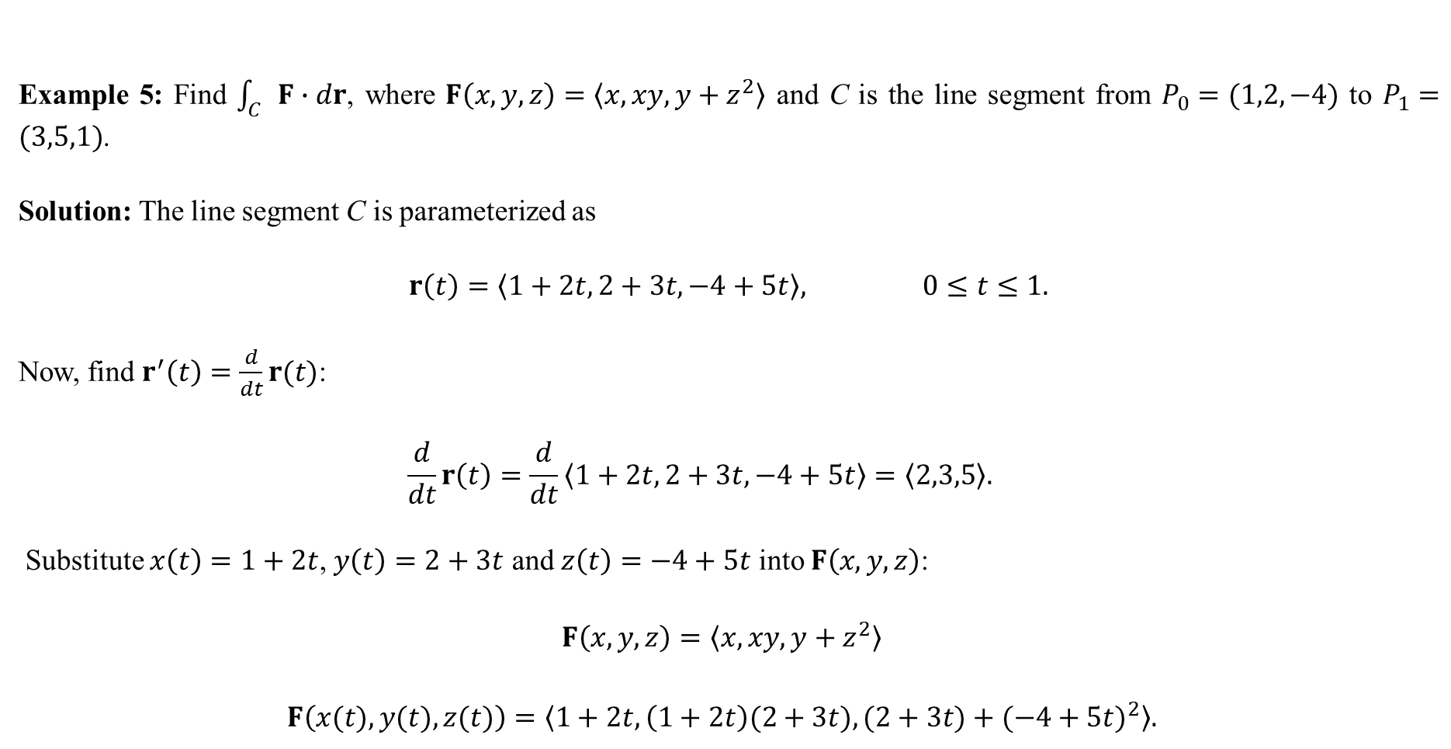
Example 5: Find $\int_{C}{F∙dr}$, where $F\left(x,y,z\right)=〈x,xy,y+z^{2}〉$ and C is the line segment from $P_{0}=(1,2,−4)$ to $P_{1}=(3,5,1)$.
Solution: The line segment C is parameterized as
$$r\left(t\right)=〈1+2t,2+3t,−4+5t〉, 0≤t≤1.$$
Now, find $r^{′}\left(t\right)=\frac{d}{dt}r(t)$:
$$\frac{d}{dt}r\left(t\right)=\frac{d}{dt}〈1+2t,2+3t,−4+5t〉=〈2,3,5〉.$$
Substitute $x\left(t\right)=1+2t$, $y\left(t\right)=2+3t$ and $z\left(t\right)=−4+5t$ into $F\left(x,y,z\right)$:
$$F\left(x,y,z\right)=〈x,xy,y+z^{2}〉$$
$$F\left(x(t),y(t),z(t)\right)=〈1+2t,\left(1+2t\right)(2+3t),(2+3t)+{(−4+5t)}^{2}〉.$$

Slide 16
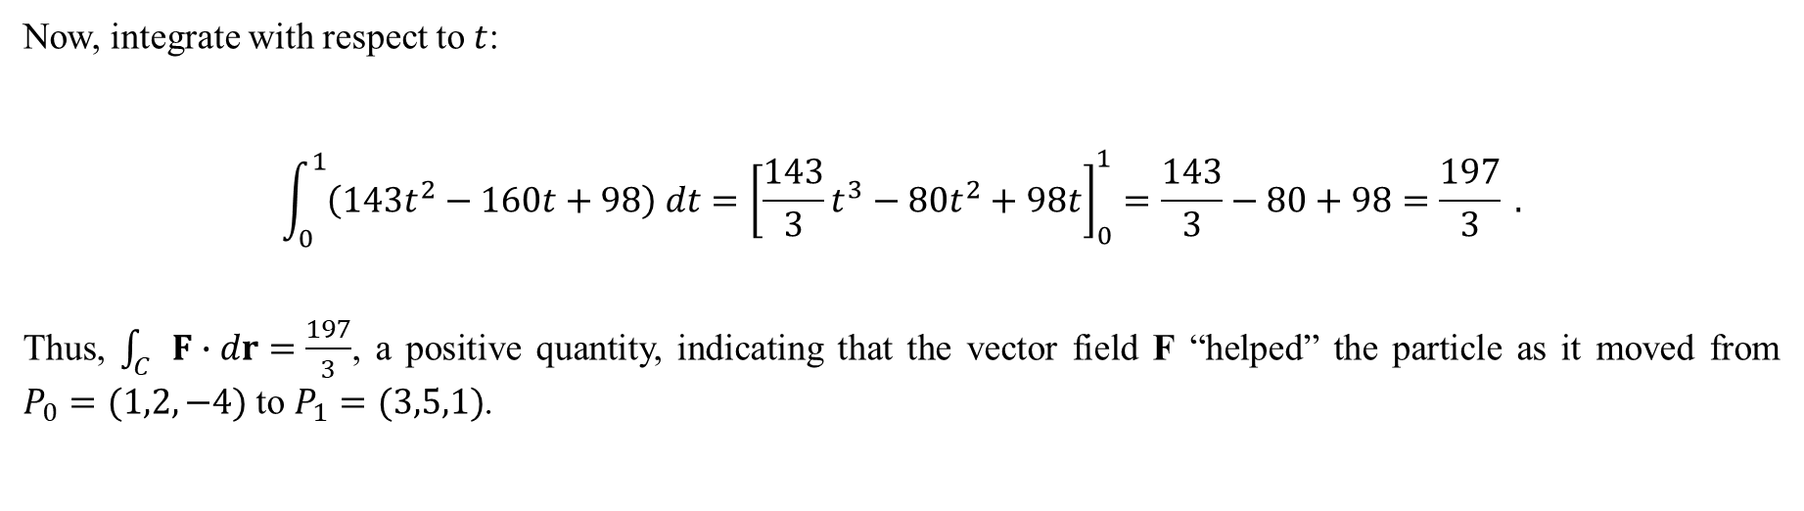
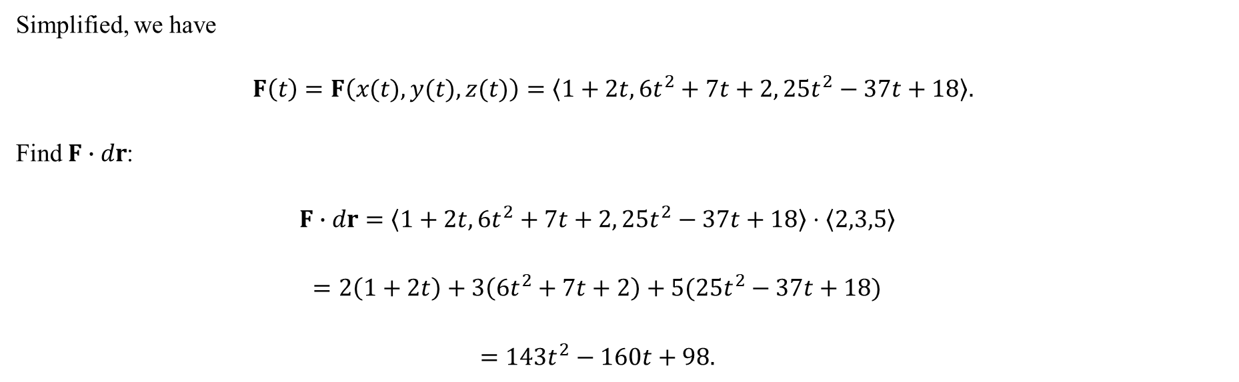
Simplified, we have
$$F\left(t\right)=F\left(x(t),y(t),z(t)\right)=〈1+2t, 6t^{2}+7t+2, 25t^{2}−37t+18〉.$$
Find $F∙dr$:
$$F∙dr=〈1+2t, 6t^{2}+7t+2, 25t^{2}−37t+18〉⋅〈2,3,5〉$$
$$=2\left(1+2t\right)+3\left(6t^{2}+7t+2\right)+5(25t^{2}−37t+18)$$
$$=143t^{2}−160t+98.$$
Now, integrate with respect to $t$:
$$\int_{0}^{1}{\left(143t^{2}−160t+98\right) dt}={\left[\frac{143}{3}t^{3}−80t^{2}+98t\right]}_{0}^{1}=\frac{143}{3}−80+98=\frac{197}{3} .$$
Thus, $\int_{C}{F∙dr}=\frac{197}{3}$, a positive quantity, indicating that the vector field F “helped” the particle as it moved from $P_{0}=(1,2,−4)$ to $P_{1}=(3,5,1)$.

Slide 17
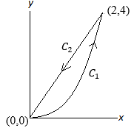
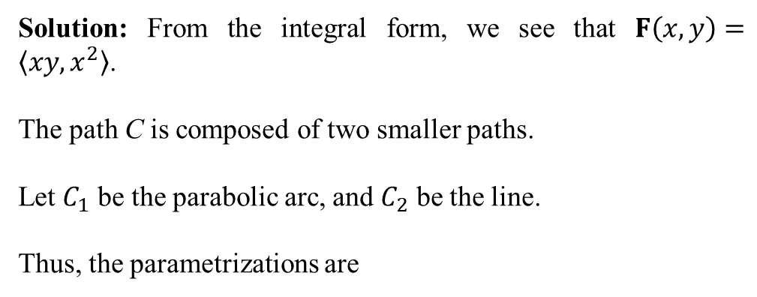
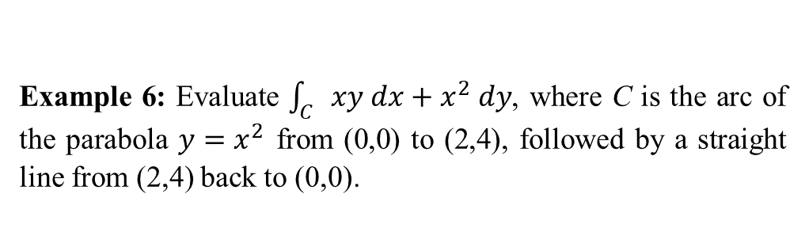


Example 6: Evaluate $\int_{C}{xy dx+x^{2} dy}$, where C is the arc of the parabola $y=x^{2}$ from (0,0) to (2,4), followed by a straight line from (2,4) back to (0,0).
Solution: From the integral form, we see that $F\left(x,y\right)=〈xy,x^{2}〉$.
The path C is composed of two smaller paths.
Let $C_{1}$ be the parabolic arc, and $C_{2}$ be the line.
Thus, the parametrizations are
In such cases, the entire path C is the union of its sub-paths, so that
$$C_{1}: r_{1}\left(t\right)=〈t,t^{2}〉, 0≤t≤2,$$
$$C_{2}: r_{2}\left(t\right)=〈2−2t,4−4t〉, 0≤t≤1.$$
$$\int_{C}{F∙dr}=\int_{C_{1}∪C_{2}}{F∙dr}$$
$$=\int_{C_{1}}{F∙dr_{1}}+\int_{C_{2}}{F∙dr_{2}} .$$

Slide 18
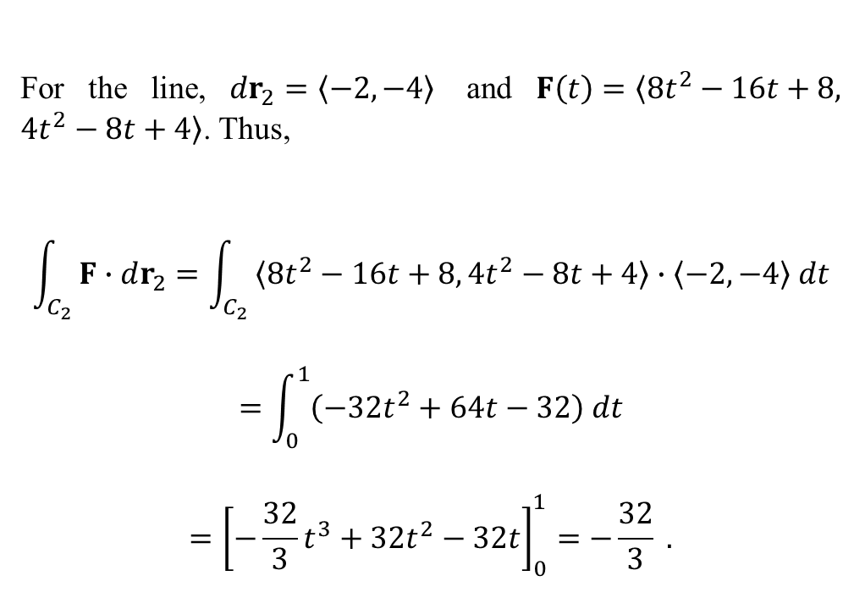
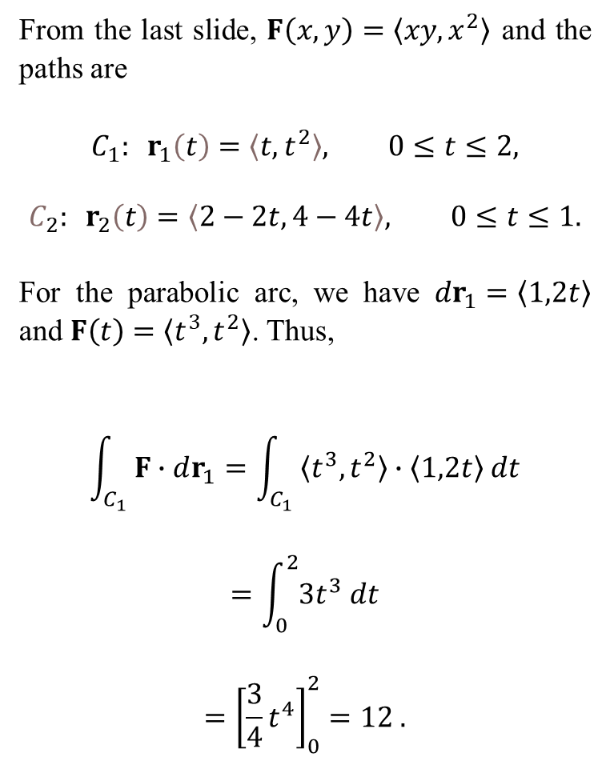
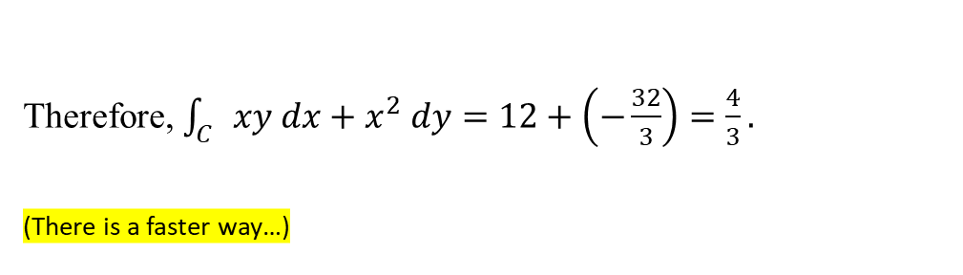
From the last slide, $F\left(x,y\right)=〈xy,x^{2}〉$ and the paths are
$$C_{1}: r_{1}\left(t\right)=〈t,t^{2}〉, 0≤t≤2,$$
$$C_{2}: r_{2}\left(t\right)=〈2−2t,4−4t〉, 0≤t≤1.$$
For the parabolic arc, we have $dr_{1}=〈1,2t〉$ and $F\left(t\right)=〈t^{3},t^{2}〉$. Thus,
$$\int_{C_{1}}{F∙dr_{1}}=\int_{C_{1}}{〈t^{3},t^{2}〉∙〈1,2t〉 dt}$$
$$=\int_{0}^{2}{3t^{3} dt}$$
$$={\left[\frac{3}{4}t^{4}\right]}_{0}^{2}=12 .$$
For the line, $dr_{2}=〈−2,−4〉$ and $F\left(t\right)=〈8t^{2}−16t+8, 4t^{2}−8t+4〉$. Thus,
$$\int_{C_{2}}{F∙dr_{2}}=\int_{C_{2}}{〈8t^{2}−16t+8, 4t^{2}−8t+4〉∙〈−2,−4〉 dt}$$
$$=\int_{0}^{1}{\left(−32t^{2}+64t−32\right) dt}$$
$$={\left[−\frac{32}{3}t^{3}+32t^{2}−32t\right]}_{0}^{1}=−\frac{32}{3} .$$
Therefore, $\int_{C}{xy dx+x^{2} dy}=12+\left(−\frac{32}{3}\right)=\frac{4}{3}.$
(There is a faster way…)

