Slide 1
Integration over General Regions
Scott Surgent

Slide 2
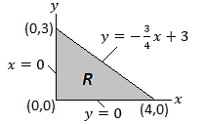
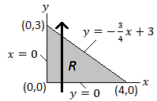
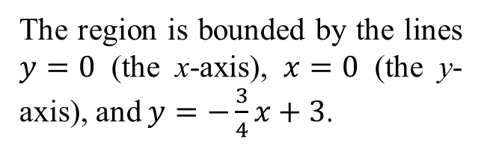
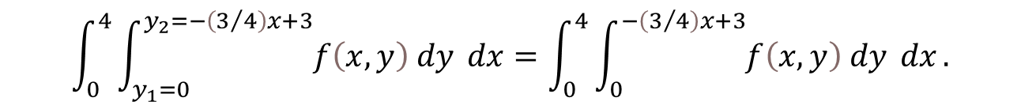
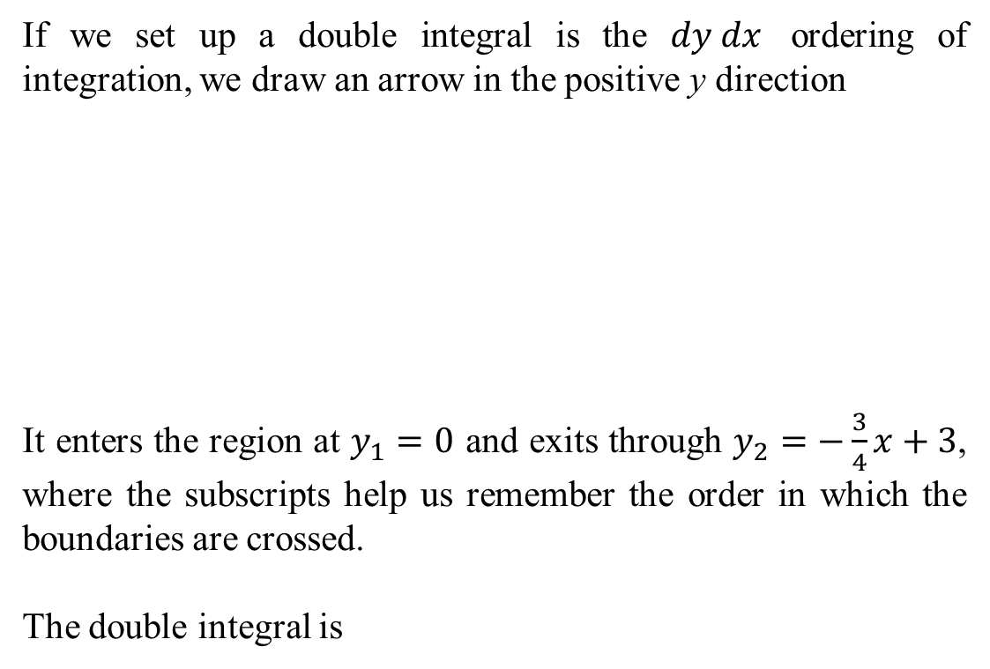
Consider the region $R$ shown below.
If we set up a double integral is the $dy dx$ ordering of integration, we draw an arrow in the positive y direction
It enters the region at $y_{1}=0$ and exits through $y_{2}=−\frac{3}{4}x+3$, where the subscripts help us remember the order in which the boundaries are crossed.
The double integral is
The region is bounded by the lines $y=0$ (the x-axis), $x=0$ (the y-axis), and $y=−\frac{3}{4}x+3$.
$$\int_{0}^{4}{\int_{y_{1}=0}^{y_{2}=−\left(3/4\right)x+3}{f\left(x,y\right) dy} dx}=\int_{0}^{4}{\int_{0}^{−\left(3/4\right)x+3}{f\left(x,y\right) dy} dx}.$$

Slide 3
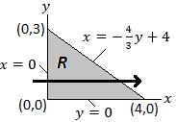
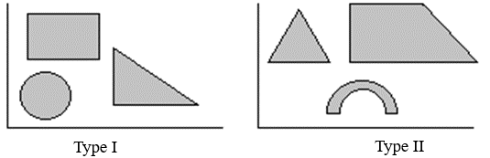
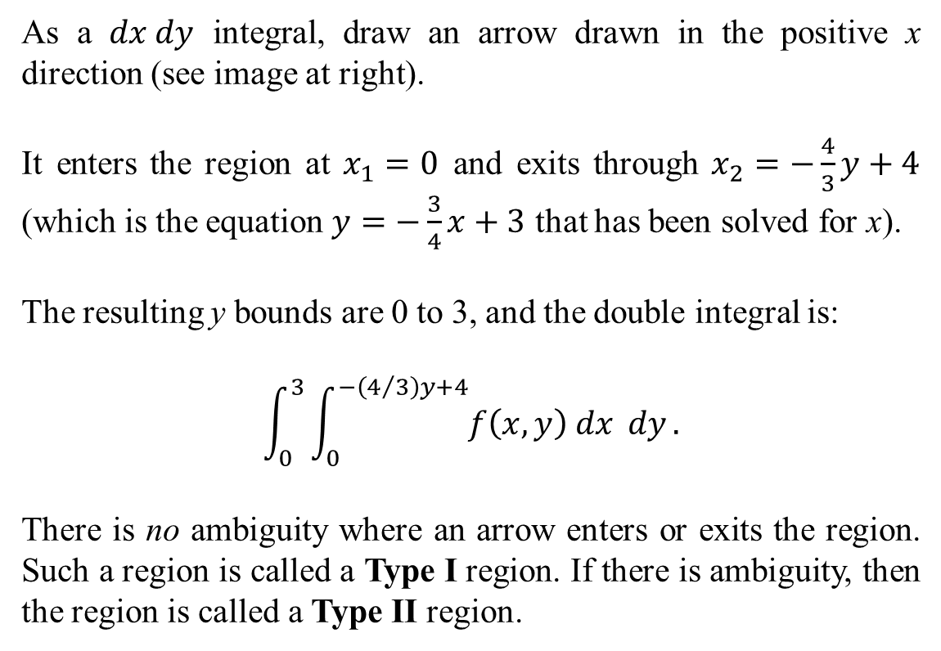
As a $dx dy$ integral, draw an arrow drawn in the positive x direction (see image at right).
It enters the region at $x_{1}=0$ and exits through $x_{2}=−\frac{4}{3}y+4$ (which is the equation $y=−\frac{3}{4}x+3$ that has been solved for x).
The resulting y bounds are 0 to 3, and the double integral is:
$$\int_{0}^{3}{\int_{0}^{−\left(4/3\right)y+4}{f\left(x,y\right) dx} dy}.$$
There is no ambiguity where an arrow enters or exits the region. Such a region is called a Type I region. If there is ambiguity, then the region is called a Type II region.

Slide 4
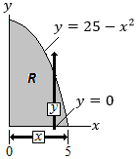
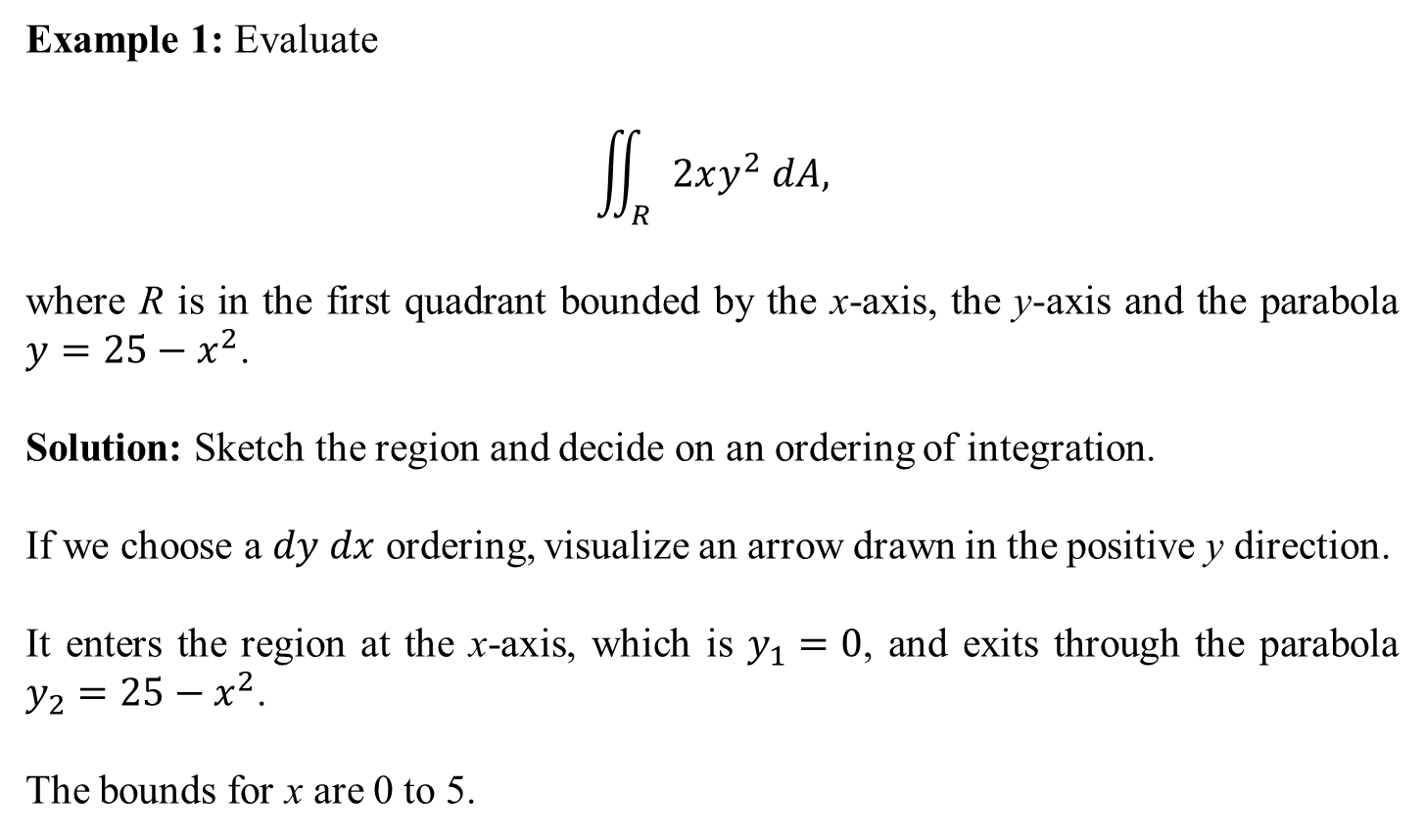
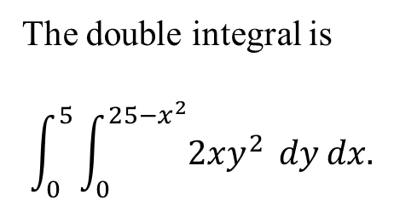
Example 1: Evaluate
$$\iint_{R}{2xy^{2} dA,}$$
where R is in the first quadrant bounded by the x-axis, the y-axis and the parabola $y=25−x^{2}$.
Solution: Sketch the region and decide on an ordering of integration.
If we choose a $dy dx$ ordering, visualize an arrow drawn in the positive y direction.
It enters the region at the x-axis, which is $y_{1}=0$, and exits through the parabola $y_{2}=25−x^{2}$.
The bounds for x are 0 to 5.
The double integral is
$$\int_{0}^{5}{\int_{0}^{25−x^{2}}{2xy^{2}} dy}dx.$$

Slide 5

The inside integral is determined:
$$\int_{0}^{25−x^{2}}{2xy^{2}} dy={\left[\frac{2}{3}xy^{3}\right]}_{0}^{25−x^{2}}=\frac{2}{3}x{\left(25−x^{2}\right)}^{3}.$$
This is integrated with respect to x using a u-du substitution, with $u=25−x^{2}$:
$$\int_{0}^{5}{\frac{2}{3}x{\left(25−x^{2}\right)}^{3} dx}={\left[−\frac{1}{12}{\left(25−x^{2}\right)}^{4}\right]}_{0}^{5}$$
$$=\left(−\frac{1}{12}{\left(25−{(5)}^{2}\right)}^{4}\right)−\left(−\frac{1}{12}{\left(25−{(0)}^{2}\right)}^{4}\right)$$
$$=0−\left(−\frac{1}{12}{\left(25\right)}^{4}\right)=\frac{390,625}{12} .$$

Slide 6
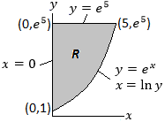
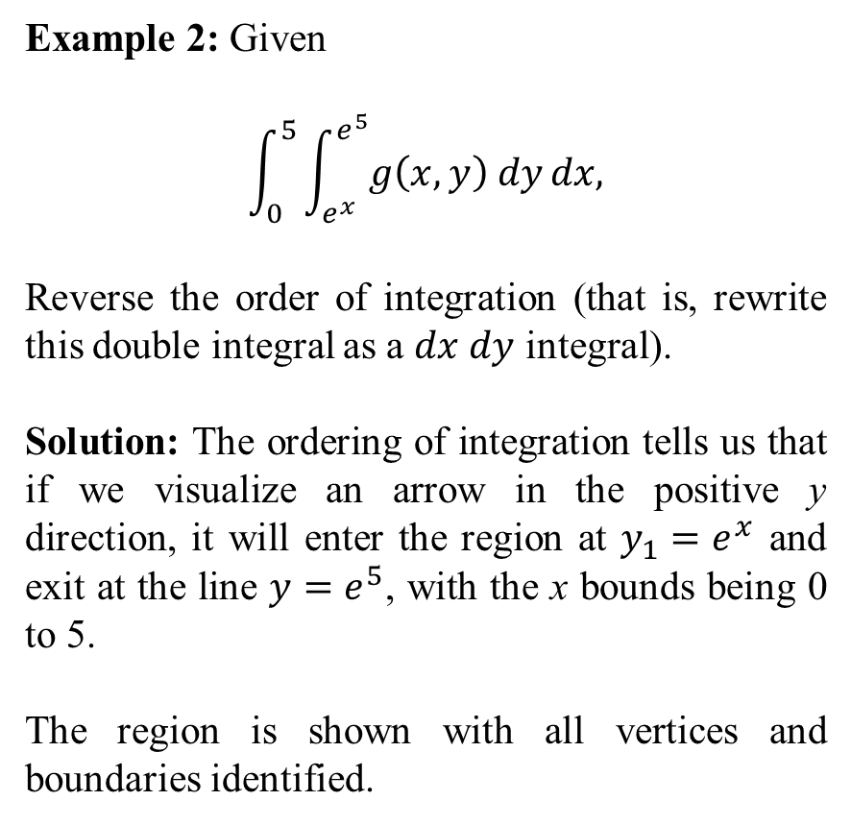
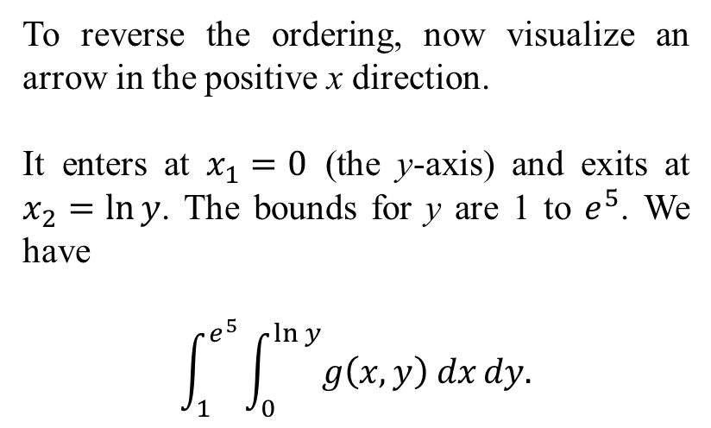
Example 2: Given
$$\int_{0}^{5}{\int_{e^{x}}^{e^{5}}{g\left(x,y\right) dy}dx,}$$
Reverse the order of integration (that is, rewrite this double integral as a $dx dy$ integral).
Solution: The ordering of integration tells us that if we visualize an arrow in the positive y direction, it will enter the region at $y_{1}=e^{x}$ and exit at the line $y=e^{5}$, with the x bounds being 0 to 5.
The region is shown with all vertices and boundaries identified.
To reverse the ordering, now visualize an arrow in the positive x direction.
It enters at $x_{1}=0$ (the y-axis) and exits at $x_{2}=\ln{y}$. The bounds for y are 1 to $e^{5}$. We have
$$\int_{1}^{e^{5}}{\int_{0}^{\ln{y}}{g\left(x,y\right) dx}dy.}$$

Slide 7
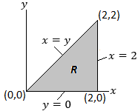
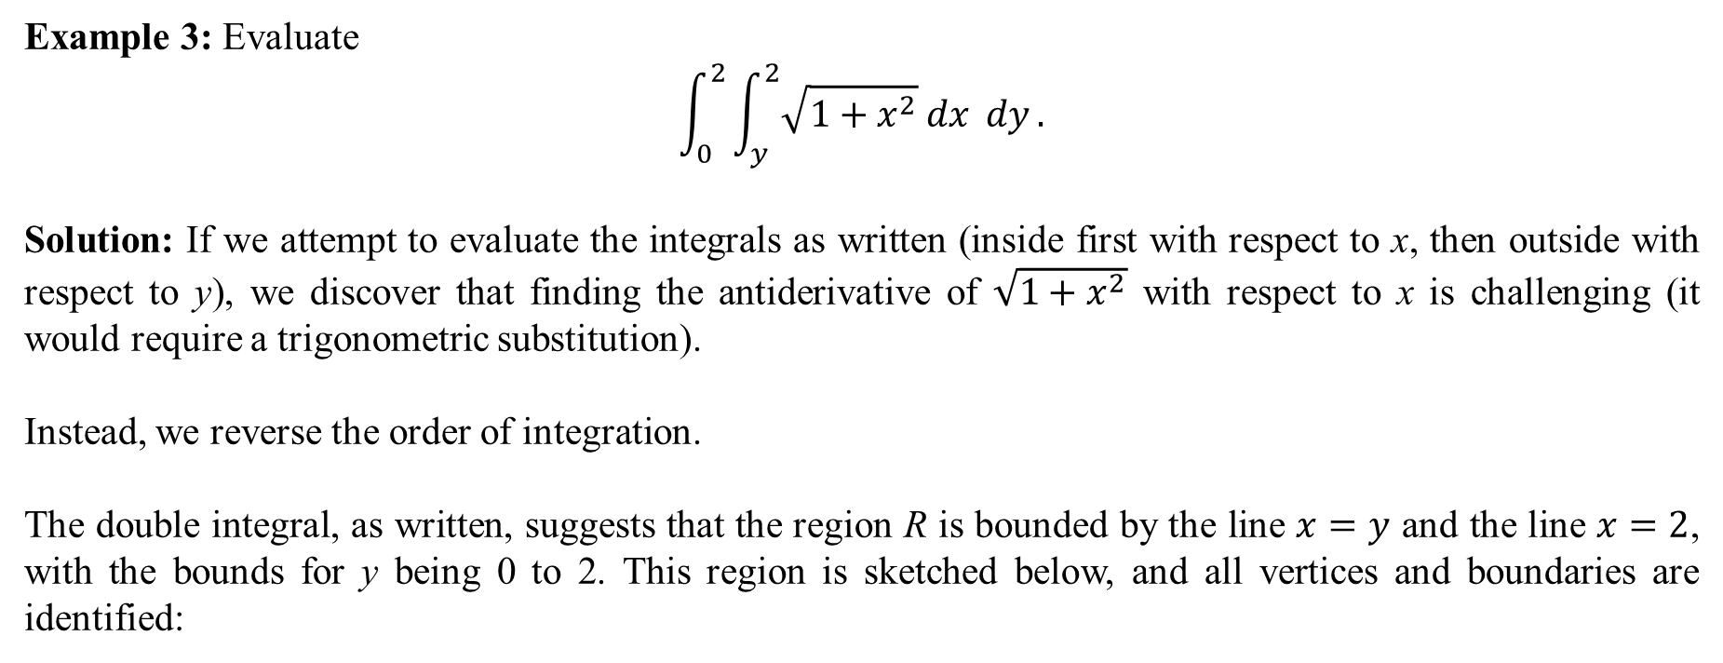
Example 3: Evaluate
$$\int_{0}^{2}{\int_{y}^{2}{\sqrt{1+x^{2}} dx} dy}.$$
Solution: If we attempt to evaluate the integrals as written (inside first with respect to x, then outside with respect to y), we discover that finding the antiderivative of $\sqrt{1+x^{2}}$ with respect to x is challenging (it would require a trigonometric substitution).
Instead, we reverse the order of integration.
The double integral, as written, suggests that the region R is bounded by the line $x=y$ and the line $x=2$, with the bounds for y being 0 to 2. This region is sketched below, and all vertices and boundaries are identified:

Slide 8
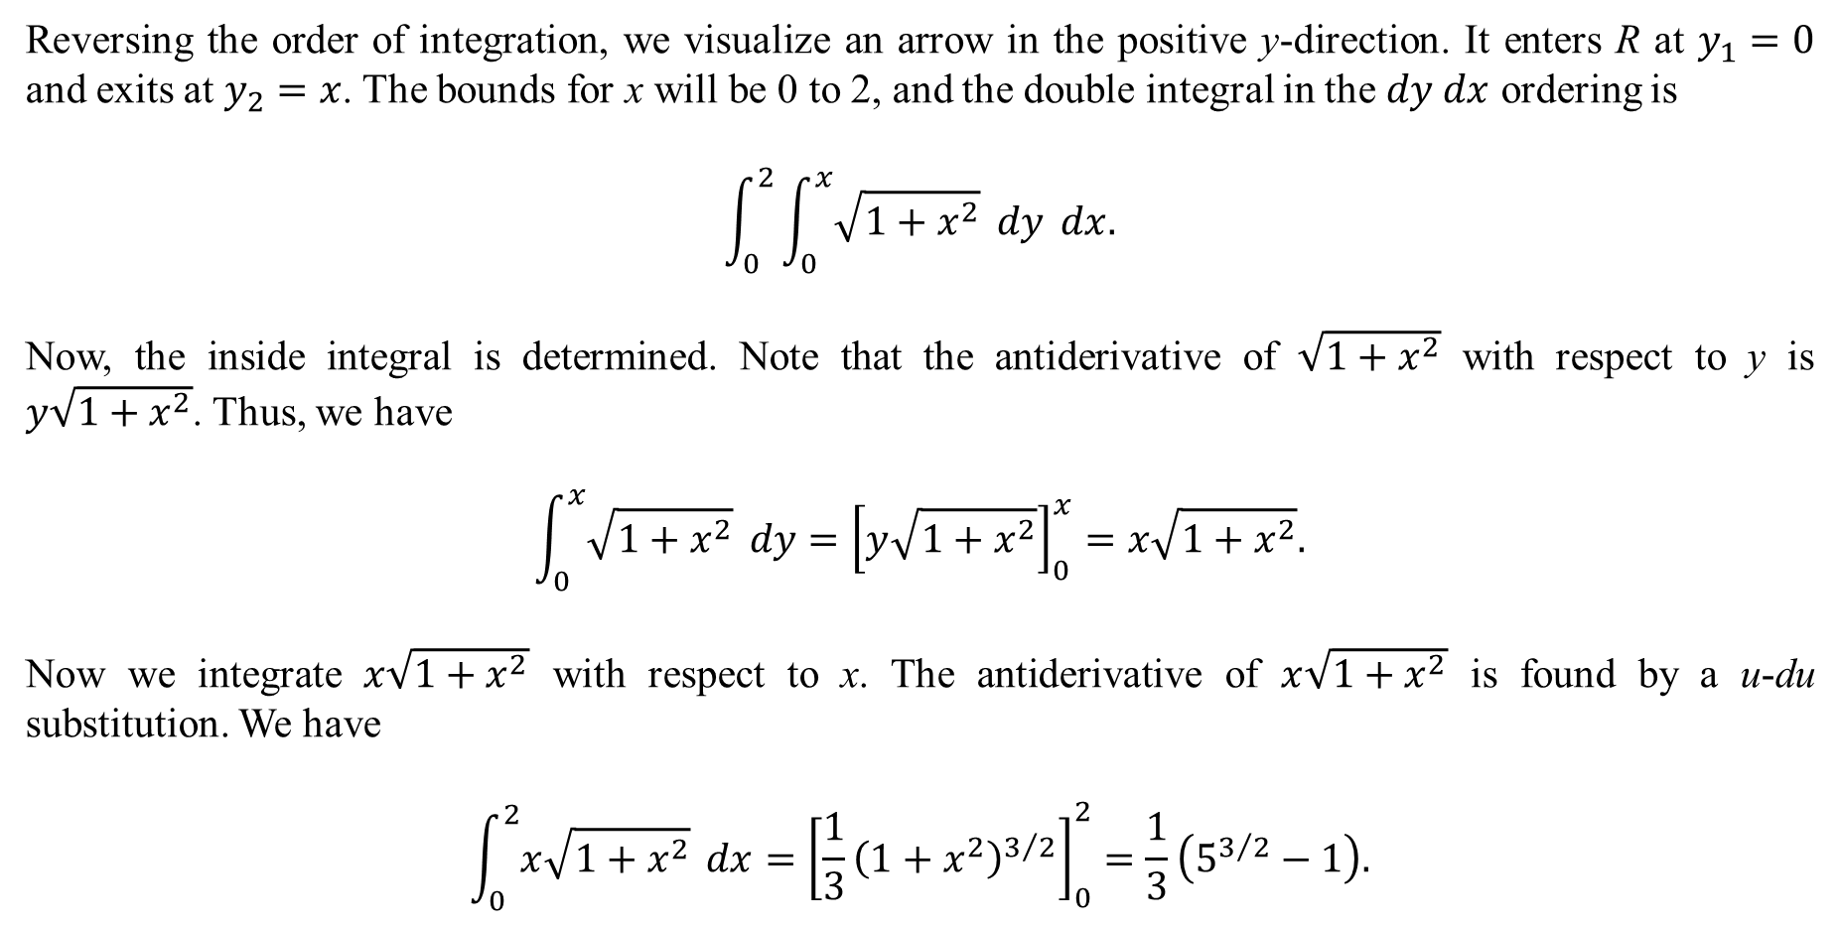
Reversing the order of integration, we visualize an arrow in the positive y-direction. It enters R at $y_{1}=0$ and exits at $y_{2}=x$. The bounds for x will be 0 to 2, and the double integral in the $dy dx$ ordering is
$$\int_{0}^{2}{\int_{0}^{x}{\sqrt{1+x^{2}}} dy} dx.$$
Now, the inside integral is determined. Note that the antiderivative of $\sqrt{1+x^{2}}$ with respect to y is $y\sqrt{1+x^{2}}$. Thus, we have
$$\int_{0}^{x}{\sqrt{1+x^{2}}} dy={\left[y\sqrt{1+x^{2}}\right]}_{0}^{x}=x\sqrt{1+x^{2}}.$$
Now we integrate $x\sqrt{1+x^{2}}$ with respect to x. The antiderivative of $x\sqrt{1+x^{2}}$ is found by a u-du substitution. We have
$$\int_{0}^{2}{x\sqrt{1+x^{2}}} dx={\left[\frac{1}{3}{\left(1+x^{2}\right)}^{3/2}\right]}_{0}^{2}=\frac{1}{3}\left(5^{3/2}−1\right).$$

