Slide 1
Green’s Theorem
Scott Surgent

Slide 2
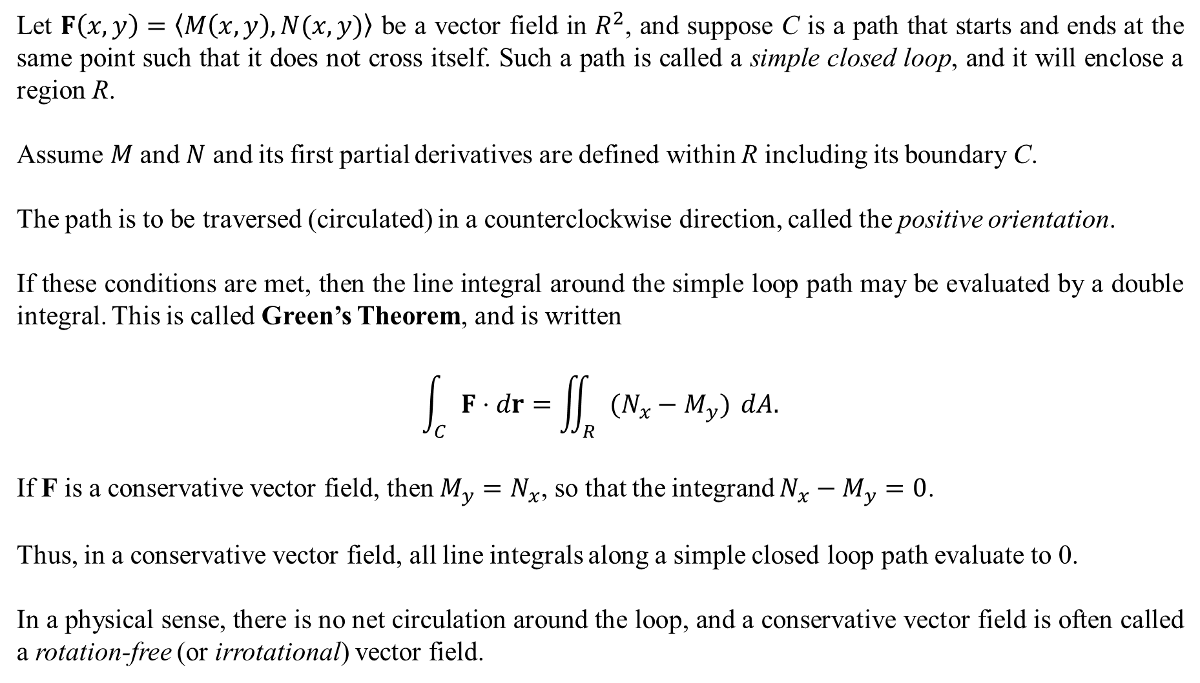
Let $F\left(x,y\right)=〈M\left(x,y\right),N(x,y)〉$ be a vector field in $R^{2}$, and suppose C is a path that starts and ends at the same point such that it does not cross itself. Such a path is called a simple closed loop, and it will enclose a region R.
Assume $M$ and $N$ and its first partial derivatives are defined within R including its boundary C.
The path is to be traversed (circulated) in a counterclockwise direction, called the positive orientation.
If these conditions are met, then the line integral around the simple loop path may be evaluated by a double integral. This is called Green’s Theorem, and is written
$$\int_{C}{F⋅dr}=\iint_{R}{(N_{x}−M_{y})} dA.$$
If F is a conservative vector field, then $M_{y}=N_{x}$, so that the integrand $N_{x}−M_{y}=0$.
Thus, in a conservative vector field, all line integrals along a simple closed loop path evaluate to 0.
In a physical sense, there is no net circulation around the loop, and a conservative vector field is often called a rotation-free (or irrotational) vector field.
This is the curl of F in R².

Slide 3
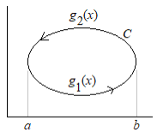
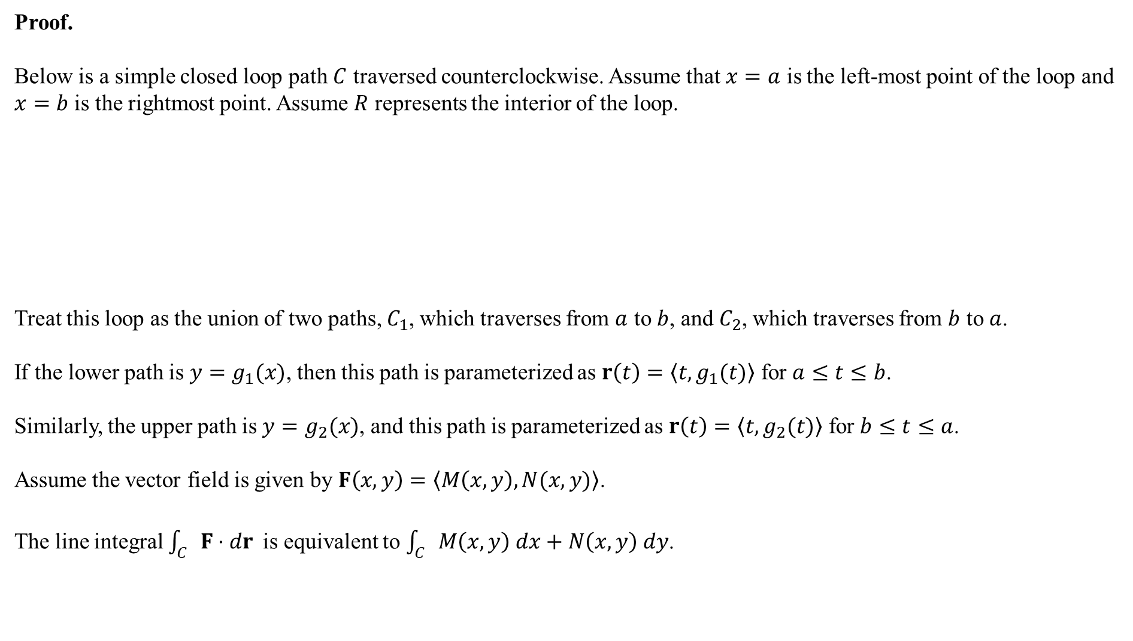

Proof.
Below is a simple closed loop path $C$ traversed counterclockwise. Assume that $x=a$ is the left-most point of the loop and $x=b$ is the rightmost point. Assume $R$ represents the interior of the loop.
Treat this loop as the union of two paths, $C_{1}$, which traverses from $a$ to $b$, and $C_{2}$, which traverses from $b$ to $a$.
If the lower path is $y=g_{1}(x)$, then this path is parameterized as $r\left(t\right)=\left\langle t,g_{1}(t)\right\rangle$ for $a≤t≤b$.
Similarly, the upper path is $y=g_{2}(x)$, and this path is parameterized as $r\left(t\right)=\left\langle t,g_{2}(t)\right\rangle$ for $b≤t≤a$.
Assume the vector field is given by $F\left(x,y\right)=\left\langle M\left(x,y\right),N(x,y)\right\rangle$.
The line integral $\int_{C}{F⋅dr }$is equivalent to $\int_{C}{M\left(x,y\right) dx+N\left(x,y\right) dy}$.
$$\left\langle M,N\right\rangle ⋅\left\langle dx,dy\right\rangle$$

Slide 4
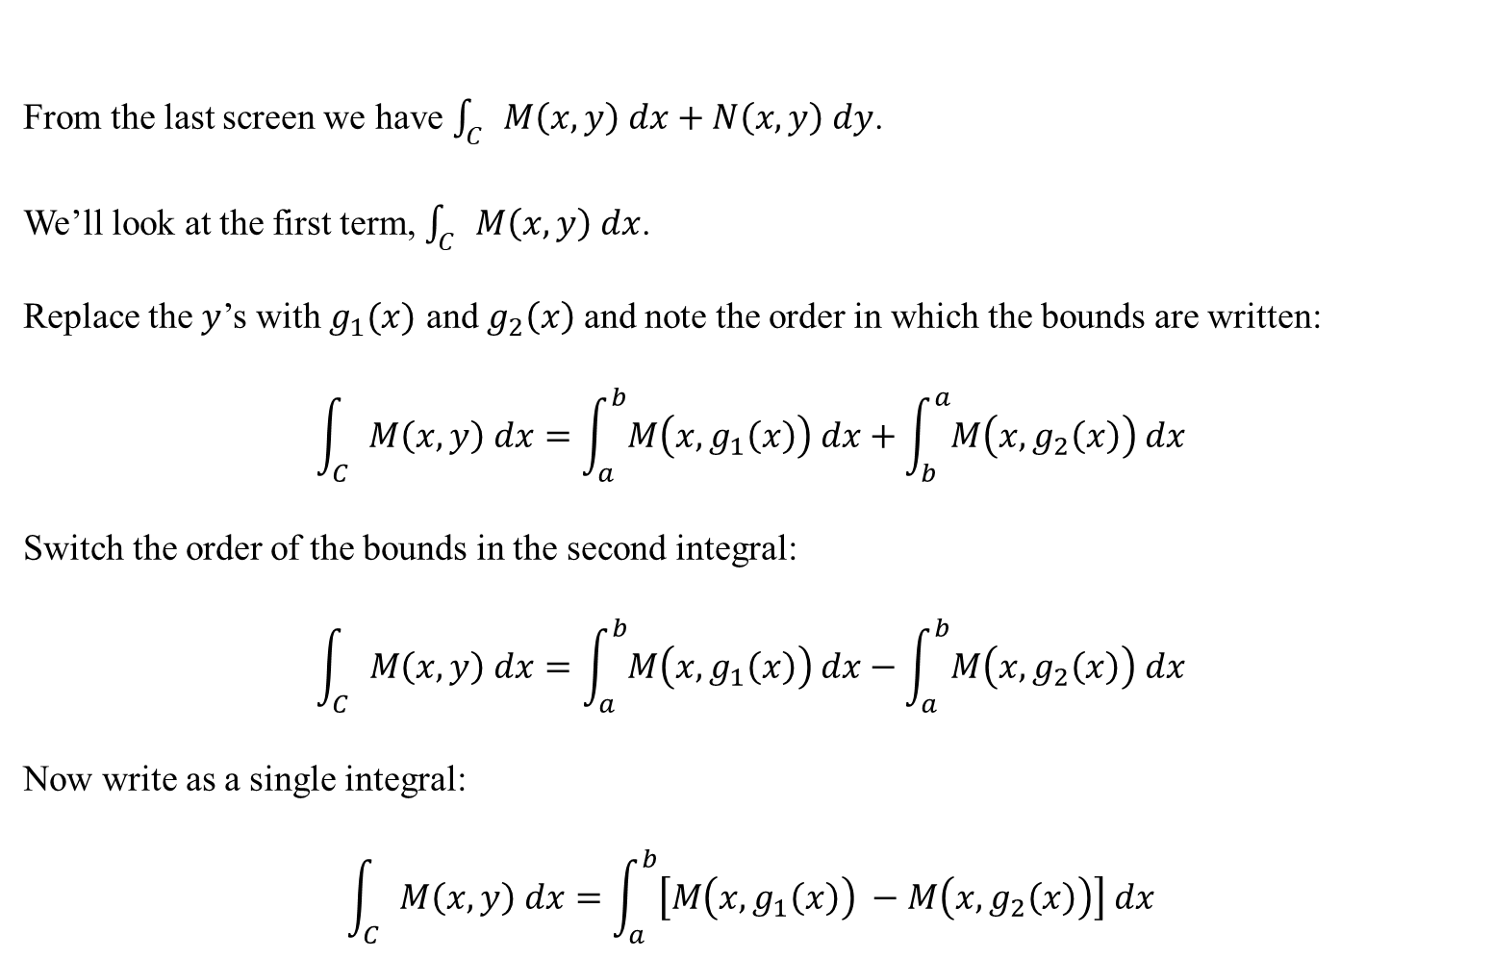
From the last screen we have $\int_{C}{M\left(x,y\right) dx+N\left(x,y\right) dy}$.
We’ll look at the first term, $\int_{C}{M\left(x,y\right) dx}$.
Replace the $y$’s with $g_{1}(x)$ and $g_{2}\left(x\right)$ and note the order in which the bounds are written:
$$\int_{C}{M\left(x,y\right) dx}=\int_{a}^{b}{M\left(x,g_{1}\left(x\right)\right) dx}+\int_{b}^{a}{M\left(x,g_{2}\left(x\right)\right) dx}$$
Switch the order of the bounds in the second integral:
$$\int_{C}{M\left(x,y\right) dx}=\int_{a}^{b}{M\left(x,g_{1}\left(x\right)\right) dx}−\int_{a}^{b}{M\left(x,g_{2}\left(x\right)\right) dx}$$
Now write as a single integral:
$$\int_{C}{M\left(x,y\right) dx}=\int_{a}^{b}{\left[M\left(x,g_{1}\left(x\right)\right) −M\left(x,g_{2}\left(x\right)\right)\right] dx}$$

Slide 5
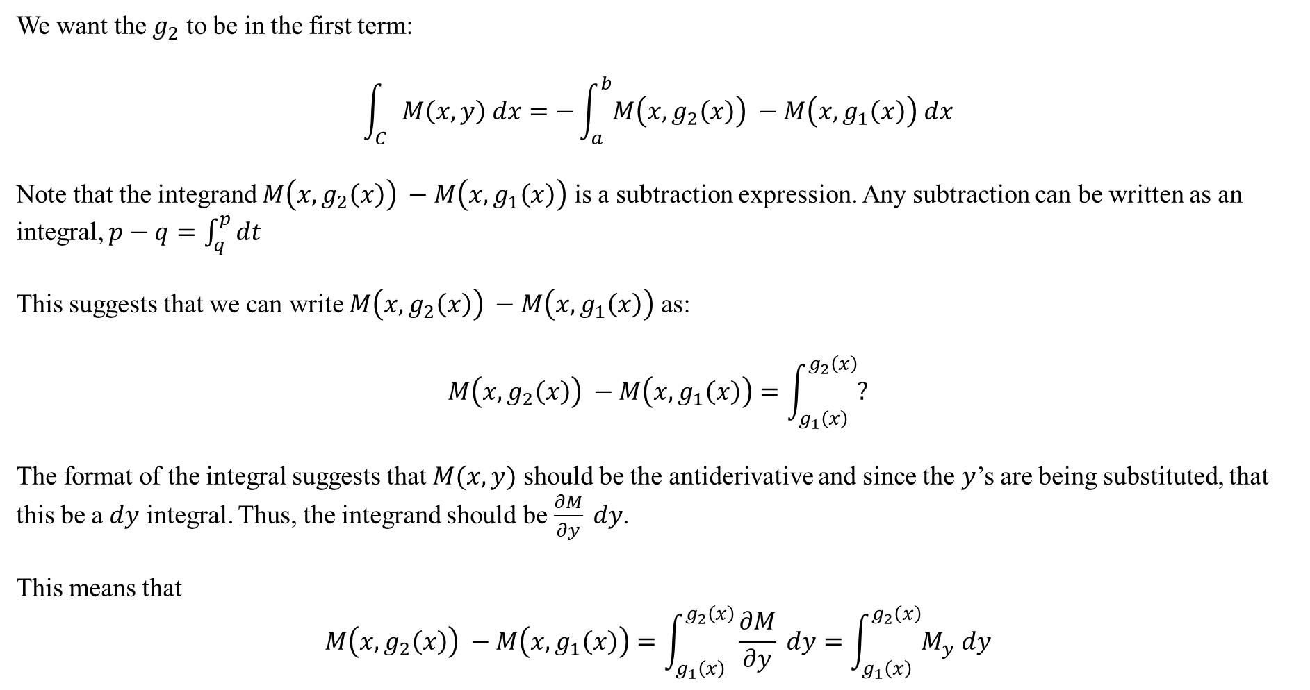
We want the $g_{2}$ to be in the first term:
$$\int_{C}{M\left(x,y\right) dx}=−\int_{a}^{b}{M\left(x,g_{2}\left(x\right)\right) −M\left(x,g_{1}\left(x\right)\right) dx}$$
Note that the integrand $M\left(x,g_{2}\left(x\right)\right) −M\left(x,g_{1}\left(x\right)\right)$ is a subtraction expression. Any subtraction can be written as an integral, $p−q=\int_{q}^{p}{dt}$
This suggests that we can write $M\left(x,g_{2}\left(x\right)\right) −M\left(x,g_{1}\left(x\right)\right)$ as:
$$M\left(x,g_{2}\left(x\right)\right) −M\left(x,g_{1}\left(x\right)\right)=\int_{g_{1}\left(x\right)}^{g_{2}\left(x\right)}{?}$$
The format of the integral suggests that $M(x,y)$ should be the antiderivative and since the $y$’s are being substituted, that this be a $dy$ integral. Thus, the integrand should be $\frac{∂M}{∂y} dy$.
This means that
$$M\left(x,g_{2}\left(x\right)\right) −M\left(x,g_{1}\left(x\right)\right)=\int_{g_{1}\left(x\right)}^{g_{2}\left(x\right)}{\frac{∂M}{∂y} dy}=\int_{g_{1}\left(x\right)}^{g_{2}\left(x\right)}{M_{y} dy}$$

Slide 6

The top of the last slide was
$$\int_{C}{M\left(x,y\right) dx}=−\int_{a}^{b}{M\left(x,g_{2}\left(x\right)\right) −M\left(x,g_{1}\left(x\right)\right) dx}$$
We just showed that
$$M\left(x,g_{2}\left(x\right)\right) −M\left(x,g_{1}\left(x\right)\right)=\int_{g_{1}\left(x\right)}^{g_{2}\left(x\right)}{M_{y} dy}$$
Thus,
$$\int_{C}{M\left(x,y\right) dx}=−\int_{a}^{b}{M\left(x,g_{2}\left(x\right)\right) −M\left(x,g_{1}\left(x\right)\right) dx}=−\int_{a}^{b}{\left[\int_{g_{1}\left(x\right)}^{g_{2}\left(x\right)}{M_{y} dy}\right] dx}=−\iint_{R}{M_{y} dA}$$
An identical construction will show that
$$\int_{C}{N\left(x,y\right) dy}=\iint_{R}{N_{x} dA}$$

Slide 7
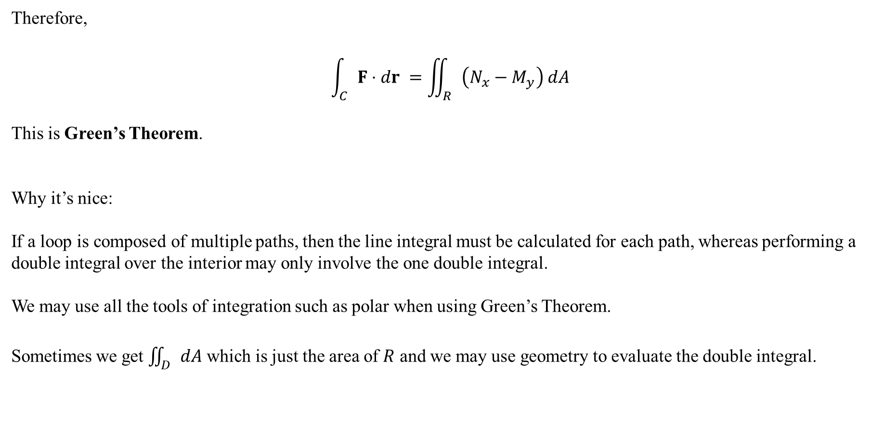
Therefore,
$$\int_{C}{F⋅dr }=\iint_{R}{\left(N_{x}−M_{y}\right) dA}$$
This is Green’s Theorem.
Why it’s nice:
If a loop is composed of multiple paths, then the line integral must be calculated for each path, whereas performing a double integral over the interior may only involve the one double integral.
We may use all the tools of integration such as polar when using Green’s Theorem.
Sometimes we get $\iint_{D}{dA}$ which is just the area of $R$ and we may use geometry to evaluate the double integral.

Slide 8
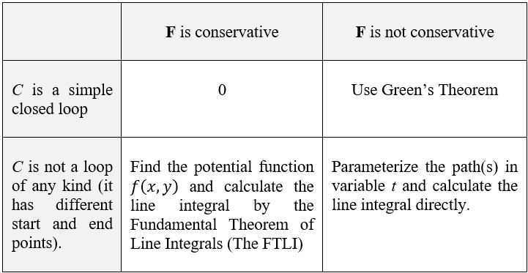
When calculating a line integral, you should check two things:
• Is the vector field conservative?
• Is the path a simple closed loop?
The following table will help plan the calculation accordingly.

Slide 9
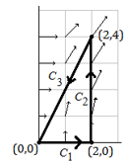

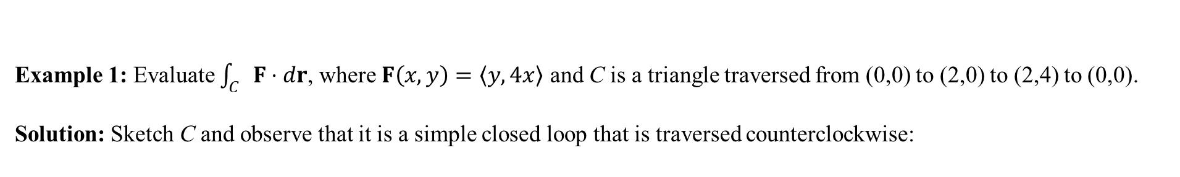
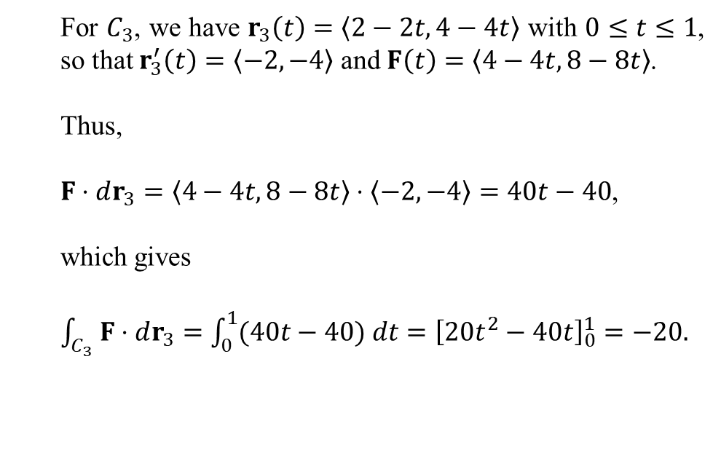

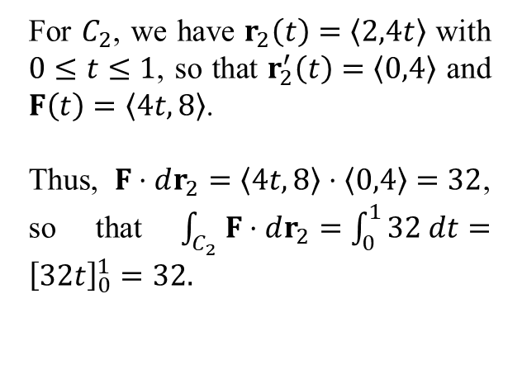
Example 1: Evaluate $\int_{C}{F⋅dr}$, where $F\left(x,y\right)=〈y,4x〉$ and C is a triangle traversed from (0,0) to (2,0) to (2,4) to (0,0).
Solution: Sketch C and observe that it is a simple closed loop that is traversed counterclockwise:
For $C_{3}$, we have $r_{3}\left(t\right)=〈2−2t,4−4t〉$ with $0≤t≤1$, so that $r_{3}^{′}\left(t\right)=〈−2,−4〉$ and $F\left(t\right)=〈4−4t,8−8t〉$.
Thus,
$F⋅dr_{3}=〈4−4t,8−8t〉⋅〈−2,−4〉=40t−40$,
which gives
$\int_{C_{3}}{F⋅dr_{3}}=\int_{0}^{1}{(40t−40) dt}={\left[20t^{2}−40t\right]}_{0}^{1}=−20.$
For $C_{2}$, we have $r_{2}\left(t\right)=〈2,4t〉$ with $0≤t≤1$, so that $r_{2}^{′}\left(t\right)=〈0,4〉$ and $F\left(t\right)=〈4t,8〉$.
Thus, $F⋅dr_{2}=〈4t,8〉⋅〈0,4〉=32$, so that $\int_{C_{2}}{F⋅dr_{2}}=\int_{0}^{1}{32 dt}={\left[32t\right]}_{0}^{1}=32.$
Thus, the line integral is the sum,
$$\int_{C}{F⋅dr}=0+32−20=12$$
For $C_{1}$, we have $r_{1}\left(t\right)=〈2t,0〉$ with $0≤t≤1$, so that $r_{1}^{′}\left(t\right)=〈2,0〉$ and $F\left(t\right)=〈0,8t〉$.
Thus, $F⋅dr_{1}=〈0,8t〉⋅〈2,0〉=0$, so that $\int_{C_{1}}{F⋅dr_{1}}=0$.

Slide 10
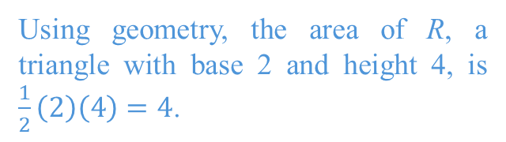
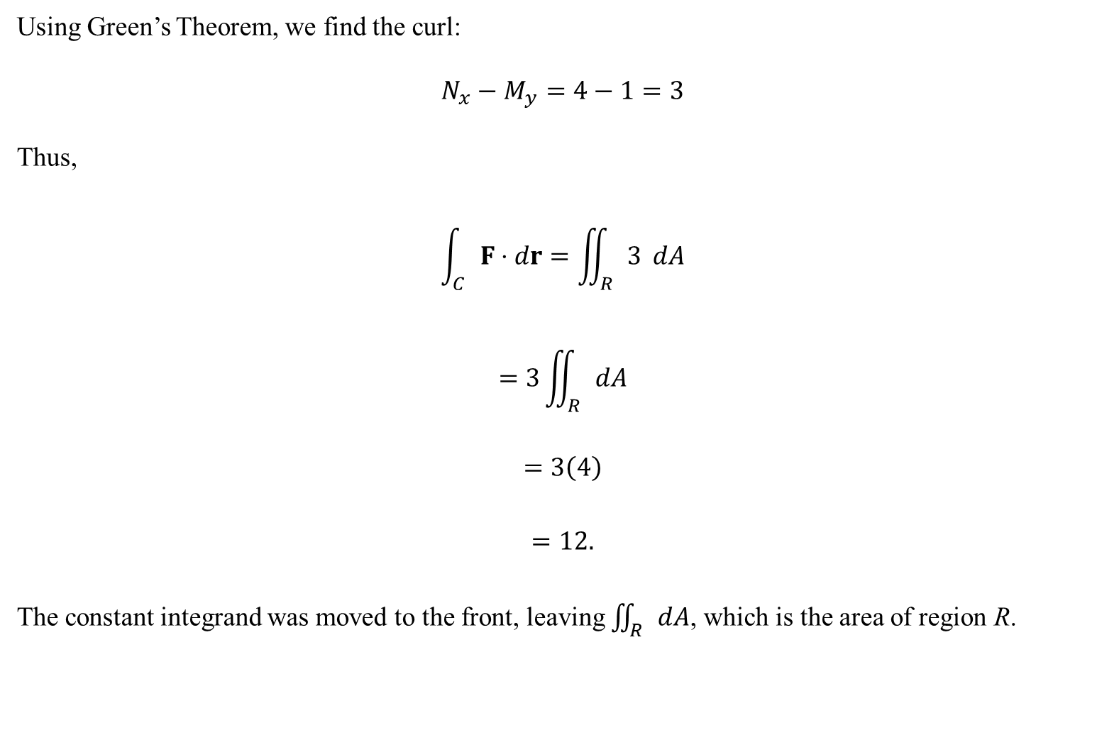
Using Green’s Theorem, we find the curl:
$$N_{x}−M_{y}=4−1=3$$
Thus,
$$\int_{C}{F⋅dr}=\iint_{R}{3} dA$$
$$=3\iint_{R}{dA}$$
$$=3\left(4\right)$$
$$=12.$$
The constant integrand was moved to the front, leaving $\iint_{R}{dA}$, which is the area of region R.
Using geometry, the area of R, a triangle with base 2 and height 4, is $\frac{1}{2}\left(2\right)\left(4\right)=4$.

Slide 11
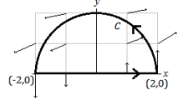
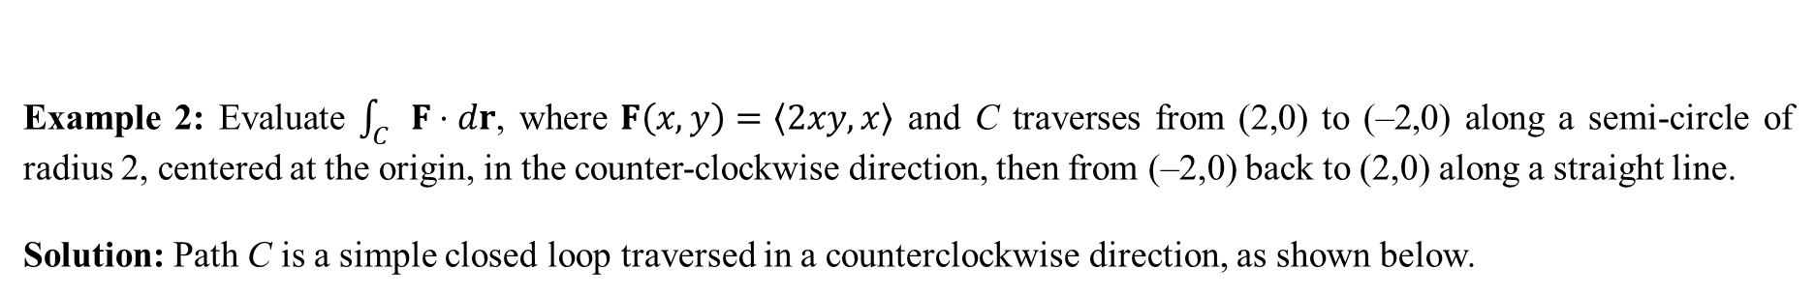
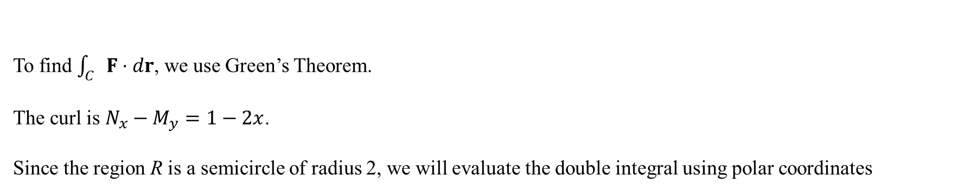
Example 2: Evaluate $\int_{C}{F⋅dr}$, where $F\left(x,y\right)=〈2xy,x〉$ and C traverses from (2,0) to (–2,0) along a semi-circle of radius 2, centered at the origin, in the counter-clockwise direction, then from (–2,0) back to (2,0) along a straight line.
Solution: Path C is a simple closed loop traversed in a counterclockwise direction, as shown below.
To find $\int_{C}{F⋅dr}$, we use Green’s Theorem.
The curl is $N_{x}−M_{y}=1−2x$.
Since the region R is a semicircle of radius 2, we will evaluate the double integral using polar coordinates

Slide 12
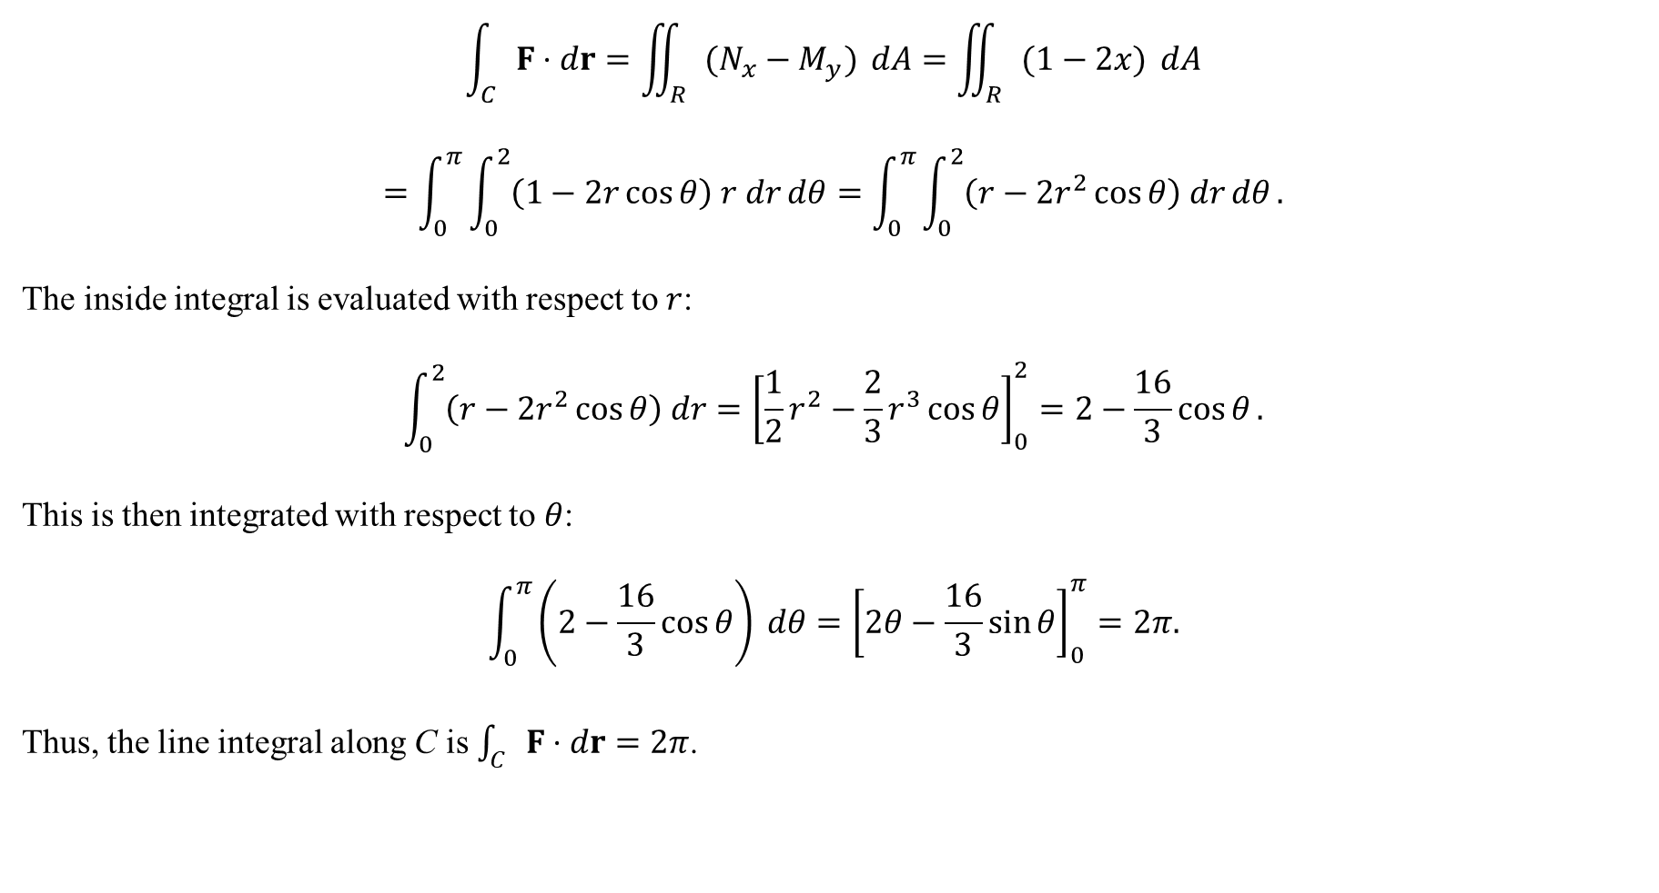
$$\int_{C}{F⋅dr}=\iint_{R}{(N_{x}−M_{y})} dA=\iint_{R}{(1−2x)} dA$$
$$=\int_{0}^{π}{\int_{0}^{2}{\left(1−2r\cos{θ}\right) r dr}dθ}=\int_{0}^{π}{\int_{0}^{2}{\left(r−2r^{2}\cos{θ}\right) dr}dθ}.$$
The inside integral is evaluated with respect to $r$:
$$\int_{0}^{2}{\left(r−2r^{2}\cos{θ}\right) dr}={\left[\frac{1}{2}r^{2}−\frac{2}{3}r^{3}\cos{θ}\right]}_{0}^{2}=2−\frac{16}{3}\cos{θ}.$$
This is then integrated with respect to $θ$:
$$\int_{0}^{π}{\left(2−\frac{16}{3}\cos{θ}\right) dθ}={\left[2θ−\frac{16}{3}\sin{θ}\right]}_{0}^{π}=2π.$$
Thus, the line integral along C is $\int_{C}{F⋅dr}=2π$.

Slide 13

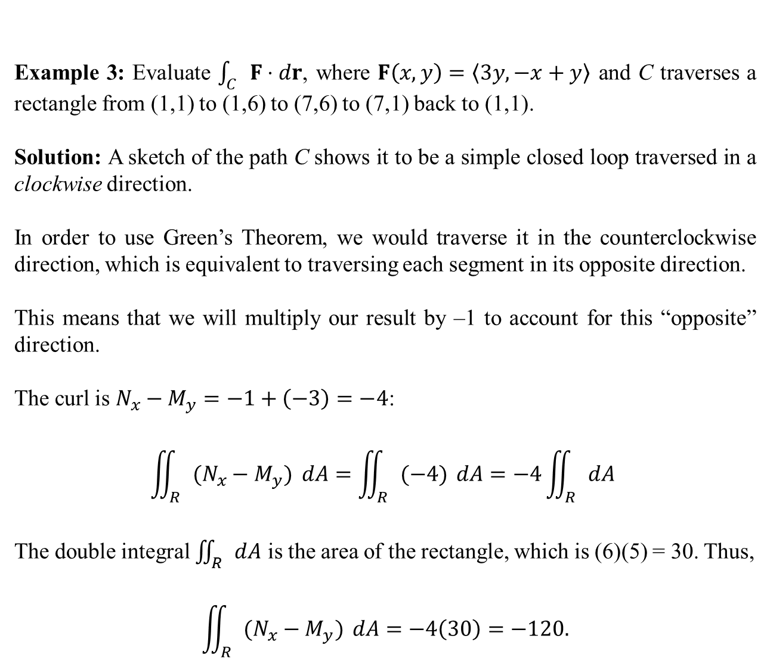
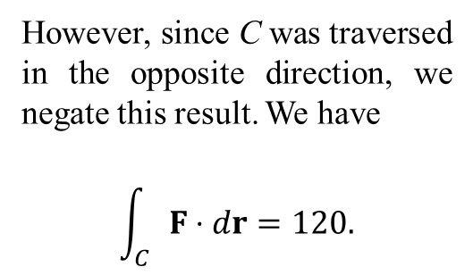
Example 3: Evaluate $\int_{C}{F⋅dr}$, where $F\left(x,y\right)=〈3y,−x+y〉$ and C traverses a rectangle from (1,1) to (1,6) to (7,6) to (7,1) back to (1,1).
Solution: A sketch of the path C shows it to be a simple closed loop traversed in a clockwise direction.
In order to use Green’s Theorem, we would traverse it in the counterclockwise direction, which is equivalent to traversing each segment in its opposite direction.
This means that we will multiply our result by –1 to account for this “opposite” direction.
The curl is $N_{x}−M_{y}=−1+\left(−3\right)=−4$:
$$\iint_{R}{(N_{x}−M_{y})} dA=\iint_{R}{(−4)} dA=−4\iint_{R}{dA}$$
The double integral $\iint_{R}{dA}$ is the area of the rectangle, which is (6)(5) = 30. Thus,
$$\iint_{R}{(N_{x}−M_{y})} dA=−4\left(30\right)=−120.$$
However, since C was traversed in the opposite direction, we negate this result. We have
$$\int_{C}{F⋅dr}=120.$$

Slide 14
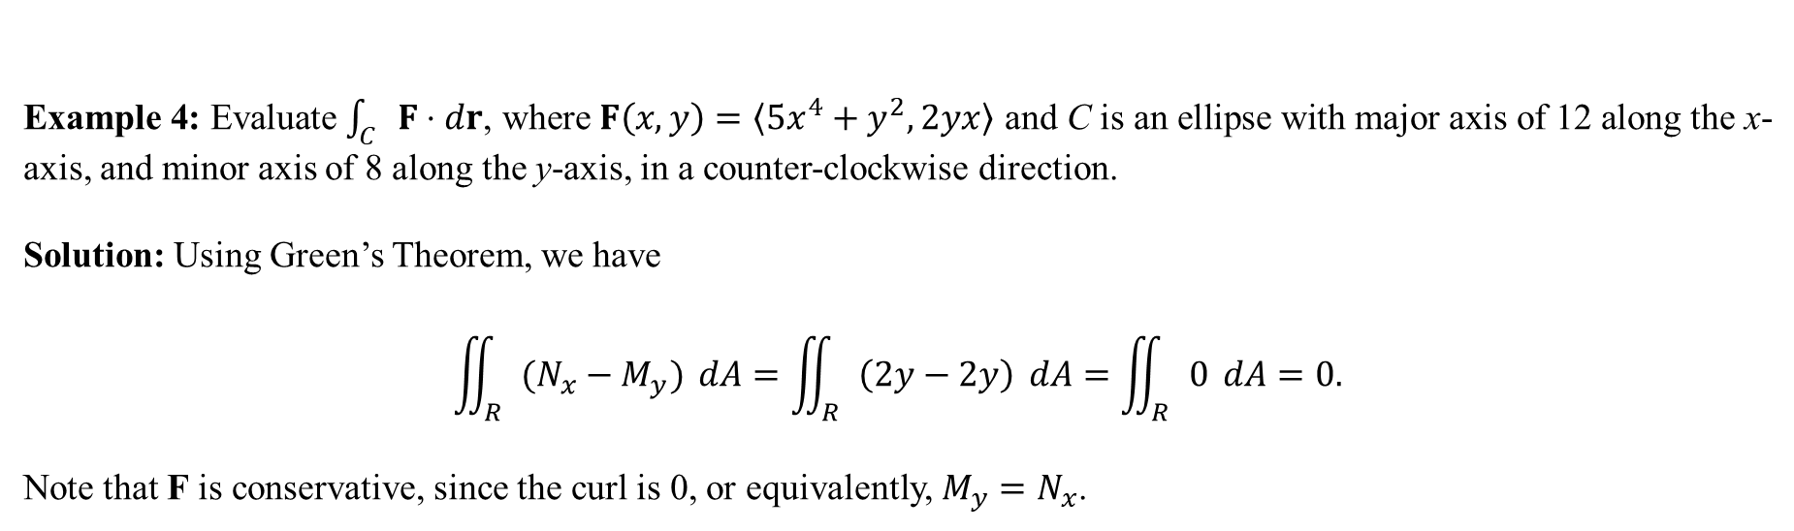
Example 4: Evaluate $\int_{C}{F⋅dr}$, where $F\left(x,y\right)=〈5x^{4}+y^{2},2yx〉$ and C is an ellipse with major axis of 12 along the x-axis, and minor axis of 8 along the y-axis, in a counter-clockwise direction.
Solution: Using Green’s Theorem, we have
$$\iint_{R}{(N_{x}−M_{y})} dA=\iint_{R}{\left(2y−2y\right)} dA=\iint_{R}{0} dA=0.$$
Note that F is conservative, since the curl is 0, or equivalently, $M_{y}=N_{x}$.

Slide 15
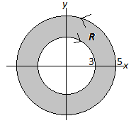
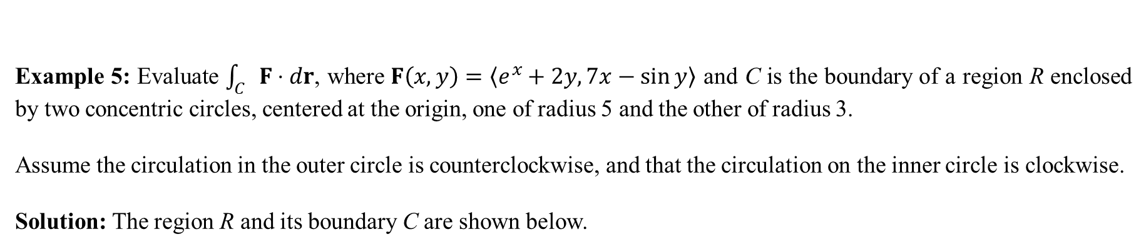

Example 5: Evaluate $\int_{C}{F⋅dr}$, where $F\left(x,y\right)=〈e^{x}+2y, 7x−\sin{y}〉$ and C is the boundary of a region R enclosed by two concentric circles, centered at the origin, one of radius 5 and the other of radius 3.
Assume the circulation in the outer circle is counterclockwise, and that the circulation on the inner circle is clockwise.
Solution: The region R and its boundary C are shown below.
Using Green’s Theorem, the curl is $N_{x}−M_{y}=7−2=5$.
Thus,
$$\int_{C}{F⋅dr}=\iint_{R}{5 dA}$$
$$=5\iint_{R}{dA}$$
$$=5(area of ring)$$
$$=5\left(25π−9π\right)=80π.$$

Slide 16
Green’s Theorem in The Age of Exploration.
Clipperton Island is a small coral island in the Pacific Ocean about 700 miles south of the tip of Baja California.
It belongs to France, but landing on the island to lay claim to the land proved difficult due to the coral reefs.
The French solved it by doing this:
…the first modern explorers to claim Clipperton were the French, in 1858. Their intention was to land on the island’s shores and read out a proclamation, but this proved to be difficult; approaching the island with the ship posed a significant risk of running aground on the coral reef, and smaller rowboats were thwarted by sharks and fickle tides. Desperate, the French resorted to sailing around the perimeter of the island while reading the proclamation out to its coastline.
(www.damninteresting.com)

