Slide 1
Directional Derivatives
& The Gradient
Scott Surgent

Slide 2
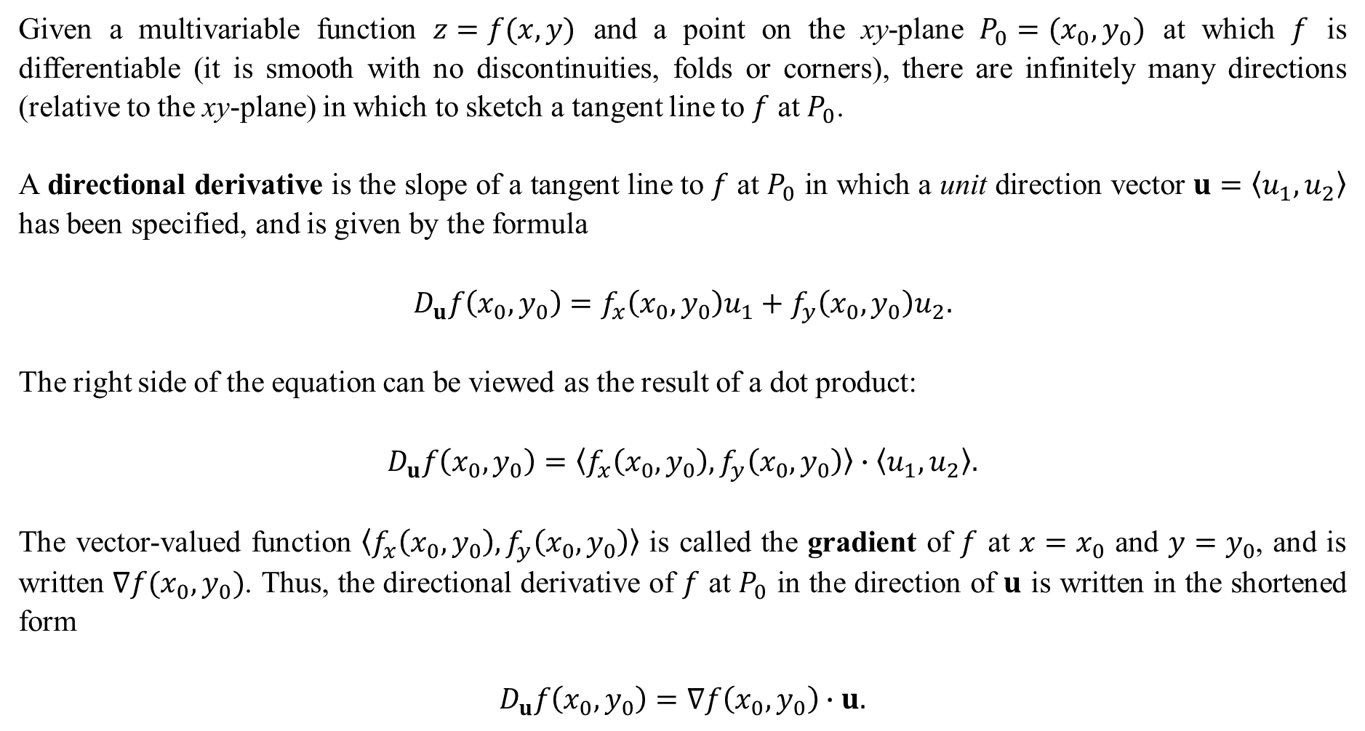
Given a multivariable function $z=f(x,y)$ and a point on the xy-plane $P_{0}=(x_{0},y_{0})$ at which $f$ is differentiable (it is smooth with no discontinuities, folds or corners), there are infinitely many directions (relative to the xy-plane) in which to sketch a tangent line to $f$ at $P_{0}$.
A directional derivative is the slope of a tangent line to $f$ at $P_{0}$ in which a unit direction vector $u=〈u_{1},u_{2}〉$ has been specified, and is given by the formula
$$D_{u}f\left(x_{0},y_{0}\right)=f_{x}\left(x_{0},y_{0}\right)u_{1}+f_{y}\left(x_{0},y_{0}\right)u_{2}.$$
The right side of the equation can be viewed as the result of a dot product:
$$D_{u}f\left(x_{0},y_{0}\right)=〈f_{x}\left(x_{0},y_{0}\right),f_{y}\left(x_{0},y_{0}\right)〉∙〈u_{1},u_{2}〉.$$
The vector-valued function $〈f_{x}\left(x_{0},y_{0}\right),f_{y}\left(x_{0},y_{0}\right)〉$ is called the gradient of $f$ at $x=x_{0}$ and $y=y_{0}$, and is written $∇f(x_{0},y_{0})$. Thus, the directional derivative of $f$ at $P_{0}$ in the direction of $u$ is written in the shortened form
$$D_{u}f\left(x_{0},y_{0}\right)=∇f\left(x_{0},y_{0}\right)∙u.$$

Slide 3
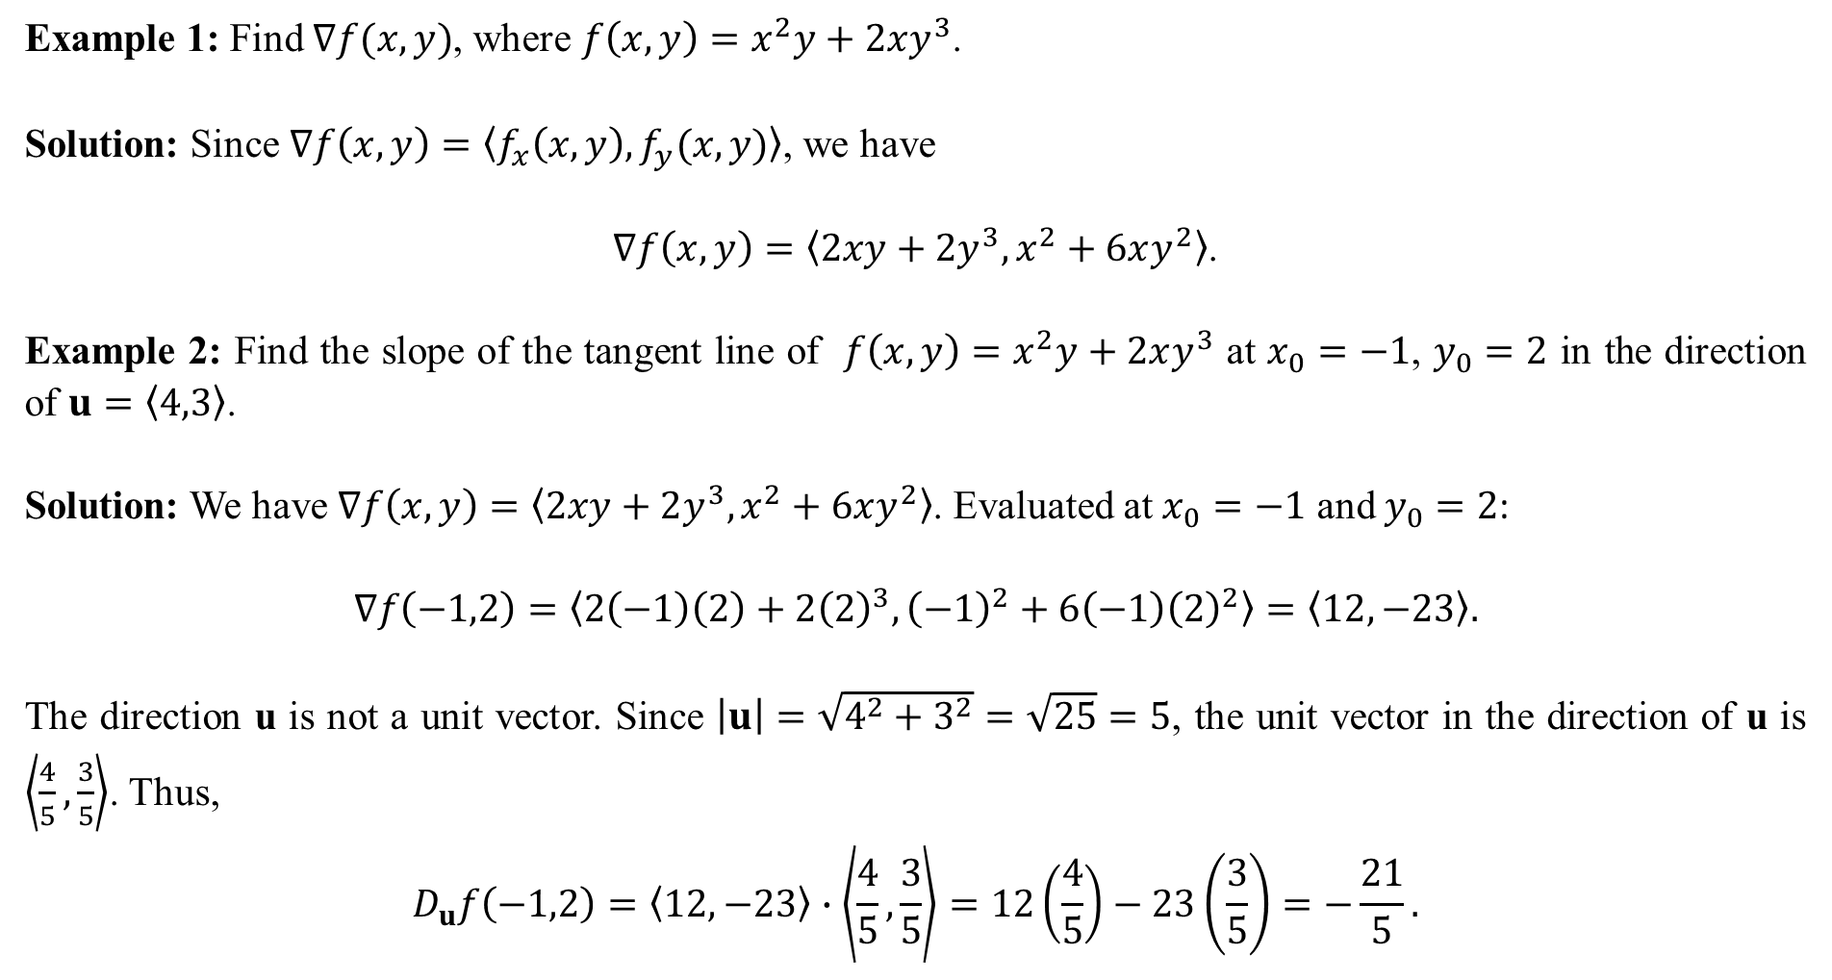
Example 1: Find $∇f(x,y)$, where $f\left(x,y\right)=x^{2}y+2xy^{3}$.
Solution: Since $∇f\left(x,y\right)=〈f_{x}\left(x,y\right), f_{y}(x,y)〉$, we have
$∇f\left(x,y\right)=〈2xy+2y^{3},x^{2}+6xy^{2}〉$.
Example 2: Find the slope of the tangent line of $f\left(x,y\right)=x^{2}y+2xy^{3}$ at $x_{0}=−1$, $y_{0}=2$ in the direction of $u=〈4,3〉$.
Solution: We have $∇f\left(x,y\right)=〈2xy+2y^{3},x^{2}+6xy^{2}〉$. Evaluated at $x_{0}=−1$ and $y_{0}=2$:
$$∇f\left(−1,2\right)=〈2\left(−1\right)\left(2\right)+2{\left(2\right)}^{3},{\left(−1\right)}^{2}+6\left(−1\right){\left(2\right)}^{2}〉=〈12,−23〉.$$
The direction u is not a unit vector. Since $\left|u\right|=\sqrt{4^{2}+3^{2}}=\sqrt{25}=5$, the unit vector in the direction of u is $\left\langle \frac{4}{5},\frac{3}{5}\right\rangle$. Thus,
$$D_{u}f\left(−1,2\right)=〈12,−23〉∙\left\langle \frac{4}{5},\frac{3}{5}\right\rangle =12\left(\frac{4}{5}\right)−23\left(\frac{3}{5}\right)=−\frac{21}{5}.$$

Slide 4
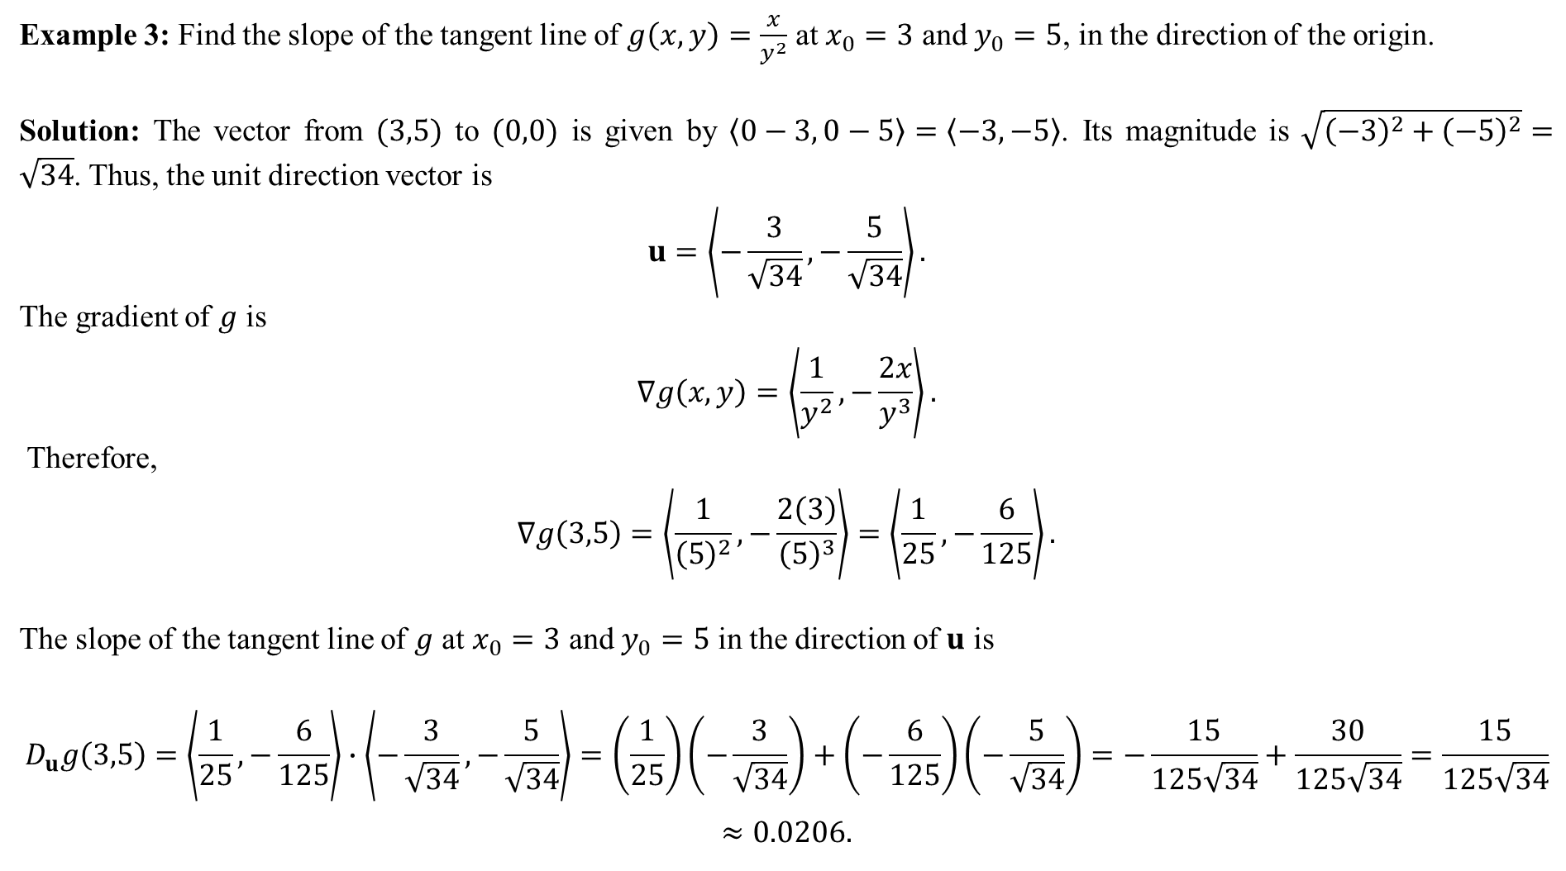
Example 3: Find the slope of the tangent line of $g\left(x,y\right)=\frac{x}{y^{2}}$ at $x_{0}=3$ and $y_{0}=5$, in the direction of the origin.
Solution: The vector from $(3,5)$ to $(0,0)$ is given by $〈0−3, 0−5〉=〈−3,−5〉$. Its magnitude is $\sqrt{{\left(−3\right)}^{2}+{\left(−5\right)}^{2}}=\sqrt{34}$. Thus, the unit direction vector is
$$u=\left\langle −\frac{3}{\sqrt{34}},−\frac{5}{\sqrt{34}}\right\rangle .$$
The gradient of $g$ is
$$∇g\left(x,y\right)=\left\langle \frac{1}{y^{2}}, −\frac{2x}{y^{3}}\right\rangle .$$
Therefore,
$$∇g\left(3,5\right)=\left\langle \frac{1}{{\left(5\right)}^{2}}, −\frac{2\left(3\right)}{{\left(5\right)}^{3}}\right\rangle =\left\langle \frac{1}{25}, −\frac{6}{125}\right\rangle .$$
The slope of the tangent line of $g$ at $x_{0}=3$ and $y_{0}=5$ in the direction of $u$ is
$$D_{u}g\left(3,5\right)=\left\langle \frac{1}{25}, −\frac{6}{125}\right\rangle ∙\left\langle −\frac{3}{\sqrt{34}},−\frac{5}{\sqrt{34}}\right\rangle =\left(\frac{1}{25}\right)\left(−\frac{3}{\sqrt{34}}\right)+\left(−\frac{6}{125}\right)\left(−\frac{5}{\sqrt{34}}\right)=−\frac{15}{125\sqrt{34}}+\frac{30}{125\sqrt{34}}=\frac{15}{125\sqrt{34}}$$
$$≈0.0206.$$

Slide 5
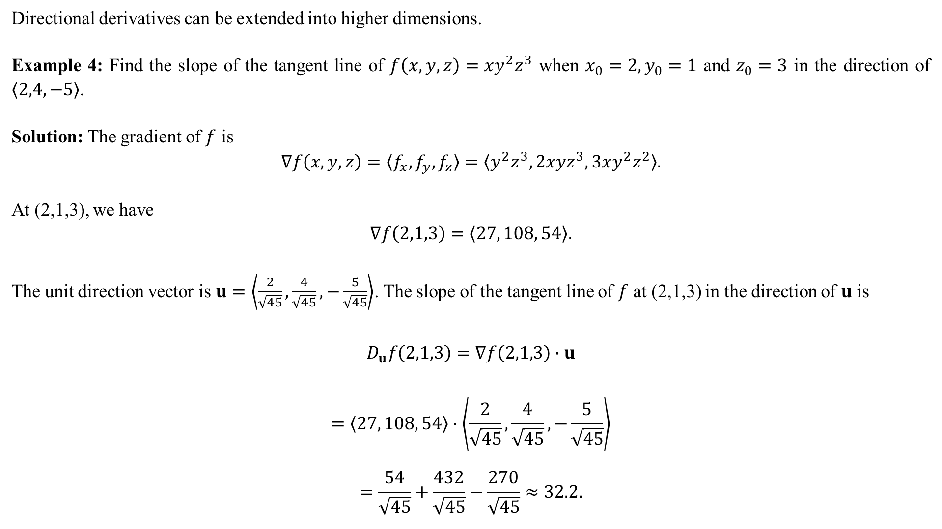
Directional derivatives can be extended into higher dimensions.
Example 4: Find the slope of the tangent line of $f\left(x,y,z\right)=xy^{2}z^{3}$ when $x_{0}=2, y_{0}=1$ and $z_{0}=3$ in the direction of $〈2,4,−5〉$.
Solution: The gradient of $f$ is
$$∇f\left(x,y,z\right)=〈f_{x}, f_{y},f_{z}〉=〈y^{2}z^{3}, 2xyz^{3}, 3xy^{2}z^{2}〉.$$
At (2,1,3), we have
$$∇f\left(2,1,3\right)=〈27, 108, 54〉.$$
The unit direction vector is $u=\left\langle \frac{2}{\sqrt{45}},\frac{4}{\sqrt{45}},−\frac{5}{\sqrt{45}}\right\rangle$. The slope of the tangent line of $f$ at (2,1,3) in the direction of $u$ is
$$D_{u}f\left(2,1,3\right)=∇f\left(2,1,3\right)∙u$$
$$=〈27, 108, 54〉⋅\left\langle \frac{2}{\sqrt{45}},\frac{4}{\sqrt{45}},−\frac{5}{\sqrt{45}}\right\rangle$$
$$=\frac{54}{\sqrt{45}}+\frac{432}{\sqrt{45}}−\frac{270}{\sqrt{45}}≈32.2.$$

Slide 6
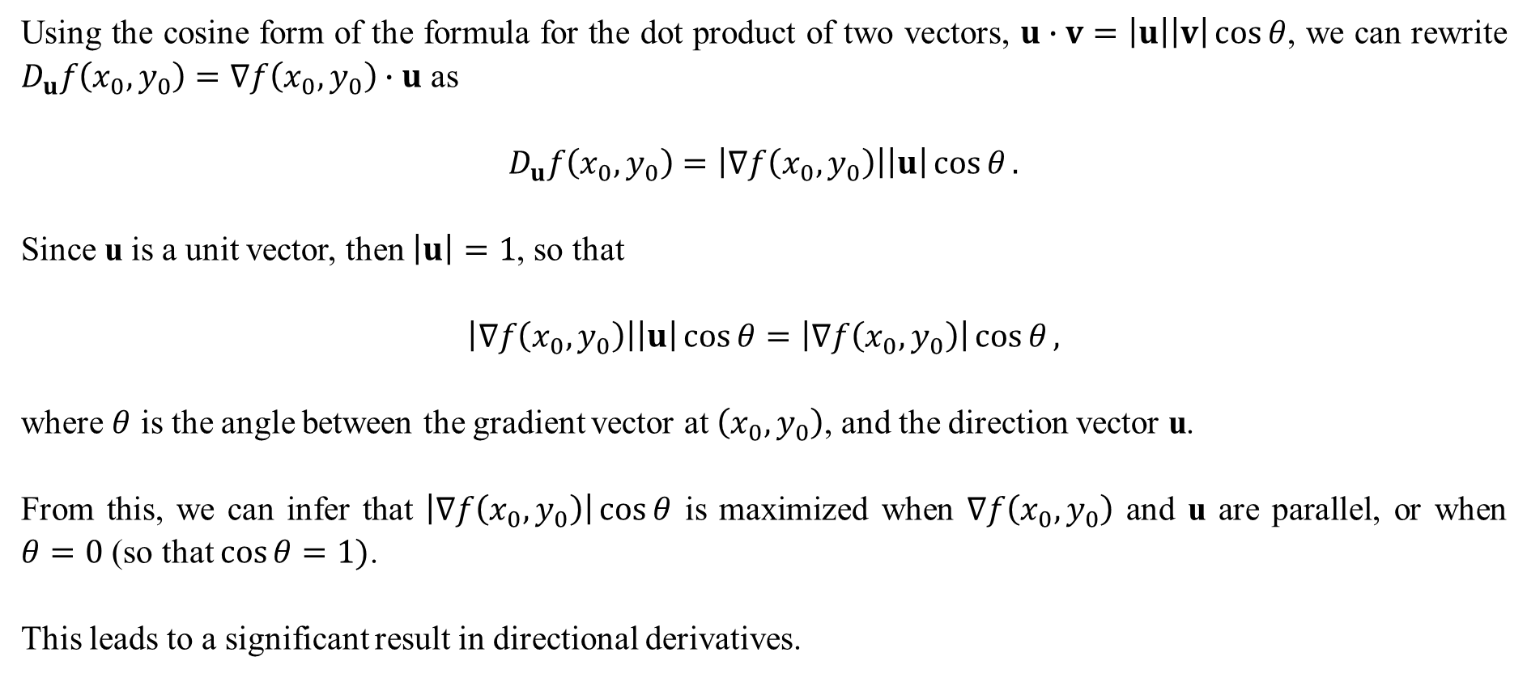
Using the cosine form of the formula for the dot product of two vectors, $u∙v=\left|u\right|\left|v\right|\cos{θ}$, we can rewrite $D_{u}f\left(x_{0},y_{0}\right)=∇f\left(x_{0},y_{0}\right)∙u$ as
$$D_{u}f\left(x_{0},y_{0}\right)=\left|∇f\left(x_{0},y_{0}\right)\right|\left|u\right|\cos{θ}.$$
Since u is a unit vector, then $\left|u\right|=1$, so that
$$\left|∇f\left(x_{0},y_{0}\right)\right|\left|u\right|\cos{θ}=\left|∇f\left(x_{0},y_{0}\right)\right|\cos{θ},$$
where $θ$ is the angle between the gradient vector at $\left(x_{0},y_{0}\right)$, and the direction vector u.
From this, we can infer that $\left|∇f\left(x_{0},y_{0}\right)\right|\cos{θ}$ is maximized when $∇f\left(x_{0},y_{0}\right)$ and u are parallel, or when $θ=0$ (so that $\cos{θ}=1)$.
This leads to a significant result in directional derivatives.

Slide 7
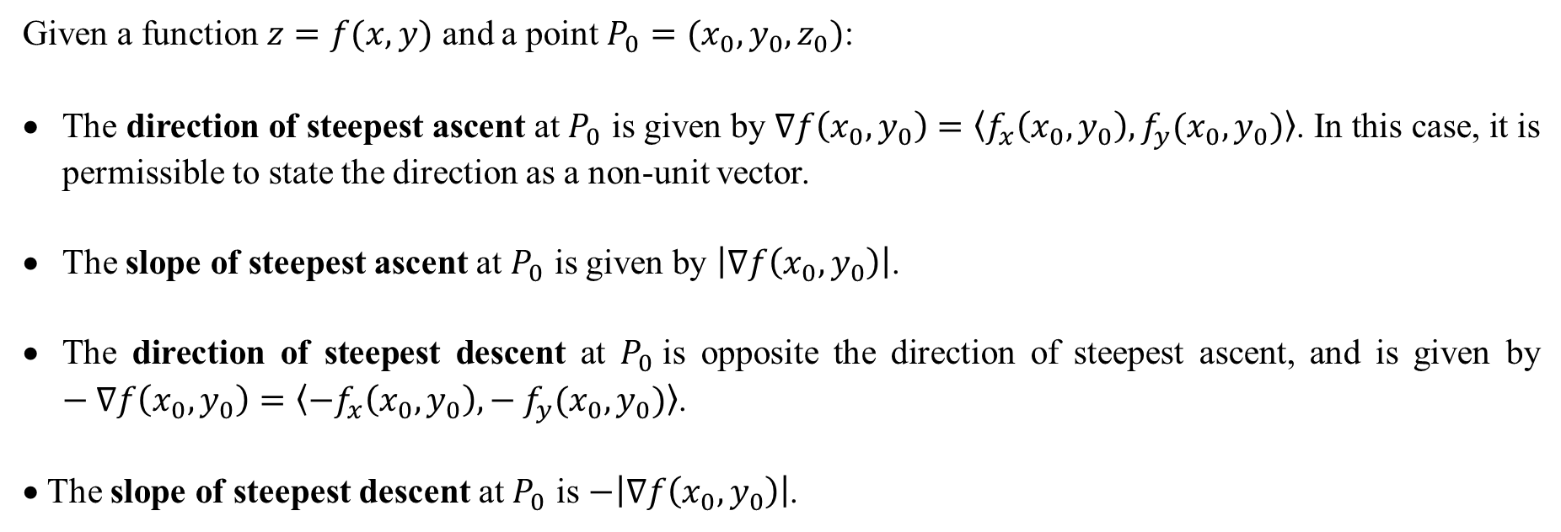
Given a function $z=f(x,y)$ and a point $P_{0}=(x_{0},y_{0},z_{0})$:
The direction of steepest ascent at $P_{0}$ is given by $∇f\left(x_{0},y_{0}\right)=〈f_{x}\left(x_{0},y_{0}\right), f_{y}(x_{0},y_{0})〉$. In this case, it is permissible to state the direction as a non-unit vector.
The slope of steepest ascent at $P_{0}$ is given by $\left|∇f\left(x_{0},y_{0}\right)\right|$.
The direction of steepest descent at $P_{0}$is opposite the direction of steepest ascent, and is given by $−∇f\left(x_{0},y_{0}\right)=〈−f_{x}\left(x_{0},y_{0}\right),− f_{y}(x_{0},y_{0})〉$.
• The slope of steepest descent at $P_{0}$ is $−\left|∇f\left(x_{0},y_{0}\right)\right|$.

Slide 8
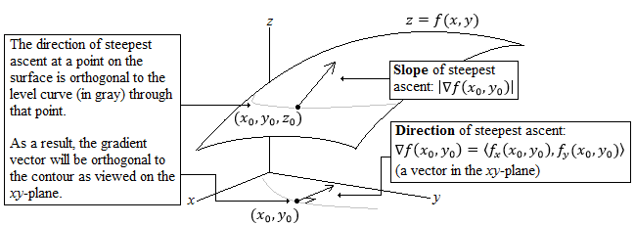

Slide 9
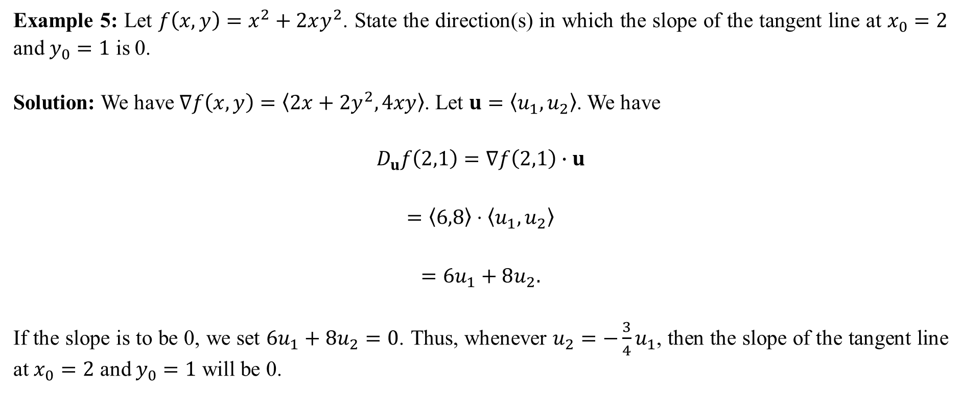
Example 5: Let $f\left(x,y\right)=x^{2}+2xy^{2}$. State the direction(s) in which the slope of the tangent line at $x_{0}=2$ and $y_{0}=1$ is 0.
Solution: We have $∇f\left(x,y\right)=〈2x+2y^{2},4xy〉$. Let $u=〈u_{1},u_{2}〉$. We have
$$D_{u}f\left(2,1\right)=∇f\left(2,1\right)∙u$$
$$=〈6,8〉⋅〈u_{1},u_{2}〉$$
$$=6u_{1}+8u_{2}.$$
If the slope is to be 0, we set $6u_{1}+8u_{2}=0$. Thus, whenever $u_{2}=−\frac{3}{4}u_{1}$, then the slope of the tangent line at $x_{0}=2$ and $y_{0}=1$ will be 0.

Slide 10
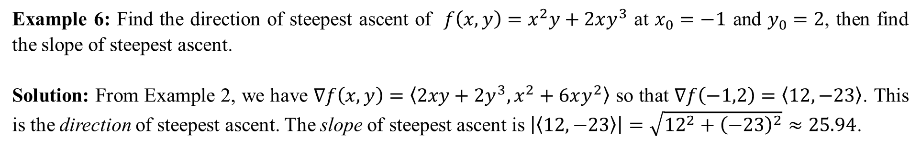
Example 6: Find the direction of steepest ascent of $f\left(x,y\right)=x^{2}y+2xy^{3}$ at $x_{0}=−1$ and $y_{0}=2$, then find the slope of steepest ascent.
Solution: From Example 2, we have $∇f\left(x,y\right)=〈2xy+2y^{3},x^{2}+6xy^{2}〉$ so that $∇f\left(−1,2\right)=〈12,−23〉$. This is the direction of steepest ascent. The slope of steepest ascent is $\left|〈12,−23〉\right|=\sqrt{{12}^{2}+{\left(−23\right)}^{2}}≈25.94$.
When finding a directional derivative where the direction is stated or to be determined, you must be sure that it is stated as a unit vector.
However, when asked to find a direction of steepest ascent, it is permissible to leave it as a non-unit vector since you will likely be calculating the slope as well.
While it is not incorrect to state the direction of steepest ascent as a unit vector, a common error is to then use that unit vector to find the slope, in which case the answer will be 1, which is likely incorrect.

Slide 11
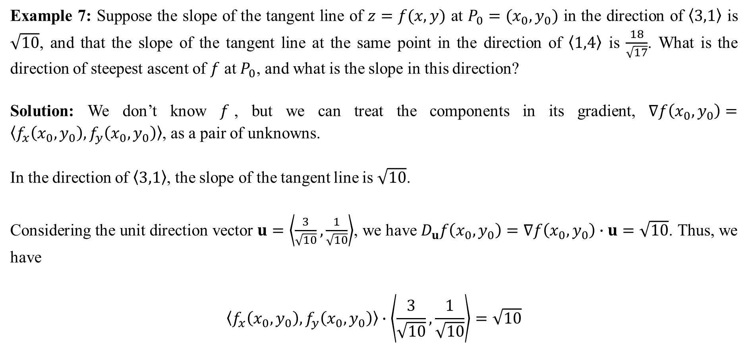
Example 7: Suppose the slope of the tangent line of $z=f(x,y)$ at $P_{0}=(x_{0},y_{0})$ in the direction of $〈3,1〉$ is $\sqrt{10}$, and that the slope of the tangent line at the same point in the direction of $〈1,4〉$ is $\frac{18}{\sqrt{17}}$. What is the direction of steepest ascent of $f$ at $P_{0}$, and what is the slope in this direction?
Solution: We don’t know $f$, but we can treat the components in its gradient, $∇f\left(x_{0},y_{0}\right)=〈f_{x}\left(x_{0},y_{0}\right), f_{y}\left(x_{0},y_{0}\right)〉$, as a pair of unknowns.
In the direction of $〈3,1〉$, the slope of the tangent line is $\sqrt{10}$.
Considering the unit direction vector $u=\left\langle \frac{3}{\sqrt{10}},\frac{1}{\sqrt{10}}\right\rangle$, we have $D_{u}f\left(x_{0},y_{0}\right)=∇f\left(x_{0},y_{0}\right)∙u=\sqrt{10}$. Thus, we have
$$〈f_{x}\left(x_{0},y_{0}\right), f_{y}\left(x_{0},y_{0}\right)〉∙\left\langle \frac{3}{\sqrt{10}},\frac{1}{\sqrt{10}}\right\rangle =\sqrt{10}$$

Slide 12

which gives
$$f_{x}\left(x_{0},y_{0}\right)\frac{3}{\sqrt{10}}+f_{y}\left(x_{0},y_{0}\right)\frac{1}{\sqrt{10}}=\sqrt{10}. (1)$$
In a similar way, we consider the unit direction vector in the direction of $〈1,4〉$, which is $\left\langle \frac{1}{\sqrt{17}},\frac{4}{\sqrt{17}}\right\rangle$. The slope in this direction is $\frac{18}{\sqrt{17}}$. We have
$$〈f_{x}\left(x_{0},y_{0}\right), f_{y}\left(x_{0},y_{0}\right)〉∙\left\langle \frac{1}{\sqrt{17}},\frac{4}{\sqrt{17}}\right\rangle =\frac{18}{\sqrt{17}} ,$$
which gives
$$f_{x}\left(x_{0},y_{0}\right)\frac{1}{\sqrt{17}}+f_{y}\left(x_{0},y_{0}\right)\frac{4}{\sqrt{17}}=\frac{18}{\sqrt{17}} . (2)$$

Slide 13
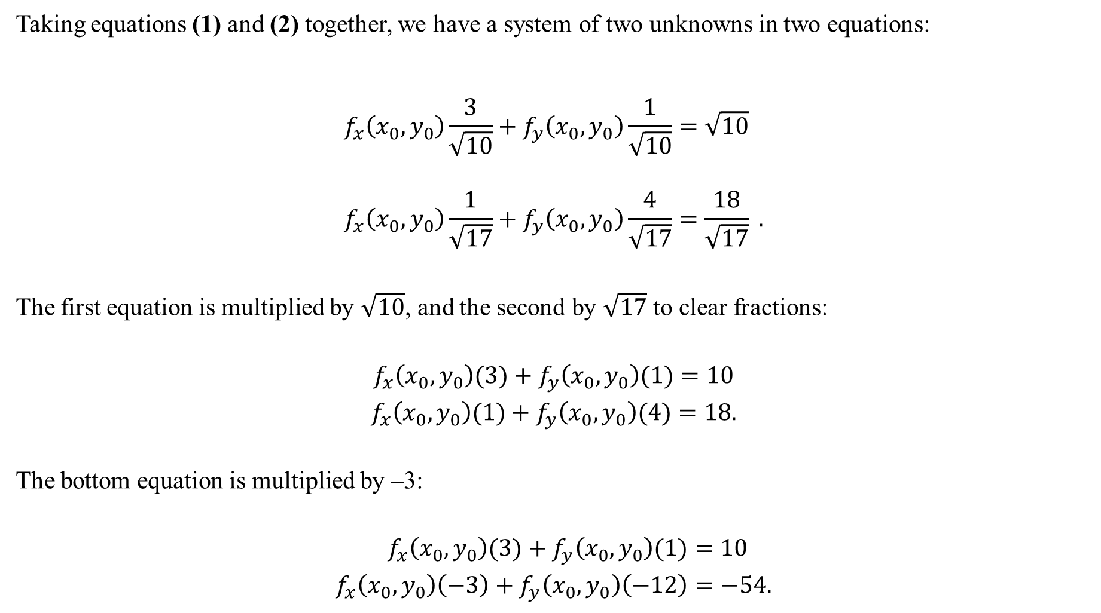
Taking equations (1) and (2) together, we have a system of two unknowns in two equations:
$$f_{x}\left(x_{0},y_{0}\right)\frac{3}{\sqrt{10}}+f_{y}\left(x_{0},y_{0}\right)\frac{1}{\sqrt{10}}=\sqrt{10} \\ f_{x}\left(x_{0},y_{0}\right)\frac{1}{\sqrt{17}}+f_{y}\left(x_{0},y_{0}\right)\frac{4}{\sqrt{17}}=\frac{18}{\sqrt{17}} .$$
The first equation is multiplied by $\sqrt{10}$, and the second by $\sqrt{17}$ to clear fractions:
$$f_{x}\left(x_{0},y_{0}\right)(3)+f_{y}\left(x_{0},y_{0}\right)(1)=10$$
$$f_{x}\left(x_{0},y_{0}\right)(1)+f_{y}\left(x_{0},y_{0}\right)(4)=18.$$
The bottom equation is multiplied by –3:
$$f_{x}\left(x_{0},y_{0}\right)(3)+f_{y}\left(x_{0},y_{0}\right)(1)=10 \\ f_{x}\left(x_{0},y_{0}\right)\left(−3\right)+f_{y}\left(x_{0},y_{0}\right)\left(−12\right)=−54.$$

Slide 14
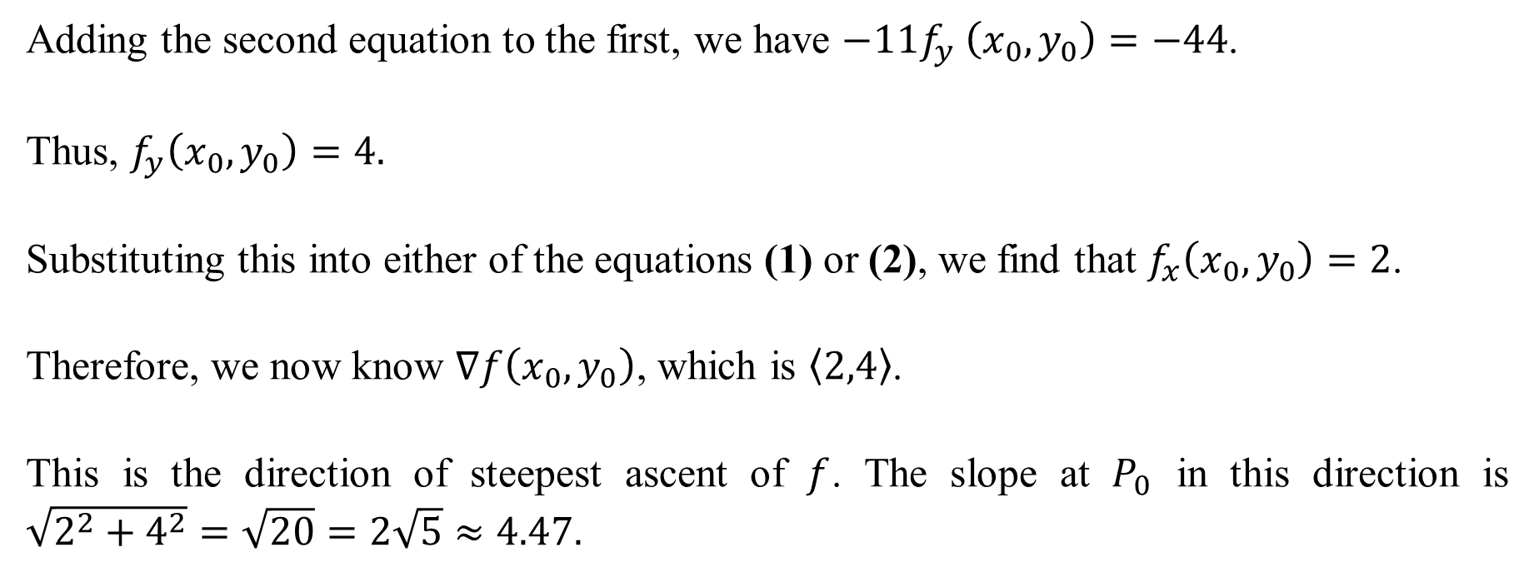
Adding the second equation to the first, we have $−11f_{y} \left(x_{0},y_{0}\right)=−44$.
Thus, $f_{y}\left(x_{0},y_{0}\right)=4.$
Substituting this into either of the equations (1) or (2), we find that $f_{x}\left(x_{0},y_{0}\right)=2$.
Therefore, we now know $∇f\left(x_{0},y_{0}\right)$, which is $〈2,4〉$.
This is the direction of steepest ascent of $f$. The slope at $P_{0}$ in this direction is $\sqrt{2^{2}+4^{2}}=\sqrt{20}=2\sqrt{5}≈4.47.$

Slide 15
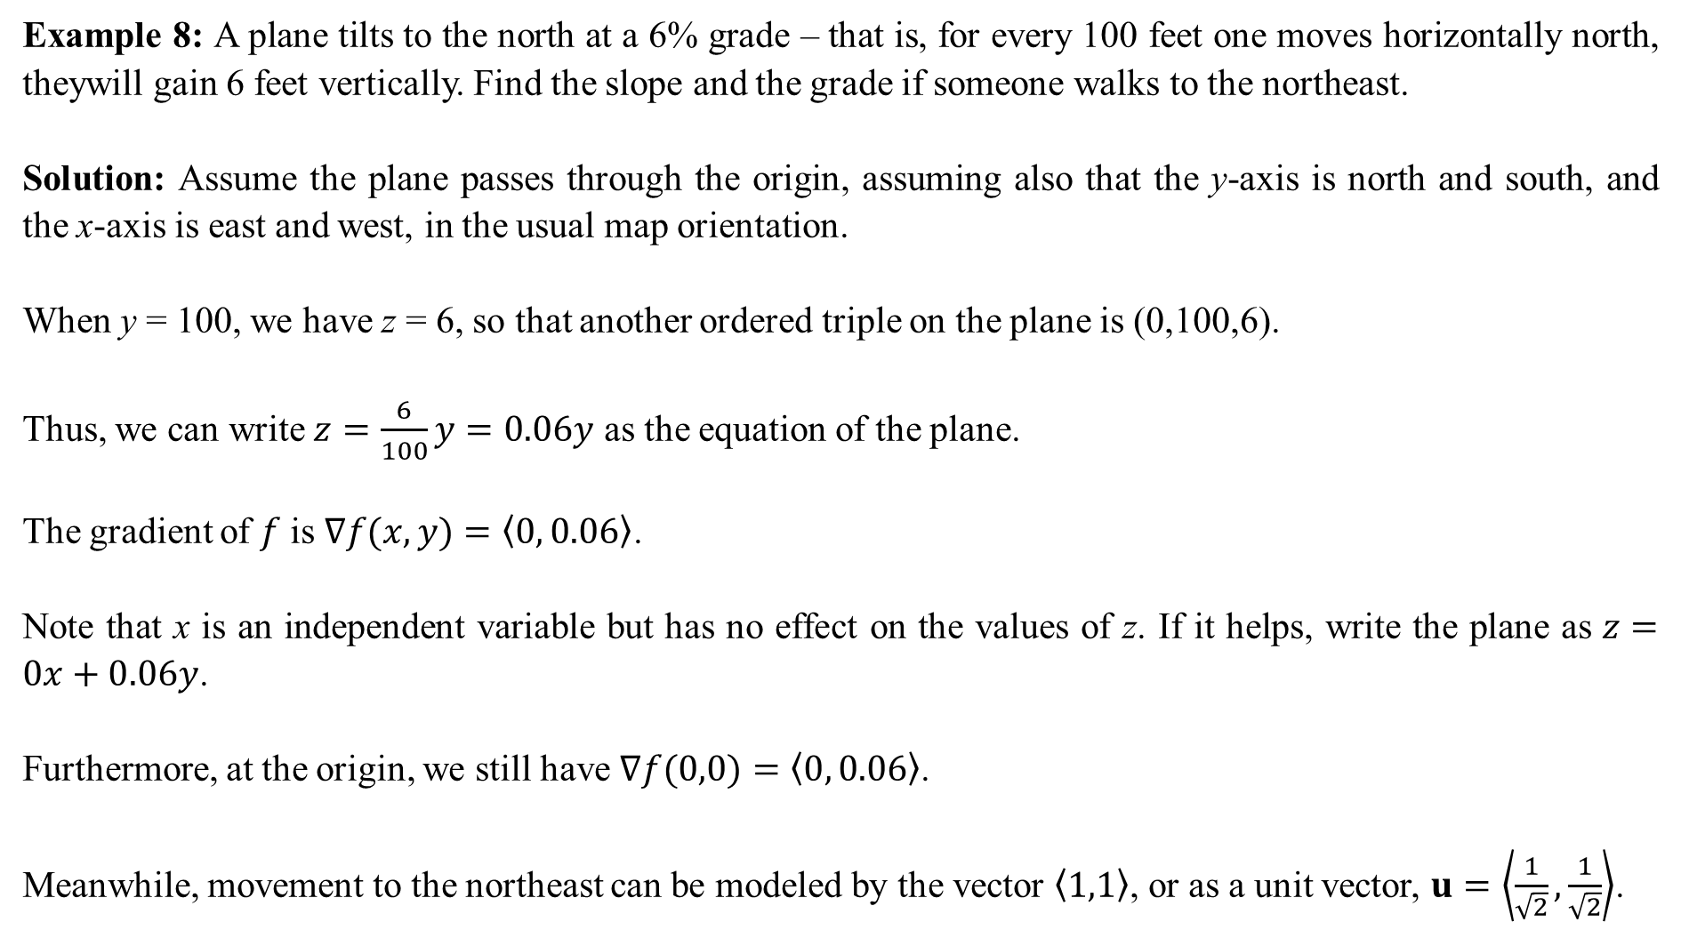
Example 8: A plane tilts to the north at a 6% grade – that is, for every 100 feet one moves horizontally north, theywill gain 6 feet vertically. Find the slope and the grade if someone walks to the northeast.
Solution: Assume the plane passes through the origin, assuming also that the y-axis is north and south, and the x-axis is east and west, in the usual map orientation.
When y = 100, we have z = 6, so that another ordered triple on the plane is (0,100,6).
Thus, we can write $z=\frac{6}{100}y=0.06y$ as the equation of the plane.
The gradient of $f$ is $∇f(x,y)=〈0, 0.06〉$.
Note that x is an independent variable but has no effect on the values of z. If it helps, write the plane as $z=0x+0.06y$.
Furthermore, at the origin, we still have $∇f(0,0)=〈0, 0.06〉$.
Meanwhile, movement to the northeast can be modeled by the vector $〈1,1〉$, or as a unit vector, $u=\left\langle \frac{1}{\sqrt{2}},\frac{1}{\sqrt{2}}\right\rangle$.

Slide 16
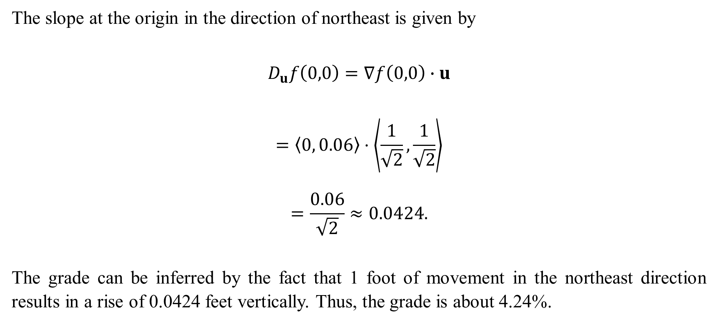
The slope at the origin in the direction of northeast is given by
$$D_{u}f\left(0,0\right)=∇f\left(0,0\right)∙u$$
$$=〈0, 0.06〉⋅\left\langle \frac{1}{\sqrt{2}},\frac{1}{\sqrt{2}}\right\rangle$$
$$=\frac{0.06}{\sqrt{2}}≈0.0424.$$
The grade can be inferred by the fact that 1 foot of movement in the northeast direction results in a rise of 0.0424 feet vertically. Thus, the grade is about 4.24%.

