Slide 1
Conservative Vector Fields and the Fundamental Theorem of Line Integrals (FTLI)
Scott Surgent

Slide 2
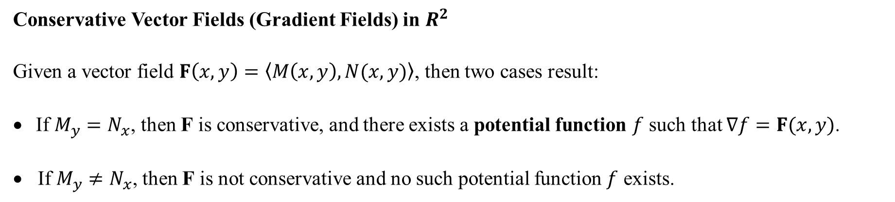
Conservative Vector Fields (Gradient Fields) in $R^{2}$
Given a vector field $F\left(x,y\right)=〈M\left(x,y\right),N(x,y)〉$, then two cases result:
If $M_{y}=N_{x}$, then F is conservative, and there exists a potential function $f$ such that $∇f=F(x,y)$.
• If $M_{y}≠N_{x}$, then F is not conservative and no such potential function $f$ exists.

Slide 3
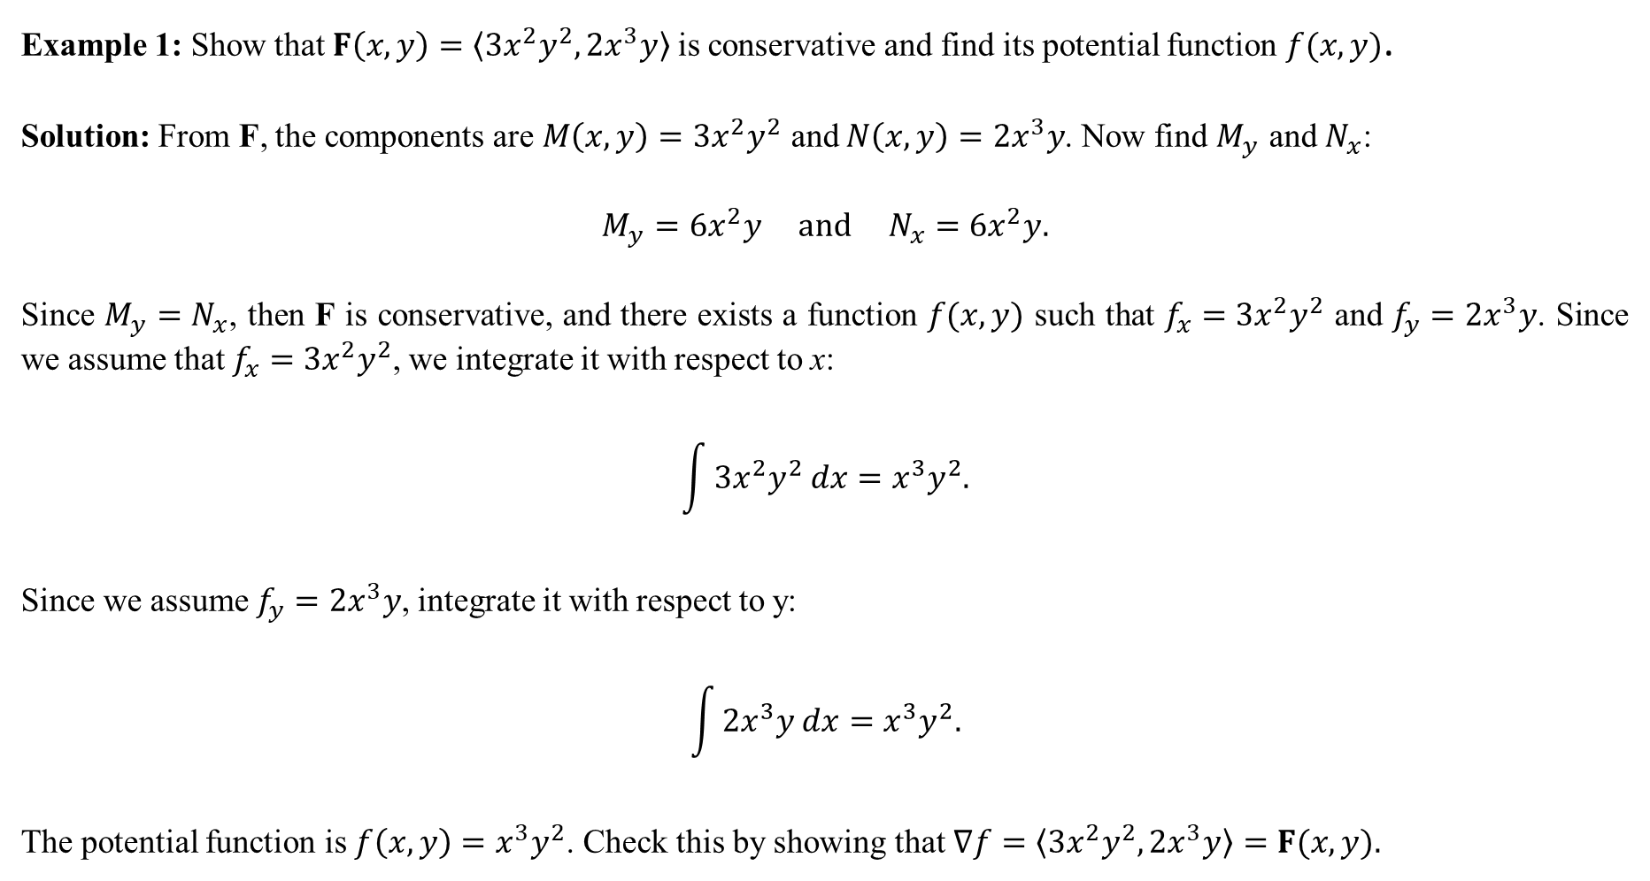
Example 1: Show that$F\left(x,y\right)=〈3x^{2}y^{2}, 2x^{3}y〉$ is conservative and find its potential function $f(x,y)$.
Solution: From F, the components are $M\left(x,y\right)=3x^{2}y^{2}$ and $N\left(x,y\right)=2x^{3}y$. Now find $M_{y}$ and $N_{x}$:
$$M_{y}=6x^{2}y and N_{x}=6x^{2}y.$$
Since $M_{y}=N_{x}$, then F is conservative, and there exists a function $f(x,y)$ such that $f_{x}=3x^{2}y^{2}$ and $f_{y}=2x^{3}y$. Since we assume that $f_{x}=3x^{2}y^{2}$, we integrate it with respect to x:
$$\int{3x^{2}y^{2} dx}=x^{3}y^{2}.$$
Since we assume $f_{y}=2x^{3}y$, integrate it with respect to y:
$$\int{2x^{3}y dx}=x^{3}y^{2}.$$
The potential function is $f\left(x,y\right)=x^{3}y^{2}$. Check this by showing that $∇f=〈3x^{2}y^{2}, 2x^{3}y〉=F(x,y).$

Slide 4
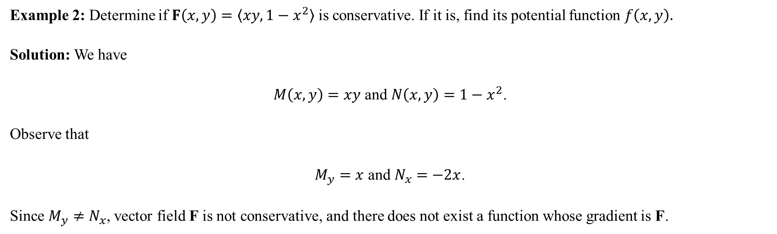
Example 2: Determine if $F\left(x,y\right)=〈xy, 1−x^{2}〉$ is conservative. If it is, find its potential function $f\left(x,y\right).$
Solution: We have
$M\left(x,y\right)=xy$ and $N\left(x,y\right)=1−x^{2}$.
Observe that
$M_{y}=x$ and $N_{x}=−2x$.
Since $M_{y}≠N_{x}$, vector field F is not conservative, and there does not exist a function whose gradient is F.

Slide 5

Example 3: Determine if $F\left(x,y\right)=〈y−3,x+2〉$ is conservative. If it is, find a potential function $f$.
Solution: We have
$M\left(x,y\right)=y−3$ and $N\left(x,y\right)=x+2$.
Observe that
$M_{y}=1$ and $N_{x}=1$.
Since $M_{y}=N_{x}$, the vector field F is conservative. To determine $f(x,y)$, integrate $M\left(x,y\right)$ with respect to x:
$$\int{\left(y−3\right) dx}=xy−3x.$$
Now integrate $N(x,y)$ with respect to $y$:
$$\int{\left(x+2\right) dy}=xy+2y.$$
The potential function is the union of these two functions: $f\left(x,y\right)=xy+2y−3x$.

Slide 6
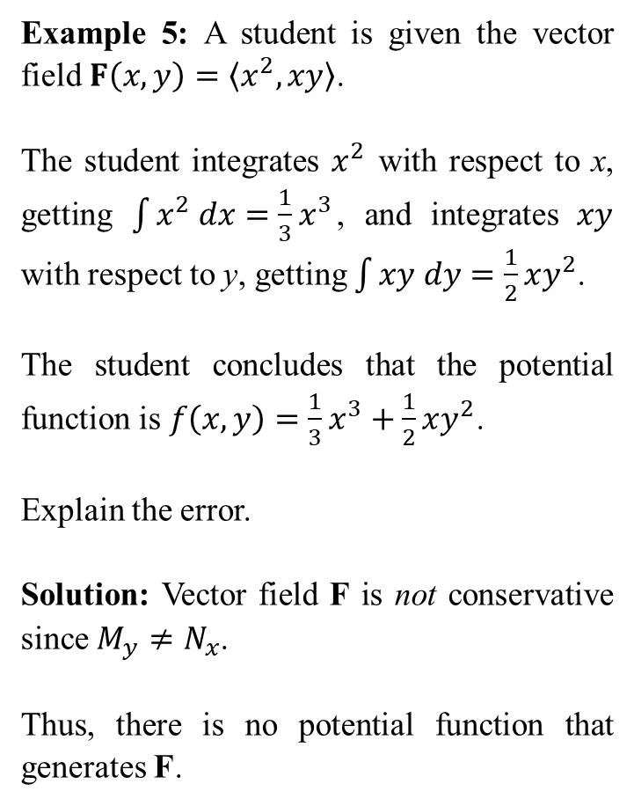
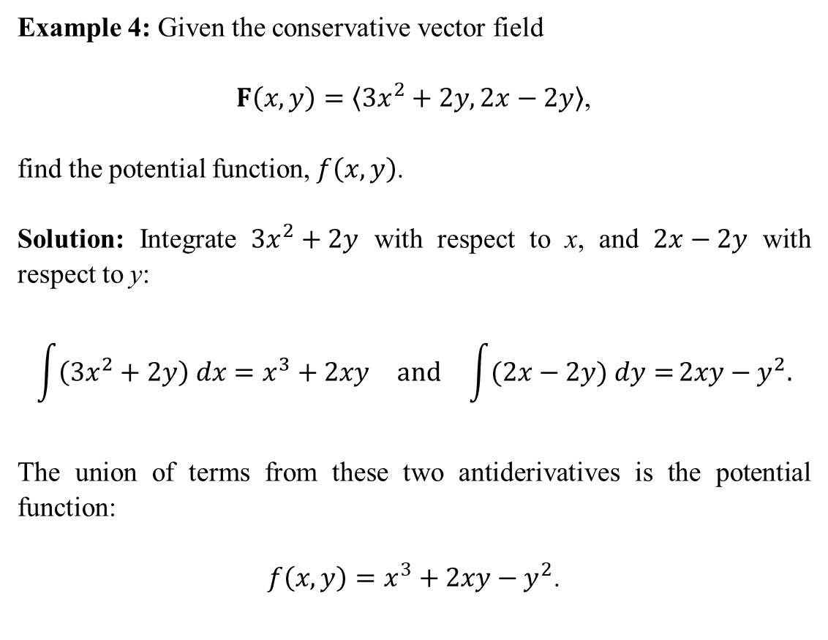
Example 4: Given the conservative vector field
$F\left(x,y\right)=〈3x^{2}+2y, 2x−2y〉$,
find the potential function, $f\left(x,y\right)$.
Solution: Integrate $3x^{2}+2y$ with respect to x, and $2x−2y$ with respect to y:
$$\begin{matrix}\int{\left(3x^{2}+2y\right) dx=x^{3}+2xy} & and & \int{(2x−2y) dy=}2xy−y^{2}.\end{matrix}$$
The union of terms from these two antiderivatives is the potential function:
$f\left(x,y\right)=x^{3}+2xy−y^{2}$.
Example 5: A student is given the vector field $F\left(x,y\right)=〈x^{2},xy〉$.
The student integrates $x^{2}$ with respect to x, getting $\int{x^{2} dx}=\frac{1}{3}x^{3}$, and integrates $xy$ with respect to y, getting $\int{xy dy}=\frac{1}{2}xy^{2}$.
The student concludes that the potential function is $f\left(x,y\right)=\frac{1}{3}x^{3}+\frac{1}{2}xy^{2}$.
Explain the error.
Solution: Vector field F is not conservative since $M_{y}≠N_{x}$.
Thus, there is no potential function that generates F.

Slide 7
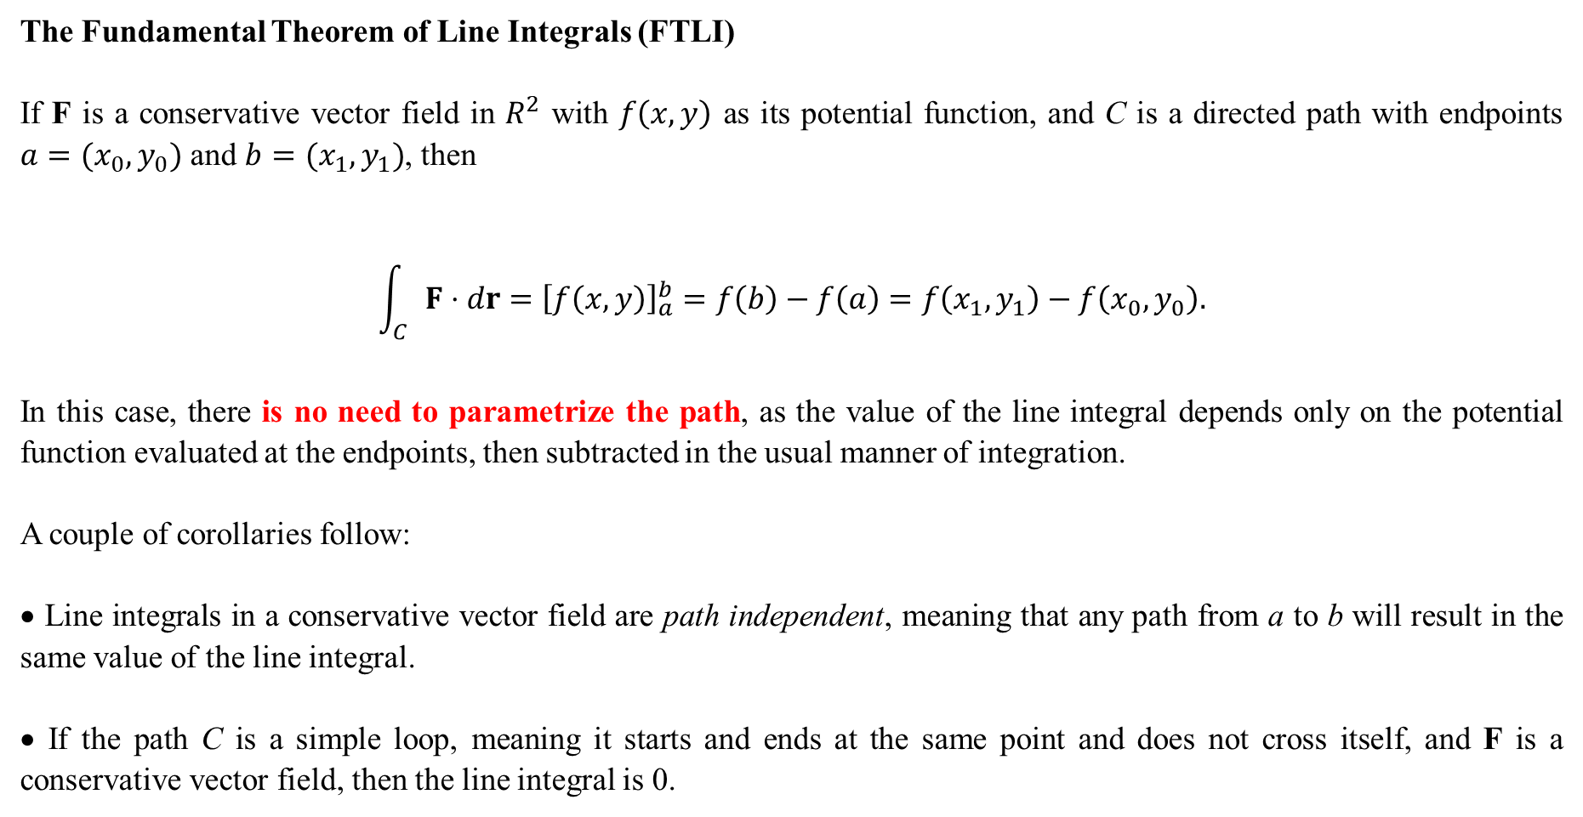
The Fundamental Theorem of Line Integrals (FTLI)
If F is a conservative vector field in $R^{2}$ with $f\left(x,y\right)$ as its potential function, and C is a directed path with endpoints $a=(x_{0},y_{0})$ and $b=(x_{1},y_{1})$, then
$$\int_{C}{F⋅dr}={\left[f\left(x,y\right)\right]}_{a}^{b}=f\left(b\right)−f\left(a\right)=f\left(x_{1},y_{1}\right)−f\left(x_{0},y_{0}\right).$$
In this case, there is no need to parametrize the path, as the value of the line integral depends only on the potential function evaluated at the endpoints, then subtracted in the usual manner of integration.
A couple of corollaries follow:
• Line integrals in a conservative vector field are path independent, meaning that any path from a to b will result in the same value of the line integral.
• If the path C is a simple loop, meaning it starts and ends at the same point and does not cross itself, and F is a conservative vector field, then the line integral is 0.

Slide 8
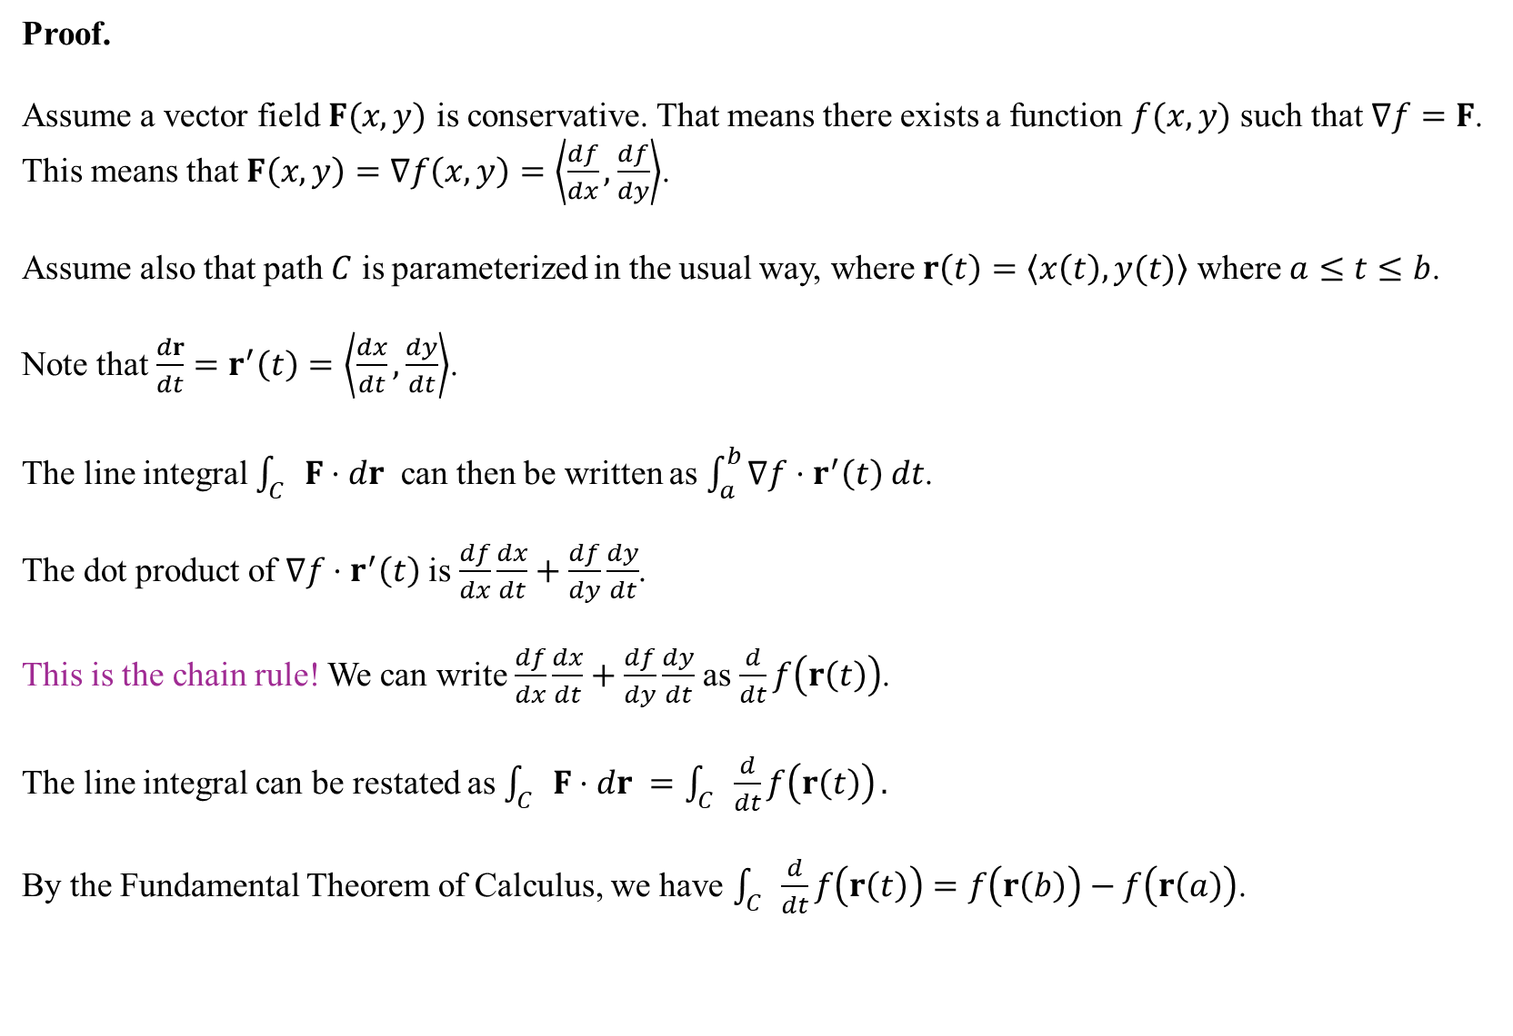
Proof.
Assume a vector field $F(x,y)$ is conservative. That means there exists a function $f(x,y)$ such that $∇f=F$. This means that $F\left(x,y\right)=∇f\left(x,y\right)=\left\langle \frac{df}{dx},\frac{df}{dy}\right\rangle$.
Assume also that path $C$ is parameterized in the usual way, where $r\left(t\right)=\left\langle x\left(t\right),y(t)\right\rangle$ where $a≤t≤b$.
Note that $\frac{dr}{dt}=r^{′}\left(t\right)=\left\langle \frac{dx}{dt},\frac{dy}{dt}\right\rangle$.
The line integral $\int_{C}{F⋅dr }$ can then be written as $\int_{a}^{b}{∇f⋅r^{′}\left(t\right) dt}$.
The dot product of $∇f⋅r^{′}\left(t\right)$is $\frac{df}{dx}\frac{dx}{dt}+\frac{df}{dy}\frac{dy}{dt}$.
This is the chain rule! We can write $\frac{df}{dx}\frac{dx}{dt}+\frac{df}{dy}\frac{dy}{dt}$ as $\frac{d}{dt}f\left(r\left(t\right)\right)$.
The line integral can be restated as $\int_{C}{F⋅dr }=\int_{C}{\frac{d}{dt}f\left(r\left(t\right)\right)}.$
By the Fundamental Theorem of Calculus, we have $\int_{C}{\frac{d}{dt}f\left(r\left(t\right)\right)}=f\left(r\left(b\right)\right)−f\left(r\left(a\right)\right)$.
If F is conservative, you DON’T need to parameterize. You just find the potential function and plug in the endpoints.
If F is not conservative, then you must parameterize.

Slide 9
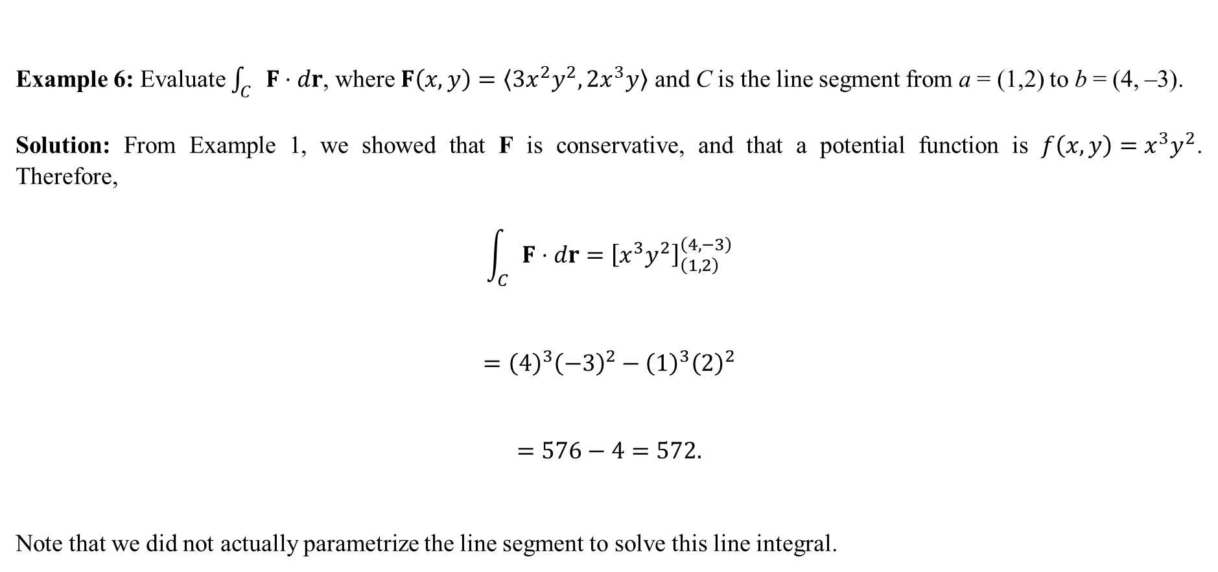
Example 6: Evaluate $\int_{C}{F⋅dr}$, where $F\left(x,y\right)=〈3x^{2}y^{2}, 2x^{3}y〉$ and C is the line segment from a = (1,2) to b = (4, –3).
Solution: From Example 1, we showed that F is conservative, and that a potential function is $f\left(x,y\right)=x^{3}y^{2}$. Therefore,
$$\int_{C}{F⋅dr}={\left[x^{3}y^{2}\right]}_{\left(1,2\right)}^{\left(4,−3\right)}$$
$$={\left(4\right)}^{3}{\left(−3\right)}^{2}−{\left(1\right)}^{3}{\left(2\right)}^{2}$$
$$=576−4=572.$$
Note that we did not actually parametrize the line segment to solve this line integral.
We just need the potential function and the endpoints!

Slide 10
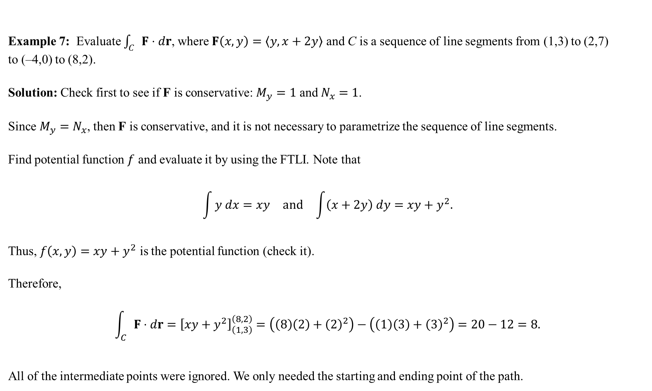
Example 7: Evaluate $\int_{C}{F⋅dr}$, where $F\left(x,y\right)=〈y,x+2y〉$ and C is a sequence of line segments from (1,3) to (2,7)
to (–4,0) to (8,2).
Solution: Check first to see if F is conservative: $M_{y}=1$ and $N_{x}=1$.
Since $M_{y}=N_{x}$, then F is conservative, and it is not necessary to parametrize the sequence of line segments.
Find potential function $f$ and evaluate it by using the FTLI. Note that
$$\begin{matrix}\int{y dx}=xy & and & \int{\left(x+2y\right) dy}=xy+y^{2}.\end{matrix}$$
Thus, $f\left(x,y\right)=xy+y^{2}$ is the potential function (check it).
Therefore,
$$\int_{C}{F⋅dr}={\left[xy+y^{2}\right]}_{\left(1,3\right)}^{\left(8,2\right)}=\left(\left(8\right)\left(2\right)+{\left(2\right)}^{2}\right)−\left(\left(1\right)\left(3\right)+{\left(3\right)}^{2}\right)=20−12=8.$$
All of the intermediate points were ignored. We only needed the starting and ending point of the path.
Because F is conservative, we only need the endpoints!

Slide 11
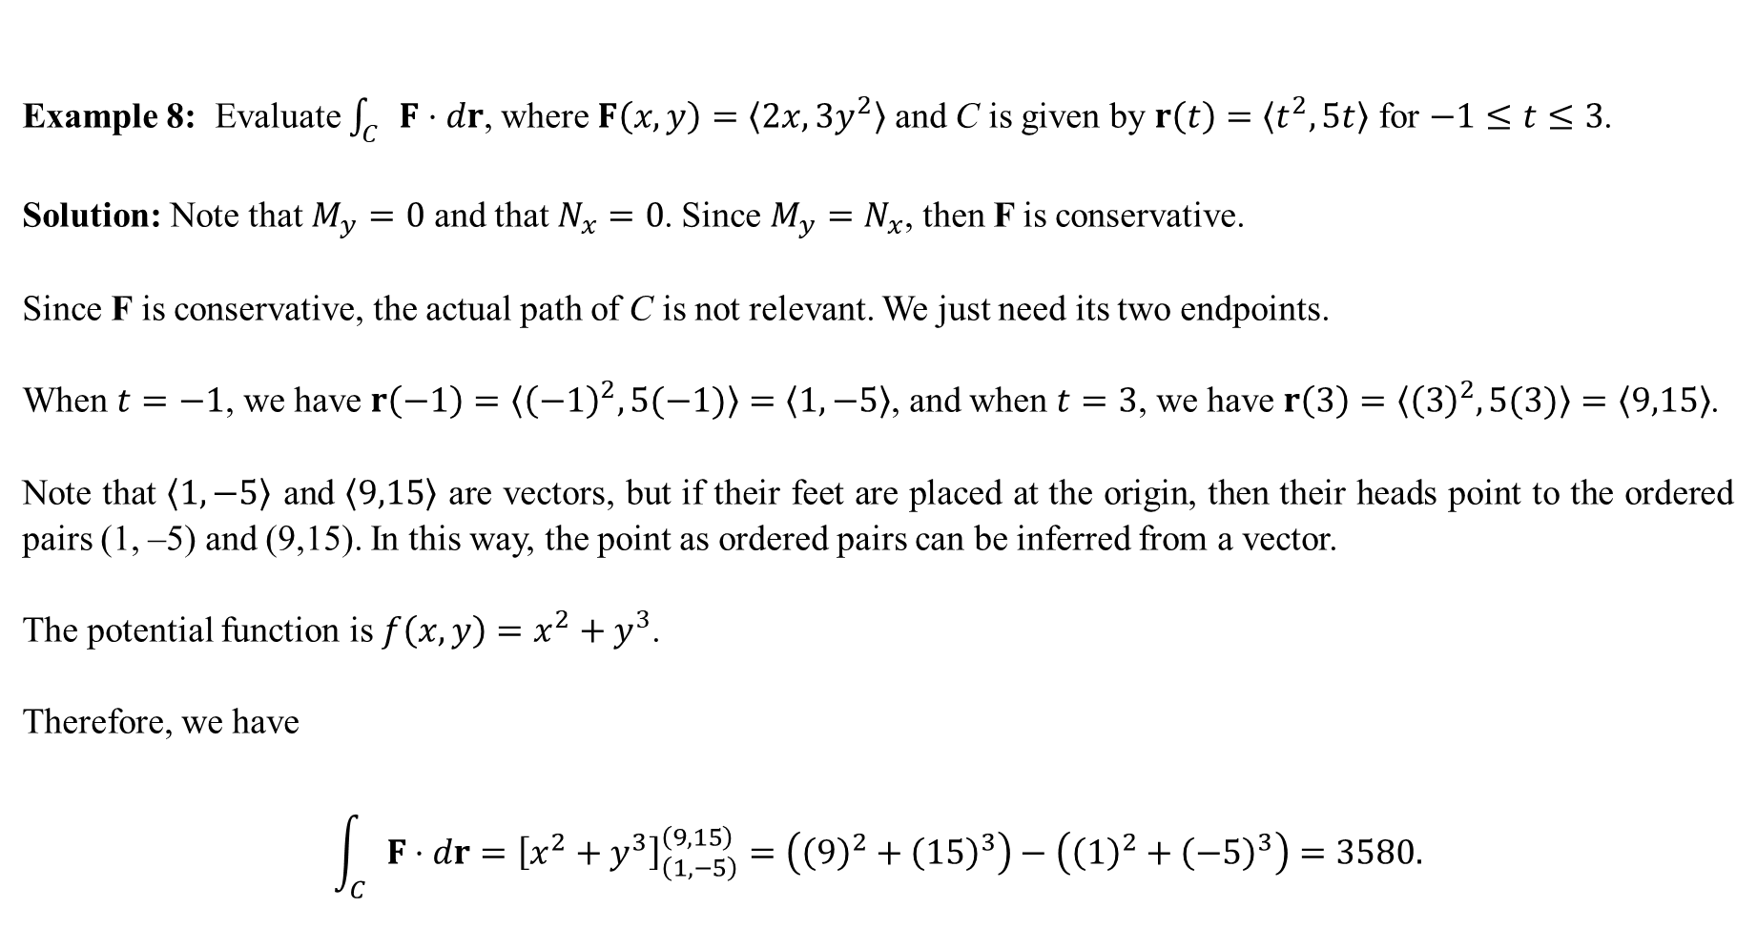
Example 8: Evaluate $\int_{C}{F⋅dr}$, where $F\left(x,y\right)=〈2x,3y^{2}〉$ and C is given by $r\left(t\right)=〈t^{2},5t〉$ for $−1≤t≤3$.
Solution: Note that $M_{y}=0$ and that $N_{x}=0$. Since $M_{y}=N_{x}$, then F is conservative.
Since F is conservative, the actual path of C is not relevant. We just need its two endpoints.
When $t=−1$, we have $r\left(−1\right)=〈{\left(−1\right)}^{2},5(−1)〉=〈1,−5〉$, and when $t=3$, we have $r\left(3\right)=〈{\left(3\right)}^{2},5(3)〉=〈9,15〉$.
Note that $〈1,−5〉$ and $〈9,15〉$ are vectors, but if their feet are placed at the origin, then their heads point to the ordered pairs (1, –5) and (9,15). In this way, the point as ordered pairs can be inferred from a vector.
The potential function is $f\left(x,y\right)=x^{2}+y^{3}$.
Therefore, we have
$$\int_{C}{F⋅dr}={\left[x^{2}+y^{3}\right]}_{\left(1,−5\right)}^{\left(9,15\right)}=\left({\left(9\right)}^{2}+{\left(15\right)}^{3}\right)−\left({\left(1\right)}^{2}+{\left(−5\right)}^{3}\right)=3580.$$
Remember, if F is conservative, we just need its potential function and the endpoints. That’s it. Nothing fancy.

Slide 12
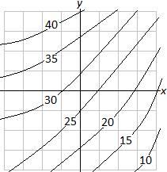
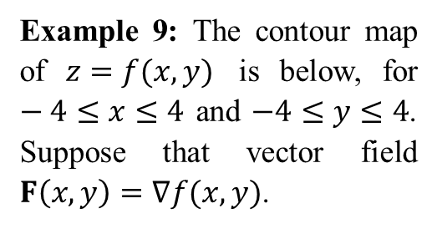
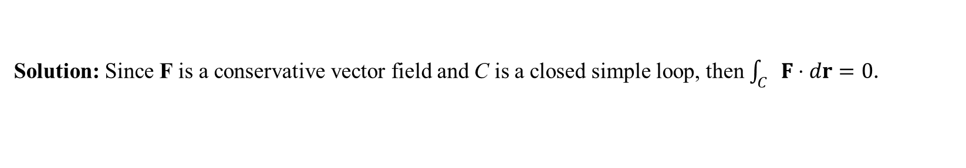
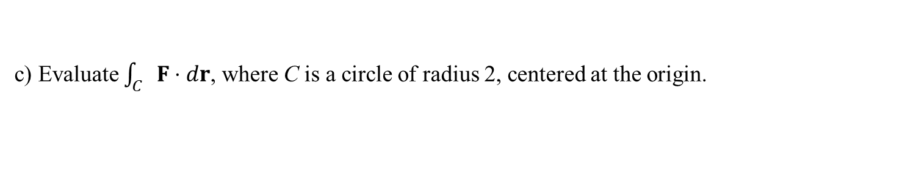
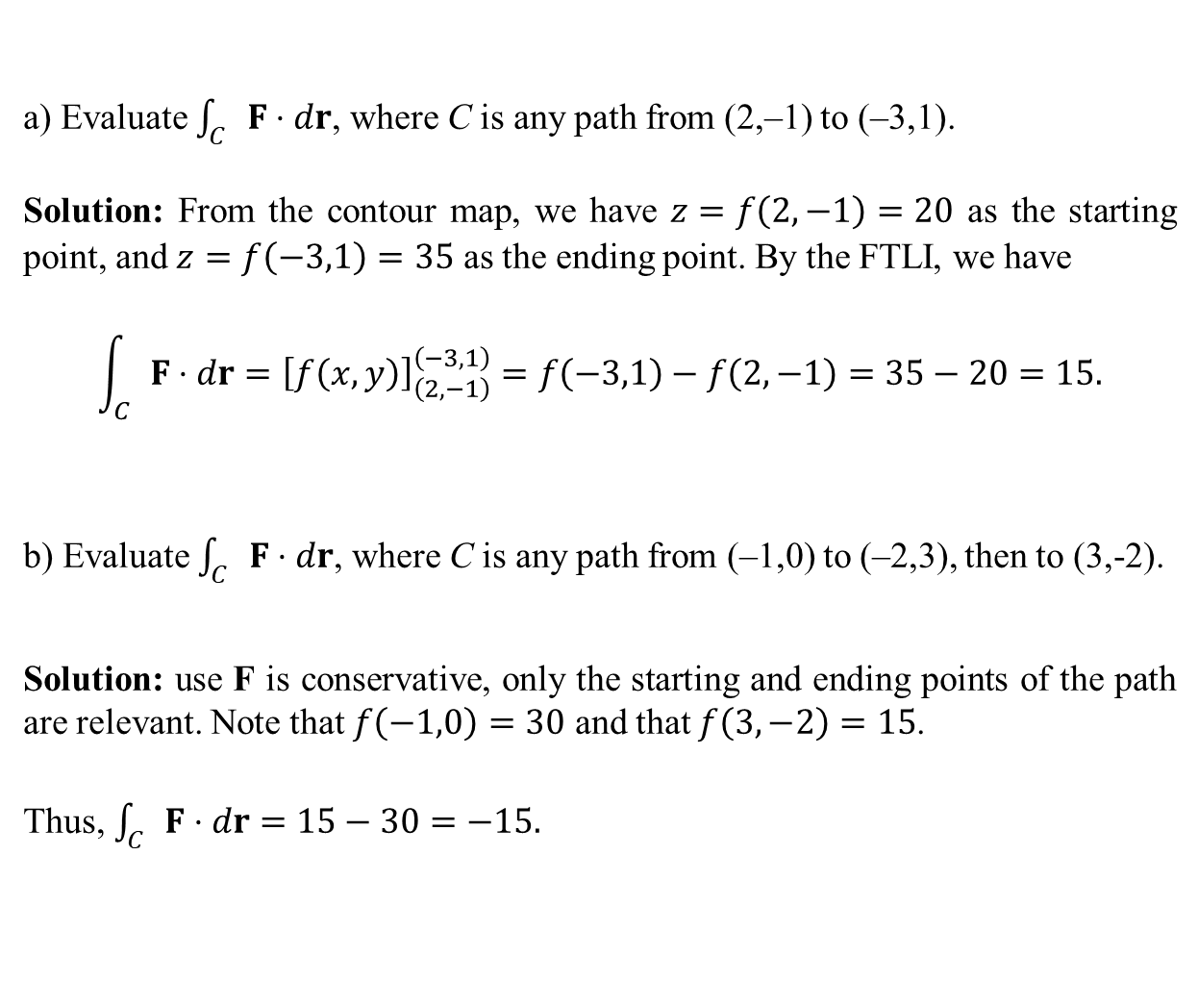
Example 9: The contour map of $z=f(x,y)$ is below, for $−4≤x≤4$ and $−4≤y≤4$. Suppose that vector field $F\left(x,y\right)=∇f(x,y)$.
a) Evaluate $\int_{C}{F⋅dr}$, where C is any path from (2,–1) to (–3,1).
Solution: From the contour map, we have $z=f\left(2,−1\right)=20$ as the starting point, and $z=f\left(−3,1\right)=35$ as the ending point. By the FTLI, we have
$$\int_{C}{F⋅dr}={\left[f\left(x,y\right)\right]}_{\left(2,−1\right)}^{\left(−3,1\right)}=f\left(−3,1\right)−f\left(2,−1\right)=35−20=15.$$
b) Evaluate $\int_{C}{F⋅dr}$, where C is any path from (–1,0) to (–2,3), then to (3,-2).
Solution: use F is conservative, only the starting and ending points of the path are relevant. Note that $f\left(−1,0\right)=30$ and that $f\left(3,−2\right)=15$.
Thus, $\int_{C}{F⋅dr}=15−30=−15.$
c) Evaluate $\int_{C}{F⋅dr}$, where C is a circle of radius 2, centered at the origin.
Solution: Since F is a conservative vector field and C is a closed simple loop, then $\int_{C}{F⋅dr}=0$.

Slide 13
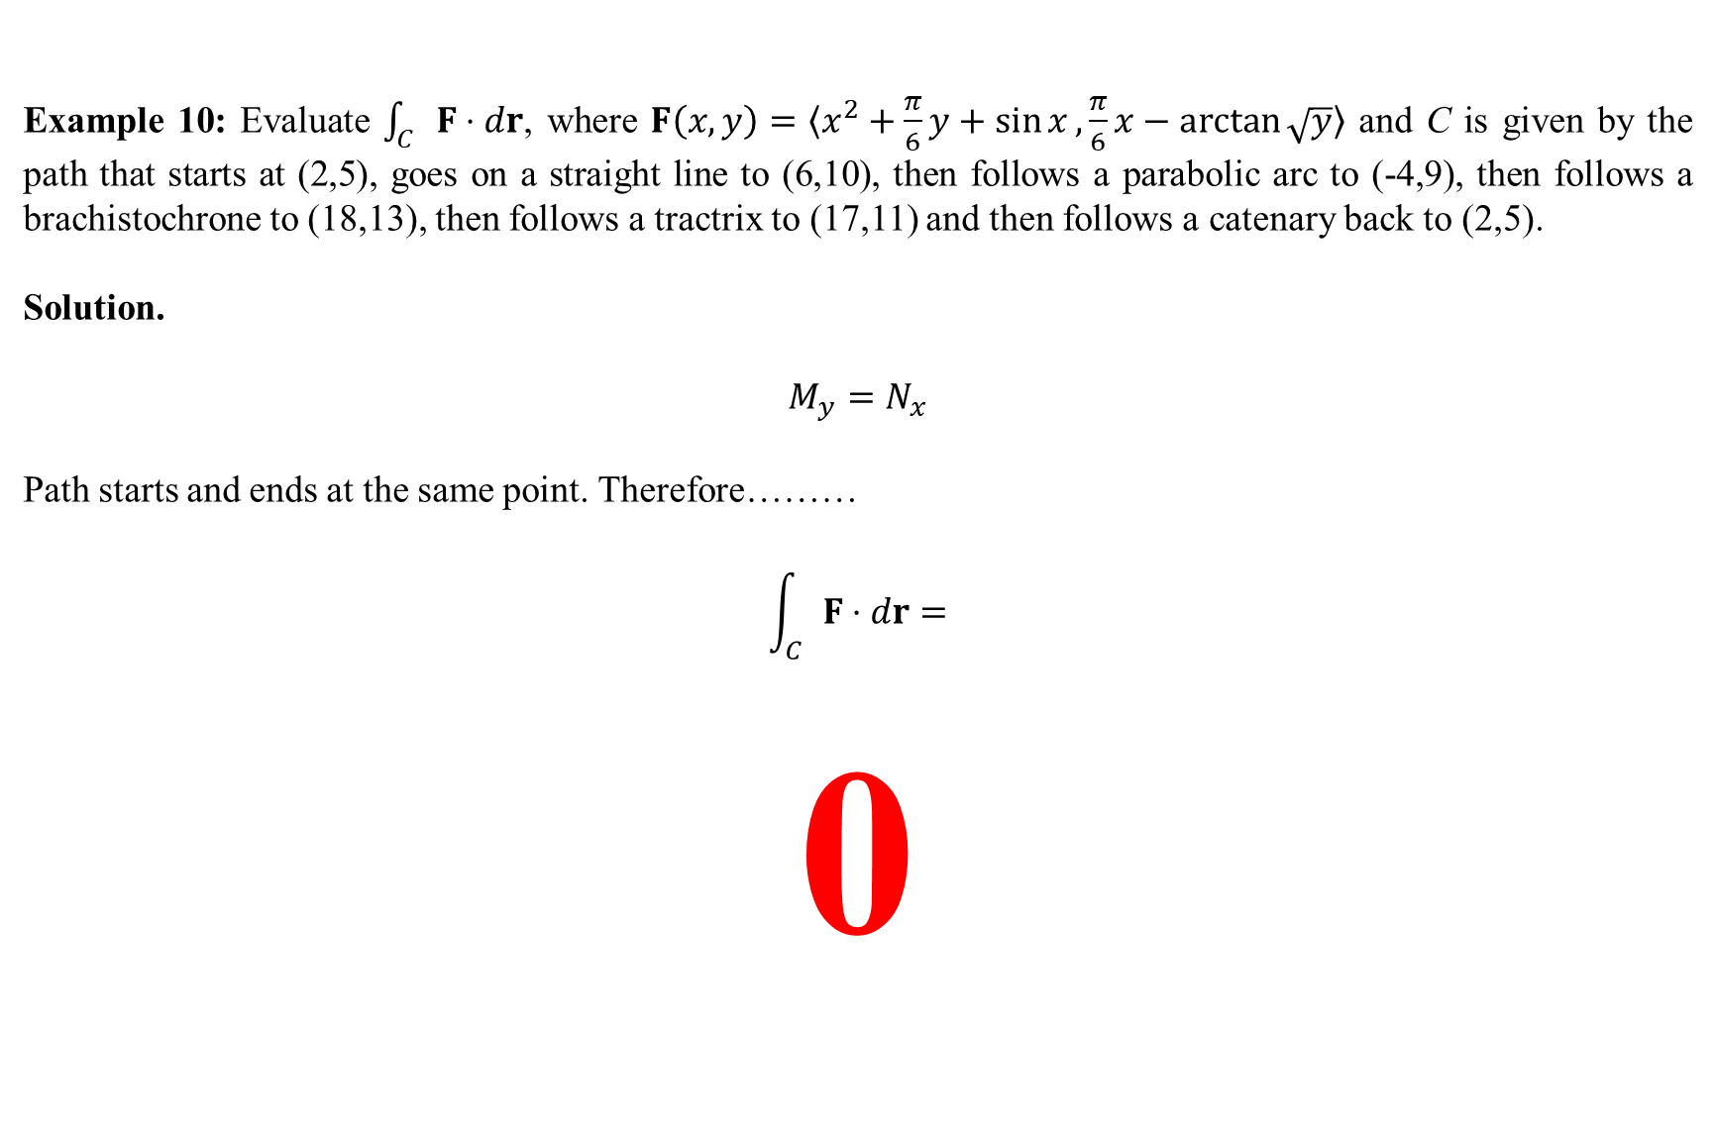
Example 10: Evaluate $\int_{C}{F⋅dr}$, where $F\left(x,y\right)=〈x^{2}+\frac{π}{6}y+\sin{x}, \frac{π}{6}x−\arctan{\sqrt{y}}〉$ and C is given by the path that starts at (2,5), goes on a straight line to (6,10), then follows a parabolic arc to (-4,9), then follows a brachistochrone to (18,13), then follows a tractrix to (17,11) and then follows a catenary back to (2,5).
Solution.
$$M_{y}=N_{x}$$
Path starts and ends at the same point. Therefore………
$$\int_{C}{F⋅dr=}$$
0

