Slide 1
Flux through
Surfaces & Solids
The Divergence Theorem
Scott Surgent

Slide 2
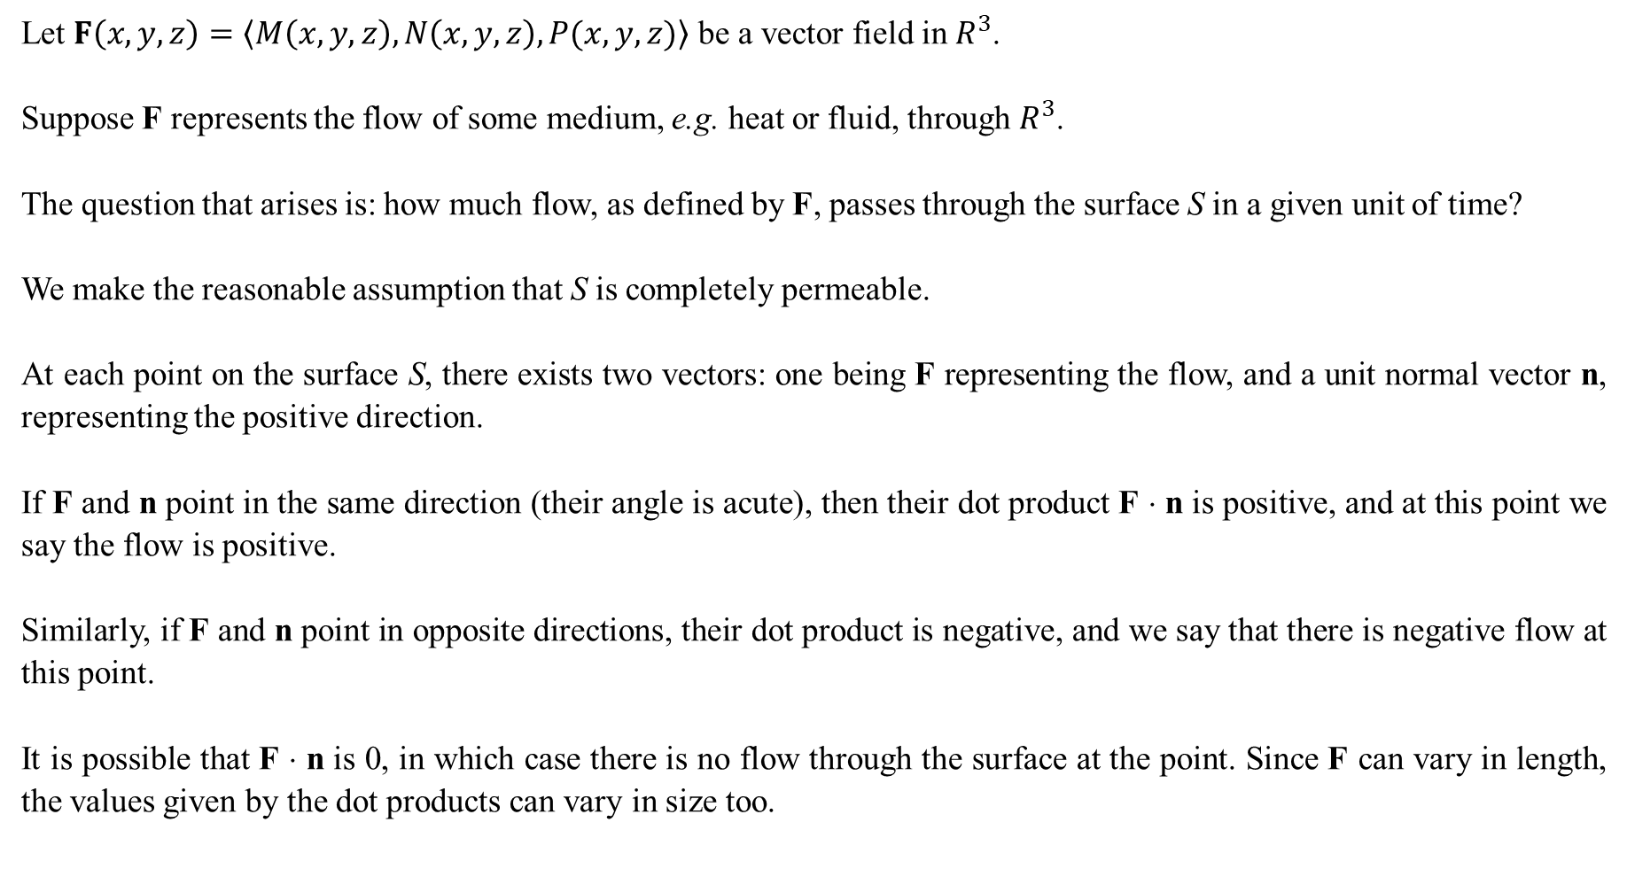
Let $F\left(x,y,z\right)=〈M\left(x,y,z\right),N\left(x,y,z\right),P(x,y,z)〉$ be a vector field in $R^{3}$.
Suppose F represents the flow of some medium, e.g. heat or fluid, through $R^{3}$.
The question that arises is: how much flow, as defined by F, passes through the surface S in a given unit of time?
We make the reasonable assumption that S is completely permeable.
At each point on the surface S, there exists two vectors: one being F representing the flow, and a unit normal vector n, representing the positive direction.
If F and n point in the same direction (their angle is acute), then their dot product F ⋅ n is positive, and at this point we say the flow is positive.
Similarly, if F and n point in opposite directions, their dot product is negative, and we say that there is negative flow at this point.
It is possible that F ⋅ n is 0, in which case there is no flow through the surface at the point. Since F can vary in length, the values given by the dot products can vary in size too.

Slide 3
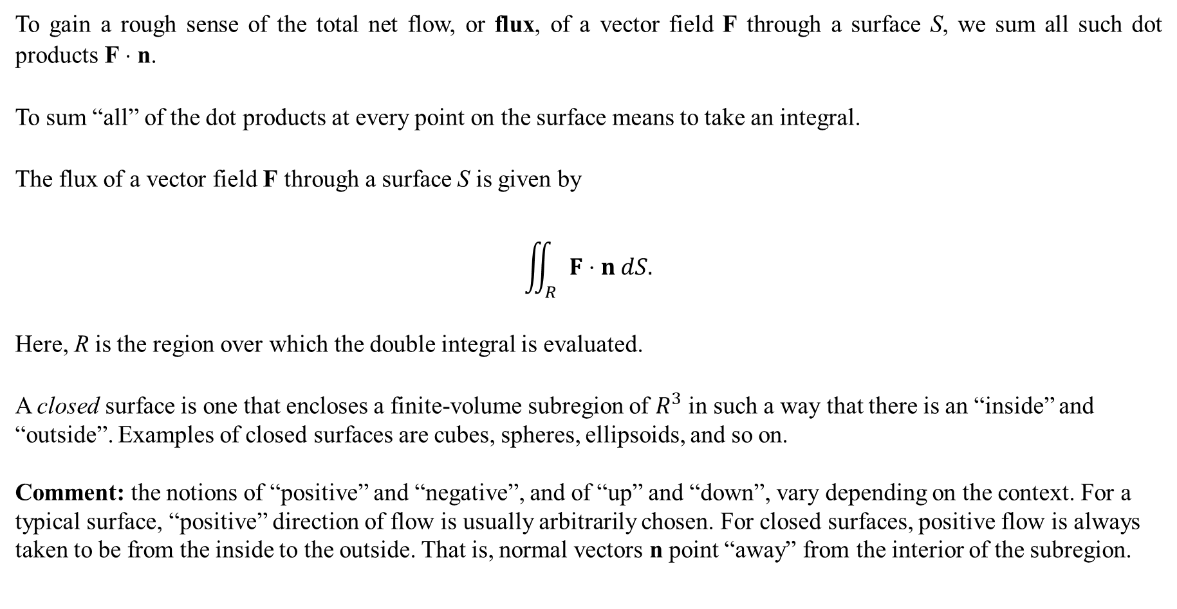
To gain a rough sense of the total net flow, or flux, of a vector field F through a surface S, we sum all such dot products F ⋅ n.
To sum “all” of the dot products at every point on the surface means to take an integral.
The flux of a vector field F through a surface S is given by
$$\iint_{R}{F⋅n dS.}$$
Here, R is the region over which the double integral is evaluated.
A closed surface is one that encloses a finite-volume subregion of $R^{3}$ in such a way that there is an “inside” and “outside”. Examples of closed surfaces are cubes, spheres, ellipsoids, and so on.
Comment: the notions of “positive” and “negative”, and of “up” and “down”, vary depending on the context. For a typical surface, “positive” direction of flow is usually arbitrarily chosen. For closed surfaces, positive flow is always taken to be from the inside to the outside. That is, normal vectors n point “away” from the interior of the subregion.

Slide 4
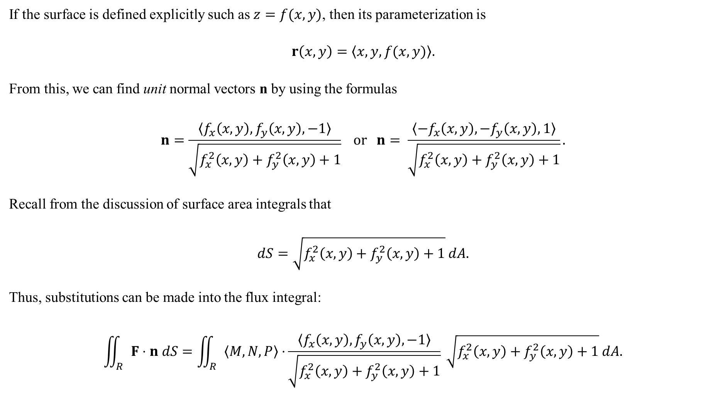
If the surface is defined explicitly such as $z=f(x,y)$, then its parameterization is
$$r\left(x,y\right)=〈x,y,f(x,y)〉.$$
From this, we can find unit normal vectors n by using the formulas
$$n=\frac{〈f_{x}\left(x,y\right),f_{y}\left(x,y\right),−1〉}{\sqrt{f_{x}^{2}\left(x,y\right)+f_{y}^{2}\left(x,y\right)+1}} or n= \frac{〈−f_{x}\left(x,y\right),−f_{y}\left(x,y\right),1〉}{\sqrt{f_{x}^{2}\left(x,y\right)+f_{y}^{2}\left(x,y\right)+1}}.$$
Recall from the discussion of surface area integrals that
$$dS=\sqrt{f_{x}^{2}\left(x,y\right)+f_{y}^{2}\left(x,y\right)+1} dA.$$
Thus, substitutions can be made into the flux integral:
$$\iint_{R}{F⋅n dS}=\iint_{R}{〈M,N,P〉⋅}\frac{〈f_{x}\left(x,y\right),f_{y}\left(x,y\right),−1〉}{\sqrt{f_{x}^{2}\left(x,y\right)+f_{y}^{2}\left(x,y\right)+1}} \sqrt{f_{x}^{2}\left(x,y\right)+f_{y}^{2}\left(x,y\right)+1} dA.$$

Slide 5
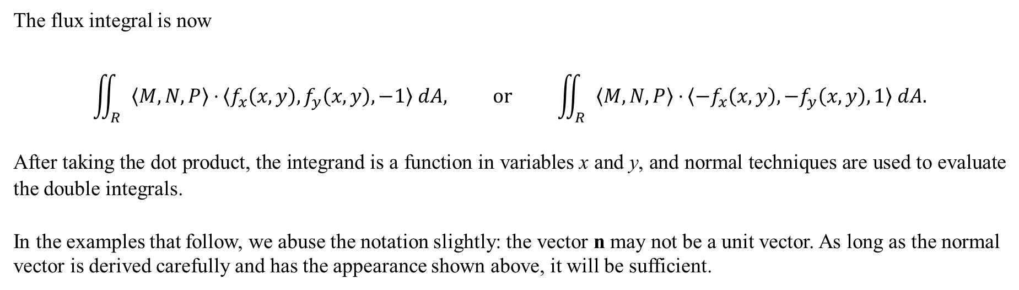
The flux integral is now
$$\iint_{R}{〈M,N,P〉⋅}〈f_{x}\left(x,y\right),f_{y}\left(x,y\right),−1〉 dA, or \iint_{R}{〈M,N,P〉⋅}〈−f_{x}\left(x,y\right),−f_{y}\left(x,y\right),1〉 dA.$$
After taking the dot product, the integrand is a function in variables x and y, and normal techniques are used to evaluate the double integrals.
In the examples that follow, we abuse the notation slightly: the vector n may not be a unit vector. As long as the normal vector is derived carefully and has the appearance shown above, it will be sufficient.

Slide 6
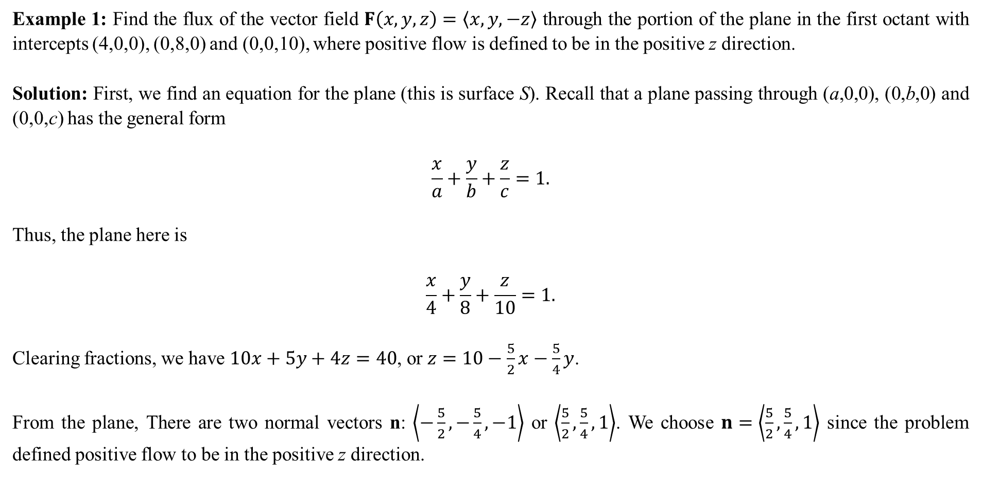
Example 1: Find the flux of the vector field $F\left(x,y,z\right)=〈x,y,−z〉$ through the portion of the plane in the first octant with intercepts (4,0,0), (0,8,0) and (0,0,10), where positive flow is defined to be in the positive z direction.
Solution: First, we find an equation for the plane (this is surface S). Recall that a plane passing through (a,0,0), (0,b,0) and (0,0,c) has the general form
$$\frac{x}{a}+\frac{y}{b}+\frac{z}{c}=1.$$
Thus, the plane here is
$$\frac{x}{4}+\frac{y}{8}+\frac{z}{10}=1.$$
Clearing fractions, we have $10x+5y+4z=40$, or $z=10−\frac{5}{2}x−\frac{5}{4}y$.
From the plane, There are two normal vectors n: $\left\langle −\frac{5}{2},−\frac{5}{4},−1\right\rangle$ or $\left\langle \frac{5}{2},\frac{5}{4},1\right\rangle$. We choose $n=\left\langle \frac{5}{2},\frac{5}{4},1\right\rangle$ since the problem defined positive flow to be in the positive z direction.

Slide 7
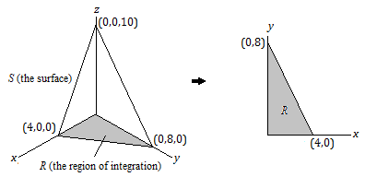

We now find $F⋅n$. Note that since $z=10−\frac{5}{2}x−\frac{5}{4}y$, we write F in terms of x and y, where $F\left(x,y\right)=〈x,y,−z〉=\left\langle x,y,−\left(10−\frac{5}{2}x−\frac{5}{4}y\right)\right\rangle$. Thus,
$$F⋅n=\left\langle x,y,−10+\frac{5}{2}x+\frac{5}{4}y\right\rangle ⋅\left\langle \frac{5}{2},\frac{5}{4},1\right\rangle$$
$$=\frac{5}{2}x+\frac{5}{4}y−10+\frac{5}{2}x+\frac{5}{4}y$$
$$=5x+\frac{5}{2}y−10.$$
This will be the integrand.
The bounds of integration lie in the xy-plane:

Slide 8
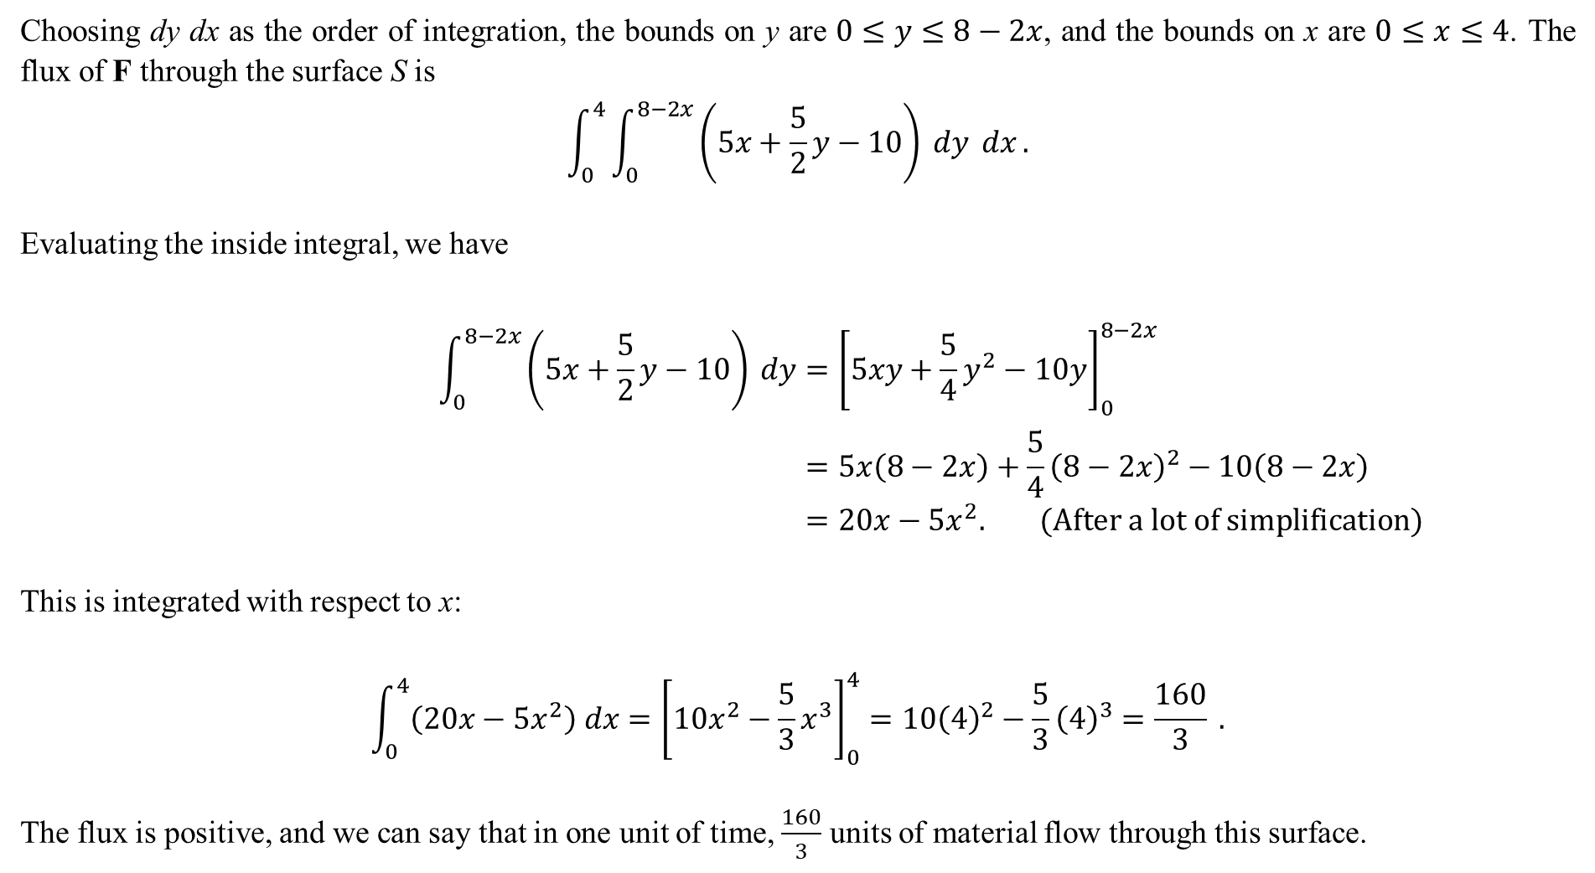
Choosing dy dx as the order of integration, the bounds on y are $0≤y≤8−2x$, and the bounds on x are $0≤x≤4$. The flux of F through the surface S is
$$\int_{0}^{4}{\int_{0}^{8−2x}{\left(5x+\frac{5}{2}y−10\right) dy} dx}.$$
Evaluating the inside integral, we have
$$\int_{0}^{8−2x}{\left(5x+\frac{5}{2}y−10\right) dy}={\left[5xy+\frac{5}{4}y^{2}−10y\right]}_{0}^{8−2x} \\ =5x\left(8−2x\right)+\frac{5}{4}{\left(8−2x\right)}^{2}−10\left(8−2x\right) \\ =20x−5x^{2}. (After a lot of simplification)$$
This is integrated with respect to x:
$$\int_{0}^{4}{\left(20x−5x^{2}\right) dx}={\left[10x^{2}−\frac{5}{3}x^{3}\right]}_{0}^{4}=10{\left(4\right)}^{2}−\frac{5}{3}{\left(4\right)}^{3}=\frac{160}{3} .$$
The flux is positive, and we can say that in one unit of time, $\frac{160}{3}$ units of material flow through this surface.

Slide 9
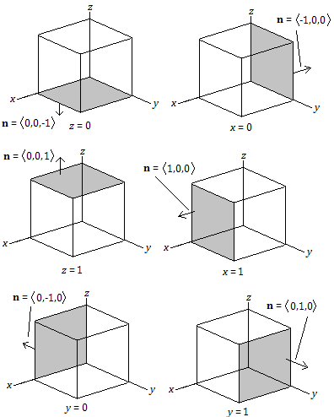
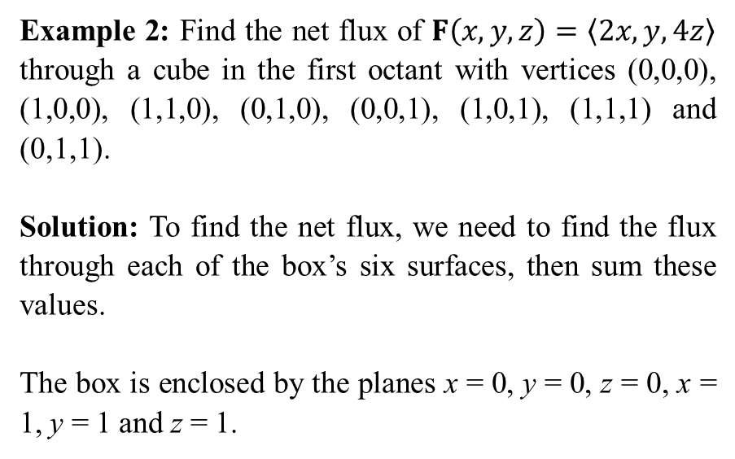
Example 2: Find the net flux of $F\left(x,y,z\right)=〈2x,y,4z〉$ through a cube in the first octant with vertices (0,0,0), (1,0,0), (1,1,0), (0,1,0), (0,0,1), (1,0,1), (1,1,1) and (0,1,1).
Solution: To find the net flux, we need to find the flux through each of the box’s six surfaces, then sum these values.
The box is enclosed by the planes x = 0, y = 0, z = 0, x = 1, y = 1 and z = 1.

Slide 10
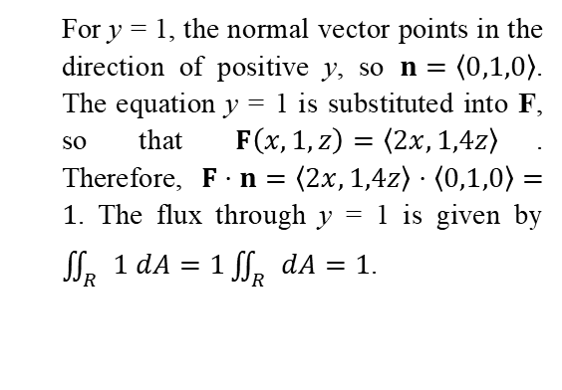


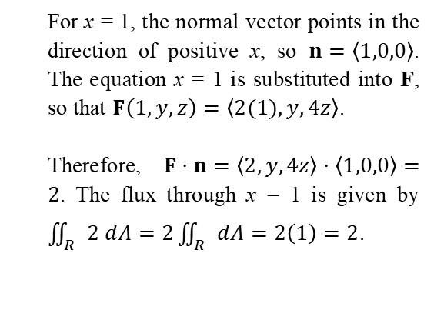


For z = 0, the normal vector points in the direction of negative z, so $n=〈0,0,−1〉$. The equation z = 0 is substituted into F, so that $F\left(x,y,0\right)=〈2x,y,0〉$. Therefore, $F⋅n=〈2x,y,0〉⋅〈0,0,−1〉=0$. The flux is zero—there is no flow generated by the vector field F through the surface z = 0.
For x = 0, the normal vector points in the direction of negative x, so $n=〈−1,0,0〉$. The equation x = 0 is substituted into F, so that $F\left(0,y,z\right)=〈0,y,4z〉$. Therefore, $F⋅n=〈0,y,4z〉⋅〈−1,0,0〉=0$. The flux is zero—there is no flow generated by the vector field F through the surface x = 0.
For z = 1, the normal vector points in the direction of positive z, so $n=〈0,0,1〉$. The equation z = 1 is substituted into F, so that $F\left(x,y,1\right)=〈2x,y,4(1)〉$. Therefore, $F⋅n=〈2x,y,4〉⋅〈0,0,1〉=4$. The flux through z = 1 is $\iint_{R}{4 dA}=4\iint_{R}{dA}=4\left(1\right)=4$, where $\iint_{R}{dA}$ is the area of the surface, which is a square with side lengths 1.
For x = 1, the normal vector points in the direction of positive x, so $n=〈1,0,0〉$. The equation x = 1 is substituted into F, so that $F\left(1,y,z\right)=〈2(1),y,4z〉$.
Therefore, $F⋅n=〈2,y,4z〉⋅〈1,0,0〉=2$. The flux through x = 1 is given by $\iint_{R}{2 dA}=2\iint_{R}{dA}=2\left(1\right)=2$.
For y = 0, the normal vector points in the direction of negative y, so $n=〈0,−1,0〉$. The equation y = 0 is substituted into F, so that $F\left(x,0,z\right)=〈2x,0,4z〉$. Therefore, $F⋅n=〈2x,0,4z〉⋅〈0,−1,0〉=0$. The flux is zero—there is no flow generated by the vector field F through the surface y = 0.
For y = 1, the normal vector points in the direction of positive y, so $n=〈0,1,0〉$. The equation y = 1 is substituted into F, so that $F\left(x,1,z\right)=〈2x,1,4z〉$. Therefore, $F⋅n=〈2x,1,4z〉⋅〈0,1,0〉=1$. The flux through y = 1 is given by $\iint_{R}{1 dA}=1\iint_{R}{dA}=1$.
The total net flux is the sum of these values: 0 + 0 + 0 + 4 + 2 + 1 = 7 units of mass per unit of time.

Slide 11
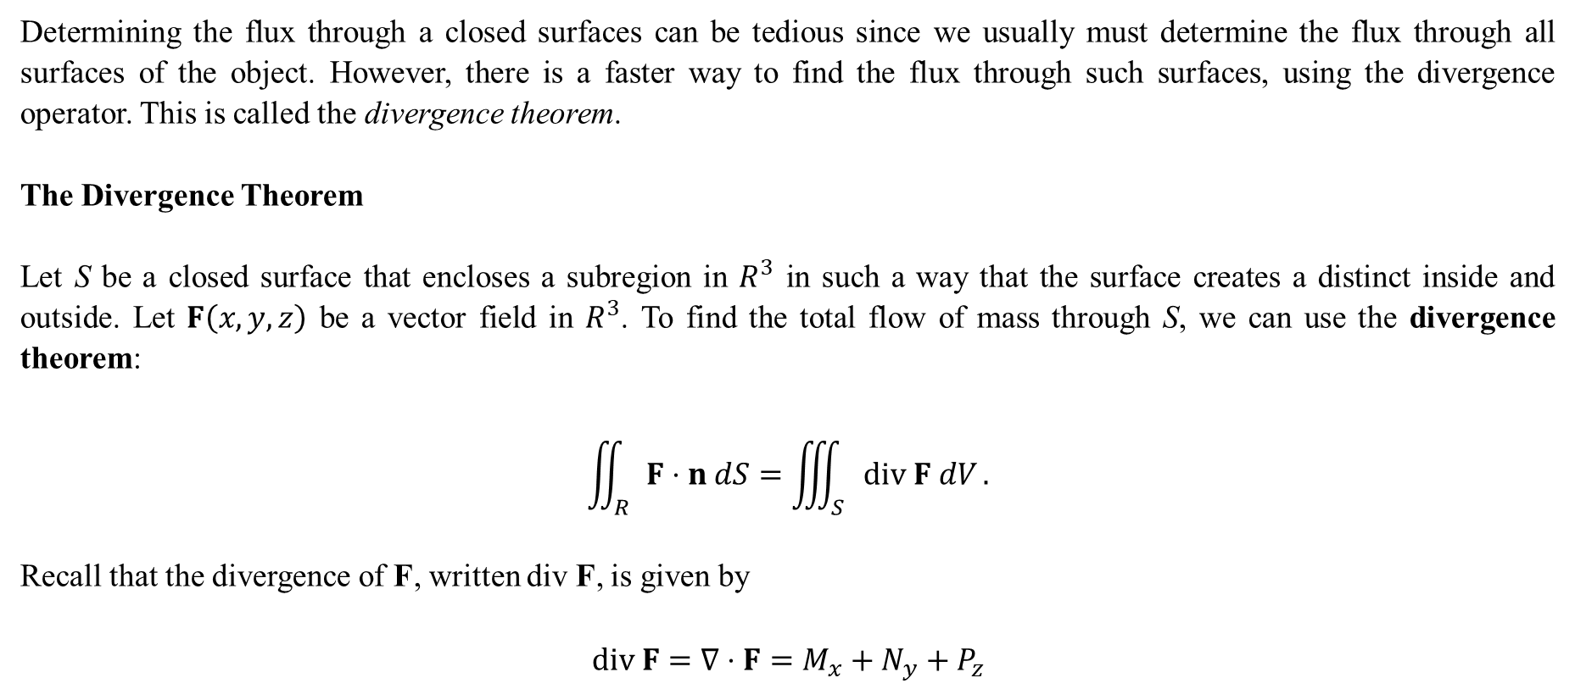
Determining the flux through a closed surfaces can be tedious since we usually must determine the flux through all surfaces of the object. However, there is a faster way to find the flux through such surfaces, using the divergence operator. This is called the divergence theorem.
The Divergence Theorem
Let S be a closed surface that encloses a subregion in $R^{3}$ in such a way that the surface creates a distinct inside and outside. Let $F\left(x,y,z\right)$ be a vector field in $R^{3}$. To find the total flow of mass through S, we can use the divergence theorem:
$$\iint_{R}{F⋅n dS}=\iiint_{S}{div F dV}.$$
Recall that the divergence of F, written div F, is given by
$$div F=∇⋅F=M_{x}+N_{y}+P_{z}$$

Slide 12

Example 3: Find the net flux of $F\left(x,y,z\right)=〈2x,y,4z〉$ through a cube in the first octant with vertices (0,0,0), (1,0,0), (1,1,0), (0,1,0), (0,0,1), (1,0,1), (1,1,1) and (0,1,1). (This is a repeat of Example 2)
Solution: Find the divergence of F:
$$div F=∇⋅F=〈∂_{x},∂_{y},∂_{z}〉⋅〈2x,y,4z〉 \\ =2+1+4 \\ =7.$$
Thus, the flux through the solid cube with side lengths 1 is
$$\iiint_{S}{div F dV}=\iiint_{S}{7 dV}$$
$$=7\iiint_{S}{dV}$$
$$=7{\left(1\right)}^{3}$$
$$=7.$$

Slide 13
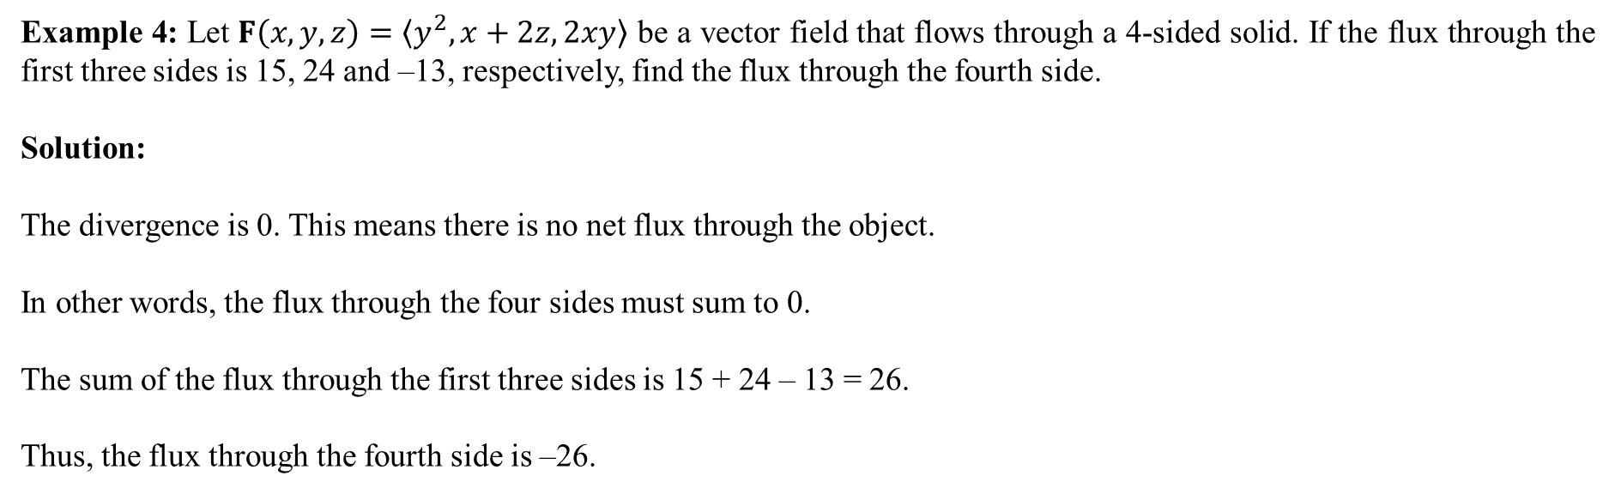
Example 4: Let $F\left(x,y,z\right)=〈y^{2},x+2z,2xy〉$ be a vector field that flows through a 4-sided solid. If the flux through the first three sides is 15, 24 and –13, respectively, find the flux through the fourth side.
Solution:
The divergence is 0. This means there is no net flux through the object.
In other words, the flux through the four sides must sum to 0.
The sum of the flux through the first three sides is 15 + 24 – 13 = 26.
Thus, the flux through the fourth side is –26.

Slide 14
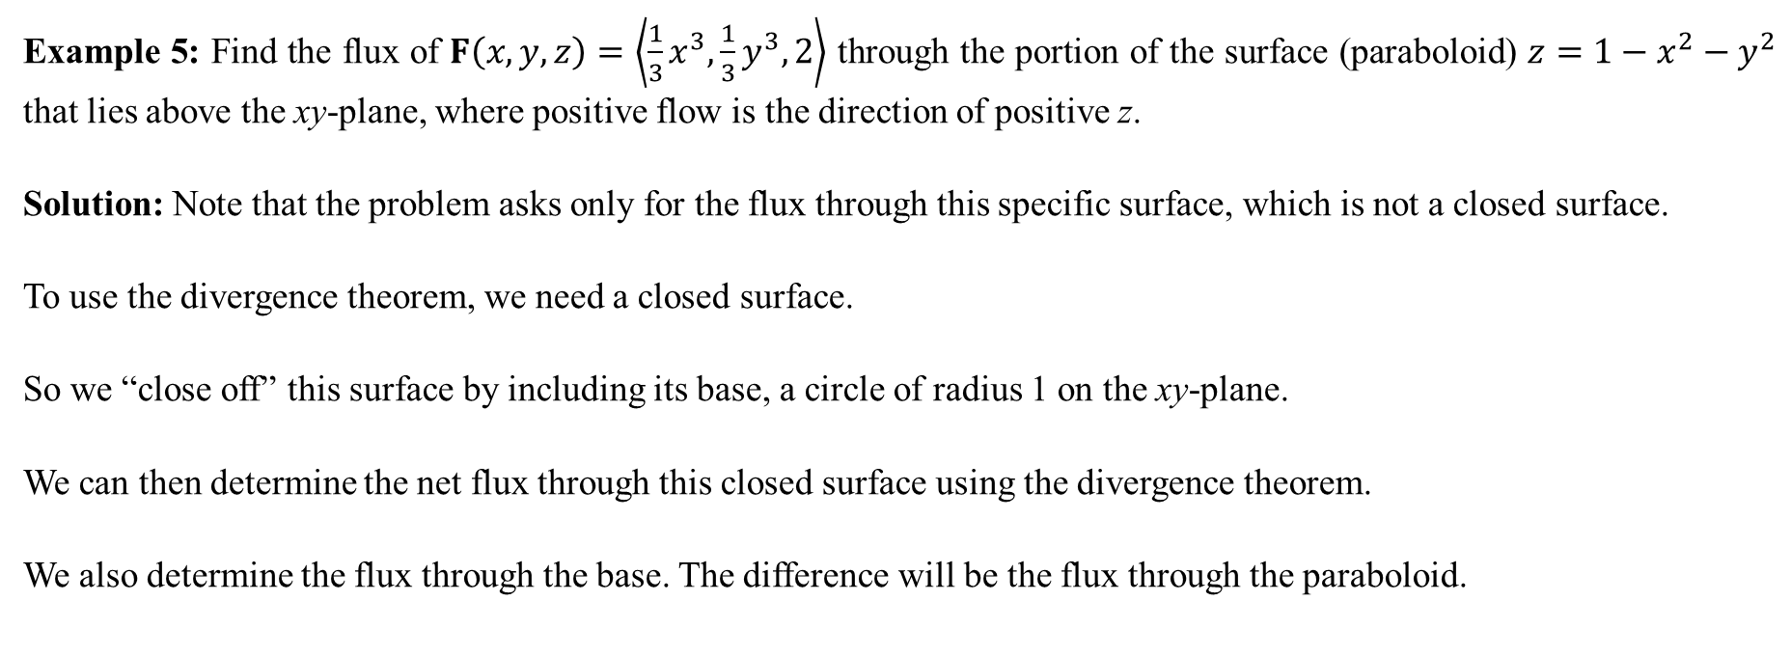
Example 5: Find the flux of $F\left(x,y,z\right)=\left\langle \frac{1}{3}x^{3},\frac{1}{3}y^{3},2\right\rangle$ through the portion of the surface (paraboloid) $z=1−x^{2}−y^{2}$ that lies above the xy-plane, where positive flow is the direction of positive z.
Solution: Note that the problem asks only for the flux through this specific surface, which is not a closed surface.
To use the divergence theorem, we need a closed surface.
So we “close off” this surface by including its base, a circle of radius 1 on the xy-plane.
We can then determine the net flux through this closed surface using the divergence theorem.
We also determine the flux through the base. The difference will be the flux through the paraboloid.

Slide 15
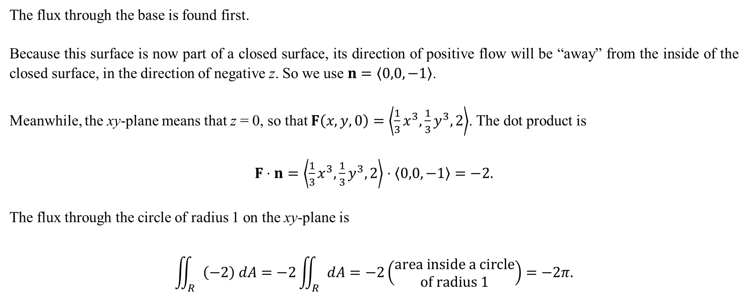
The flux through the base is found first.
Because this surface is now part of a closed surface, its direction of positive flow will be “away” from the inside of the closed surface, in the direction of negative z. So we use $n=〈0,0,−1〉$.
Meanwhile, the xy-plane means that z = 0, so that $F\left(x,y,0\right)=\left\langle \frac{1}{3}x^{3},\frac{1}{3}y^{3},2\right\rangle$. The dot product is
$F⋅n=\left\langle \frac{1}{3}x^{3},\frac{1}{3}y^{3},2\right\rangle ⋅〈0,0,−1〉=−2.$
The flux through the circle of radius 1 on the xy-plane is
$$\iint_{R}{\left(−2\right) dA}=−2\iint_{R}{dA}=−2\left(\begin{matrix}area inside a circle \\ of radius 1\end{matrix}\right)=−2π.$$

Slide 16
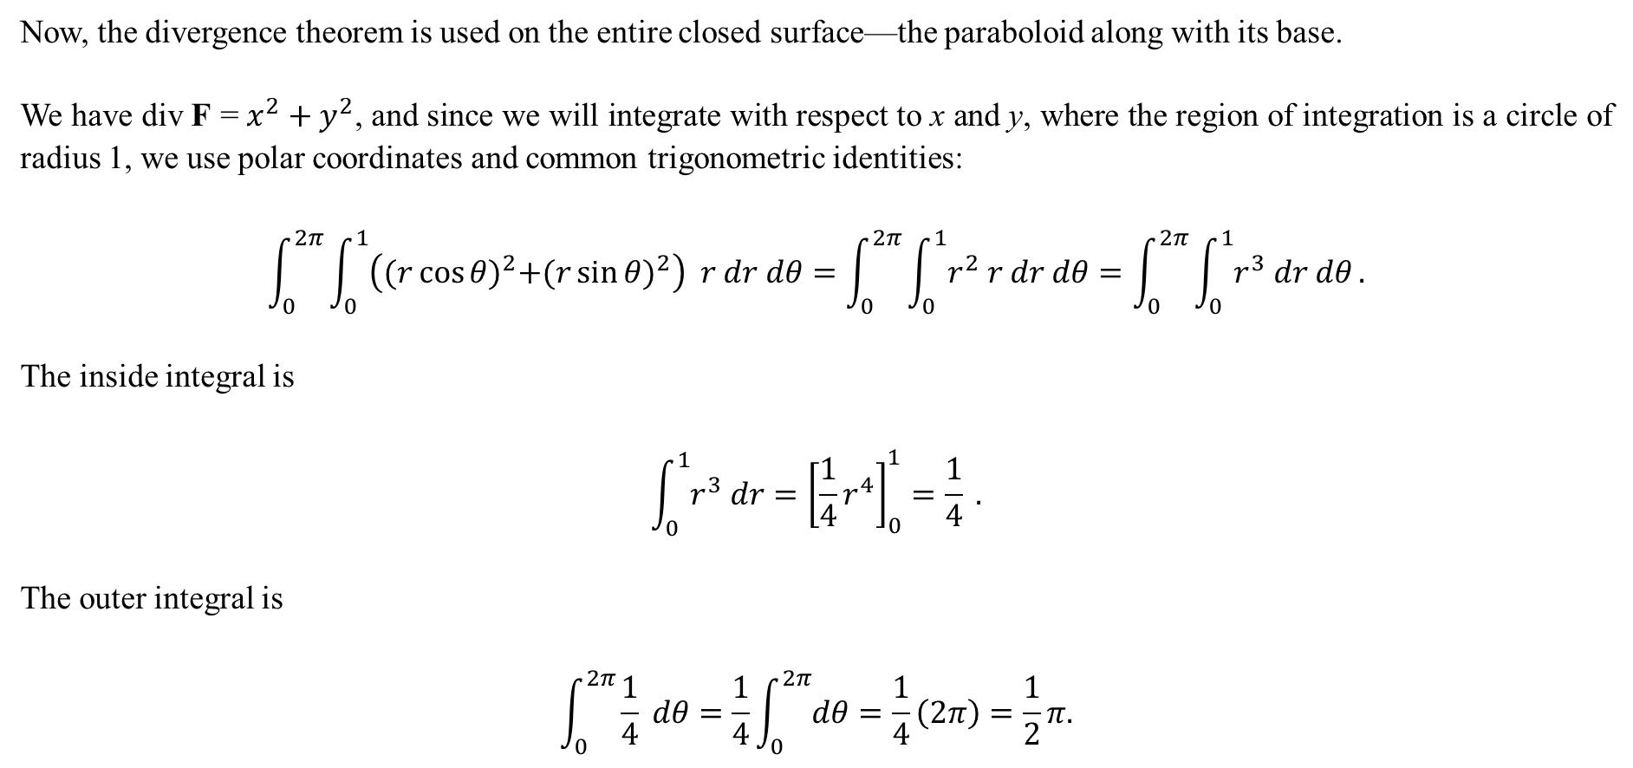
Now, the divergence theorem is used on the entire closed surface—the paraboloid along with its base.
We have div F = $x^{2}+y^{2}$, and since we will integrate with respect to x and y, where the region of integration is a circle of radius 1, we use polar coordinates and common trigonometric identities:
$$\int_{0}^{2π}{\int_{0}^{1}{\left({(r\cos{θ})}^{2}+{(r\sin{θ})}^{2}\right) r dr dθ}}=\int_{0}^{2π}{\int_{0}^{1}{r^{2} r dr dθ}}=\int_{0}^{2π}{\int_{0}^{1}{r^{3} dr dθ}}.$$
The inside integral is
$$\int_{0}^{1}{r^{3} dr}={\left[\frac{1}{4}r^{4}\right]}_{0}^{1}=\frac{1}{4} .$$
The outer integral is
$$\int_{0}^{2π}{\frac{1}{4} dθ}=\frac{1}{4}\int_{0}^{2π}{dθ}=\frac{1}{4}\left(2π\right)=\frac{1}{2}π.$$

Slide 17
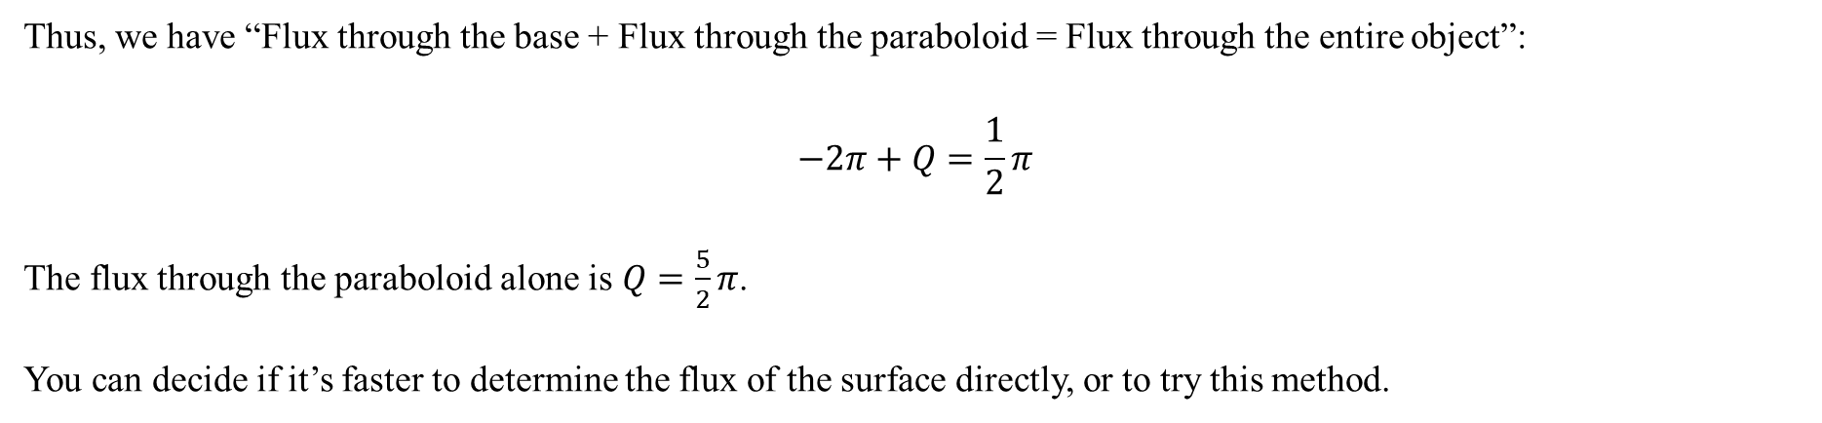
Thus, we have “Flux through the base + Flux through the paraboloid = Flux through the entire object”:
$$−2π+Q=\frac{1}{2}π$$
The flux through the paraboloid alone is $Q=\frac{5}{2}π$.
You can decide if it’s faster to determine the flux of the surface directly, or to try this method.

