Slide 1
Dot Product & Projections
Scott Surgent

Slide 2
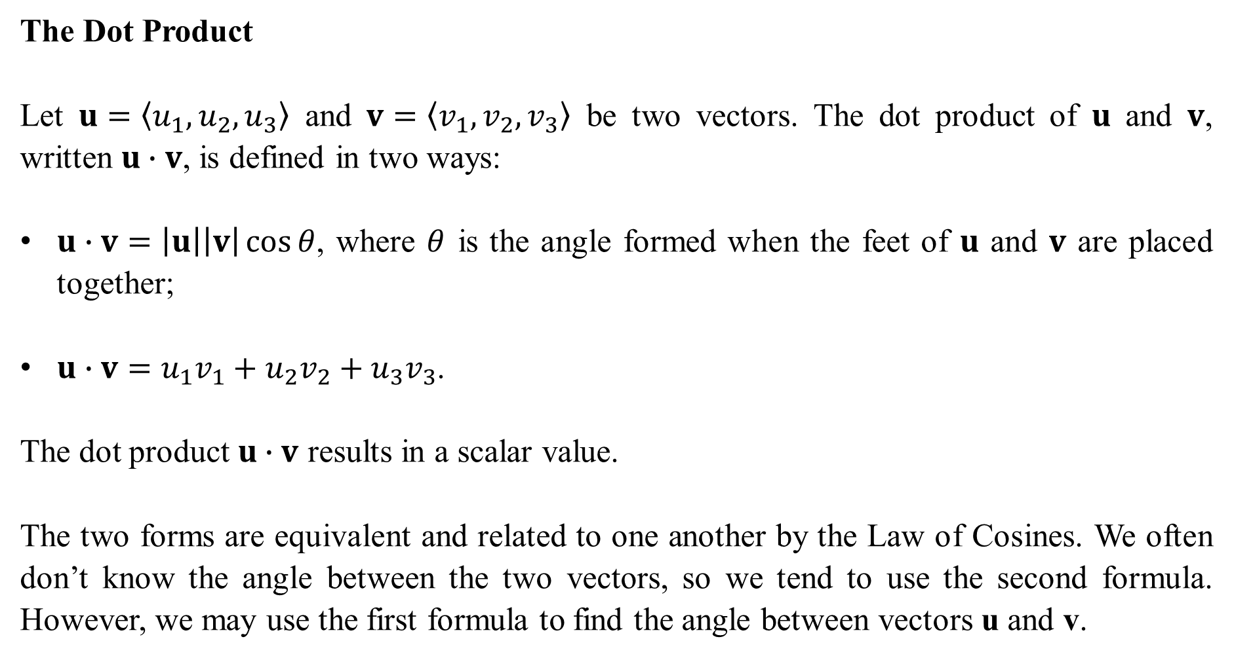
The Dot Product
Let $u=〈u_{1},u_{2},u_{3}〉$ and $v=〈v_{1},v_{2},v_{3}〉$ be two vectors. The dot product of $u$ and $v$, written $u∙v$, is defined in two ways:
$u∙v=\left|u\right|\left|v\right|\cos{θ}$, where $θ$ is the angle formed when the feet of $u$ and $v$ are placed together;
$u∙v=u_{1}v_{1}+u_{2}v_{2}+u_{3}v_{3}$.
The dot product $u∙v$ results in a scalar value.
The two forms are equivalent and related to one another by the Law of Cosines. We often don’t know the angle between the two vectors, so we tend to use the second formula. However, we may use the first formula to find the angle between vectors u and v.

Slide 3
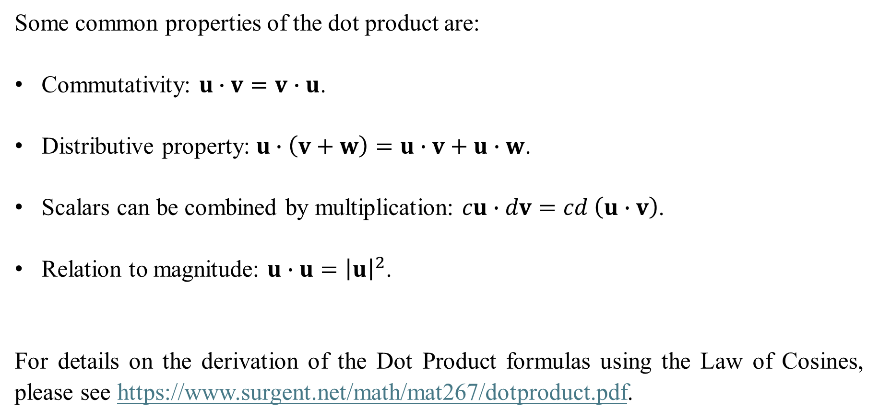
Some common properties of the dot product are:
Commutativity: $u∙v=v∙u$.
Distributive property: $u∙\left(v+w\right)=u∙v+u∙w$.
Scalars can be combined by multiplication: $cu∙dv=cd \left(u∙v\right)$.
Relation to magnitude: $u∙u={\left|u\right|}^{2}$.
For details on the derivation of the Dot Product formulas using the Law of Cosines, please see https://www.surgent.net/math/mat267/dotproduct.pdf.

Slide 4
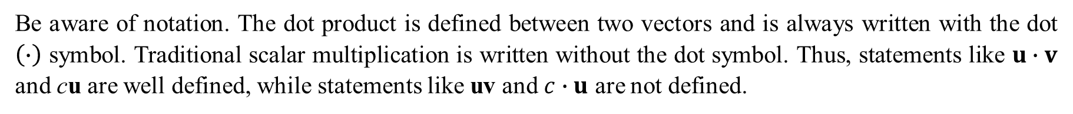
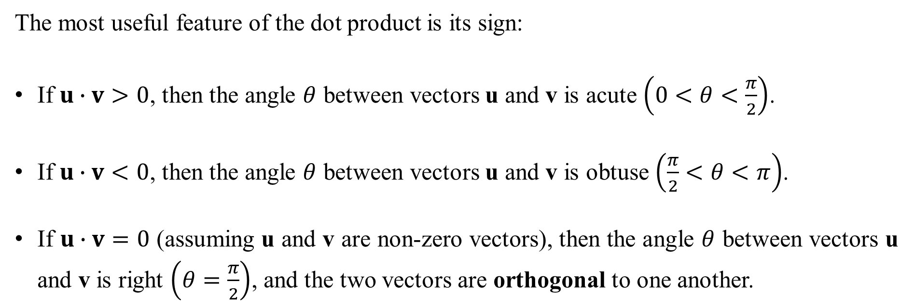
The most useful feature of the dot product is its sign:
If $u∙v>0$, then the angle $θ$ between vectors u and v is acute $\left(0<θ<\frac{π}{2}\right)$.
If $u∙v<0$, then the angle $θ$ between vectors u and v is obtuse $\left(\frac{π}{2}<θ<π\right)$.
If $u∙v=0$ (assuming u and v are non-zero vectors), then the angle $θ$ between vectors u and v is right $\left(θ=\frac{π}{2}\right)$, and the two vectors are orthogonal to one another.
Be aware of notation. The dot product is defined between two vectors and is always written with the dot $\left(∙\right)$ symbol. Traditional scalar multiplication is written without the dot symbol. Thus, statements like $u∙v$ and cu are well defined, while statements like uv and $c∙u$ are not defined.

Slide 5
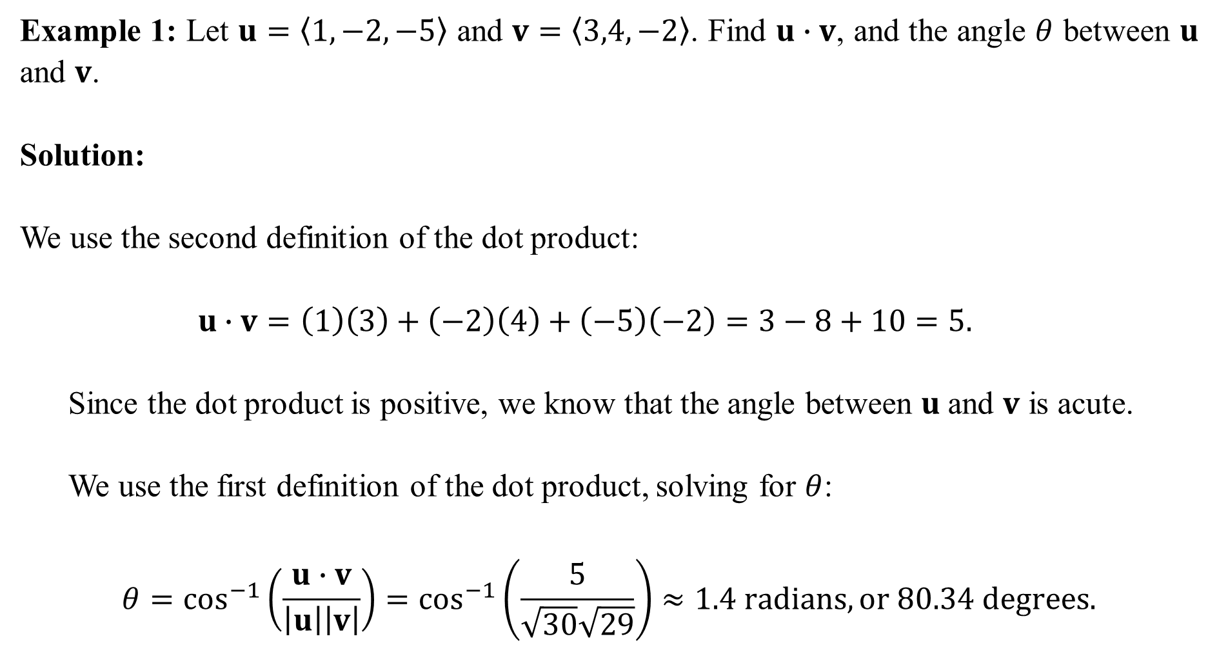
Example 1: Let $u=〈1,−2,−5〉$ and $v=〈3,4,−2〉$. Find $u∙v$, and the angle $θ$ between $u$ and $v$.
Solution:
We use the second definition of the dot product:
$$u∙v=\left(1\right)\left(3\right)+\left(−2\right)\left(4\right)+\left(−5\right)\left(−2\right)=3−8+10=5.$$
Since the dot product is positive, we know that the angle between $u$ and $v$ is acute.
We use the first definition of the dot product, solving for $θ$:
$$θ=\cos^{−1}\left(\frac{u∙v}{\left|u\right|\left|v\right|}\right)=\cos^{−1}\left(\frac{5}{\sqrt{30}\sqrt{29}}\right)≈1.4 radians, or 80.34 degrees.$$

Slide 6
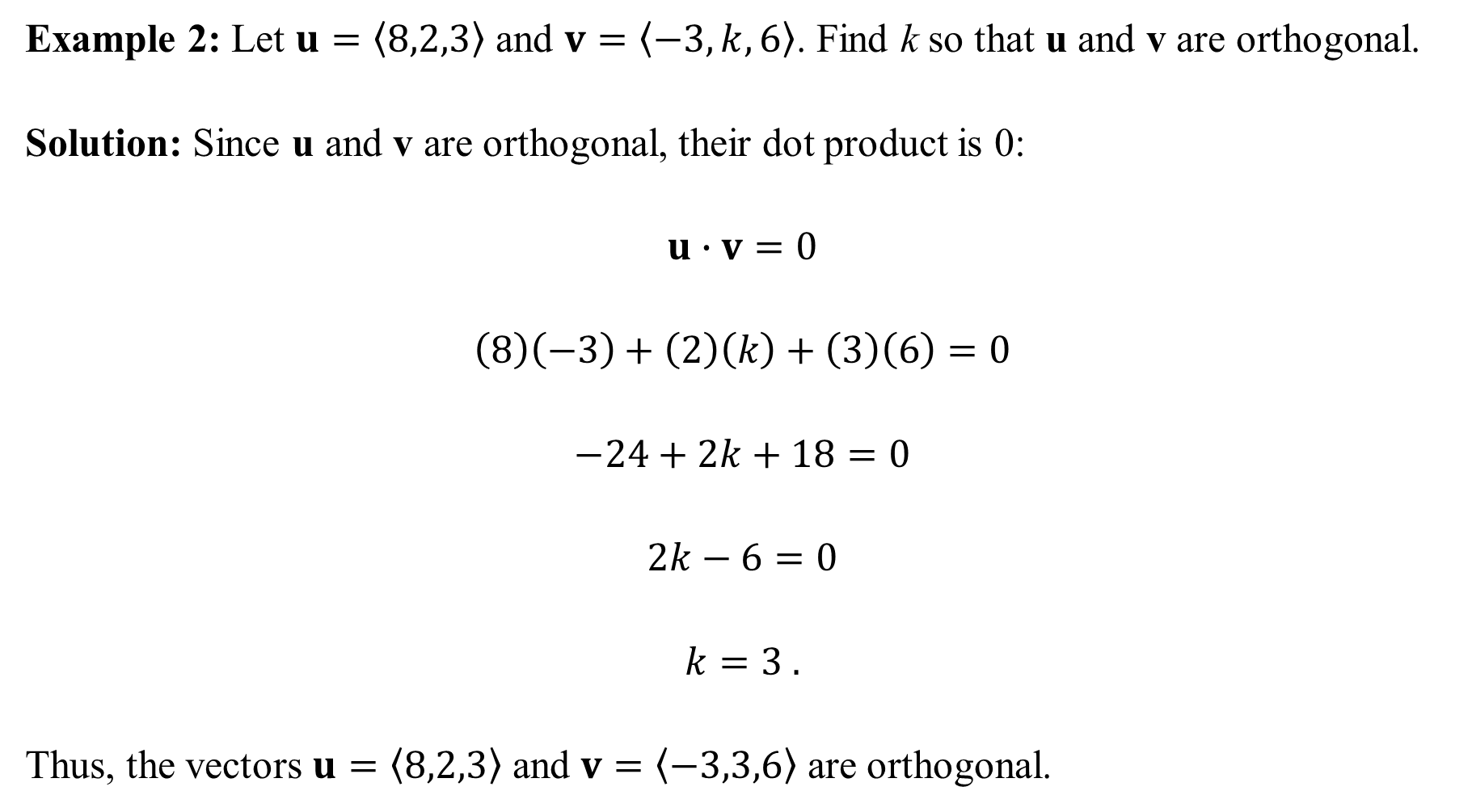
Example 2: Let $u=〈8,2,3〉$ and $v=〈−3,k,6〉$. Find k so that u and v are orthogonal.
Solution: Since u and v are orthogonal, their dot product is 0:
$$u∙v=0$$
$$\left(8\right)\left(−3\right)+\left(2\right)\left(k\right)+\left(3\right)\left(6\right)=0$$
$$−24+2k+18=0$$
$$2k−6=0$$
$$k=3 .$$
Thus, the vectors $u=〈8,2,3〉$ and $v=〈−3,3,6〉$ are orthogonal.

Slide 7
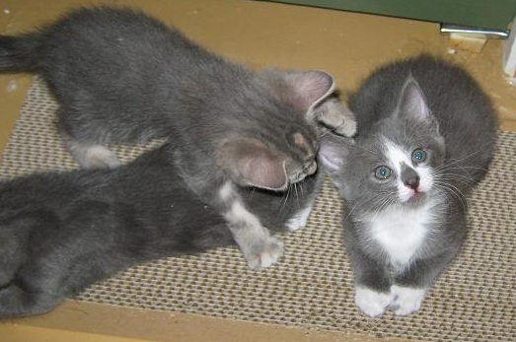
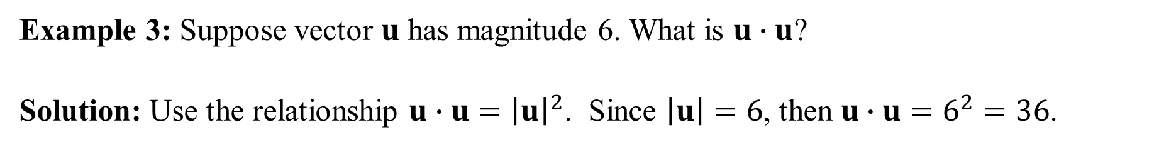
Example 3: Suppose vector $u$ has magnitude 6. What is $u∙u$?
Solution: Use the relationship $u∙u={\left|u\right|}^{2}$. Since $\left|u\right|=6$, then $u∙u=6^{2}=36$.

Slide 8

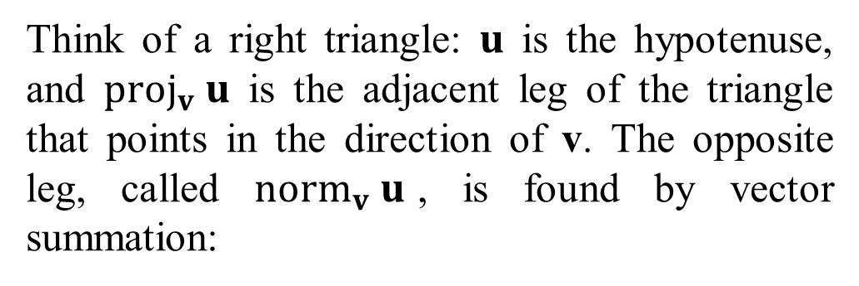
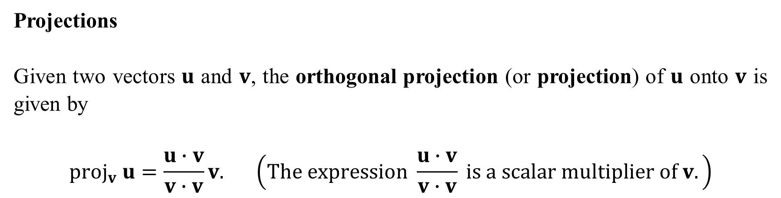
Projections
Given two vectors $u$ and $v$, the orthogonal projection (or projection) of $u$ onto $v$ is given by
$$proj_{v} u=\frac{u∙v}{v∙v}v. \left(The expression \frac{u∙v}{v∙v} is a scalar multiplier of v.\right)$$
Think of a right triangle: $u$ is the hypotenuse, and $proj_{v} u$ is the adjacent leg of the triangle that points in the direction of v. The opposite leg, called $norm_{v} u$, is found by vector summation:

Slide 9

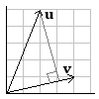

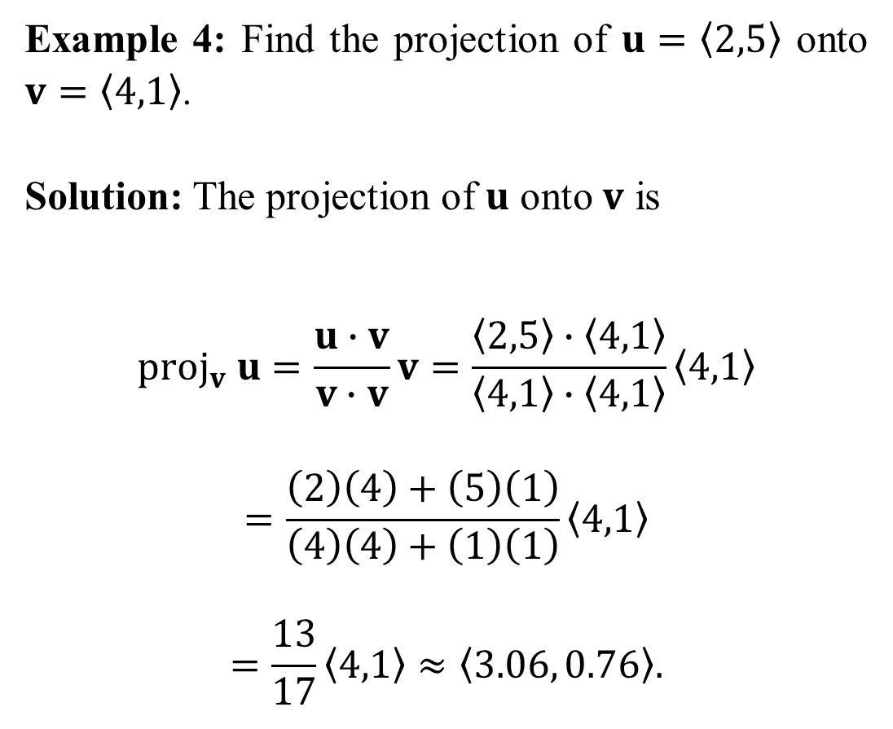
Example 4: Find the projection of $u=〈2,5〉$ onto $v=〈4,1〉$.
Solution: The projection of $u$ onto $v$ is
$$proj_{v} u=\frac{u∙v}{v∙v}v=\frac{〈2,5〉∙〈4,1〉}{〈4,1〉∙〈4,1〉}〈4,1〉$$
$$=\frac{\left(2\right)\left(4\right)+\left(5\right)\left(1\right)}{\left(4\right)\left(4\right)+\left(1\right)\left(1\right)}〈4,1〉$$
$$=\frac{13}{17}〈4,1〉≈〈3.06, 0.76〉.$$

Slide 10
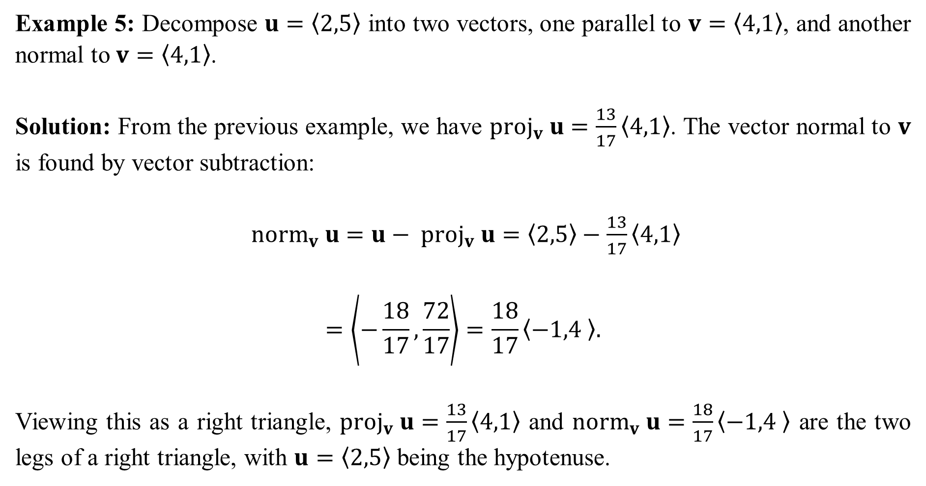
Example 5: Decompose $u=〈2,5〉$ into two vectors, one parallel to $v=〈4,1〉$, and another normal to $v=〈4,1〉$.
Solution: From the previous example, we have $proj_{v} u=\frac{13}{17}〈4,1〉$. The vector normal to $v$ is found by vector subtraction:
$norm_{v} u=u− proj_{v} u=〈2,5〉−\frac{13}{17}〈4,1〉$
$$=\left\langle −\frac{18}{17}, \frac{72}{17}\right\rangle =\frac{18}{17}〈−1,4 〉.$$
Viewing this as a right triangle, $proj_{v} u=\frac{13}{17}〈4,1〉$ and $norm_{v} u=\frac{18}{17}〈−1,4 〉$ are the two legs of a right triangle, with $u=〈2,5〉$ being the hypotenuse.

Slide 11
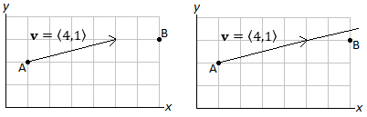
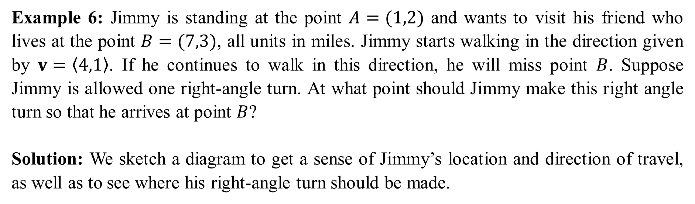
Example 6: Jimmy is standing at the point $A=(1,2)$ and wants to visit his friend who lives at the point $B=(7,3)$, all units in miles. Jimmy starts walking in the direction given by $v=〈4,1〉$. If he continues to walk in this direction, he will miss point $B$. Suppose Jimmy is allowed one right-angle turn. At what point should Jimmy make this right angle turn so that he arrives at point $B$?
Solution: We sketch a diagram to get a sense of Jimmy’s location and direction of travel, as well as to see where his right-angle turn should be made.

Slide 12
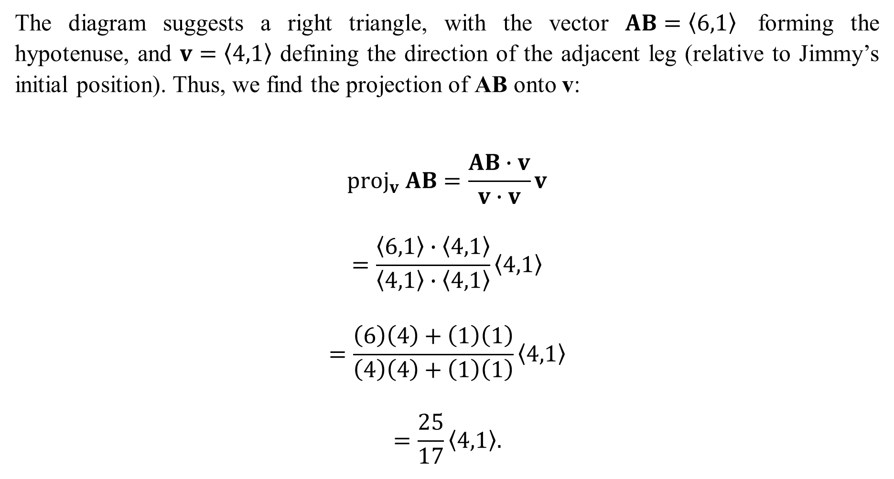
The diagram suggests a right triangle, with the vector $AB=〈6,1〉$ forming the hypotenuse, and $v=〈4,1〉$ defining the direction of the adjacent leg (relative to Jimmy’s initial position). Thus, we find the projection of AB onto v:
$$proj_{v} AB=\frac{AB∙v}{v∙v}v$$
$$=\frac{〈6,1〉∙〈4,1〉}{〈4,1〉∙〈4,1〉}〈4,1〉$$
$$=\frac{\left(6\right)\left(4\right)+\left(1\right)\left(1\right)}{\left(4\right)\left(4\right)+\left(1\right)\left(1\right)}〈4,1〉$$
$$=\frac{25}{17}〈4,1〉.$$

Slide 13
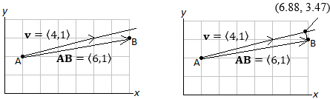
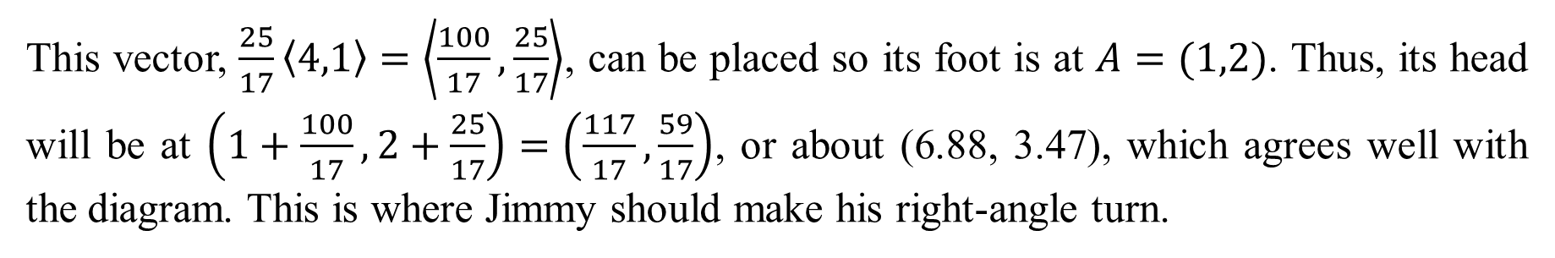
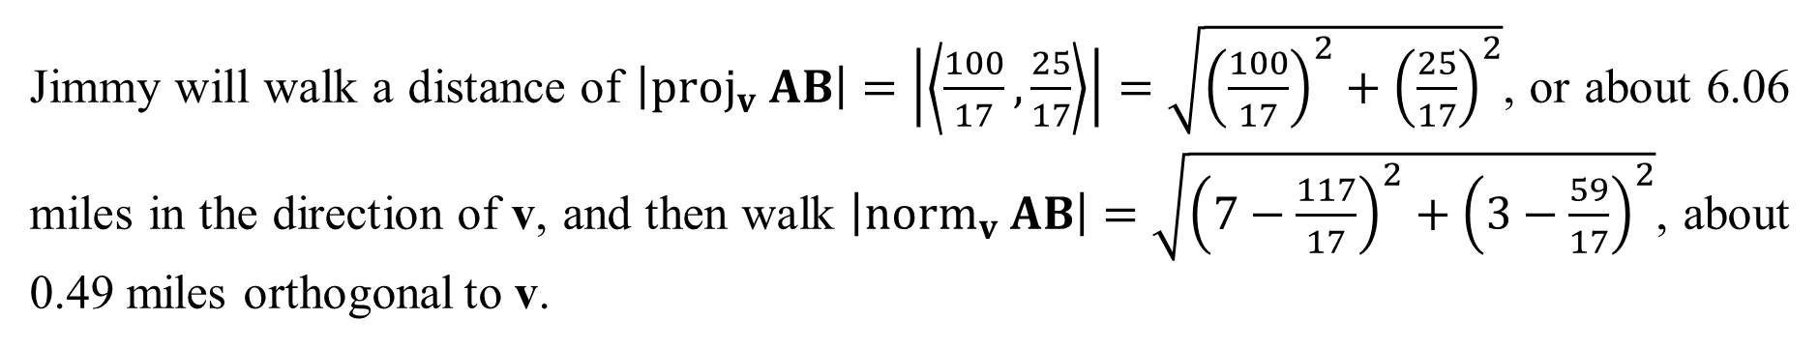
This vector, $\frac{25}{17}〈4,1〉=\left\langle \frac{100}{17},\frac{25}{17}\right\rangle$, can be placed so its foot is at $A=(1,2)$. Thus, its head will be at $\left(1+\frac{100}{17},2+\frac{25}{17}\right)=\left(\frac{117}{17},\frac{59}{17}\right)$, or about (6.88, 3.47), which agrees well with the diagram. This is where Jimmy should make his right-angle turn.
Jimmy will walk a distance of $\left|proj_{v} AB\right|=\left|\left\langle \frac{100}{17},\frac{25}{17}\right\rangle \right|=\sqrt{{\left(\frac{100}{17}\right)}^{2}+{\left(\frac{25}{17}\right)}^{2}}$, or about 6.06 miles in the direction of v, and then walk $\left|norm_{v} AB\right|=\sqrt{{\left(7−\frac{117}{17}\right)}^{2}+{\left(3−\frac{59}{17}\right)}^{2}}$, about 0.49 miles orthogonal to v.

