Slide 1
Triple Integration:
Cylindrical & Spherical Coordinate Systems
Scott Surgent

Slide 2
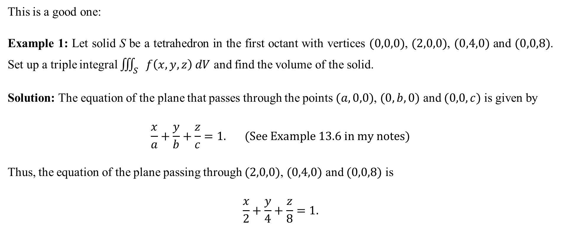
This is a good one:
Example 1: Let solid S be a tetrahedron in the first octant with vertices $(0,0,0)$, $(2,0,0)$, $(0,4,0)$ and $(0,0,8)$. Set up a triple integral $\iiint_{S}{f\left(x,y,z\right) dV}$ and find the volume of the solid.
Solution: The equation of the plane that passes through the points $(a,0,0)$, $(0,b,0)$ and $(0,0,c)$ is given by
$$\frac{x}{a}+\frac{y}{b}+\frac{z}{c}=1. (See Example 13.6 in my notes)$$
Thus, the equation of the plane passing through $(2,0,0)$, $(0,4,0)$ and $(0,0,8)$ is
$$\frac{x}{2}+\frac{y}{4}+\frac{z}{8}=1.$$

Slide 3
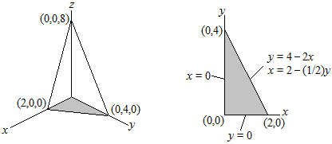
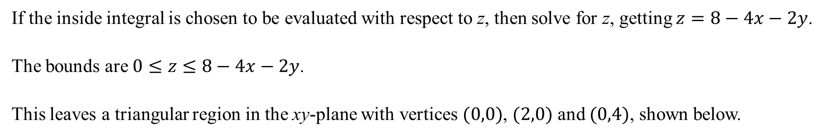
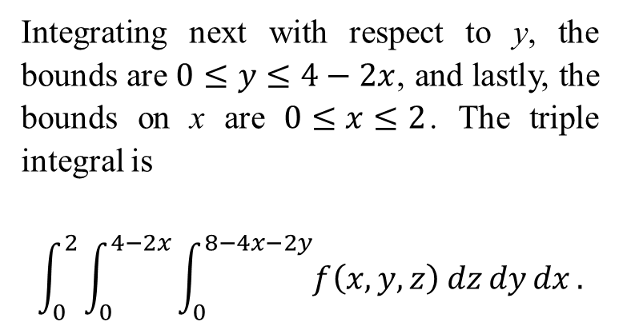
If the inside integral is chosen to be evaluated with respect to z, then solve for z, getting $z=8−4x−2y$.
The bounds are $0≤z≤8−4x−2y$.
This leaves a triangular region in the xy-plane with vertices $(0,0)$, $(2,0)$ and $(0,4)$, shown below.
Integrating next with respect to y, the bounds are $0≤y≤4−2x$, and lastly, the bounds on x are $0≤x≤2$. The triple integral is
$$\int_{0}^{2}{\int_{0}^{4−2x}{\int_{0}^{8−4x−2y}{f\left(x,y,z\right) dz}dy}dx}.$$

Slide 4

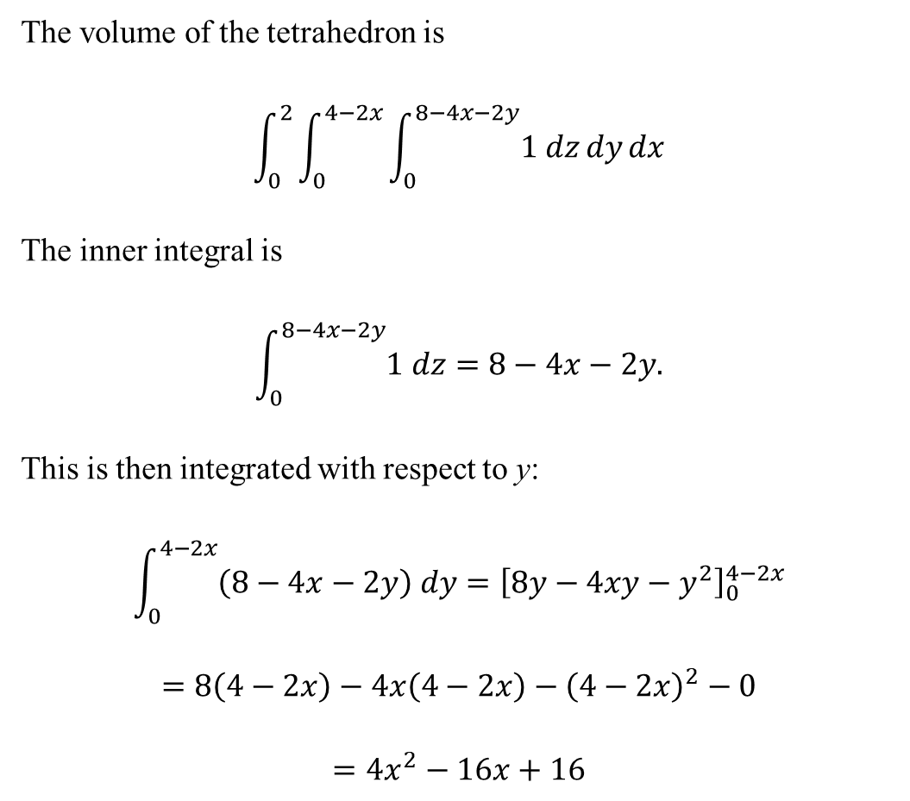
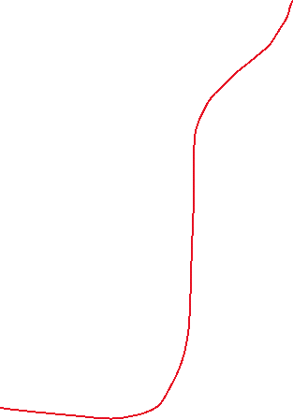
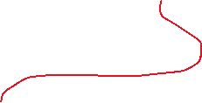
The volume of the tetrahedron is
$$\int_{0}^{2}{\int_{0}^{4−2x}{\int_{0}^{8−4x−2y}{1 dz}dy}dx}$$
The inner integral is
$$\int_{0}^{8−4x−2y}{1 dz=8−4x−2y.}$$
This is then integrated with respect to y:
$$\int_{0}^{4−2x}{\left(8−4x−2y\right) dy}={\left[8y−4xy−y^{2}\right]}_{0}^{4−2x}$$
$$=8\left(4−2x\right)−4x\left(4−2x\right)−{\left(4−2x\right)}^{2}−0$$
$$=4x^{2}−16x+16$$
This is then integrated with respect to x:
$$\int_{0}^{2}{\left(4x^{2}−16x+16\right) dx}={\left[\frac{4}{3}x^{3}−8x^{2}+16x\right]}_{0}^{2}$$
$$=\frac{4}{3}{\left(2\right)}^{3}−8{\left(2\right)}^{2}+16(2)−0$$
$$=\frac{32}{3}−32+32$$
$$=\frac{32}{3}$$

Slide 5
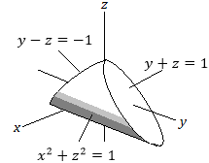
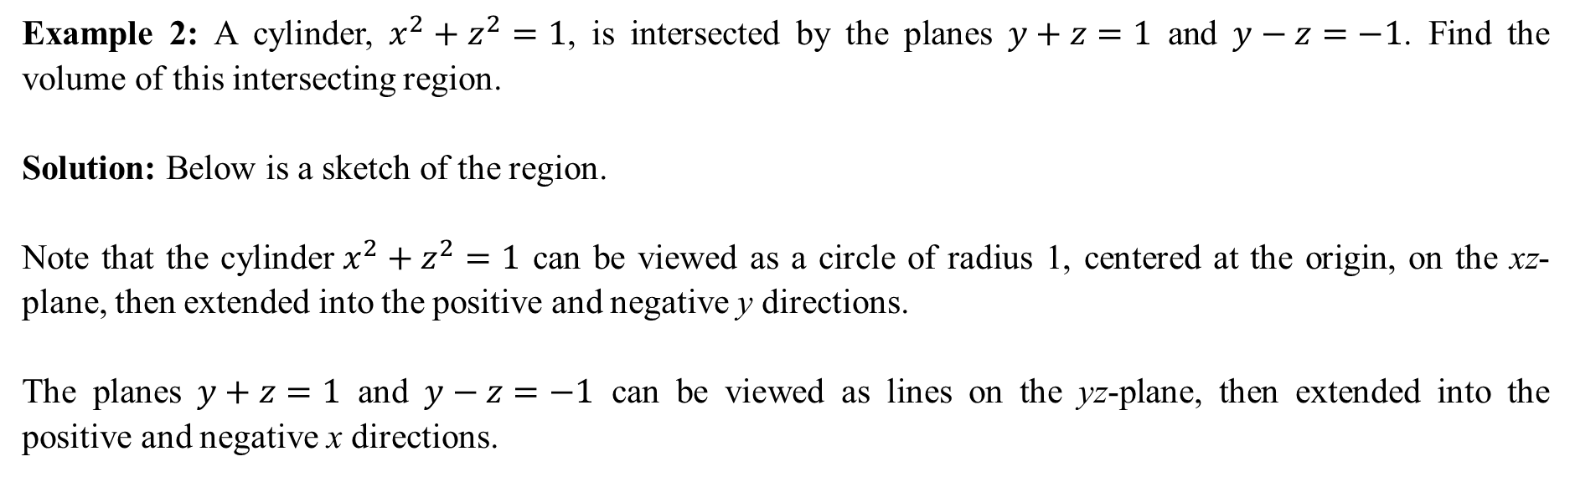
Example 2: A cylinder, $x^{2}+z^{2}=1$, is intersected by the planes $y+z=1$ and $y−z=−1$. Find the volume of this intersecting region.
Solution: Below is a sketch of the region.
Note that the cylinder$x^{2}+z^{2}=1$ can be viewed as a circle of radius 1, centered at the origin, on the xz-plane, then extended into the positive and negative y directions.
The planes $y+z=1$ and $y−z=−1$ can be viewed as lines on the yz-plane, then extended into the positive and negative x directions.

Slide 6

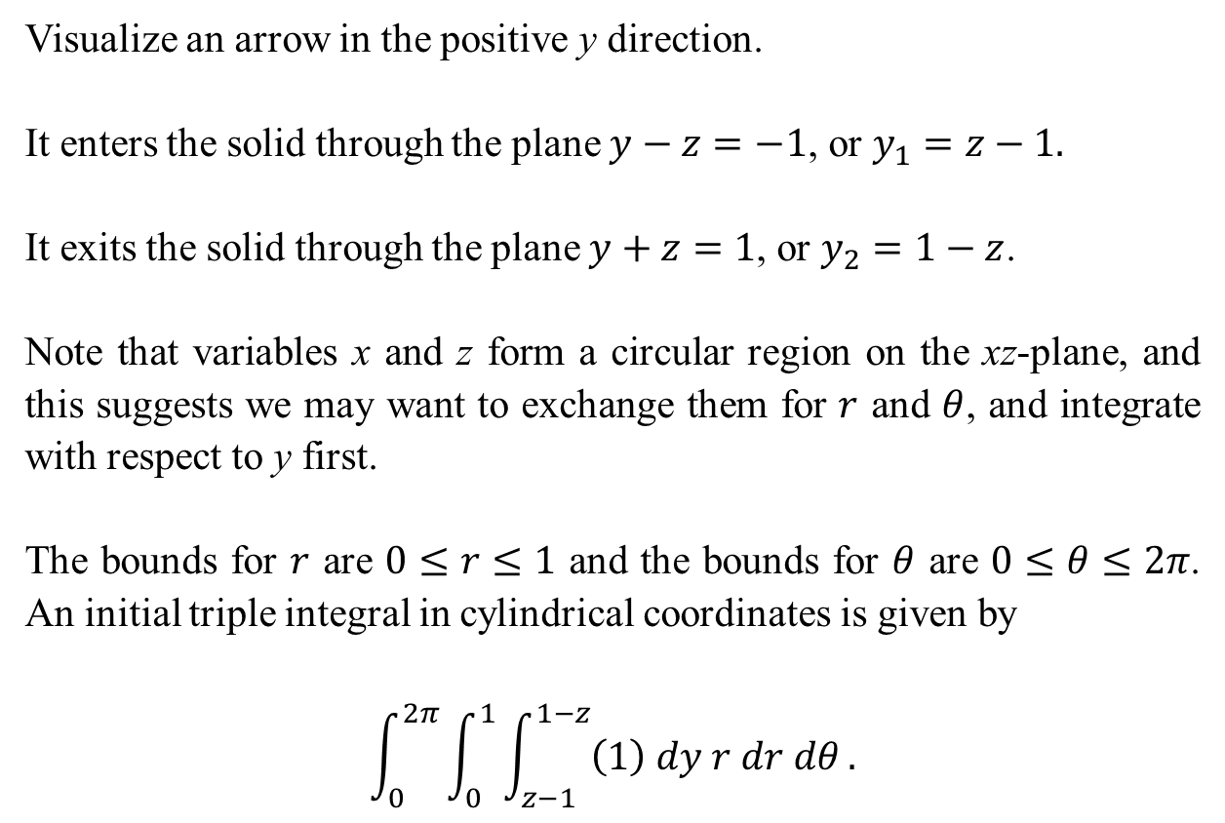
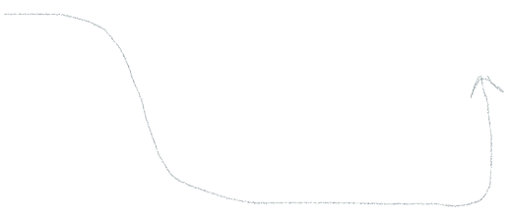


Visualize an arrow in the positive y direction.
It enters the solid through the plane $y−z=−1$, or $y_{1}=z−1.$
It exits the solid through the plane $y+z=1$, or $y_{2}=1−z$.
Note that variables x and z form a circular region on the xz-plane, and this suggests we may want to exchange them for $r$ and $θ$, and integrate with respect to y first.
The bounds for $r$ are $0≤r≤1$ and the bounds for $θ$ are $0≤θ≤2π$. An initial triple integral in cylindrical coordinates is given by
$$\int_{0}^{2π}{\int_{0}^{1}{\int_{z−1}^{1−z}{\left(1\right) dy r dr dθ}.}}$$

Slide 7
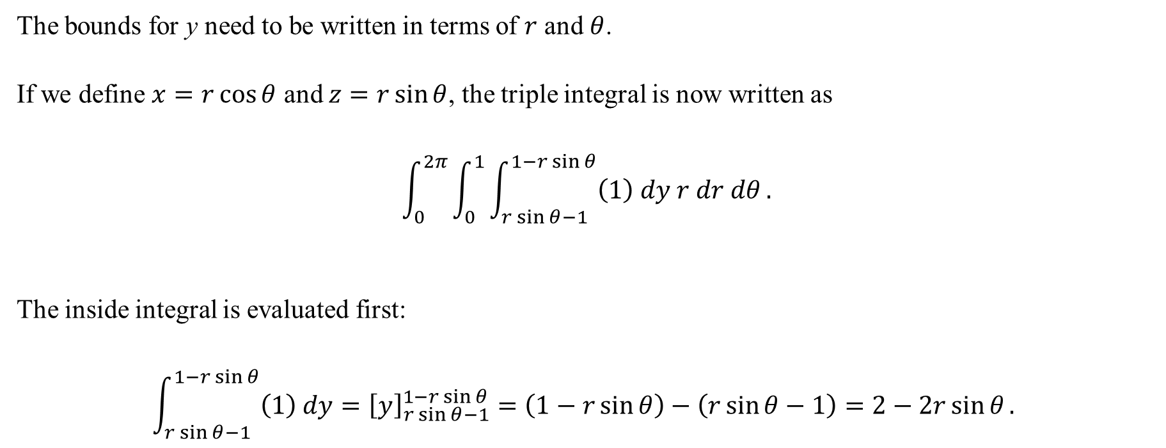
The bounds for y need to be written in terms of $r$ and $θ$.
If we define $x=r\cos{θ}$ and $z=r\sin{θ}$, the triple integral is now written as
$$\int_{0}^{2π}{\int_{0}^{1}{\int_{r\sin{θ}−1}^{1−r\sin{θ}}{\left(1\right) dy r dr dθ}.}}$$
The inside integral is evaluated first:
$$\int_{r\sin{θ}−1}^{1−r\sin{θ}}{\left(1\right) dy}={\left[y\right]}_{r\sin{θ}−1}^{1−r\sin{θ}}=\left(1−r\sin{θ}\right)−\left(r\sin{θ}−1\right)=2−2r\sin{θ}.$$

Slide 8

This is integrated with respect to $r$:
$$\int_{0}^{1}{\left(2−2r\sin{θ}\right)}r dr=\int_{0}^{1}{\left(2r−2r^{2}\sin{θ}\right)} dr={\left[r^{2}−\frac{2}{3}r^{3}\sin{θ}\right]}_{0}^{1}=1−\frac{2}{3}\sin{θ}.$$
Finally, this is integrated with respect to $θ$:
$$\int_{0}^{2π}{(}1−\frac{2}{3}\sin{θ}) dθ={\left[θ+\frac{2}{3}\cos{θ}\right]}_{0}^{2π}$$
$$=\left(\left(2π\right)+\frac{2}{3}\cos\left(2π\right)\right)−\left(\left(0\right)+\frac{2}{3}\cos\left(0\right)\right) \left\{\begin{matrix}Recall that\cos\left(2π\right)=1 \\ and\cos\left(0\right)=1. \end{matrix}\right.$$
$$=2π+\frac{2}{3}−\frac{2}{3}=2π.$$

Slide 9
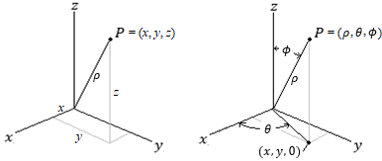
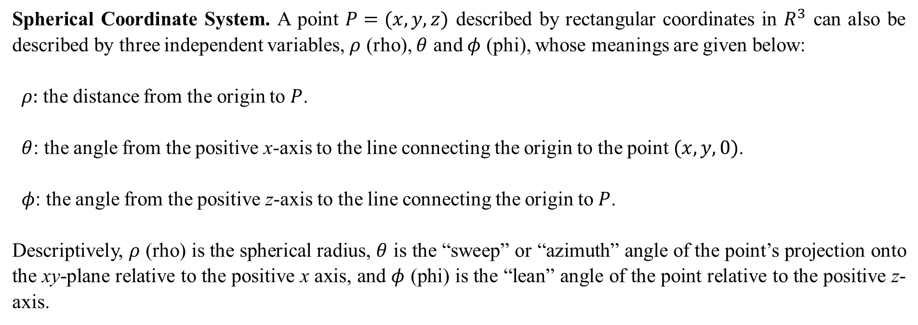
Spherical Coordinate System. A point $P=(x,y,z)$ described by rectangular coordinates in $R^{3}$ can also be described by three independent variables, $ρ$ (rho), $θ$ and $φ$ (phi), whose meanings are given below:
$ρ:$ the distance from the origin to $P$.
$θ$: the angle from the positive x-axis to the line connecting the origin to the point $(x,y,0)$.
$φ$: the angle from the positive z-axis to the line connecting the origin to $P$.
Descriptively, $ρ$ (rho) is the spherical radius, $θ$ is the “sweep” or “azimuth” angle of the point’s projection onto the xy-plane relative to the positive x axis, and $φ$ (phi) is the “lean” angle of the point relative to the positive z-axis.

Slide 10
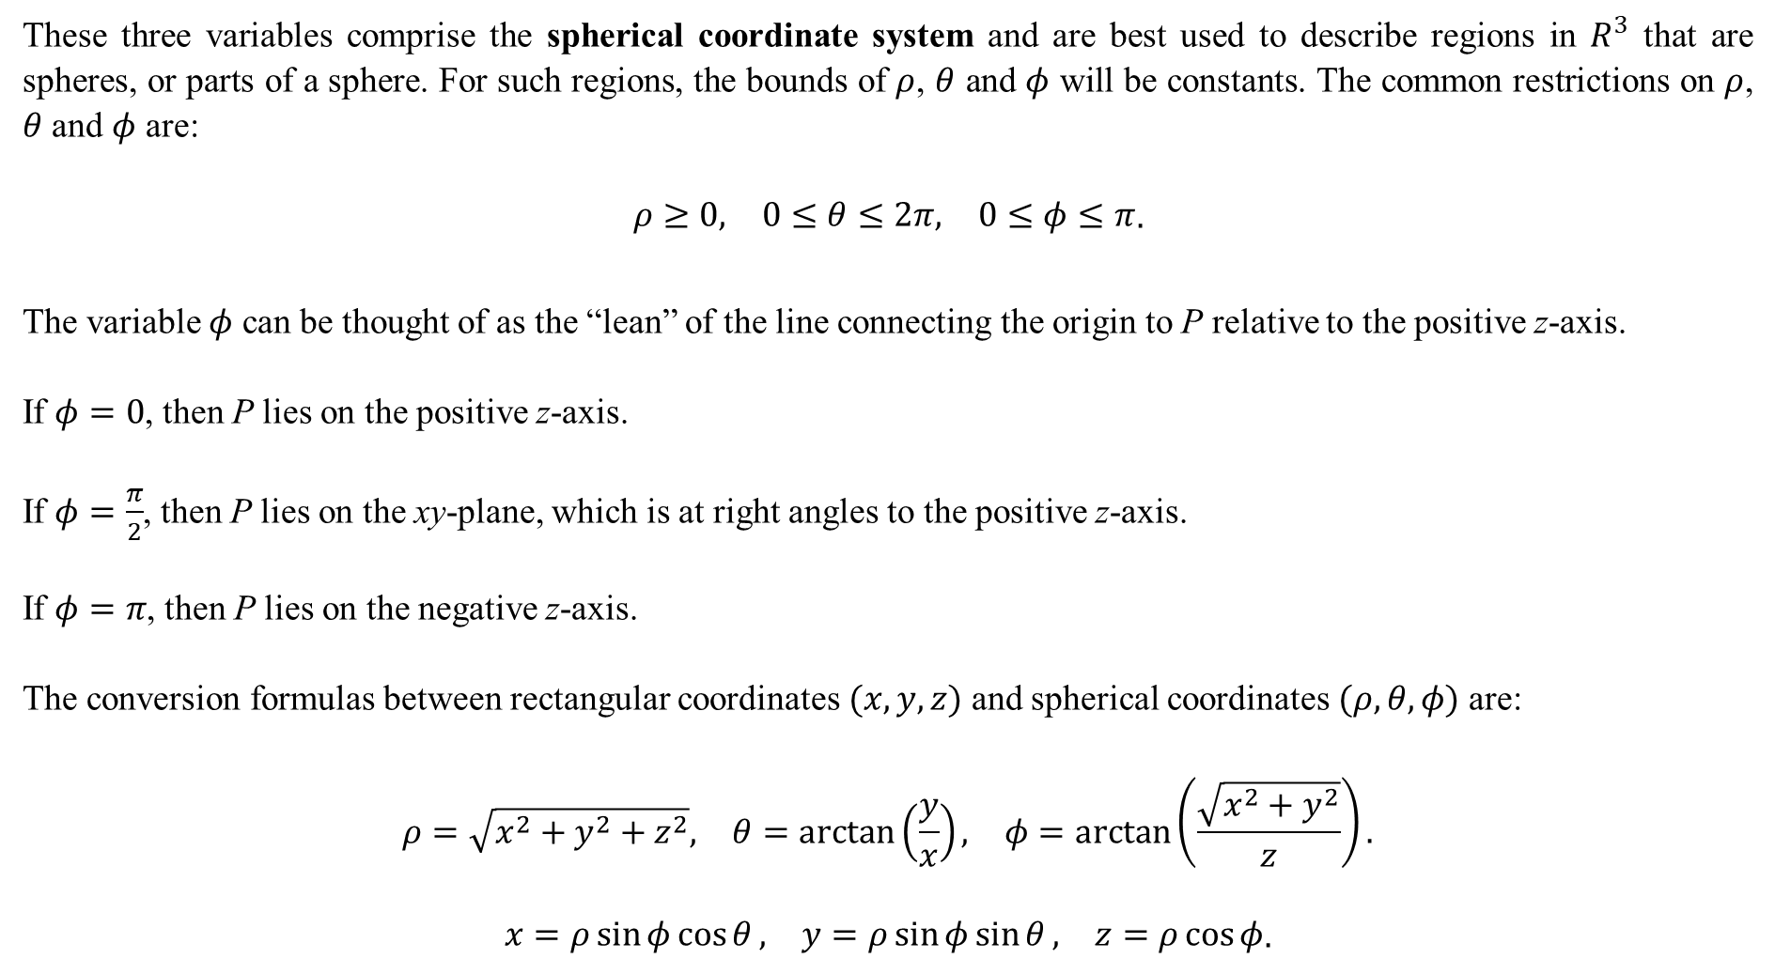
These three variables comprise the spherical coordinate system and are best used to describe regions in $R^{3}$ that are spheres, or parts of a sphere. For such regions, the bounds of $ρ$, $θ$ and $φ$ will be constants. The common restrictions on $ρ$, $θ$ and $φ$ are:
$$\begin{matrix}ρ≥0, & 0≤θ≤2π, & 0≤φ≤π\end{matrix}.$$
The variable $φ$ can be thought of as the “lean” of the line connecting the origin to P relative to the positive z-axis.
If $φ=0$, then P lies on the positive z-axis.
If $φ=\frac{π}{2}$, then P lies on the xy-plane, which is at right angles to the positive z-axis.
If $φ=π$, then P lies on the negative z-axis.
The conversion formulas between rectangular coordinates $(x,y,z)$ and spherical coordinates $(ρ, θ, φ)$ are:
$$\begin{matrix}ρ=\sqrt{x^{2}+y^{2}+z^{2}}, & θ=\arctan\left(\frac{y}{x}\right), & φ=\arctan\left(\frac{\sqrt{x^{2}+y^{2}}}{z}\right).\end{matrix}$$
$$\begin{matrix}x=ρ\sin{φ}\cos{θ}, & y=ρ\sin{φ}\sin{θ}, & z=ρ\cos{φ}\end{matrix}.$$

Slide 11
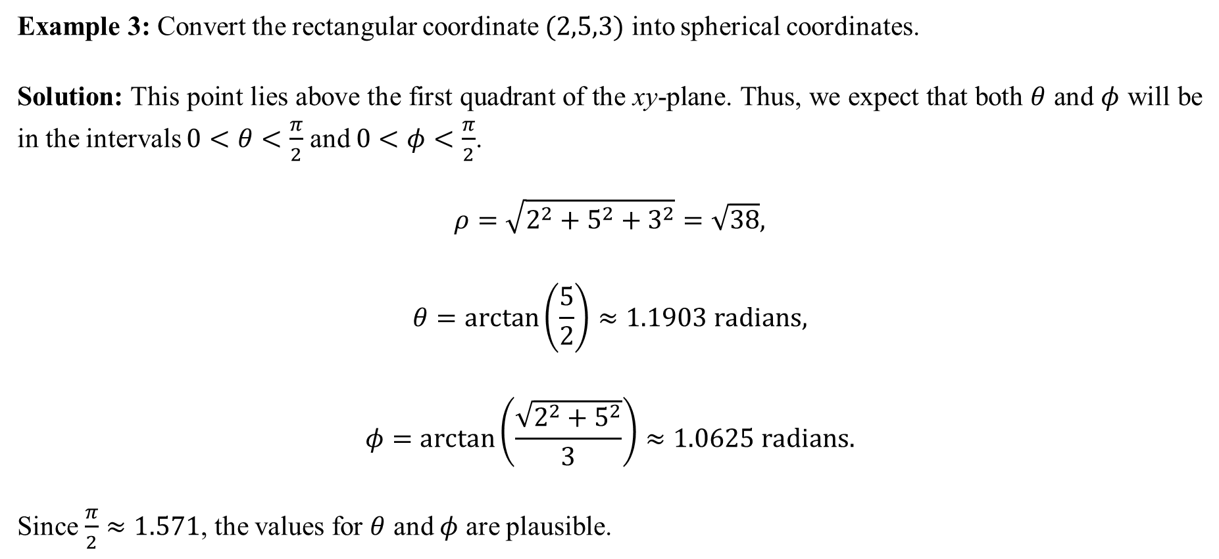
Example 3: Convert the rectangular coordinate $(2,5,3)$ into spherical coordinates.
Solution: This point lies above the first quadrant of the xy-plane. Thus, we expect that both $θ$ and $φ$ will be in the intervals $0<θ<\frac{π}{2}$ and $0<φ<\frac{π}{2}$.
$$ρ=\sqrt{2^{2}+5^{2}+3^{2}}=\sqrt{38},$$
$$θ=\arctan\left(\frac{5}{2}\right)≈1.1903 radians,$$
$$φ=\arctan\left(\frac{\sqrt{2^{2}+5^{2}}}{3}\right)≈1.0625 radians.$$
Since $\frac{π}{2}≈1.571$, the values for $θ$ and $φ$ are plausible.

Slide 12
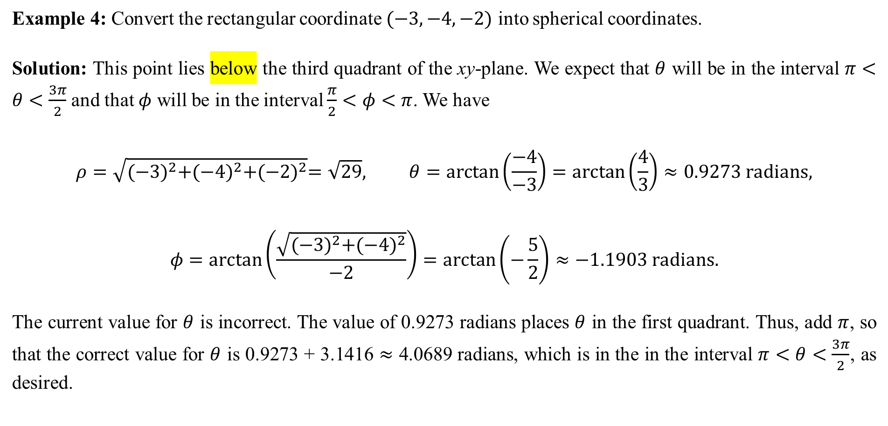
Example 4: Convert the rectangular coordinate $(−3,−4,−2)$ into spherical coordinates.
Solution: This point lies below the third quadrant of the xy-plane. We expect that $θ$ will be in the interval $π<θ<\frac{3π}{2}$ and that $φ$ will be in the interval $\frac{π}{2}<φ<π$. We have
$$ρ=\sqrt{{(−3)}^{2}+{(−4)}^{2}+{(−2)}^{2}}=\sqrt{29}, θ=\arctan\left(\frac{−4}{−3}\right)=\arctan\left(\frac{4}{3}\right)≈0.9273 radians,$$
$$φ=\arctan\left(\frac{\sqrt{{(−3)}^{2}+{(−4)}^{2}}}{−2}\right)=\arctan\left(−\frac{5}{2}\right)≈−1.1903 radians.$$
The current value for $θ$ is incorrect. The value of 0.9273 radians places $θ$ in the first quadrant. Thus, add $π$, so that the correct value for $θ$ is 0.9273 + 3.1416 $≈$ 4.0689 radians, which is in the in the interval $π<θ<\frac{3π}{2}$, as desired.

Slide 13
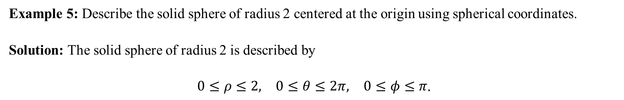
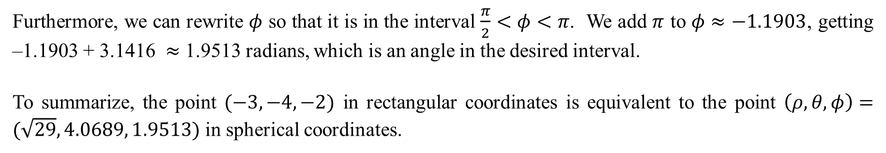
Furthermore, we can rewrite $φ$ so that it is in the interval $\frac{π}{2}<φ<π$. We add $π$ to $φ≈−1.1903$, getting –1.1903 + 3.1416 $≈$ 1.9513 radians, which is an angle in the desired interval.
To summarize, the point $(−3,−4,−2)$ in rectangular coordinates is equivalent to the point $\left(ρ, θ, φ\right)=(\sqrt{29}, 4.0689, 1.9513)$ in spherical coordinates.
Example 5: Describe the solid sphere of radius 2 centered at the origin using spherical coordinates.
Solution: The solid sphere of radius 2 is described by
$$\begin{matrix}0≤ρ≤2, & 0≤θ≤2π, & 0≤φ≤π\end{matrix}.$$

Slide 14
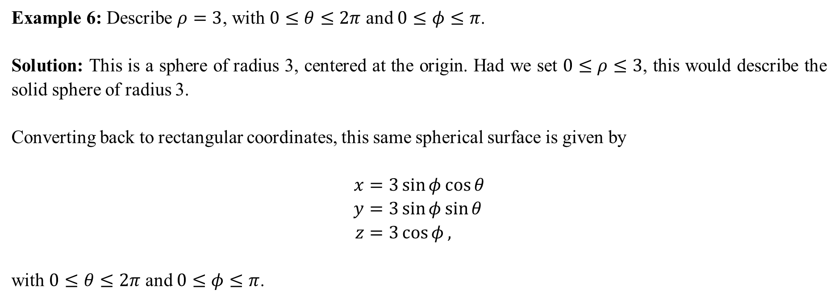
Example 6: Describe $ρ=3$, with $0≤θ≤2π$ and $0≤φ≤π$.
Solution: This is a sphere of radius 3, centered at the origin. Had we set $0≤ρ≤3$, this would describe the solid sphere of radius 3.
Converting back to rectangular coordinates, this same spherical surface is given by
$$x=3\sin{φ}\cos{θ} \\ y=3\sin{φ}\sin{θ} \\ z=3\cos{φ},$$
with $0≤θ≤2π$ and $0≤φ≤π$.

Slide 15
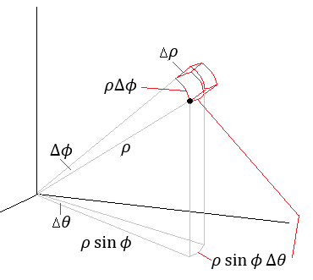
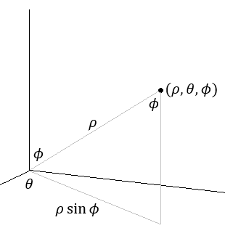

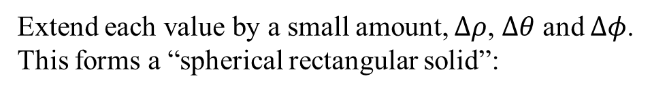
The Jacobian of spherical integration.
Let $(ρ, θ, φ)$ be a point in $R^{3}$.
Extend each value by a small amount, $Δρ$, $Δθ$ and $Δφ$. This forms a “spherical rectangular solid”:
Use geometry to find the arc lengths as shown.

Slide 16
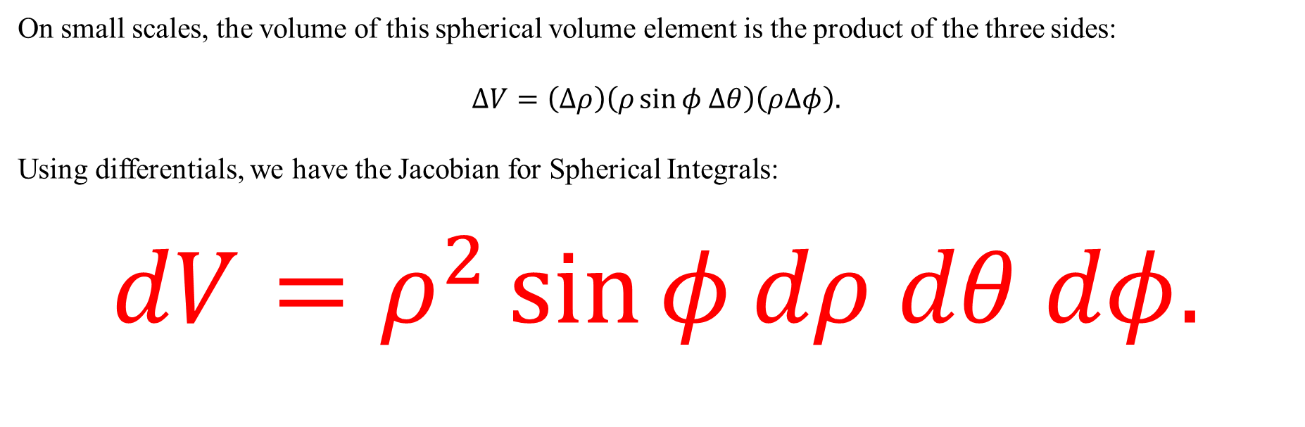
On small scales, the volume of this spherical volume element is the product of the three sides:
$$ΔV=\left(Δρ\right)\left(ρ\sin{φ Δθ}\right)\left(ρΔφ\right).$$
Using differentials, we have the Jacobian for Spherical Integrals:
$$dV=ρ^{2}\sin{φ}dρ dθ dφ.$$
“rho squared sine phi, d rho d theta d phi”

Slide 17
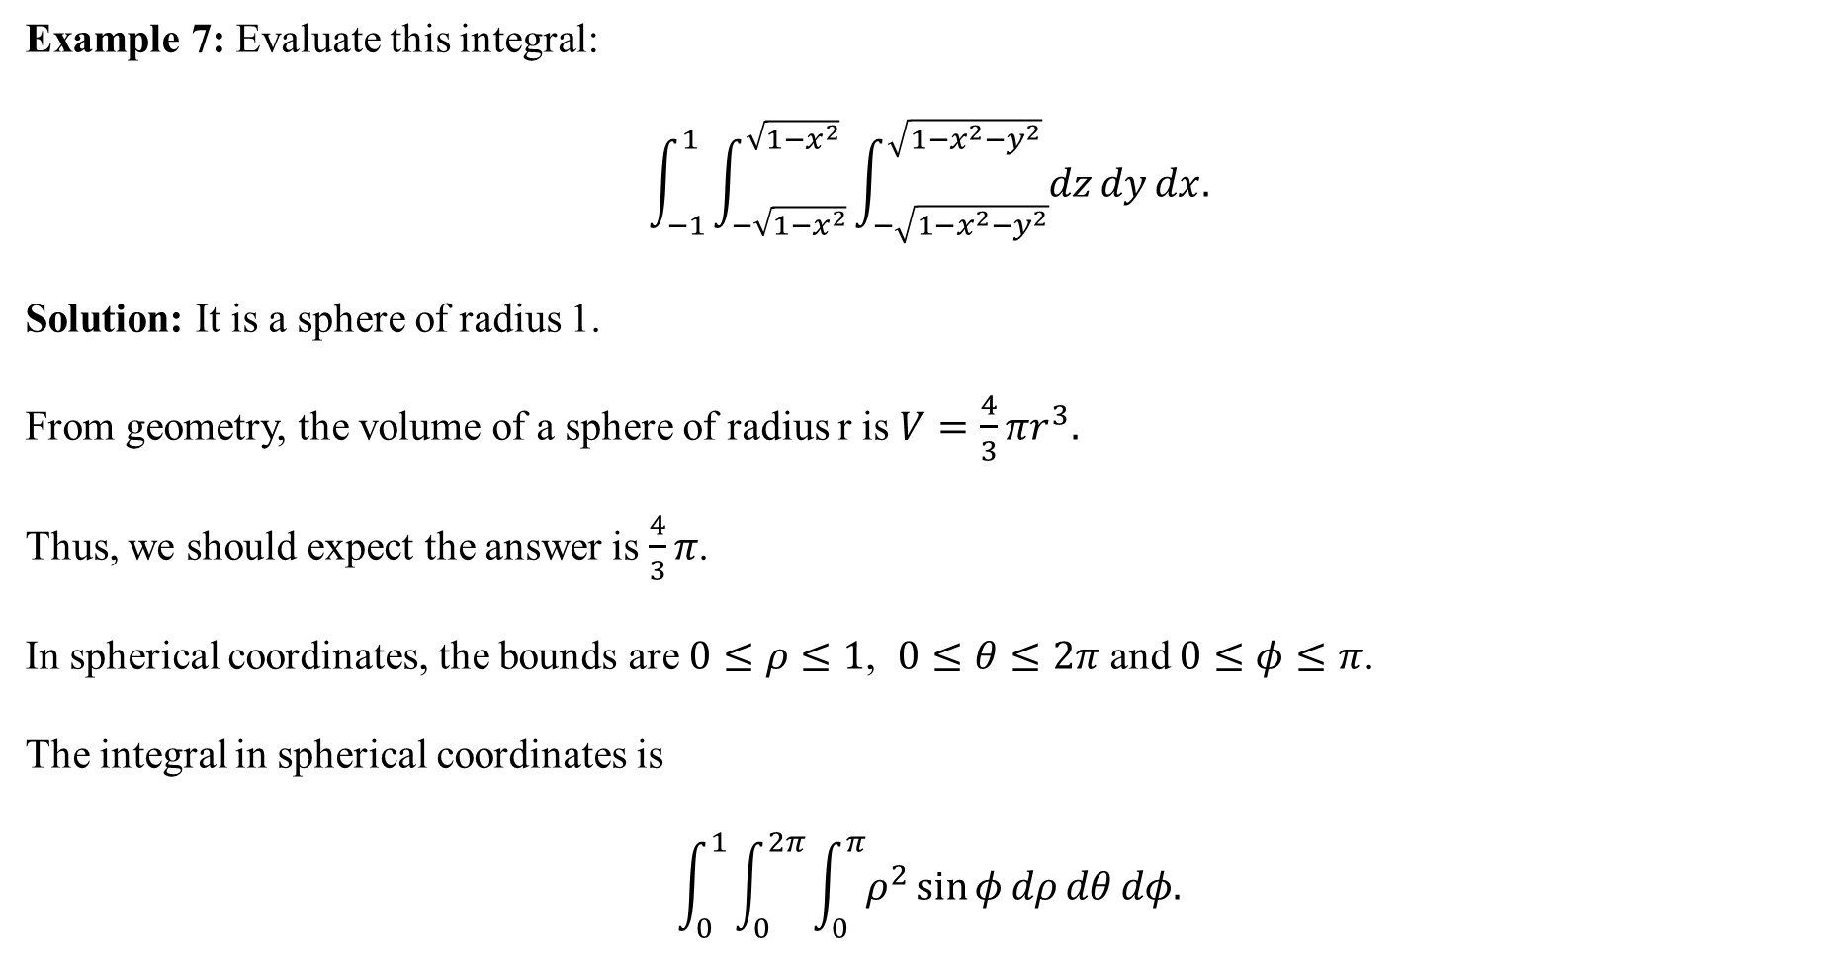
Example 7: Evaluate this integral:
$$\int_{−1}^{1}{\int_{−\sqrt{1−x^{2}}}^{\sqrt{1−x^{2}}}{\int_{−\sqrt{1−x^{2}−y^{2}}}^{\sqrt{1−x^{2}−y^{2}}}{dz}dy}dx.}$$
Solution: It is a sphere of radius 1.
From geometry, the volume of a sphere of radius r is $V=\frac{4}{3}πr^{3}.$
Thus, we should expect the answer is $\frac{4}{3}π$.
In spherical coordinates, the bounds are $0≤ρ≤1$, $0≤θ≤2π$ and $0≤φ≤π$.
The integral in spherical coordinates is
$$\int_{0}^{1}{\int_{0}^{2π}{\int_{0}^{π}{ρ^{2}\sin{φ}dρ}dθ}dφ.}$$

Slide 18


From the last slide, we have
$$\int_{0}^{1}{\int_{0}^{2π}{\int_{0}^{π}{ρ^{2}\sin{φ}dρ}dθ}dφ.}$$
These are constant bounds and the integrand is held by multiplication. So we can treat this as the product of three single-variable integrals:
$$\left(\int_{0}^{1}{ρ^{2} dρ}\right)\left(\int_{0}^{2π}{dθ}\right)\left(\int_{0}^{π}{\sin{φ}}\right)$$
$$=\left({\left[\frac{1}{3}ρ^{3}\right]}_{0}^{1}\right)\left({\left[θ\right]}_{0}^{2π}\right)\left({\left[−\cos{φ}\right]}_{0}^{π}\right)$$
$$=\left(\frac{1}{3}\right)(2π)\left(−\left(−1\right)−\left(−1\right)\right)$$
$$=\left(\frac{1}{3}\right)\left(2π\right)\left(2\right)=\frac{4}{3}π$$

