Slide 1
Cross Product
Scott Surgent

Slide 2
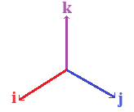
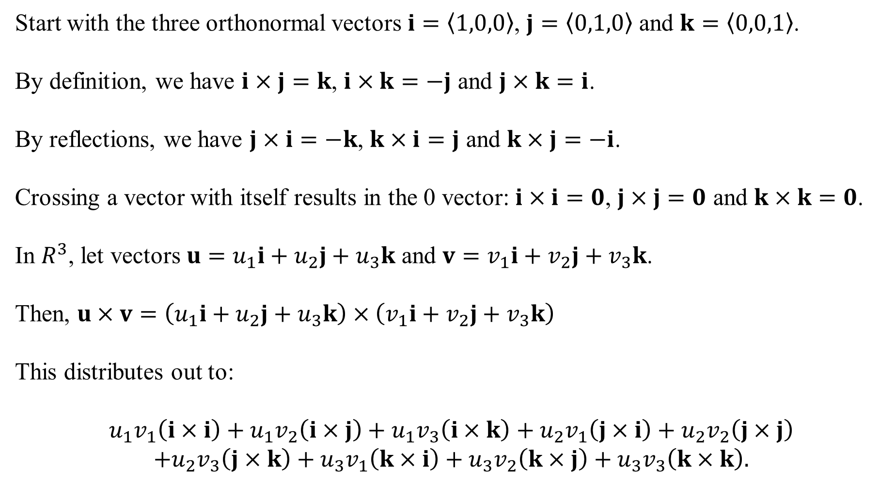
Start with the three orthonormal vectors $i=\left\langle 1,0,0\right\rangle$, $j=\left\langle 0,1,0\right\rangle$ and $k=\left\langle 0,0,1\right\rangle$.
By definition, we have $i×j=k$, $i×k=−j$ and $j×k=i$.
By reflections, we have $j×i=−k$, $k×i=j$ and $k×j=−i$.
Crossing a vector with itself results in the 0 vector: $i×i=0$, $j×j=0$ and $k×k=0$.
In $R^{3}$, let vectors $u=u_{1}i+u_{2}j+u_{3}k$ and $v=v_{1}i+v_{2}j+v_{3}k$.
Then, $u×v=\left(u_{1}i+u_{2}j+u_{3}k\right)×\left(v_{1}i+v_{2}j+v_{3}k\right)$
This distributes out to:
$$u_{1}v_{1}\left(i×i\right)+u_{1}v_{2}\left(i×j\right)+u_{1}v_{3}\left(i×k\right)+u_{2}v_{1}\left(j×i\right)+u_{2}v_{2}\left(j×j\right)$$
$$+u_{2}v_{3}\left(j×k\right)+u_{3}v_{1}\left(k×i\right)+u_{3}v_{2}\left(k×j\right)+u_{3}v_{3}\left(k×k\right).$$

Slide 3
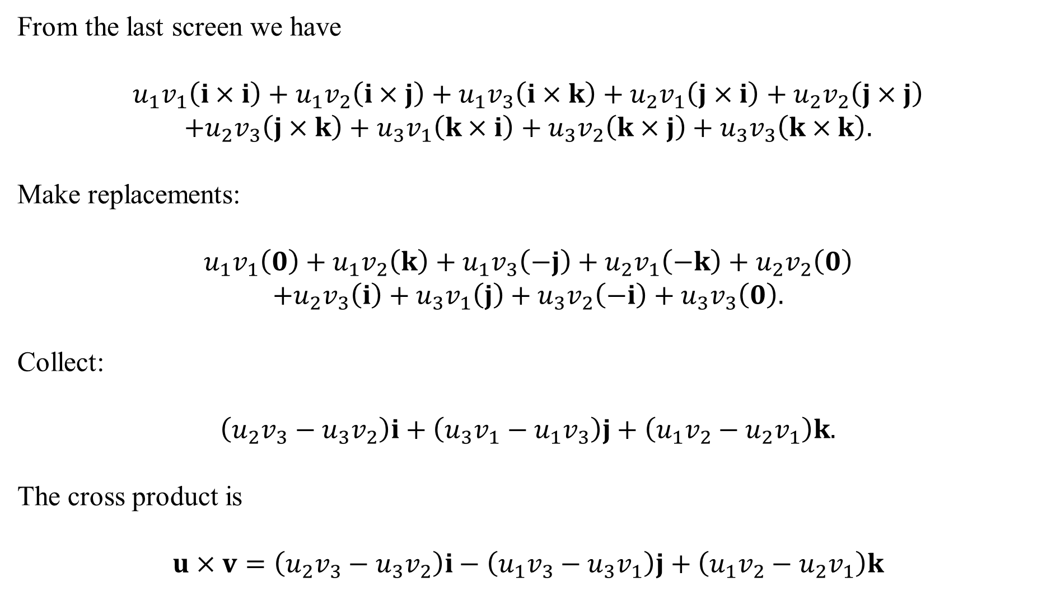
From the last screen we have
$$u_{1}v_{1}\left(i×i\right)+u_{1}v_{2}\left(i×j\right)+u_{1}v_{3}\left(i×k\right)+u_{2}v_{1}\left(j×i\right)+u_{2}v_{2}\left(j×j\right)$$
$$+u_{2}v_{3}\left(j×k\right)+u_{3}v_{1}\left(k×i\right)+u_{3}v_{2}\left(k×j\right)+u_{3}v_{3}\left(k×k\right).$$
Make replacements:
$$u_{1}v_{1}\left(0\right)+u_{1}v_{2}\left(k\right)+u_{1}v_{3}\left(−j\right)+u_{2}v_{1}\left(−k\right)+u_{2}v_{2}\left(0\right)$$
$$+u_{2}v_{3}\left(i\right)+u_{3}v_{1}\left(j\right)+u_{3}v_{2}\left(−i\right)+u_{3}v_{3}\left(0\right).$$
Collect:
$$\left(u_{2}v_{3}−u_{3}v_{2}\right)i+\left(u_{3}v_{1}−u_{1}v_{3}\right)j+\left(u_{1}v_{2}−u_{2}v_{1}\right)k.$$
The cross product is
$$u×v=\left(u_{2}v_{3}−u_{3}v_{2}\right)i−\left(u_{1}v_{3}−u_{3}v_{1}\right)j+\left(u_{1}v_{2}−u_{2}v_{1}\right)k$$

Slide 4
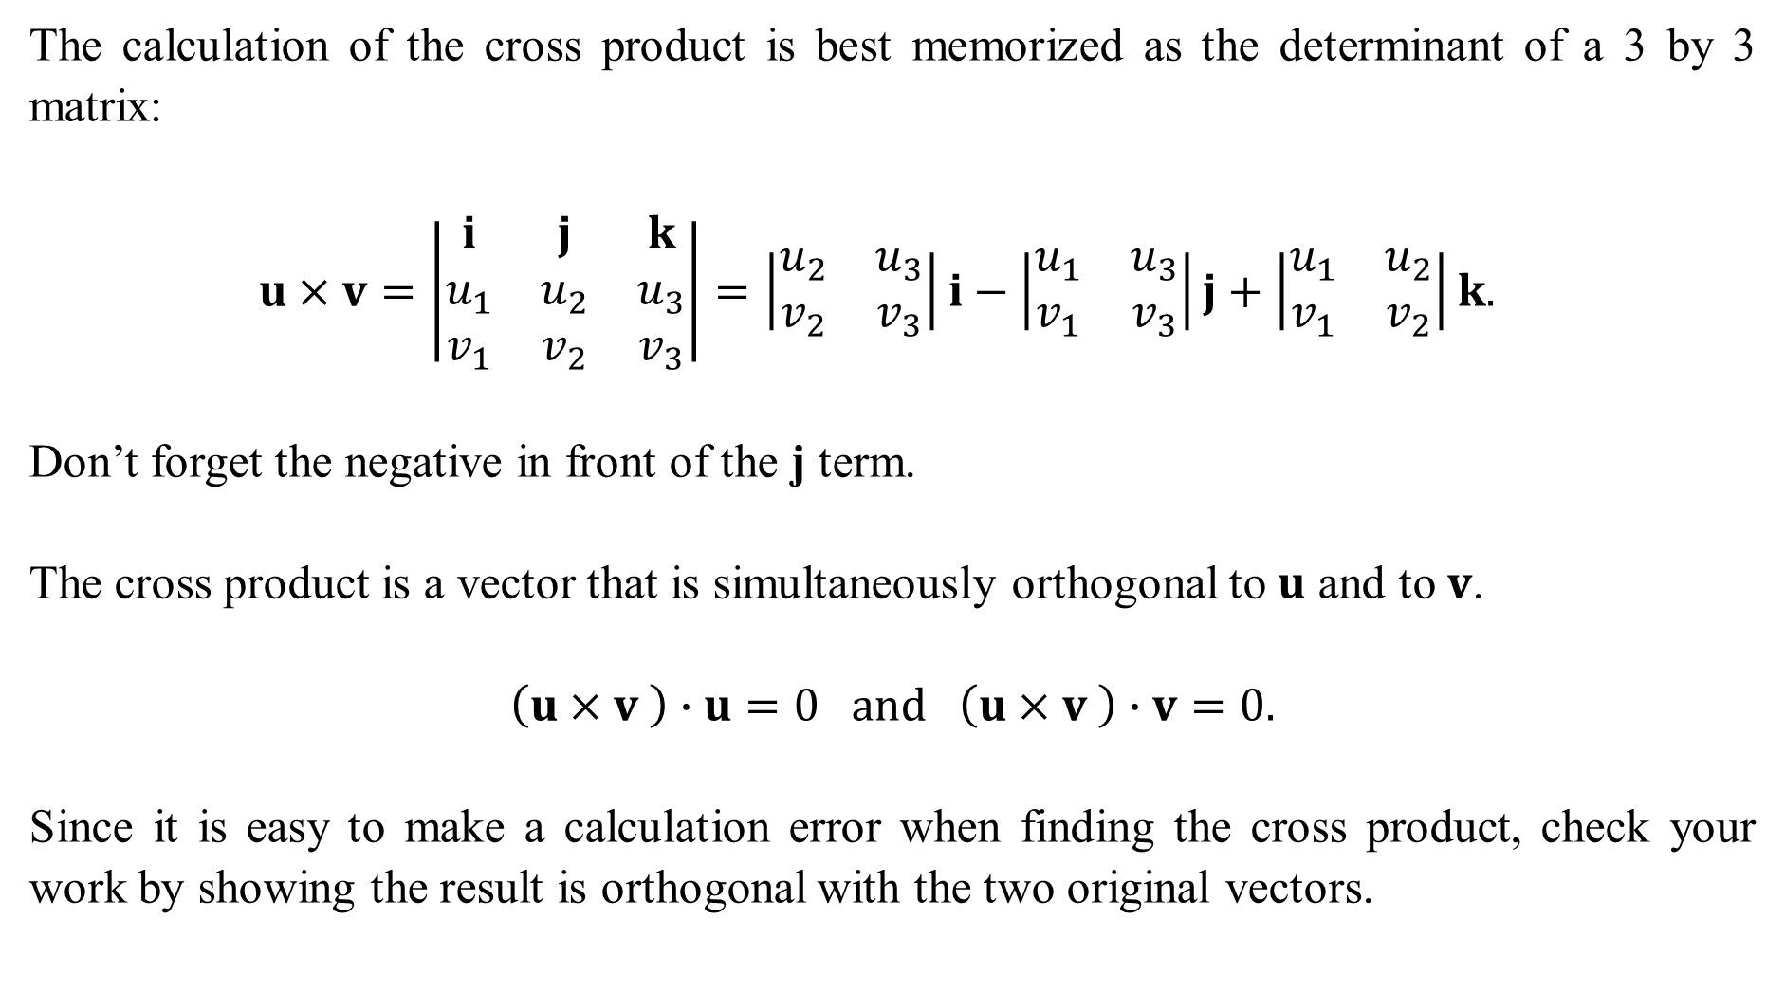
The calculation of the cross product is best memorized as the determinant of a 3 by 3 matrix:
$$u×v=\left|\begin{matrix}i & j & k \\ u_{1} & u_{2} & u_{3} \\ v_{1} & v_{2} & v_{3}\end{matrix}\right|=\left|\begin{matrix}u_{2} & u_{3} \\ v_{2} & v_{3}\end{matrix}\right|i−\left|\begin{matrix}u_{1} & u_{3} \\ v_{1} & v_{3}\end{matrix}\right|j+\left|\begin{matrix}u_{1} & u_{2} \\ v_{1} & v_{2}\end{matrix}\right|k.$$
Don’t forget the negative in front of the j term.
The cross product is a vector that is simultaneously orthogonal to $u$ and to $v$.
$$\left(u×v \right)∙u=0 and \left(u×v \right)∙v=0.$$
Since it is easy to make a calculation error when finding the cross product, check your work by showing the result is orthogonal with the two original vectors.

Slide 5
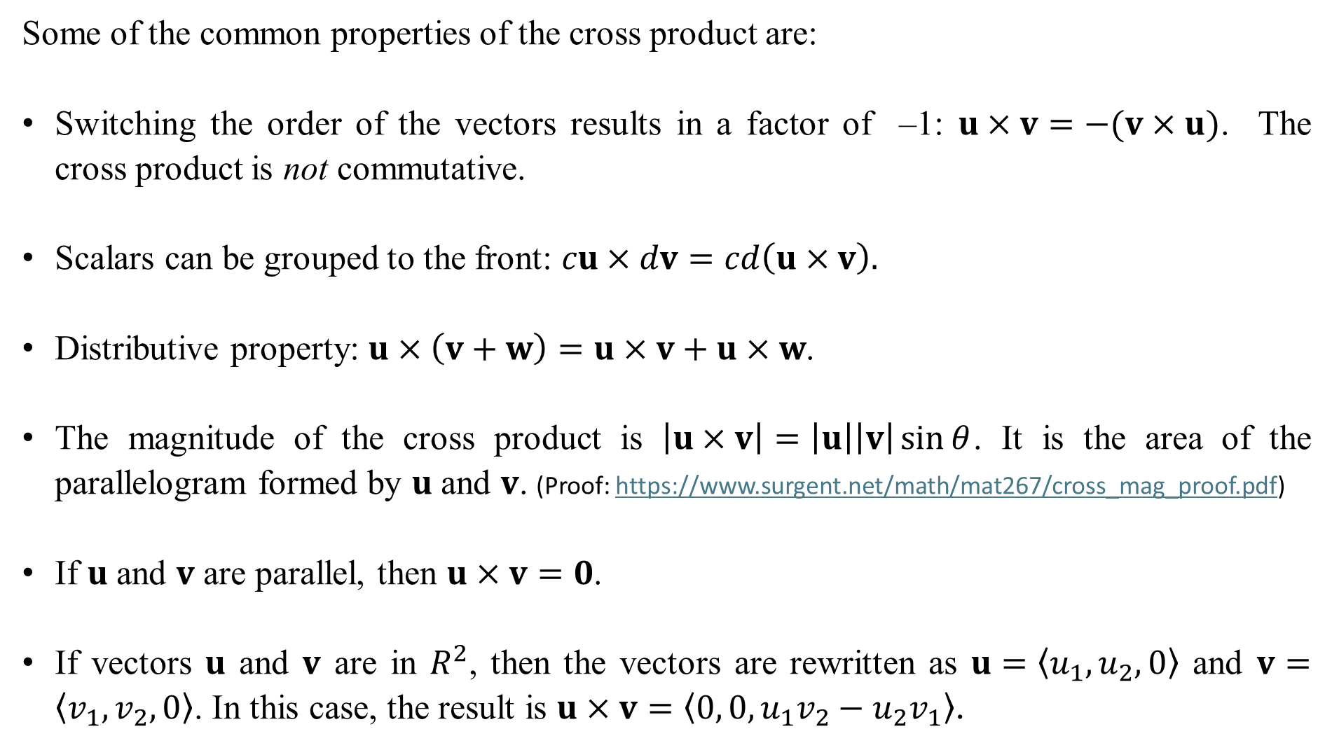
Some of the common properties of the cross product are:
Switching the order of the vectors results in a factor of –1: $u×v=−(v×u)$. The cross product is not commutative.
Scalars can be grouped to the front: $cu×dv=cd\left(u×v\right).$
Distributive property: $u×\left(v+w\right)=u×v+u×w$.
The magnitude of the cross product is $\left|u×v\right|=\left|u\right|\left|v\right|\sin{θ}$. It is the area of the parallelogram formed by $u$ and $v$. (Proof: https://www.surgent.net/math/mat267/cross_mag_proof.pdf)
If $u$ and $v$ are parallel, then $u×v=0$.
If vectors $u$ and $v$ are in $R^{2}$, then the vectors are rewritten as $u=〈u_{1},u_{2},0〉$ and $v=〈v_{1},v_{2},0〉$. In this case, the result is $u×v=〈0, 0, u_{1}v_{2}−u_{2}v_{1}〉$.

Slide 6
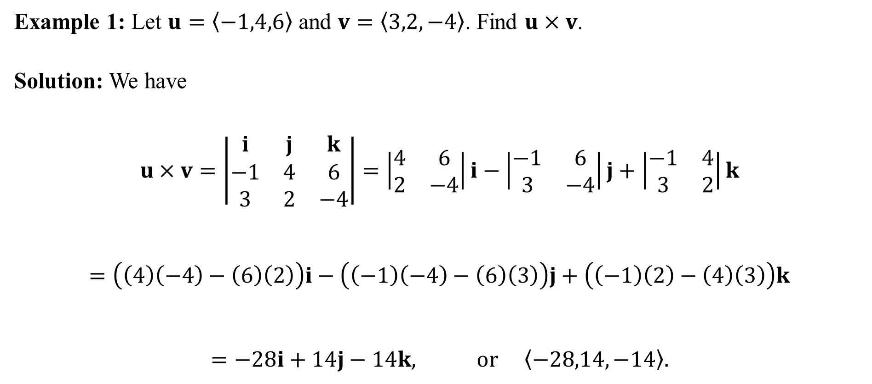
Example 1: Let $u=〈−1,4,6〉$ and $v=〈3,2,−4〉$. Find $u×v$.
Solution: We have
$$u×v=\left|\begin{matrix}i & j & k \\ −1 & 4 & 6 \\ 3 & 2 & −4\end{matrix}\right|=\left|\begin{matrix}4 & 6 \\ 2 & −4\end{matrix}\right|i−\left|\begin{matrix}−1 & 6 \\ 3 & −4\end{matrix}\right|j+\left|\begin{matrix}−1 & 4 \\ 3 & 2\end{matrix}\right|k$$
$$=\left(\left(4\right)\left(−4\right)−\left(6\right)\left(2\right)\right)i−\left(\left(−1\right)\left(−4\right)−\left(6\right)\left(3\right)\right)j+\left(\left(−1\right)\left(2\right)−\left(4\right)\left(3\right)\right)k$$
$$=−28i+14j−14k, or 〈−28,14,−14〉.$$

Slide 7
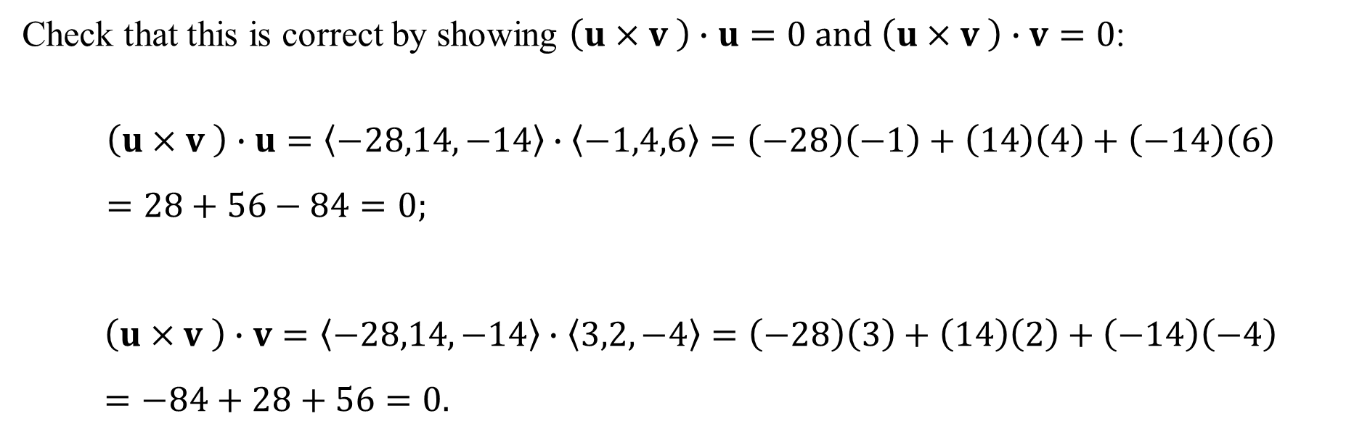
Check that this is correct by showing $\left(u×v \right)∙u=0 and \left(u×v \right)∙v=0$:
$$\left(u×v \right)∙u=〈−28,14,−14〉∙〈−1,4,6〉=\left(−28\right)\left(−1\right)+\left(14\right)\left(4\right)+\left(−14\right)\left(6\right)=28+56−84=0;$$
$$\left(u×v \right)∙v=〈−28,14,−14〉∙〈3,2,−4〉=\left(−28\right)\left(3\right)+\left(14\right)\left(2\right)+\left(−14\right)\left(−4\right)=−84+28+56=0.$$

Slide 8
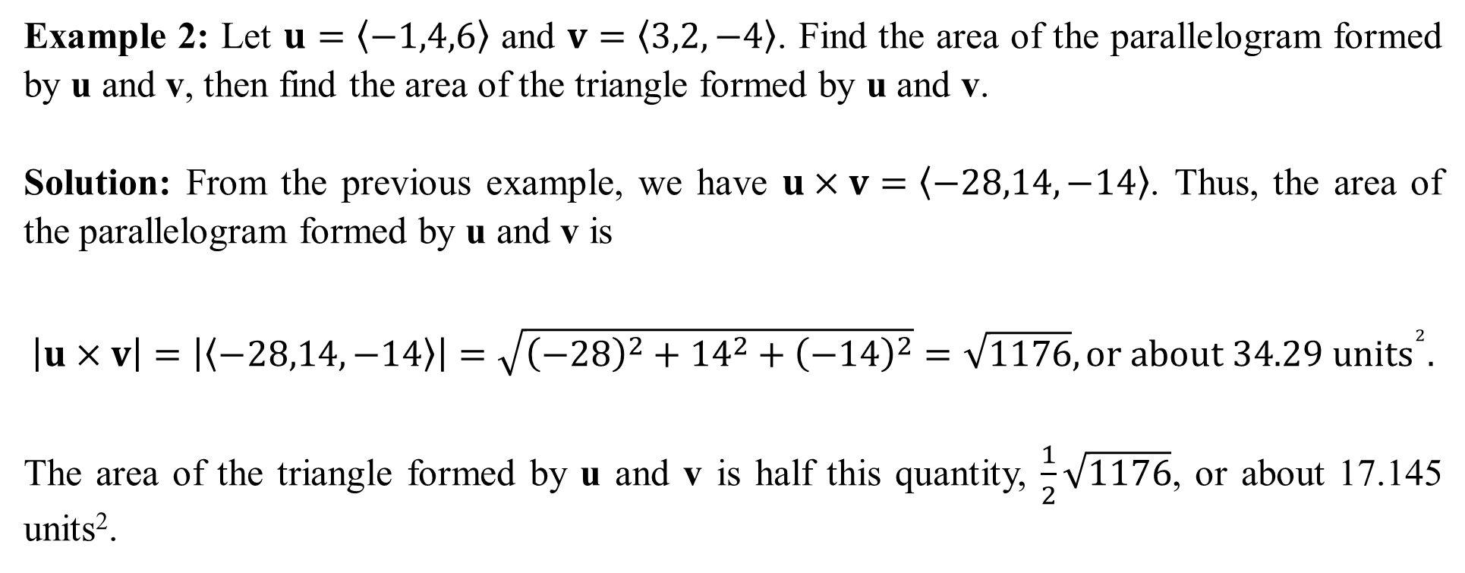
Example 2: Let $u=〈−1,4,6〉$ and $v=〈3,2,−4〉$. Find the area of the parallelogram formed by u and v, then find the area of the triangle formed by u and v.
Solution: From the previous example, we have $u×v=〈−28,14,−14〉$. Thus, the area of the parallelogram formed by u and v is
$$\left|u×v\right|=\left|〈−28,14,−14〉\right|=\sqrt{{\left(−28\right)}^{2}+{14}^{2}+{\left(−14\right)}^{2}}=\sqrt{1176}, or about 34.29 {units}^{2}.$$
The area of the triangle formed by u and v is half this quantity, $\frac{1}{2}\sqrt{1176}$, or about 17.145 units².

Slide 9
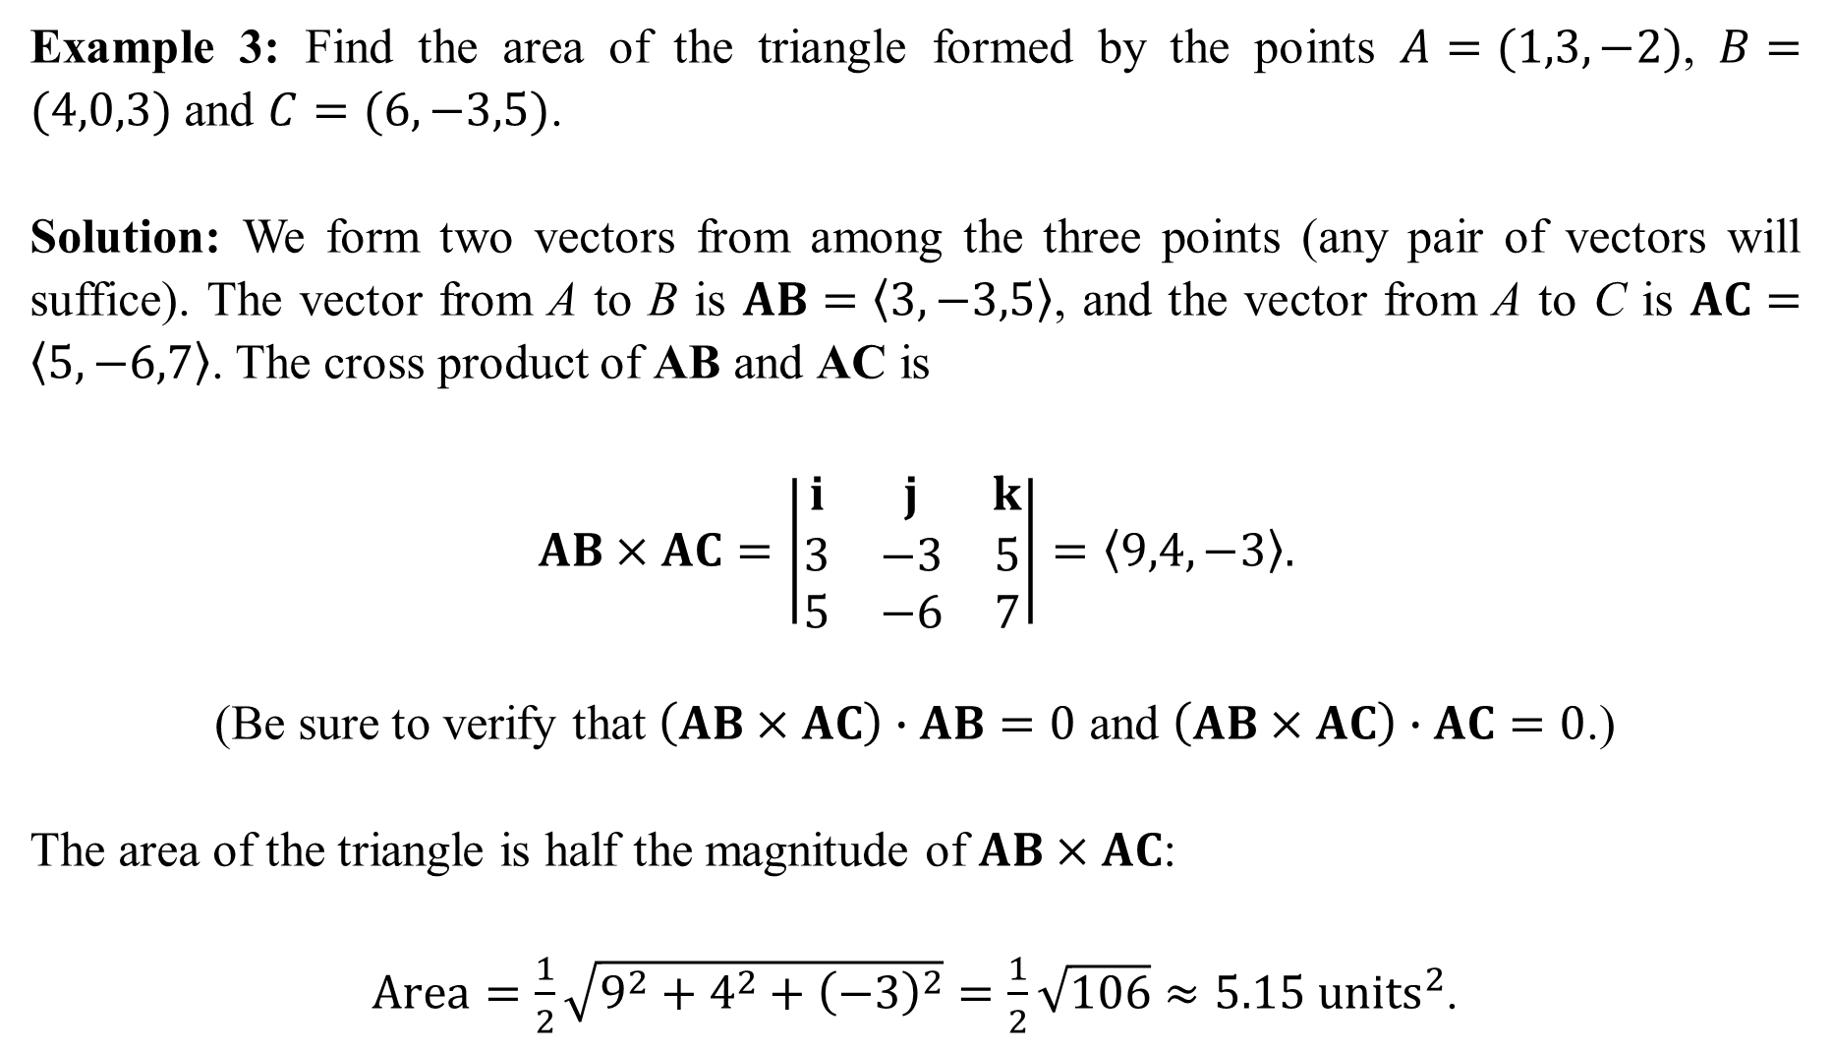
Example 3: Find the area of the triangle formed by the points $A=(1,3,−2)$, $B=(4,0,3)$ and $C=(6,−3,5)$.
Solution: We form two vectors from among the three points (any pair of vectors will suffice). The vector from A to B is $AB=〈3,−3,5〉$, and the vector from A to C is $AC=〈5,−6,7〉$. The cross product of AB and AC is
$$AB×AC=\left|\begin{matrix}i & j & k \\ 3 & −3 & 5 \\ 5 & −6 & 7\end{matrix}\right|=〈9,4,−3〉.$$
(Be sure to verify that $\left(AB×AC\right)∙AB=0$ and $\left(AB×AC\right)∙AC=0$.)
The area of the triangle is half the magnitude of $AB×AC$:
$Area=\frac{1}{2}\sqrt{9^{2}+4^{2}+{\left(−3\right)}^{2}}=\frac{1}{2}\sqrt{106}≈5.15 units^{2}$.

Slide 10
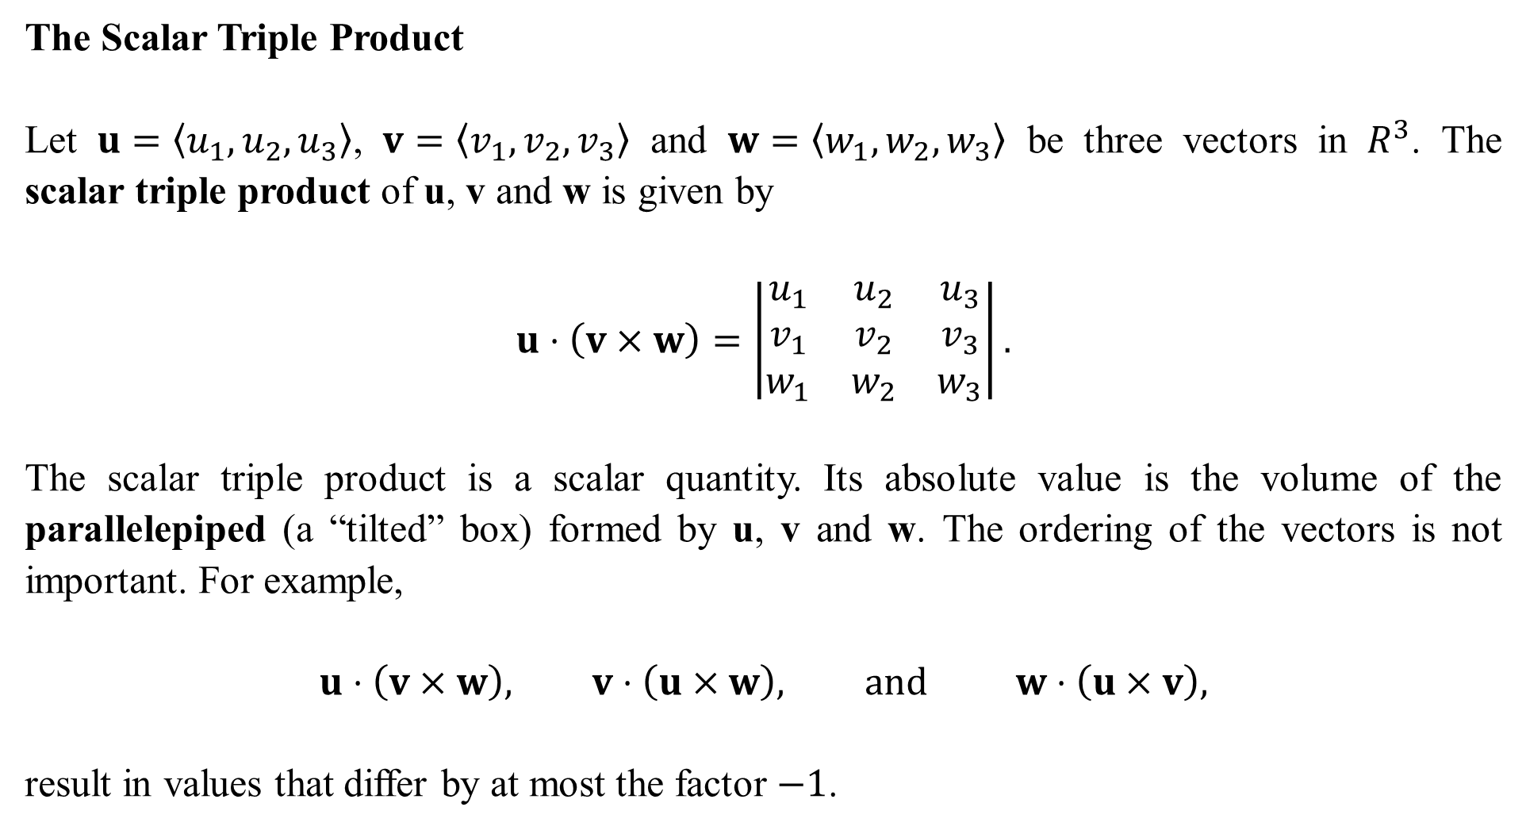
The Scalar Triple Product
Let $u=〈u_{1},u_{2},u_{3}〉$, $v=〈v_{1},v_{2},v_{3}〉$ and $w=〈w_{1},w_{2},w_{3}〉$ be three vectors in $R^{3}$. The scalar triple product of u, v and w is given by
$$u⋅\left(v×w\right)=\left|\begin{matrix}u_{1} & u_{2} & u_{3} \\ v_{1} & v_{2} & v_{3} \\ w_{1} & w_{2} & w_{3}\end{matrix}\right|.$$
The scalar triple product is a scalar quantity. Its absolute value is the volume of the parallelepiped (a “tilted” box) formed by u, v and w. The ordering of the vectors is not important. For example,
$$u⋅\left(v×w\right), v⋅\left(u×w\right), and w⋅\left(u×v\right),$$
result in values that differ by at most the factor $−1$.

Slide 11
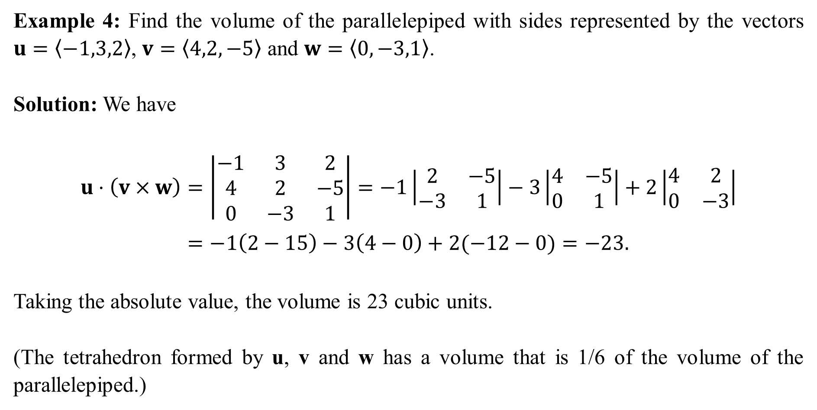
Example 4: Find the volume of the parallelepiped with sides represented by the vectors $u=〈−1,3,2〉$, $v=〈4,2,−5〉$ and $w=〈0,−3,1〉$.
Solution: We have
$$u⋅\left(v×w\right)=\left|\begin{matrix}−1 & 3 & 2 \\ 4 & 2 & −5 \\ 0 & −3 & 1\end{matrix}\right|=−1\left|\begin{matrix}2 & −5 \\ −3 & 1\end{matrix}\right|−3\left|\begin{matrix}4 & −5 \\ 0 & 1\end{matrix}\right|+2\left|\begin{matrix}4 & 2 \\ 0 & −3\end{matrix}\right| \\ =−1\left(2−15\right)−3\left(4−0\right)+2(−12−0)=−23.$$
Taking the absolute value, the volume is 23 cubic units.
(The tetrahedron formed by u, v and w has a volume that is 1/6 of the volume of the parallelepiped.)

Slide 12
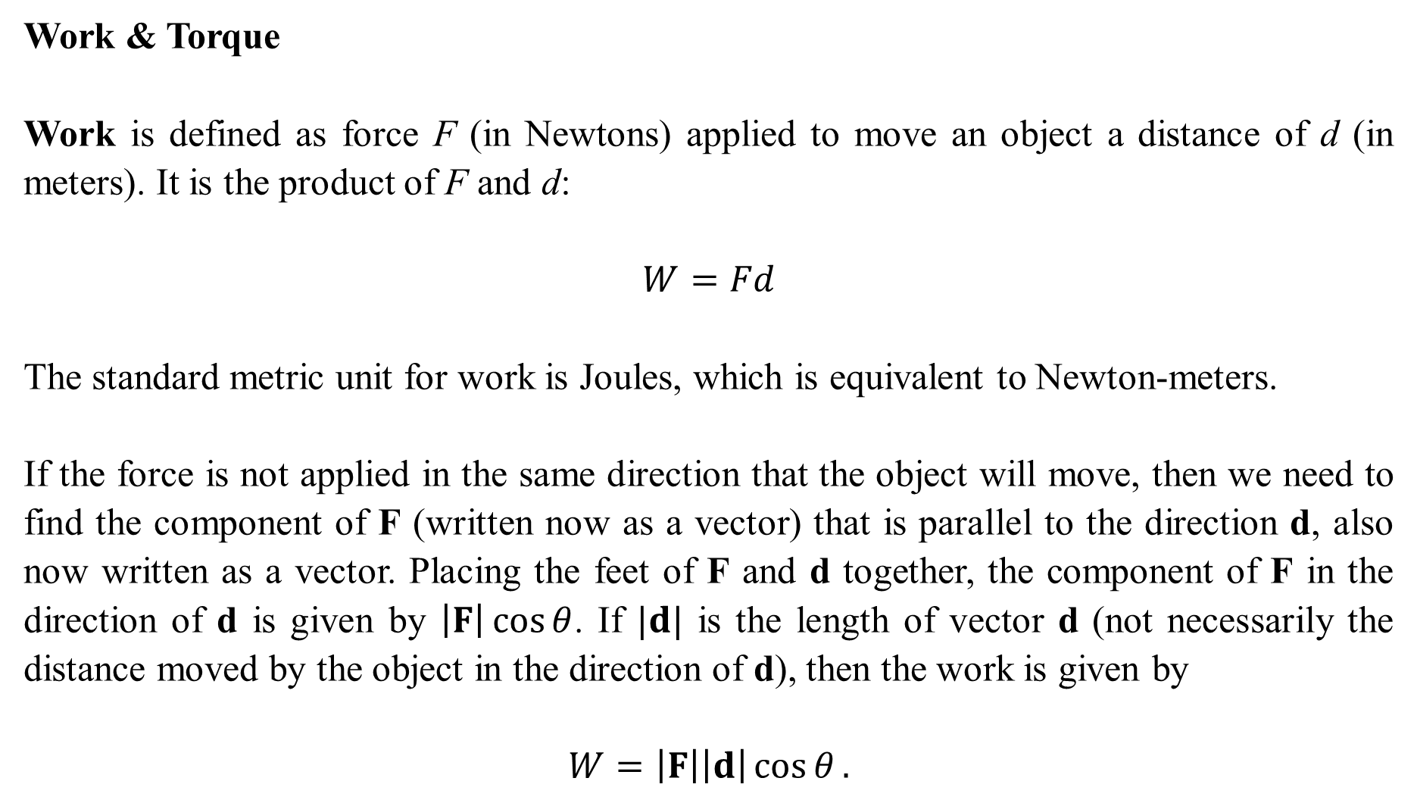
Work & Torque
Work is defined as force F (in Newtons) applied to move an object a distance of d (in meters). It is the product of F and d:
$$W=Fd$$
The standard metric unit for work is Joules, which is equivalent to Newton-meters.
If the force is not applied in the same direction that the object will move, then we need to find the component of F (written now as a vector) that is parallel to the direction d, also now written as a vector. Placing the feet of F and d together, the component of F in the direction of d is given by $\left|F\right|\cos{θ}$. If $|d|$ is the length of vector d (not necessarily the distance moved by the object in the direction of d), then the work is given by
$$W=\left|F\right|\left|d\right|\cos{θ}.$$

Slide 13
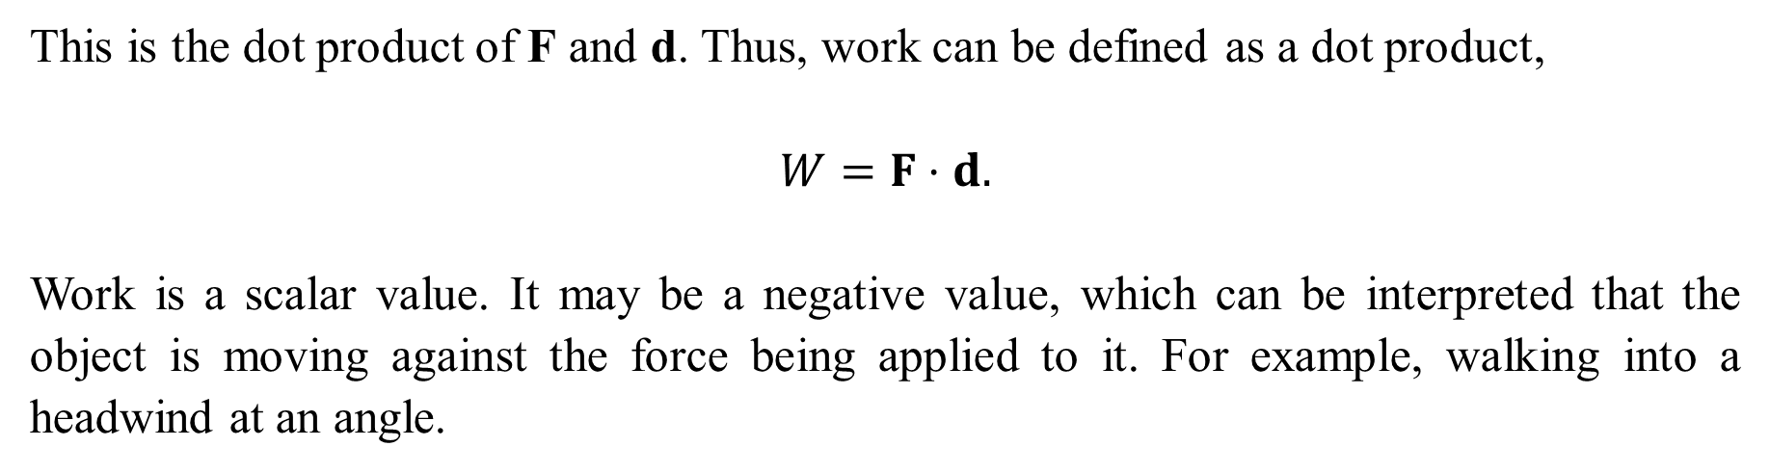
This is the dot product of F and d. Thus, work can be defined as a dot product,
$$W=F⋅d.$$
Work is a scalar value. It may be a negative value, which can be interpreted that the object is moving against the force being applied to it. For example, walking into a headwind at an angle.

Slide 14
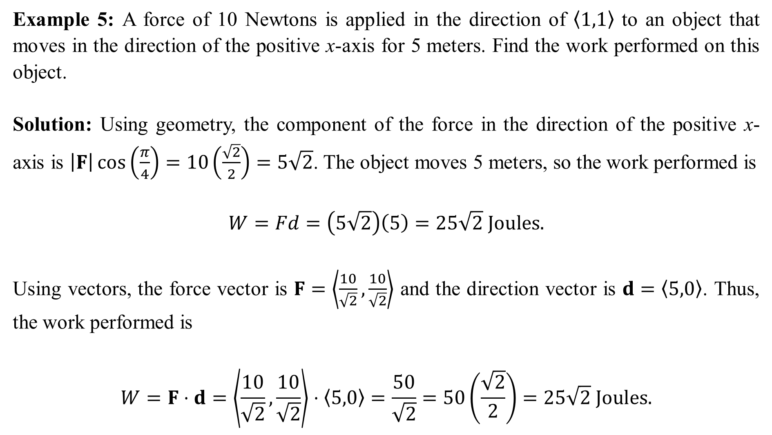
Example 5: A force of 10 Newtons is applied in the direction of $〈1,1〉$ to an object that moves in the direction of the positive x-axis for 5 meters. Find the work performed on this object.
Solution: Using geometry, the component of the force in the direction of the positive x-axis is $\left|F\right|\cos\left(\frac{π}{4}\right)=10\left(\frac{\sqrt{2}}{2}\right)=5\sqrt{2}$. The object moves 5 meters, so the work performed is
$$W=Fd=\left(5\sqrt{2}\right)\left(5\right)=25\sqrt{2} Joules.$$
Using vectors, the force vector is $F=\left\langle \frac{10}{\sqrt{2}}, \frac{10}{\sqrt{2}}\right\rangle$ and the direction vector is $d=〈5,0〉$. Thus, the work performed is
$$W=F⋅d=\left\langle \frac{10}{\sqrt{2}}, \frac{10}{\sqrt{2}}\right\rangle ⋅〈5,0〉=\frac{50}{\sqrt{2}}=50\left(\frac{\sqrt{2}}{2}\right)=25\sqrt{2} Joules.$$

Slide 15
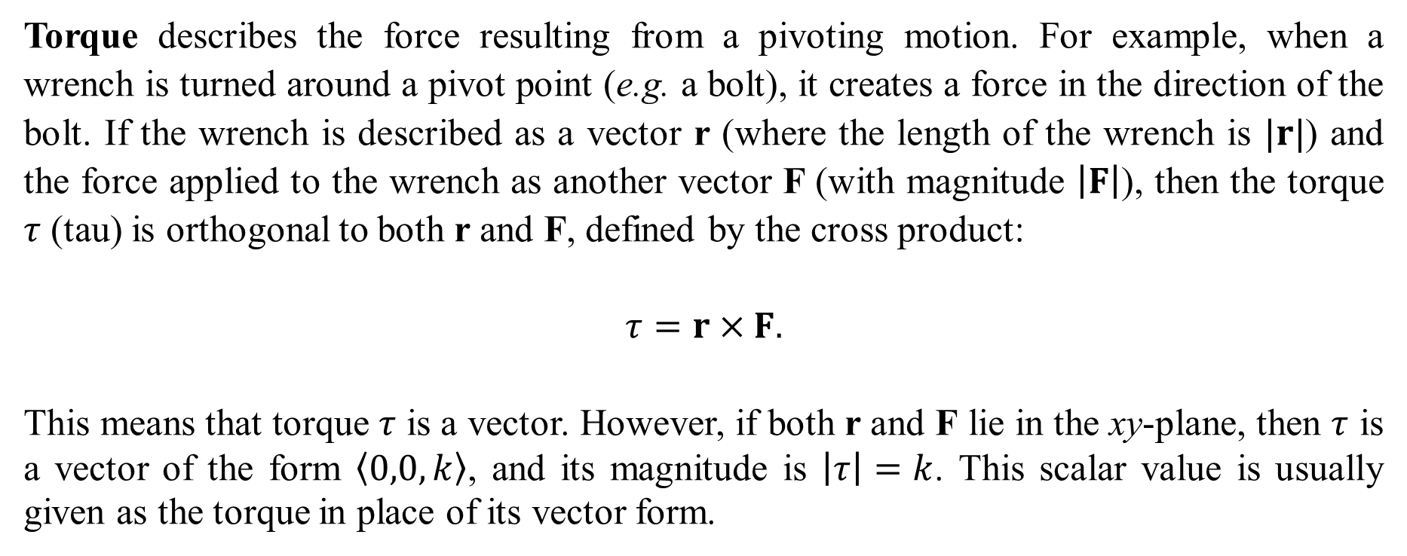
Torque describes the force resulting from a pivoting motion. For example, when a wrench is turned around a pivot point (e.g. a bolt), it creates a force in the direction of the bolt. If the wrench is described as a vector r (where the length of the wrench is $|r|$) and the force applied to the wrench as another vector F (with magnitude $\left|F\right|$), then the torque $τ$ (tau) is orthogonal to both r and F, defined by the cross product:
$$τ=r×F.$$
This means that torque $τ$ is a vector. However, if both r and F lie in the xy-plane, then $τ$ is a vector of the form $〈0,0,k〉$, and its magnitude is $\left|τ\right|=k$. This scalar value is usually given as the torque in place of its vector form.

Slide 16
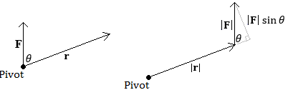
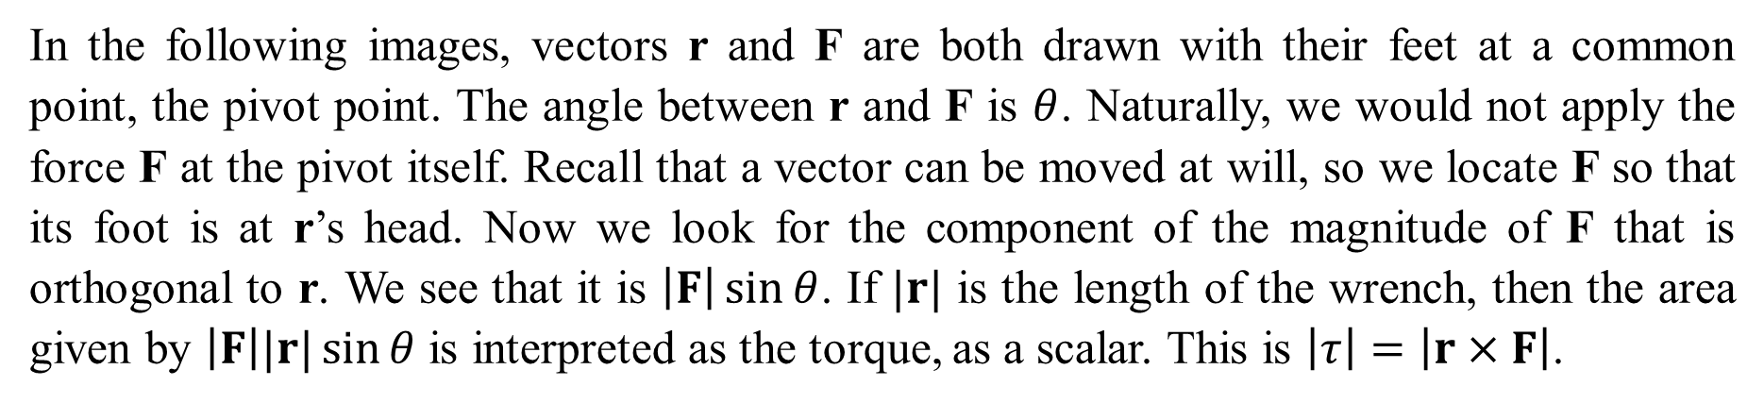
In the following images, vectors r and F are both drawn with their feet at a common point, the pivot point. The angle between r and F is $θ$. Naturally, we would not apply the force F at the pivot itself. Recall that a vector can be moved at will, so we locate F so that its foot is at r’s head. Now we look for the component of the magnitude of F that is orthogonal to r. We see that it is $\left|F\right|\sin{θ}$. If $|r|$ is the length of the wrench, then the area given by $\left|F\right||r|\sin{θ}$ is interpreted as the torque, as a scalar. This is $\left|τ\right|=\left|r×F\right|$.

Slide 17

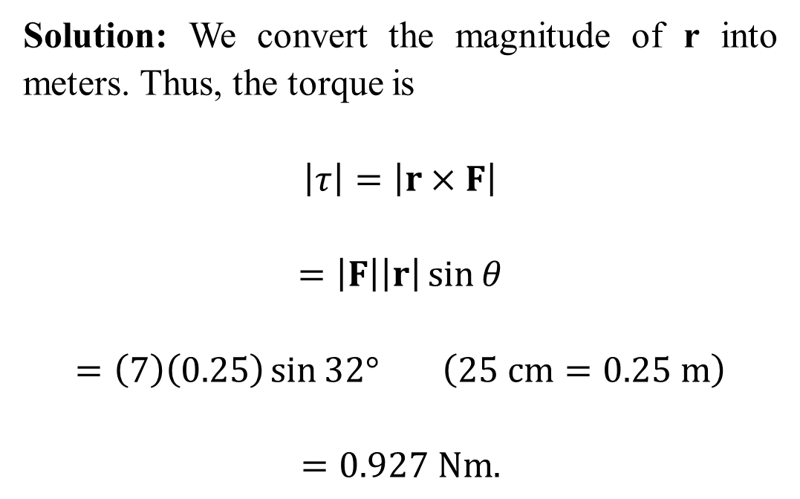
Example 6: Find the torque around the pivot shown in the following diagram.
Solution: We convert the magnitude of r into meters. Thus, the torque is
$$\left|τ\right|=\left|r×F\right|$$
$$=\left|F\right|\left|r\right|\sin{θ}$$
$$=\left(7\right)\left(0.25\right)\sin{32°} \left(25 cm=0.25 m\right)$$
$$=0.927 Nm.$$

