Slide 1
The Chain Rule
Scott Surgent

Slide 2
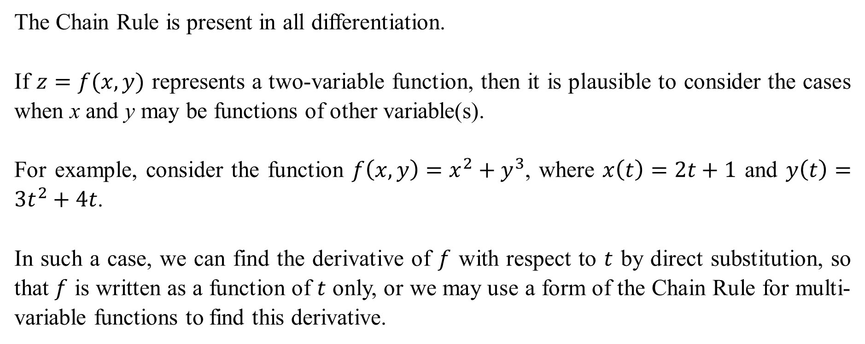
The Chain Rule is present in all differentiation.
If $z=f(x,y)$ represents a two-variable function, then it is plausible to consider the cases when x and y may be functions of other variable(s).
For example, consider the function $f\left(x,y\right)=x^{2}+y^{3}$, where $x\left(t\right)=2t+1$ and $y\left(t\right)=3t^{2}+4t$.
In such a case, we can find the derivative of $f$ with respect to $t$ by direct substitution, so that $f$ is written as a function of $t$ only, or we may use a form of the Chain Rule for multi-variable functions to find this derivative.

Slide 3
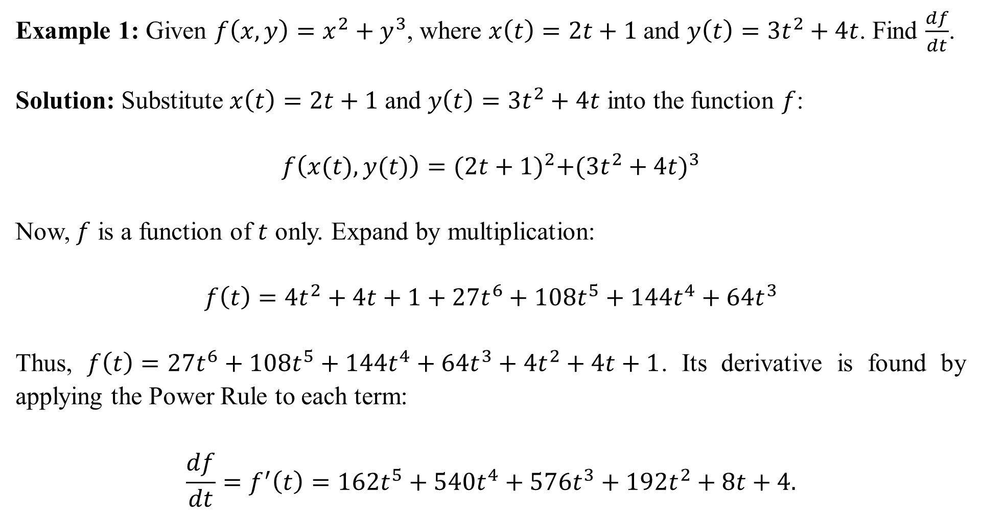
Example 1: Given $f\left(x,y\right)=x^{2}+y^{3}$, where $x\left(t\right)=2t+1$ and $y\left(t\right)=3t^{2}+4t$. Find $\frac{df}{dt}$.
Solution: Substitute $x\left(t\right)=2t+1$ and $y\left(t\right)=3t^{2}+4t$ into the function $f$:
$$f\left(x(t),y(t)\right)={(2t+1)}^{2}+{(3t^{2}+4t)}^{3}$$
Now, $f$ is a function of $t$ only. Expand by multiplication:
$$f\left(t\right)=4t^{2}+4t+1+27t^{6}+108t^{5}+144t^{4}+{64t}^{3}$$
Thus, $f\left(t\right)=27t^{6}+108t^{5}+144t^{4}+64t^{3}+4t^{2}+4t+1$. Its derivative is found by applying the Power Rule to each term:
$$\frac{df}{dt}=f^{′}\left(t\right)=162t^{5}+540t^{4}+576t^{3}+192t^{2}+8t+4.$$

Slide 4
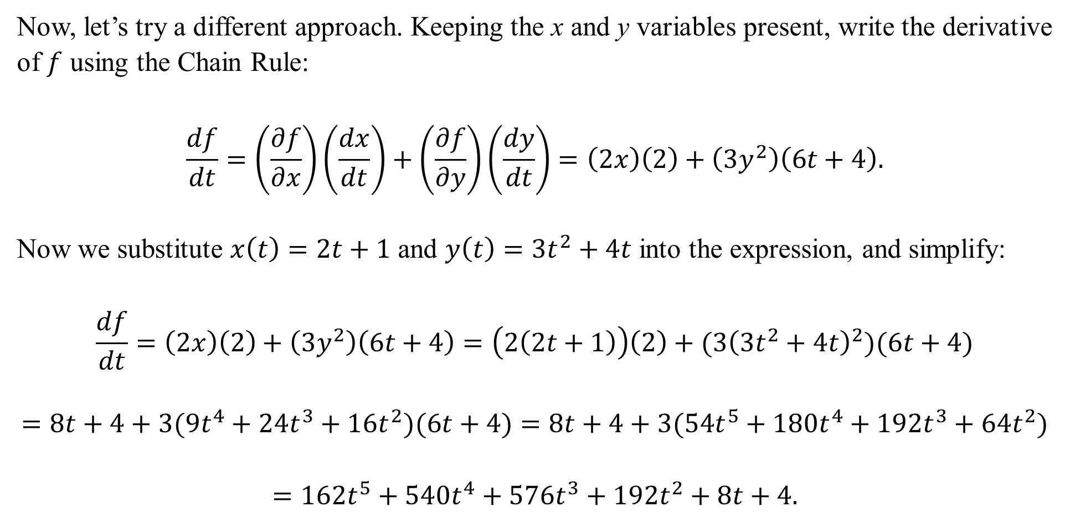
Now, let’s try a different approach. Keeping the x and y variables present, write the derivative of $f$ using the Chain Rule:
$$\frac{df}{dt}=\left(\frac{∂f}{∂x}\right)\left(\frac{dx}{dt}\right)+\left(\frac{∂f}{∂y}\right)\left(\frac{dy}{dt}\right)=\left(2x\right)\left(2\right)+\left(3y^{2}\right)\left(6t+4\right).$$
Now we substitute $x\left(t\right)=2t+1$ and $y\left(t\right)=3t^{2}+4t$ into the expression, and simplify:
$$\frac{df}{dt}=\left(2x\right)\left(2\right)+\left(3y^{2}\right)\left(6t+4\right)=\left(2\left(2t+1\right)\right)\left(2\right)+(3{\left(3t^{2}+4t\right)}^{2})(6t+4)$$
$$=8t+4+3(9t^{4}+24t^{3}+16t^{2})(6t+4)=8t+4+3(54t^{5}+180t^{4}+192t^{3}+64t^{2})$$
$$=162t^{5}+540t^{4}+576t^{3}+192t^{2}+8t+4.$$

Slide 5
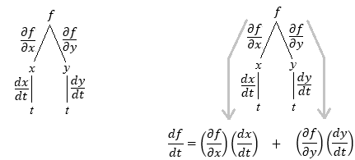
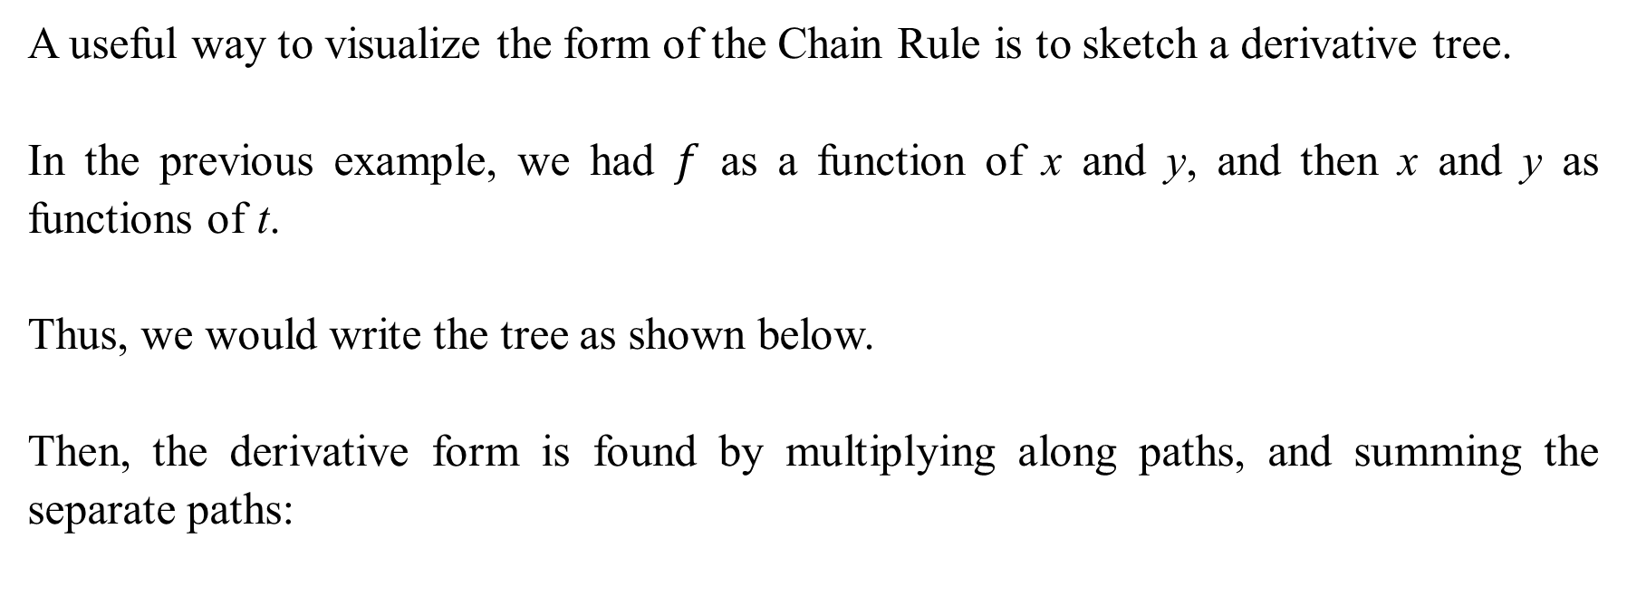
A useful way to visualize the form of the Chain Rule is to sketch a derivative tree.
In the previous example, we had $f$ as a function of x and y, and then x and y as functions of t.
Thus, we would write the tree as shown below.
Then, the derivative form is found by multiplying along paths, and summing the separate paths:

Slide 6
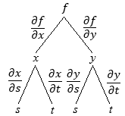
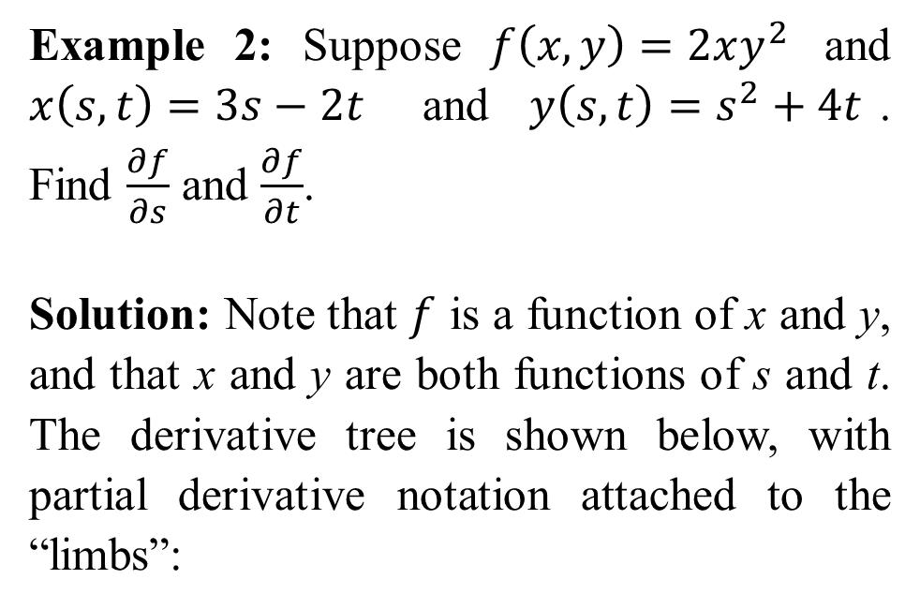
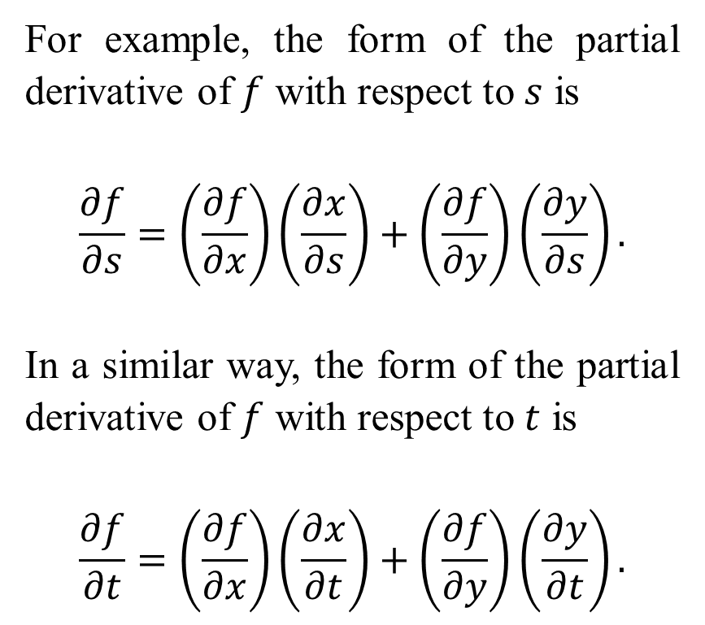
Example 2: Suppose $f\left(x,y\right)=2xy^{2}$ and $x\left(s,t\right)=3s−2t$ and $y\left(s,t\right)=s^{2}+4t$. Find $\frac{∂f}{∂s}$ and $\frac{∂f}{∂t}$.
Solution: Note that $f$ is a function of x and y, and that x and y are both functions of s and t. The derivative tree is shown below, with partial derivative notation attached to the “limbs”:
For example, the form of the partial derivative of $f$ with respect to $s$ is
$$\frac{∂f}{∂s}=\left(\frac{∂f}{∂x}\right)\left(\frac{∂x}{∂s}\right)+\left(\frac{∂f}{∂y}\right)\left(\frac{∂y}{∂s}\right).$$
In a similar way, the form of the partial derivative of $f$ with respect to $t$ is
$$\frac{∂f}{∂t}=\left(\frac{∂f}{∂x}\right)\left(\frac{∂x}{∂t}\right)+\left(\frac{∂f}{∂y}\right)\left(\frac{∂y}{∂t}\right).$$

Slide 7
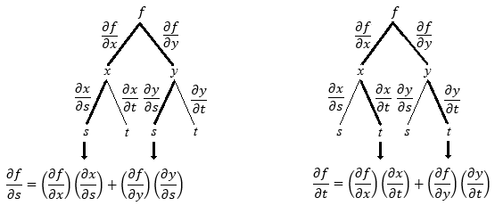

Slide 8

To find $\frac{∂f}{∂s}$, we have
$$\frac{∂f}{∂s}=\left(\frac{∂f}{∂x}\right)\left(\frac{∂x}{∂s}\right)+\left(\frac{∂f}{∂y}\right)\left(\frac{∂y}{∂s}\right)$$
$$=\left(2y^{2}\right)\left(3\right)+(4xy)(2s)=6y^{2}+8xys$$
$$=6{\left(s^{2}+4t\right)}^{2}+8\left(3s−2t\right)\left(s^{2}+4t\right)s \left\{\begin{matrix}y=s^{2}+4t \\ x=3s−2t\end{matrix}\right.$$
This is simplified to
$$\frac{∂f}{∂s}=30s^{4}−16s^{3}t+144s^{2}t−64st^{2}+96t^{2}.$$

Slide 9

To find $\frac{∂f}{∂t}$, we have
$$\frac{∂f}{∂t}=\left(\frac{∂f}{∂x}\right)\left(\frac{∂x}{∂t}\right)+\left(\frac{∂f}{∂y}\right)\left(\frac{∂y}{∂t}\right)$$
$$=\left(2y^{2}\right)\left(−2\right)+(4xy)(4)=−4y^{2}+16xy$$
$$=−4{\left(s^{2}+4t\right)}^{2}+16\left(3s−2t\right)\left(s^{2}+4t\right) \left\{\begin{matrix}y=s^{2}+4t \\ x=3s−2t\end{matrix}\right.$$
This simplifies to
$$\frac{∂f}{∂t}=−4s^{4}+48s^{3}−64s^{2}t+192st−192t^{2}.$$

Slide 10
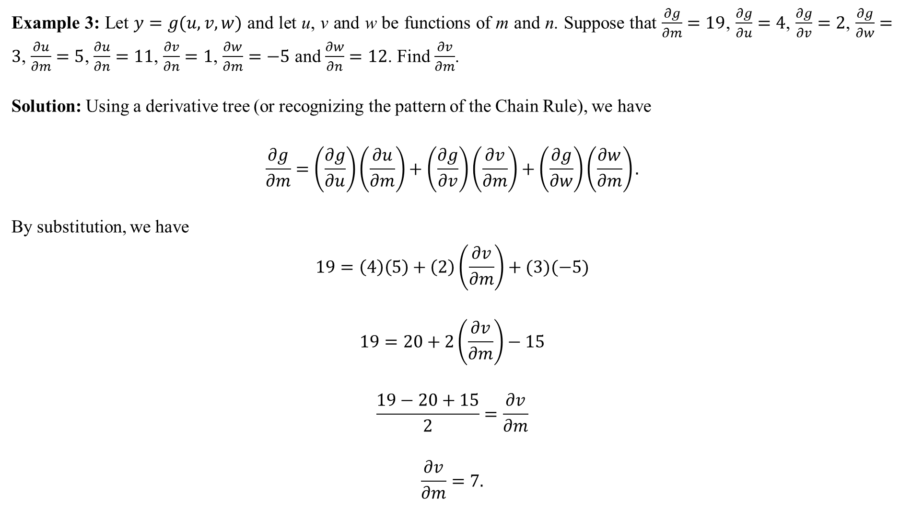
Example 3: Let $y=g(u,v,w)$ and let u, v and w be functions of m and n. Suppose that $\frac{∂g}{∂m}=19$, $\frac{∂g}{∂u}=4$, $\frac{∂g}{∂v}=2$, $\frac{∂g}{∂w}=3$, $\frac{∂u}{∂m}=5$, $\frac{∂u}{∂n}=11$, $\frac{∂v}{∂n}=1$, $\frac{∂w}{∂m}=−5$ and $\frac{∂w}{∂n}=12$. Find $\frac{∂v}{∂m}$.
Solution: Using a derivative tree (or recognizing the pattern of the Chain Rule), we have
$$\frac{∂g}{∂m}=\left(\frac{∂g}{∂u}\right)\left(\frac{∂u}{∂m}\right)+\left(\frac{∂g}{∂v}\right)\left(\frac{∂v}{∂m}\right)+\left(\frac{∂g}{∂w}\right)\left(\frac{∂w}{∂m}\right).$$
By substitution, we have
$$19=\left(4\right)\left(5\right)+\left(2\right)\left(\frac{∂v}{∂m}\right)+(3)(−5)$$
$$19=20+2\left(\frac{∂v}{∂m}\right)−15$$
$$\frac{19−20+15}{2}=\frac{∂v}{∂m}$$
$$\frac{∂v}{∂m}=7.$$

Slide 11
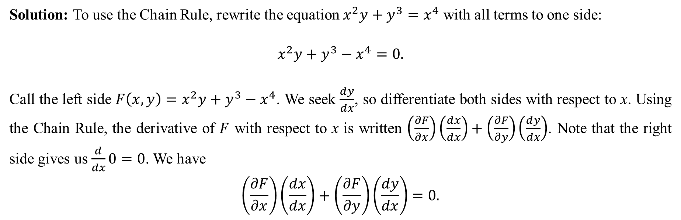
Implicit Differentiation can be performed by employing the chain rule of a multivariable function.
Often, this technique is much faster than the “traditional” direct method seen in single-variable calculus can be applied to functions of many variables with ease.
Example 4: Use implicit differentiation to find $\frac{dy}{dx}$ where $x^{2}y+y^{3}=x^{4}$.
Solution: To use the Chain Rule, rewrite the equation $x^{2}y+y^{3}=x^{4}$ with all terms to one side:
$$x^{2}y+y^{3}−x^{4}=0.$$
Call the left side $F\left(x,y\right)=x^{2}y+y^{3}−x^{4}$. We seek $\frac{dy}{dx}$, so differentiate both sides with respect to x. Using the Chain Rule, the derivative of $F$ with respect to x is written $\left(\frac{∂F}{∂x}\right)\left(\frac{dx}{dx}\right)+\left(\frac{∂F}{∂y}\right)\left(\frac{dy}{dx}\right)$. Note that the right side gives us $\frac{d}{dx}0=0$. We have
$$\left(\frac{∂F}{∂x}\right)\left(\frac{dx}{dx}\right)+\left(\frac{∂F}{∂y}\right)\left(\frac{dy}{dx}\right)=0.$$

Slide 12

Now, $\frac{∂F}{∂x}=2xy−4x^{3}$ and $\frac{∂F}{∂y}=x^{2}+3y^{2}$. Furthermore, $\frac{dx}{dx}=1$, and $\frac{dy}{dx}$ is the unknown. Make the substitutions and solve for the unknown:
$$\left(2xy−4x^{3}\right)\left(1\right)+\left(x^{2}+3y^{2}\right)\frac{dy}{dx}=0$$
$$\left(x^{2}+3y^{2}\right)\frac{dy}{dx}=4x^{3}−2xy$$
$$\frac{dy}{dx}=\frac{4x^{3}−2xy}{x^{2}+3y^{2}} .$$

Slide 13

In general, if x and y are implicitly related, collect all terms to one side and call the collected expression$F\left(x,y\right)$. Thus,
$$\frac{dy}{dx}=−\frac{F_{x}}{F_{y}} and \frac{dx}{dy}=−\frac{F_{y}}{F_{x}} .$$
This is true for implicit functions of three or more variables, too.
Example 5: Given $xy^{2}z+3xz^{3}=yz^{6}$, find $\frac{dy}{dz}$ .
Solution: Call $F\left(x,y,z\right)=xy^{2}z+3xz^{3}−yz^{6}$. Using the formula $\frac{dy}{dz}=−\frac{F_{z}}{F_{y}}$, we have
$$F_{z}=xy^{2}+9xz^{2}−6yz^{5} and F_{y}=2xyz−z^{6}.$$
Thus,
$$\frac{dy}{dz}=−\frac{F_{z}}{F_{y}}=−\left(\frac{xy^{2}+9xz^{2}−6yz^{5}}{2xyz−z^{6}}\right)=\frac{6yz^{5}−xy^{2}−9xz^{2}}{2xyz−z^{6}} .$$

