Slide 1
Arc Length, Unit Tangent & Normal Vectors
Scott Surgent

Slide 2
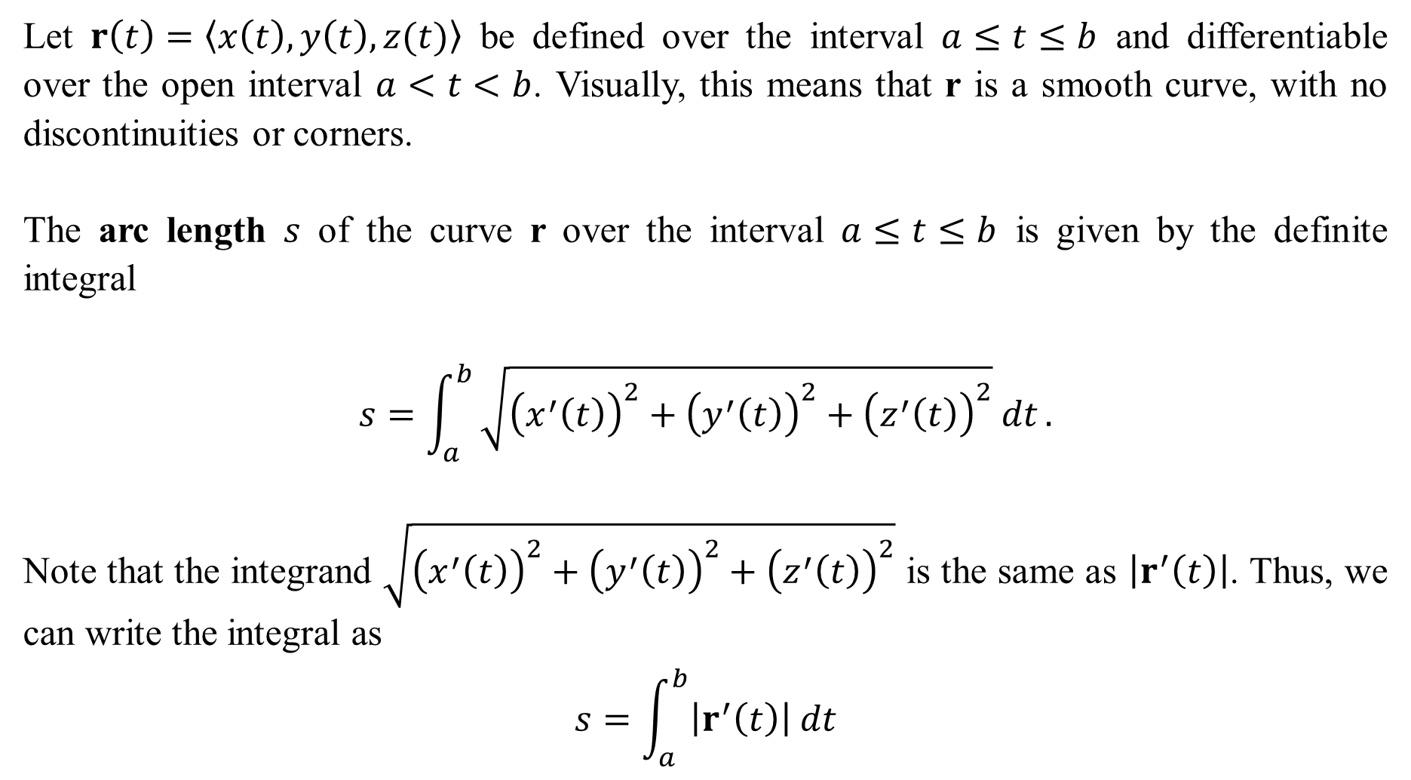
Let $r\left(t\right)=〈x\left(t\right), y\left(t\right),z(t)〉$ be defined over the interval $a≤t≤b$ and differentiable over the open interval $a<t<b$. Visually, this means that r is a smooth curve, with no discontinuities or corners.
The arc length $s$ of the curve r over the interval $a≤t≤b$ is given by the definite integral
$$s=\int_{a}^{b}{\sqrt{{\left(x^{′}\left(t\right)\right)}^{2}+{\left(y^{′}\left(t\right)\right)}^{2}+{\left(z^{′}\left(t\right)\right)}^{2}} dt}.$$
Note that the integrand $\sqrt{{\left(x^{′}\left(t\right)\right)}^{2}+{\left(y^{′}\left(t\right)\right)}^{2}+{\left(z^{′}\left(t\right)\right)}^{2}}$ is the same as $\left|r^{′}\left(t\right)\right|$. Thus, we can write the integral as
$$s=\int_{a}^{b}{\left|r^{′}\left(t\right)\right| dt}$$

Slide 3
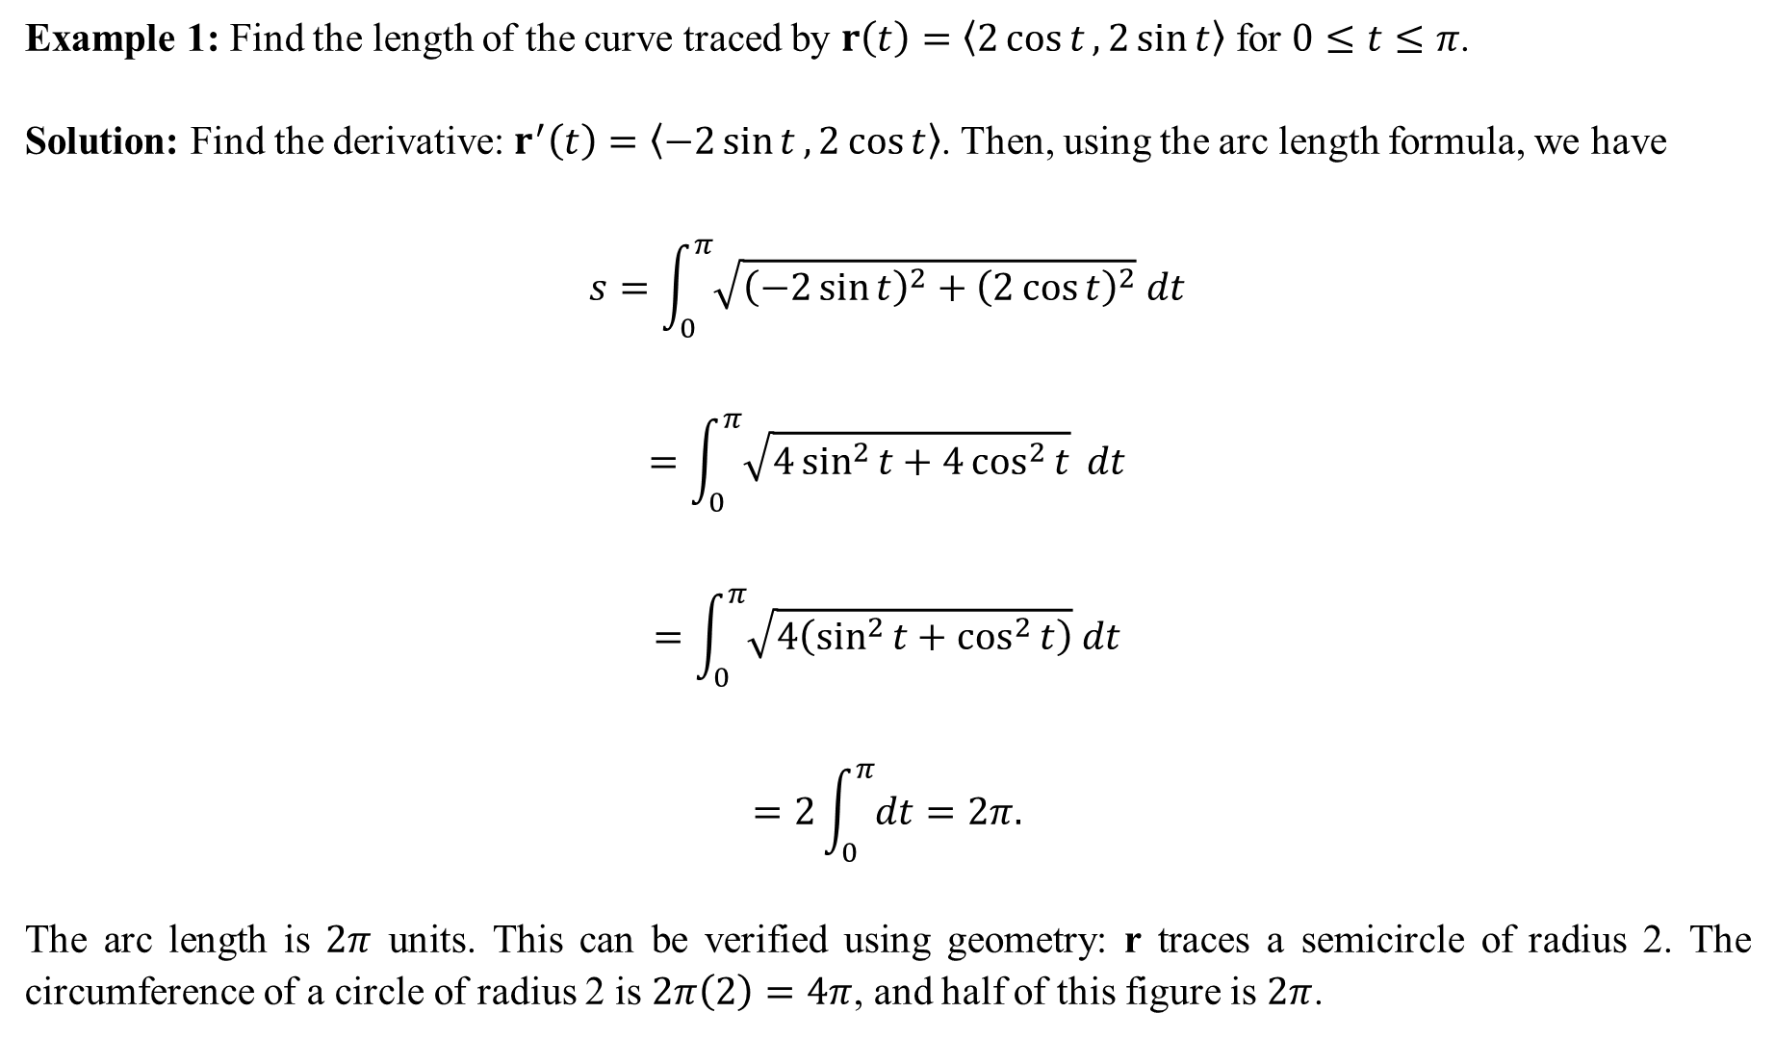
Example 1: Find the length of the curve traced by $r\left(t\right)=〈2\cos{t}, 2\sin{t}〉$ for $0≤t≤π$.
Solution: Find the derivative: $r^{′}\left(t\right)=〈−2\sin{t}, 2\cos{t}〉$. Then, using the arc length formula, we have
$$s=\int_{0}^{π}{\sqrt{{\left(−2\sin{t}\right)}^{2}+{\left(2\cos{t}\right)}^{2}} dt}$$
$$=\int_{0}^{π}{\sqrt{4\sin^{2}{t}+4\cos^{2}{t}} dt}$$
$$=\int_{0}^{π}{\sqrt{4\left(\sin^{2}{t+\cos^{2}{t}}\right)} dt}$$
$$=2\int_{0}^{π}{dt}=2π.$$
The arc length is $2π$ units. This can be verified using geometry: r traces a semicircle of radius 2. The circumference of a circle of radius 2 is $2π\left(2\right)=4π$, and half of this figure is $2π$.

Slide 4
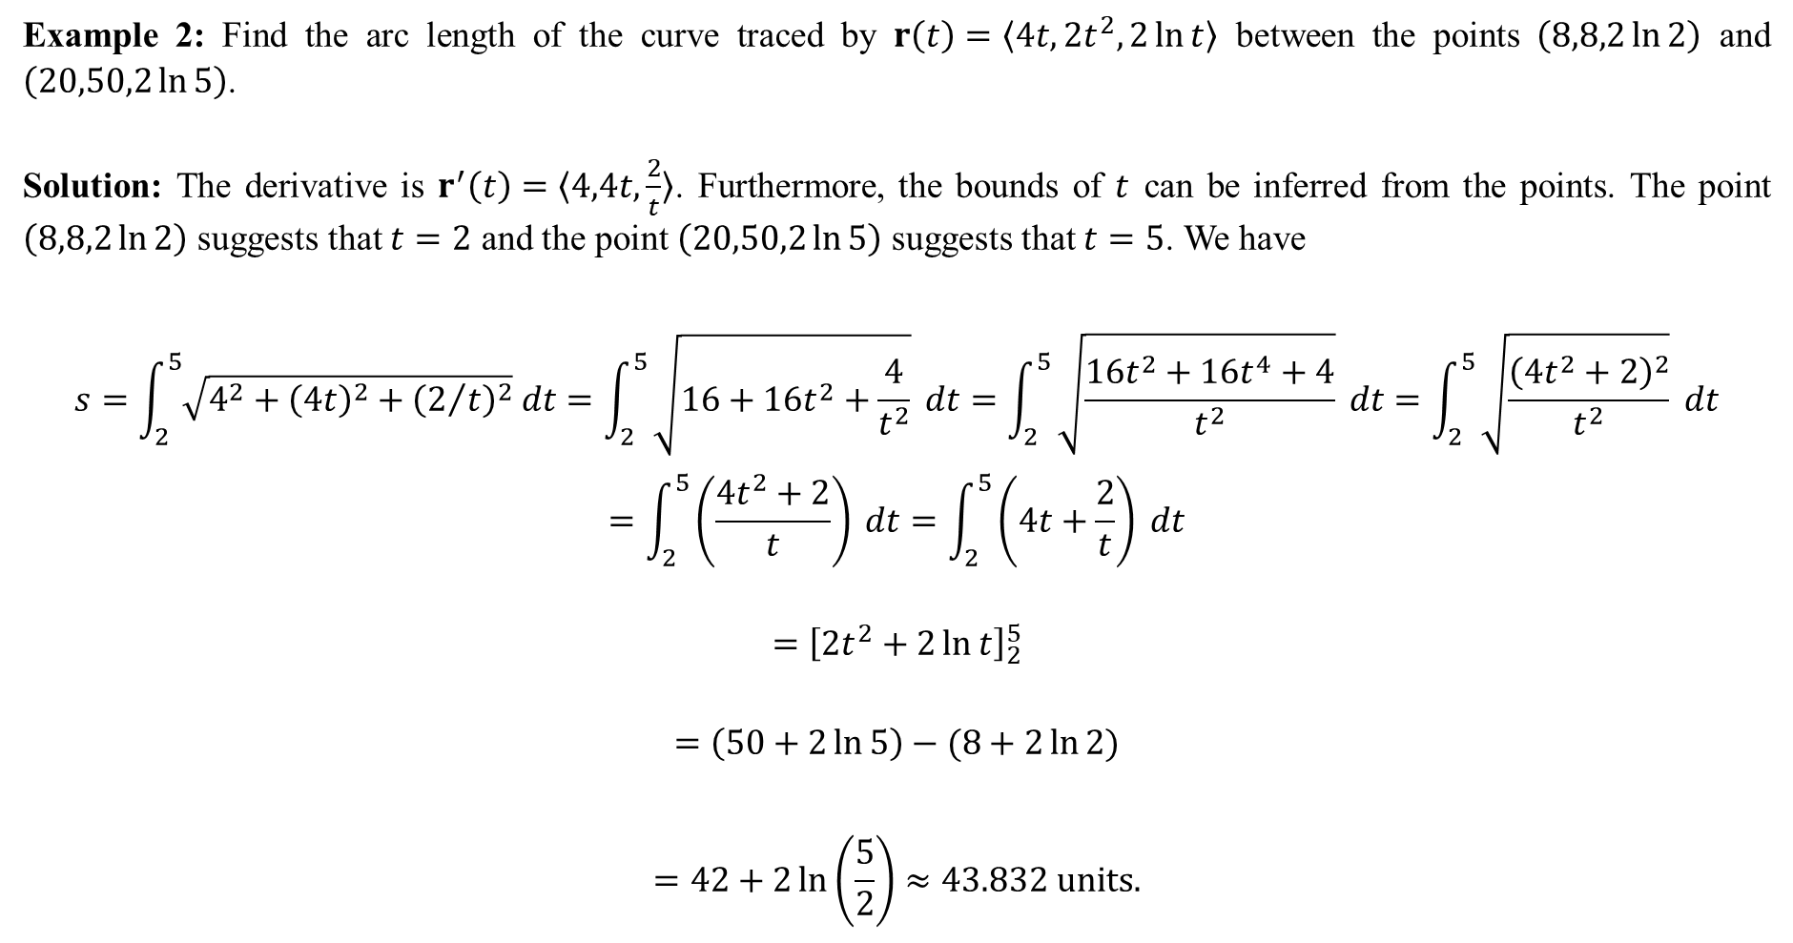
Example 2: Find the arc length of the curve traced by $r\left(t\right)=〈4t,2t^{2},2\ln{t}〉$ between the points $\left(8,8,2\ln{2}\right)$ and $\left(20,50,2\ln{5}\right)$.
Solution: The derivative is $r^{′}\left(t\right)=〈4,4t,\frac{2}{t}〉$. Furthermore, the bounds of $t$ can be inferred from the points. The point $\left(8,8,2\ln{2}\right)$ suggests that $t=2$ and the point $\left(20,50,2\ln{5}\right)$ suggests that $t=5$. We have
$$s=\int_{2}^{5}{\sqrt{4^{2}+{\left(4t\right)}^{2}+{\left(2/t\right)}^{2}} dt}=\int_{2}^{5}{\sqrt{16+16t^{2}+\frac{4}{t^{2}}}} dt=\int_{2}^{5}{\sqrt{\frac{16t^{2}+16t^{4}+4}{t^{2}}} dt}=\int_{2}^{5}{\sqrt{\frac{{\left(4t^{2}+2\right)}^{2}}{t^{2}}} dt}$$
$$=\int_{2}^{5}{\left(\frac{4t^{2}+2}{t}\right) dt}=\int_{2}^{5}{\left(4t+\frac{2}{t}\right) dt}$$
$$={\left[2t^{2}+2\ln{t}\right]}_{2}^{5}$$
$$=\left(50+2\ln{5}\right)−(8+2\ln{2})$$
$$=42+2\ln\left(\frac{5}{2}\right)≈43.832 units.$$

Slide 5
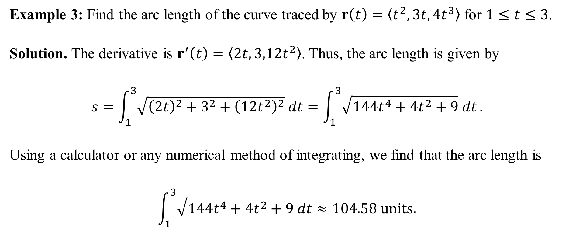
Example 3: Find the arc length of the curve traced by $r\left(t\right)=〈t^{2},3t,4t^{3}〉$ for $1≤t≤3$.
Solution. The derivative is $r^{′}\left(t\right)=〈2t,3,12t^{2}〉$. Thus, the arc length is given by
$$s=\int_{1}^{3}{\sqrt{{\left(2t\right)}^{2}+3^{2}+{\left(12t^{2}\right)}^{2}} dt}=\int_{1}^{3}{\sqrt{144t^{4}+4t^{2}+9} dt}.$$
Using a calculator or any numerical method of integrating, we find that the arc length is
$$\int_{1}^{3}{\sqrt{144t^{4}+4t^{2}+9} dt}≈104.58 units.$$

Slide 6
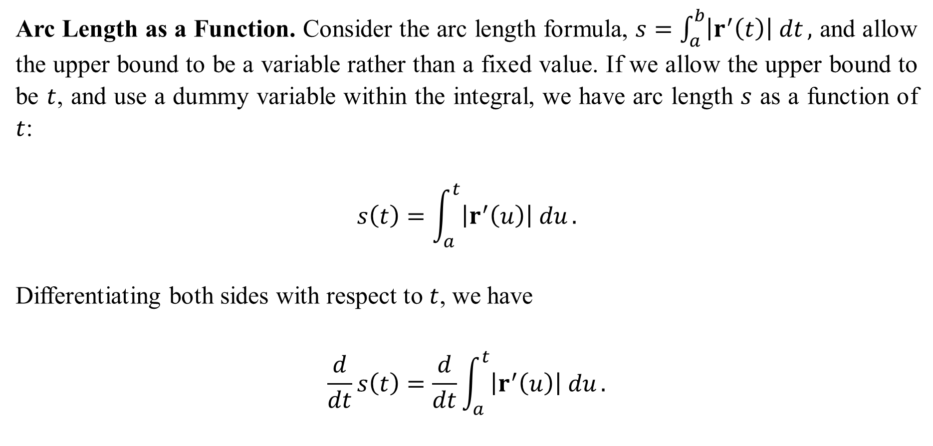
Arc Length as a Function. Consider the arc length formula, $s=\int_{a}^{b}{\left|r^{′}\left(t\right)\right| dt},$ and allow the upper bound to be a variable rather than a fixed value. If we allow the upper bound to be $t$, and use a dummy variable within the integral, we have arc length $s$ as a function of $t$:
$$s\left(t\right)=\int_{a}^{t}{\left|r^{′}\left(u\right)\right| du}.$$
Differentiating both sides with respect to $t$, we have
$$\frac{d}{dt}s\left(t\right)=\frac{d}{dt}\int_{a}^{t}{\left|r^{′}\left(u\right)\right| du}.$$

Slide 7

Using the Fundamental Theorem of Calculus, we have
$$\frac{d}{dt}\int_{a}^{t}{\left|r^{′}\left(u\right)\right| du}=\left|r^{′}\left(t\right)\right|.$$
Thus, we have
$$\frac{ds}{dt}=\left|r^{′}\left(t\right)\right|, or equivalently, ds=\left|r^{′}\left(t\right)\right| dt.$$
★  This formula is extremely useful later on! Do not forget it!  

Slide 8
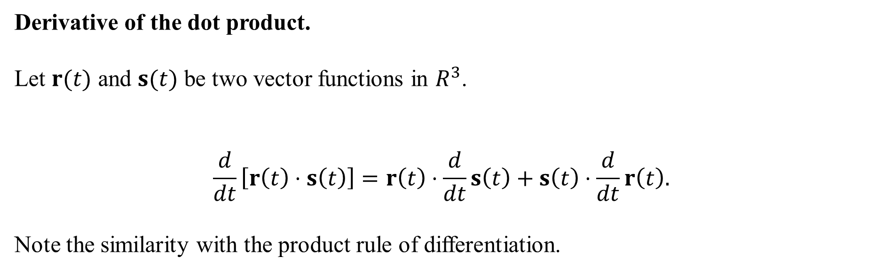
Derivative of the dot product.
Let $r(t)$ and $s(t)$ be two vector functions in $R^{3}$.
$$\frac{d}{dt}\left[r\left(t\right)⋅s\left(t\right)\right]=r\left(t\right)⋅\frac{d}{dt}s\left(t\right)+s\left(t\right)⋅\frac{d}{dt}r\left(t\right).$$
Note the similarity with the product rule of differentiation.

Slide 9
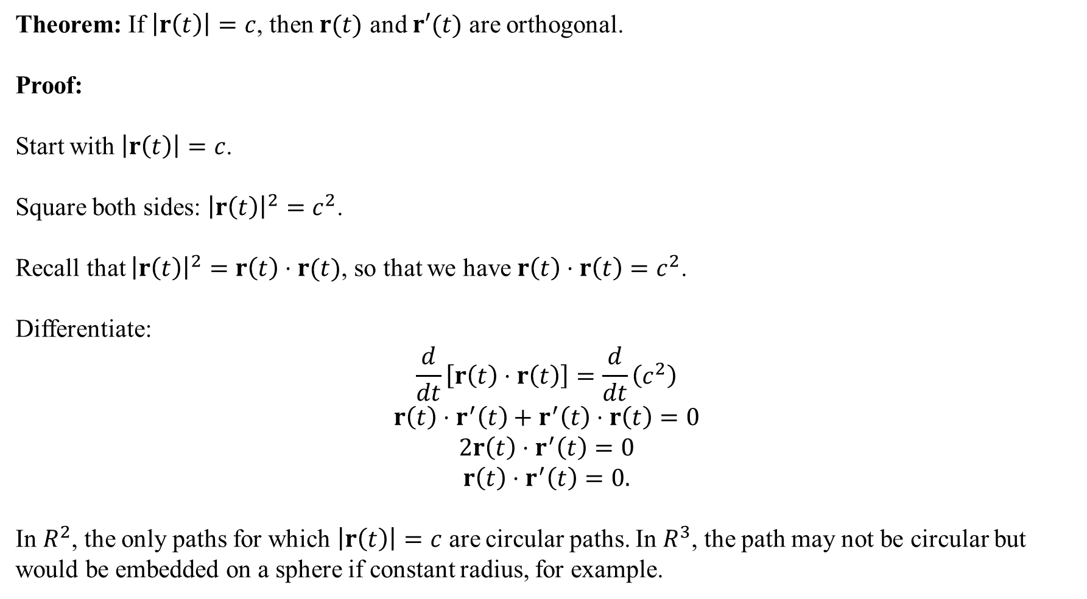
Theorem: If $\left|r\left(t\right)\right|=c$, then $r(t)$ and $r′(t)$ are orthogonal.
Proof:
Start with $\left|r\left(t\right)\right|=c$.
Square both sides: ${\left|r\left(t\right)\right|}^{2}=c^{2}$.
Recall that ${\left|r\left(t\right)\right|}^{2}=r\left(t\right)⋅r(t)$, so that we have $r\left(t\right)⋅r\left(t\right)=c^{2}$.
Differentiate:
$$\frac{d}{dt}\left[r\left(t\right)⋅r\left(t\right)\right]=\frac{d}{dt}\left(c^{2}\right)$$
$$r\left(t\right)⋅r^{′}\left(t\right)+r^{′}\left(t\right)⋅r\left(t\right)=0$$
$$2r\left(t\right)⋅r^{′}\left(t\right)=0$$
$$r\left(t\right)⋅r^{′}\left(t\right)=0.$$
In $R^{2}$, the only paths for which $\left|r\left(t\right)\right|=c$ are circular paths. In $R^{3}$, the path may not be circular but would be embedded on a sphere if constant radius, for example.

Slide 10
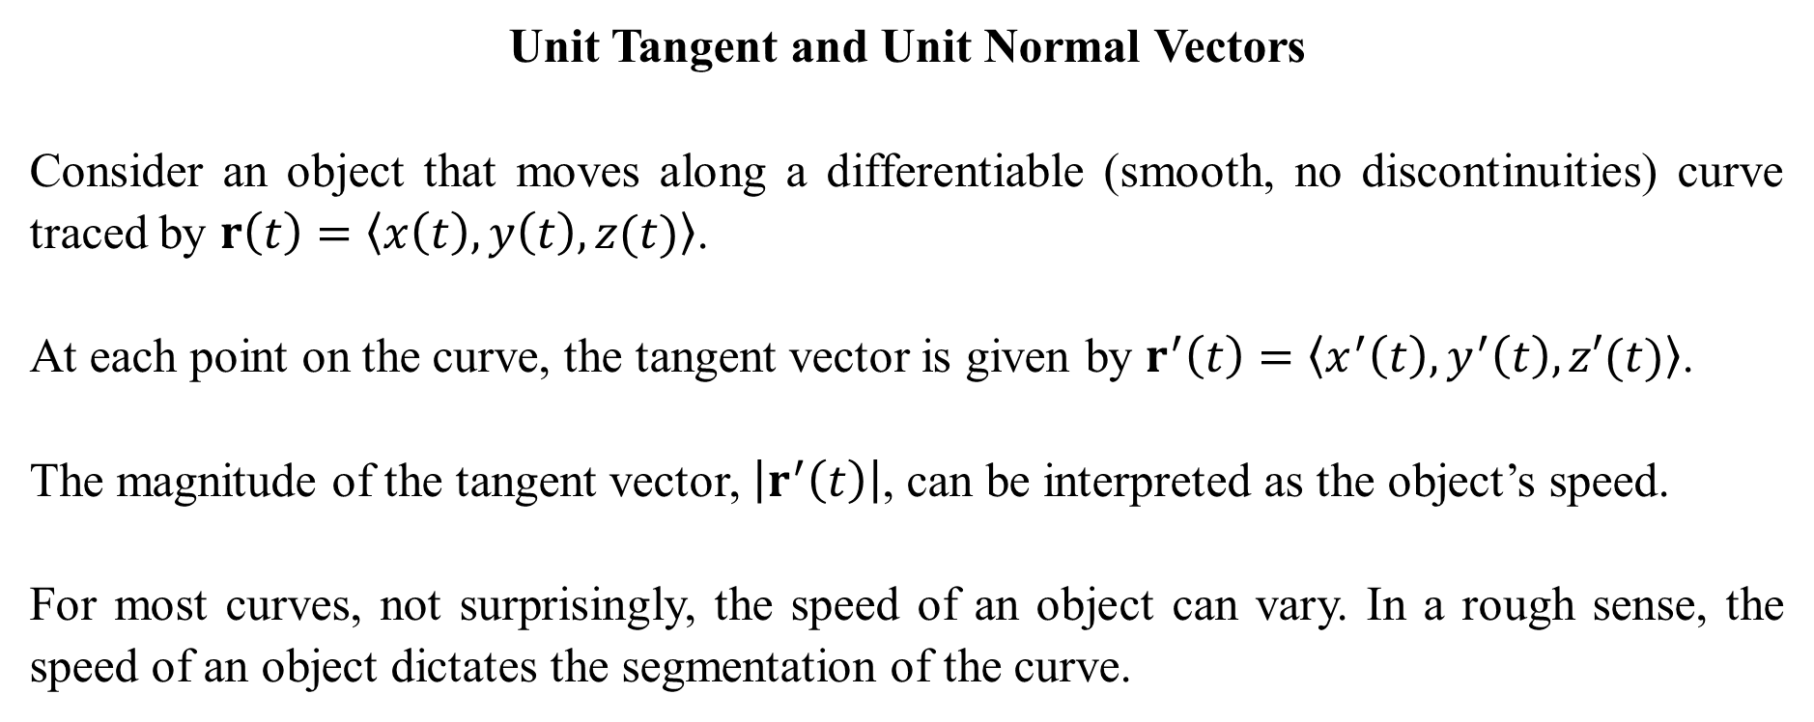
Unit Tangent and Unit Normal Vectors
Consider an object that moves along a differentiable (smooth, no discontinuities) curve traced by $r\left(t\right)=〈x\left(t\right), y\left(t\right),z(t)〉$.
At each point on the curve, the tangent vector is given by $r^{′}\left(t\right)=〈x^{′}\left(t\right),y^{′}\left(t\right),z′(t)〉$.
The magnitude of the tangent vector, $\left|r^{′}\left(t\right)\right|$, can be interpreted as the object’s speed.
For most curves, not surprisingly, the speed of an object can vary. In a rough sense, the speed of an object dictates the segmentation of the curve.

Slide 11
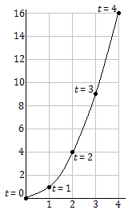
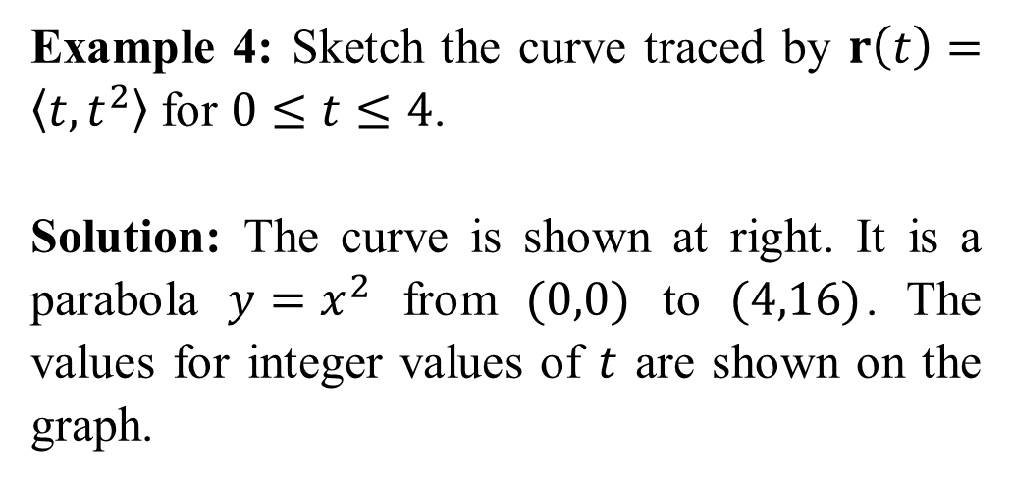
Example 4: Sketch the curve traced by $r\left(t\right)=〈t,t^{2}〉$ for $0≤t≤4$.
Solution: The curve is shown at right. It is a parabola $y=x^{2}$ from $(0,0)$ to $(4,16)$. The values for integer values of $t$ are shown on the graph.

Slide 12
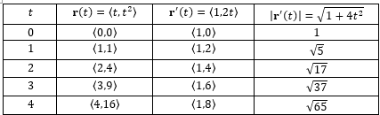
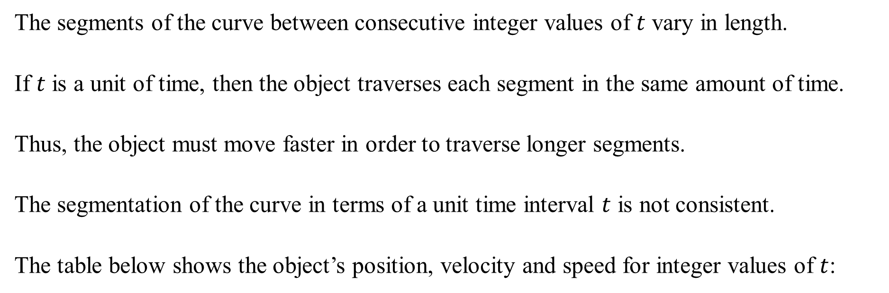
The segments of the curve between consecutive integer values of $t$ vary in length.
If $t$ is a unit of time, then the object traverses each segment in the same amount of time.
Thus, the object must move faster in order to traverse longer segments.
The segmentation of the curve in terms of a unit time interval $t$ is not consistent.
The table below shows the object’s position, velocity and speed for integer values of $t$:

Slide 13
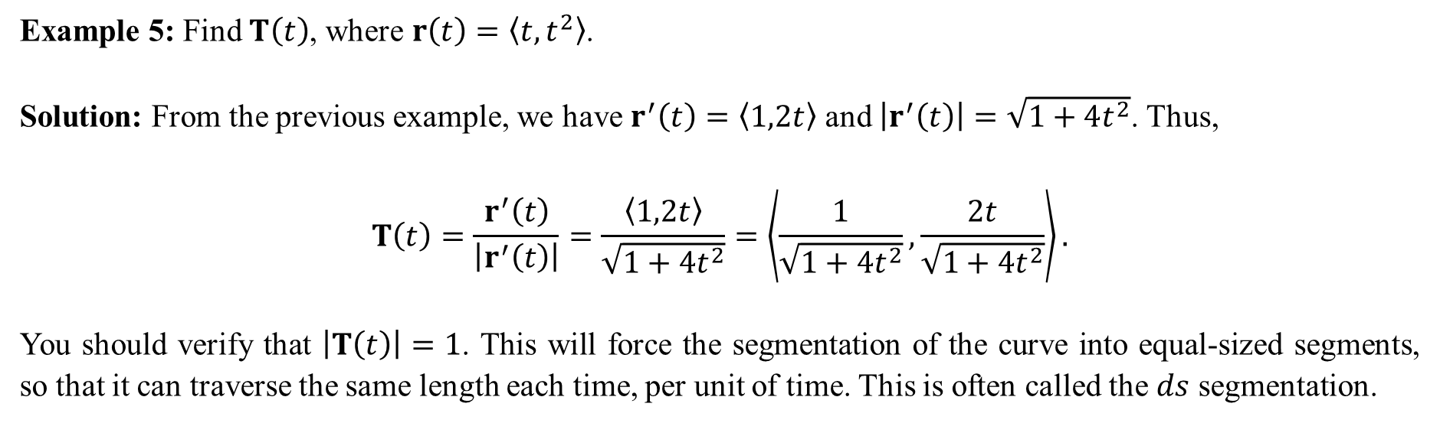
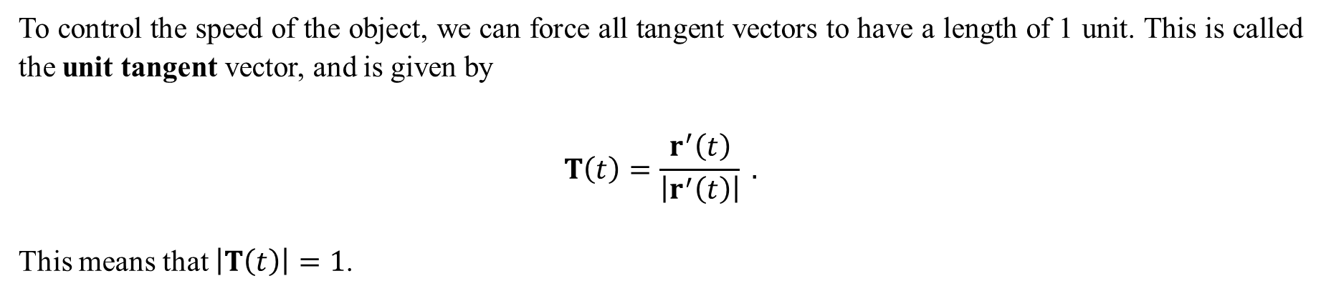
To control the speed of the object, we can force all tangent vectors to have a length of 1 unit. This is called the unit tangent vector, and is given by
$$T\left(t\right)=\frac{r^{′}\left(t\right)}{\left|r^{′}\left(t\right)\right|} .$$
This means that $\left|T\left(t\right)\right|=1$.
Example 5: Find $T\left(t\right)$, where $r\left(t\right)=〈t,t^{2}〉$.
Solution: From the previous example, we have $r^{′}\left(t\right)=〈1,2t〉$ and $\left|r^{′}\left(t\right)\right|=\sqrt{1+4t^{2}}$. Thus,
$$T\left(t\right)=\frac{r^{′}\left(t\right)}{\left|r^{′}\left(t\right)\right|}=\frac{〈1,2t〉}{\sqrt{1+4t^{2}}}=\left\langle \frac{1}{\sqrt{1+4t^{2}}},\frac{2t}{\sqrt{1+4t^{2}}}\right\rangle .$$
You should verify that $\left|T\left(t\right)\right|=1$. This will force the segmentation of the curve into equal-sized segments, so that it can traverse the same length each time, per unit of time. This is often called the $ds$ segmentation.

Slide 14
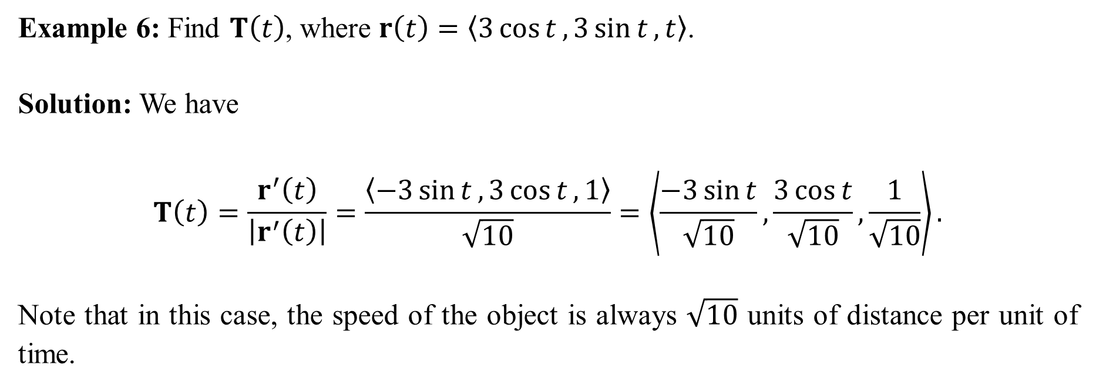
Example 6: Find $T\left(t\right)$, where $r\left(t\right)=〈3\cos{t},3\sin{t},t〉$.
Solution: We have
$$T\left(t\right)=\frac{r^{′}\left(t\right)}{\left|r^{′}\left(t\right)\right|}=\frac{〈−3\sin{t},3\cos{t},1〉}{\sqrt{10}}=\left\langle \frac{−3\sin{t}}{\sqrt{10}},\frac{3\cos{t}}{\sqrt{10}},\frac{1}{\sqrt{10}}\right\rangle .$$
Note that in this case, the speed of the object is always $\sqrt{10}$ units of distance per unit of time.

Slide 15
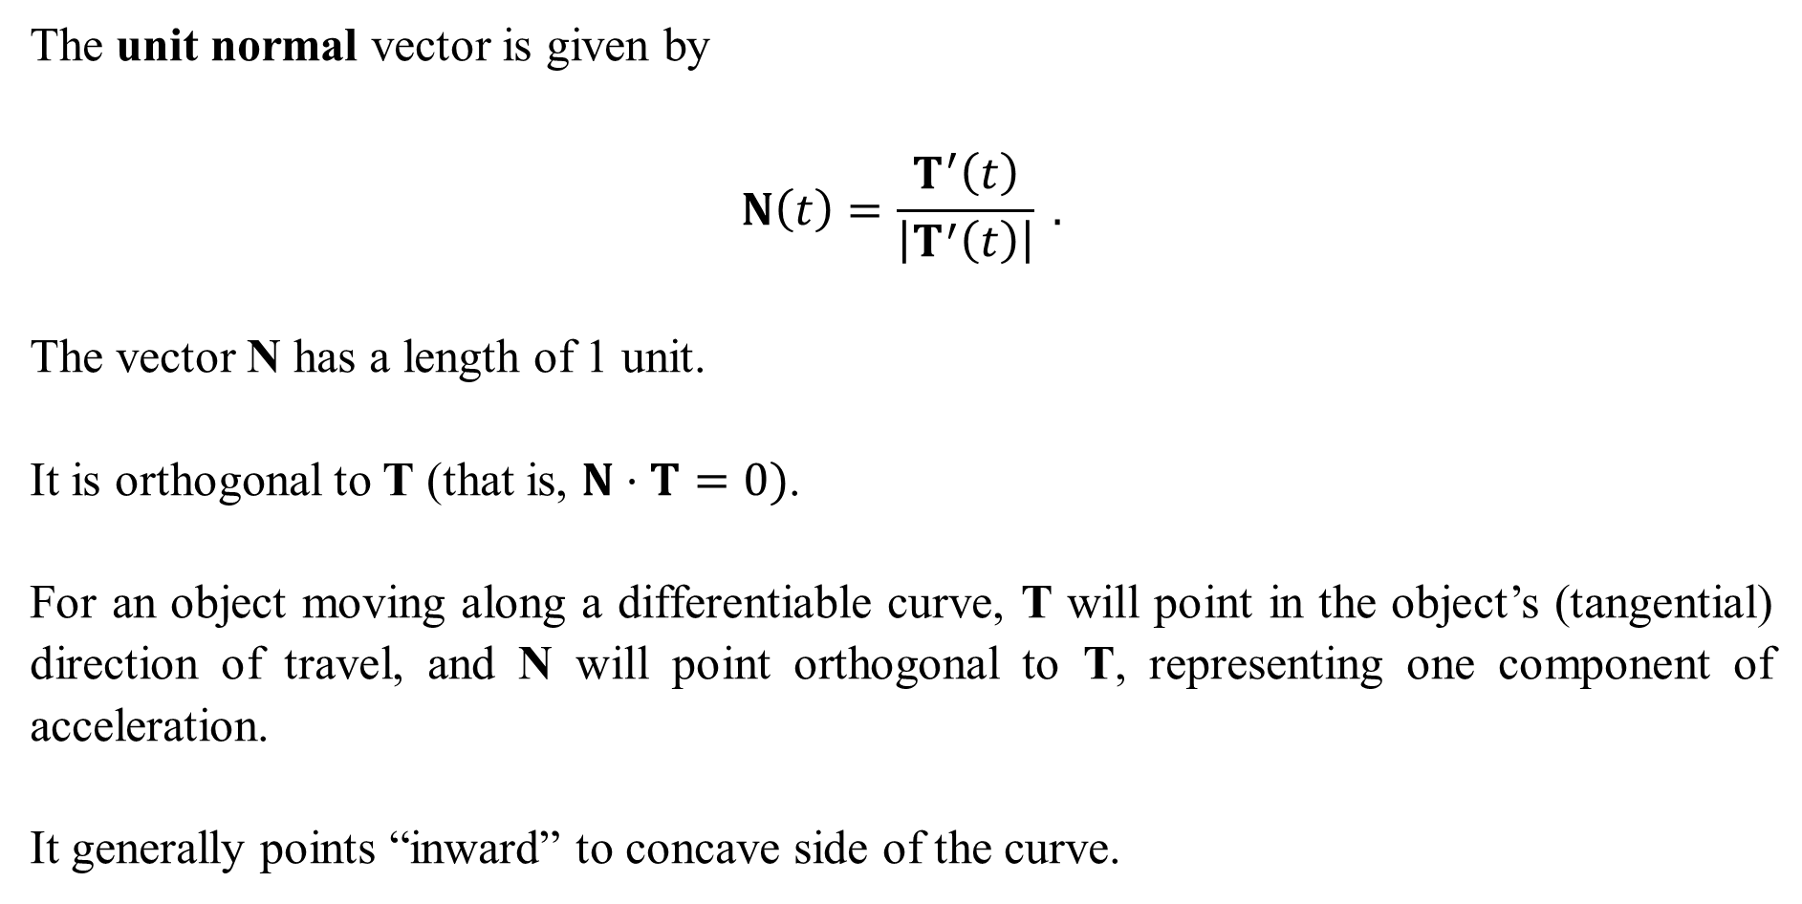
The unit normal vector is given by
$$N\left(t\right)=\frac{T^{′}\left(t\right)}{\left|T^{′}\left(t\right)\right|} .$$
The vector N has a length of 1 unit.
It is orthogonal to T (that is, $N⋅T=0)$.
For an object moving along a differentiable curve, T will point in the object’s (tangential) direction of travel, and N will point orthogonal to T, representing one component of acceleration.
It generally points “inward” to concave side of the curve.

Slide 16
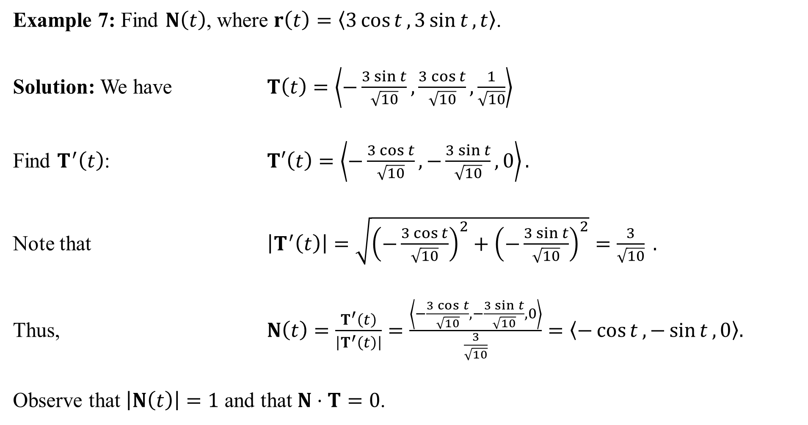
Example 7: Find $N\left(t\right)$, where $r\left(t\right)=〈3\cos{t},3\sin{t},t〉$.
Solution: We have $T\left(t\right)=\left\langle −\frac{3\sin{t}}{\sqrt{10}},\frac{3\cos{t}}{\sqrt{10}},\frac{1}{\sqrt{10}}\right\rangle$
Find $T^{′}\left(t\right)$: $T′\left(t\right)=\left\langle −\frac{3\cos{t}}{\sqrt{10}},−\frac{3\sin{t}}{\sqrt{10}},0\right\rangle .$
Note that $\left|T^{′}\left(t\right)\right|=\sqrt{{\left(−\frac{3\cos{t}}{\sqrt{10}}\right)}^{2}+{\left(−\frac{3\sin{t}}{\sqrt{10}}\right)}^{2}}=\frac{3}{\sqrt{10}} .$
Thus, $N\left(t\right)=\frac{T^{′}\left(t\right)}{\left|T^{′}\left(t\right)\right|}=\frac{\left\langle −\frac{3\cos{t}}{\sqrt{10}},−\frac{3\sin{t}}{\sqrt{10}},0\right\rangle }{\frac{3}{\sqrt{10}}}=〈−\cos{t},−\sin{t},0〉.$
Observe that $\left|N\left(t\right)\right|=1$ and that $N⋅T=0$.

